Slide 1
Robust Sample Budget Allocation for MIS László Szirmay-Kalos & Mateu Sbert

Slide 2
Importance sampling
$$L=\int{f\left(\overline{x}\right)dσ(\overline{x})=}\int{\frac{f\left(\overline{x}\right)}{p\left(\overline{x}\right)}p\left(\overline{x}\right)dσ(\overline{x})=}E_{p}\left[\frac{f\left(\overline{x}\right)}{p\left(\overline{x}\right)}\right]=\frac{1}{n}\sum_{i=1}^{n}{\frac{f\left({\overline{x}}_{i}\right)}{p\left({\overline{x}}_{i}\right)}}$$
$$f/p$$
$$f/p$$
$$f$$
$$f$$
$$p$$
$$p$$
good
bad
Notes:
Rendering means the integration of the contribution of those light paths that connect the light sources with the camera through a pixel. As a light path is defined by an arbitrarily long sequence of visited points, this is a high, in theory infinite dimensional integral. Monte Carlo methods offer a feasible approach to estimate such high dimensional integrals, which uses randomly generated light paths, and obtains the estimate as the average of the ratios of the transported radiance and the probability density of the light path sample.
According to the concept of importance sampling, it is worth using probability densities that are at least approximately proportional to the integrand. The intuitive explanation is that in this case, the ratios will be close to constant, thus the average will have only small fluctuations. However, if the density does not follow the integrand, then there will be regions where the integrand is large but the probability density is small. Such regions are rarely sampled, but when we are lucky enough to generate a sample here, a huge integrand per probability density ratio is added to the estimator. Thus the estimates are smaller than the real value for a longer time, then they make a huge increase, which introduces significant noise and supernova like artifacts in the image.

Slide 3
Multiple Important sampling
$p\left(\overline{x}\right)=α$ $p_{1}\left(\overline{x}\right)+(1−α)p_{2}\left(\overline{x}\right)$
What is the optimal $α$?
What is the optimality criterion?
$$f$$
$$p_{1}$$
$$p_{2}$$
$$\overline{x}$$
Notes:
An appropriate probability density should not only mimick the integrand, but should also provide easy sample generation, for example, by transforming uniformly distributed samples, which often contradicts to the requirement of being similar to the integrand. A successful compromise is the concept of multiple importance sampling, which uses a mixture of probability densities, where each density is good for easy sample generation but typically fails to mimick the integrand alone. However, by appropriately mixing several densities, the approximate proportionality can also be satistified.
Then, the crucial decision is the weighting scheme of such a mixture, or the allocation of the total sample budget for individual sampling schemes. This weighting is defined by variable alpha when only two densities are mixed. Here p1 and p2 are the mixed densities and p is the resulting density.
Intuitively, we wish maximize the image accuracy, for which, we need to maximize the similarity of the integrand and the mixture probability density. This seems straightforward, but what is the exact measure of the similarity between the integrand and the probability density. In this paper, we investigate these problems.

Slide 4
Previous work
Multiple importance sampling, balance heuristics [Veach95],
Equal sample budget [Veach97]
Non-equal sample budget is worth [Havran14], [Hachishuka14]
Minimizing variance using gradients [Lu13],
Heuristics with Newton-Raphson solver [Sbert19]
Kullback-Leibler divergence instead of the variance [Vorba19]
Deep learning [Müller19], [Murray20]
Theoretical analysis of the optimal weighting [He14], [Kondapaneni19], [Sbert22]
Notes:
Multiple importance sampling and its balance heuristics were introduced to computer graphics by Veach. It has very many applications and generated a lot of follow up papers, so we can concentrate only on the most relevant ones from the point of view of our contribution. Veach also proposed to give equal sample budget to each combined techniques stating that other strategies can only be slightly better. This was proven wrong and Sbert, Hachisuka, Lu and Havran proposed heuristics for the sample allocation with more significant variance reduction. Vorba and Müller proposed the consideration of the more stable Kullback-Leibler divergence instead of the variance during the optimization, and Müller and Murray also used neural networks for the optimal sample budget allocation. Kondapaneni and Sbert and Elvira also investigated the theoretical optimum, but this leads to equations which require numerical methods.

Slide 5
General solution
Dissimilarity $S\left(f,p\left(α\right)\right)=\int{D(f,p(α))dσ(\overline{x}),}$ must be minimized
Equation of optimality: $\frac{dS}{dα}=\int{\frac{dD}{dp}\left(p_{1}−p_{2}\right)dσ\left(\overline{x}\right)=0}$
Invariant: $\int{\frac{dD}{dp}p_{i}dσ\left(\overline{x}\right)=E_{p_{i}}\left[\frac{dD}{dp}\right]=}$ constant
Solution of the equation of optimality: Newton-Raphson
Problem: uncertain parameters in the equation
Notes:
Generally, we can use the following scheme for optimal sample budget allocation. First a dissimilarity functional must be defined that assigns a scalar value to the pair of functions including integrand f and probability density p. Here D can compare their local values and the integral is responsible for taking into account the whole domain. The control parameter alpha is included in the mixture density.
Minimal integration error corresponds to the minimal dissimilarity, thus the derivative of the dissimilarity with respect to alpha must be made equal to zero. As mixture density depends on the control parameter linearly, this condition can always be re-written in the form expressing the fact that the expectation of the derivative of D with respect to density p must be constant for different sampling methods, which is an equation expressing the optimality.
In rendering neither the integrand f nor difference D is available analytically, we can only evaluate them in discrete samples. Thus, the parameters of the equation of optimality need to be also estimated from a typically low number of random samples taken previously, in order not to introduce too high overhead. These estimates have some error, which may modify of choice aiming at the optimality. Thus, when appropriate measures are searched, the robustness of their estimates should also be taken into consideration.
This observation leads to the motivation that the general solution process is traversed in the reverse order. Instead of first defining the dissimilarity and obtaining an equation of optimality where the parameters are hard to find, we start with the heuristics establishment of the invariant, that is the equation of optimality, with the objective of robust parameter estimation, and go backward to check whether the resulting dissimilarity measure makes sense.

Slide 6
Invariant and Equation of optimality
Heuristics:
$$E_{p_{i}}\left[\frac{f\left(\overline{x}\right)}{p\left(\overline{x}\right)}\right]=constant$$
If $p$ is really similar to $f$, then this must hold
If $p$ is at least approximately similar, then it can be estimated from a few samples.
Corresponding similarity measure = cross entropy:
$\frac{dS}{dα}=0 → S(f,p(α))\text{ = }\text{−}\int{f\left(\overline{x}\right)log(p\left(α,\overline{x}\right))dσ(\overline{x})}$
Notes:
Our heuristics is fairly simple, we require the expectation of the ratio of the integrand and the mixture density to be invariant for the selection of the sampling method. First of all, it makes sense since when the mixture density is exactly proportional to the integrand, the ratio is equal to the integral, so the expectation value is also equal to the integral no matter how samples are generated. Moreover, if the mixture density is at least approximately proportional to the integrand, the ratios have small fluctuation, so the parameters of the equation of optimality can be estimated from a few samples.
The definition is further justified by the expression of the corresponding dissimilarity measure, which can be obtained by integration. This is the cross entropy between integrand and the mixture density, which is a widely accepted measure for such measurements.

Slide 7
Results
Light source sampling
BRDF sampling
Equal sample MIS
Notes:
To demonstrate the merits of the proposed heuristics, we take the classical scene of Veach where spherical light sources of different size illuminate rectangular surfaces of increasing specularity. Light source sampling is good for small light sources but fails at highly specular surfaces. On the other hand, BFDF sampling handles highly specular surfaces well, but is poor to simulate small light sources. Equal sample MIS combines the advantages of both techniques. The question is whether we can do it even better with non-equal sample allocation.

Slide 8
Error curves
Method | Relative Efficiency
Equal sample MIS | 1
Sbert [19] | 1.15
Lu [13] | 1.09
Müller [19] | 1.13
New method | 1.18
New method
Notes:
We have compared equal sample MIS considering it as a reference and relevant previous work with our new proposal. Note that there is room for close to 20% improvement.

Slide 9
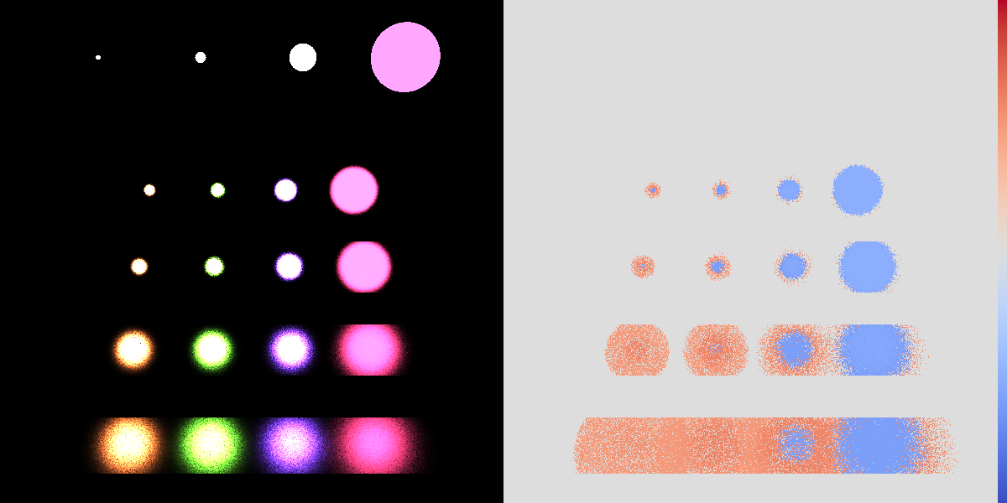
Lu et al.
Notes:
Lu et al. used Taylor approximation of the variance around the equal budget case, and solved the resulting equation for the weight.

Slide 10
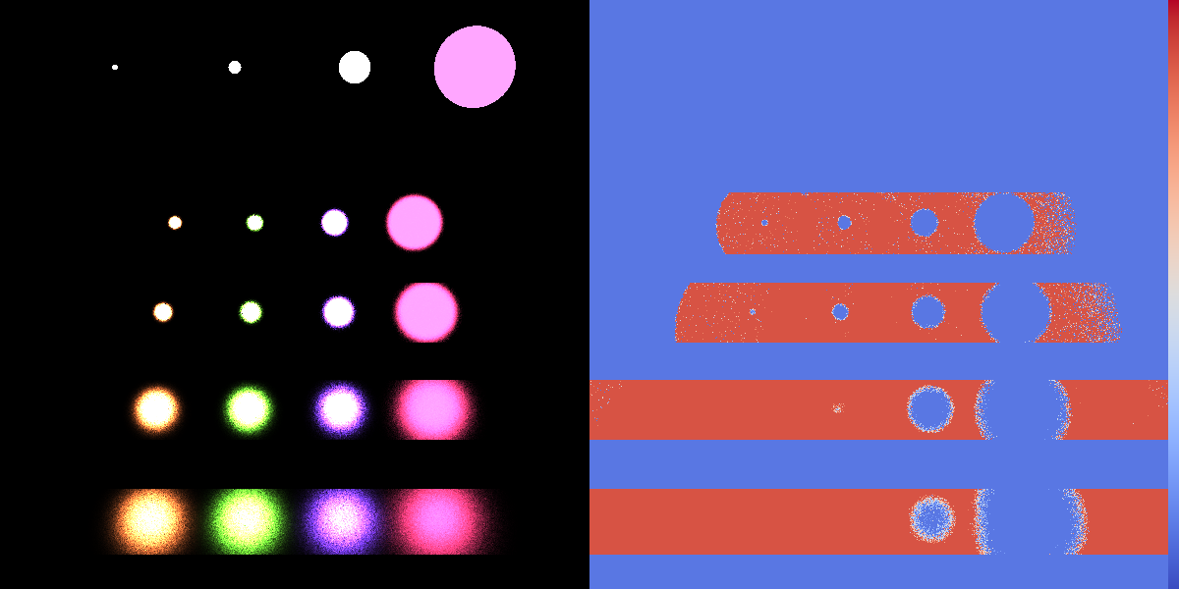
Sbert et al.
Notes:
Sbert et al. used also optimized the variance but with an interative Newton-Raphson solver.

Slide 11
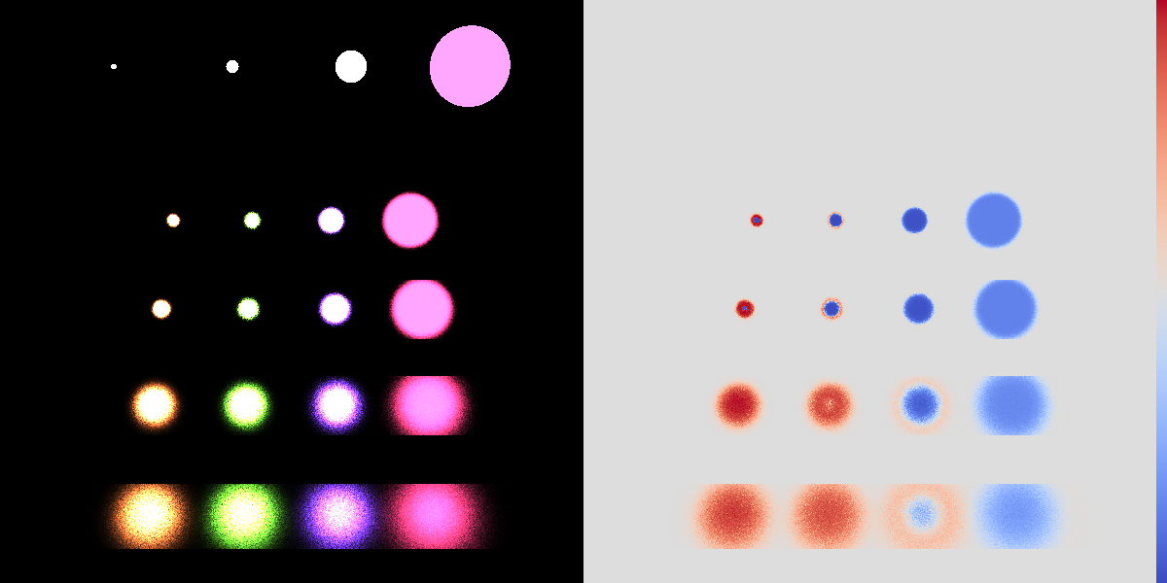
Müller et al.
Notes:
Müller et al. optimized the Kullback-Leibler divergence instead of the variance with the Adam version of gradient search. Furthermore, instead of executing the search in the unit interval, the mapped the unit interval to the whole number line with the sigmoid function, thus handled the interval boundaries in a better way.

Slide 12
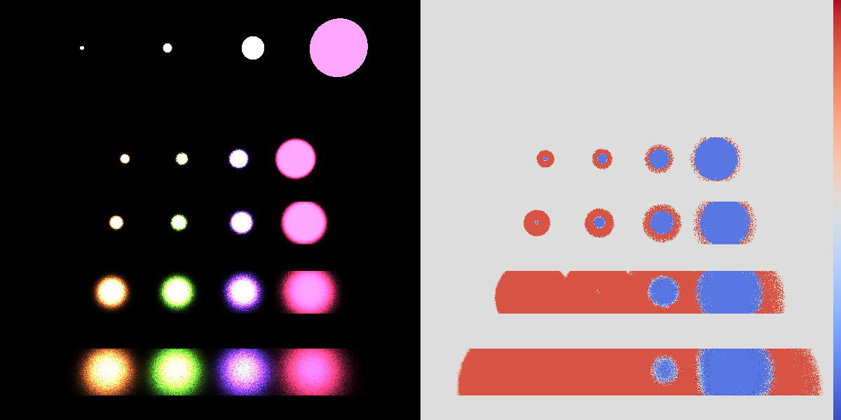
New method
Notes:
And finally our method solves the requirement that the expectations of the integrand per the density must be independent of the sampling method, which is equivalent to the optimization of the cross entropy.

Slide 13
Conclusions
Heuristics can provide better options than precise theoretical approaches if the parameters are uncertain
We propose a general scheme for heuristics to find optimal mixture densities
Particular robust heuristics: $E_{p_{i}}\left[\frac{f\left(\overline{x}\right)}{p\left(\overline{x}\right)}\right]=$ constant
which minimizes the cross entropy dissimilarity
Notes:
This paper proposed a heuristics to find the quasi-optimal budget allocation in multiple importance sampling. This heuristics aims at the equality of the expectation of the ratios of the integrand and the combined density when samples are generated with each particular sampling method.

