Slide 1
Android OpenGL alapok
OpenGL és OpenCV kamera nézet ötvözése

Slide 2
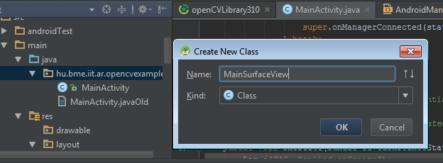

Slide 3
OpenGL ES – MainSurfaceView.java
import android.content.Context; import android.opengl.GLSurfaceView; import android.graphics.PixelFormat; public class MainSurfaceView extends GLSurfaceView { private MainRenderer mRenderer;
public MainRenderer getRenderer(){return mRenderer;} public MainSurfaceView(Context context) { super(context); this.getHolder().setFormat(PixelFormat.TRANSLUCENT); setEGLConfigChooser( 8, 8, 8, 8, 16, 0); this.mRenderer = new MainRenderer(getContext()); setRenderer(this.mRenderer); } }
Notes:
Create the MainSurfaceView.java file and paste these code lines to it. The MainSurfaceView extends the GLSurfaceView class. SurfaceView class is a blank area where we can draw and GLSurfaceView class is a draw area with an OpenGL context. GLSurfaceView classes will need a renderer class which controls what is drawn on the view.

Slide 4
OpenGL ES – MainRenderer.java
import android.content.Context; import android.opengl.GLSurfaceView; import javax.microedition.khronos.egl.EGLConfig; import javax.microedition.khronos.opengles.GL10; public class MainRenderer implements GLSurfaceView.Renderer{ private Context context; public MainRenderer(Context context) { this.context = context; } public void onSurfaceCreated(GL10 gl, EGLConfig config) { gl.glClearColor(0.5F, 0.5F, 1.0F, 0.2F); } public void onDrawFrame(GL10 gl) { gl.glClear(gl.GL_COLOR_BUFFER_BIT | gl.GL_DEPTH_BUFFER_BIT ); } public void onSurfaceChanged(GL10 gl, int width, int height) { gl.glViewport(0, 0, width, height); } }
Notes:
Create the MainRenderer.java file and paste these code lines. This class is a GLSurfaceViewRenderer implementation and has callback functions when the OpenGL surface is created, changed (resized for e.g.), and when a new frame is drawn. When these callbacks are called the OpenGL context of the surface is ready, so we can now call OpenGL functions. If we have a look at this code we will find some familiar calls. Basically we have a wrapper class with type GL10, which has the same functions that are defined in the OpenGL API. So setting the clear color is simply calling the well known glClearColor method of the GL10 opject. Constants like GL_COLOR_BUFFER_BIT are also defined in this class. If we are familiar with glut for example we can say that we can place the initialization code we usually write before glutMainLoop in onSurfaceCreated. We place the code that handles window resize in onSurfaceChanged, and we should place rendering calls in onDrawFrame. By default onDrawFrame is called continuously, but we can also make it refresh only on demand.

Slide 5
OpenGL ES – MainActivity.java
public class MainActivity extends Activity
{
…
private MainSurfaceView mGLView;
…
public void onCreate(Bundle savedInstanceState) { Log.i(TAG, "called onCreate"); super.onCreate(savedInstanceState); setRequestedOrientation(ActivityInfo.SCREEN_ORIENTATION_LANDSCAPE); getWindow().addFlags(WindowManager.LayoutParams.FLAG_KEEP_SCREEN_ON); mGLView = new MainSurfaceView(this); setContentView(mGLView); mOpenCvCameraView = (CameraBridgeViewBase) new JavaCameraView(this, -1); mOpenCvCameraView.setCvCameraViewListener(this); addContentView(mOpenCvCameraView, new ActionBar.LayoutParams( ActionBar.LayoutParams.WRAP_CONTENT, ActionBar.LayoutParams.WRAP_CONTENT));
}
Notes:
Now we make a big step and modify our code to create a OpenGL window. We can add views not only using predefined layout files, but also from code. We will use the GLSurfaceView class as a main view of our activity.
We have to create an instance of our own MainSurfaceView class which extends GLSurfaceView and set it as content view.

Slide 6
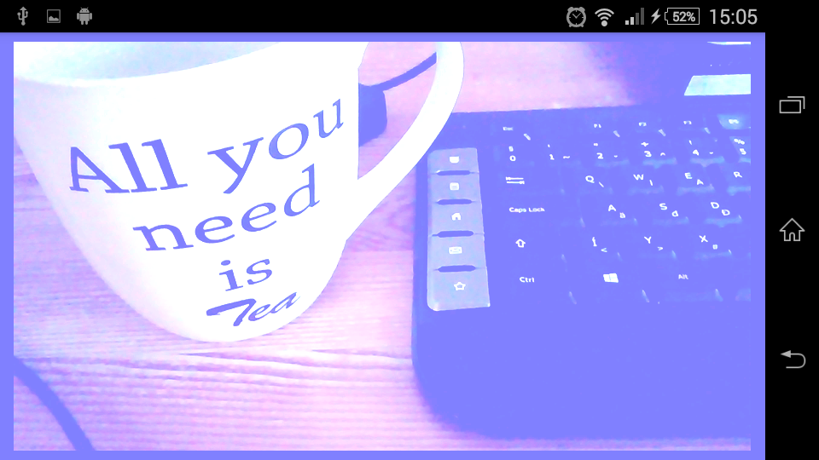
Próba
gl.glClearColor(0.5F, 0.5F, 1.0F, 0.2F); -> gl.glClearColor(0,0,0,0);

Slide 7
Draw something - MainRenderer
New imports
import java.nio.ByteBuffer;
import java.nio.ByteOrder;
import java.nio.FloatBuffer;
New data member
private int windowWidth = 0;
private int windowHeight = 0;
protected FloatBuffer VB = null;
public float rotAngle = 0;
Notes:
Now we should really render something: a quad for example. Our quad will need a float buffer that stores the vertex coordinates, we make the VB datamember to store this buffer. The quad will continuously rotate and the current rotation angle is stored in rotAngle

Slide 8
Draw something - MainRenderer
public void onSurfaceCreated(GL10 gl, EGLConfig config) {
gl.glClearColor(0.5F, 0.5F, 1.0F, 1.0F);
float[] VCoords = {
-1.0F, -1.0F, 0.0F,
1.0F, -1.0F, 0.0F,
1.0F, 1.0F, 0.0F,
-1.0F, -1.0F, 0.0F,
1.0F, 1.0F, 0.0F,
-1.0F, 1.0F, 0.0F };
ByteBuffer vbb = ByteBuffer.allocateDirect(VCoords.length * 4);
vbb.order(ByteOrder.nativeOrder());
this.VB = vbb.asFloatBuffer();
this.VB.put(VCoords);
this.VB.position(0);
}
Notes:
We have to create the vertex position buffer in initialization time: create a float array, fill it with vertex positions, and create a FloatBuffer from it.

Slide 9
Draw something - MainRenderer
public void onDrawFrame(GL10 gl) {
gl.glClear(gl.GL_COLOR_BUFFER_BIT | gl.GL_DEPTH_BUFFER_BIT );
gl.glMatrixMode(gl.GL_MODELVIEW);
gl.glLoadIdentity();
gl.glTranslatef(0,0,-6);
gl.glColor4f(1, 0, 0, 1);
gl.glRotatef(rotAngle, 0, 1, 0);
gl.glEnableClientState(gl.GL_VERTEX_ARRAY);
gl.glVertexPointer(3, gl.GL_FLOAT, 0, this.VB);
gl.glDrawArrays(gl.GL_TRIANGLES, 0, 6);
gl.glDisableClientState(gl.GL_VERTEX_ARRAY);
rotAngle += 2.5f;
}
Notes:
Our drawing function will clear the window first, then fill up the transformation matrix with a translation and a rotation. The rotation angle will be incremented in each frame, the rotation axis is the up(y) direction. Rendering is done with vertex arrays. We set vertex color to a red color. This will keep its value until the next glColor.. call (remember the state machine behavior of render APIs). First we state that the vertex positions will be filled from a vertex array, we give the pointer to the data storing position information and tell that each vertex will have a 3 component float position data, and finally draw 2 triangles (6 vertex, 3 for each triangle). Note that we use OpenGL ES 1 here which is similar to OpenGL 1.3. We have all the fixed function things but glBegin-glEnd type of rendering is not allowed, we have to use vertex arrays.

Slide 10
Draw something - MainRenderer
public void onSurfaceChanged(GL10 gl, int width, int height) {
windowWidth = width;
windowHeight = height;
gl.glViewport(0, 0, width, height);
float ratio = (float) width / height;
gl.glMatrixMode(gl.GL_PROJECTION);
gl.glLoadIdentity();
gl.glFrustumf(-ratio, ratio, -1, 1, 1.0f, 10);
}
Notes:
We should also set a projection matrix, we do it if the window is resized, as aspect ratio is needed. We used a perspective projection here.

Slide 11
Próba

Slide 12
MainRenderer
New imports
import android.content.res.AssetManager;
import android.graphics.Bitmap;
import android.graphics.BitmapFactory;
import android.opengl.GLUtils;
New members
protected FloatBuffer TB = null;
public AssetManager assetManager = null;
protected int[] textureIDs = new int[1];
Constructor
assetManager = context.getAssets();

Slide 13
MainRenderer
public void onSurfaceCreated(GL10 gl, EGLConfig config) {
…
float[] TCoords = { 0.0F, 0.0F, 1.0F, 0.0F, 1.0F, 1.0F, 0.0F, 0.0F, 1.0F, 1.0F, 0.0F, 1.0F}; ByteBuffer tbb = ByteBuffer.allocateDirect(TCoords.length * 4); tbb.order(ByteOrder.nativeOrder()); this.TB = tbb.asFloatBuffer(); this.TB.put(TCoords); this.TB.position(0);
loadTextures(gl);
}

Slide 14
MainRenderer
private void loadTextures(GL10 gl)
{ gl.glGenTextures(1, textureIds, 0); Bitmap bitmap; try{ bitmap = BitmapFactory.decodeStream(assetManager.open("brick.jpg")); catch (java.io.IOException e){ e.printStackTrace(); return; } gl.glBindTexture(gl.GL_TEXTURE_2D, this.id[0]); gl.glTexParameterx(gl.GL_TEXTURE_2D, gl.GL_TEXTURE_MIN_FILTER, gl.GL_NEAREST); gl.glTexParameterx(gl.GL_TEXTURE_2D, gl.GL_TEXTURE_MAG_FILTER, gl.GL_NEAREST); GLUtils.texImage2D(gl.GL_TEXTURE_2D, 0, bitmap, 0); bitmap.recycle();
}

Slide 15
MainRenderer
public void onDrawFrame(GL10 gl) {
…
gl.glEnable(gl.GL_TEXTURE_2D); gl.glBindTexture(gl.GL_TEXTURE_2D, textureIDs[0]); gl.glEnableClientState(gl.GL_TEXTURE_COORD_ARRAY); gl.glTexCoordPointer(2, gl.GL_FLOAT, 0, this.TB); gl.glEnableClientState(gl.GL_VERTEX_ARRAY); gl.glVertexPointer(3, gl.GL_FLOAT, 0, this.VB); gl.glDrawArrays(gl.GL_TRIANGLES, 0, 6); gl.glDisableClientState(gl.GL_VERTEX_ARRAY); gl.glDisableClientState(gl.GL_TEXTURE_COORD_ARRAY); gl.glDisable(gl.GL_TEXTURE_2D);
}

Slide 16
Assets mappa létrehozása
Brick.jpg-t másoljuk az assets mappába

Slide 17
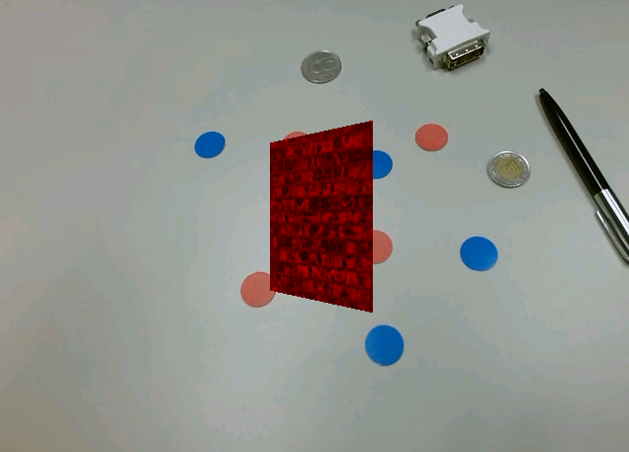
Próba

Slide 18
Új osztályok (már kész vannak)
Globals
Resource
Texture
Material
Mesh
Quad

Slide 19
MainRenderer
Új tagváltozók
Material m;
Texture t;
Mesh mesh;
Régi tagváltozók nem kellenek:
FloatBuffer VB;
FloatBuffer TB;
int[] textureIDs ;

Slide 20
MainRenderer
public void onSurfaceCreated(GL10 gl, EGLConfig config) {
Globals.assetManager = assetManager;
gl.glClearColor(0, 0, 0, 0);
t = new Texture("TestTexture");
t.setFileName("brick.jpg");
t.load();
m = new Material("TestMaterial");
m.setTexture(t);
m.load();
mesh = new Quad("TestQuad");
mesh.load();
}
LoadTextures(): lehet törölni

Slide 21
MainRenderer
public void onDrawFrame(GL10 gl) {
gl.glClear(gl.GL_COLOR_BUFFER_BIT | gl.GL_DEPTH_BUFFER_BIT );
gl.glMatrixMode(gl.GL_MODELVIEW);
gl.glLoadIdentity();
gl.glTranslatef(0,0,-6);
m.set();
gl.glRotatef(rotAngle, 0, 1, 0);
mesh.render();
rotAngle += 2.5f;
}

Slide 22
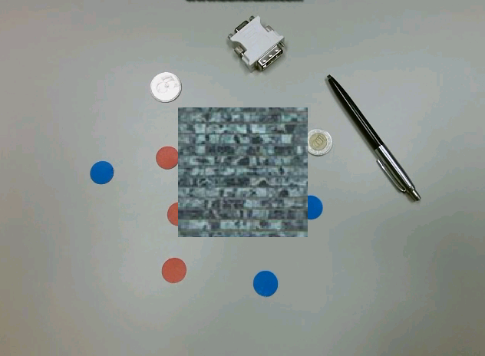
Próba

Slide 23
Több Quad renderelése
public void onDrawFrame(GL10 gl) {
gl.glClear(gl.GL_COLOR_BUFFER_BIT | gl.GL_DEPTH_BUFFER_BIT );
gl.glMatrixMode(gl.GL_MODELVIEW);
gl.glLoadIdentity();
gl.glTranslatef(0,0,-6);
m.set();
gl.glPushMatrix();
gl.glRotatef(rotAngle, 0, 1, 0);
mesh.render();
gl.glPopMatrix();
gl.glPushMatrix();
gl.glTranslatef(3.0f,0,0);
gl.glRotatef(rotAngle*2, 0, 1, 0);
mesh.render();
gl.glPopMatrix();
rotAngle += 2.5f;
}

Slide 24
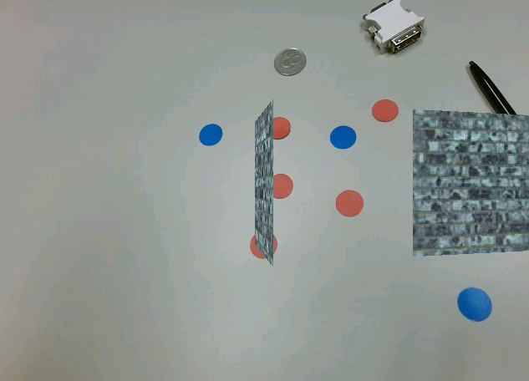
Próba

Slide 25
ObjMesh
MainRenderer
ObjMesh objMesh;
Material objMeshMat;
public void onSurfaceCreated(GL10 gl, EGLConfig config) {
…
objMesh = new ObjMesh(“ObjMesh1");
objMesh.setFileName("stanfordBunny.obj");
objMesh.load();
objMeshMat = new Material(“ObjMeshMaterial");
objMeshMat.setLighting(false);
objMeshMat.setColor(1.0f,0.5f,0.2f,1.0f);
objMeshMat.load();
}
public void onDrawFrame(GL10 gl) {
…//második quad helyére:
gl.glPushMatrix();
gl.glTranslatef(3.0f,0,0);
objMeshMat.set();
objMesh.render();
gl.glPopMatrix();
rotAngle += 2.5f;
}

Slide 26
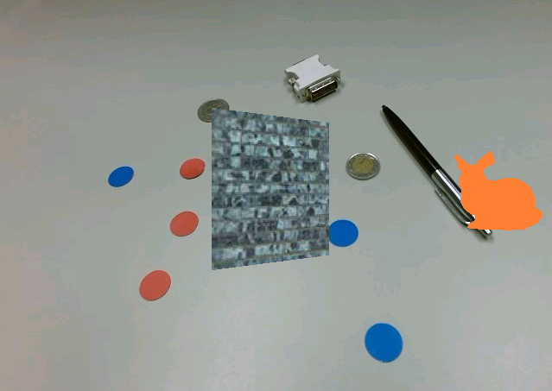
Próba

Slide 27
Fények
objMeshMat.setLighting(true);
public void onDrawFrame(GL10 gl) {
gl.glClear(gl.GL_COLOR_BUFFER_BIT | gl.GL_DEPTH_BUFFER_BIT );
gl.glMatrixMode(gl.GL_MODELVIEW);
gl.glLoadIdentity();
gl.glEnable(gl.GL_LIGHT0);
float lightColor[] = {1,1,1,1};
gl.glLightfv(gl.GL_LIGHT0,gl.GL_DIFFUSE,lightColor,0);
gl.glLightfv(gl.GL_LIGHT0,gl.GL_SPECULAR,lightColor,0);
float ambientLightColor[] = {1,1,1,1};
gl.glLightfv(gl.GL_LIGHT0,gl.GL_AMBIENT,ambientLightColor,0);
float lightPos[] = {0,0,0,1};
gl.glLightfv(gl.GL_LIGHT0,gl.GL_POSITION, lightPos,0);
gl.glTranslatef(0,0,-6);

Slide 28
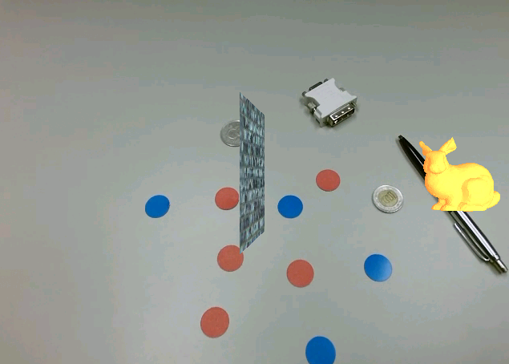
Próba

Slide 29
Kördetektálás
MainActivity
import org.opencv.core.Core;
import org.opencv.core.MatOfPoint;
import org.opencv.core.MatOfPoint2f;
import org.opencv.core.Point;
import org.opencv.core.RotatedRect;
import org.opencv.core.Scalar;
import org.opencv.imgproc.Imgproc;
import java.util.ArrayList;

Slide 30
MainActivity
public Mat onCameraFrame(CvCameraViewFrame inputFrame) {
Mat inputMat = inputFrame.rgba();
ArrayList<RotatedRect> minRect = new ArrayList<>();
ArrayList<RotatedRect> minEllipse = new ArrayList<>();
ArrayList<MatOfPoint> contours;
Mat segmentedInput = colorSegment(inputMat);
contours = detectContours( segmentedInput );
detectEllipses(contours, minRect, minEllipse);
// debug: draw what we detected
for (int i = 0; i< contours.size(); i++)
{
//Scalar color = new Scalar((int)(Math.random() * 256), (int)(Math.random() * 256), (int)(Math.random() * 256)); // random color
Scalar color = new Scalar(0, 255, 255);
//Imgproc.drawContours(inputMat, contours, i, color, 1);
if (i < minEllipse.size()) {
//Imgproc.ellipse(inputMat, minEllipse.get(i), color, 2, 8);
Point points[] = new Point[4];
minRect.get(i).points(points);
for (int j = 0; j < 4; j++) {
Imgproc.line(inputMat, points[j], points[(j + 1) % 4], color);
}
}
}
return inputMat;
}

Slide 31
MainActivity
public Mat colorSegment(Mat src) {
Mat result = new Mat();
Mat hsv_image = new Mat(), mask = new Mat();
Imgproc.cvtColor(src, hsv_image, Imgproc.COLOR_RGB2HSV);
Core.inRange(hsv_image, new Scalar(0,100,100), new Scalar(10,255,255), mask); // red
//Core.inRange(hsv_image, new Scalar(100,100,100), new Scalar(110,255,255), mask); // blue
result = Mat.zeros(src.size(),src.type());
src.copyTo(result, mask);
return result;
}

Slide 32
MainActivity
public ArrayList<MatOfPoint> detectContours(Mat src) {
Mat src_gray = new Mat(), canny_output = new Mat();
ArrayList<MatOfPoint> contours = new ArrayList<>();
Imgproc.cvtColor(src, src_gray, Imgproc.COLOR_BGR2GRAY);
double threshold = 100.0;
Imgproc.Canny(src_gray, canny_output, threshold, threshold * 2.0);
Mat hierarchy = new Mat();
Imgproc.findContours(canny_output, contours, hierarchy, Imgproc.RETR_TREE, Imgproc.CHAIN_APPROX_SIMPLE, new Point(0,0));
return contours;
}

Slide 33
MainActivity
public void detectEllipses(ArrayList<MatOfPoint> contours, ArrayList<RotatedRect> minRect, ArrayList<RotatedRect> minEllipse) {
for (int i = 0; i < contours.size(); i++)
{
MatOfPoint2f contoursF = new MatOfPoint2f( contours.get(i).toArray() );
minRect.add(Imgproc.minAreaRect(contoursF));
if (contours.get(i).rows() > 5) {
minEllipse.add(Imgproc.fitEllipse(contoursF));
}
}
}

Slide 34
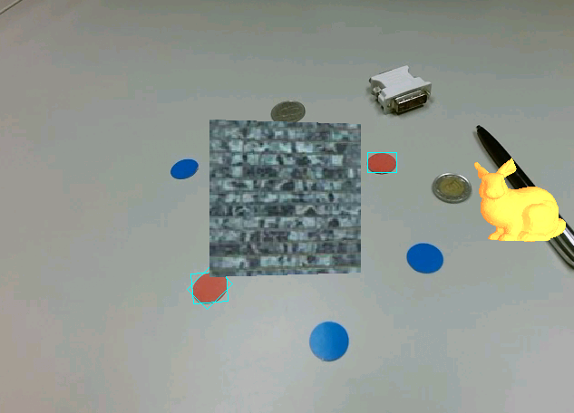
Próba

Slide 35
Körökre nyuszit
MainRenderer
Új tagváltozó
ArrayList<RotatedRect> detectedRectangles = new ArrayList<>();
private Size videoSize=null;
Új függvény:
public void setVideoSize(Size s){videoSize = s;}
public void setDetectedRectangles(ArrayList<RotatedRect> rects) {
synchronized(detectedRectangles) {
detectedRectangles.clear();
detectedRectangles.addAll(rects);
}
}

Slide 36
MainActivity
public Mat onCameraFrame(CvCameraViewFrame inputFrame) {
…
mGLView.getRenderer().setDetectedRectangles(minRect);
mGLView.getRenderer().setVideoSize(inputMat.size());
return inputMat;
}

Slide 37
MainRenderer
public void onDrawFrame(GL10 gl) {
if(videoSize == null)
videoSize = new Size(windowWidth, windowHeight);
float ratio = (float) (videoSize.width / videoSize.height);
gl.glViewport(windowWidth / 2 - (int) videoSize.width / 2, windowHeight / 2 - (int) videoSize.height / 2, (int) videoSize.width, (int) videoSize.height);
gl.glMatrixMode(gl.GL_PROJECTION);
gl.glLoadIdentity();
float frontPlane = 1.0f;
float frustumRight = ratio;
float frustumTop = 1.0f;
gl.glFrustumf(-frustumRight, frustumRight, -frustumTop, frustumTop, frontPlane, 1000);
gl.glClear(gl.GL_COLOR_BUFFER_BIT | gl.GL_DEPTH_BUFFER_BIT );
}

Slide 38
MainRenderer
public void onDrawFrame(GL10 gl) {
… //ModelView és Light0 beállítása
objMeshMat.set();
synchronized(detectedRectangles) {
for (int i = 0; i < detectedRectangles.size(); ++i) {
float x = (float) detectedRectangles.get(i).center.x;
float y = (float) detectedRectangles.get(i).center.y;
//convert pixel coordinates to screen(-1 - 1)
x /= (float) videoSize.width;
x *= 2.0;
x -= 1.0;
y /= (float) videoSize.height;
y *= 2.0;
y -= 1.0;
x *= frustumRight;
y *= -frustumTop;//also flip y
float z = -frontPlane;
//set distance according to rectangle size
float markerWidthSS = (float) detectedRectangles.get(i).size.width / (float) videoSize.width;
float zratio = 0.5f / markerWidthSS;
x *= zratio;
y *= zratio;
z *= zratio;
gl.glPushMatrix();
gl.glTranslatef(x, y, z);
//gl.glRotatef(rotAngle*2, 0, 1, 0);
//gl.glScalef(0.05f,0.05f,0.05f);
//gl.glScalef(0.1f,0.1f,0.1f);
objMesh.render();
gl.glPopMatrix();
}
}
rotAngle += 2.5f;
}

Slide 39
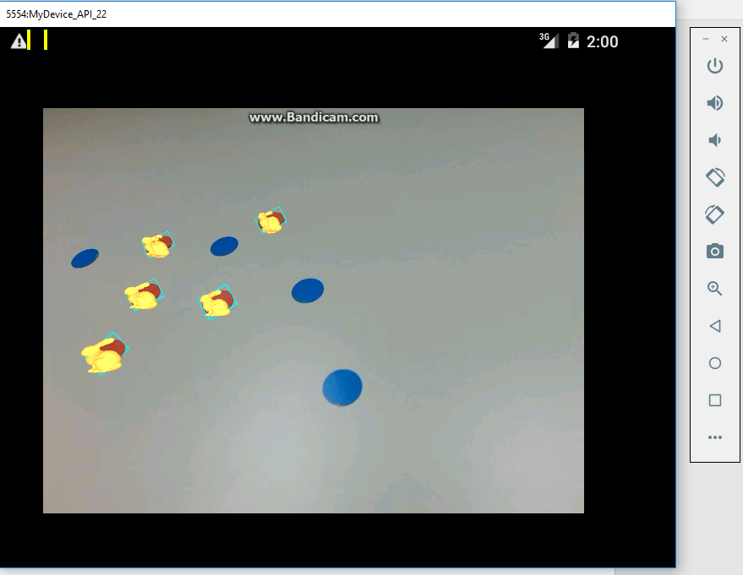
Próba

Slide 40
Vége

