Slide 1
Hierarchical Volumetric Fusion of Depth Images
László Szirmay-Kalos, Milán Magdics
Balázs Tóth, Tamás Umenhoffer
Notes:
In this talk we present algorithms for on-line and real-time reconstruction of the 3D geometry based on the images of RGB and depth cameras.

Slide 2
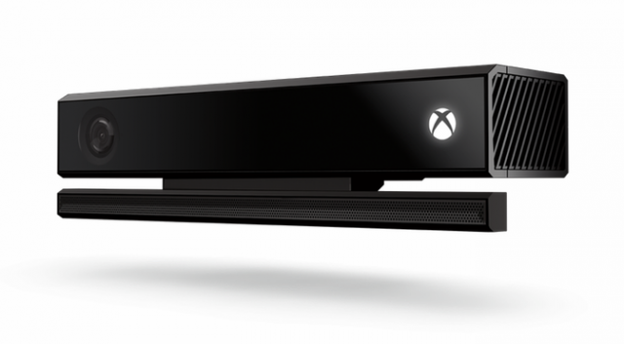
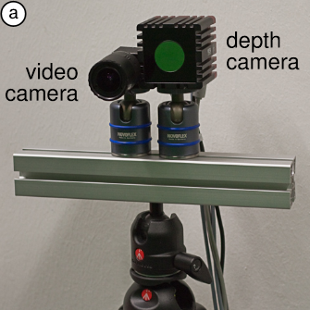
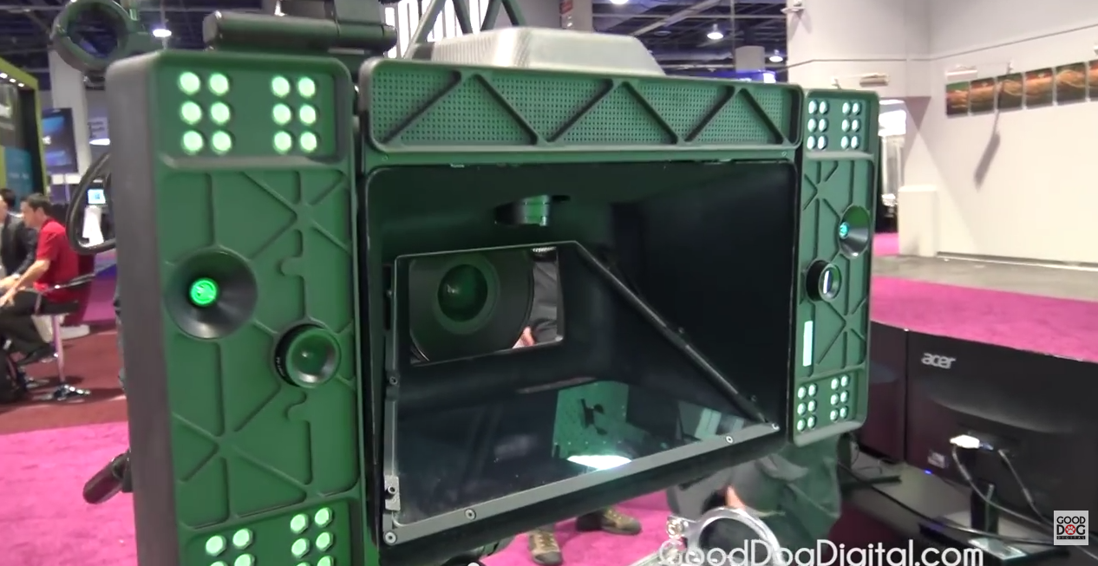
Real-time color & 3D information
Affordable integrated depth and color cameras

Slide 3
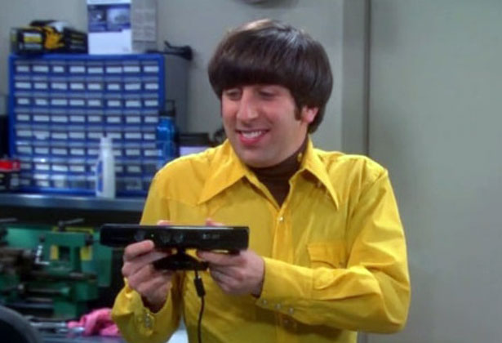
Application: 3D scanning

Slide 4
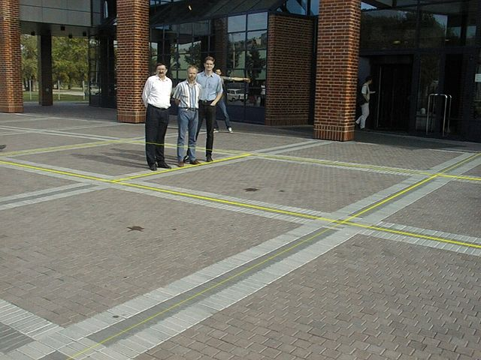
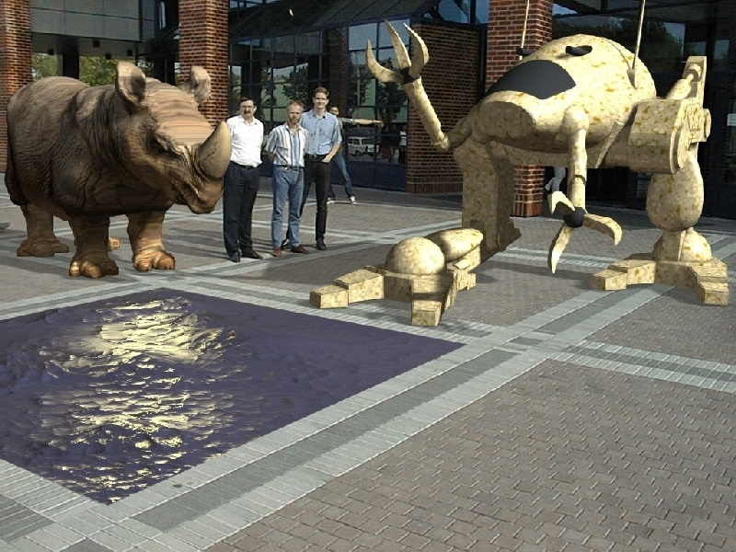
Application: limitations of compositing
Chroma keying
Augmented reality
Compositing can be based on color:
Fixed order
No shadows
No reflections, refractions, cross illumination

Slide 5
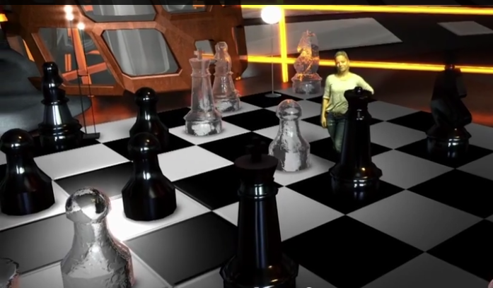
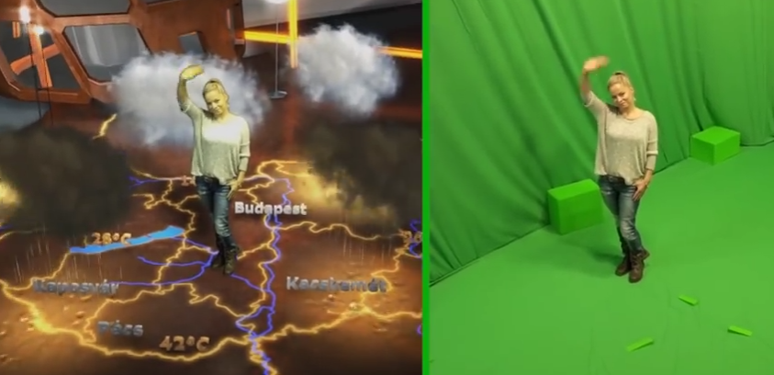
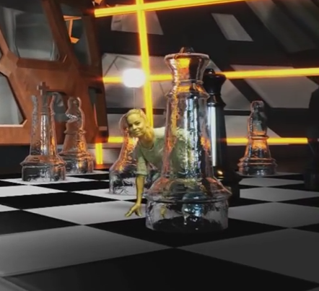
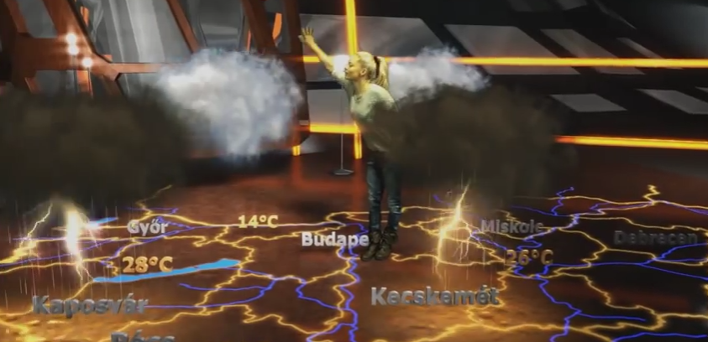
Deph compositing (Zinemath)
Zinemath - ZLense

Slide 6
3D reconstruction of a point
f
(x_{c},y_{c},z_{c})
(x_{i},y_{i})
x_{i} = fx_{c}/z_{c}
y_{i} = fy_{c}/z_{c}
x_{i} =(X-c_{x})s_{x}
y_{i} =(Y-c_{y})s_{y}
t
(c_{x}, c_{y})
(c_{x},c_{y})
z_{c}
(X,Y)
Back projection

Slide 7
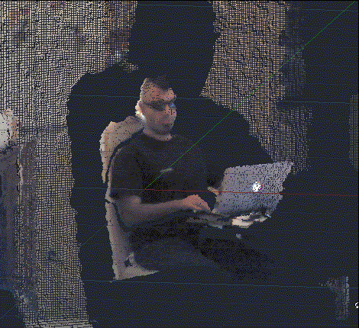
3D point cloud
http://through-the-interface.typepad.com/through_the_interface/2012/11/updated-autocad-integration-samples-for-kinect-sdk-v16.html

Slide 8
Dynamic camera, static scene
Fusion
Projection
Point cloud
Object
Problems:
in different images the camera changes
camera tracking based on static objects
in different frames different points are visible
We need to maintain surface information
between points
Solution (Curless/Levoy):
Scene is represented by an emerging
distance field

Slide 9
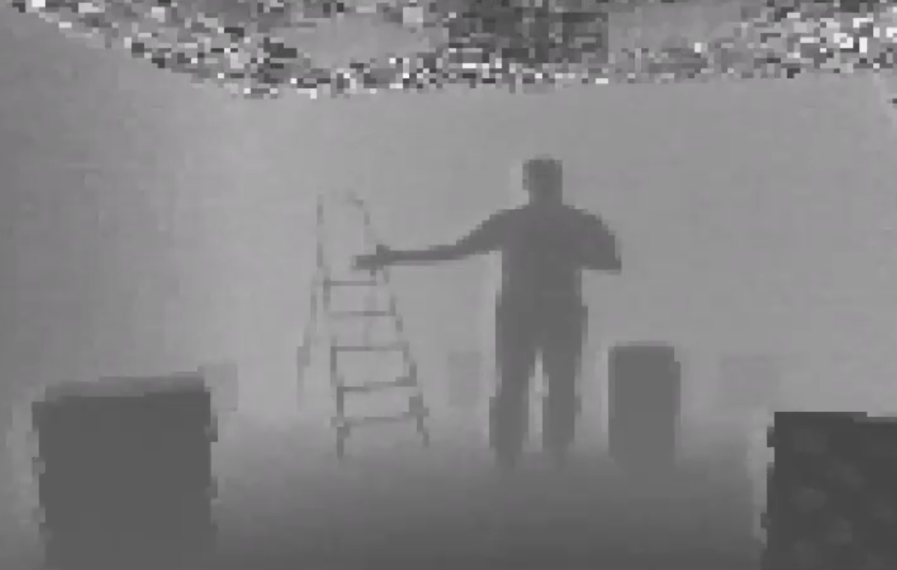
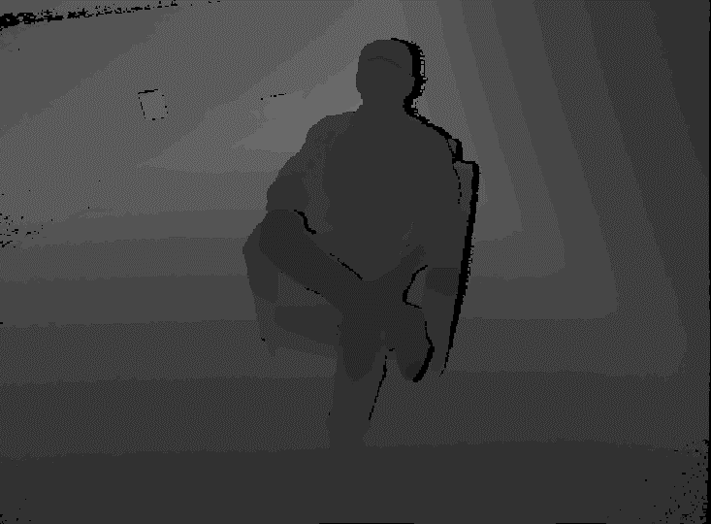
3D reconstruction input
Depth image: distance of the visible surface in each pixel
Noisy and unreliable

Slide 10
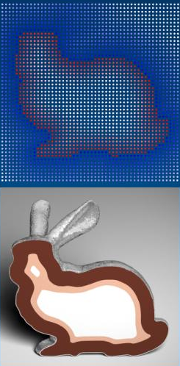
Surface reconstruction
Curless-Levoy algorithm
Truncated Signed Distance Field (TSDF)
d(x,y,z)
d
voxel

Slide 11
Aims
Reconstruct static scenes with moving camera
Real-time reconstruction
GPU-based implementation
Fast camera tracking
Common methods (SIFT, SURF etc.) are slow
Efficient, high resolution TSDF storage
To reconstruct fine geometric details
GPU memory is limited

Slide 12
Proposed method
Two-level, hierarchical TSDF
Observation: usually most of the scanned 3D space is empty
Iterative reconstruction algorithm
Measured depth image
Camera pose
Intersected
macro-cells
Camera tracking
Macrocell marking
Depths and normal vectors
Macrocell refinement
Distance generation
Divided cells
3D mesh, etc.
Applications
Distance fusion
TSDF

Slide 13
Hierarchical TSDF
Empty
macro-cell
Decomposed
macro-cell
Micro cell block
8×8 ×8
Micro-cell store
Macro-cell array
Empty list

Slide 14
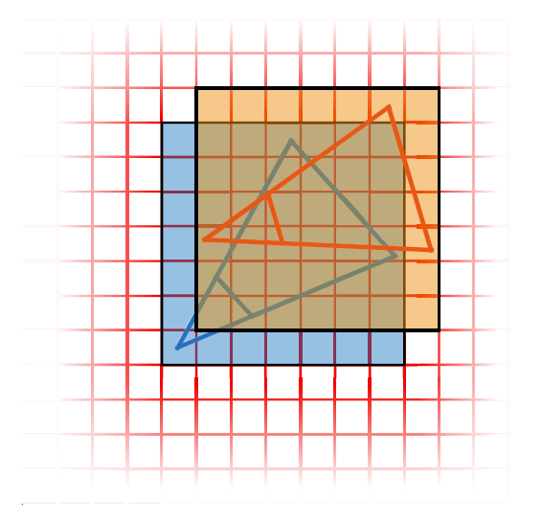
Macro-cell marking
visible surface
not affected
intersected
empty
Truncation distance
macro-cells

Slide 15
Macro-cell marking: gather-style
Wasteful!
Project each voxel
to the depth map
and compare depth
macro-cells

Slide 16
Scatter-style marking (but still faster)
visible surface
not affected
intersected
Visit affected voxels
by ray-casting
empty
Truncation distance
macro-cells
DDA steps

Slide 17
Avoiding atomic operations
Macro-cell marking
Determine empty and intersected cells
Without synchronization!
31
24
20
0
Empty counter
Index to the block of child micro-cells
is intersected
is empty

Slide 18
Fusion
Distance fusion
Only for the previously marked micro-cells
1
0.9
0.5
-0.1
-0.8
-1
0.5

Slide 19
Rendering
Distance map generation
Hierarchical DDA
Different step size in the macro and micro cells
ray

Slide 20
Camera tracking
Iterative Closest Point (ICP)
Projective matching
q₁
q₂
R, t
q_{n}
p₁
p₂
p_{n}
Back projection
of current depth
Zero-crossings
of the TSDF

Slide 21
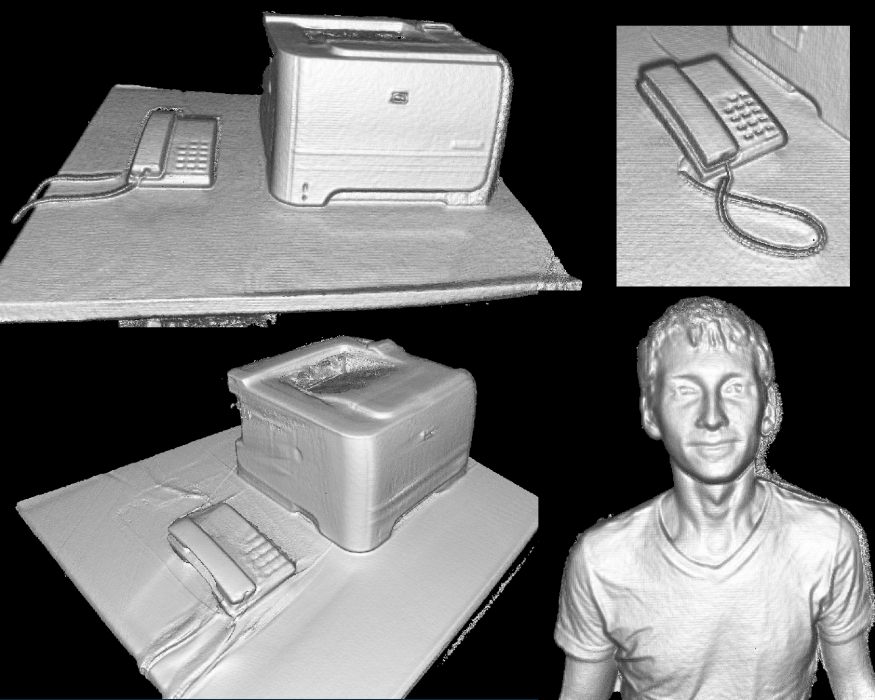
Results
Kinect2 depth camera
NVIDIA 690GTX GPU
Real-time reconstruction
1mm cell resolution

Slide 22
Results
With the same memory usage: 8mm vs 1mm cell size
Kinect Fusion
Proposed method

Slide 23
Thank you!

Slide 24
Time of flight depth sensors
Pulsed modulation:
Accurate time measurement
expensive
Continuous modulation
Periodic distance

