Slide 1
Geometry shader-based effect

Slide 2
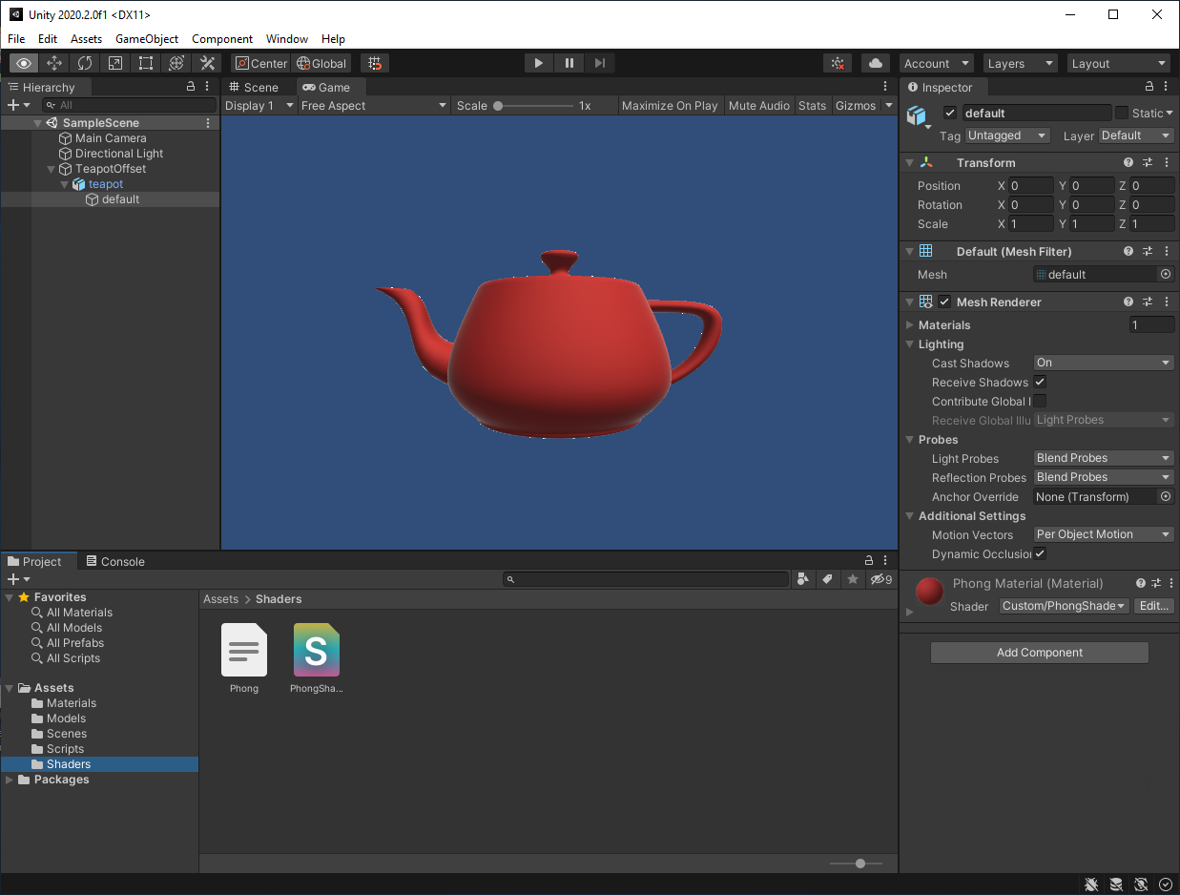
Starting project
Contains a simple Phong-shading shader

Slide 3
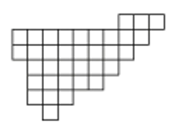
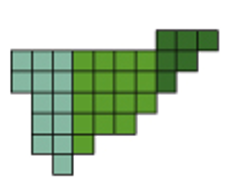
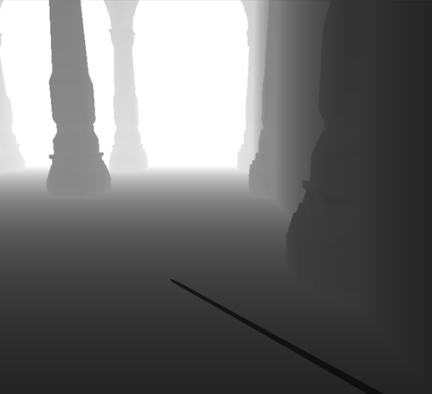
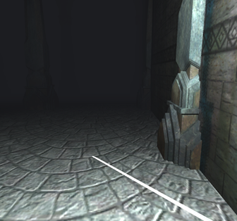
Geometry shader
3D pipeline
Depth buffer
Vertex shader
Geometry shader
Rasterization
Fragment shader
Compositing
Color buffer
Normal buffer

Slide 4
Geometry shader
Requires shader model 4+
In the shader: #pragma target 4.0
Create a new material + shader:
Geometry.shader, Geometry.material
Modern graphics engines can pass adjacency information to the geometry shader (adjacent lines or triangles)
Adjacency is not supported by most game engines (including Unity) ☹
Shader "Custom/Geometry" {
Properties {
_Color ("Color", Color) = (1,1,1,1)
_Emissive ("Emissive", Color) = (0,0,0,1)
_Specular ("Specular", Color) = (1,1,1,1)
_Smoothness ("Shininess", Range (0.0, 1.0)) = 0.1
}
SubShader {
Tags { "Queue" = "Geometry"}
Pass
{
CGPROGRAM
#pragma target 4.0
#pragma vertex mainVS
#pragma fragment mainPS
#pragma geometry mainGS
#include "Phong.cginc"
ENDCG
}
}
}

Slide 5
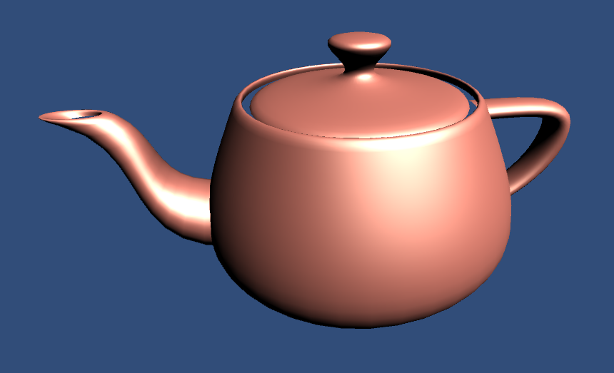
Trivial geometry shader
#pragma geometry mainGS_passthrough
// …
[maxvertexcount(3)]
void mainGS_passthrough(
triangle VS_OUT IN[3],
inout TriangleStream<VS_OUT> stream)
{
stream.Append(IN[0]);
stream.Append(IN[1]);
stream.Append(IN[2]);
stream.RestartStrip();
}

Slide 6
Example: triangle shrinking
float _Scale;
[maxvertexcount(3)]
void mainGS_shrink(
triangle VS_OUT IN[3],
inout TriangleStream<VS_OUT> stream)
{
float4 A = IN[0].hPos;
float4 B = IN[1].hPos;
float4 C = IN[2].hPos;
float T = _Scale;
IN[0].hPos = lerp(A, lerp(B, C, 0.5), 1 - T);
IN[1].hPos = lerp(B, lerp(A, C, 0.5), 1 - T);
IN[2].hPos = lerp(C, lerp(A, B, 0.5), 1 - T);
stream.Append(IN[0]);
stream.Append(IN[1]);
stream.Append(IN[2]);
stream.RestartStrip();
}
Properties {
_Color ("Color", Color) = (1,1,1,1)
_Emissive ("Emissive", Color) = (0,0,0,1)
_Specular ("Specular", Color) = (1,1,1,1)
_Smoothness ("Shininess", Range (0.0, 1.0)) = 0.1
_Scale("Scale", Range(0.0, 1.0)) = 0.9
}
C
lerp(B,C,0.5)
A
B

Slide 7
Example: triangle shrinking
float _Scale;
[maxvertexcount(3)]
void mainGS_shrink(
triangle VS_OUT IN[3],
inout TriangleStream<VS_OUT> stream)
{
float4 A = IN[0].hPos;
float4 B = IN[1].hPos;
float4 C = IN[2].hPos;
float T = _Scale;
IN[0].hPos = lerp(A, lerp(B, C, 0.5), 1 - T);
IN[1].hPos = lerp(B, lerp(A, C, 0.5), 1 - T);
IN[2].hPos = lerp(C, lerp(A, B, 0.5), 1 - T);
stream.Append(IN[0]);
stream.Append(IN[1]);
stream.Append(IN[2]);
stream.RestartStrip();
}
Properties {
_Color ("Color", Color) = (1,1,1,1)
_Emissive ("Emissive", Color) = (0,0,0,1)
_Specular ("Specular", Color) = (1,1,1,1)
_Smoothness ("Shininess", Range (0.0, 1.0)) = 0.1
_Scale("Scale", Range(0.0, 1.0)) = 0.9
}
Note that we interpolated the clip-space vertices (before homogeneous division, after the perspective transform). In this case it is equivalent to interpolating in world-space and then applying the perspective transform, as the latter is in linear in homogeneous coordinates.
C
lerp(B,C,0.5)
A
B

Slide 8
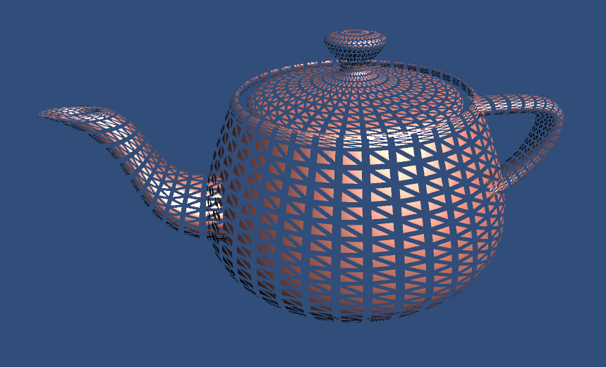
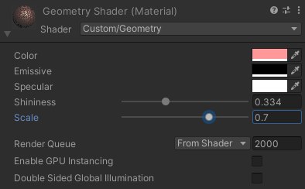
Example: triangle shrinking

Slide 9
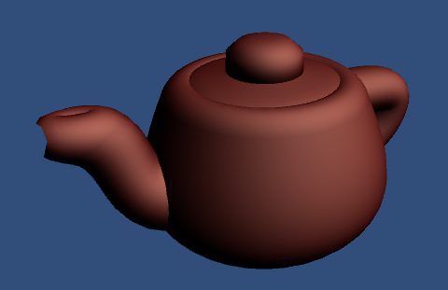
Example: Fat shader
Offset the vertices along the normals

Slide 10
Example: Fat shader
Translate the vertices along the normals
[maxvertexcount(3)]
void mainGS_fat(triangle VS_OUT IN[3], inout TriangleStream<VS_OUT> stream)
{
for (int i = 0; i < 3; ++i)
{
float4 wp = float4(IN[i].wPos, 1);
wp.xyz = wp.xyz + IN[i].N*_Scale; // add an offset to the vertex in world-space
IN[i].hPos = mul(UNITY_MATRIX_VP, wp);
stream.Append(IN[i]);
}
stream.RestartStrip();
}

Slide 11
Topology
So far we built triangles from triangles
void mainGS(triangle VS_OUT IN[3],
inout TriangleStream<VS_OUT> stream)
Both the input and the output can also be lines, the two can be combined freely (lines → triangles or vice versa)
line VS_OUT IN[2]
inout LineStream<VS_OUT> stream

Slide 12
Example: Normal rendering
The Unity Editor does not draw mesh normals, let’s write a shader for it
Draw a line from the vertex in the normal’s direction in world space
We are going to need the world position of the vertex
The vertex shader of the starting project already computes it, let’s pass it!
Phong.cginc:
VS_OUT mainVS(float4 position : POSITION,
float3 normal : NORMAL)
{
VS_OUT OUT = (VS_OUT) 0;
OUT.hPos = UnityObjectToClipPos(position);
float3 wPos = mul(unity_ObjectToWorld, position).xyz;
float3 wNormal = mul(float4(normal, 0),
unity_WorldToObject).xyz;
OUT.N = normalize(wNormal);
OUT.L = normalize(_WorldSpaceLightPos0.xyz
- wPos * _WorldSpaceLightPos0.w);
OUT.V = normalize(_WorldSpaceCameraPos.xyz - wPos);
OUT.wPos = wPos;
return OUT;
}
struct VS_OUT
{
float4 hPos : SV_Position;
float3 N : NORMAL;
float2 texCoord : TEXCOORD0;
float3 L : TEXCOORD1;
float3 V : TEXCOORD2;
float3 wPos : TEXCOORD3;
};

Slide 13
Example: Normal rendering
[maxvertexcount(6)]
void mainGS_normal(triangle VS_OUT IN[3], inout LineStream<VS_OUT> stream)
{
for (int i = 0; i < 3; ++i)
{
float4 wp = float4(IN[i].wPos, 1);
wp.xyz = wp.xyz;
IN[i].hPos = mul(UNITY_MATRIX_VP, wp);
stream.Append(IN[i]);
wp.xyz = wp.xyz + IN[i].N*_Scale;
IN[i].hPos = mul(UNITY_MATRIX_VP, wp);
stream.Append(IN[i]);
stream.RestartStrip();
}
}

Slide 14
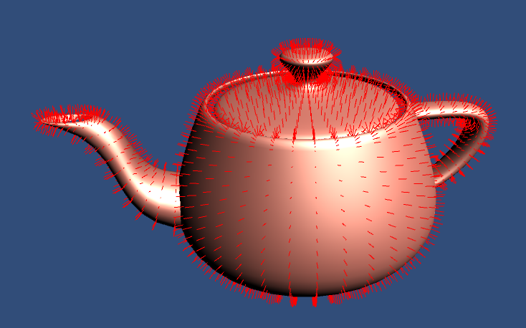
Example: Normal rendering
Normals may be rendered with a constant color, e.g.:
float4 mainPS_red(VS_OUT IN) : SV_Target {
return float4(1,0,0,1);
}
We can also draw the shaded geometry, we only need to add another pass for this in Unity
Pass {
Tags{ "LightMode" = "ForwardBase" }
CGPROGRAM
#pragma target 3.0
#pragma vertex mainVS
#pragma fragment mainPS
#include "Phong.cginc"
ENDCG
}

Slide 15
Example: Contour rendering
Recall that contours drawn in the fragment shader usually do not have uniform width
See Pr04, Contour rendering: modified toon shader
Idea: draw the contour as geometry!
Can also be textured (we will not implement this)
In the geometry shader, identify triangles which contain a contour line (which are at the border/silhouette of the object) and extend the contour line to a quad!

Slide 16
Locate contours
Contour line is defined by dot(N,V) = 0, where N is the normal and V is the viewing direction, in world-space
Contour lines intersect an edge iff the sign of dot(N,V) is different for the end vertices of the edge
(N,V)>0
(N,V)=0
(N,V)<0
(N,V)=0
(N,V)>0

Slide 17
Contour triangles
[maxvertexcount(3)]
void mainGS_bordertriangles(triangle VS_OUT IN[3], inout TriangleStream<VS_OUT> stream) {
float dot0 = dot(IN[0].N, IN[0].V);
float dot1 = dot(IN[1].N, IN[1].V);
float dot2 = dot(IN[2].N, IN[2].V);
int found = 0;
if (dot0 * dot1 < 0) {
++found;
}
if (dot0 * dot2 < 0) {
++found;
}
if (dot1 * dot2 < 0) {
++found;
}
if (found == 0) return;
stream.Append(IN[0]);
stream.Append(IN[1]);
stream.Append(IN[2]);
stream.RestartStrip();
}

Slide 18
Task/homework: contour drawing
(N,V)>0
Start with the shader on the previous slide
Determine which two edges intersect the contour
dot(N, V) is known at the vertices, compute its zero crossing along the edges → A, B in the figure
Stretch the line segment AB to a quad (two triangles) of fixed width, perpendicular to AB
If we compute the vertices of the quad in image space, the contour width can be made constant on the final image
Where do we need to compute the homogeneous division?
(N,V)=0
A
(N,V)<0
(N,V)=0
B
(N,V)>0

Slide 19
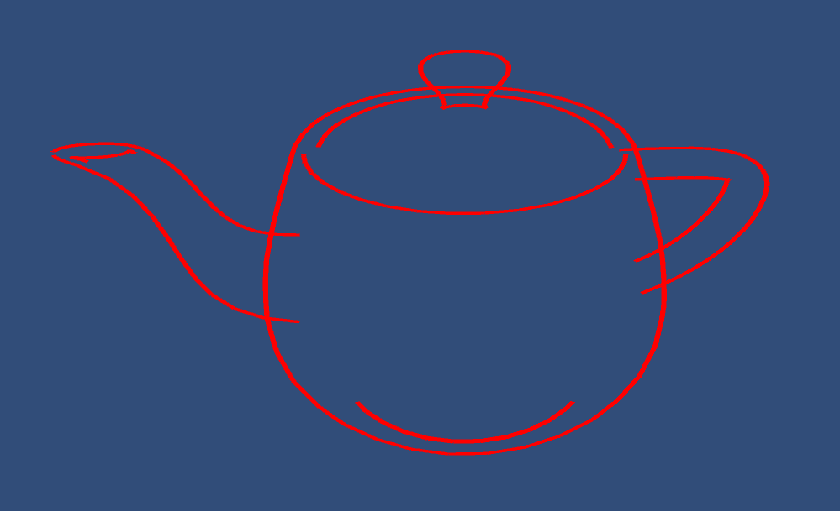
Task/homework: contour drawing

