Slide 1
Unity Shader graph

Slide 2
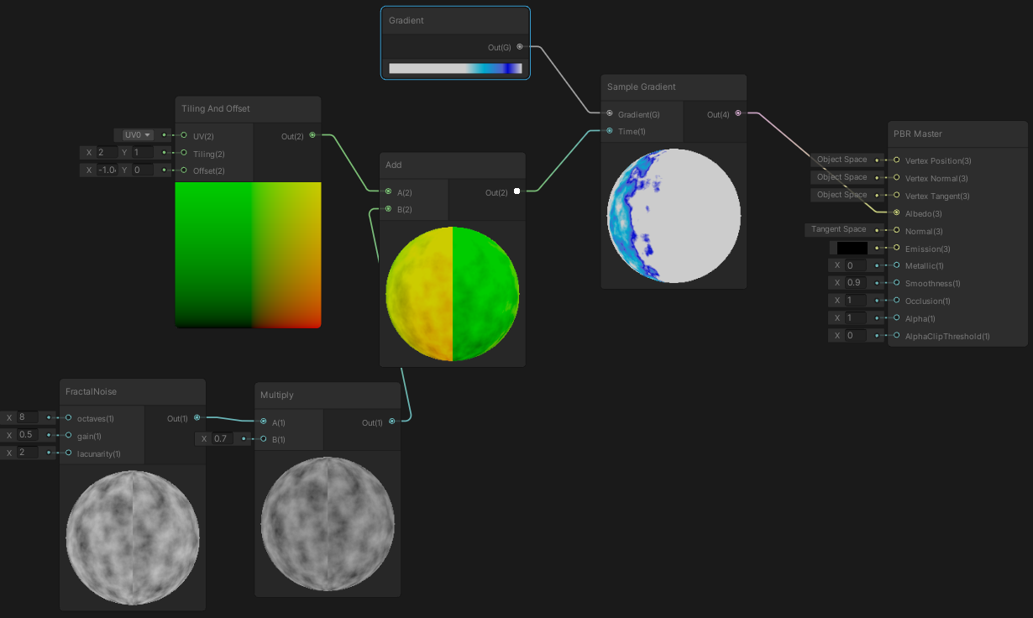
Shader graph
Visual programming tool for shaders
Directed graph: nodes are shader functions / code snippets, edges connect their input/output

Slide 3
Shader graph
Many built-in nodes
You may have a look at the actual implementation of nodes in (Windows) PATH_TO_UNITY/Editor/Data/Resources/PackageManager/Editor/com.unity.shadergraph-*.*.*.tgz
Generated code for every graph can be shown in the shader graph editor (see later)
Can be used to implement almost everything
(Including most NPR shaders we have seen so far)
Here we are going to play with procedural textures

Slide 4
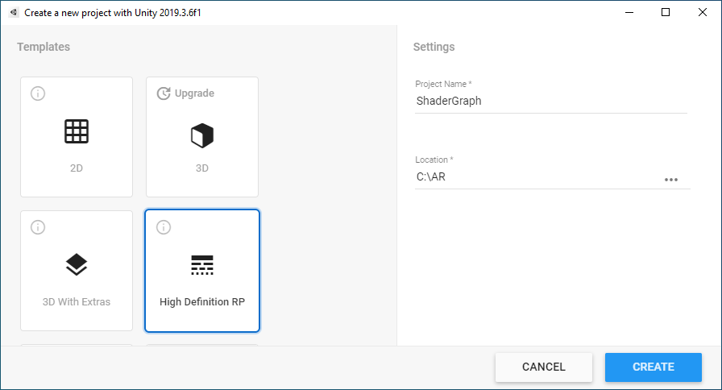
New project
Minimum Unity 2019 (but 2020 is less bugged)
High Definition Render Pipeline project

Slide 5
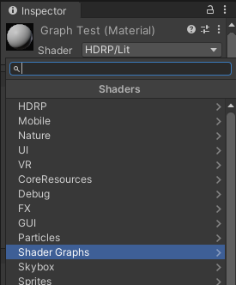
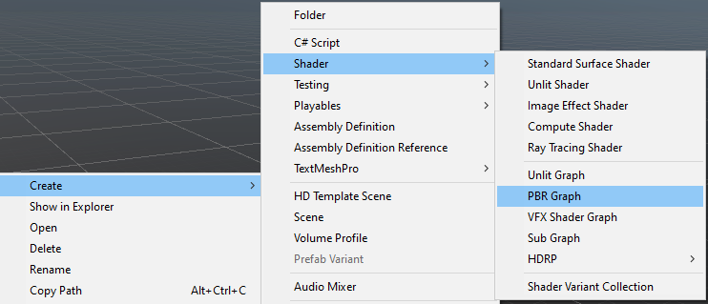
New shader graph
New asset: Shader/PBR Graph
Call it TestGraph
New material: GraphTest, set the shader

Slide 6
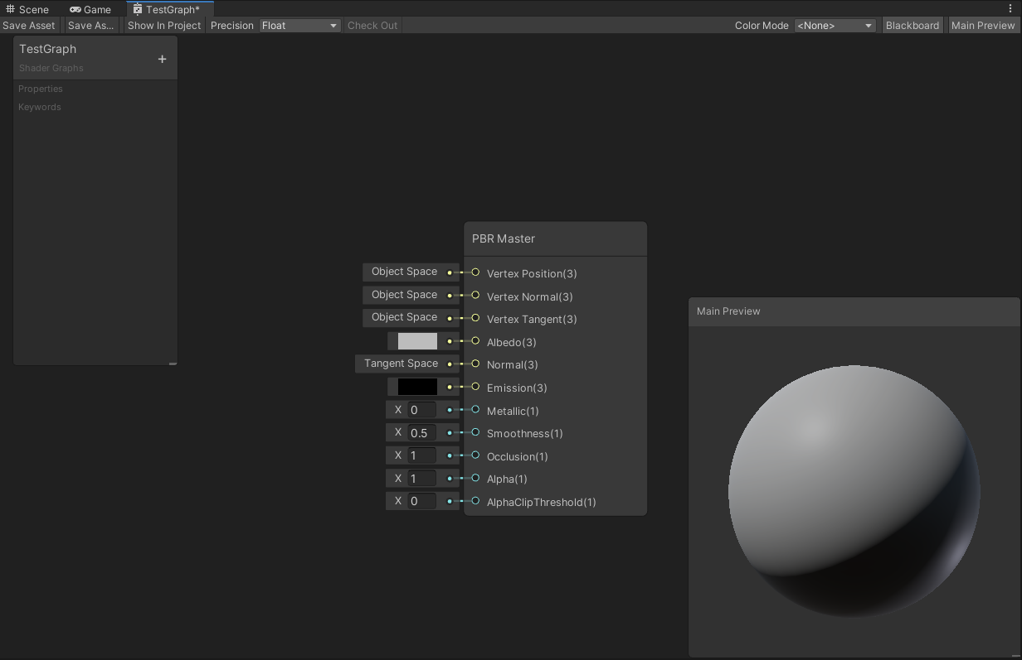
Graph editor
Double click on the asset: the graph editor opens
Nodes and their connections can be edited

Slide 7
Procedural textures
We define the image as a (1,2,3,… dimensional) function
The „image” pixels are generated by a procedure, hence the name
If we define it in shader graph, the shader evaluates the image on-the-fly, does not generate and store the actual pixels
Benefits:
Potentially infinite resolution
Very small memory footprint (we store the code instead of pixel values)
Texture can be edited within the Unity engine
Can be faster (memory fetch on the GPU is slow!)
Can be time dependent (moving, floating, deforming etc. textures)
Drawbacks:
Can be slower (if the function is too complex)
Filtering, anti-aliasing, mip-mapping is not automatic
Need to implement these in the actual function that generates the image

Slide 8
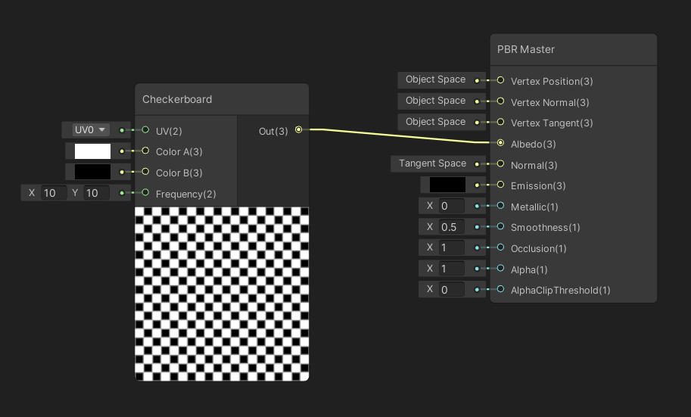
Checkerboard texture
Right click, create node, Procedural/Checkerboard
Connect its output to the albedo of the Master node
Set one of the colors white, the other one black
Frequency (defines tiling): 10, 10

Slide 9
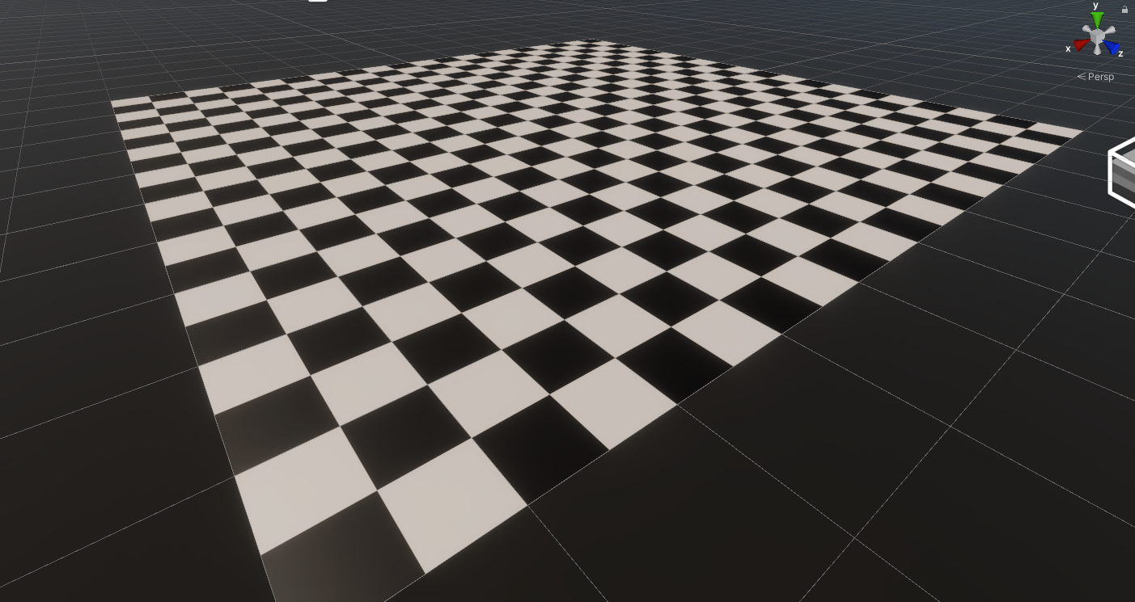
Checkerboard texture
Always save the graph after editing!!!
Add a new plane to the scene, assign the GraphTest material to it
No matter how close we zoom, borders are sharp!

Slide 10
Built-in Anti-Aliasing
Increase frequency of the Checkerboard node to 100
Notice the anti-aliasing, there are no Moiré patterns
It is implemented in the shader!
(You may check it: right click on the node, Show generated code)

Slide 11
Built-in Anti-Aliasing
Have a look at how coders at Unity implemented the shader!
Notice the anti-aliasing
void Unity_Checkerboard_float(float2 UV, float3 ColorA, float3 ColorB, float2 Frequency, out float3 Out)
{
UV = (UV.xy + 0.5) * Frequency;
float4 derivatives = float4(ddx(UV), ddy(UV));
float2 duv_length = sqrt(float2(dot(derivatives.xz, derivatives.xz),
dot(derivatives.yw, derivatives.yw)));
float width = 1.0;
float2 distance3 = 4.0 * abs(frac(UV + 0.25) - 0.5) - width;
float2 scale = 0.35 / duv_length.xy;
float freqLimiter = sqrt(clamp(1.1f - max(duv_length.x, duv_length.y),
0.0, 1.0));
float2 vector_alpha = clamp(distance3 * scale.xy, -1.0, 1.0);
float alpha = saturate(0.5f + 0.5f * vector_alpha.x * vector_alpha.y * freqLimiter);
Out = lerp(ColorA, ColorB, alpha.xxx);
}

Slide 12
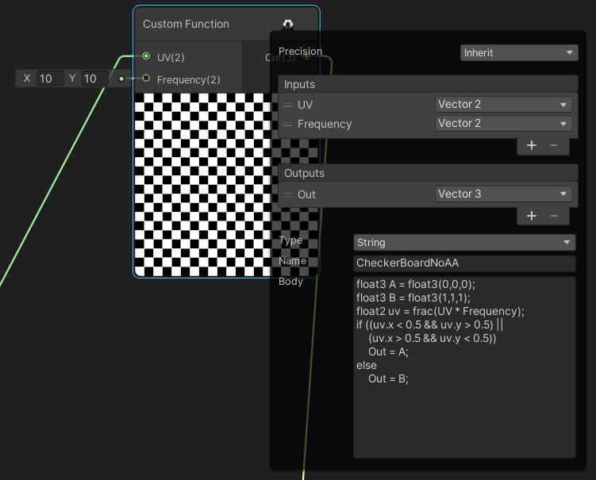
Implement our own, without AA
Create a new „Custom Function” node
You may write arbitrary shader code in it
Define two new input parameters and an output as in the built-in checkerboard node
Create a new TilingAndOffset node and connect its output to the UV input of the custom function node

Slide 13
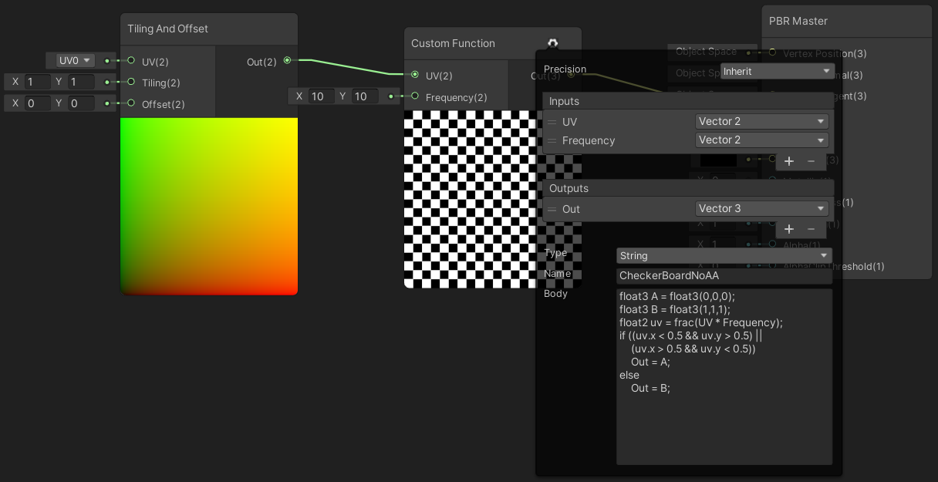
Implement our own, without AA
Naive implementation: only the checkerboard function, no AA
float3 A = float3(0,0,0);
float3 B = float3(1,1,1);
float2 uv = frac(UV * Frequency);
if ((uv.x < 0.5 && uv.y > 0.5) ||
(uv.x > 0.5 && uv.y < 0.5))
Out = A;
else Out = B;

Slide 14
Implement our own, without AA
Naive implementation: only the checkerboard function, no AA
float3 A = float3(0,0,0);
float3 B = float3(1,1,1);
float2 uv = frac(UV * Frequency);
if ((uv.x < 0.5 && uv.y > 0.5) ||
(uv.x > 0.5 && uv.y < 0.5))
Out = A;
else Out = B;

Slide 15
Implement our own, without AA
Look at the plane in the scene view at a flat angle
Edges are jagged
Observe the Moiré patterns!
Most built-in nodes have anti-aliasing

Slide 16
Noise functions
In nature, almost nothing is regular
We can add irregularity (a more natural look) to texture patterns using noise functions
Usually a function that maps the UV space to [0,1]
Save the CheckerBoard graph and start a new one
Create Node / Procedural / Noise / …

Slide 17
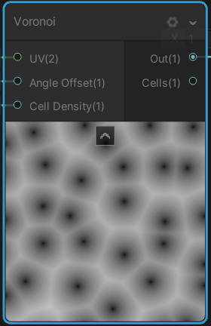
Worley/Cellular/Voronoi noise
Linear combination of distance functions from randomly placed sample points

Slide 18
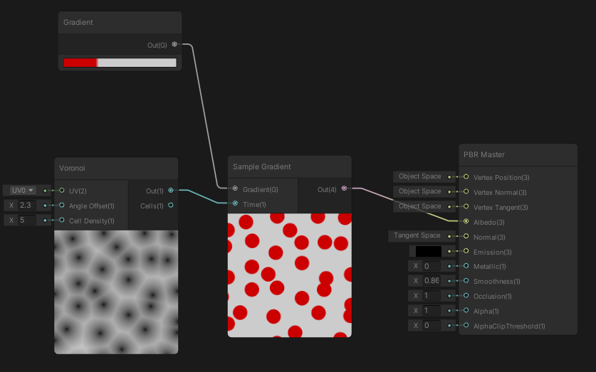
Noise usage: Color Ramp
Map the noise value to colors
New nodes: Voronoi, Gradient, Sample gradient

Slide 19
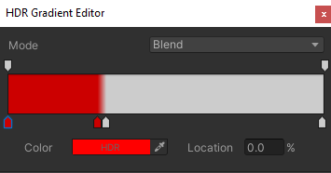
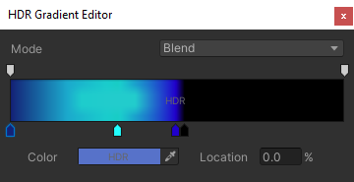
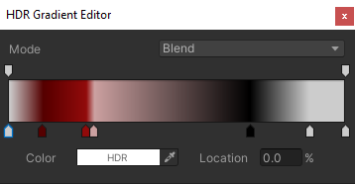
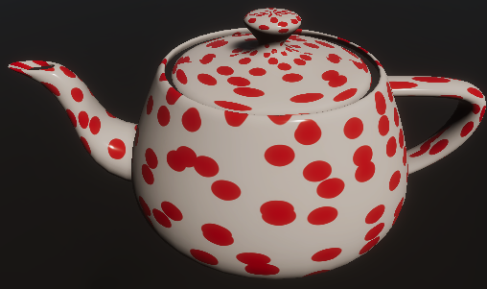
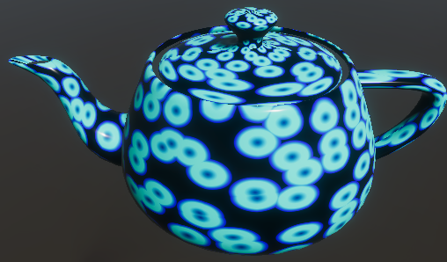
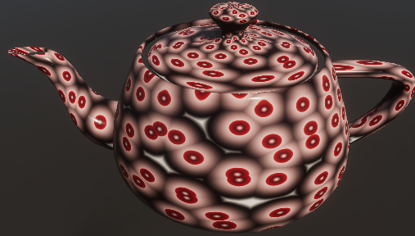
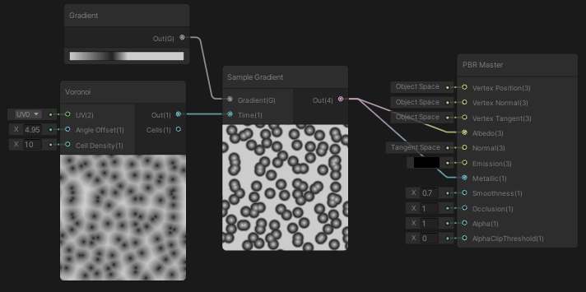
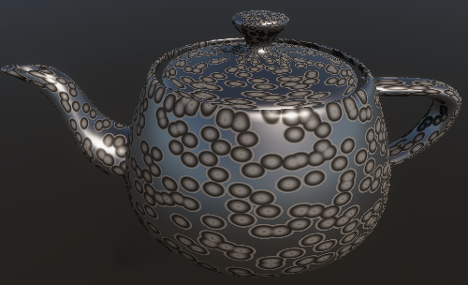

Slide 20
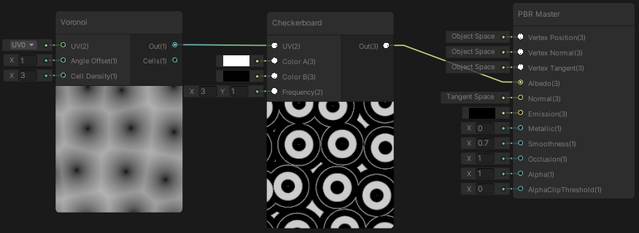
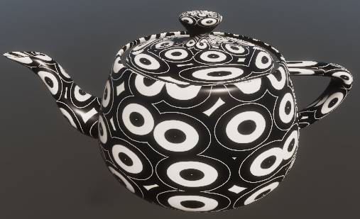
Noise usage: UV input (Ramp v2)
Connect the noise eg. to CheckerBoard UV

Slide 21
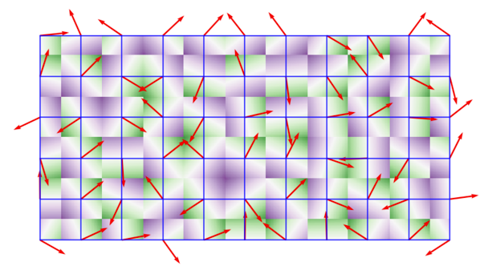
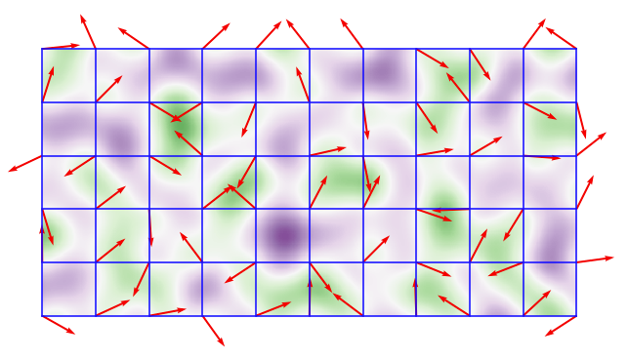
Perlin noise
Linear interpolation of dot products with random gradient vectors stored in a regular grid
Has better spectrum then simply interpolating random scalar values
Perlin noise is zero at the grid points, 1-2 bumps in between

Slide 22
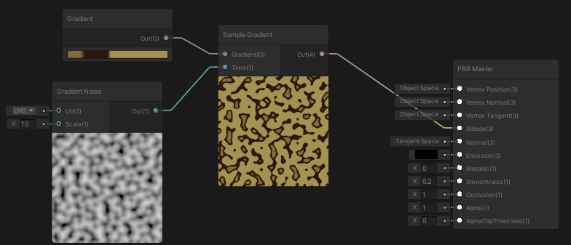
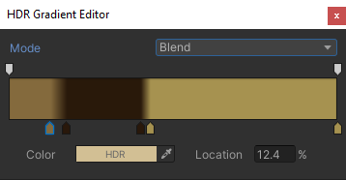
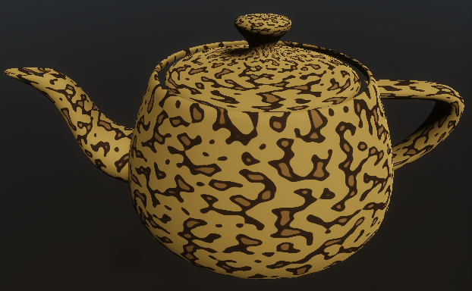
Perlin noise Color Ramp

Slide 23
Fractal noise
Sum of the same (noise) function with increasing frequency and decreasing amplitude
$$\frac{1}{2}∗$$
$$+\frac{1}{4}∗$$
$$+\frac{1}{8}∗$$
F(x)
F(2x)
F(4x)
$$=$$

Slide 24
New subgraph
There is no fractal noise in Unity, we implement it in a new custom node
In the current Unity version it is a bit „hacky”, we need to call the function that defines the frequencies (F in the previous slide) in our own custom node
In order to be able to call it (for the shader compiler to see it) we need to connect the function as a dummy input to our custom node
Asset / Create / Shader / Sub Graph
Call it FractalNoise

Slide 25
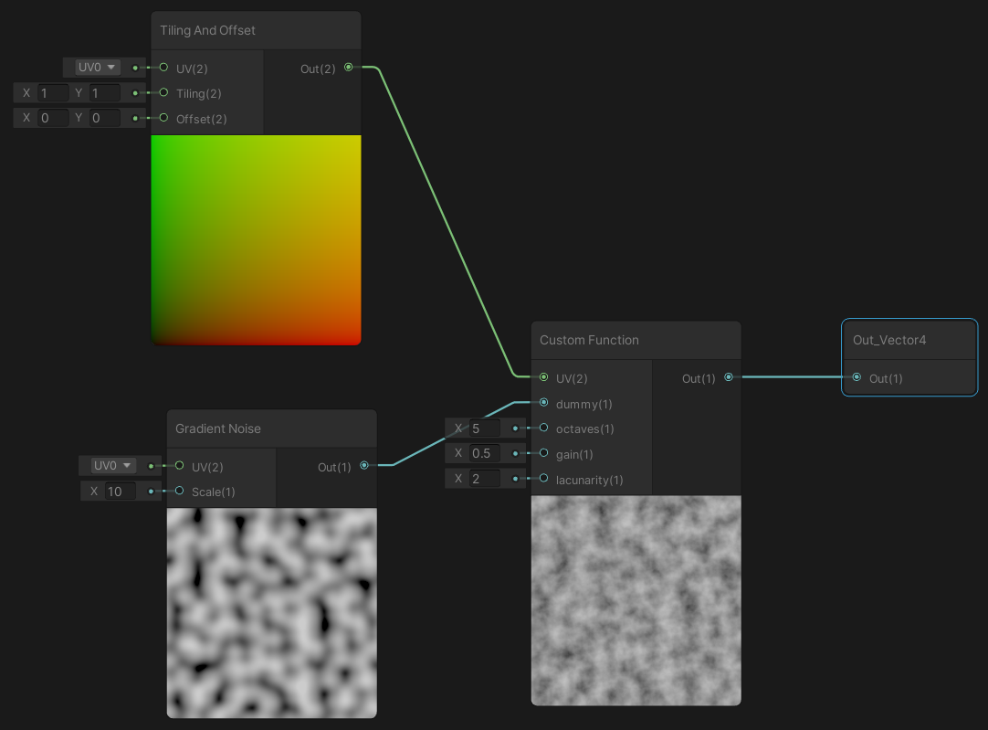
New subgraph

Slide 26
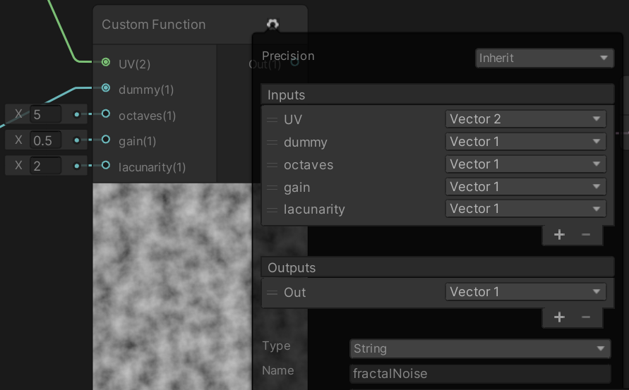
New subgraph
Function body:
float xOut = 0;
float scale = 10;
float amplitude = 0.5;
float result = 0;
for (float octave = 0; octave < octaves; ++octave){
Unity_GradientNoise_float(UV, scale, xOut); // defined by Gradient Noise node
result += amplitude * xOut;
scale *= lacunarity; // lacunarity input parameter
amplitude *= gain; // gain input parameter, a.k.a. persistence
}
Out = result; // We called the output parameter of the node output

Slide 27
New subgraph
Function body:
float xOut = 0;
float scale = 10;
float amplitude = 0.5;
float result = 0;
for (float octave = 0; octave < octaves; ++octave){
Unity_GradientNoise_float(UV, scale, xOut); // defined by Gradient Noise node
result += amplitude * xOut;
scale *= lacunarity; // lacunarity input parameter
amplitude *= gain; // gain input parameter, a.k.a. persistence
}
Out = result; // We called the output parameter of the node output
This function is defined in the Gradient Noise built-in node, we connected that node to a dummy parameter of our Custom Function node so the shader compiler can see it

Slide 28
Noise usage: UV perturbation
F(x + c*noise(x))
F(x)
F(x + c*noise(x))
x
x + c*noise(x)
noise(x)
c*noise(x)

Slide 29
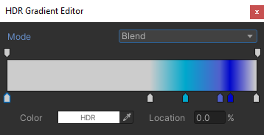
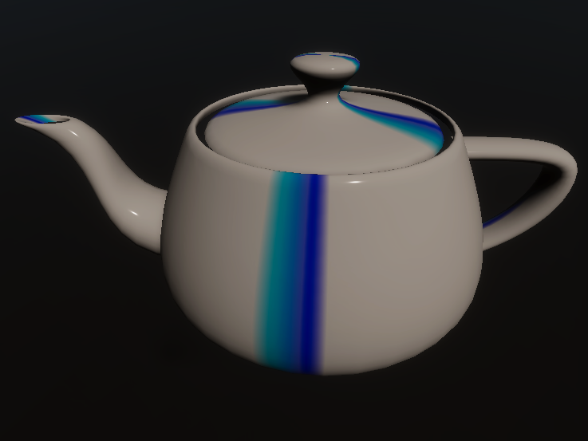
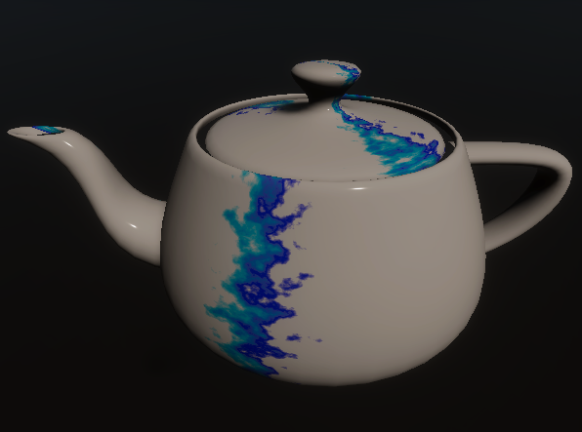
Noise usage: UV perturbation
Marble-like texture
F(x)
F(x + c*noise(x))

