Slide 1
Reduction Based Techniques

Slide 2
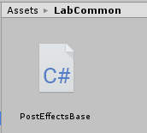
Starting project
Use the starting project of this practical – Pr07-ReductionBasedTechniques.zip
Contains the PostEffectsBase base class for image effects from earlier weeks
Contains some example color style images for the color transfer effect
Open the base unity scene:
Lab07/Lab07-Scene.unity

Slide 3
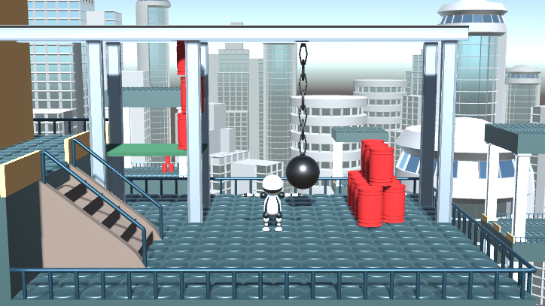
Pixelization effect
Emulate low-resolution screen, pixels are "blocky"
Final image resolution should not change (that is determined by the Unity Screen resolution, i.e. monitor/mobile/etc. screen resolution)
Basic idea: downsample the image and use Point (Nearest) interpolation

Slide 4
First version: manual downsampling
Implement the downsampling (Reduction to a lower image) in shaders
Every pixel of the output image should be the average of many pixels (e.g. 4, 8, 16) of the input image
Instead of doing the averaging in one pass (slow!) we halve the image resolution (4-times less pixels) gradually, several times, like Mip-Maps
E.g. 2-times halving = 4-times downsampling (1/16 pixels)
Note: Log₂(resolution) times downsampling gives the pixel average!

Slide 5
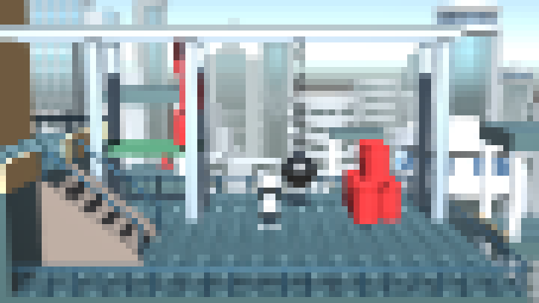
N = 1
Downsampling rate = 2
N = 3
Downsampling rate = 8
Average of all pixels
N = 2
Downsampling rate = 4
N = Log₂( Max(imageWidth, imageHeight) )
Downsampling rate = Max(imageWidth, imageHeight)

Slide 6
N = 3
Downsampling rate = 8
Average of 8x8 pixels
Original image
(N = 0
Downsampling rate = 1)

Slide 7
2x2 downsampling
A fragment shader instance writes one pixel of the output and reads four pixels from the input
UV = (0,0)
UV = (1,0)
UV = (0,0)
UV = (1,0)
Sample 4 pixels at pixel centers
(or anywhere inside the pixel with nearest neighbour sampling)
and take their average
UV = (0,1)
UV = (1,1)
UV = (0,1)
UV = (1,1)

Slide 8
2x2 downsampling
A fragment shader instance writes one pixel of the output and reads four pixels from the input
UV = (0,0)
UV = (1,0)
UV = (0,0)
UV = (1,0)
Make sure every pixel of the higher resolution input image contributes to exactly one pixel of the lower resolution output
UV = (0,1)
UV = (1,1)
UV = (0,1)
UV = (1,1)

Slide 9
Upsampling
A fragment shader instance writes one pixel of the high resolution output and reads one pixel from the low resolution input with nearest neighbours sampling
UV = (0,0)
UV = (1,0)
UV = (0,0)
UV = (1,0)
Take one sample from the input at the center of the output pixel
UV = (0,1)
UV = (1,1)
UV = (0,1)
UV = (1,1)

Slide 10
Upsampling
A fragment shader instance writes one pixel of the high resolution output and reads one pixel from the low resolution input with nearest neighbours sampling
UV = (0,0)
UV = (1,0)
UV = (0,0)
UV = (1,0)
Blocks of pixels of the output read the same pixel from the input
UV = (0,1)
UV = (1,1)
UV = (0,1)
UV = (1,1)

Slide 11
Upsampling
A fragment shader instance writes one pixel of the high resolution output and reads one pixel from the low resolution input with nearest neighbours sampling
UV = (0,0)
UV = (1,0)
UV = (0,0)
UV = (1,0)
Blocks of pixels of the output read the same pixel from the input
UV = (0,1)
UV = (1,1)
UV = (0,1)
UV = (1,1)

Slide 12
Upsampling
A fragment shader instance writes one pixel of the high resolution output and reads one pixel from the low resolution input with nearest neighbours sampling
UV = (0,0)
UV = (1,0)
UV = (0,0)
UV = (1,0)
Blocks of pixels of the output read the same pixel from the input
UV = (0,1)
UV = (1,1)
UV = (0,1)
UV = (1,1)

Slide 13
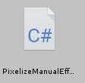
Pixelization C# script
Create new C# script, call it PixelizeManualEffect
Attach it to the main camera

Slide 14
Pixelization C# script
Derive from the PostEffectsBase base class, as before
[ExecuteInEditMode]
[RequireComponent(typeof(Camera))]
public class PixelizeManualEffect : PostEffectsBase
{
[Range(0, 4)]
public int level = 1;
void Start () {
shader = Shader.Find("NPR/PixelizeManualShader");
CreateMaterial();
}

Slide 15
Pixelization C# script
Derive from the PostEffectsBase base class, as before
[ExecuteInEditMode]
[RequireComponent(typeof(Camera))]
public class PixelizeManualEffect : PostEffectsBase
{
[Range(0, 4)]
public int level = 1;
void Start () {
shader = Shader.Find("NPR/PixelizeManualShader");
CreateMaterial();
}
This parameter will tell how many times to apply 2x2 downsampling

Slide 16
Pixelization C# script
void OnRenderImage(RenderTexture source, RenderTexture destination) {
if (CreateMaterial()) {
RenderTexture inTexture = source;
for (int l = 0; l < level; ++l) {
RenderTexture outTexture = RenderTexture.GetTemporary(
inTexture.width / 2, inTexture.height / 2);
inTexture.filterMode = FilterMode.Point;
Graphics.Blit(inTexture, outTexture, material);
inTexture = outTexture;
}
inTexture.filterMode = FilterMode.Point;
Graphics.Blit(inTexture, destination);
}
else {
Graphics.Blit(source, destination);
}
}

Slide 17
Pixelization C# script
void OnRenderImage(RenderTexture source, RenderTexture destination) {
if (CreateMaterial()) {
RenderTexture inTexture = source;
for (int l = 0; l < level; ++l) {
RenderTexture outTexture = RenderTexture.GetTemporary(
inTexture.width / 2, inTexture.height / 2);
inTexture.filterMode = FilterMode.Point;
Graphics.Blit(inTexture, outTexture, material);
inTexture = outTexture;
}
inTexture.filterMode = FilterMode.Point;
Graphics.Blit(inTexture, destination);
}
else {
Graphics.Blit(source, destination);
}
}
Gradual 2x2 downsampling

Slide 18
Pixelization C# script
void OnRenderImage(RenderTexture source, RenderTexture destination) {
if (CreateMaterial()) {
RenderTexture inTexture = source;
for (int l = 0; l < level; ++l) {
RenderTexture outTexture = RenderTexture.GetTemporary(
inTexture.width / 2, inTexture.height / 2);
inTexture.filterMode = FilterMode.Point;
Graphics.Blit(inTexture, outTexture, material);
inTexture = outTexture;
}
inTexture.filterMode = FilterMode.Point;
Graphics.Blit(inTexture, destination);
}
else {
Graphics.Blit(source, destination);
}
}
Render to a half resolution texture
(with 4-times less pixels)

Slide 19
Pixelization C# script
void OnRenderImage(RenderTexture source, RenderTexture destination) {
if (CreateMaterial()) {
RenderTexture inTexture = source;
for (int l = 0; l < level; ++l) {
RenderTexture outTexture = RenderTexture.GetTemporary(
inTexture.width / 2, inTexture.height / 2);
inTexture.filterMode = FilterMode.Point;
Graphics.Blit(inTexture, outTexture, material);
inTexture = outTexture;
}
inTexture.filterMode = FilterMode.Point;
Graphics.Blit(inTexture, destination);
}
else {
Graphics.Blit(source, destination);
}
}
In the shader we want no interpolation right now, so set filtering mode to Point (nearest neighbour)

Slide 20
Pixelization C# script
void OnRenderImage(RenderTexture source, RenderTexture destination) {
if (CreateMaterial()) {
RenderTexture inTexture = source;
for (int l = 0; l < level; ++l) {
RenderTexture outTexture = RenderTexture.GetTemporary(
inTexture.width / 2, inTexture.height / 2);
inTexture.filterMode = FilterMode.Point;
Graphics.Blit(inTexture, outTexture, material);
inTexture = outTexture;
}
inTexture.filterMode = FilterMode.Point;
Graphics.Blit(inTexture, destination);
}
else {
Graphics.Blit(source, destination);
}
}
Do the 2x2 downsampling (implemented in pass 0 of the shader)

Slide 21
Pixelization C# script
void OnRenderImage(RenderTexture source, RenderTexture destination) {
if (CreateMaterial()) {
RenderTexture inTexture = source;
for (int l = 0; l < level; ++l) {
RenderTexture outTexture = RenderTexture.GetTemporary(
inTexture.width / 2, inTexture.height / 2);
inTexture.filterMode = FilterMode.Point;
Graphics.Blit(inTexture, outTexture, material);
inTexture = outTexture;
}
inTexture.filterMode = FilterMode.Point;
Graphics.Blit(inTexture, destination);
}
else {
Graphics.Blit(source, destination);
}
}
Continue downsampling on the smaller texture

Slide 22
Pixelization C# script
void OnRenderImage(RenderTexture source, RenderTexture destination) {
if (CreateMaterial()) {
RenderTexture inTexture = source;
for (int l = 0; l < level; ++l) {
RenderTexture outTexture = RenderTexture.GetTemporary(
inTexture.width / 2, inTexture.height / 2);
inTexture.filterMode = FilterMode.Point;
Graphics.Blit(inTexture, outTexture, material);
inTexture = outTexture;
}
inTexture.filterMode = FilterMode.Point;
Graphics.Blit(inTexture, destination);
}
else {
Graphics.Blit(source, destination);
}
}
Now we have the image rendered by the camera downsampled to the desired, lower resolution. We simply need to copy (upsample, with nearest neighbour interpolation) this texture to destination, which has the same resolution as the original source.

Slide 23
Pixelization Shader
Create a new Image Effect Shader
Call it PixelizeManualShader.shader
Set the shader name string to NPR/PixelizeManualShader
Shader "NPR/PixelizeManualShader"
{
Properties

Slide 24
Pixelization Shader: first pass
Take four pixels of the input return their average
Note: the fragment shader shader is invoked for every pixel of the output texture and i.uv points to the center of output pixels
_MainTex_TexelSize is the texel size (i.e. inverse of the resolution) of the input texture, which has now two times higher linear resolution (4-times more pixels) as the input
float4 _MainTex_TexelSize;
float4 frag (v2f i) : SV_Target {
float4 col = tex2D(_MainTex, i.uv + float2(-1,-1)*_MainTex_TexelSize.xy / 4);
col += tex2D(_MainTex, i.uv + float2( 1,-1)*_MainTex_TexelSize.xy / 4);
col += tex2D(_MainTex, i.uv + float2(-1, 1)*_MainTex_TexelSize.xy / 4);
col += tex2D(_MainTex, i.uv + float2( 1, 1)*_MainTex_TexelSize.xy / 4);
col /= 4;
return col;
}

Slide 25
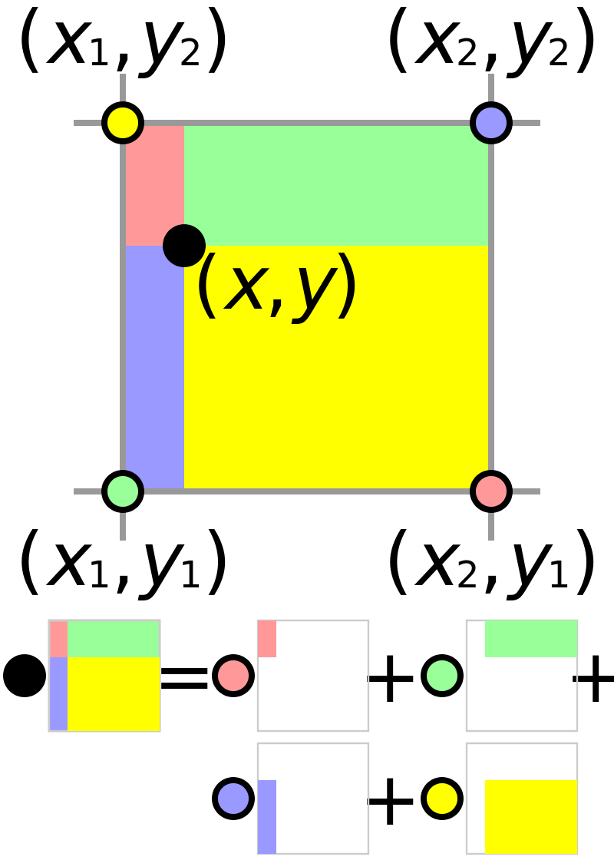
More efficient implementation
Use the builtin hardware interpolation support to compute the average of four pixels
Fetch from the texture only once instead of four times ⇒ lower memory bandwidth
Source: Wikipedia

Slide 26
2x2 downsampling – bilinear interpolation
UV = (0,0)
UV = (1,0)
UV = (0,0)
UV = (1,0)
Take one sample exactly at the pixel corner between the four target pixels, i.e. at the same UV as the center of the output pixel:
bilinear interpolation will fetch the average of the four neighbour pixels
(hardware accerelated, has the came cost as one texture fetch!)
UV = (0,1)
UV = (1,1)
UV = (0,1)
UV = (1,1)

Slide 27
Pixelization Shader: first pass, v2
Take a single fetch exactly at the corner of 4 pixels
Bilinear interpolation returns their average
Note: the fragment shader shader is invoked for every pixel of the output texture and i.uv points to the center of output pixels
_MainTex_TexelSize is the texel size (i.e. inverse of the resolution) of the input texture, which has now two times higher linear resolution (4-times more pixels) as the input
Note that this is the default behaviour in Graphics.Blit, so we do not even need a material to make this work, simply call Graphics.Blit(inTexture, outTexture);
float4 frag (v2f i) : SV_Target
{
float4 col = tex2D(_MainTex, i.uv); // Don't forget to set bilinear sampling!
return col;
}

Slide 28
Bilinear interpolation
Set filter mode of the downsampled texture to bilinear
void OnRenderImage(RenderTexture source, RenderTexture destination) {
if (CreateMaterial()) {
RenderTexture inTexture = source;
for (int l = 0; l < level; ++l) {
RenderTexture outTexture = RenderTexture.GetTemporary(
inTexture.width / 2, inTexture.height / 2);
inTexture.filterMode = FilterMode.Point;
inTexture.filterMode = FilterMode.Bilinear;
Graphics.Blit(inTexture, outTexture, material); // We can omit material now
inTexture = outTexture;
}

Slide 29
Pixelization with built-in Mip-Maps
We did the 2x2 downsampling manually
Many graphics APIs and engines has support for automatic Mip-Map generation, which does exactly the same downsampling
useMipMap has to be set before we render into the RenderTexture
After rendering, Unity generates all Mip-Map levels automatically
Graphics.Blit(source, renderTex);
this generates mip-maps if renderTex.useMipMaps == true
Note: according to the Unity manual Mip-Mapping works only for power of two texture resolutions
Experience shows that it works even for other resolutions ☺
RenderTexture renderTex = ... // initialize
renderTex.useMipMap = true;

Slide 30
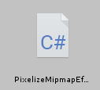
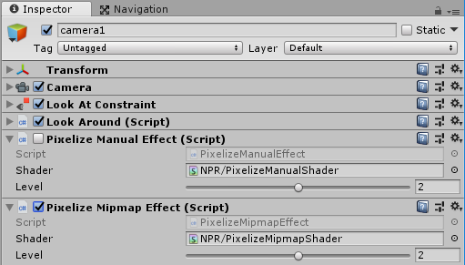
Pixelization C# script with Mip-Maps
Create new C# script, call it PixelizeMipMapEffect
Replace the older effect with this one on the main camera

Slide 31
Pixelization C# script with Mip-Maps
Similarly to the former effect…
[ExecuteInEditMode]
[RequireComponent(typeof(Camera))]
public class PixelizeMipmapEffect : PostEffectsBase {
[Range(0, 4)]
public int level = 1;
void Start () {
shader = Shader.Find("NPR/PixelizeMipmapShader");
CreateMaterial();
}

Slide 32
Pixelization C# script with Mip-Maps
No need to do the downsampling loop, a simple copy to the texture generates all mip map levels
void OnRenderImage(RenderTexture source, RenderTexture destination) {
if (CreateMaterial()) {
RenderTexture renderTex = RenderTexture.GetTemporary(source.width, source.height);
renderTex.useMipMap = true; // all renders to the texture will generate mip-maps
Graphics.Blit(source, renderTex); // this generates all mip-maps
renderTex.filterMode = FilterMode.Point; // use nearest neighbour sampling as before
material.SetInt("lodLevel", level); // level is now used to select the appropriate Mip level
Graphics.Blit(renderTex, destination, material); // shader: read the desired mip-map level
RenderTexture.ReleaseTemporary(renderTex);
}
else {
Graphics.Blit(source, destination);
}
}

Slide 33
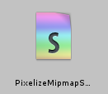
Pixelization shader with Mip-Maps
Create a new Image Effect Shader
Call it PixelizeMipMapShader.shader
Set the shader name string to NPR/PixelizeMipMapShader
Shader "NPR/PixelizeMipmapShader"
{
Properties

Slide 34
Pixelization shader with Mip-Maps
Instead of the texture function we use the tex2Dlod function to sample from _MainTex
tex2Dlod samples from the desired Mip-Map level
tex2Dlod( textureName, float4(uv.x, uv.y, notUsed, mipMapLevel) )
sampler2D _MainTex;
int lodLevel;
float4 frag (v2f i) : SV_Target
{
float4 col = tex2Dlod(_MainTex, float4(i.uv, 0, lodLevel));
return col;
}

Slide 35
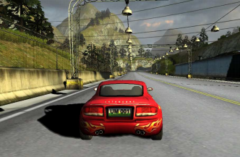
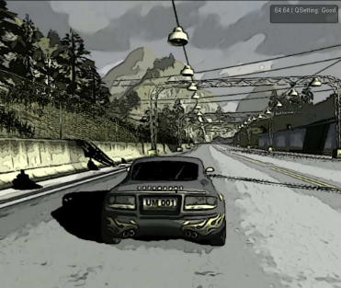
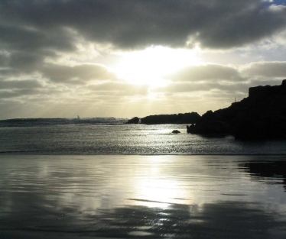
Next effect: Color transfer
Reinhard, Erik, et al. "Color transfer between images." IEEE Computer graphics and applications 21.5 (2001): 34-41.
Extract color average
and variance
Input
(Target)
Set Input average and variance to Source values
Extract color average
and variance
Source style

Slide 36
Color transfer
Do only once, when a new exemplar is set:
Compute mean of the exemplar image’s pixels
Compute variance of the exemplar image’s pixels
In every frame:
Compute mean of the current frame’s (target’s) pixels
Compute variance of the current frame’s (target’s) pixels
Shift pixel values of the current frame such that their average will match the average of the exemplar
Scale pixel values of the current frame such that their the variance will match the variance of the exemplar

Slide 37
Color transfer
How to compute the pixel average?
Use built-in Mip-Map generation, the lowest level is the average
How to compute pixel variance?
Given the average:
Compute (p – mean)² for every pixel p in the image.
The variance is the average of these values. Use Mip-Mapping to compute the average.

Slide 38
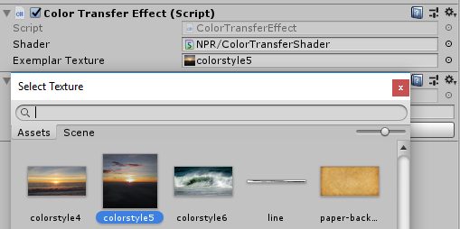
Color transfer – new C# script
[ExecuteInEditMode]
[RequireComponent(typeof(Camera))]
public class ColorTransferEffect : PostEffectsBase {
public Texture exemplarTexture;
void Start () {
shader = Shader.Find("NPR/ColorTransferShader");
CreateMaterial();
}

Slide 39
Color transfer – new C# script
void OnRenderImage(RenderTexture input, RenderTexture destination) {
if (CreateMaterial() && exemplarTexture != null)
{
// See the next two slides
}
else
{
Graphics.Blit(input, destination);
}
}

Slide 40
Color transfer – computation of image statistics
// compute mean for the exemplar (source) texture
RenderTexture meanTexExemplar = RenderTexture.GetTemporary(
exemplarTexture.width, exemplarTexture.height);
meanTexExemplar.useMipMap = true; // the next Blit automatically generates mip-maps
Graphics.Blit(exemplarTexture, meanTexExemplar);
// compute variance for the exemplar (source) texture
RenderTexture varianceTexExemplar = CreateVarianceTexture(meanTexExemplar);
// compute mean for target texture
RenderTexture meanTexTarget = RenderTexture.GetTemporary(input.width, input.height);
meanTexTarget.useMipMap = true; // the next Blit automatically generates mip-maps
Graphics.Blit(input, meanTexTarget);
// compute variance for target texture
RenderTexture varianceTexTarget = CreateVarianceTexture(meanTexTarget);
// continued on the next slide...
The exemplar texture is set from the Unity editor, so it does not change every frame.
Homework: compute this part only when the exemplar texture changes
This is for the current frame, so it has to be recomputed every time OnRenderImage is called

Slide 41
Color transfer – apply the mean and variance
// maximum mip-map level (1 pixel) that contains the average of the corresponding values
int maxLevelTarget = (int)Mathf.Log(Mathf.Max(meanTexTarget.width, meanTexTarget.height), 2);
int maxLevelExemplar = (int)Mathf.Log(Mathf.Max(meanTexExemplar.width, meanTexExemplar.height), 2);
// pass parameters to the shader
material.SetInt("singlePixelLevelTarget", maxLevelTarget);
material.SetInt("singlePixelLevelExemplar", maxLevelExemplar);
material.SetTexture("meanTexTarget", meanTexTarget);
material.SetTexture("meanTexExemplar", meanTexExemplar);
material.SetTexture("varianceTexTarget", varianceTexTarget);
material.SetTexture("varianceTexExemplar", varianceTexExemplar);
// call pass no. 1 from the shader
Graphics.Blit(input, destination, material, 1);
// cleanup
RenderTexture.ReleaseTemporary(meanTexTarget);
RenderTexture.ReleaseTemporary(meanTexExemplar);
RenderTexture.ReleaseTemporary(varianceTexTarget);
RenderTexture.ReleaseTemporary(varianceTexExemplar);

Slide 42
Color transfer – variance computation
// meanTex is assumed to have all mip-map levels generated
// The finest level contains the original pixels values,
// the coarsest level is the mean pixel value.
RenderTexture CreateVarianceTexture(Texture meanTex) {
RenderTexture varianceTex = RenderTexture.GetTemporary(
meanTex.width, meanTex.height, 0, RenderTextureFormat.DefaultHDR);
// this will generate the Mip-Maps and thus the average of distances from the mean
varianceTex.useMipMap = true;
// maximum mip-map level (1 pixel)
int maxLevel = (int)Mathf.Log(Mathf.Max(meanTex.width, meanTex.height), 2);
material.SetInt("singlePixelLevel", maxLevel);
// pass 0: variance computation shader, computes (pixel-mean)^2
// mip-mapping generates their average
Graphics.Blit(meanTex, varianceTex, material, 0);
return varianceTex;
}

Slide 43
Color transfer – shader
Create new Image Effect Shader: ColorTransferShader
The shader will contain two passes:
The first one computes the variance
The second applies the image statistics (mean and variance) to its input
Shader "NPR/ColorTransferShader"
{
Properties

Slide 44
Color transfer – variance fragment shader
In the existing pass, edit the fragment shader
We compute the square of the pixel distance from the mean
The mean comes from the lowest Mip-Map level of _MainTex
As we set useMipMaps = true in the C# code, this render call will also generate Mip-Maps, in the coarsest Mip-Map level we get the average of distance squares
sampler2D _MainTex;
int singlePixelLevel; // the coarsest Mip-Map level, i.e. 1 pixel
float4 frag (v2f i) : SV_Target
{
float4 pixel = tex2D(_MainTex, i.uv); // x
float4 mean = tex2Dlod(_MainTex, float4 (0.5,0.5 , 0, singlePixelLevel)); // E[x]
float4 diff = pixel - mean; // x - E[x]
return diff*diff; // (x - E[x])^2 -> variance = E[(x - E[x])^2]
}

Slide 45
Color transfer – style application fragment shader
Create a new pass in the shader
Pass { } tag after the existing one
Create new uniform parameters in this new pass
sampler2D _MainTex;
sampler2D meanTexTarget;
sampler2D meanTexExemplar;
sampler2D varianceTexTarget;
sampler2D varianceTexExemplar;
int singlePixelLevelTarget;
int singlePixelLevelExemplar;

Slide 46
Color transfer – style application fragment shader
Create a new pass in the shader
Pass { } tag after the existing one
Edit the fragment shader of this new pass
float4 frag (v2f i) : SV_Target {
float4 pixel = tex2D(_MainTex, i.uv);
// read image statistics that had been computed in previous passes
float4 targetMean = tex2Dlod(meanTexTarget, float4 (0.5,0.5 , 0, singlePixelLevelTarget));
float4 sourceMean = tex2Dlod(meanTexExemplar, float4 (0.5, 0.5, 0, singlePixelLevelExemplar));
float4 targetVariance = tex2Dlod(varianceTexTarget, float4 (0.5, 0.5, 0, singlePixelLevelTarget));
float4 sourceVariance = tex2Dlod(varianceTexExemplar, float4 (0.5, 0.5, 0, singlePixelLevelExemplar));
// Shift and scale the pixel according to the source mean and variance
pixel = pixel - targetMean;
float4 varianceScale = sourceVariance / targetVariance;
pixel *= varianceScale; // or sqrt(varianceScale) to scale the std. deviation, sometimes better
pixel += sourceMean;
return pixel;
}

Slide 47
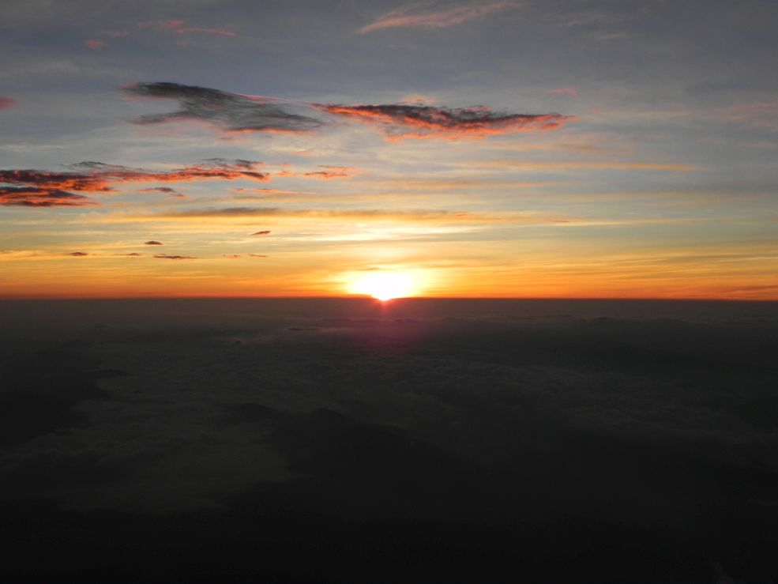
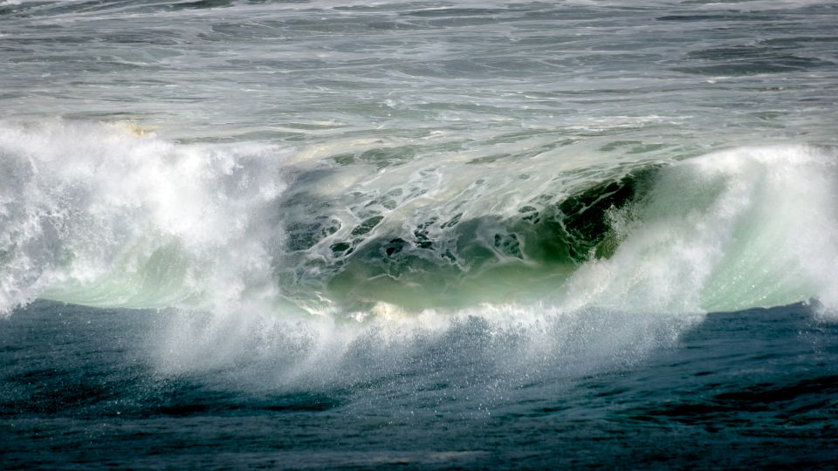
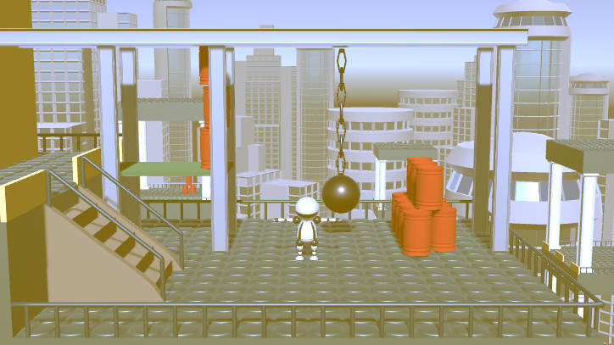
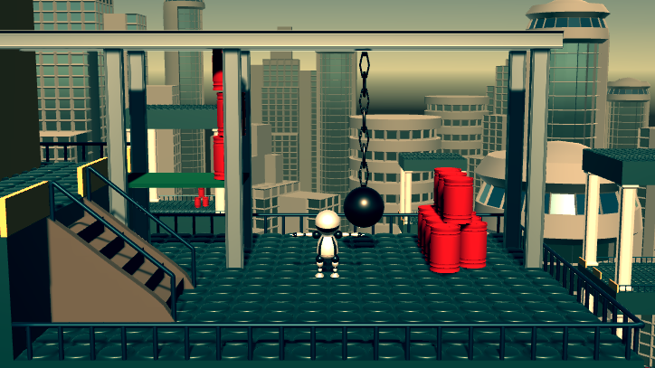
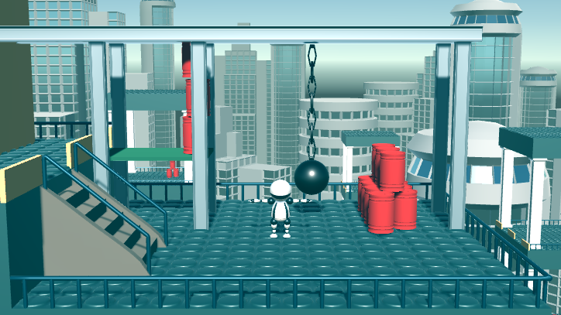
Results
Original image

Slide 48
Homework #1
The exemplar does not change in every frame
Compute its mean and variance only once and save them to textures, when the exemplar texture has changed

Slide 49
Homework #2
Try other color spaces
Before computing the mean and variance Convert both the source and the exemplar images to another color space
HSV, CIE Lab, XYZ etc.
Compute the mean and variance as before (in the new color space)
Apply the mean and variance to the target image as before (in the new color space)
Convert back the image to RGB

Slide 50
Homework #3
As the method is quite simple, results are sometimes unpleasant
Limit the shift and scale of pixels so that the output will be closer to the original image

