Slide 1
Stroke Based Rendering

Slide 2
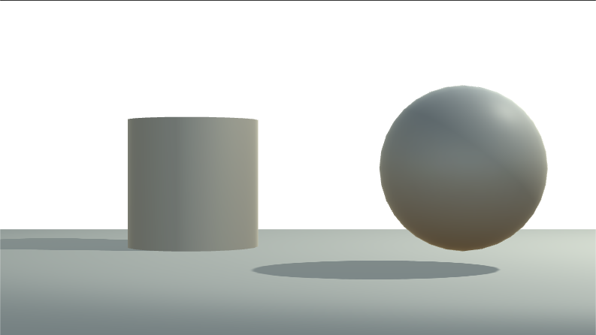
Starting project
Use the starting project of this practical – Pr06-StrokeBasedRenderingProject.zip
Open the test unity scene:
Lab06/TestScene.unity
We will use a test scene with simple geometry, as texture based stroke rendering needs good and even UV mapping, and the Robo scene does not satisfy this

Slide 3
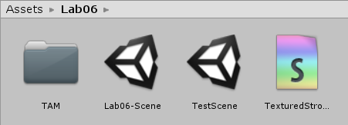
Texture Based Stroke Rendering
Create a new Unlit Surface Shader and name it TexturedStrokesShader
Shader "NPR/TexturedStrokes"
{
Properties
{
}
SubShader
{
Tags { "RenderType"="Opaque" }
LOD 100
Pass
{
Tags{ "LightMode" = "ForwardAdd" }
CGPROGRAM
#pragma vertex vert
#pragma fragment frag

Slide 4
Texture Based Stroke Rendering
#include "UnityCG.cginc"
struct appdata
{
float4 vertex : POSITION;
float3 normal : NORMAL;
float2 texcoord : TEXCOORD;
};
struct v2f
{
float3 normal : NORMAL;
float2 texcoord : TEXCOORD0;
float3 lightDir : TEXCOORD1;
float4 vertex : SV_POSITION;
};
v2f vert(appdata v)
{
v2f o;
o.vertex = UnityObjectToClipPos(v.vertex);
o.texcoord = v.texcoord;
o.normal = UnityObjectToWorldNormal(v.normal);
float4 worldPos = mul(unity_ObjectToWorld, v.vertex);
o.lightDir = normalize(_WorldSpaceLightPos0.xyz - worldPos * _WorldSpaceLightPos0.w);
return o;
}

Slide 5
Texture Based Stroke Rendering
uniform sampler2D _StrokeMap;
uniform float2 textureScale;
float4 frag(v2f i) : SV_Target
{
float3 N = normalize(i.normal);
float3 L = normalize(i.lightDir);
float3 stroke = tex2D(_StrokeMap, i.texcoord * textureScale).rgb;
return float4(stroke, 1);
}
ENDCG
}
}
}

Slide 6
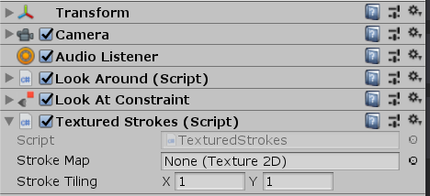
Texture Based Stroke Rendering
Create a new C# script, name it TexturedStrokes
This script defines a replacement shader to overwrite all materials in the scene with our shader
Add it to the main camera
From the ST (stands for stroke texture) folder drag the darkest texture to the stroke map property
using System.Collections;
using System.Collections.Generic;
using UnityEngine;
[ExecuteInEditMode]
[RequireComponent(typeof(Camera))]
public class TexturedStrokes : MonoBehaviour {
public Texture2D strokeMap;
public Vector2 strokeTiling = new Vector2(1, 1);
// Use this for initialization
void Start () {
Camera camera = GetComponent<Camera>();
Shader shader = Shader.Find("NPR/TexturedStrokes");
camera.SetReplacementShader(shader, "");
}
// Update is called once per frame
void Update () {
Shader.SetGlobalTexture("_StrokeMap", strokeMap);
Shader.SetGlobalVector("textureScale", strokeTiling);
}
}

Slide 7
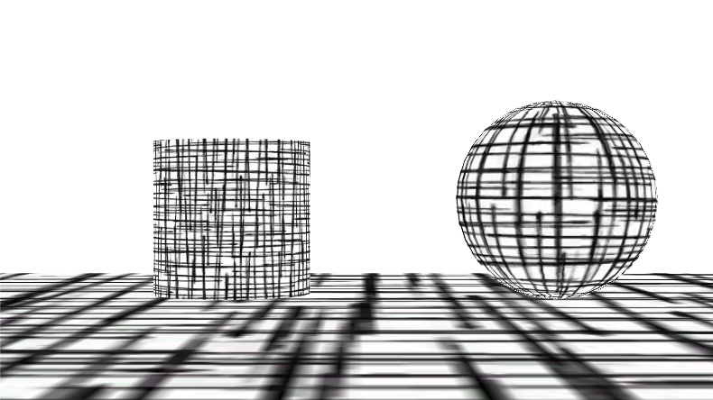
Texture Based Stroke Rendering
Make sure that the camera uses a solid white background
We should see this:

Slide 8
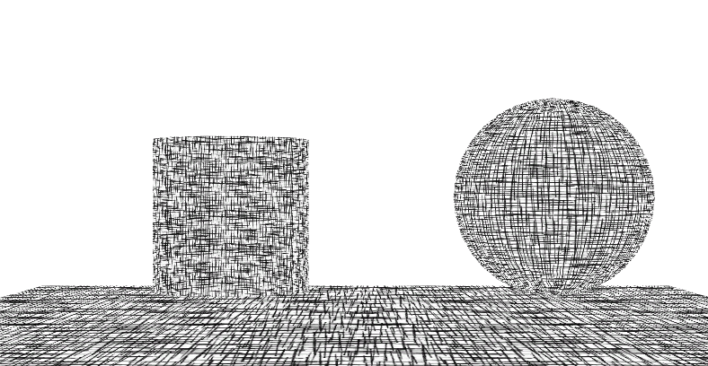
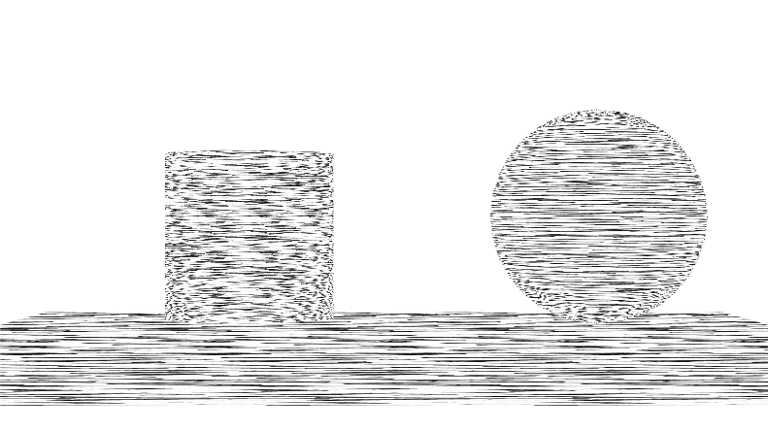
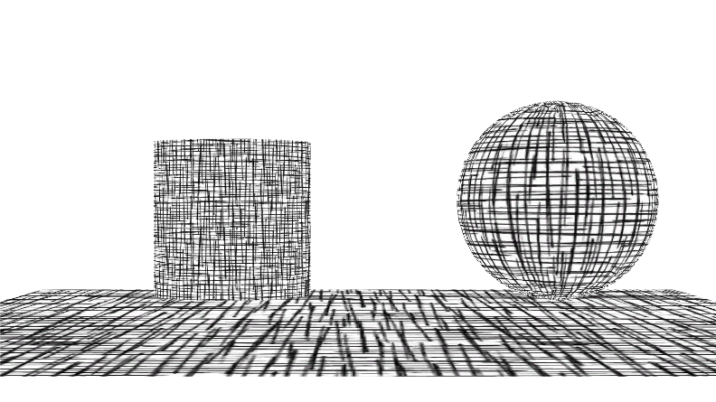
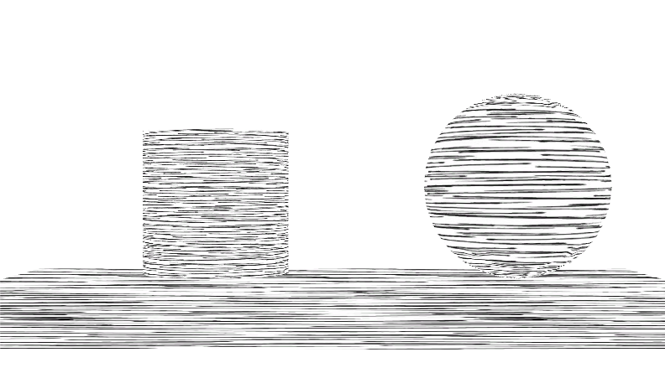
Texture Based Stroke Rendering
Try it with different textures and stroke tiling (we can also scale the quad down to 4 to match texture tiling)
Texture: 5_1
Texture: 3_1
Tiling: 5
Tiling: 2

Slide 9
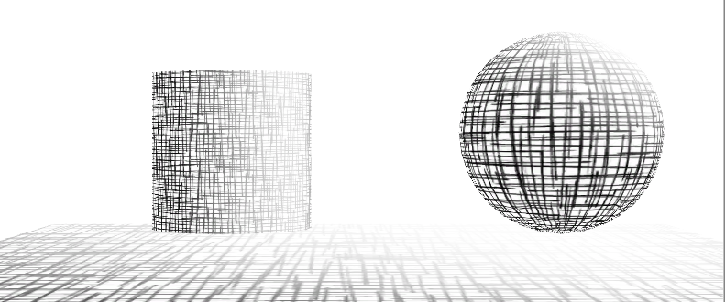
Introducing Tone
Simple solution: blend white color and stroke texture color based on tone.
(Not a nice solution)
Shader:
float4 frag(v2f i) : SV_Target
{
float3 N = normalize(i.normal);
float3 L = normalize(i.lightDir);
float tone = max(0,dot(N,L));
float3 stroke = tex2D(_StrokeMap, i.texcoord * textureScale).rgb;
float3 finalColor = lerp(stroke, float3(1,1,1), tone);
return float4(finalColor, 1);
}

Slide 10
Introducing Tone v2
Change texture based on tone
We can use a 3D texture to easily address different textures
Our 5 stroke textures will be uploaded to the layers of the 3D texture
We have to build up the 3D texture manually from the 2D textures
C# script
using System.Collections.Generic;
using UnityEngine;
using UnityEditor;
[ExecuteInEditMode]
[RequireComponent(typeof(Camera))]
public class TexturedStrokes : MonoBehaviour {
public Texture2D strokeMap;
Texture3D strokeMap;
public Vector2 strokeTiling = new Vector2(1, 1);

Slide 11
Introducing Tone v2
In start() we load the five textures manually
We create a 3D texture manually with the same resolution as the 5 textures
We fill the pixel data of the 3D texture manually (allPixels)
void Start () {
Camera camera = GetComponent<Camera>();
Shader shader = Shader.Find("NPR/TexturedStrokes");
camera.SetReplacementShader(shader, "");
Texture2D texture2 = (Texture2D)AssetDatabase.LoadAssetAtPath("Assets/Lab06/ST/4_1.jpg", typeof(Texture2D));
Texture2D texture3 = (Texture2D)AssetDatabase.LoadAssetAtPath("Assets/Lab06/ST/3_1.jpg", typeof(Texture2D));
Texture2D texture1 = (Texture2D)AssetDatabase.LoadAssetAtPath("Assets/Lab06/ST/5_1.jpg", typeof(Texture2D));
Texture2D texture4 = (Texture2D)AssetDatabase.LoadAssetAtPath("Assets/Lab06/ST/2_1.jpg", typeof(Texture2D));
Texture2D texture5 = (Texture2D)AssetDatabase.LoadAssetAtPath("Assets/Lab06/ST/1_1.jpg", typeof(Texture2D));
strokeMap = new Texture3D(texture1.width, texture1.height, 5, TextureFormat.RGBA32, false);
int pixelCount = texture1.width * texture1.height;
Color32[] allPixels = new Color32[pixelCount * 5];
Load texture assets from script.
5 is the third dimension of the 3D texture: slice/layer count. Pixel data of slices are packed one ofter an other in a single array, and passed to the GPU.

Slide 12
Introducing Tone v2
We copy the five texture data one by one to allPixels
Set 3D texture data
3D texture will be uploaded to the GPU after calling Apply()
Color32[] texPixels;
texPixels = texture1.GetPixels32(0);
System.Array.Copy(texPixels, 0, allPixels, 0, pixelCount);
texPixels = texture2.GetPixels32(0);
System.Array.Copy(texPixels, 0, allPixels, pixelCount, pixelCount);
texPixels = texture3.GetPixels32(0);
System.Array.Copy(texPixels, 0, allPixels, 2 * pixelCount, pixelCount);
texPixels = texture4.GetPixels32(0);
System.Array.Copy(texPixels, 0, allPixels, 3 * pixelCount, pixelCount);
texPixels = texture5.GetPixels32(0);
System.Array.Copy(texPixels, 0, allPixels, 4 * pixelCount, pixelCount);
strokeMap.SetPixels32(allPixels, 0);
strokeMap.wrapModeU = TextureWrapMode.Repeat;
strokeMap.wrapModeV = TextureWrapMode.Repeat;
strokeMap.wrapModeW = TextureWrapMode.Clamp;
strokeMap.Apply();
} //End of Start()
Copies the content of from a position in an array to a position in an other array.
Arguments:
Source array to copy from
Position in source array to copy from
Destination array to copy to
Position in destination array to copy to
Number of elements to copy
Sets texture pixel data (only affects CPU memory)
Our 3D texture cannot be tiled in the third dimension
Upload to the GPU, texture is ready to be used

Slide 13
Introducing Tone v2
Shader
3D textures are addressed with a 3D coordinate, the third coordinate is the layer (addressed with coordinates between 0 and 1 like the UV coordinates)
Layer is defined by tone
The GPU automatically interpolates between layers
uniform sampler2D _StrokeMap;
uniform sampler3D _StrokeMap;
uniform float2 textureScale;
float4 frag(v2f i) : SV_Target
{
float3 N = normalize(i.normal);
float3 L = normalize(i.lightDir);
float tone = max(0,dot(N,L));
float3 stroke = tex3D(_StrokeMap, float3(i.texcoord * textureScale, tone)).rgb;
return float4(stroke, 1);
}

Slide 14
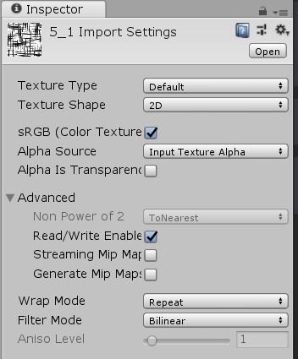
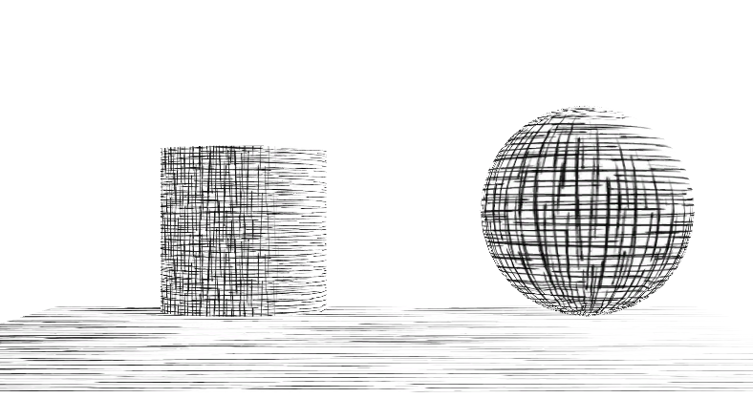
Introducing Tone v2
Try it
(We may start the game to load texture resources)
Note:
For this script to work, texture should be readable
(And generating mip maps should be disabled to have a sharp effect on distance surfaces)

Slide 15
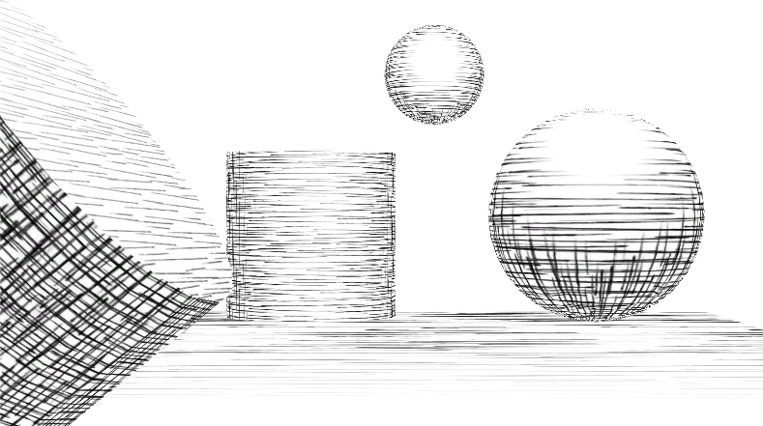
Introducing Tone v2
Try moving/rotating (even duplicating) the objects or moving the light source

Slide 16
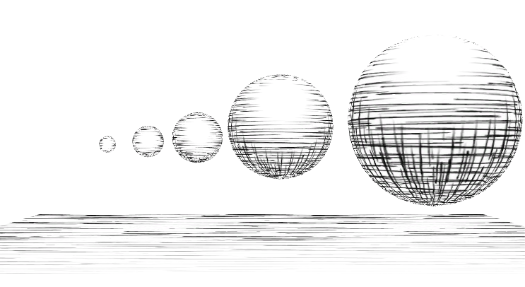
Problem
Lines are getting narrower at distance surfaces
Line density also grows

Slide 17
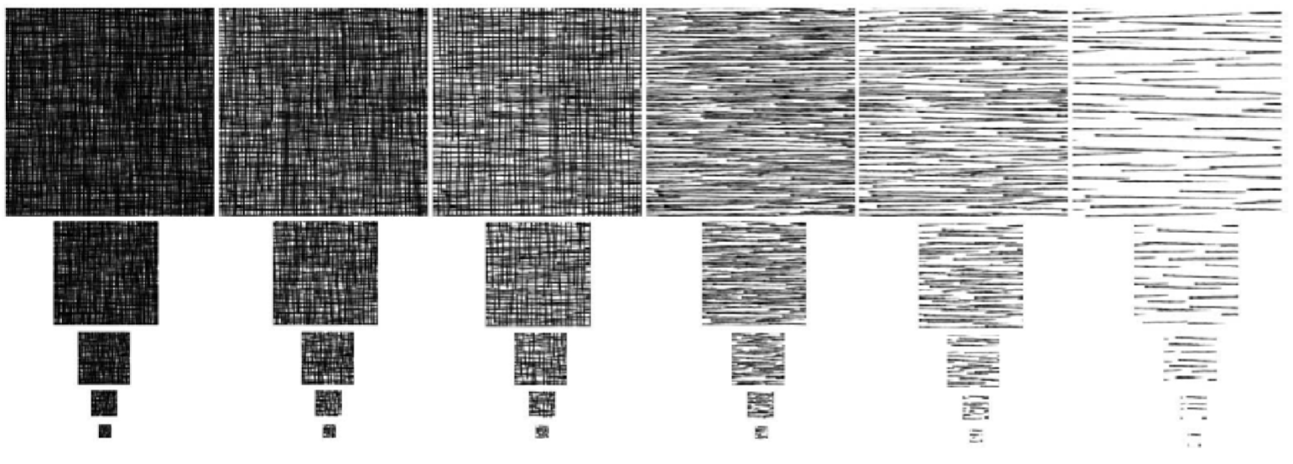
Solution
Tonal Art Maps (TAM)
Define mip maps manually and make line width and density consistent
Generating TAM textures is not straightforward. We can refer to:
Emil Praun, Hugues Hoppe, Matthew Webb, Adam Finkelstein, “Real-time Hatching,” Computer Graphics (SIGGRAPH 2001 Proceedings), pages 581-586.

Slide 18
Tonal Art Maps implementation I.
Looking at the TAM image below, we can see, that this is still a 3D texture but with mip mapping.
However for 3D textures going down to a lower mip map not only halves the resolution in the x and y direction but also in the z (thus layer count). This is not suitable for TAMs, as the number of slices remain the same.
We could implement this TAM with four 3D textures, bind all four of them to the shader and do the interpolation between them manually. (Note: only interpolating between mip maps should be done manually within one mip map trilinear interpolation can be used just like in our TexturedStrokes shader)
Texture 1
No interpolation
Texture 2
…

Slide 19
Tonal Art Maps implementation II.
Manually choosing between mip maps and interpolating between them would make the shader too complex, so we use another solution
We will use a single 3D mip mapped texture, but make sure that even halving the number of slices we can still pack all TAM images in the texture
We know, that we have four mip maps. We multiply the slice resolution by 8 (2^(4-1) = 8). We duplicate the highest resolution images, and store 8 identical layers next each other.
For the second mip map level we duplicate each TAM image 4 times
For the third 2 times
For the fourth mip map we store only one instance of each TAM slice
This solution needs more memory, but we can still use our previous TexturedStroke shader unchanged. Mip mapped 3D textures are supported by most hardware.
Mip map resolution:
Mip mapped 3D Texture
256 x 256 x 40
8X
8X
8X
8X
8X
128 x 128 x 20
4X
4X
4X
4X
4X
64 x 64 x 10
2X
2X
2X
2X
2X
32 x 32 x 5
1X
1X
1X
1X
1X

Slide 20
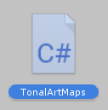
Tonal Art Maps
Create new C# script and name it TonalArtMaps. Code:
using System.Collections;
using System.Collections.Generic;
using UnityEngine;
using UnityEditor;
[ExecuteInEditMode]
[RequireComponent(typeof(Camera))]
public class TonalArtMaps : MonoBehaviour {
Texture3D strokeMap;
public Vector2 strokeTiling = new Vector2(1, 1);
void Start()
{
…

Slide 21
Tonal Art Maps C# code
void Start()
{
Camera camera = GetComponent<Camera>();
Shader shader = Shader.Find("NPR/TexturedStrokes");
camera.SetReplacementShader(shader, "");
int Res = 256; //highest resolution
int LayerDuplicates = 8;
strokeMap = new Texture3D(Res, Res, 5 * LayerDuplicates, TextureFormat.RGBA32, true);
for (int mips = 0; mips < 4; mips++)
{
int offset = 0;
Color32[] allPixels = new Color32[Res * Res * 5 * LayerDuplicates];
for (int layers = 0; layers < 5; layers++)
{
string textureName = "Assets/Lab06/TAM/" + (5 - layers) + "_" + (mips + 1) + ".jpg";
Texture2D texture = (Texture2D)AssetDatabase.LoadAssetAtPath(textureName, typeof(Texture2D));
Color32[] texPixels = texture.GetPixels32(0);
for (int dup = 0; dup < LayerDuplicates; ++dup)
{
System.Array.Copy(texPixels, 0, allPixels, offset, Res * Res);
offset += Res * Res;
}
}
strokeMap.SetPixels32(allPixels, mips);
Res /= 2;
LayerDuplicates /= 2;
}
…
We can use our last shader
Use mip mapping. All mip map levels will be generated by Unity, but we should fill them one by one
Specify the mip map level to upload

Slide 22
Tonal Art Maps C# code
…
for (int mips = 4; mips < 9; mips++)
{
Color32[] pixels = strokeMap.GetPixels32(mips);
for (int p = 0; p < pixels.Length; ++p)
pixels[p].r = pixels[p].g = pixels[p].b = pixels[p].a = 255;
strokeMap.SetPixels32(pixels, mips);
}
strokeMap.wrapModeU = TextureWrapMode.Repeat;
strokeMap.wrapModeV = TextureWrapMode.Repeat;
strokeMap.wrapModeW = TextureWrapMode.Clamp;
strokeMap.filterMode = FilterMode.Trilinear;
strokeMap.mipMapBias = -0.5f;
strokeMap.Apply(false);
}//end of Start()
void Update()
{
Shader.SetGlobalTexture("_StrokeMap", strokeMap);
Shader.SetGlobalVector("textureScale", strokeTiling);
}
}
Fill remaining mip levels to white, as they are far away.
The appropriate mip level will be chosen by the GPU. With this bias we can control when mip maps should be changed.
As a practice we can bind this value to a public variable and examine its effect runtime.
(We have to move this line to update() )

Slide 23
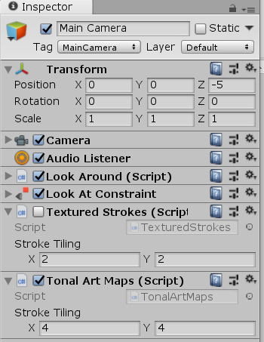
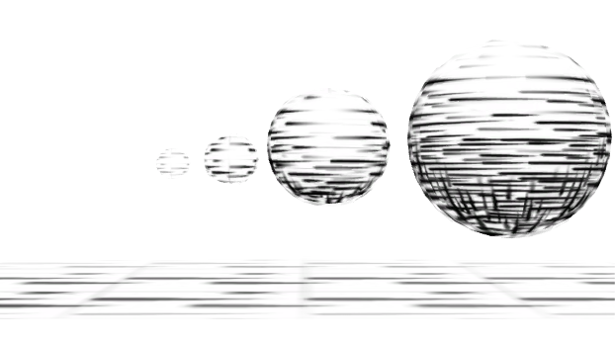
Tonal Art Maps
Add script to camera
Delete or disable TexturedStrokes Script
Run the game to load resources
Note: these artifacts are not caused by the technique itself. Our textures are not clean: not perfectly tileable (not seamless).

Slide 24
TAM implementation III.
Looking at the TAM images again, we can realize, that they are really much like a texture array.
Texture array is a GPU feature (since DirectX 11 and OpenGL 3.0) to support an array of textures with the same properties: resolution, mip map count, pixel format, filtering mode.
TAM images have these properties.
One limitation in use for TAMs: no interpolation between the textures in the array, we have to do it manually.
No interpolation
Texture 1
Texture 2
…

Slide 25
TAM Implementation III.
Create a new Unlit Shader, name it TAMTextureArrayShader
Copy the content of TexturedStrokesShader, as this shader will be similar, only pixel shader differs
But don’t forget to rename it:
Shader "NPR/TAMTextureArray"
{

Slide 26
TAM Implementation III.
Pixel shader:
Definition of texture arrays differs from other texture types
The third coordinate is an integer fro texture arrays: the index of the texture in the array
UNITY_DECLARE_TEX2DARRAY(_StrokeMap);
uniform float2 textureScale;
float4 frag(v2f i) : SV_Target
{
float3 N = normalize(i.normal);
float3 L = normalize(i.lightDir);
float tone = max(0,dot(N,L));
float slice = floor(tone * 4);
float3 stroke1 = UNITY_SAMPLE_TEX2DARRAY(_StrokeMap, float3(i.texcoord * textureScale, slice)).rgb;
float3 stroke2 = UNITY_SAMPLE_TEX2DARRAY(_StrokeMap, float3(i.texcoord * textureScale, slice + 1)).rgb;
float3 stroke = lerp(stroke1, stroke2,tone * 4 - slice);
return float4(stroke, 1);
}
Sampling from texture arrays differs from other texture types
We sample two adjacent textures and interpolate between them according to tone
„fractional part of texture index”
4 = number of textures - 1

Slide 27
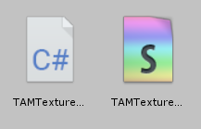
TAM Implementation III.
Create a new C# script, name it TAMTextureArray
using System.Collections;
using System.Collections.Generic;
using UnityEngine;
using UnityEditor;
[ExecuteInEditMode]
[RequireComponent(typeof(Camera))]
public class TAMTextureArray : MonoBehaviour {
Texture2DArray strokeMap;
public Vector2 strokeTiling = new Vector2(1, 1);
void Start()
{
…
}
void Update()
{
Shader.SetGlobalTexture("_StrokeMap", strokeMap);
Shader.SetGlobalVector("textureScale", strokeTiling);
}
}

Slide 28
TAM Implementation III.
void Start()
{
Camera camera = GetComponent<Camera>();
Shader shader = Shader.Find("NPR/TAMTextureArray");
camera.SetReplacementShader(shader, "");
int Res = 256; //highest resolution
strokeMap = new Texture2DArray(Res, Res, 5, TextureFormat.RGBA32, true);
for (int mips = 0; mips < 4; mips++)
{
for (int layers = 0; layers < 5; layers++)
{
string textureName = "Assets/Lab06/TAM/" + (5 - layers) + "_" + (mips + 1) + ".jpg";
Texture2D texture = (Texture2D)AssetDatabase.LoadAssetAtPath(textureName, typeof(Texture2D));
Color32[] texPixels = texture.GetPixels32(0);
strokeMap.SetPixels32(texPixels, layers, mips);
}
Res /= 2;
}
…
Fill one mip map of one texture in the array

Slide 29
TAM Implementation III.
…
for (int mips = 4; mips < 9; mips++)
{
for (int layers = 0; layers < 5; layers++)
{
Color32[] pixels = strokeMap.GetPixels32(layers, mips);
for (int p = 0; p < pixels.Length; ++p)
pixels[p].r = pixels[p].g = pixels[p].b = pixels[p].a = 255;
strokeMap.SetPixels32(pixels, layers, mips);
}
}
strokeMap.wrapModeU = TextureWrapMode.Repeat;
strokeMap.wrapModeV = TextureWrapMode.Repeat;
strokeMap.wrapModeW = TextureWrapMode.Clamp;
strokeMap.filterMode = FilterMode.Trilinear;
strokeMap.mipMapBias = -0.5f;
strokeMap.Apply(false);
}
Fill remaining mip levels to white, as they are far away.

Slide 30
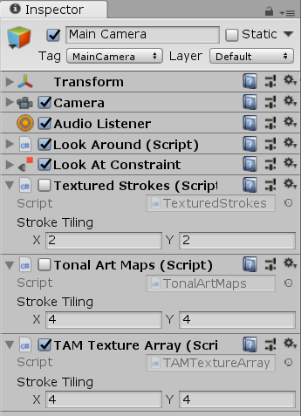
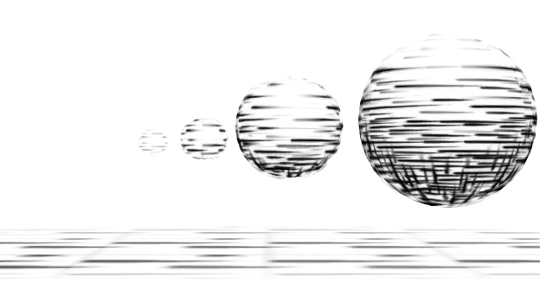
Tonal Art Maps
Add script to camera
Delete or disable Tonal Art Maps Script
Run the game to load resources
We should get similar results but tones are blended a bit more smoothly

Slide 31
Screen Space Strokes

Slide 32
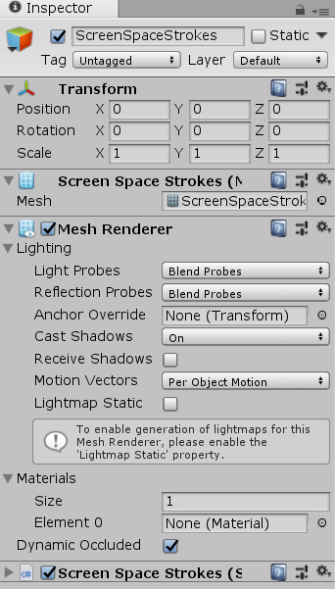
Screen Space strokes
Create new empty gameobject
Name it ScreenSpaceStrokes
Add a MeshFilter component to it
Add a MeshRenderer component to it
Create a new C# script
Name it ScreenSpaceStrokes
Add this component to the new gameobject

Slide 33
Screen Space Strokes C# script
We define a mesh in the C# script
This mesh will contain screen space quadrilaterals
For each stroke we render a textured quad
All quads are packed to one mesh
using System.Collections;
using System.Collections.Generic;
using UnityEngine;
[ExecuteInEditMode]
[RequireComponent(typeof(MeshFilter))]
public class ScreenSpaceStrokes : MonoBehaviour {
Vector3[] meshVertices; // vertex positions
Vector2[] meshUVs; // vertex texture coordinates
int[] meshTriangles; // triangle vertex indices
int lastStrokeCount = 0;
public int strokeCount = 0;
public Vector2 strokeSize = new Vector2(0.01f, 0.005f); //stroke length and width
Vector2 lastStrokeSize = new Vector2(0.01f, 0.005f);

Slide 34
Screen Space Strokes C# script
void Start () {
Mesh mesh = new Mesh();
GetComponent<MeshFilter>().mesh = mesh;
mesh.indexFormat = UnityEngine.Rendering.IndexFormat.UInt32;
mesh.vertices = meshVertices;
mesh.uv = meshUVs;
mesh.triangles = meshTriangles;
}
Start with an empty mesh

Slide 35
Screen Space Strokes C# script
Update mesh data if number of stroke changes or stroke width/length changes
void Update ()
{
if(strokeCount != lastStrokeCount || strokeSize != lastStrokeSize)
{
Mesh mesh = GetComponent<MeshFilter>().sharedMesh;
mesh.Clear();
lastStrokeCount = strokeCount;
meshVertices = new Vector3[strokeCount * 4];
meshUVs = new Vector2[strokeCount * 4];
meshTriangles = new int[strokeCount * 6];
A quad has four vertices
A quad has 2 triangles = 6 indices

Slide 36
Screen Space Strokes C# script
for(int i = 0; i < strokeCount; ++i)
{
float randX = Random.Range(-1.0f, 1.0f);
float randY = Random.Range(-1.0f, 1.0f);
meshVertices[i * 4 ] = new Vector3(randX, randY, 0);
meshUVs[i * 4 ] = new Vector2(0, 0);
meshVertices[i * 4 + 1] = new Vector3(randX+ strokeSize.x, randY, 0);
meshUVs[i * 4 + 1] = new Vector2(1, 0);
meshVertices[i * 4 + 2] = new Vector3(randX+ strokeSize.x, randY+ strokeSize.y, 0);
meshUVs[i * 4 + 2] = new Vector2(1, 1);
meshVertices[i * 4 + 3] = new Vector3(randX, randY+ strokeSize.y, 0);
meshUVs[i * 4 + 3] = new Vector2(0, 1);
meshTriangles[i * 6 ] = i * 4 + 3;
meshTriangles[i * 6 + 1] = i * 4 + 1;
meshTriangles[i * 6 + 2] = i * 4;
meshTriangles[i * 6 + 3] = i * 4 + 3;
meshTriangles[i * 6 + 4] = i * 4 + 2;
meshTriangles[i * 6 + 5] = i * 4 + 1;
}
mesh.vertices = meshVertices;
mesh.uv = meshUVs;
mesh.triangles = meshTriangles;
}
}//End of Update()
}//End of class definition

Slide 37
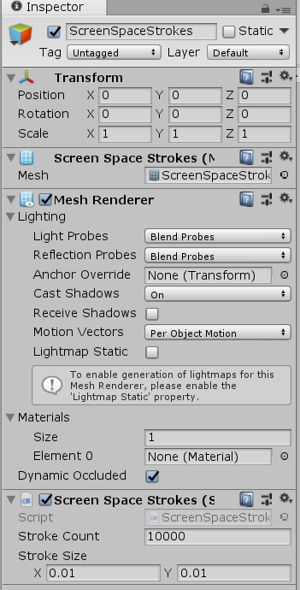
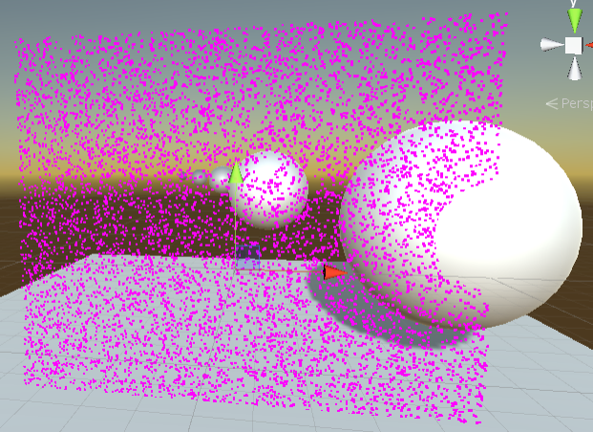
Try the mesh
Change stroke count
Change stroke size
(Strokes are using a default material for missing material definitions, thus strokes are magenta and are in world space)

Slide 38
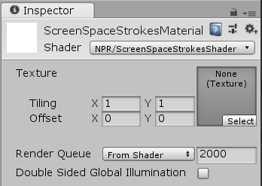
Screen Space Strokes Material
Create a new Unlit Shader, name it ScreenSpaceStrokesShader
Shader "NPR/ScreenSpaceStrokesShader"
{
Create a new Material, name it ScreenSpaceStrokesMaterial
Set NPR/ScreenSpaceStrokesShader as the shader to the ScreenSpaceStrokesMaterial

Slide 39
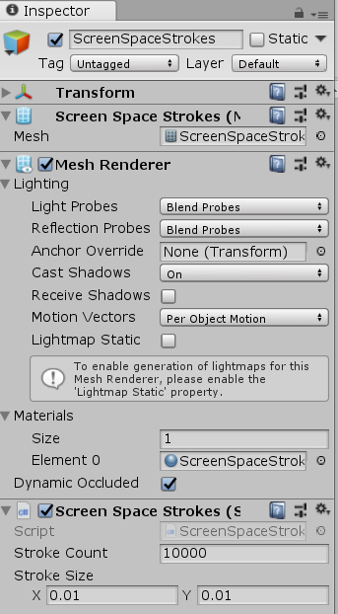
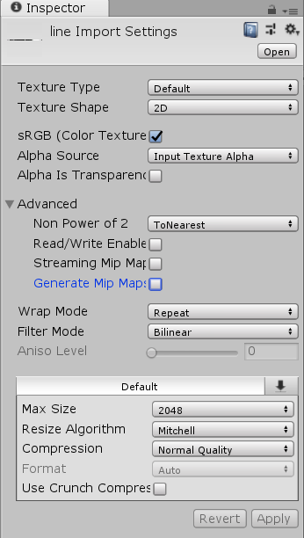
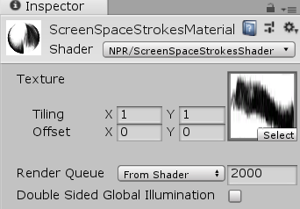
Screen Space Strokes Material
Bind Assets/Lab06/line.jpg to the texture slot of the material
(make sure that the texture asset does not use mip maps)
Bind the material to the mesh renderer

Slide 40
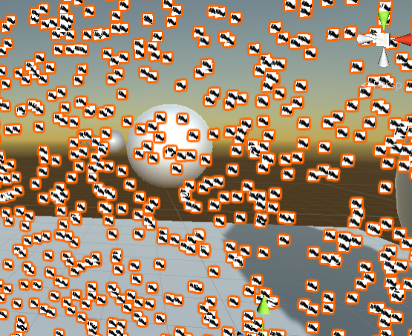
We should see this:

Slide 41
Screen Space Strokes shader
Shader "NPR/ScreenSpaceStrokesShader"
{
Properties
{
[NoScaleOffset] _MainTex ("Texture", 2D) = "black" {}
}
SubShader
{
Tags { "Queue" = "Overlay" }
Pass
{
Cull Off
ZWrite Off
ZTest Off
Blend SrcAlpha OneMinusSrcAlpha

Slide 42
Screen Space Strokes shader
CGPROGRAM
#pragma vertex vert
#pragma fragment frag
#include "UnityCG.cginc"
struct appdata
{
float4 vertex : POSITION;
float2 uv : TEXCOORD0;
};
struct v2f
{
float2 uv : TEXCOORD0;
float4 vertex : SV_POSITION;
};

Slide 43
Screen Space Strokes shader
float4 strokeSize;
v2f vert (appdata v)
{
v2f o;
o.vertex = float4(v.vertex.xy + strokeSize.xy * v.uv, 0, 1);
o.uv = v.uv;
return o;
}
sampler2D _MainTex;
float4 strokeColor;
float4 frag (v2f i) : SV_Target
{
float strokeAlpha = 1.0 - tex2D(_MainTex, i.uv).r;
return float4(strokeColor.rgb, strokeColor.a * strokeAlpha);
}
ENDCG
}
}
}

Slide 44
Screen Space Strokes C# script
New public member variable
Vector2 lastStrokeSize = new Vector2(0.01f, 0.005f);
public Color strokeColor = new Color(0,0,0,1);
In Update delete the offsets from the positions
meshVertices[i * 4 ] = new Vector3(randX, randY, 0); meshUVs[i * 4 ] = new Vector2(0, 0);
meshVertices[i * 4 + 1] = new Vector3(randX, randY, 0); meshUVs[i * 4 + 1] = new Vector2(1, 0);
meshVertices[i * 4 + 2] = new Vector3(randX, randY, 0); meshUVs[i * 4 + 2] = new Vector2(1, 1);
meshVertices[i * 4 + 3] = new Vector3(randX, randY, 0); meshUVs[i * 4 + 3] = new Vector2(0, 1);
Higher values will be easier to tune on the GUI
Insert to the end of Update:
Material material = GetComponent<MeshRenderer>().sharedMaterial;
material.SetVector("strokeSize", new Vector4(strokeSize.x * 0.01f, strokeSize.y * 0.01f, 0, 0));
material.SetColor("strokeColor", strokeColor);

Slide 45
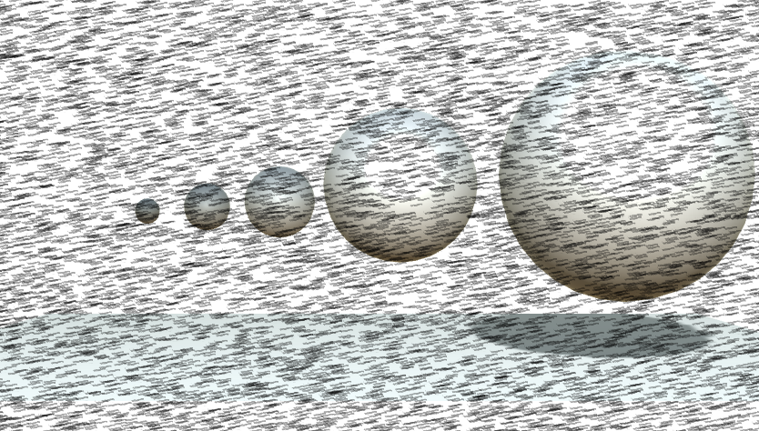
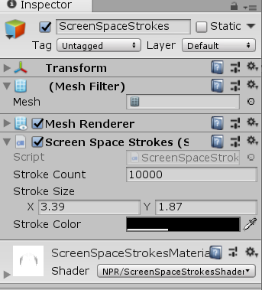
Try it!

Slide 46
Screen Space Strokes – Introducing tone, C# script
Assign a random priority to all strokes (store it in the free z position coordinate)
float randX = Random.Range(-1.0f, 1.0f);
float randY = Random.Range(-1.0f, 1.0f);
float priority = Random.Range(0.0f, 1.0f);
meshVertices[i * 4 ] = new Vector3(randX, randY, priority); meshUVs[i * 4 ] = new Vector2(0, 0);
meshVertices[i * 4 + 1] = new Vector3(randX, randY, priority); meshUVs[i * 4 + 1] = new Vector2(1, 0);
meshVertices[i * 4 + 2] = new Vector3(randX, randY, priority); meshUVs[i * 4 + 2] = new Vector2(1, 1);
meshVertices[i * 4 + 3] = new Vector3(randX, randY, priority); meshUVs[i * 4 + 3] = new Vector2(0, 1);

Slide 47
Screen Space Strokes – Introducing tone, Shader
Add a grab pass before our pass (stores framebuffer content to a texture)
SubShader
{
Tags { "Queue" = "Overlay" }
GrabPass
{
"_BackgroundTexture"
}
Pass
{

Slide 48
Screen Space Strokes – Introducing tone, Shader
Modify vertex shader
float4 strokeSize;
sampler2D _BackgroundTexture;
v2f vert (appdata v)
{
v2f o;
o.vertex = float4(v.vertex.xy + strokeSize.xy * v.uv, 0, 1);
o.uv = v.uv;
float2 screenPos = ComputeGrabScreenPos(float4(v.vertex.xy,0,1)).xy;
float4 screenColor = tex2Dlod(_BackgroundTexture, float4(screenPos,0,0));
float3 rgb2lum = float3(0.2126, 0.7152, 0.0722);
float Lum = dot(screenColor.rgb, rgb2lum);
float priority = v.vertex.z;
if (priority < Lum)
o.vertex.z = -2;
return o;
}
Only Lod sampling is prohibited in vertex shaders. Texture coordinates are float4.
Rejection sampling
based on luminance
Transform vertex out of view (behind camera)

Slide 49
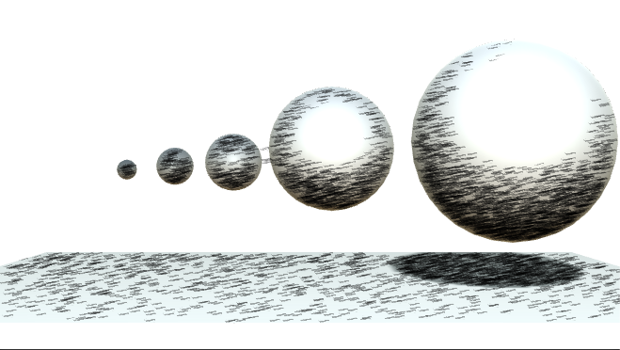
Try it! (needs higher particle count)

Slide 50
Using luminance gradient as stroke direction
Luminance gradient is calculated with Sobel in x and y directions
v2f vert (appdata v)
{
v2f o;
float3 rgb2lum = float3(0.2126, 0.7152, 0.0722);
float2 screenPos = ComputeGrabScreenPos(float4(v.vertex.xy,0,1)).xy;
float2 invPixelSize = float2(2.0 / _ScreenParams.x, 2.0 / _ScreenParams.y);
float dLdx = -1 * dot(tex2Dlod(_BackgroundTexture, float4(screenPos + invPixelSize * float2(-1, 1), 0, 0)).rgb, rgb2lum) +
-2 * dot(tex2Dlod(_BackgroundTexture, float4(screenPos + invPixelSize * float2(-1, 0), 0, 0)).rgb, rgb2lum) +
-1 * dot(tex2Dlod(_BackgroundTexture, float4(screenPos + invPixelSize * float2(-1,-1), 0, 0)).rgb, rgb2lum) +
1 * dot(tex2Dlod(_BackgroundTexture, float4(screenPos + invPixelSize * float2( 1, 1), 0, 0)).rgb, rgb2lum) +
2 * dot(tex2Dlod(_BackgroundTexture, float4(screenPos + invPixelSize * float2( 1, 0), 0, 0)).rgb, rgb2lum) +
1 * dot(tex2Dlod(_BackgroundTexture, float4(screenPos + invPixelSize * float2( 1,-1), 0, 0)).rgb, rgb2lum);
float dLdy = -1 * dot(tex2Dlod(_BackgroundTexture, float4(screenPos + invPixelSize * float2(-1, 1), 0, 0)).rgb, rgb2lum) +
-2 * dot(tex2Dlod(_BackgroundTexture, float4(screenPos + invPixelSize * float2( 0, 1), 0, 0)).rgb, rgb2lum) +
-1 * dot(tex2Dlod(_BackgroundTexture, float4(screenPos + invPixelSize * float2( 1, 1), 0, 0)).rgb, rgb2lum) +
1 * dot(tex2Dlod(_BackgroundTexture, float4(screenPos + invPixelSize * float2(-1,-1), 0, 0)).rgb, rgb2lum) +
2 * dot(tex2Dlod(_BackgroundTexture, float4(screenPos + invPixelSize * float2( 0,-1), 0, 0)).rgb, rgb2lum) +
1 * dot(tex2Dlod(_BackgroundTexture, float4(screenPos + invPixelSize * float2( 1,-1), 0, 0)).rgb, rgb2lum);

Slide 51
Using luminance gradient as stroke direction
Default stroke direction in screen space
float2 dir = normalize(float2(1, 1));
float2 dirPerp = normalize(float2(-1, 1));
if (dLdx != 0 || dLdy != 0)
{
dir = normalize(float2(dLdx, dLdy));
dirPerp = float2(-dir.y, dir.x);
}
o.vertex = float4(v.vertex.xy + strokeSize.x * v.uv.x * dirPerp +
strokeSize.y * v.uv.y * dir, 0, 1);
o.uv = v.uv;
float4 screenColor = tex2Dlod(_BackgroundTexture, float4(screenPos, 0, 0));
float Lum = dot(screenColor.rgb, rgb2lum);
float priority = v.vertex.z;
if (priority < Lum)
o.vertex.z = -2;
return o;
}
Default perpendicular direction
If gradient is not zero, calculate direction from gradient
Use stroke direction when offsetting vertex position
Rejection sampling is same as before

Slide 52
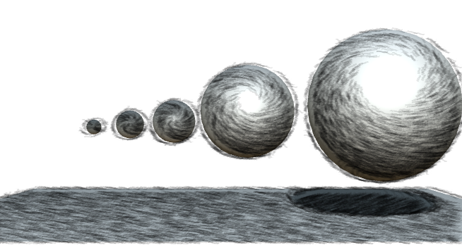
Try it!
Note2: object borders have discontinuities, screen space methods should avoid drawing to these areas
Note2: lines are fixed to the screen, which causes a shower door effect. Eliminating this is far beyond the scope of this practice

Slide 53
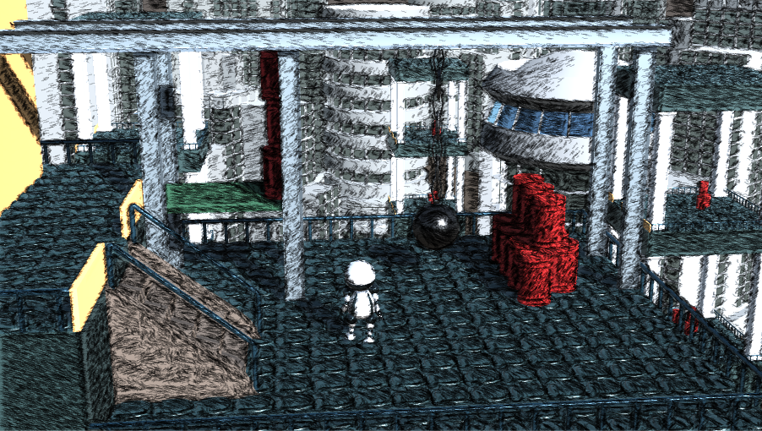
Robo scene
Screen space strokes can be tried out in the Robo scene
We have to set up the same ScreenSpaceStrokes gameobject to the Robo scene, and it should work …

Slide 54
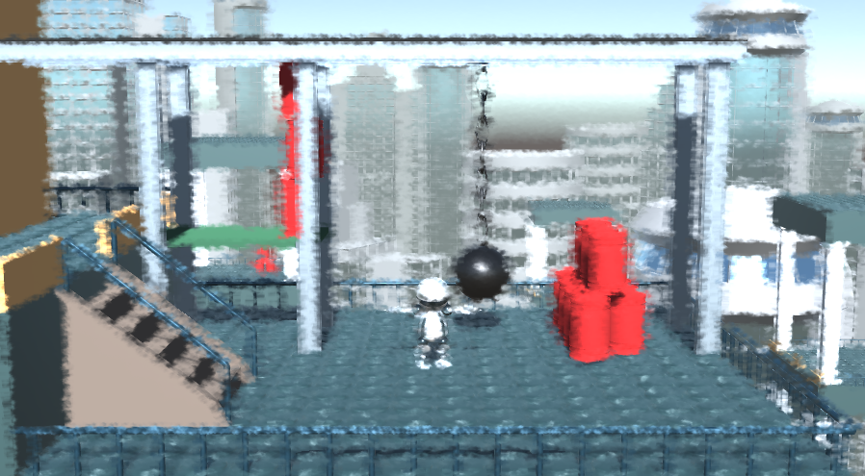
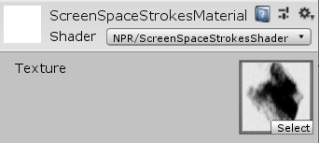
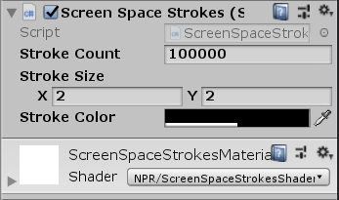
Practice
Let the lines use scene color (we can turn off line rejecting in this case, and set up brush-like strokes)

