Slide 1
Image Simplification

Slide 2
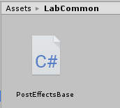
Starting project
Use the starting project of this practical – Pr05-ImageSimplificationBaseProject.zip
Contains the PostEffectsBase base class for image effects from last week
Open the base unity scene:
Lab05/Lab05-Scene.unity

Slide 3
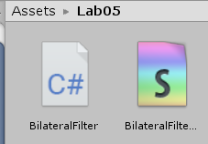
Edge preserve smoothing - Bilateral filter
Recall: bilateral filter uses two Gaussian weights:
One weight for distance from center pixel
One weight for the pixel value difference
The two weights are multiplied
Lets start with a single Gaussian filter
Create a new C# script and Image Effect Shader
Call them BilateralFilter and BilateralFilterShader
Change the shader name in the shader code (first row)
Shader "NPR/BilateralFilter"
{
Properties
// ...

Slide 4
Bilateral filter – C# script
Use the PostEffectsBase base class
Find the shader and create the material in the Start function
[ExecuteInEditMode]
[RequireComponent(typeof(Camera))]
public class BilateralFilter : PostEffectsBase {
[Range(0, 5.0f)]
public float sigmaDistance = 1.0f;
void Start () {
shader = Shader.Find("NPR/BilateralFilter");
CreateMaterial();
}
// see next slide for OnRenderImage
}
User-controlled smooth strength

Slide 5
Bilateral filter – C# script
OnRenderImage refreshes the material if needed and passes the threshold to the shader
void OnRenderImage(RenderTexture source, RenderTexture destination)
{
if (CreateMaterial())
{
material.SetFloat("sigma", sigmaDistance);
Graphics.Blit(source, destination, material);
}
else
{
Graphics.Blit(source, destination);
}
}

Slide 6
Bilateral filter – Shader
Shader "NPR/BilateralFilter"
{
Properties
{
_MainTex("Texture", 2D) = "white" {}
}
SubShader
{
// No culling or depth
Cull Off ZWrite Off ZTest Always
Pass
{
CGPROGRAM
#pragma vertex vert
#pragma fragment frag
#include "UnityCG.cginc"

Slide 7
Bilateral filter – Shader
struct appdata
{
float4 vertex : POSITION;
float2 uv : TEXCOORD0;
};
struct v2f
{
float2 uv : TEXCOORD0;
float4 vertex : SV_POSITION;
};
v2f vert(appdata v)
{
v2f o;
o.vertex = UnityObjectToClipPos(v.vertex);
o.uv = v.uv;
return o;
}
sampler2D _MainTex;
float4 _MainTex_TexelSize;
float sigma;
float Gauss(float d, float sigma)
{
return 1.0 / (sigma*sqrt(2.0*3.14)) * exp((-d*d) / (2.0*sigma*sigma));
}

Slide 8
Bilateral filter – Shader
float4 frag(v2f i) : SV_Target
{
float3 SUM = float3(0,0,0);
float SUMW = 0;
if (sigma == 0)
SUM = tex2D(_MainTex, i.uv).rgb;
else
{
for (int iy = -5; iy <= 5; iy++)
for (int ix = -5; ix <= 5; ix++)
{
float2 uv = i.uv + _MainTex_TexelSize.xy * float2(ix, iy);
float3 col = tex2D(_MainTex, uv).rgb;
float w = Gauss(length((i.uv - uv) / _MainTex_TexelSize.xy), sigma);
SUMW += w;
SUM += col*w;
}
SUM /= SUMW;
}
return float4(SUM, 1);
}
ENDCG
}
}
}

Slide 9
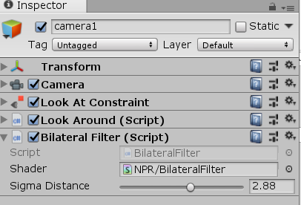
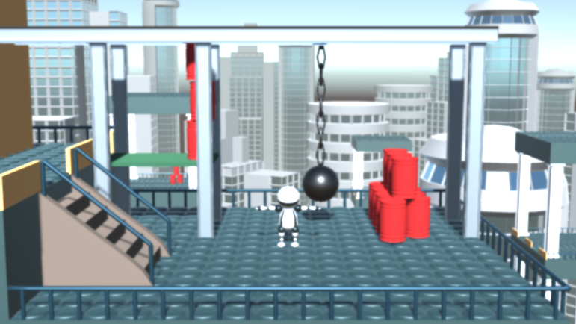
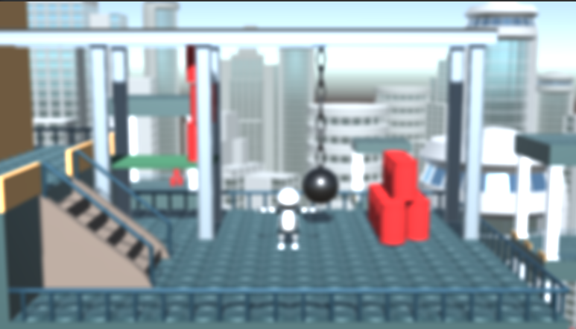
Bilateral filter
Attach the script to the main camera and try it!
This is just a simple Gaussian blur yet!
sigma = 1.0
sigma = 2.88

Slide 10
Bilateral filter – value weighting – C# script
Add sigma parameter for value difference
Pass parameter value to shader
[Range(0, 2.0f)]
public float sigmaValue = 1.0f;
void OnRenderImage(RenderTexture source, RenderTexture destination)
{
if (CreateMaterial())
{
material.SetFloat("sigma", sigmaDistance);
material.SetFloat("sigmaDistance", sigmaDistance);
material.SetFloat("sigmaValue", sigmaValue);
Graphics.Blit(source, destination, material);
}

Slide 11
Bilateral filter – value weighting Shader
sampler2D _MainTex;
float4 _MainTex_TexelSize;
float sigma;
float sigmaDistance;
float sigmaValue;
float4 frag(v2f i) : SV_Target
{
float3 SUM = float3(0,0,0);
float SUMW = 0;
if (sigma == 0)
if (sigmaDistance * sigmaValue == 0)
SUM = tex2D(_MainTex, i.uv).rgb;
else
{
float3 col0 = tex2D(_MainTex, i.uv).rgb;
for (int iy = -5; iy <= 5; iy++)
for (int ix = -5; ix <= 5; ix++)
{
float2 uv = i.uv + _MainTex_TexelSize.xy * float2(ix, iy);
float3 col = tex2D(_MainTex, uv).rgb;
float w = Gauss(length((i.uv - uv) / _MainTex_TexelSize.xy), sigma);
float wd = Gauss(length((i.uv - uv) / _MainTex_TexelSize.xy), sigmaDistance);
float wv = Gauss(length(col-col0), sigmaValue);
float w = wd*wv;
SUMW += w;
…

Slide 12
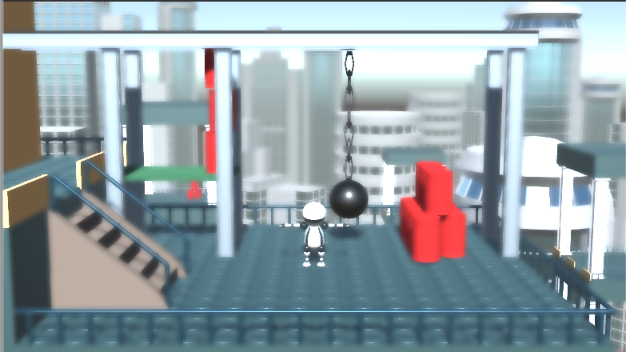
Bilateral filter
Try it!
sigmaValue basically determines how strong edges are kept
sigmaDistance = 4.33
sigmaValue = 1.58
sigmaDistance = 4.33
sigmaValue = 0.61

Slide 13
Separable Bilateral Filter
Though Bilateral filter is not separable, we can try to use it as a separable filter
Need two passes: one filters in x direction, one in y direction
C# script:
void OnRenderImage(RenderTexture source, RenderTexture destination)
{
if (CreateMaterial())
{
RenderTexture tmp = RenderTexture.GetTemporary(source.width, source.height, 0, RenderTextureFormat.DefaultHDR);
material.SetFloat("sigmaDistance", sigmaDistance);
material.SetFloat("sigmaValue", sigmaValue);
material.SetInt("filterDir", 0);
Graphics.Blit(source, tmp, material);
material.SetInt("filterDir", 1);
Graphics.Blit(tmp, destination, material);
tmp.Release();
}

Slide 14
Separable Bilateral Filter - Shader
float sigmaValue;
int filterDir;
float Gauss(float d, float sigma)
{
return 1.0 / (sigma*sqrt(2.0*3.14)) * exp((-d*d) / (2.0*sigma*sigma));
}
float4 frag(v2f i) : SV_Target
{
float2 dir = filterDir == 0 ? float2(1,0) : float2(0,1);
float3 SUM = float3(0,0,0);
float SUMW = 0;
if (sigmaDistance * sigmaValue == 0)
SUM = tex2D(_MainTex, i.uv).rgb;
else
{
float3 col0 = tex2D(_MainTex, i.uv).rgb;
for (int ix = -5; ix <= 5; ix++)
{
float2 uv = i.uv + _MainTex_TexelSize.xy * dir * float(ix);
Single loop!

Slide 15
Separable Bilateral filter
Try it!
Similar quality!

Slide 16
Iterative Separabe Bilateral filter C#
To have larger blurs, it can be more efficient to run the filter multiple times instead of using larger kernel sizes
[Range(0, 5.0f)]
public float sigmaDistance = 1.0f;
[Range(0, 2.0f)]
public float sigmaValue = 1.0f;
public int iterations = 1;

Slide 17
Iterative Separabe Bilateral filter C#
void OnRenderImage(RenderTexture source, RenderTexture destination)
{
if (CreateMaterial())
{
RenderTexture tmp = RenderTexture.GetTemporary(source.width, source.height, 0, RenderTextureFormat.DefaultHDR);
RenderTexture rt1 = source;
RenderTexture rt2 = tmp;
for (int i = 0; i < iterations; ++i)
{
material.SetFloat("sigmaDistance", sigmaDistance);
material.SetFloat("sigmaValue", sigmaValue);
material.SetInt("filterDir", 0);
Graphics.Blit(rt1, rt2, material);
material.SetInt("filterDir", 1);
if (i == iterations - 1)
rt1 = destination;
Graphics.Blit(rt2, rt1, material);
}
tmp.Release();
}

Slide 18
Iterative Separabe Bilateral filter C#
Try it!
10 iterations

Slide 19
Symmetric nearest neighbor filter (SNN)
P1 | P2 | P3 | P4 | P5
P6 | P7 | P8 | P9 | P10
P11 | P12 | P13 | P14 | P15
P16 | P17 | P18 | P19 | P20
P21 | P22 | P23 | P24 | P25
P1 | P2 | P3 | P4 | P5
P6 | P7 | P8 | P9 | P10
P11 | P12 | P13 | P14 | P15
P16 | P17 | P18 | P19 | P20
P21 | P22 | P23 | P24 | P25
Visit pixel pairs on opposite directions
Choose the pixel from the pair, which is closer (in value) to center pixel (P13)
Take the average of closer pixels for all pairs
D. Harwood, M. Subbarao, H. Hakalahti, and L.S. Davis: A New Class Of Edge-Preserving Smoothing Filters PRL Vol. 6, pp. 155-162, 1987.

Slide 20
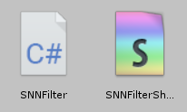
Symmetric nearest neighbor filter
Create a new C# script and Image Effect Shader
Call them SNNFilter and SNNFilterShader
Change the shader name in the shader code (first row)
Shader "NPR/SNNFilter"
{
Properties
// ...

Slide 21
Symmetric nearest neighbor filter – C# script
[ExecuteInEditMode]
[RequireComponent(typeof(Camera))]
public class SNNFilter : PostEffectsBase
{
public int filterSize = 5;
void Start()
{
shader = Shader.Find("NPR/SNNFilter");
CreateMaterial();
}
void OnRenderImage(RenderTexture source, RenderTexture destination)
{
if (CreateMaterial())
{
material.SetInt("filterSize", filterSize);
Graphics.Blit(source, destination, material);
}
else
{
Graphics.Blit(source, destination);
}
}
}

Slide 22
SNN filter – Shader
sampler2D _MainTex;
float4 _MainTex_TexelSize;
int filterSize;
float4 frag (v2f i) : SV_Target
{
int N = filterSize;
//Inverse of the number of pixels pairs we are going to visit
//It will be needed for taking the average
float PcountInv = 1.0 / float((2 * N + 1)*N + N);
//Read the center pixel value in the filter window
float3 PCenter = tex2D(_MainTex, i.uv).rgb;
float3 AVG = float3(0, 0, 0);
//SNN filter reads pair of pixels in filter window
//The pairs are pixels mirrored to the filter origin
//Thus we only have to loop the half of the filter window
for (int iy = -N; iy <= 0; iy++)
for (int ix = -N; ix <= N; ix++)
{
… next slide
}
AVG *= PcountInv; //take the average of the more similar pixel values
return float4(AVG, 1);
}

Slide 23
SNN filter – Shader
for (int iy = -N; iy <= 0; iy++)
for (int ix = -N; ix <= N; ix++)
{
if (iy == 0 && ix == 0)//if we reached the half of the filter window
{
ix = N + 1; iy = 1; break; //quit the double loop
}
//sample the pixel and its mirrored pair
float3 P1 = tex2D(_MainTex, i.uv + _MainTex_TexelSize.xy*float2( ix, iy)).rgb;
float3 P2 = tex2D(_MainTex, i.uv + _MainTex_TexelSize.xy*float2(-ix,-iy)).rgb;
float3 minP = P1;
//Compute pixel value difference from center pixel
float D1 = length(P1 - PCenter);
float D2 = length(P2 - PCenter);
//choose the pixel which is more similar to center pixel
if (D2 < D1)
minP = P2;
AVG += minP;
}

Slide 24
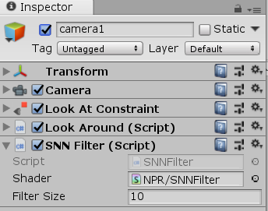
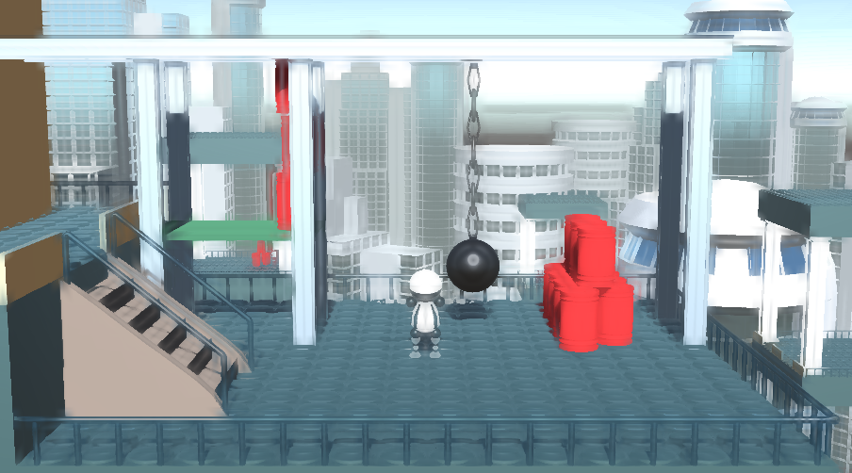
SNN filter
Attach the script to the main camera and try it!
First disable or remove Bilateral Filter image effect component

Slide 25
Iterative SNN Filter
void OnRenderImage(RenderTexture source, RenderTexture destination)
{
if (CreateMaterial())
{
RenderTexture tmp = RenderTexture.GetTemporary(source.width, source.height, 0, RenderTextureFormat.DefaultHDR);
RenderTexture rt1 = source;//reference to source render texture
RenderTexture rt2 = tmp; //reference to destination render texture
material.SetInt("filterSize", filterSize);
for (int i = 0; i < iterations; ++i)
{
if (i == iterations - 1) //in the last iteration
rt2 = destination; //the destination texture should be the final destination
Graphics.Blit(rt1, rt2, material);
//swap the two render textures
RenderTexture t = rt2;
rt2 = rt1;
rt1 = t;
}
tmp.Release();
}
else
{
Graphics.Blit(source, destination);
}
}

Slide 26
Iterative SNN filter
Try it!
Filtersize 5
4 iterations

Slide 27
Kuwahara filter
P1 | P2 | P3
P4 | P5 | P6
P7 | P8 | P9
P1 | P2 | P3
P4 | P5 | P6
P7 | P8 | P9
P1 | P2 | P3
P4 | P5 | P6
P7 | P8 | P9
P1 | P2 | P3
P4 | P5 | P6
P7 | P8 | P9
P1 | P2 | P3
P4 | P5 | P6
P7 | P8 | P9
R1 = {P1,P2,P4,P5}
R2 = {P2,P3,P5,P6}
R3 = {P4,P5,P7,P8}
R4 = {P5,P6,P8,P9}
Divide pixel neighborhood to four rectangular sub regions: R1,R2,R3,R4
Compute expected value and variance for all regions
E_{R1} = ¼ * (P1+P2+P3+P4)
Var_{R1} = ¼ * (P1²+P2²+P3²+P4²) - E_{R1}²
Find region with minimum variance and replace P5 with the expected value of this region

Slide 28
Kuwahara filter
Create a new C# script and Image Effect Shader
Call them KuwaharaFilter and KuwaharaFilterShader
Change the shader name in the shader code (first row)
Shader "NPR/KuwaharaFilter"
{
Properties
// ...

Slide 29
Kuwahara filter – C# script
[ExecuteInEditMode]
[RequireComponent(typeof(Camera))]
public class KuwaharaFilter : PostEffectsBase {
[Range(0, 20)]
public int filterSize = 5;
void Start()
{
shader = Shader.Find("NPR/KuwaharaFilter");
CreateMaterial();
}
void OnRenderImage(RenderTexture source, RenderTexture destination)
{
if (CreateMaterial())
{
material.SetInt("filterSize", filterSize);
Graphics.Blit(source, destination, material);
}
else
{
Graphics.Blit(source, destination);
}
}
}

Slide 30
Kuwahara filter – Shader I.
sampler2D _MainTex;
float4 _MainTex_TexelSize;
int filterSize;
float4 frag (v2f I) : SV_Target
{
int N = filterSize;
//Kuwahara filter divides the filter window to four equal parts
//PcountInv is the inv number of pixels in one window part
float PcountInv = 1.0 / float((N + 1)*(N + 1));
//First window region
float3 E1 = float3(0, 0, 0); //expected value of region
float3 E1_2 = float3(0, 0, 0); //expected squared value of region
for (int i = -N; i <= 0; i++)
for (int j = -N; j <= 0; j++)
{
float3 P = tex2D(_MainTex, I.uv + _MainTex_TexelSize.xy*float2(i, j)).rgb;
E1 += P;
E1_2 += P*P;
}
E1 *= PcountInv;
float V1 = length(PcountInv*E1_2 - E1*E1); //variance of region

Slide 31
Kuwahara filter Shader II.
//Second window region
float3 E2 = float3(0, 0, 0);
float3 E2_2 = float3(0, 0, 0);
for (int i = -N; i <= 0; i++)
for (int j = 0; j <= N; j++)
{
float3 P = tex2D(_MainTex, I.uv + _MainTex_TexelSize.xy*float2(i, j)).rgb;
E2 += P;
E2_2 += P*P;
}
E2 *= PcountInv;
float V2 = length(PcountInv*E2_2 - E2*E2);
//Third window region
float3 E3 = float3(0, 0, 0);
float3 E3_2 = float3(0, 0, 0);
for (int i = 0; i <= N; i++)
for (int j = 0; j <= N; j++)
{
float3 P = tex2D(_MainTex, I.uv + _MainTex_TexelSize.xy*float2(i, j)).rgb;
E3 += P;
E3_2 += P*P;
}
E3 *= PcountInv;
float V3 = length(PcountInv*E3_2 - E3*E3);

Slide 32
Kuwahara filter Shader III.
//Fourth window region
float3 E4 = float3(0, 0, 0);
float3 E4_2 = float3(0, 0, 0);
for (int i = 0; i <= N; i++)
for (int j = -N; j <= 0; j++)
{
float3 P = tex2D(_MainTex, I.uv + _MainTex_TexelSize.xy*float2(i, j)).rgb;
E4 += P;
E4_2 += P*P;
}
E4 *= PcountInv;
float V4 = length(PcountInv*E4_2 - E4*E4);
//Find the region with least variance
float3 minE = E1;
float minV = V1;
if (V2 < minV) { minE = E2; minV = V2; }
if (V3 < minV) { minE = E3; minV = V3; }
if (V4 < minV) { minE = E4; minV = V4; }
//Use the excepted value of the region with least variance
return float4(minE, 1);
}
ENDCG

Slide 33
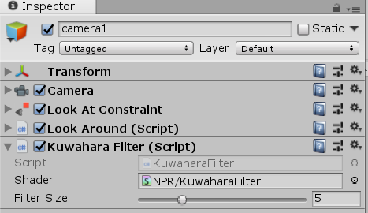
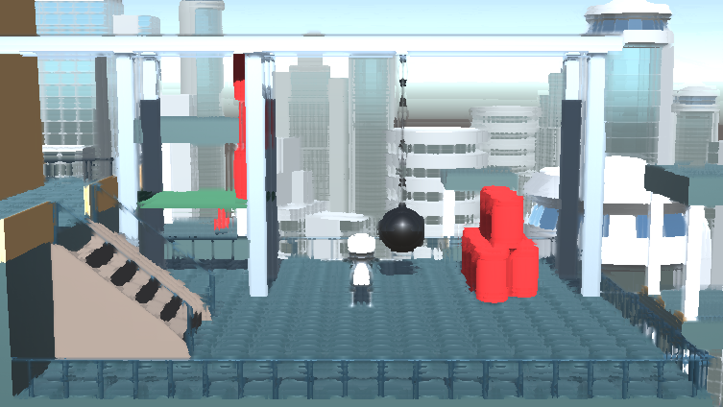
Kuwahara filter
Attach the script to the main camera and try it!
First disable or remove SNN Filter image effect component

Slide 34
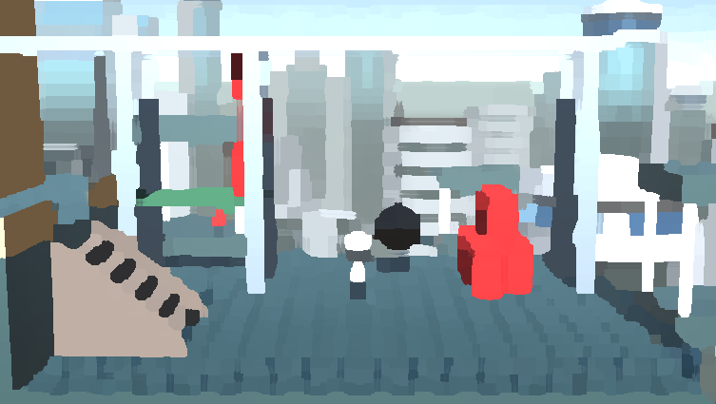
Task
Make the Kuwahara filter iterative

Slide 35
Luminance quantization
Define N bins of luminance, and replace pixel luminance value with bin luminance
Need to convert to a color space with luminance channel (e.g. HSV or CIELab)
After quantization convert back to RGB
Original luminance values
3 luminance bins
can be implemented with floor() or step()
3 luminance with smooth transition
can be implemented with smoothstep()

Slide 36
Luminance quantization
Create a new C# script and Image Effect Shader
Call them Quantization and QuantizationShader
Change the shader name in the shader code (first row)
Shader "NPR/Quantization"
{
Properties
// ...

Slide 37
Luminance quantization – C# script
[ExecuteInEditMode]
[RequireComponent(typeof(Camera))]
public class Quantization : PostEffectsBase
{
[Range(1, 20)]
public int levels = 5;
void Start()
{
shader = Shader.Find("NPR/Quantization");
CreateMaterial();
}
void OnRenderImage(RenderTexture source, RenderTexture destination)
{
if (CreateMaterial())
{
material.SetInt("levels", levels);
Graphics.Blit(source, destination, material);
}
else
{
Graphics.Blit(source, destination);
}
}
}

Slide 38
Luminance quantization – Shader
CGPROGRAM
#pragma vertex vert
#pragma fragment frag
#include "UnityCG.cginc"
#include "../Lab03/colorspaces.cginc"
…
sampler2D _MainTex;
int levels;
float3 frag (v2f i) : SV_Target
{
float3 col = tex2D(_MainTex, i.uv).rgb;
float3 hsv = rgb_to_hsv(col);
hsv.b = floor(hsv.b * levels) / float(levels);
col = hsv_to_rgb(hsv);
return float4(col,1);
}
ENDCG

Slide 39
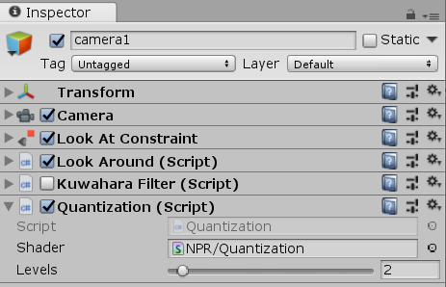
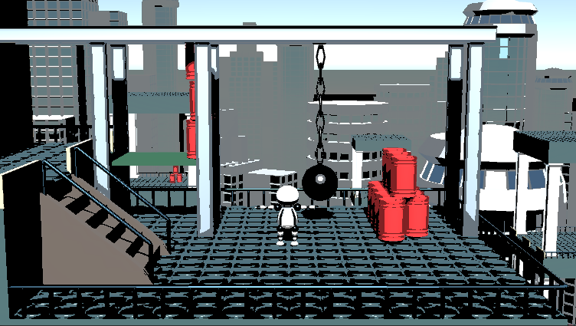
Quantization
Attach the script to the main camera and try it!
We can disable previous effects.

Slide 40
Quantization with smooth transitions
Add new variable to C# script
public class Quantization : PostEffectsBase
{
[Range(1, 20)]
public int levels = 5;
[Range(0, 1)]
public float transitionSharpness = 0.8f;
void OnRenderImage(RenderTexture source, RenderTexture destination)
{
if (CreateMaterial())
{
material.SetInt("levels", levels);
material.SetFloat("transitionSharpness", transitionSharpness);
Graphics.Blit(source, destination, material);
}

Slide 41
Quantization with smooth transitions - Shader
int levels;
float transitionSharpness;
float3 frag (v2f i) : SV_Target
{
float3 col = tex2D(_MainTex, i.uv).rgb;
float3 hsv = rgb_to_hsv(col);
float V = hsv.b * levels;
float Vfloor = floor(V);
float Vfrac = V - Vfloor;
hsv.b = (Vfloor + smoothstep(Vfloor + transitionSharpness, Vfloor+1, V)) / float(levels);
col = hsv_to_rgb(hsv);
return float4(col,1);
}

Slide 42
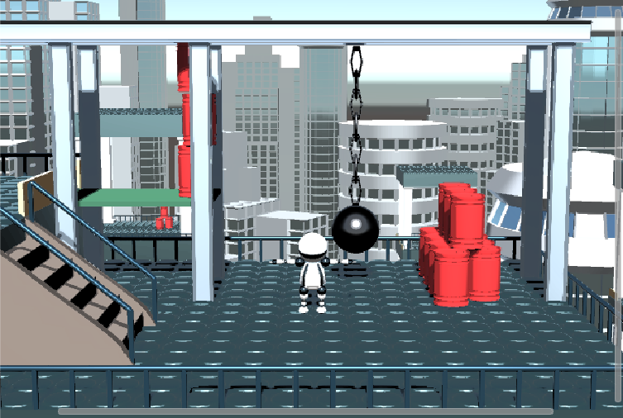
Quantization with smooth transitions
Try it!

Slide 43
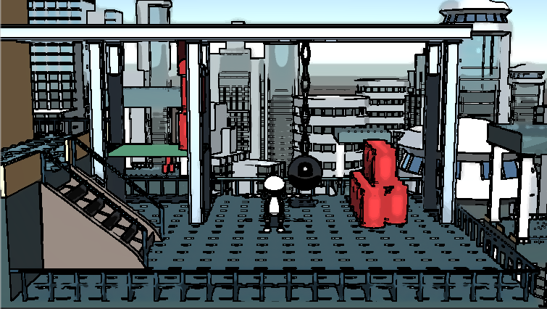
Task
Use an edge preserve smooth, a quantization and an edge detect filter (from previous practice Lab04) to achieve a look similar to this:

