Slide 1
Edge Detection

Slide 2
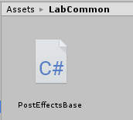
Starting project
Use the starting project of this practical – Pr04-ContoursBaseProject.zip
Contains the PostEffectsBase base class for image effects from earlier
Open the base unity scene:
Lab04/Lab04-Scene.unity

Slide 3
Edge detection using gradients
Our first effects will detect edges based on image gradient magnitudes
2 versions of gradient magnitude calculation:
Central differences
Sobel Filter
Create a new C# script and Image Effect Shader
Call them ContoursGradient and ContoursGradientShader
Change the shader name in the shader code (first row)
Shader "NPR/ContoursGradient"
{
Properties
// ...

Slide 4
Edge detection using gradients – C# script
Use the PostEffectsBase base class
Find the shader and create the material in the Start function
[ExecuteInEditMode]
[RequireComponent(typeof(Camera))]
public class ContoursGradient : PostEffectsBase {
[Range(0, 2)]
public float luminanceThreshold = 0.5f;
void Start () {
shader = Shader.Find("NPR/ContoursGradient");
CreateMaterial();
}
// see next slide for OnRenderImage
}
User-controlled threshold

Slide 5
Edge detection using gradients – C# script
OnRenderImage refreshes the material if needed and passes the threshold to the shader
void OnRenderImage(RenderTexture source, RenderTexture destination)
{
if (CreateMaterial())
{
material.SetFloat("gradMagnitudeThreshold", gradMagnitudeThreshold);
Graphics.Blit(source, destination, material);
}
else
{
Graphics.Blit(source, destination);
}
}

Slide 6
Edge detection using gradients – Shader
Compute derivatives in x and y direction. Compute gradient magnitude and apply a threshold. Do an inverse at the end to make the background white and the contours black.
sampler2D _MainTex;
float4 _MainTex_TexelSize;
float gradMagnitudeThreshold;
float4 frag(v2f i) : SV_Target{
float3 gradX = 0.5f * (tex2D(_MainTex, i.uv + float2( _MainTex_TexelSize.x, 0)).rgb
- tex2D(_MainTex, i.uv + float2(-_MainTex_TexelSize.x, 0)).rgb);
float3 gradY = 0.5f * (tex2D(_MainTex, i.uv + float2(0, _MainTex_TexelSize.y)).rgb
- tex2D(_MainTex, i.uv + float2(0, -_MainTex_TexelSize.y)).rgb);
float gradRMag = length(float2(gradX.r, gradY.r));
float gradGMag = length(float2(gradX.g, gradY.g));
float gradBMag = length(float2(gradX.b, gradY.b));
float sumMag = gradRMag + gradGMag + gradBMag;
float edgeValue = step(sumMag, gradMagnitudeThreshold); //threshold
edgeValue = 1.0f- edgeValue; //inversion
return float4(edgeValue, edgeValue, edgeValue,1);
}

Slide 7
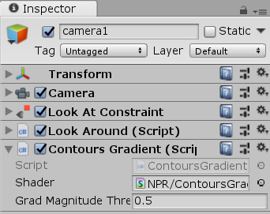
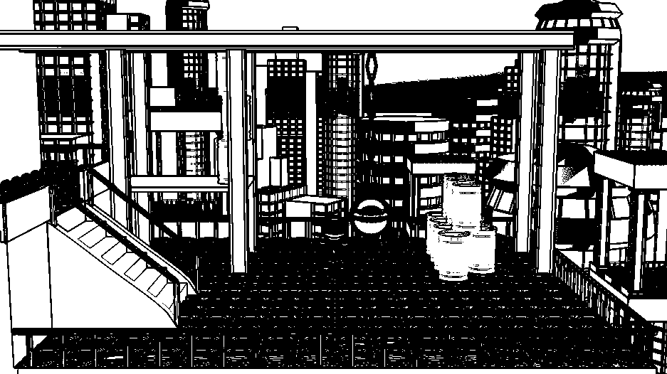
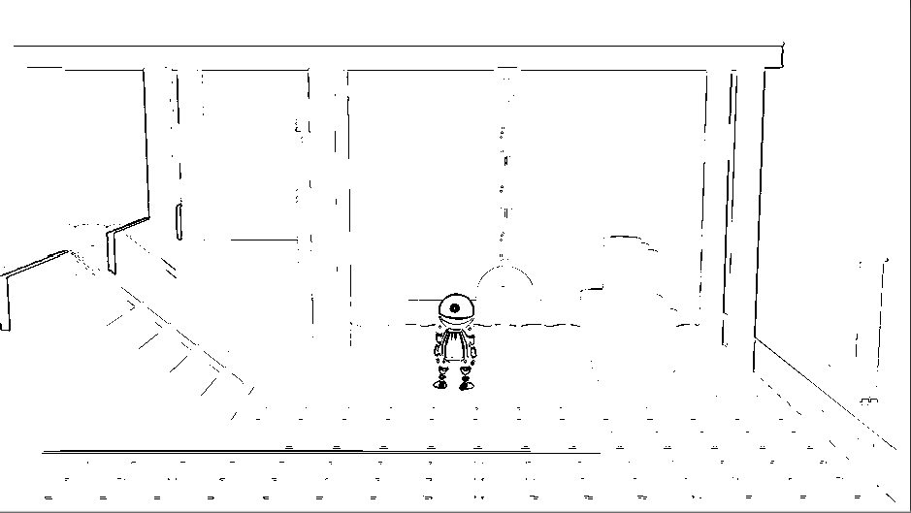
Edge detection using gradients
Attach it to the main camera and try it!
Threshold = 0.01
Threshold = 0.5

Slide 8
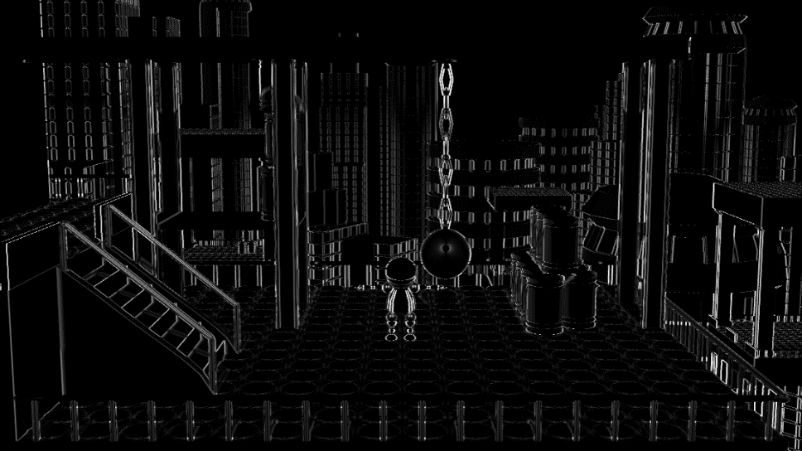
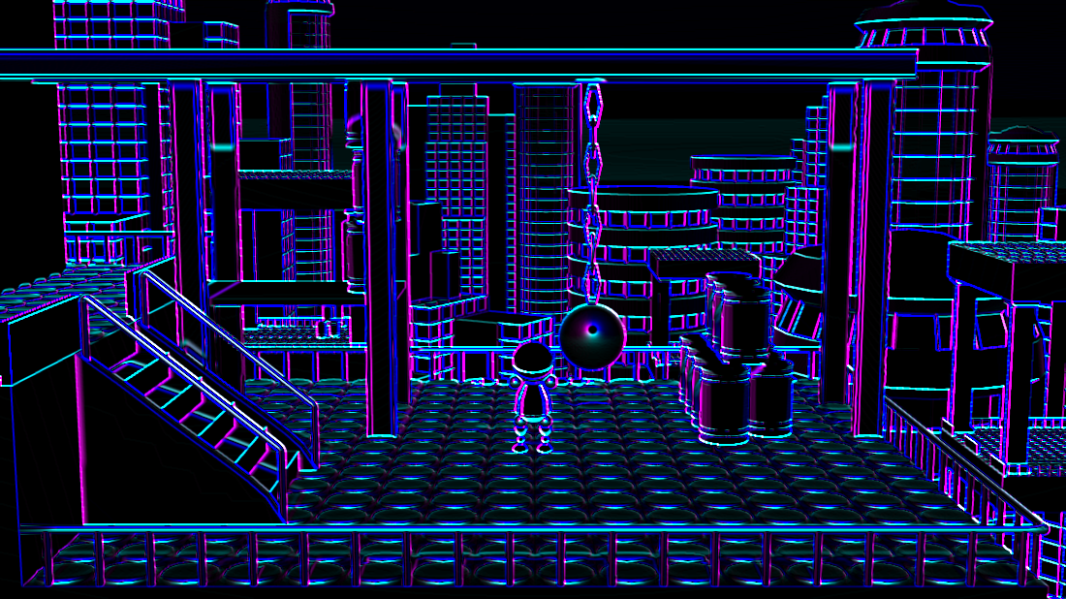
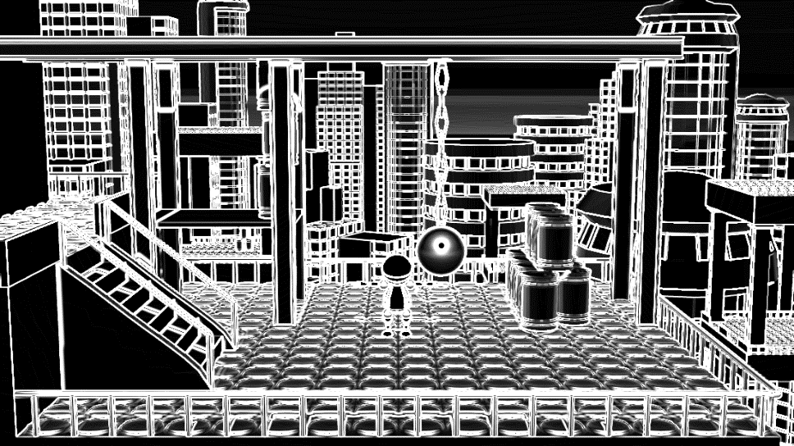
Task
Examine some temporal features e.g.:
Derivative of red channel in X direction
Derivative of red channel in Y direction
Other channels
Gradient magnitude of each channel
Sum of gradient magnitudes

Slide 9
Smooth Contour Edges
public class ContoursGradient : PostEffectsBase {
[Range(0, 2)]
public float gradMagnitudeThreshold = 0.5f;
[Range(0, 2)]
public float edgeFalloff = 0.05f;
…
material.SetFloat("gradMagnitudeThreshold", gradMagnitudeThreshold);
material.SetFloat("edgeFalloff", edgeFalloff);
Graphics.Blit(source, destination, material);
Add new member to C# script (controls edge smoothness)
Pass its value to the shader
float4 _MainTex_TexelSize;
float gradMagnitudeThreshold;
float edgeFalloff;
…
float edgeValue = step(sumMag, gradMagnitudeThreshold); //threshold
float edgeValue = smoothstep(max(0.0, gradMagnitudeThreshold - edgeFalloff),
gradMagnitudeThreshold + edgeFalloff,
sumMag); //smooth threshold
Replace step() with smoothstep() in shader
(Smoothstep uses a range instead of a single threshold value)

Slide 10
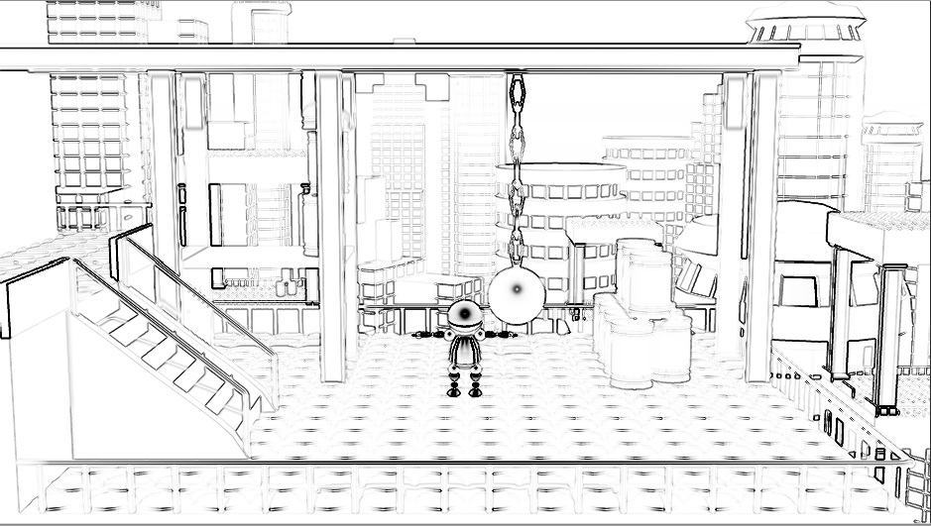
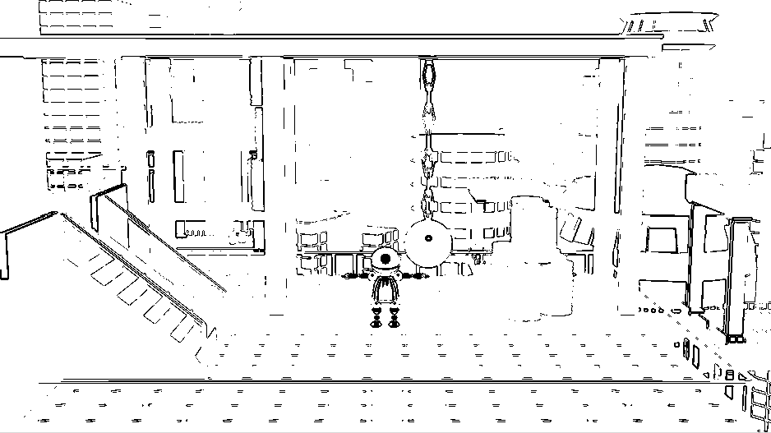
Smooth contour edges
Try it!
Threshold = 0.6
Edge falloff = 0.72
Threshold = 0.6
Edge falloff = 0

Slide 11
Combine with image color
Multiply original pixel color with edge value to combine color and contours (in shader)
return float4(edgeValue, edgeValue, edgeValue,1);
float4 imageColor = tex2D(_MainTex, i.uv);
imageColor.rgb *= edgeValue;
return imageColor;

Slide 12
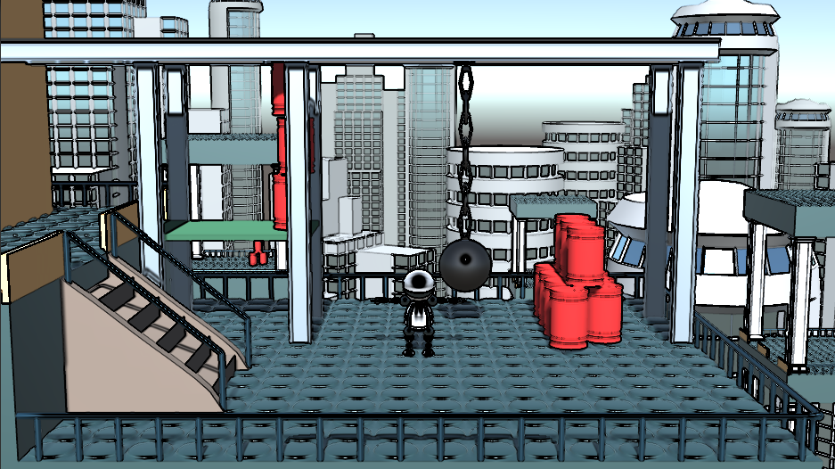
Combine with image color
Try it!

Slide 13
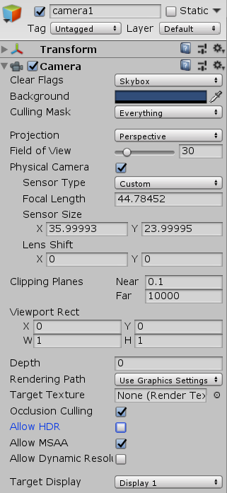
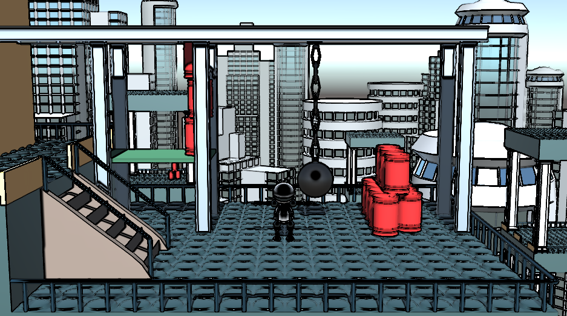
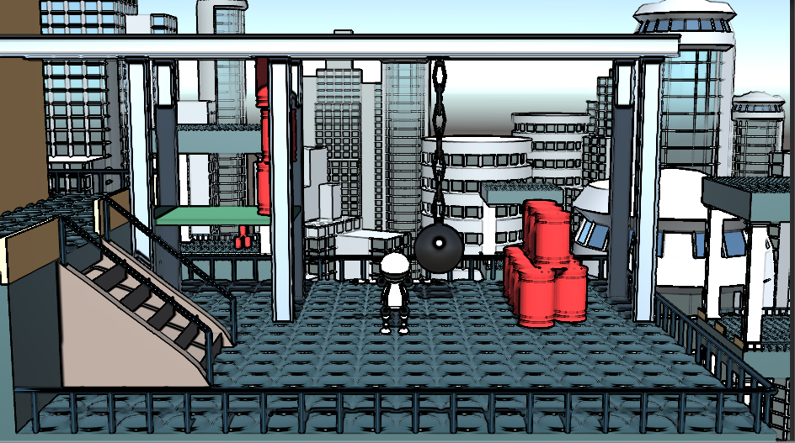
Effect of HDR
Try turning on/off HDR on camera
HDR ON
better
worse
HDR OFF

Slide 14
Sobel
Replace derivative calculation with Sobel operator
$$\frac{∂}{∂x}=\left[\begin{matrix}−1 & 0 & 1 \\ −2 & 0 & 2 \\ −1 & 0 & 1\end{matrix}\right], \frac{∂}{∂y}=\left[\begin{matrix}1 & 2 & 1 \\ 0 & 0 & 0 \\ −1 & −2 & −1\end{matrix}\right]$$
float3 gradX = 2 * tex2D(_MainTex, i.uv + _MainTex_TexelSize * float2( 1, 0)).rgb
+ tex2D(_MainTex, i.uv + _MainTex_TexelSize * float2( 1, 1)).rgb
+ tex2D(_MainTex, i.uv + _MainTex_TexelSize * float2( 1,-1)).rgb
-2 * tex2D(_MainTex, i.uv + _MainTex_TexelSize * float2(-1, 0)).rgb
- tex2D(_MainTex, i.uv + _MainTex_TexelSize * float2(-1, 1)).rgb
- tex2D(_MainTex, i.uv + _MainTex_TexelSize * float2(-1,-1)).rgb;
float3 gradY = 2 * tex2D(_MainTex, i.uv + _MainTex_TexelSize * float2( 0, 1)).rgb
+ tex2D(_MainTex, i.uv + _MainTex_TexelSize * float2(-1, 1)).rgb
+ tex2D(_MainTex, i.uv + _MainTex_TexelSize * float2( 1, 1)).rgb
-2 * tex2D(_MainTex, i.uv + _MainTex_TexelSize * float2( 0,-1)).rgb
- tex2D(_MainTex, i.uv + _MainTex_TexelSize * float2(-1,-1)).rgb
- tex2D(_MainTex, i.uv + _MainTex_TexelSize * float2( 1,-1)).rgb;

Slide 15
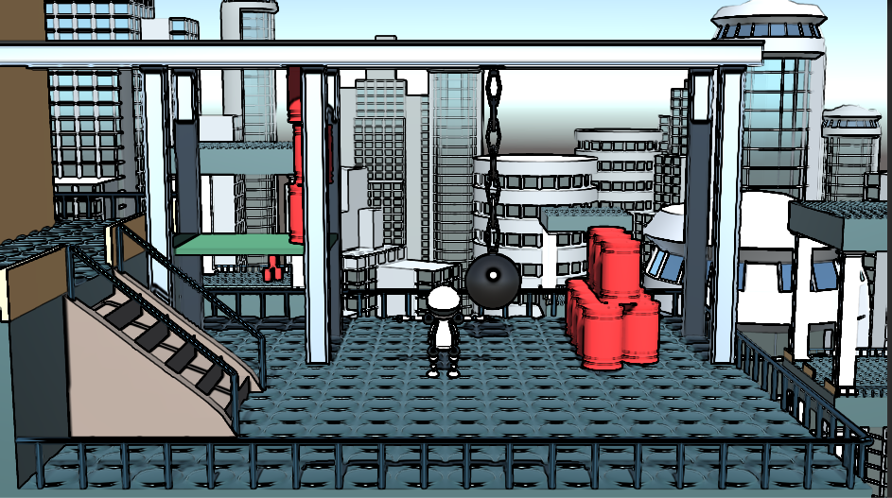
Sobel
Try it!

Slide 16
Task
Try the Prewitt operator!
$$\frac{∂}{∂x}=\left[\begin{matrix}−1 & 0 & 1 \\ −1 & 0 & 1 \\ −1 & 0 & 1\end{matrix}\right], \frac{∂}{∂y}=\left[\begin{matrix}1 & 1 & 1 \\ 0 & 0 & 0 \\ −1 & −1 & −1\end{matrix}\right]$$

Slide 17
Contours with Laplacian
Work on a greyscale image -> calculate pixel luminance
Compute image gradient
Compute image Laplacian
Find pixels with near zero Laplacian value and high gradient magnitude
Pixels with low gradient value are flat areas. Flat areas Laplacian is also zero, but they are not edges!

Slide 18
Contours with Laplacian
Create a new C# script and Image Effect Shader
Call them ContoursLaplace and ContoursLaplaceShader
Change the shader name in the shader code
[ExecuteInEditMode]
[RequireComponent(typeof(Camera))]
public class ContoursLaplace : PostEffectsBase {
void Start() {
shader = Shader.Find("NPR/ContoursLaplace");
CreateMaterial();
}
void OnRenderImage(RenderTexture source, RenderTexture destination){
//next slide
}
}
Shader "NPR/ContoursLaplace"
{
Properties
// ...

Slide 19
Contours with Laplacian – C# script
void OnRenderImage(RenderTexture source, RenderTexture destination)
{
if (CreateMaterial())
{
Graphics.Blit(source, destination, material, 0);
}
else
{
Graphics.Blit(source, destination);
}
}
Render first pass in shader
(later we will have multiple passes)

Slide 20
Contours with Laplacian – Luminance Shader
Write a simple RGB -> greyscale shader
sampler2D _MainTex;
float4 frag (v2f i) : SV_Target
{
float L = dot(tex2D(_MainTex, i.uv).rgb, float3(0.2126, 0.7152, 0.0722));
return float4(L,L,L,1);
}

Slide 21
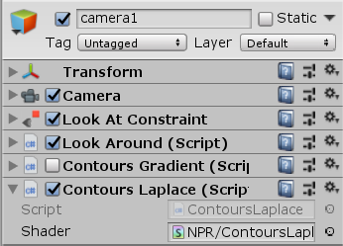
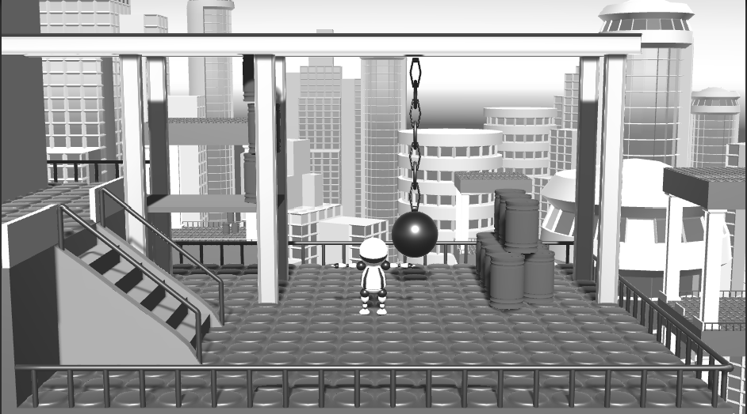
Contours with Laplacian – Luminance Shader
Attach it to the main camera and try it!
(disable or delete ContoursGradient script)

Slide 22
Contours with Laplacian – Laplace operator
Shader "NPR/ContoursLaplace
{
Properties
{
_MainTex ("Texture", 2D) = "white" {}
}
SubShader
{
// No culling or depth
Cull Off ZWrite Off ZTest Always
Pass
{
…
}
Pass
{
…
}
Add new pass to shader (duplicate the first pass)
Copy - Paste

Slide 23
Contours with Laplacian – Laplace operator
In new pass replace the fragment shader
sampler2D _MainTex;
float4 _MainTex_TexelSize;
float4 frag(v2f i) : SV_Target
{
float Lapl = tex2D(_MainTex, i.uv + _MainTex_TexelSize * float2(1, 0)).r
+ tex2D(_MainTex, i.uv + _MainTex_TexelSize * float2(0, 1)).r
+ tex2D(_MainTex, i.uv + _MainTex_TexelSize * float2(-1, 0)).r
+ tex2D(_MainTex, i.uv + _MainTex_TexelSize * float2(0,-1)).r
- 4 * tex2D(_MainTex, i.uv).r;
return float4(Lapl, Lapl, Lapl, 1);
}

Slide 24
Contours with Laplacian – Laplace operator
In C# script
Get a temporary texture with the same dimensions as “source”
void OnRenderImage(RenderTexture source, RenderTexture destination)
{
if (CreateMaterial())
{
RenderTexture tmp =
RenderTexture.GetTemporary(source.width, source.height, 0, RenderTextureFormat.DefaultHDR);
Graphics.Blit(source, tmp, material, 0);
Graphics.Blit(tmp, destination, material, 1);
RenderTexture.ReleaseTemporary(tmp);
}
else
{
Graphics.Blit(source, destination);
}
}
Render luminance to temporary texture (pass 0)
Calculate Laplacian on luminance image
(pass 1)

Slide 25
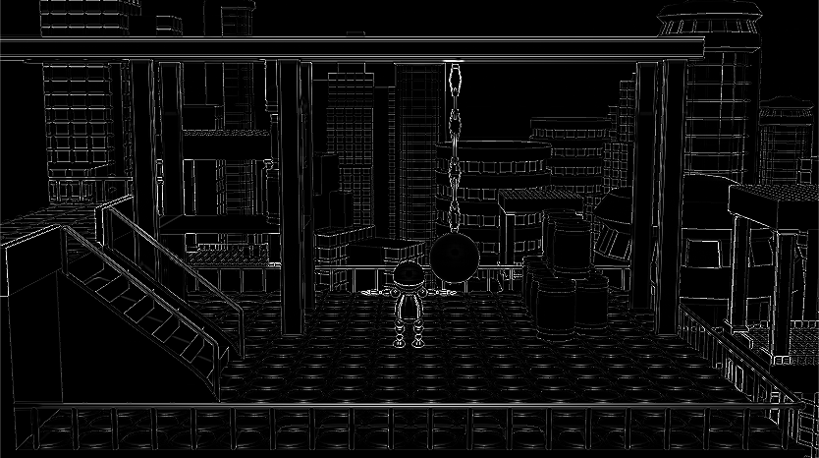
Contours with Laplacian – Laplace operator
Try it!

Slide 26
Contours with Laplacian –Edge detecion
New variables in C# script
public class ContoursLaplace : PostEffectsBase {
[Range(0, 0.2f)]
public float LaplaceThreshold = 0.01f;
[Range(0, 1.0f)]
public float gradientThreshold = 0.05f;
[Range(0, 0.5f)]
…
void OnRenderImage(RenderTexture source, RenderTexture destination)
{
…
Graphics.Blit(source, tmp, material, 0);
material.SetFloat("LaplaceThreshold", LaplaceThreshold);
material.SetFloat("gradientThreshold", gradientThreshold);
Graphics.Blit(tmp, destination, material, 1);
RenderTexture.ReleaseTemporary(tmp);

Slide 27
Contours with Laplacian –Edge detecion
In shader find pixels with near zero Laplacian and high enough gradient magnitude
Gradient is calculated with central differences
edgeValue = 0 -> not a contour
edgevalue = 1 -> contour
float LaplaceThreshold;
float gradientThreshold;
float4 frag(v2f i) : SV_Target {
float Lapl = tex2D(_MainTex, i.uv + _MainTex_TexelSize * float2(1, 0)).r
+ tex2D(_MainTex, i.uv + _MainTex_TexelSize * float2(0, 1)).r
+ tex2D(_MainTex, i.uv + _MainTex_TexelSize * float2(-1, 0)).r
+ tex2D(_MainTex, i.uv + _MainTex_TexelSize * float2(0,-1)).r
- 4 * tex2D(_MainTex, i.uv).r;
float edgeValue = 1.0 - step(LaplaceThreshold, abs(Lapl));//near zero Laplacian
float gradX = tex2D(_MainTex, i.uv + _MainTex_TexelSize*float2(1, 0)).r
- tex2D(_MainTex, i.uv + _MainTex_TexelSize*float2(-1, 0)).r;
float gradY = tex2D(_MainTex, i.uv + _MainTex_TexelSize*float2(0, 1)).r
- tex2D(_MainTex, i.uv + _MainTex_TexelSize*float2(0,-1)).r;
float gradMag = length(float2(gradX, gradY));
edgeValue *= step(gradientThreshold, gradMag);//high enough gradient magnitude
edgeValue = 1.0 - edgeValue;//make black contours on white background
return float4(edgeValue, edgeValue, edgeValue, 1);
}

Slide 28
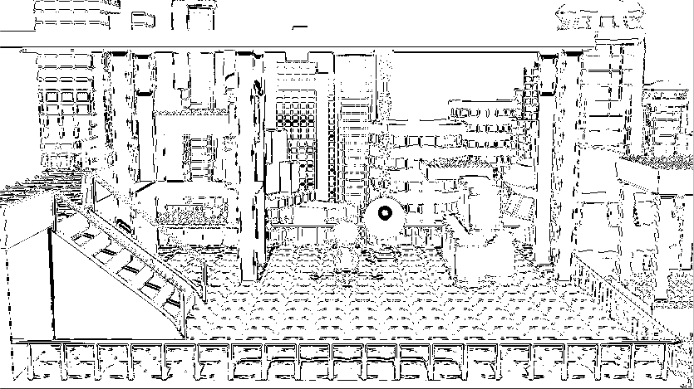
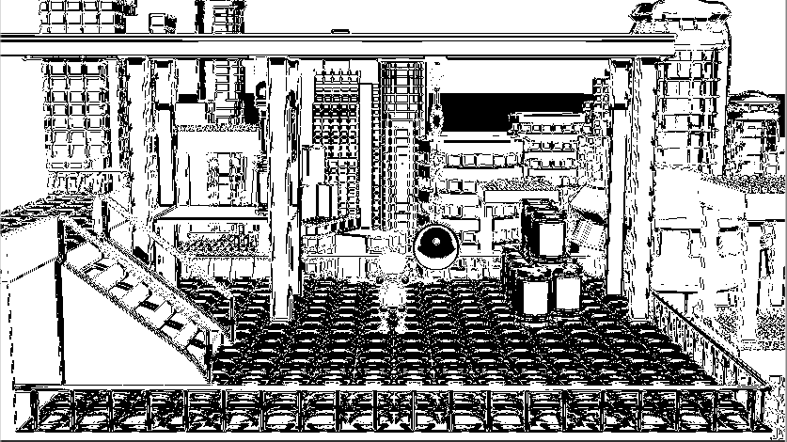
Contours with Laplacian –Edge detecion
Try it!
LaplaceThreshold = 0.184
gradientThreshold = 0.104
LaplaceThreshold = 0.184
gradientThreshold = 0.016

Slide 29
Contours with Laplacian – Smooth Edges
New variables in C# script
public class ContoursLaplace : PostEffectsBase {
[Range(0, 0.5f)]
public float LaplaceFalloff = 0.01f;
[Range(0, 0.5f)]
public float gradientFalloff= 0.01f;
…
void OnRenderImage(RenderTexture source, RenderTexture destination)
{
…
material.SetFloat("gradientThreshold", gradientThreshold);
material.SetFloat("LaplaceFalloff", LaplaceFalloff);
material.SetFloat("gradientFalloff", gradientFalloff);
Graphics.Blit(tmp, destination, material, 1);
RenderTexture.ReleaseTemporary(tmp);

Slide 30
Contours with Laplacian – Smooth Edges
In shader replace step() with smoothstep()
Introduce smooth weighting both in Laplacian and in gradient magnitude thresholding
float edgeValue = 1.0 - step(LaplaceThreshold, abs(Lapl));
float edgeValue = 1.0 - smoothstep(LaplaceThreshold, LaplaceThreshold + LaplaceFalloff, abs(Lapl));
edgeValue *= step(gradientThreshold, gradMag);
edgeValue *= smoothstep(max(0,gradientThreshold-gradientFalloff), gradientThreshold + gradientFalloff, gradMag);

Slide 31
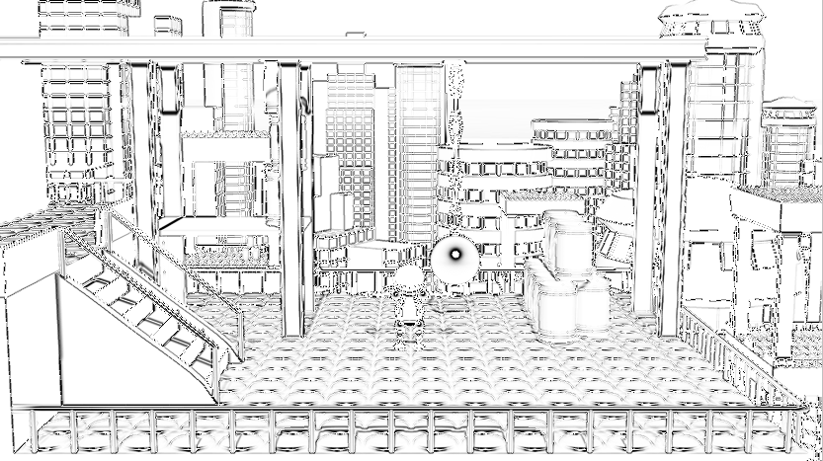
Contours with Laplacian – Smooth Edges
Try it!
LaplaceThreshold
= 0.11
LaplaceFalloff
= 0.288
gradientThreshold
= 0.088
gradientFalloff
= 0.264

Slide 32
Laplacian of Gaussian
Smooth the luminance image before Laplacian edge detection with a Gaussian blur
Gaussian and Laplacian can be convolved: Laplacian of Gaussian (LoG):
LoG can be calculated with a single convolution

Slide 33
Laplacian of Gaussian
Add new variable to C# script
[Range(0, 5.0f)]
public float sigma = 1.0f;
…
material.SetFloat("gradientFalloff", gradientFalloff);
material.SetFloat("sigma", sigma);
Graphics.Blit(tmp, destination, material, 1);

Slide 34
Laplacian of Gaussian
float sigma;
//Laplacian of Gaussian
float LoG(float d, float sigma)
{
float t = -(d*d) / (2 * sigma*sigma);
return -1.0 / (sigma*sigma*sigma*sigma*3.14) * (1.0+t) * exp(t);
}
float4 frag(v2f i) : SV_Target {
float Lapl;
if (sigma == 0)
{
Lapl = tex2D(_MainTex, i.uv + _MainTex_TexelSize * float2(1, 0)).r
+ tex2D(_MainTex, i.uv + _MainTex_TexelSize * float2(0, 1)).r
+ tex2D(_MainTex, i.uv + _MainTex_TexelSize * float2(-1, 0)).r
+ tex2D(_MainTex, i.uv + _MainTex_TexelSize * float2(0, -1)).r
- 4 * tex2D(_MainTex, i.uv).r;
}
else
{
float3 SUM = float3(0, 0, 0);
float SUMW = 0;
for (int iy = -5; iy <= 5; iy++)
for (int ix = -5; ix <= 5; ix++)
{
float2 uv = i.uv + _MainTex_TexelSize.xy * float2(ix, iy);
float3 col = tex2D(_MainTex, uv).rgb;
float w = LoG(length((i.uv - uv) / _MainTex_TexelSize.xy), sigma);
SUMW += w;
SUM += col*w;
}
SUM /= SUMW;
Lapl = SUM;
}
…
In shader modify the calculation of Lapl variable
If sigma is zero (no smoothing), use original Laplace operator
Convolve in a 11x11 convolution window with the LoG kernel

Slide 35
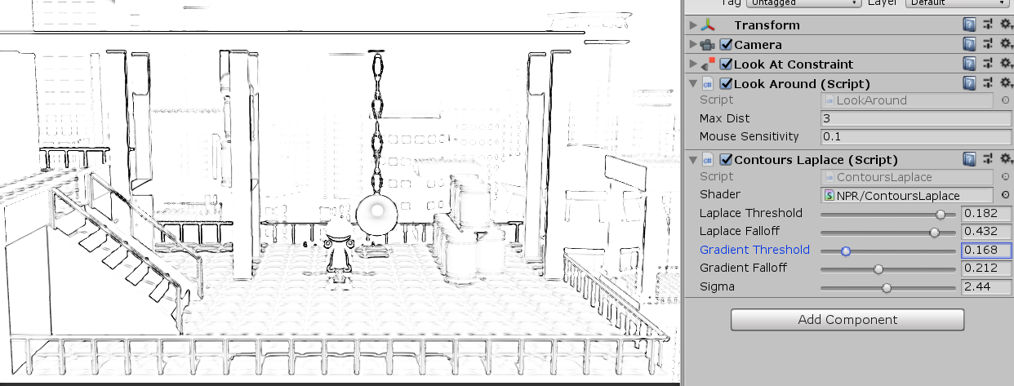
Laplacian of Gaussian
Try it!

Slide 36
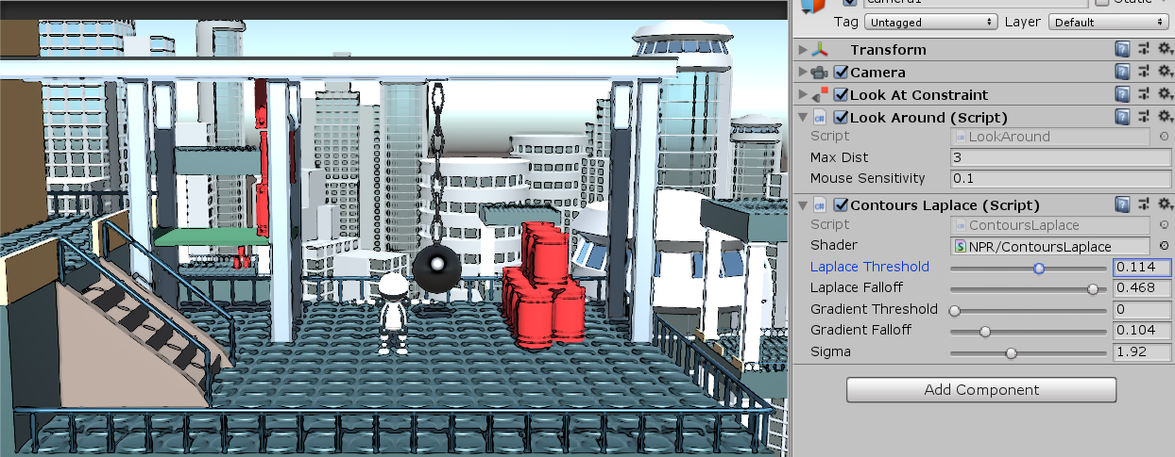
Task
Combine LoG edges with image color!
(We have to bind the original texture to the final shader)

Slide 37
Difference of Gaussians
Create a new C# script and Image Effect Shader
Call them ContoursDoG and ContoursDoGShader
Change the shader name in the shader code
[ExecuteInEditMode]
[RequireComponent(typeof(Camera))]
public class ContoursDoG : PostEffectsBase {
[Range(0, 5.0f)]
public float sigma1 = 1.0f;
[Range(0, 5.0f)]
public float sigma2 = 1.0f;
void Start() {
shader = Shader.Find("NPR/ContoursDoG");
CreateMaterial();
}
void OnRenderImage(RenderTexture source, RenderTexture destination){
//next slide
}
}
Shader "NPR/ContoursDoG"
{
Properties
// ...

Slide 38
Difference of Gaussians – C# script
void OnRenderImage(RenderTexture source, RenderTexture destination)
{
if (CreateMaterial())
{
RenderTexture lum = RenderTexture.GetTemporary(source.width, source.height,0, RenderTextureFormat.DefaultHDR);
Graphics.Blit(source, lum, material, 0);
RenderTexture G1 = RenderTexture.GetTemporary(source.width, source.height, 0, RenderTextureFormat.DefaultHDR);
material.SetFloat("sigma", sigma1);
Graphics.Blit(lum, G1, material, 1);
RenderTexture G2 = RenderTexture.GetTemporary(source.width, source.height, 0, RenderTextureFormat.DefaultHDR);
material.SetFloat("sigma", sigma2);
Graphics.Blit(lum, G2, material, 1);
material.SetTexture("Gauss1Tex", G1);
material.SetTexture("Gauss2Tex", G2);
Graphics.Blit(source, destination, material, 2);
RenderTexture.ReleaseTemporary(lum);
RenderTexture.ReleaseTemporary(G1);
RenderTexture.ReleaseTemporary(G2);
}
else
{
Graphics.Blit(source, destination);
}
}

Slide 39
Difference of Gaussians – Shader
Shader "NPR/ContoursDoG"
{
Properties
{
_MainTex ("Texture", 2D) = "white" {}
}
SubShader
{
// No culling or depth
Cull Off ZWrite Off ZTest Always
Pass
{
…
}
Pass
{
…
}
Create a three pass shader
(copy-paste the pass in the basic shader twice)
Copy – Paste
2X

Slide 40
Difference of Gaussians - Shader – Pass1
Luminance calculation (same as in Laplacian shader)
sampler2D _MainTex;
float4 frag(v2f i) : SV_Target
{
float L = dot(tex2D(_MainTex, i.uv).rgb, float3(0.2126, 0.7152, 0.0722));
return float4(L,L,L,1);
}

Slide 41
Difference of Gaussians - Shader - Pass2
sampler2D _MainTex;
float4 _MainTex_TexelSize;
float sigma;
float Gauss(float d, float sigma)
{
return 1.0 / (sigma*sqrt(2.0*3.14)) * exp((-d*d) / (2.0*sigma*sigma));
}
float4 frag(v2f i) : SV_Target
{
float3 SUM = float3(0,0,0);
float SUMW = 0;
if (sigma == 0)
SUM = tex2D(_MainTex, i.uv).rgb;
else
{
for (int iy = -5; iy <= 5; iy++)
for (int ix = -5; ix <= 5; ix++)
{
float2 uv = i.uv + _MainTex_TexelSize.xy * float2(ix, iy);
float3 col = tex2D(_MainTex, uv).rgb;
float w = Gauss(length((i.uv - uv) / _MainTex_TexelSize.xy), sigma);
SUMW += w;
SUM += col*w;
}
SUM /= SUMW;
}
return float4(SUM, 1);
}
Convolve in a 11x11 convolution window with the Gaussian kernel

Slide 42
Difference of Gaussians - Shader – Pass3
Take the difference of the two Gaussian blurred image
sampler2D _MainTex;
sampler2D Gauss1Tex;
sampler2D Gauss2Tex;
float4 frag (v2f i) : SV_Target
{
float G1 = tex2D(Gauss1Tex, i.uv).r;
float G2 = tex2D(Gauss2Tex, i.uv).r;
float DoG = abs(G1 - G2);
return float4(DoG,DoG,DoG,1);
}

Slide 43
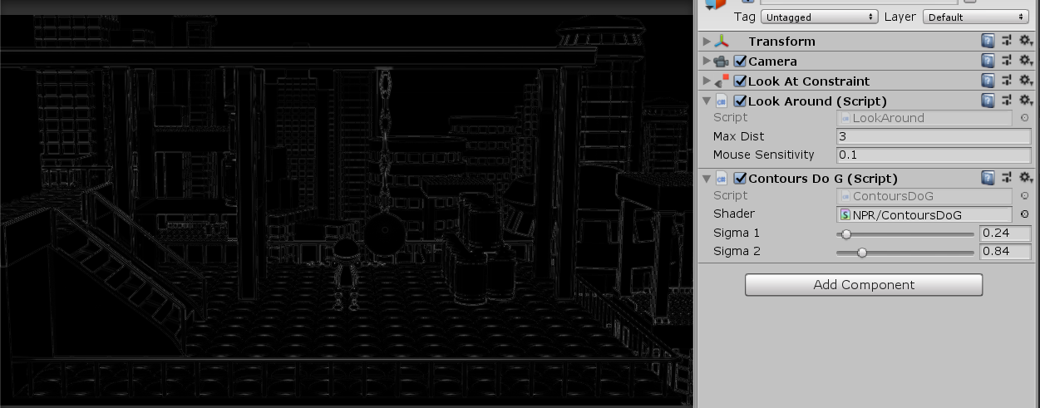
Difference of Gaussians
Attach it to the main camera and try it!
(disable or delete ContoursLaplace script)

Slide 44
Difference of Gaussians – Edge Detection
Add new member variables in C# script and pass them to final shader
[Range(0, 0.2f)]
public float DoGThreshold = 0.01f;
[Range(0, 0.2f)]
public float diffThreshold = 0.01f;
Zero crossing threshold
Flat area threshold
Graphics.Blit(lum, G2, material, 1);
material.SetTexture("Gauss1Tex", G1);
material.SetTexture("Gauss2Tex", G2);
material.SetFloat("DoGThreshold", DoGThreshold);
material.SetFloat("diffThreshold", diffThreshold);
Graphics.Blit(source, destination, material, 2);

Slide 45
Difference of Gaussians – Edge Detection
sampler2D _MainTex;
float4 _MainTex_TexelSize;
sampler2D Gauss1Tex;
sampler2D Gauss2Tex;
float DoGThreshold;
float diffThreshold;
In shader
edgeValue = 0 -> not a contour
edgevalue = 1 -> contour
float4 frag (v2f i) : SV_Target
{
float G1 = tex2D(Gauss1Tex, i.uv).r;
float G2 = tex2D(Gauss2Tex, i.uv).r;
float DoG = abs(G1 - G2);
float edgeValue = 1.0 - step(DoGThreshold, DoG);
float gradX = tex2D(_MainTex, i.uv + _MainTex_TexelSize*float2(1, 0)).r
- tex2D(_MainTex, i.uv + _MainTex_TexelSize*float2(-1, 0)).r;
float gradY = tex2D(_MainTex, i.uv + _MainTex_TexelSize*float2(0, 1)).r
- tex2D(_MainTex, i.uv + _MainTex_TexelSize*float2(0, -1)).r;
float gradMag = length(float2(gradX, gradY));
edgeValue *= step(diffThreshold, gradMag);
edgeValue = 1.0 - edgeValue; //make black contours on white background
return float4(edgeValue, edgeValue, edgeValue, 1);
}
Zero crossing threshold
Flat area threshold
Using gradient magnitudes
(central differenes)

Slide 46
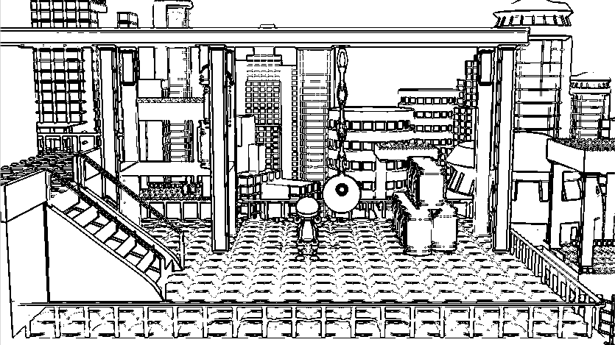
Difference of Gaussians – Edge Detection
Try it!

Slide 47
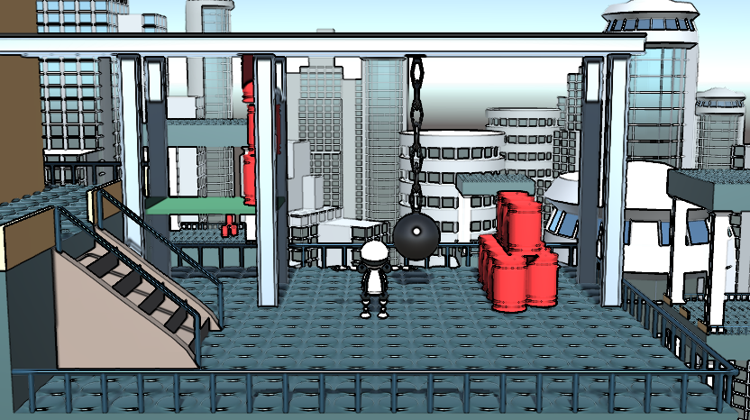
Tasks
Create smooth edges (DoGFalloff and gradientFalloff)
combine with color image

Slide 48
Object Space Contours

Slide 49
Per Pixel Contour detection
Check the angle between view direction and normal vector
If they are almost perpendicular darken the output color
Fast solution is to check dot(N,V), if both N and V are normalized
This check should be inserted to the fragment shader
We need a new surface shader to test it
We use our toon shading as a base
Original toon shader is already included in the starting project, under Assets/Lab01/ToonShadingShader.shader

Slide 50
Per Pixel Contour detection
Create a new Unlit shader and name it ToonShaderWithContour
Shader "NPR/ToonShaderWithContours"
{
Properties
{
_MainTex ("Texture", 2D) = "white" {}
}
SubShader
{
Tags { "RenderType"="Opaque" "LightMode"="ForwardBase" }
LOD 100
Pass
{
Continued …

Slide 51
CGPROGRAM
#pragma vertex vert_toon
#pragma fragment frag_toon
#include "UnityCG.cginc"
struct appdata
{
float4 vertex : POSITION;
float3 normal : NORMAL;
};
struct v2f_toon
{
float3 normal : NORMAL;
float3 viewDir : TEXCOORD0;
float3 lightDir : TEXCOORD1;
float4 vertex : SV_POSITION;
};
Continued …

Slide 52
v2f_toon vert_toon(appdata v)
{
v2f_toon o;
o.vertex = UnityObjectToClipPos(v.vertex);
o.normal = UnityObjectToWorldNormal(v.normal);
o.viewDir = WorldSpaceViewDir(v.vertex);
o.lightDir = WorldSpaceLightDir(v.vertex);
return o;
}
sampler2D _MainTex;
float4 frag_toon(v2f_toon i) : SV_Target
{
float3 N = normalize(i.normal);
float3 L = normalize(i.lightDir);
float NdL = dot(N, L);
float4 col = tex2D(_MainTex, float2(NdL, 0.5));
return col;
}
ENDCG
}
}
}
End of shader file

Slide 53
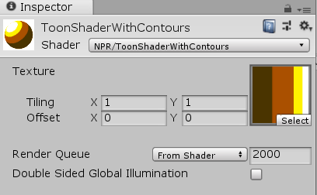
Per Pixel Contour detection
Create new material and name it ToonShaderWithContour
Change the shader of the new material to NPR/ToonShaderWithContour
Bind a toon texture from the assets of the first practice
Assets/Lab01/toonshading-color-ramp.png

Slide 54
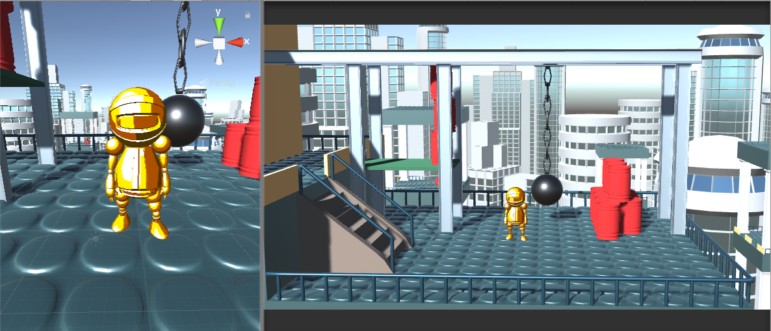
Per Pixel Contour detection
Apply the new material to the Robo
(drag and drop the material to group3 under Robo in the Hierarchy view)
(disable or delete ContoursDoG script on camera)

Slide 55
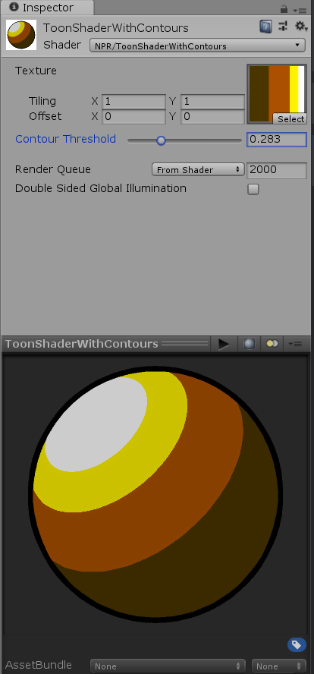
Per Pixel Contour detection
Modify the Toon shader
Add new property
Use it in the fragment shader
Properties
{
_MainTex ("Texture", 2D) = "white" {}
contourThreshold ("Contour Threshold", Range(0.0,1.0)) = 0.0
float contourThreshold;
float4 frag_toon(v2f_toon i) : SV_Target
{
float3 N = normalize(i.normal);
float3 L = normalize(i.lightDir);
float NdL = dot(N, L);
float4 col = tex2D(_MainTex, float2(NdL, 0.5));
float3 V = normalize(i.viewDir);
float edgeValue = step(contourThreshold, dot(N,V));
col.rgb *= edgeValue;
return col;
}

Slide 56
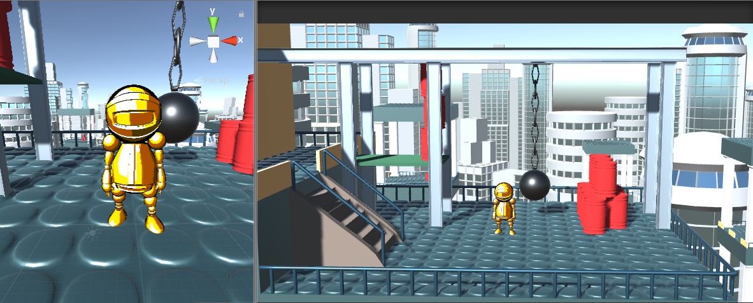
Per Pixel Contour detection
Try it!

Slide 57
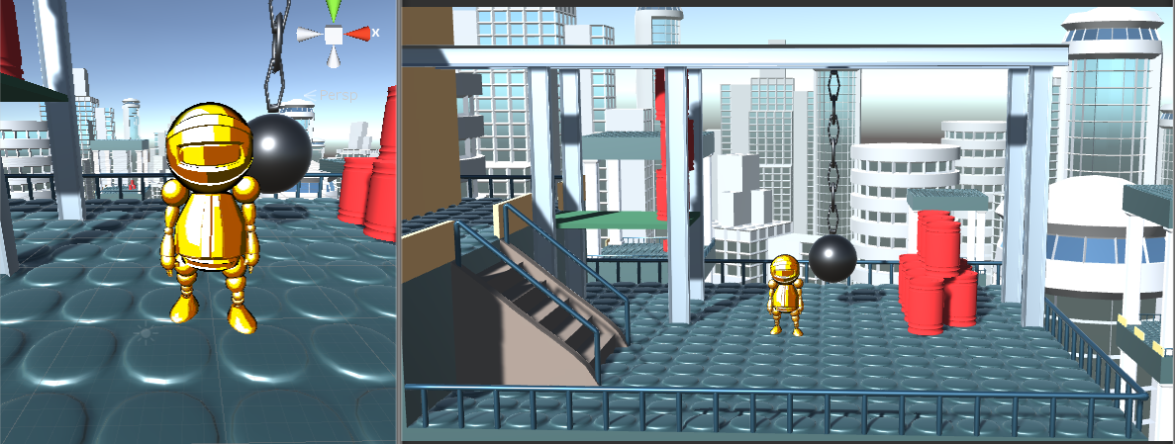
Task
Create a smooth edge (replace step() with smoothstep())

Slide 58
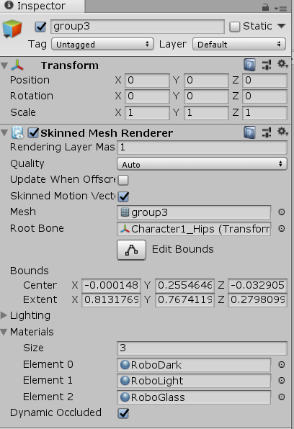
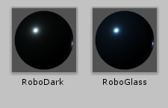
How to apply Per Pixel contours to the whole scene?
We will render the whole scene twice and use shader replacement in the second pass
First restore Robo’s materials
Select group3
Bind the 3 correct materials (from Asset/Materials) to the Material slots

Slide 59
Per Pixel contours for the whole scene
Create a new unlit shader and name it PerPixelContoursReplacementShader
Shader "NPR/PerPixelContoursReplacementShader"
{
Properties
{
contourThreshold("Contour Threshold", Range(0.0,1.0)) = 0.3
contourFalloff("Contour Falloff", Range(0.0,1.0)) = 0.05
}
SubShader
{
Tags{ "RenderType" = "Opaque" "LightMode" = "ForwardBase" }
LOD 100
Pass
{
Cull Off
ZWrite Off
ZTest LEqual
//Blend DstColor Zero
Important!
This shader is rendered after the whole scene is already rendered, and z buffer filled
We can disable Zwrite as no overwrites will happen (we have no closer pixels than in the first render pass)
We set Ztest to less equal to make sure the second rendering passes the z test for closest surfaces
Blending will be used to darken the image with the edge color. First we turn it off to visualize the edge color only.

Slide 60
CGPROGRAM
#pragma vertex vert_contours
#pragma fragment frag_contours
#include "UnityCG.cginc"
struct appdata
{
float4 vertex : POSITION;
float3 normal : NORMAL;
};
struct v2f_toon
{
float3 normal : NORMAL;
float3 viewDir : TEXCOORD0;
float4 vertex : SV_POSITION;
};
v2f_toon vert_contours(appdata v)
{
v2f_toon o;
o.vertex = UnityObjectToClipPos(v.vertex);
o.normal = UnityObjectToWorldNormal(v.normal);
o.viewDir = WorldSpaceViewDir(v.vertex);
return o;
}
Similar to NPR/ToonShaderWithContours, but light direction is not needed

Slide 61
float contourThreshold;
float contourFalloff;
float4 frag_contours(v2f_toon i) : SV_Target
{
float3 N = normalize(i.normal);
float4 col = float4(1,1,1,1);
float3 V = normalize(i.viewDir);
float edgeValue = smoothstep(contourThreshold, contourThreshold + contourFalloff, dot(N,V));
col.rgb *= edgeValue;
return col;
}
ENDCG
}
}
}
Similar to NPR/ToonShaderWithContours, but lighting calculation and texturing is not needed, only contour color is returned

Slide 62
Per Pixel contours for the whole scene
To render the whole scene twice we need a second camera
Duplicate camera1 and name it camera2
(Right click on camera1 in the hierarchy view and select "Duplicate")
Duplication makes the two cameras have identical parameters, like FoV, aspect, clipping planes etc.
It needs the same components, but no image effect components
After duplication it also has the user control scripts so it moves identically to the main camera
The alternative would be to use Camera.CopyFrom in the C# scripts
Add a new script component to it and name the script: WholeScenePerPixelContours
Script contents on next slide …

Slide 63
WholeScenePerPixelContours script
using System.Collections;
using System.Collections.Generic;
using UnityEngine;
[ExecuteInEditMode]
[RequireComponent(typeof(Camera))]
public class WholeScenePerPixelContours : MonoBehaviour {
[Range(0, 1.0f)]
public float contourThreshold;
[Range(0, 1.0f)]
public float contourFalloff;
// Use this for initialization
void Start () {
Camera camera = GetComponent<Camera>();
Shader shader = Shader.Find(" NPR/PerPixelContoursReplacementShader");
camera.SetReplacementShader(shader, "");
}
// Update is called once per frame
void Update () {
Shader.SetGlobalFloat("contourThreshold", contourThreshold);
Shader.SetGlobalFloat("contourFalloff", contourFalloff);
}
}
Here we tell Unity to use our replacement shader when rendering from this camera.
Every object in the scene will be rendered with this shader instead of their own material.
Our replacement shader is not bound to a material, thus we cannot set shader attributes the way we used to.
Shader replacement wants to use attribute values of the material that is replaced. As general materials do not define these attributes, we define them globally (for all materials), and change the global value in each frame.

Slide 64
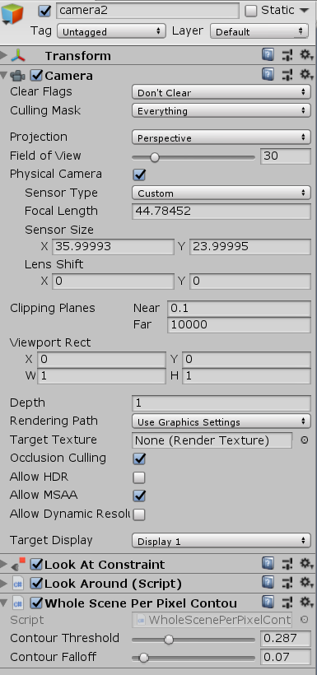
Per Pixel contours for the whole scene
Camera settings for the new camera are important
We have to make sure, that it does not clear the scene before rendering (otherwise the first camera image will be cleared)
We have to make sure that this camera is rendered after the first one
And this is our new script with contour attributes

Slide 65
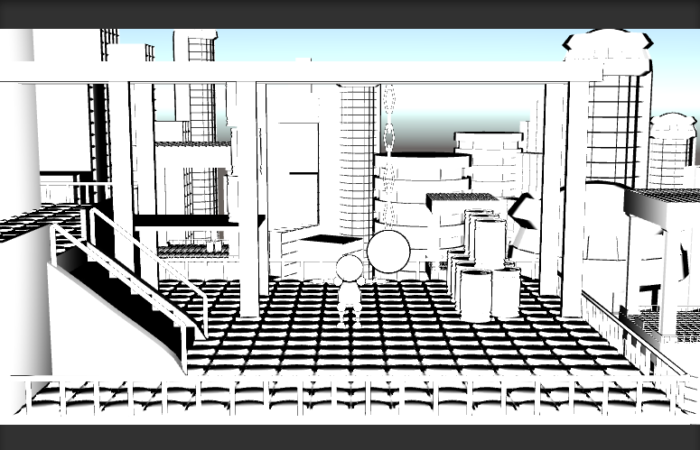
Per Pixel contours for the whole scene
Try it!
Works good for smooth surfaces
Works badly for flat surfaces

Slide 66
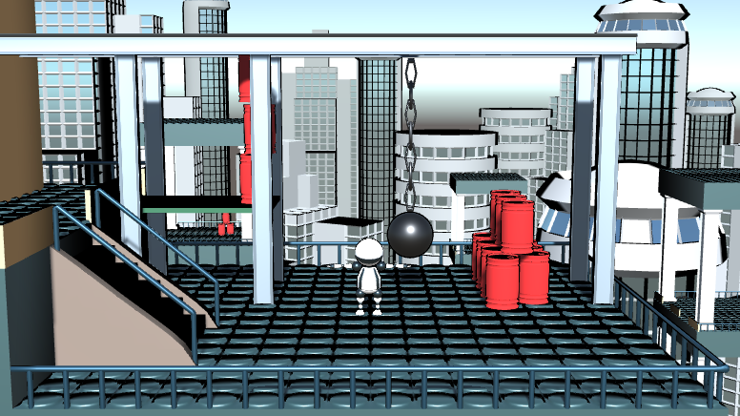
Per Pixel contours for the whole scene
To combine with the image color uncomment the following line from the shader:
//Blend DstColor Zero

