Slide 1
Color effects

Slide 2
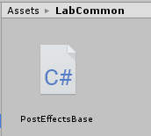
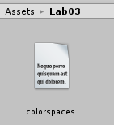
Starting project
Use the starting project of this practical – Pr03-ColorsBaseProject.zip
Contains the PostEffectsBase base class for image effects from last week
Also contains a shader include file colorspaces.cginc

Slide 3
CG include files
We can share code between shader files using CG include files (.cginc extension)
Similar to e.g. C/C++ header files
Should contain include guards, exactly like in C/C++
To include a cginc file in your shader use the #include directive
Just like we included Unity files earlier: #include "UnityCG.cginc"
The colorspaces.cginc file in the starting project contains some basic color space conversion routines
E.g. convert from RGB to HSV and vice versa, we are going to use this in some effects
#ifndef COLORSPACES_INC // This prevents including the file multiple times
#define COLORSPACES_INC // (which could lead to compiler errors)
// Code comes here
#endif

Slide 4
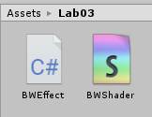
Black & White effect
First effect for today: post processing effect that performs a global luminance thresholding
Create a new C# script and Image Effect Shader
Call them e.g. BWEffect and BWShader
Change the shader name in the shader code (first row)
Shader "NPR/BWShader"
{
Properties
// ...

Slide 5
Black & White effect – C# script
Similar to the post processing effects we saw last week
Use the PostEffectsBase base class
Find the shader and create the material in the Start function
[ExecuteInEditMode]
[RequireComponent(typeof(Camera))]
public class BWEffect : PostEffectsBase {
public float luminanceThreshold = 0.5f;
void Start () {
shader = Shader.Find("NPR/BWShader");
CreateMaterial();
}
// see next slide for OnRenderImage
}
User-controlled threshold between black and white
(In a more sophisticated version, this could be the median or average luminance computed for the current frame. Do it as homework ☺)

Slide 6
Black & White effect – C# script
Similar to the post processing effects we saw last week
OnRenderImage refreshes the material if needed and passes the threshold to the shader
void OnRenderImage(RenderTexture source, RenderTexture destination) {
if (CreateMaterial()) {
material.SetFloat("luminanceThreshold", luminanceThreshold);
Graphics.Blit(source, destination, material);
}
else {
Graphics.Blit(source, destination);
}
}

Slide 7
Black & White effect – Shader
Compute luminance and apply a simple global thresholding
sampler2D _MainTex;
float luminanceThreshold;
float luminance(float3 rgb) {
return 0.2126*rgb.r + 0.7152*rgb.g + 0.0722*rgb.b;
}
float4 frag (v2f i) : SV_Target {
float4 col = tex2D(_MainTex, i.uv);
float lum = luminance(col);
if (lum < luminanceThreshold) return float4(0, 0, 0, 1);
return float4(1, 1, 1, 1);
}

Slide 8
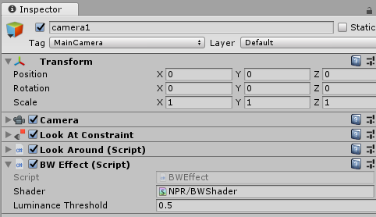
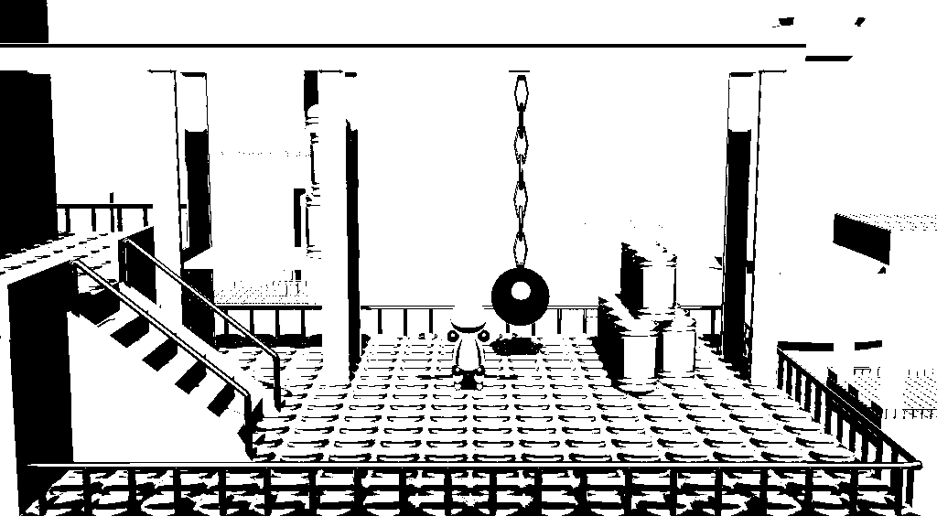
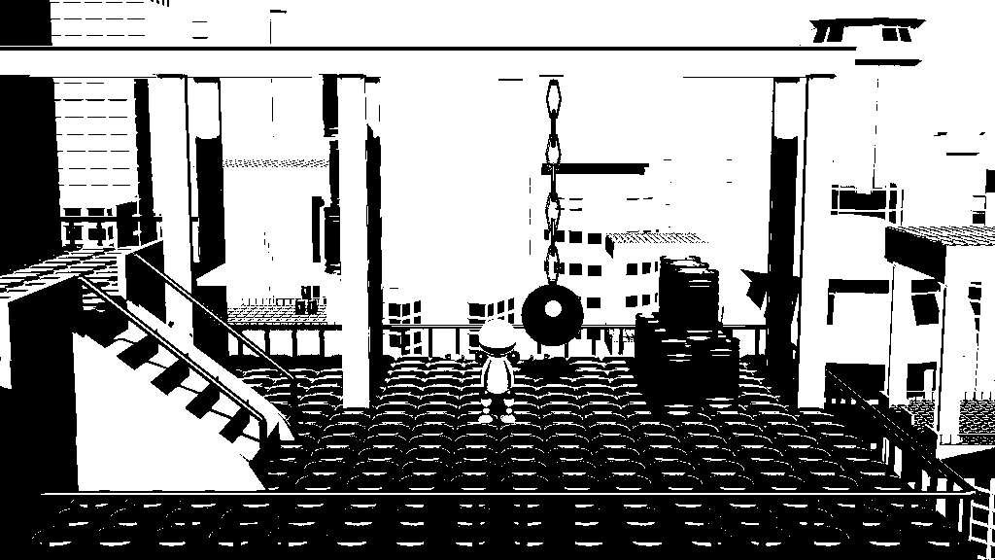
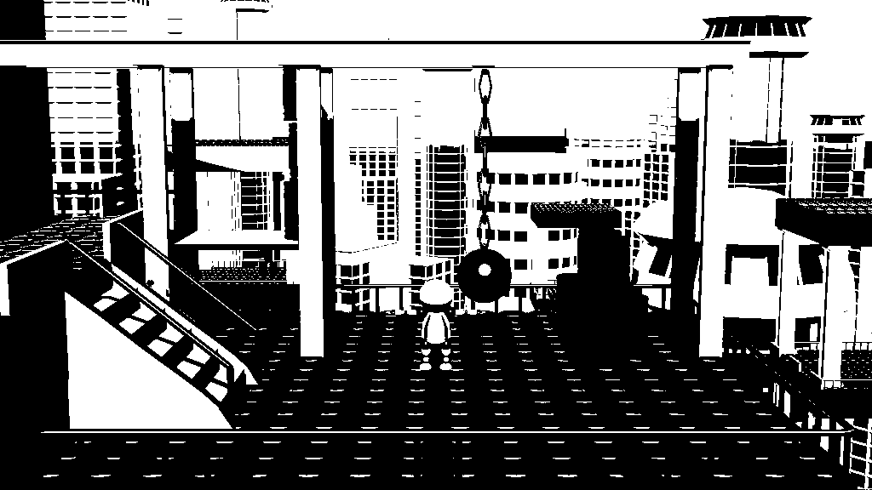
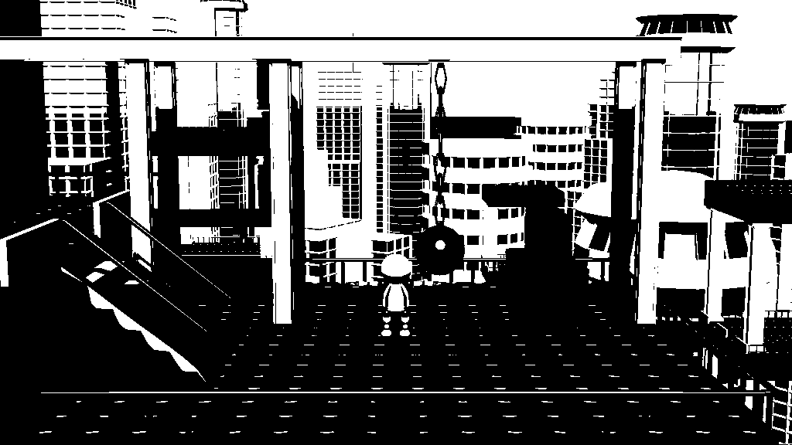
Black & White effect
Attach it to the main camera and try it!
Threshold = 0.4
Threshold = 0.5
Threshold = 0.6
Threshold = 0.7

Slide 9
Black & White effect with local thresholding
Alternative: instead of a globally uniform threshold, compare the pixel luminance to the average of all pixels in a window
Need to use the TexelSize to visit the neighbour texels
Recall: declare _MyTextureName_TexelSize in the shader and Unity fills it automatically with the reciprocal of the texture resolution
sampler2D _MainTex;
float4 _MainTex_TexelSize;
float luminanceThreshold;

Slide 10
Black & White effect with local thresholding
Alternative: instead of a globally uniform threshold, compare the pixel luminance to the average of all pixels in a window
float4 frag (v2f i) : SV_Target {
float4 colPixel = tex2D(_MainTex, i.uv); // color of the current pixel
float4 colAvg = float4(0,0,0,0); // average color of the neighbourhood
int kernelWidth = 9;
float weight = 1.0 / (float)kernelWidth / (float)kernelWidth;
for (int u = -kernelWidth / 2; u <= kernelWidth / 2; ++u) { // visit neighbours (horizontal)
for (int v = -kernelWidth / 2; v <= kernelWidth / 2; ++v) { // visit neighbours (vertical)
colAvg += weight *
tex2D(_MainTex, i.uv + float2(u*_MainTex_TexelSize.x, v*_MainTex_TexelSize.y));
}
}
// if the color is darker than the neighbourhood average -> black, else white
if (luminance(colPixel) < luminance(colAvg)*luminanceThreshold) return float4(0, 0, 0, 1);
return float4(1, 1, 1, 1);
}

Slide 11
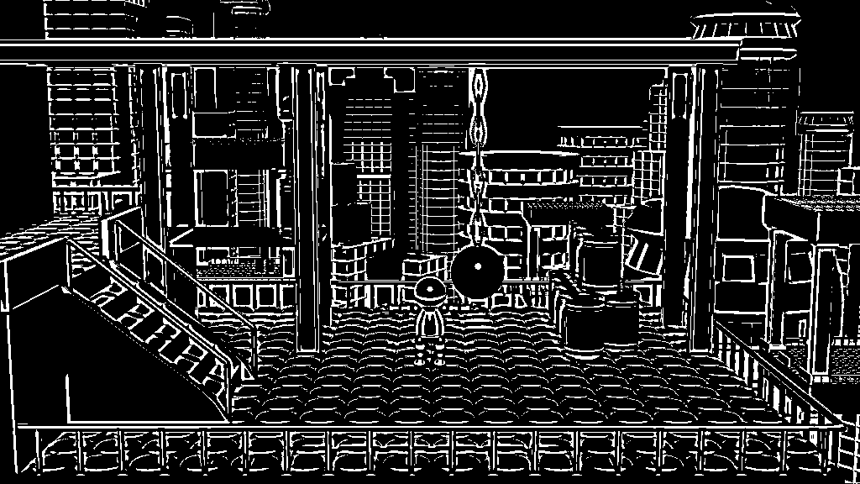
Black & White effect with local thresholding
Set threshold to slightly higher than 1.0 (e.g. 1.1), meaning that pixels that are slightly brighter than the neighbourhood average are set to white

Slide 12
Shader variants
We can have multiple variants of a shader using #if shader preprocessor macros
#pragma multi_compile SOME_KEYWORD SOME_OTHER_KEYWORD
This makes Unity compile our shader twice, once with SOME_KEYWORD define and once with SOME_OTHER_KEYWORD defined.
We can select the variant we need by setting the keyword through the material
The first keyword can be all underscores
Example: this compiles one variant without SOME_KEYWORD and one variant with SOME_KEYWORD defined:
#pragma multi_compile __ SOME_KEYWORD
More on shader variants: https://docs.unity3d.com/Manual/SL-MultipleProgramVariants.html
float4 frag(v2f i) : SV_Target {
#if ADAPTIVE // compile-time conditional, selects which branch is compiled
// do local thresholding
#else
// do global thresholding
#endif
}

Slide 13
Thresholding – Shader variant example
#pragma multi_compile __ ADAPTIVE // compiles with and without ADAPTIVE defined
#pragma vertex vert
#pragma fragment frag
float4 frag(v2f i) : SV_Target{
float4 colPixel = tex2D(_MainTex, i.uv); // color of the current pixel
#if ADAPTIVE // this compiles only when ADAPTIVE keyword is defined
float4 colAvg = float4(0,0,0,0); // average color of the neighbourhood
int kernelWidth = 9;
float weight = 1.0 / (float)kernelWidth / (float)kernelWidth;
for (int u = -kernelWidth / 2; u <= kernelWidth / 2; ++u) { // visit neighbours (horizontal)
for (int v = -kernelWidth / 2; v <= kernelWidth / 2; ++v) { // visit neighbours (vertical)
colAvg += weight *
tex2D(_MainTex, i.uv + float2(u*_MainTex_TexelSize.x, v*_MainTex_TexelSize.y));
}
}
if (luminance(colPixel) < luminance(colAvg)*luminanceThreshold) return float4(0, 0, 0, 1);
#else // this compiles only when ADAPTIVE keyword is not defined
if (luminance(colPixel) < luminanceThreshold) return float4(0, 0, 0, 1);
#endif
return float4(1, 1, 1, 1);
}

Slide 14
Thresholding – Shader variant example
public class BWEffect : PostEffectsBase {
public float luminanceThreshold = 0.5f;
public bool adaptive = false;
void Start () {
shader = Shader.Find("NPR/BWShader");
CreateMaterial();
}
void Update() {
// we can also put these in OnRenderImage, does not matter
if (adaptive) material.EnableKeyword("ADAPTIVE");
else material.DisableKeyword("ADAPTIVE");
}
// ...

Slide 15
Thresholding – Shader variant example
public class BWEffect : PostEffectsBase {
public float luminanceThreshold = 0.5f;
public bool adaptive = false;
void Start () {
shader = Shader.Find("NPR/BWShader");
CreateMaterial();
}
void Update() {
// we can also put these in OnRenderImage, does not matter
if (adaptive) material.EnableKeyword("ADAPTIVE");
else material.DisableKeyword("ADAPTIVE");
}
// ...
material.EnableKeyword("key") selects the shader variant that was compiled with the keyword "key" defined

Slide 16
Thresholding – Shader variant example
public class BWEffect : PostEffectsBase {
public float luminanceThreshold = 0.5f;
public bool adaptive = false;
void Start () {
shader = Shader.Find("NPR/BWShader");
CreateMaterial();
}
void Update() {
// we can also put these in OnRenderImage, does not matter
if (adaptive) material.EnableKeyword("ADAPTIVE");
else material.DisableKeyword("ADAPTIVE");
}
// ...
float4 frag(v2f i) : SV_Target{
// ...
#if ADAPTIVE
// this runs for
// EnableKeyword("ADAPTIVE")
#else
// this runs for
// DisableKeyword("ADAPTIVE")
#endif

Slide 17
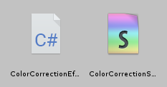
Color correction in HSV
Next effect: playing with the coordinates of HSV
Create a new C# script and an Image Effect Shader
Call them e.g. ColorCorrectionEffect and ColorCorrectionShader
Rename the shader
Shader "NPR/ColorCorrectionShader"
{
Properties

Slide 18
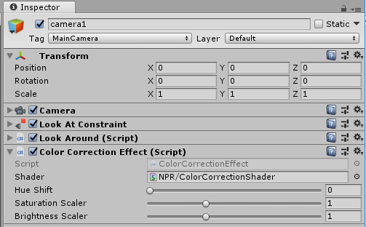
Color correction in HSV – C# script
Have a parameter to shift/scale each coordinates of HSV
[ExecuteInEditMode]
[RequireComponent(typeof(Camera))]
public class ColorCorrectionEffect : PostEffectsBase {
[Range(0.0f, 1.0f)]
public float hueShift = 0.0f;
[Range(0.0f, 3.0f)]
public float saturationScaler = 1.0f;
[Range(0.0f, 3.0f)]
public float brightnessScaler = 1.0f;
void Start () {
shader = Shader.Find("NPR/ColorCorrectionShader");
CreateMaterial();
}

Slide 19
Color correction in HSV – C# script
Pass the parameters to the shader, just like before
void OnRenderImage(RenderTexture source, RenderTexture destination) {
if (CreateMaterial())
{
material.SetFloat("hueShift", hueShift);
material.SetFloat("saturationScaler", saturationScaler);
material.SetFloat("brightnessScaler", brightnessScaler);
Graphics.Blit(source, destination, material);
}
else
{
Graphics.Blit(source, destination);
}
}

Slide 20
Color correction in HSV – Shader
Include the colorspaces.cginc file (included in the starting project)
Convert the pixel RGB color to HSV, apply the correction and the convert back to RGB
#pragma vertex vert
#pragma fragment frag
#include "UnityCG.cginc"
#include "colorspaces.cginc"
sampler2D _MainTex;
float hueShift;
float saturationScaler;
float brightnessScaler;

Slide 21
Color correction in HSV – Shader
Include the colorspaces.cginc file (included in the starting project)
Convert the pixel RGB color to HSV, apply the correction and the convert back to RGB
float4 frag (v2f i) : SV_Target
{
float4 col = tex2D(_MainTex, i.uv);
float3 hsv = rgb_to_hsv(col.xyz); // rgb_to_hsv comes from our colorspaces.cginc
hsv.x = frac(hsv.x + hueShift);
hsv.y *= saturationScaler;
hsv.z *= brightnessScaler;
col.xyz = hsv_to_rgb(hsv); // hsv_to_rgb from our colorspaces.cginc
return col;
}

Slide 22
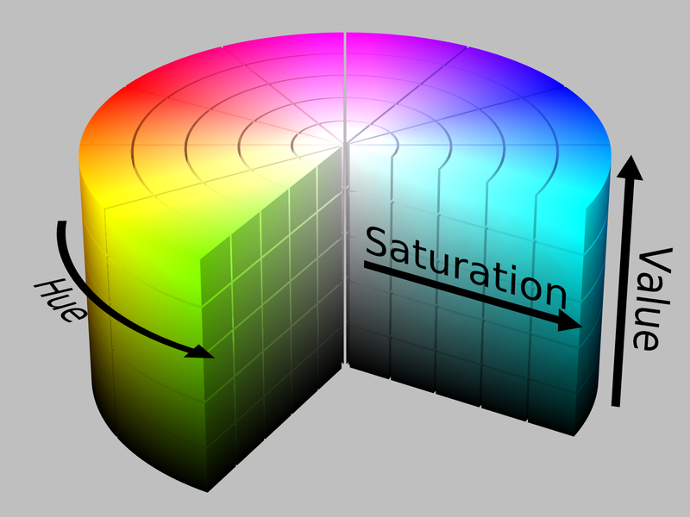
Color correction in HSV – Shader
Include the colorspaces.cginc file (included in the starting project)
Convert the pixel RGB color to HSV, apply the correction and the convert back to RGB
Modified color
Original color
float4 frag (v2f i) : SV_Target
{
float4 col = tex2D(_MainTex, i.uv);
float3 hsv = rgb_to_hsv(col.xyz); // rgb_to_hsv comes from our colorspaces.cginc
hsv.x = frac(hsv.x + hueShift);
hsv.y *= saturationScaler;
hsv.z *= brightnessScaler;
col.xyz = hsv_to_rgb(hsv); // hsv_to_rgb from our colorspaces.cginc
return col;
}
The implementation of this function scales the HSV components to [0,1].
hueShift
Hue is assumed to be periodic, so we take the its fractional part after shifting it.
hueShift is the normalized rotation (hueShift=1 corresponds to 360°)

Slide 23
Color correction in HSV – Shader
Include the colorspaces.cginc file (included in the starting project)
Convert the pixel RGB color to HSV, apply the correction and the convert back to RGB
saturationScaler
Original color
float4 frag (v2f i) : SV_Target
{
float4 col = tex2D(_MainTex, i.uv);
float3 hsv = rgb_to_hsv(col.xyz); // rgb_to_hsv comes from our colorspaces.cginc
hsv.x = frac(hsv.x + hueShift);
hsv.y *= saturationScaler;
hsv.z *= brightnessScaler;
col.xyz = hsv_to_rgb(hsv); // hsv_to_rgb from our colorspaces.cginc
return col;
}
Modified color

Slide 24
Color correction in HSV – Shader
Include the colorspaces.cginc file (included in the starting project)
Convert the pixel RGB color to HSV, apply the correction and the convert back to RGB
Original color
float4 frag (v2f i) : SV_Target
{
float4 col = tex2D(_MainTex, i.uv);
float3 hsv = rgb_to_hsv(col.xyz); // rgb_to_hsv comes from our colorspaces.cginc
hsv.x = frac(hsv.x + hueShift);
hsv.y *= saturationScaler;
hsv.z *= brightnessScaler;
col.xyz = hsv_to_rgb(hsv); // hsv_to_rgb from our colorspaces.cginc
return col;
}
Modified color
brightnessScaler

Slide 25
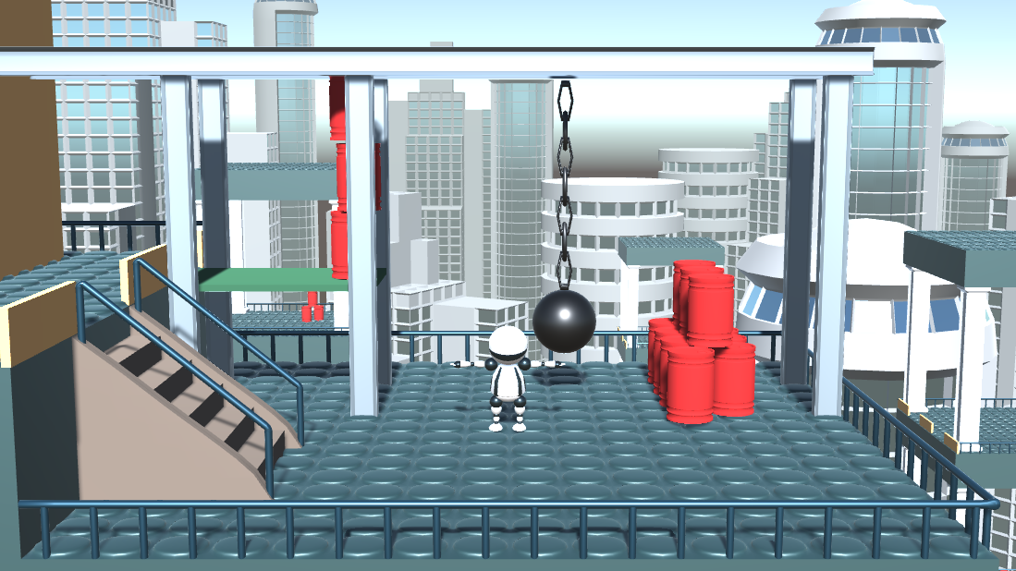
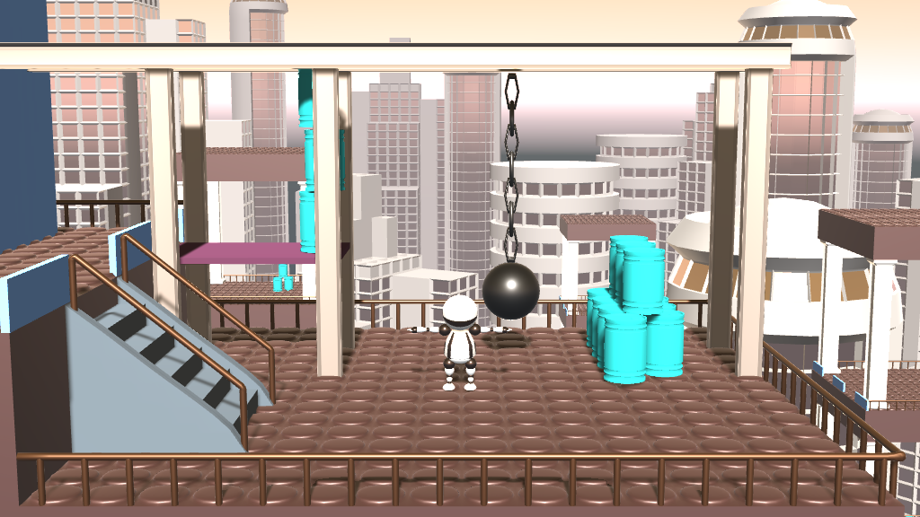
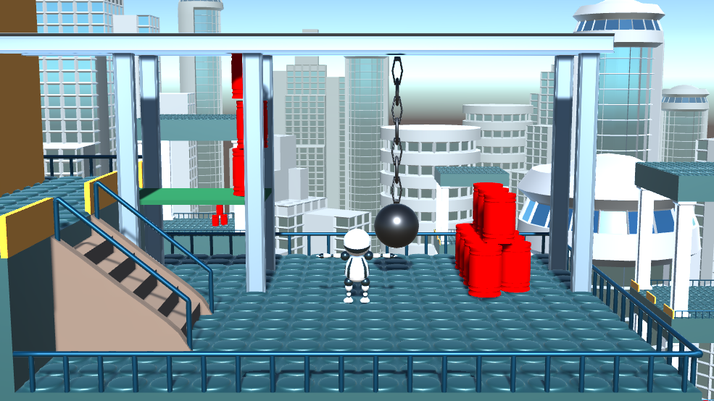
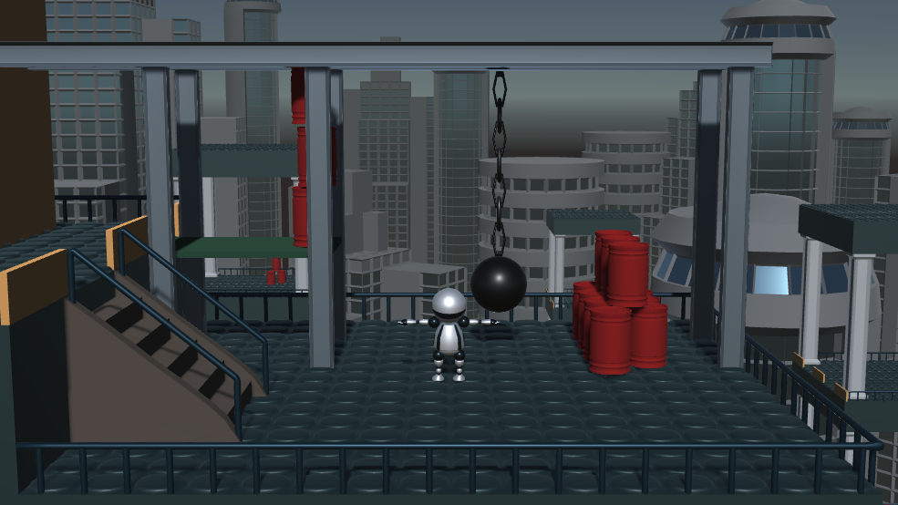
Color correction in HSV – Try it!
Original
hueShift = 0.5
Complementary color!
"Boosted" colors
Decreased brightness

Slide 26
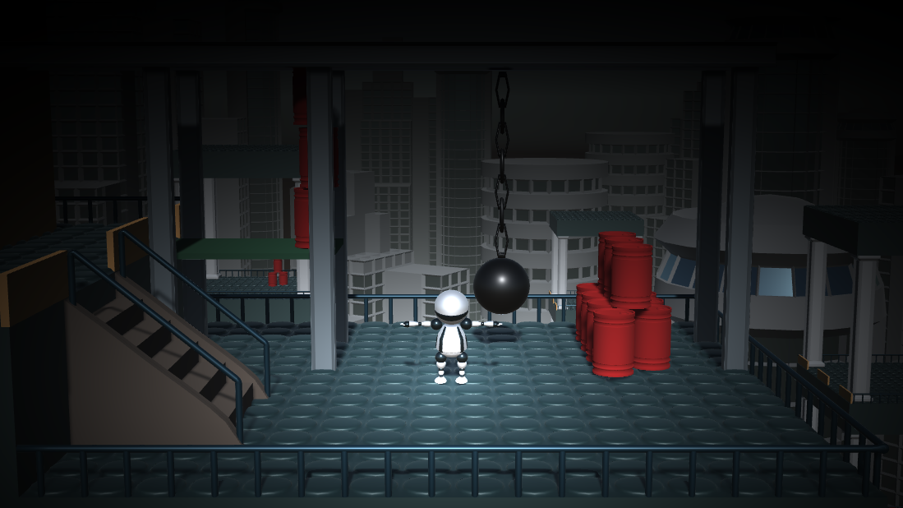
Radial attenuation effect
Goal: fade an attribute of the color radially, from a selected center
Examples: reduced brightness ("chiaroscuro") or saturation
Reduce brigthness based on the distance from a ”center” pixel (e.g. the player)
brightness
distance

Slide 27
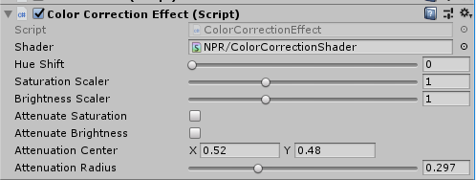
Attenuation: C# script modifications
Add new control parameters for the attenuation effect
public class ColorCorrectionEffect : PostEffectsBase {
[Range(0.0f, 1.0f)]
public float hueShift = 0.0f;
[Range(0.0f, 3.0f)]
public float saturationScaler = 1.0f;
[Range(0.0f, 3.0f)]
public float brightnessScaler = 1.0f;
public bool attenuateSaturation = true;
public bool attenuateBrightness = true;
public Vector2 attenuationCenter = new Vector2(0.5f, 0.5f);
[Range(0.0f, 1.0f)]
public float attenuationRadius = 0.3f;

Slide 28
Attenuation: C# script modifications
Pass new control parameters to the shader
void OnRenderImage(RenderTexture source, RenderTexture destination) {
if (CreateMaterial())
{
material.SetFloat("hueShift", hueShift);
material.SetFloat("saturationScaler", saturationScaler);
material.SetFloat("brightnessScaler", brightnessScaler);
material.SetVector("attenuationCenter", attenuationCenter);
material.SetFloat("attenuationRadius", attenuationRadius);
if (attenuateSaturation) material.EnableKeyword("ATTENUATE_SATURATION");
else material.DisableKeyword("ATTENUATE_SATURATION");
if (attenuateBrightness) material.EnableKeyword("ATTENUATE_BRIGHTNESS");
else material.DisableKeyword("ATTENUATE_BRIGHTNESS");
Graphics.Blit(source, destination, material);
}

Slide 29
Attenuation: shader modifications
Don’t forget to define the shader uniforms
We are also going to need the texel size for aspect correction
sampler2D _MainTex;
float4 _MainTex_TexelSize;
float hueShift;
float saturationScaler;
float brightnessScaler;
float2 attenuationCenter;
float attenuationRadius;

Slide 30
Attenuation function in the shader, version 1.
Goal: a function that has value one at the center point and drops to zero at distance attenuationRadius
Note: uv is in normalized screen coordinates, so [0,1]
(0.5, 0.5) means the center of the screen
attenuation = 1
float attenuation(float2 uv)
{
float dist = length((uv - attenuationCenter));
return clamp(1.0 - dist / attenuationRadius, 0, 1);
}
attenuation = 0
center
dist = 0
dist =
attenuationRadius

Slide 31
Test
Return the attenuation as color for the test
#pragma vertex vert
//#pragma fragment frag // put this back after the test
#pragma fragment frag_show_atten
float4 frag_show_atten (v2f i) : SV_Target
{
float4 col = tex2D(_MainTex, i.uv);
col.xyz = attenuation(i.uv);
return col;
}

Slide 32
Test
float attenuation(float2 uv)
{
float dist = length((uv - attenuationCenter));
return clamp(1.0 - dist / attenuationRadius, 0, 1);
}
The attenuation is not circular but oval
This is because in normalized coordinates a pixel is not a square
uv.y ∈ [0,1]
uv.x ∈ [0,1]

Slide 33
Attenuation function in the shader, version 2.
Let’s take the screen aspect ratio into account
The attenuation function is now isotropic!
aspect ratio
float attenuation(float2 uv)
{
float2 aspectCorrection = float2(1.0, _MainTex_TexelSize.x / _MainTex_TexelSize.y);
float dist = length((uv - attenuationCenter)*aspectCorrection);
return clamp(1.0 - dist / attenuationRadius, 0, 1);
}

Slide 34
Attenuation function in the shader, version 3.
The derivative of the attenuation function is not continuous at 0 and 1
This may sometimes cause visible artifacts
Replace it with a function with smoother derivatives!
attenuation = 1
attenuation = 1
attenuation = 0
attenuation = 0
center
dist = 0
dist =
attenuationRadius
center
dist = 0
dist =
attenuationRadius

Slide 35
Attenuation function in the shader, version 3.
// No need to define this, it is included in
// the CG language
float smoothstep(float a, float b, float x)
{
float t = saturate((x - a)/(b - a));
return t*t*(3.0 - (2.0*t));
}
Use the smoothstep built-in shader function!
http://developer.download.nvidia.com/cg/smoothstep.html
float dist = length((uv - attenuationCenter)*aspectCorrection);
return clamp(1.0 - dist / attenuationRadius, 0, 1);
return smoothstep(0, 1, 1.0 - dist / attenuationRadius);
linear transition
smoothstep

Slide 36
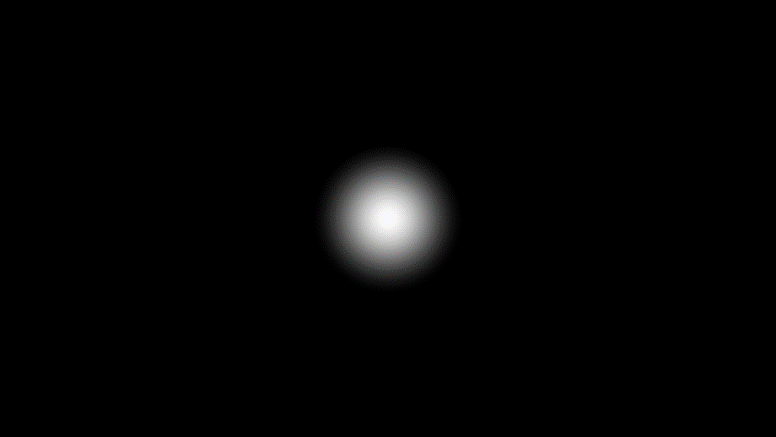
Attenuation function in the shader, test
See how the attenuation function changes with the parameters
Center = (0.2, 0.5)
Radius = 0.3
Center = (0.5, 0.2)
Radius = 0.3
Center = (0.5, 0.5)
Radius = 0.1

Slide 37
Use the attenuation function in color correction
#pragma multi_compile __ ATTENUATE_SATURATION
#pragma multi_compile __ ATTENUATE_BRIGHTNESS
#pragma vertex vert
#pragma fragment frag
float4 frag(v2f i) : SV_Target // extend the previous color correction shader
{
float4 col = tex2D(_MainTex, i.uv);
float3 hsv = rgb_to_hsv(col.xyz);
hsv.x = frac(hsv.x + hueShift);
hsv.y *= saturationScaler;
hsv.z *= brightnessScaler;
#ifdef ATTENUATE_SATURATION // toggled by the C# script with material.EnableKeyword and DisableKeyword
hsv.y *= attenuation(i.uv); // attenuate saturation
#endif
#ifdef ATTENUATE_BRIGHTNESS // toggled by the C# script with material.EnableKeyword and DisableKeyword
hsv.z *= attenuation(i.uv); // attenuate brightness
#endif
col.xyz = hsv_to_rgb(hsv);
return col;
}

Slide 38
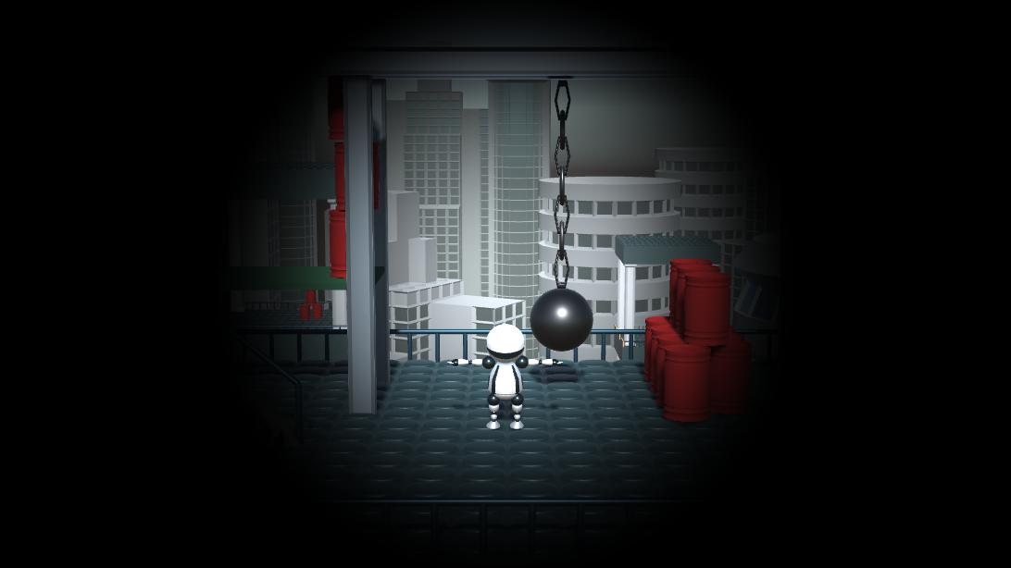
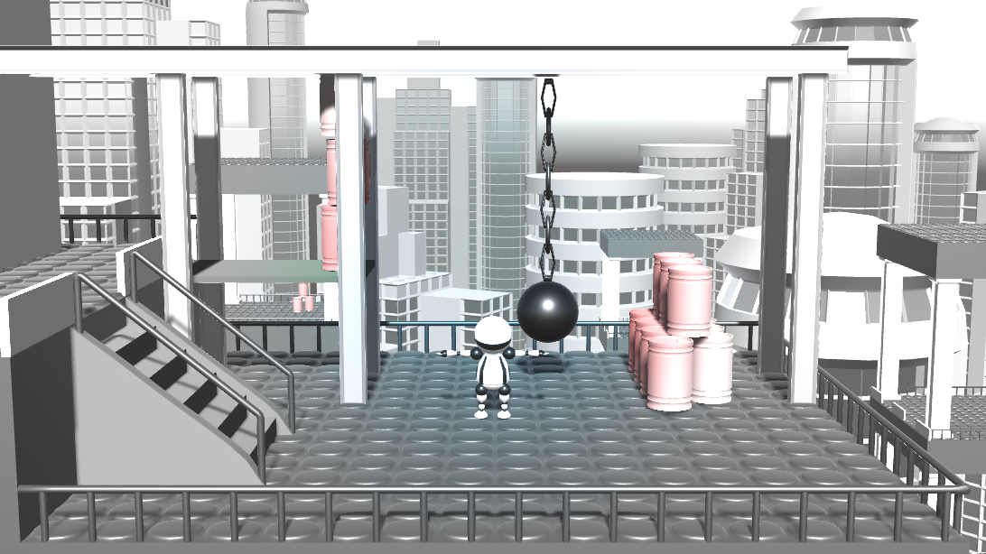
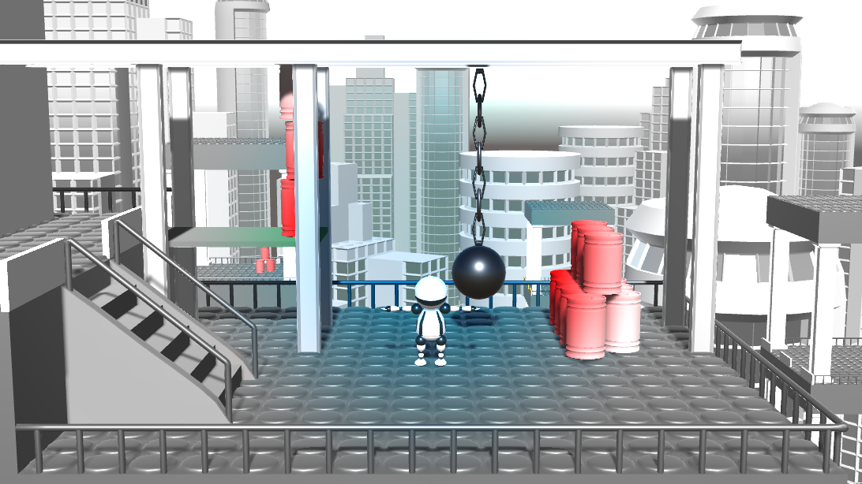
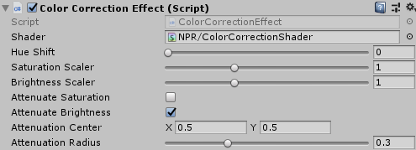
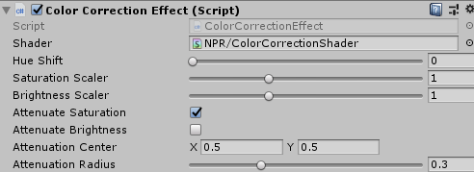
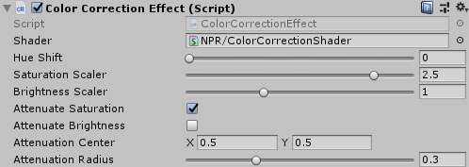
Result
Play with it! Hint: desaturation looks nicer with an increased saturation scaler

Slide 39
Follow an object with the radial fade
Goal: make the attenuation center follow an object
For instance the player
Implementation: set the attenuationCenter to the normalized screen position of the followed object
No need to touch the shader, only the C# script

Slide 40
Follow an object with the radial fade
public Vector2 attenuationCenter = new Vector2(0.5f, 0.5f);
[Range(0.0f, 1.0f)]
public float attenuationRadius = 0.3f;
public Transform followObject;
void Update() {
if (followObject != null) {
Vector3 screenPoint =
GetComponent<Camera>().WorldToScreenPoint(followObject.position);
attenuationCenter = new Vector2(
screenPoint.x / Screen.width,
screenPoint.y / Screen.height
);
}
}

Slide 41
Follow an object with the radial fade
public Vector2 attenuationCenter = new Vector2(0.5f, 0.5f);
[Range(0.0f, 1.0f)]
public float attenuationRadius = 0.3f;
public Transform followObject;
WorldToScreenPoint transforms a 3D point from world space to (integer) pixel coordinates on the screen
void Update() {
if (followObject != null) {
Vector3 screenPoint =
GetComponent<Camera>().WorldToScreenPoint(followObject.position);
attenuationCenter = new Vector2(
screenPoint.x / Screen.width,
screenPoint.y / Screen.height
);
}
}
We need to normalize the pixel coordinates to [0,1]. Screen.width and Screen.height give the resolution of the game window (global variables in Unity).

Slide 42
Follow the robot!
Connect the robot to the followObject parameter

Slide 43
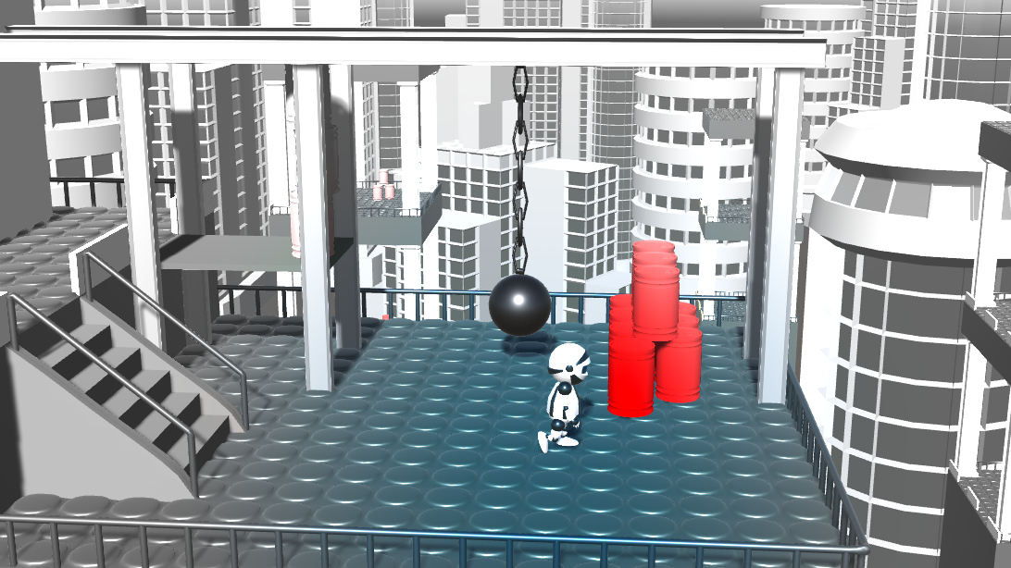
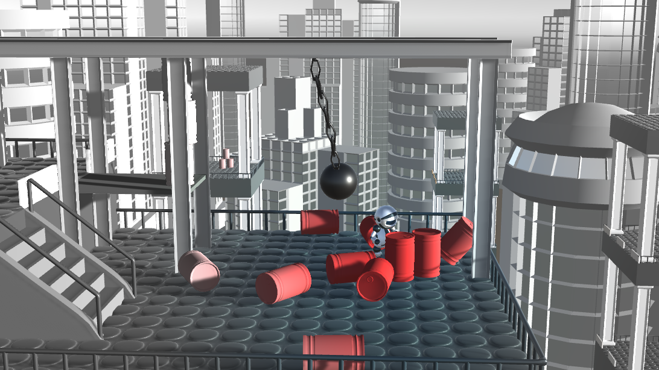
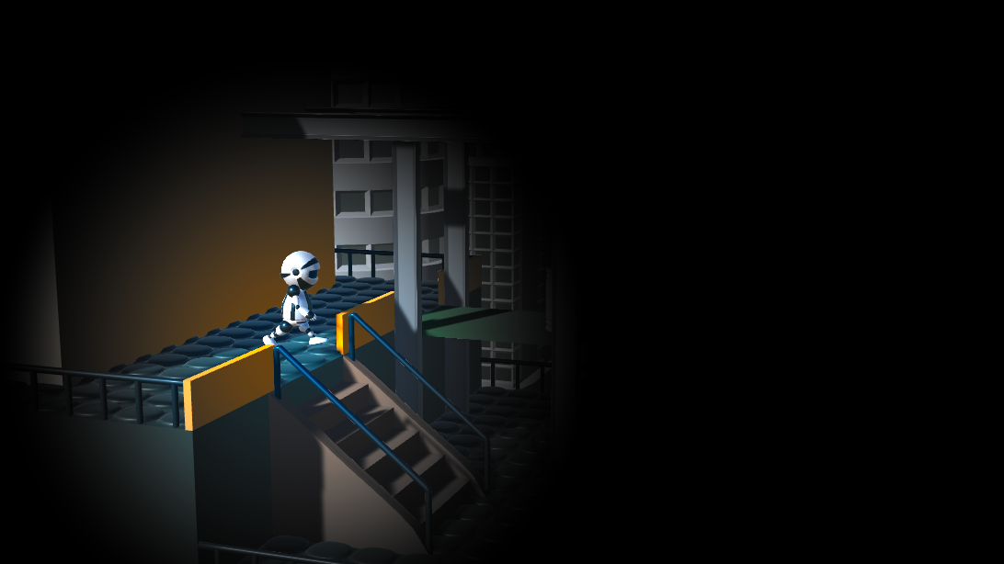
Follow the robot!

Slide 44
Task: shadow recolorization
Implement an effect that combines global thresholding with color correction
Pixels with luminance above threshold are assumed to be lit, they remain unchanged
Pixels with luminance below the threshold are assumed to be in shadow
Shadow color can be e.g. pure black, complementary color, or it can be the original color with very low brightness/saturation (see next slides for examples)
A global luminance threshold of 0.3 works well for this scene
Fragment shader pseudocode:
color = current pixel color;
if luminance(color) > threshold
return color;
else
return shadowColor(color);

Slide 45
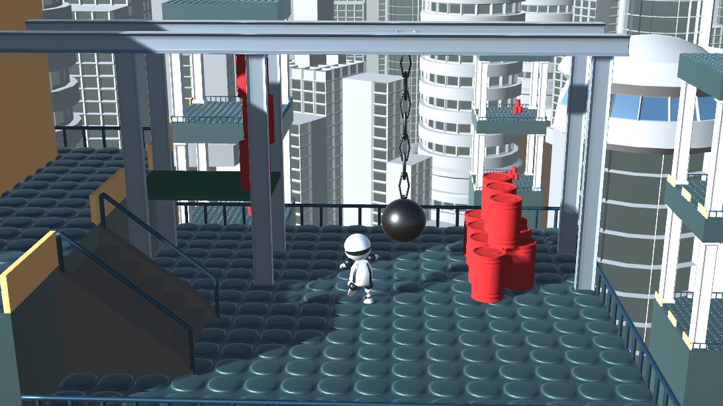
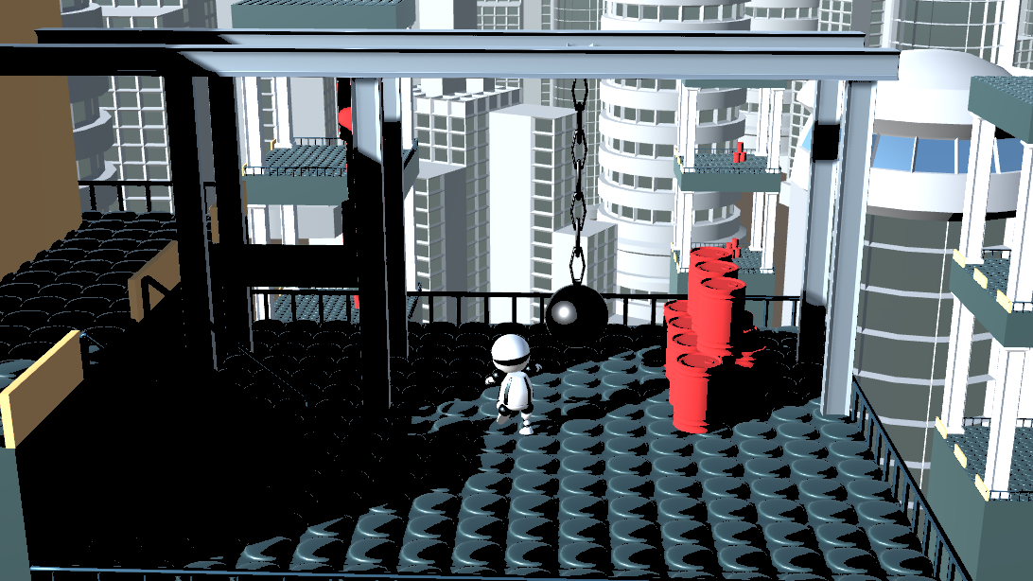
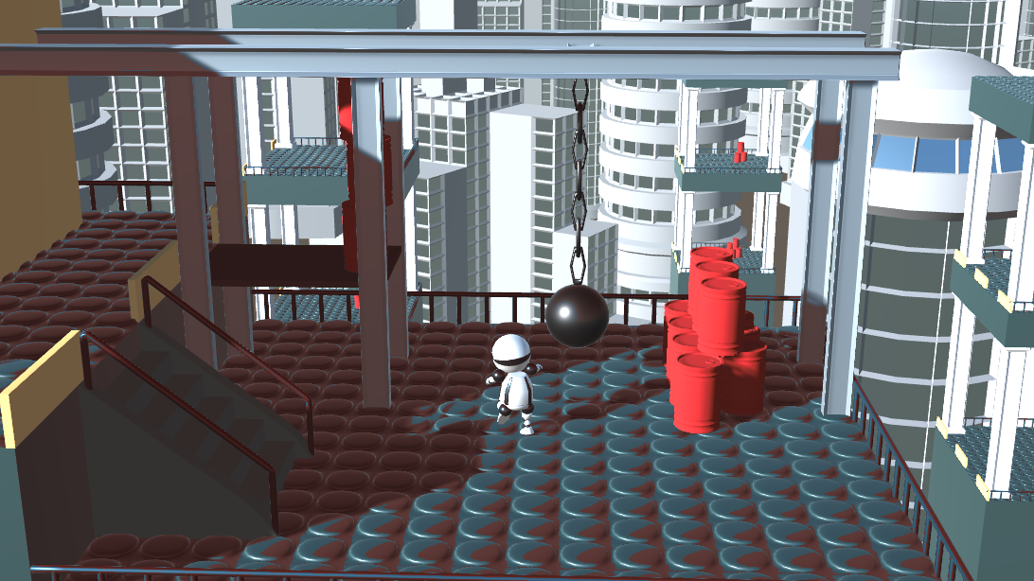
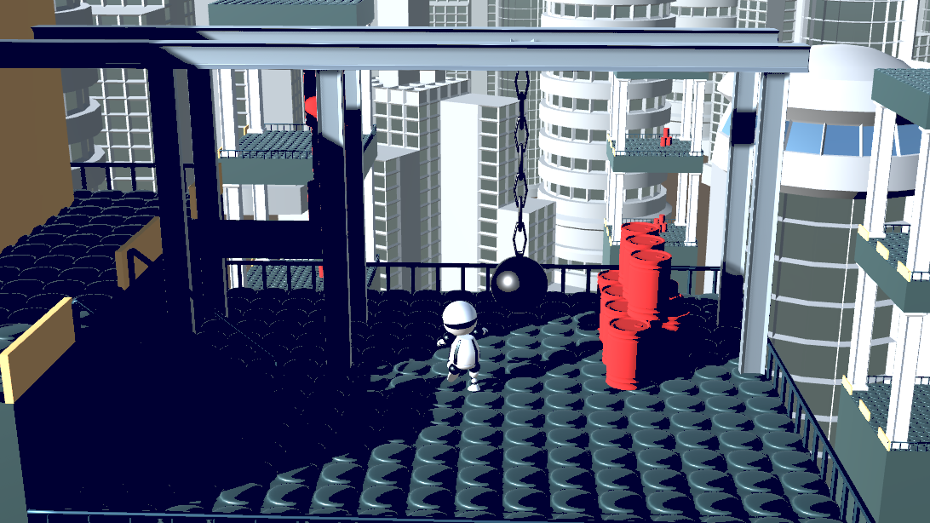
Task – ideas for shadow color
Original image
Constant black
shadows
RGB = (0,0,0)
Constant red hue shadows
(brigthness and saturation is not modified)
HSV.hue = 0.01
Constant dark blue shadows
RGB = (0,0,0.2)

Slide 46
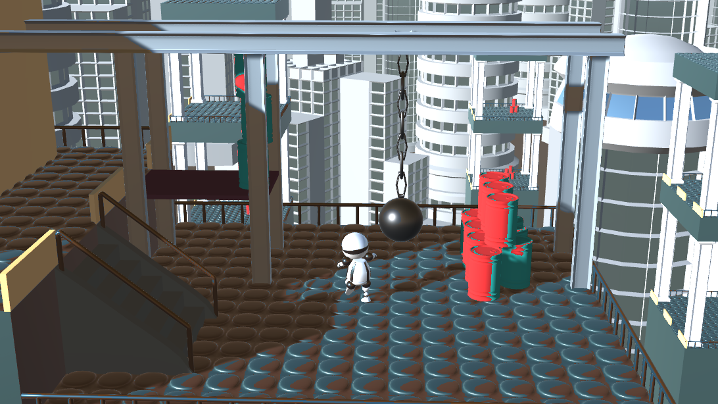
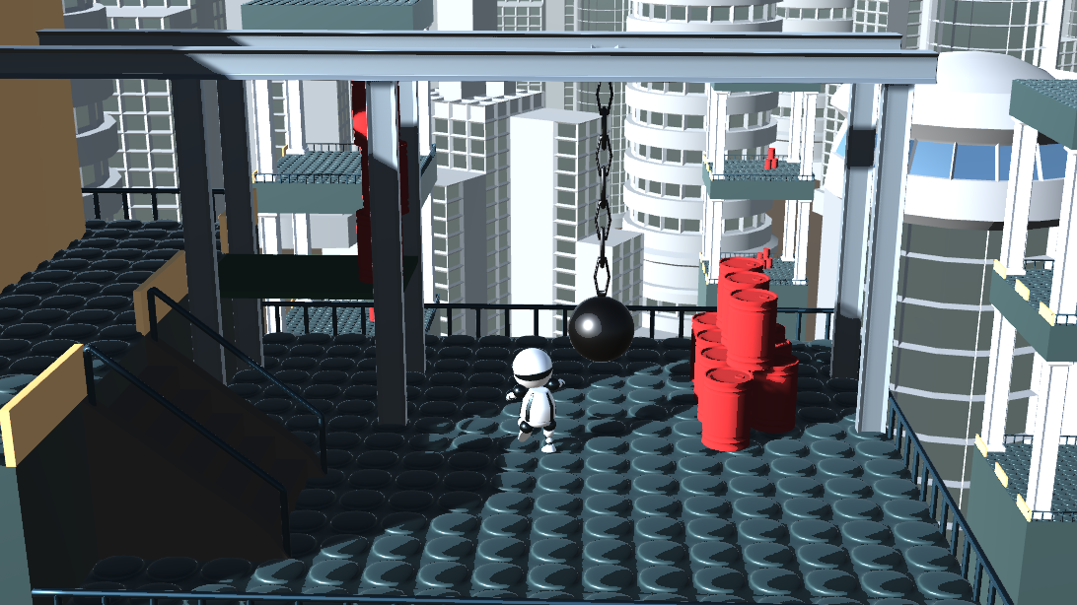
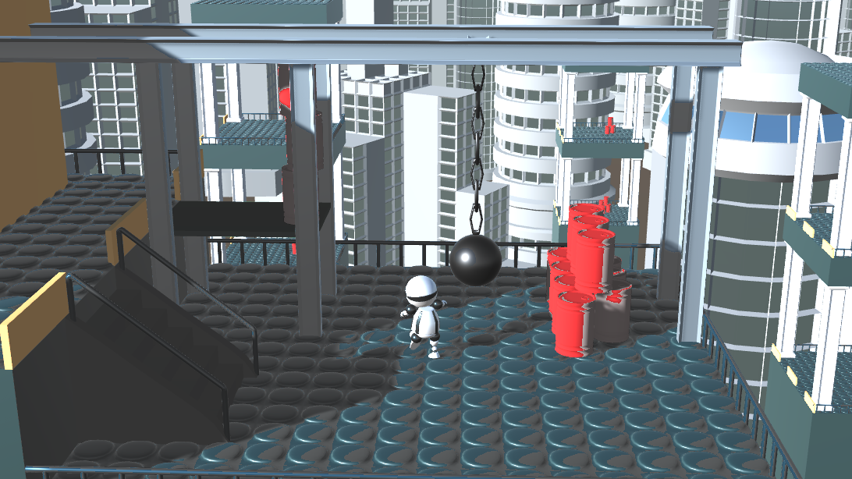
Task – ideas for shadow color
Original image
Complementary color shadows
HSV.hue += 0.5
Reduced brightness shadows
RGB *= 0.5
Desaturated shadows
HSV.sat *= 0.1

Slide 47
Correct shadow recolorization
Note: in this last effect we determine the shadowed pixels by their color
The result is not the same as Unity’s shadow algorithm
A better implementation would use the result of Unity’s shadow calculations
In Unity there is no universal solution to determine which pixels are in shadow that works in every configuration
The implementation of the shadow map algorithm depends on parameters like rendering mode (forward/deferred), type of light etc.
In the shadow recolorization shader we would need to give a different solution for every possible rendering mode, shadow map algorithm etc.
Out of scope for this practical (it would take a full lesson to go through all the details)

