Slide 1
Post processing basics

Slide 2
Base class for image effects
Create new C# script, call it PostEffectsBase
We do not want to attach it to any object ⇒ make it an abstract class
Abstract class: cannot be instantiated
This base class stores the Unity shader and has a method to create the material from the shader, with some extra checks
public abstract class PostEffectsBase : MonoBehaviour {
public Shader shader = null;
protected Material material = null;
// CreateMaterial: see next slide
}

Slide 3
Base class for image effects
protected bool CreateMaterial() {
if (!SystemInfo.supportsImageEffects) {
Debug.LogWarning("Image Effects are not supported on the current platform in " + ToString());
enabled = false;
return false;
}
if (shader == null) {
Debug.LogWarning("No shader is set in " + ToString());
enabled = false;
return false;
}
if (!shader.isSupported) {
Debug.LogWarning("Unsupported shader in " + ToString());
enabled = false;
return false;
}
if (material != null && material.shader == shader) return true;
material = new Material(shader);
material.hideFlags = HideFlags.DontSave;
return material != null;
}

Slide 4
Base class for image effects
protected bool CreateMaterial() {
if (!SystemInfo.supportsImageEffects) {
Debug.LogWarning("Image Effects are not supported on the current platform in " + ToString());
enabled = false;
return false;
}
if (shader == null) {
Debug.LogWarning("No shader is set in " + ToString());
enabled = false;
return false;
}
if (!shader.isSupported) {
Debug.LogWarning("Unsupported shader in " + ToString());
enabled = false;
return false;
}
if (material != null && material.shader == shader) return true;
material = new Material(shader);
material.hideFlags = HideFlags.DontSave;
return material != null;
}
Some platforms may not support post processing effects (image effects) at all, which can be checked with SystemInfo.supportImageEffects

Slide 5
Base class for image effects
protected bool CreateMaterial() {
if (!SystemInfo.supportsImageEffects) {
Debug.LogWarning("Image Effects are not supported on the current platform in " + ToString());
enabled = false;
return false;
}
if (shader == null) {
Debug.LogWarning("No shader is set in " + ToString());
enabled = false;
return false;
}
if (!shader.isSupported) {
Debug.LogWarning("Unsupported shader in " + ToString());
enabled = false;
return false;
}
if (material != null && material.shader == shader) return true;
material = new Material(shader);
material.hideFlags = HideFlags.DontSave;
return material != null;
}
Check if we have set any shader

Slide 6
Base class for image effects
protected bool CreateMaterial() {
if (!SystemInfo.supportsImageEffects) {
Debug.LogWarning("Image Effects are not supported on the current platform in " + ToString());
enabled = false;
return false;
}
if (shader == null) {
Debug.LogWarning("No shader is set in " + ToString());
enabled = false;
return false;
}
if (!shader.isSupported) {
Debug.LogWarning("Unsupported shader in " + ToString());
enabled = false;
return false;
}
if (material != null && material.shader == shader) return true;
material = new Material(shader);
material.hideFlags = HideFlags.DontSave;
return material != null;
}
The isSupported flag of the shader tells if the shader can be compiled for the current platform.
(Either because it uses something that is not supported by the platform OR because the shader programmer made an error).

Slide 7
Base class for image effects
protected bool CreateMaterial() {
if (!SystemInfo.supportsImageEffects) {
Debug.LogWarning("Image Effects are not supported on the current platform in " + ToString());
enabled = false;
return false;
}
if (shader == null) {
Debug.LogWarning("No shader is set in " + ToString());
enabled = false;
return false;
}
if (!shader.isSupported) {
Debug.LogWarning("Unsupported shader in " + ToString());
enabled = false;
return false;
}
if (material != null && material.shader == shader) return true;
material = new Material(shader);
material.hideFlags = HideFlags.DontSave;
return material != null;
}
Lazy material creation: if there is already a material with the same shader do nothing, otherwise continue and create a new material.

Slide 8
Base class for image effects
protected bool CreateMaterial() {
if (!SystemInfo.supportsImageEffects) {
Debug.LogWarning("Image Effects are not supported on the current platform in " + ToString());
enabled = false;
return false;
}
if (shader == null) {
Debug.LogWarning("No shader is set in " + ToString());
enabled = false;
return false;
}
if (!shader.isSupported) {
Debug.LogWarning("Unsupported shader in " + ToString());
enabled = false;
return false;
}
if (material != null && material.shader == shader) return true;
material = new Material(shader);
material.hideFlags = HideFlags.DontSave;
return material != null;
}
Create a material object that uses our current shader.
HideFlags.DontSave simply tells Unity not to save this material to the project (so it will be recreated every time we open the project in Unity or enter play mode). Need this for lazy creation to work properly.

Slide 9
Base class for image effects
protected bool CreateMaterial() {
if (!SystemInfo.supportsImageEffects) {
Debug.LogWarning("Image Effects are not supported on the current platform in " + ToString());
enabled = false;
return false;
}
if (shader == null) {
Debug.LogWarning("No shader is set in " + ToString());
enabled = false;
return false;
}
if (!shader.isSupported) {
Debug.LogWarning("Unsupported shader in " + ToString());
enabled = false;
return false;
}
if (material != null && material.shader == shader) return true;
material = new Material(shader);
material.hideFlags = HideFlags.DontSave;
return material != null;
}
Return value tells whether we could create a material with a valid shader

Slide 10
Base class for image effects
Similar (but much more complex) can be found in the Unity Post Pocessing Stack
https://github.com/Unity-Technologies/PostProcessing/tree/v2/PostProcessing
Similar (but using some obsolete methods) can be found in the Unity Standard Assets, under Effects/Image Effects
https://assetstore.unity.com/packages/essentials/asset-packs/standard-assets-32351
We will use our own base class from the previous slides instead

Slide 11
Luminance quantization effect – Shader
Create a new Unity shader
Assets menu → Create → Shader → Image Effect Shader
Call it e.g. LuminanceQuantization
Edit the shader, change its name to NPR/LuminanceQuantization

Slide 12
Luminance quantization effect – C# Script
Create a new C# script, call it e.g. LumQuantEffect
[ExecuteInEditMode]
[RequireComponent(typeof(Camera))]
public class LumQuantEffect : PostEffectsBase {
void Start() {
shader = Shader.Find("NPR/LuminanceQuantization");
CreateMaterial();
}
void OnRenderImage(RenderTexture source, RenderTexture destination) {
if (CreateMaterial()) {
Graphics.Blit(source, destination, material);
}
else {
Graphics.Blit(source, destination);
}
}
}

Slide 13
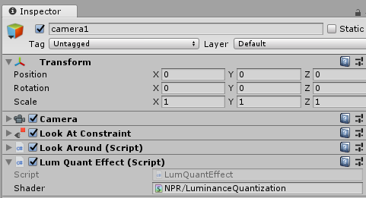
Luminance quantization effect – C# Script
The script will be applied also in editor mode
(The result of the effect is visible in the Game window without pressing the ”Play” button)
Create a new C# script, call it e.g. LumQuantEffect
[ExecuteInEditMode]
[RequireComponent(typeof(Camera))]
public class LumQuantEffect : PostEffectsBase {
void Start() {
shader = Shader.Find("NPR/LuminanceQuantization ");
CreateMaterial();
}
void OnRenderImage(RenderTexture source, RenderTexture destination) {
if (CreateMaterial()) {
Graphics.Blit(source, destination, material);
}
else {
Graphics.Blit(source, destination);
}
}
}
Post processing effects work on the image rendered by the camera, so we require our object to have a Camera component

Slide 14
Luminance quantization effect – C# Script
Create a new C# script, call it e.g. LumQuantEffect
[ExecuteInEditMode]
[RequireComponent(typeof(Camera))]
public class LumQuantEffect : PostEffectsBase {
void Start() {
shader = Shader.Find("NPR/LuminanceQuantization ");
CreateMaterial();
}
void OnRenderImage(RenderTexture source, RenderTexture destination) {
if (CreateMaterial()) {
Graphics.Blit(source, destination, material);
}
else {
Graphics.Blit(source, destination);
}
}
}
Use our previous script as base class, so we have a Shader, a Material and a function to check errors and create the material from the shader

Slide 15
Luminance quantization effect – C# Script
Create a new C# script, call it e.g. LumQuantEffect
We can set our shader in the inspector, or use Shader.Find to load it automatically.
Important note: custom shaders are not included automatically into the build, so if we simply use Shader.Find, our shader will not be included in the build.
To include a shader in the build either:
Refer to it anywhere in the scene (assign it manually to an object)
Or tell Unity to always include it in the build
[ExecuteInEditMode]
[RequireComponent(typeof(Camera))]
public class LumQuantEffect : PostEffectsBase {
void Start() {
shader = Shader.Find("NPR/LuminanceQuantization ");
CreateMaterial();
}
void OnRenderImage(RenderTexture source, RenderTexture destination) {
if (CreateMaterial()) {
Graphics.Blit(source, destination, material);
}
else {
Graphics.Blit(source, destination);
}
}
}
Set manually here
or call Shader.Find in the script

Slide 16
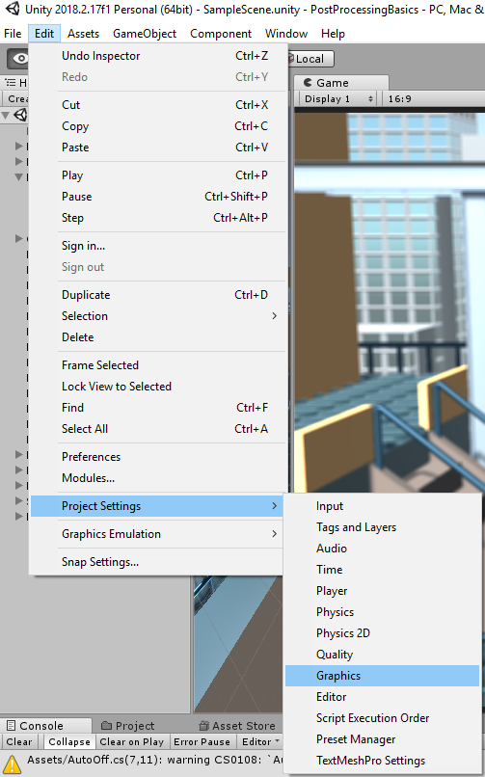
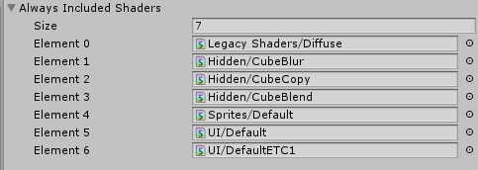
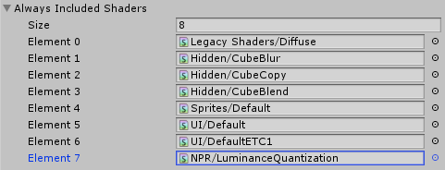
Always include shaders in the build
Edit → Project settings → Graphics
There is a list for shaders to be included into the build, even if there is no reference for them
Do this if you have not assigned your shader manually to any scene objects

Slide 17
Luminance quantization effect – C# Script
Create a new C# script, call it e.g. LumQuantEffect
This is called by Unity after the camera rendered the scene.
source contains the rendered image
destination is where we have to write the result of our post processing effect
[ExecuteInEditMode]
[RequireComponent(typeof(Camera))]
public class LumQuantEffect : PostEffectsBase {
void Start() {
shader = Shader.Find("NPR/LuminanceQuantization ");
CreateMaterial();
}
void OnRenderImage(RenderTexture source, RenderTexture destination) {
if (CreateMaterial()) {
Graphics.Blit(source, destination, material);
}
else {
Graphics.Blit(source, destination);
}
}
}

Slide 18
Luminance quantization effect – C# Script
Create a new C# script, call it e.g. LumQuantEffect
[ExecuteInEditMode]
[RequireComponent(typeof(Camera))]
public class LumQuantEffect : PostEffectsBase {
void Start() {
shader = Shader.Find("NPR/LuminanceQuantization ");
CreateMaterial();
}
void OnRenderImage(RenderTexture source, RenderTexture destination) {
if (CreateMaterial()) {
Graphics.Blit(source, destination, material);
}
else {
Graphics.Blit(source, destination);
}
}
}
If the material was created successfully (i.e. there is a shader and there are no shader errors) we render a full screen quad with our shader (through the material), using Graphics.Blit.
Otherwise just copy the source to the destination texture.
Recall: CreateMaterial does a lazy material creation, so we do not recreate the material in every frame.

Slide 19
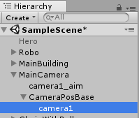
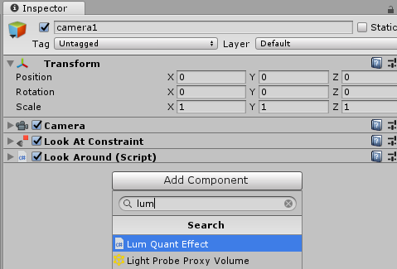
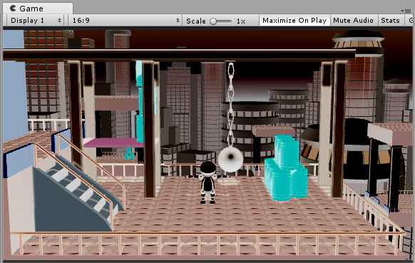
Test the effect
Attach it to the main camera
Look for the object with a Camera component
Colors are inverted!
This is the default behaviour of the Unity Image Effect shader template

Slide 20
Image Effect shader template
Shader "Hidden/DummyShader"
{
Properties
{
_MainTex ("Texture", 2D) = "white" {}
}
SubShader
{
// No culling or depth
Cull Off ZWrite Off ZTest Always
Pass
{
// ...
}
}
}
See first practical
Graphics.Blit(source, ...) binds source to this parameter.
With the full-screen quad rendering exactly one fragment is generated for each pixel of the destination texture in Graphics.Blit(source, destination).
We want to make sure that the full-screen quad survives the triangle culling and all fragments survive the depth test (Z-test), so we disable triangle culling and Z-test.

Slide 21
Image Effect shader template
Pass {
CGPROGRAM
#pragma vertex vert
#pragma fragment frag
#include "UnityCG.cginc"
struct appdata
{
float4 vertex : POSITION;
float2 uv : TEXCOORD0;
};
struct v2f
{
float2 uv : TEXCOORD0;
float4 vertex : SV_POSITION;
};
See first practical: we define which vertex and fragment shader programs to use and we define the input/output data for the vertex shader

Slide 22
Image Effect shader template
v2f vert (appdata v)
{
v2f o;
// could be o.vertex = v.vertex
// (recall: Graphics.Blit sets all matrices to the identity)
o.vertex = UnityObjectToClipPos(v.vertex);
o.uv = v.uv;
return o;
}
Pass-through vertex shader
Output vertex and UV coordinates are the same as the input

Slide 23
Image Effect shader template
sampler2D _MainTex;
fixed4 frag (v2f i) : SV_Target
{
fixed4 col = tex2D(_MainTex, i.uv);
// just invert the colors
col.rgb = 1 - col.rgb;
return col;
}
The actual effect (image processing) is implemented in the fragment shader
For this template it is a simple color inversion, we subtract the colors of the texture from pure white
Graphics.Blit(source, ...) binds source to _MainTex
So in our case _MainTex contains the image that the camera has rendered

Slide 24
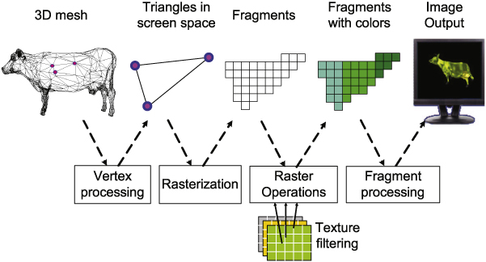
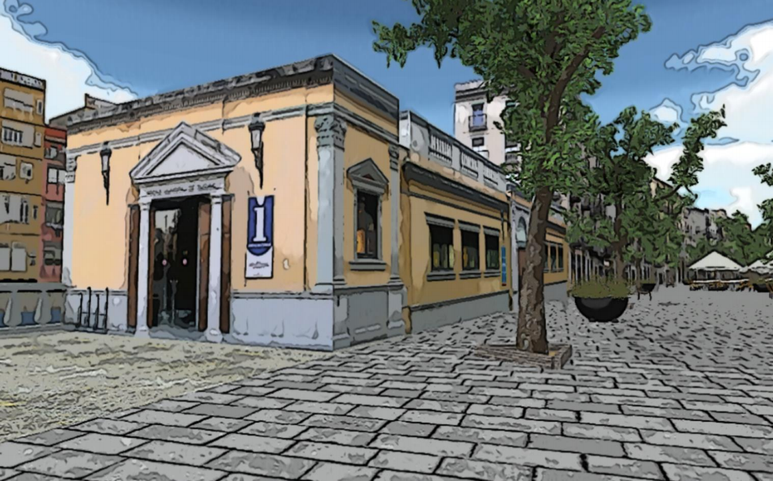
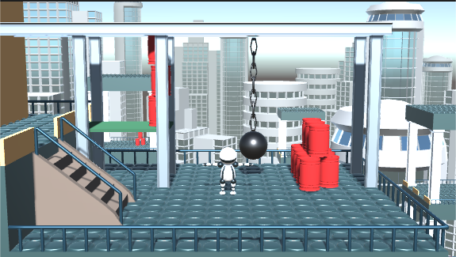
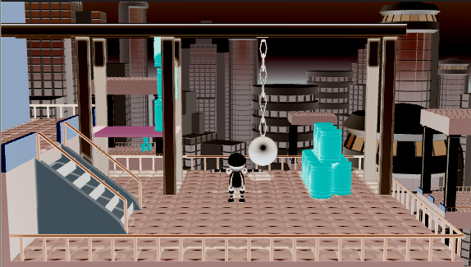
Image Effect shader template
sampler2D _MainTex;
fixed4 frag (v2f i) : SV_Target
{
fixed4 col = tex2D(_MainTex, i.uv);
// just invert the colors
col.rgb = 1 - col.rgb;
return col;
}

Slide 25
Image Effect shader template
Every instance of the fragment shader has a unique uv, corresponding to one pixel of the texture.
tex2D reads this corresponding pixel of _MainTex and applies some function.
So the fragment shader should tell how to compute a single pixel of the output.
Note: fragment shader instances run in parallel, that is why the GPU is so fast (also: fragments have to be independent)
sampler2D _MainTex;
fixed4 frag (v2f i) : SV_Target
{
fixed4 col = tex2D(_MainTex, i.uv);
// just invert the colors
col.rgb = 1 - col.rgb;
return col;
}
Fragment shader transforms a pixel of the input texture

Slide 26
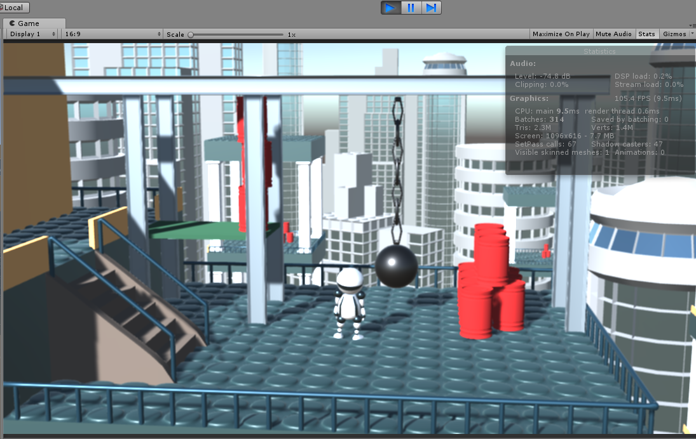
How fast is the graphics card?
Enter play mode, open Stats panel, check the FPS (frames per seconds)

Slide 27
How fast is the graphics card?
Try: put the rendering in a for loop
Modern graphics cards can run a simple post processing effect a few hundred times per frame with 30+ FPS
public int cnt = 100; // only for this test, remove after
void OnRenderImage(RenderTexture source, RenderTexture destination) {
if (CreateMaterial()) {
for (int i = 0; i < cnt; ++i) // only for this test, remove after
Graphics.Blit(source, destination, material);
}
else {
Graphics.Blit(source, destination);
}
}

Slide 28
Let’s change the shader
fixed4 frag (v2f i) : SV_Target
{
fixed4 col = tex2D(_MainTex, i.uv);
// just invert the colors
col.rgb = 1 - col.rgb;
return col;
}
float4 frag (v2f i) : SV_Target
{
float3 col = tex2D(_MainTex, i.uv).rgb;
float3 rgb2lum = float3(0.2126, 0.7152, 0.0722);
// 0.2126*col.r + 0.7152*col.g + 0.0722*col.b
float luminance = dot(col, rgb2lum);
col = luminance; // implicit conversion to float3
return float4(col, 1);
}

Slide 29
Let’s change the shader
The same with function call
float luminance(float3 rgb)
{
return 0.2126*rgb.r + 0.7152*rgb.g + 0.0722*rgb.b;
}
float4 frag (v2f i) : SV_Target
{
float3 col = tex2D(_MainTex, i.uv).rgb;
col = luminance(col);
return float4(col, 1);
}

Slide 30
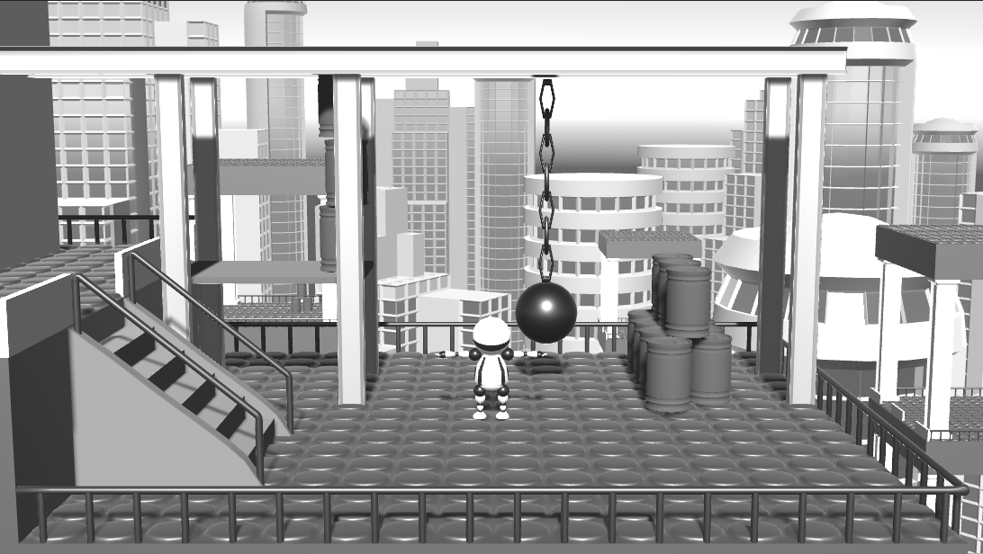
Luminance post effect

Slide 31
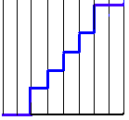
Basic image simplification effect
Motivation: decrease the number of colors
Quantize the luminance
float luminance(float3 rgb)
{
return 0.2126*rgb.r + 0.7152*rgb.g + 0.0722*rgb.b;
}
float4 frag(v2f i) : SV_Target { // replace the old "frag" with this one
float3 col = tex2D(_MainTex, i.uv).rgb;
float luminance_orig = luminance(col);
int levels = 8;
float luminance_new = floor(luminance_orig * levels) / levels;
col.rgb *= luminance_new / luminance_orig;
return float4(col, 1);
}

Slide 32
Basic image simplification effect
Motivation: decrease the number of colors
Quantize the luminance
float luminance(float3 rgb)
{
return 0.2126*rgb.r + 0.7152*rgb.g + 0.0722*rgb.b;
}
float4 frag(v2f i) : SV_Target { // replace the old "frag" with this one
float3 col = tex2D(_MainTex, i.uv).rgb;
float luminance_orig = luminance(col);
int levels = 8;
float luminance_new = floor(luminance_orig * levels) / levels;
col.rgb *= luminance_new / luminance_orig;
return float4(col, 1);
}
Quantization

Slide 33
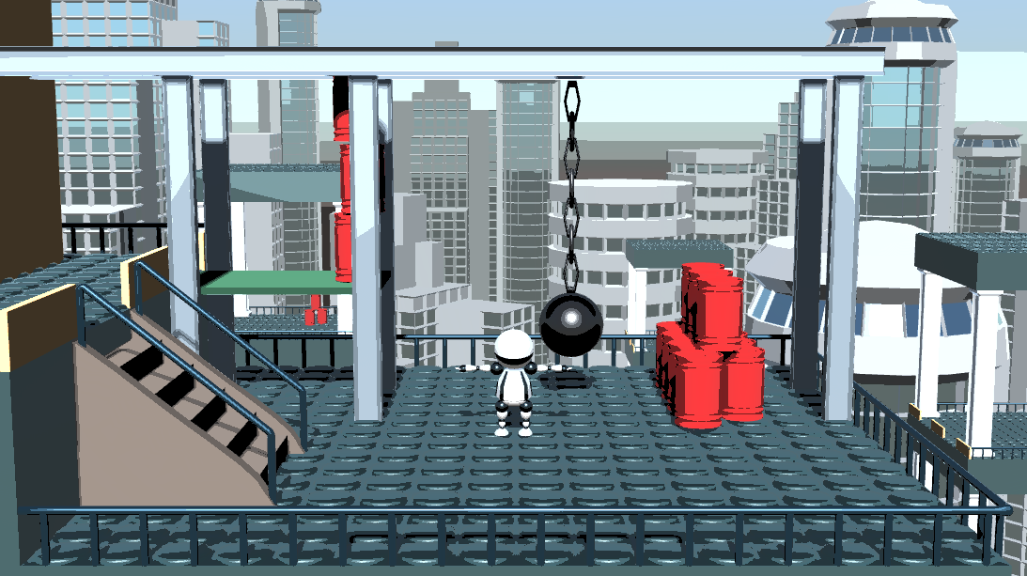
Luminance quantization post effect

Slide 34
Passing parameters to the shader
The number of quantization levels should be a user parameter
float4 frag(v2f i) : SV_Target { // replace the old "frag" with this one
float3 col = tex2D(_MainTex, i.uv).rgb;
float luminance_orig = luminance(col);
int levels = 8;
float luminance_new = floor(luminance_orig * levels) / levels;
col.rgb *= luminance_new / luminance_orig;
return float4(col, 1);
}

Slide 35
Passing parameters to the shader
The number of quantization levels should be a user parameter
sampler2D _MainTex;
int levels;
float4 frag(v2f i) : SV_Target { // replace the old "frag" with this one
float3 col = tex2D(_MainTex, i.uv).rgb;
float luminance_orig = luminance(col);
int levels = 8;
float luminance_new = floor(luminance_orig * levels) / levels;
col.rgb *= luminance_new / luminance_orig;
return float4(col, 1);
}

Slide 36
Passing parameters to the shader
General form of uniform setter function:
material.set[VariableType]("nameInTheShader",scriptVariable)
public class LumQuantEffect : PostEffectsBase {
[Range(1,50)] // allowed range in the inspector view
public int levels = 8;
// ...
void OnRenderImage(RenderTexture source, RenderTexture destination) {
if (CreateMaterial()) {
material.SetInt("levels", levels);
Graphics.Blit(source, destination, material);
}
// ...

Slide 37
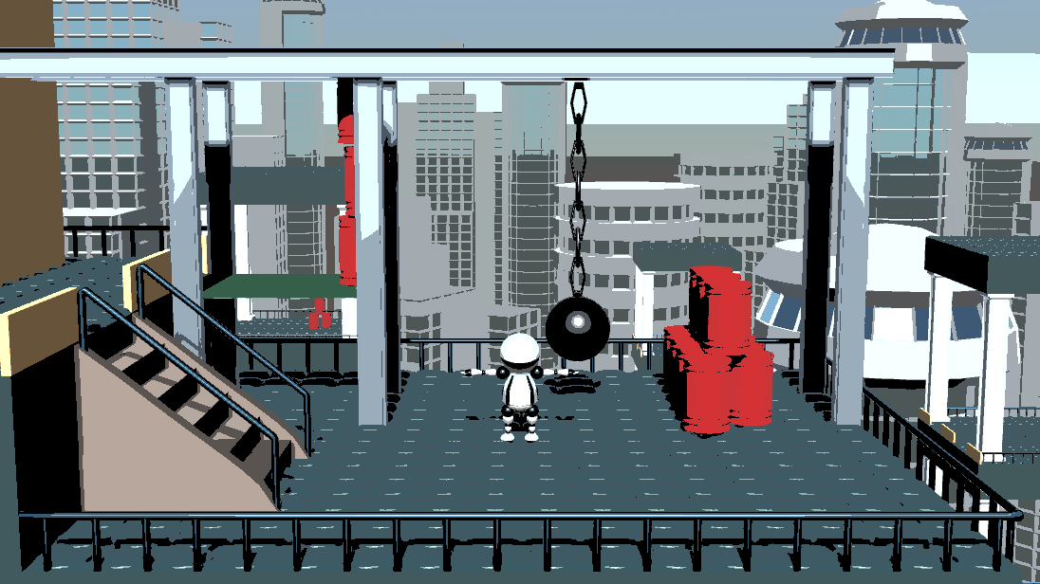
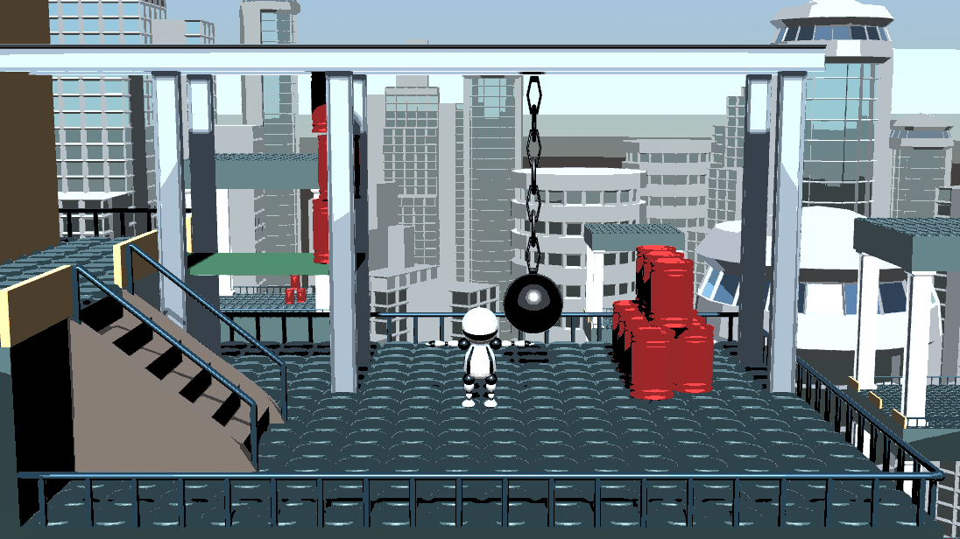
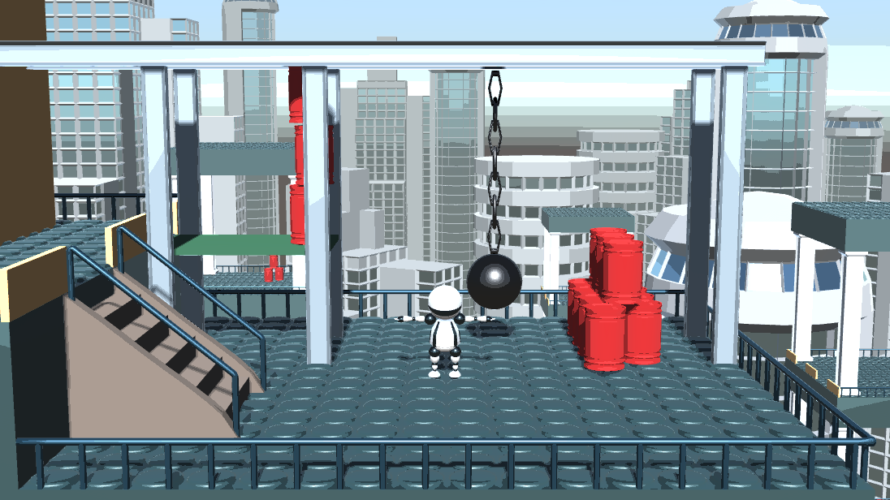
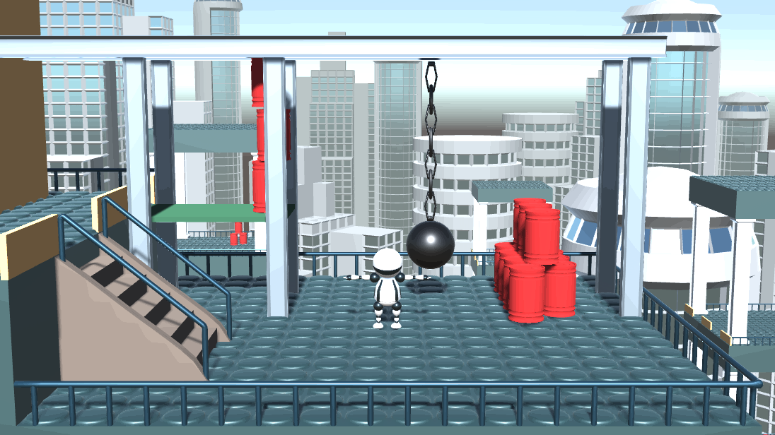
Effect of quantization levels
Play with it! (not much difference over 30)
Levels = 2
Levels = 4
Levels = 8
Levels = 30

Slide 38
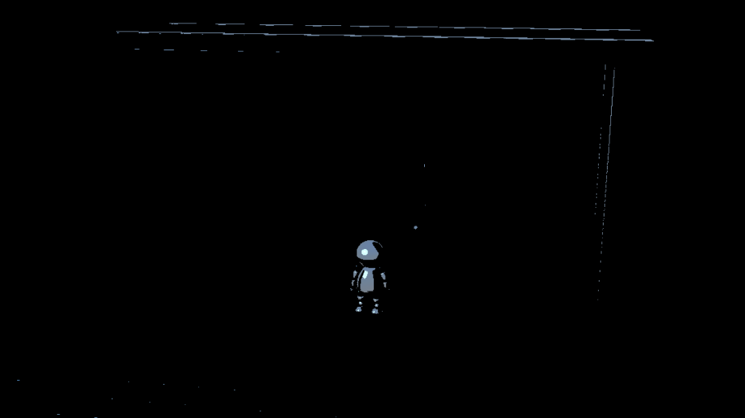
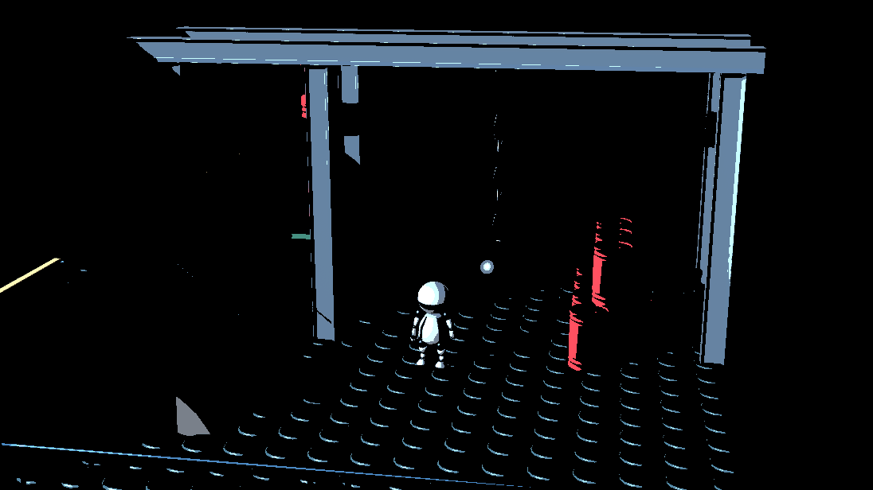
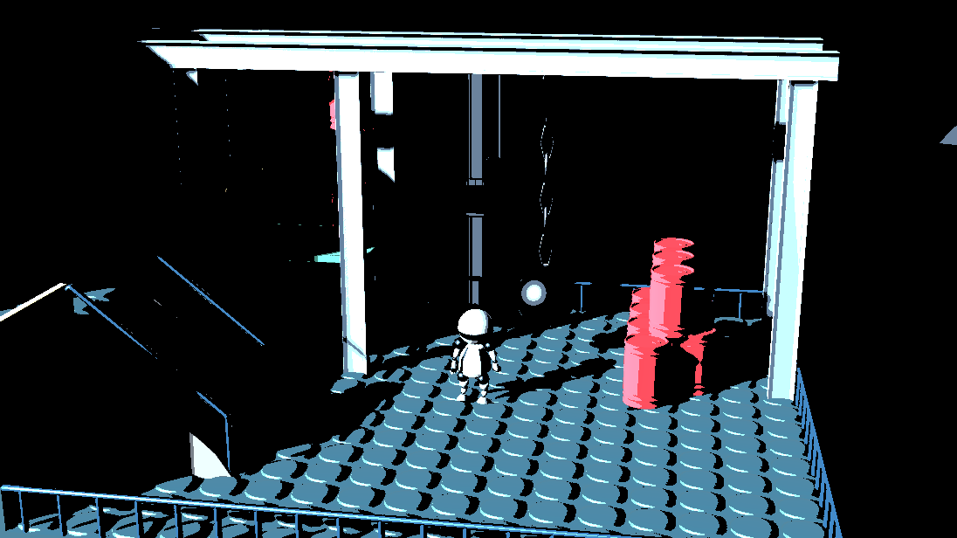
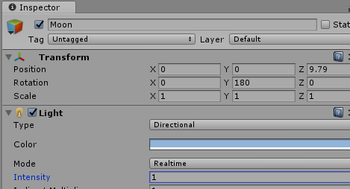
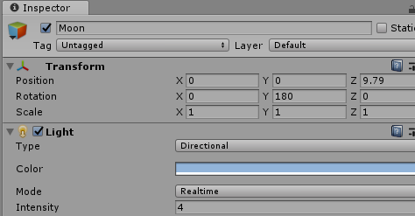
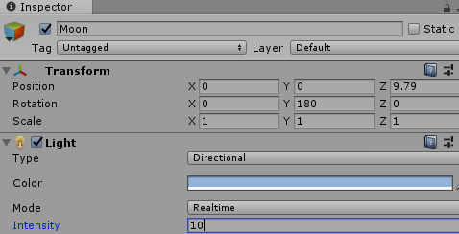
Effect of quantization levels + light intensity
For low number of quantization bins the result may be too dark depending on the light sources (Moon and Sun in the sample scene)
Try to play with the light intensity!

Slide 39
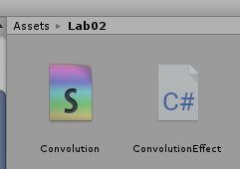
Convolution
Create a new C# script and a new Image Effect Shader
Call them ConvolutionEffect and Convolution, respectively

Slide 40
Convolution C# script
Similar to the Luminance Quantization Effect script
[ExecuteInEditMode]
[RequireComponent(typeof(Camera))]
public class ConvolutionEffect : PostEffectsBase {
void Start() {
shader = Shader.Find("NPR/Convolution");
CreateMaterial();
}
void OnRenderImage(RenderTexture source, RenderTexture destination) {
if (CreateMaterial()) {
Graphics.Blit(source, destination, material);
}
else {
Graphics.Blit(source, destination);
}
}
}

Slide 41
Convolution shader
Change the shader name
Shader "NPR/Convolution"
{
Properties
{
_MainTex ("Texture", 2D) = "white" {}
}

Slide 42
Convolution shader
Need to visit the neighbouring pixels of the texture (texels)
Texture coordinates are normalized to [0,1] in the shader
fixed4 frag (v2f i) : SV_Target
{
fixed4 col = tex2D(_MainTex, i.uv);

Slide 43
Convolution shader
Unity automatically fills a builtin variable with the texel size
Reciprocal of the image resolution
Name is the texture name appended by the ”_TexelSize” postfix
sampler2D _MainTex;
float4 _MainTex_TexelSize;

Slide 44
Convolution shader
float4 frag(v2f i) : SV_Target{
float4 col = float4(0,0,0,0);
const int kernelWidth = 3; // width of the filter window
float weights[kernelWidth*kernelWidth] = { // filter weight matrix
0, 0, 0,
0, 1, 0, // center of the matrix is the width of the current pixel
0, 0, 0 };
float weightSum = 0, weight = 0;
for (int u = -kernelWidth / 2; u <= kernelWidth / 2; ++u) { // visit neighbours (horizontal)
for (int v = -kernelWidth / 2; v <= kernelWidth / 2; ++v) { // visit neighbours (vertical)
weight = weights[(u + kernelWidth / 2) * kernelWidth + (v + kernelWidth / 2)];
col += weight * tex2D(_MainTex, i.uv +
float2(u*_MainTex_TexelSize.x, v*_MainTex_TexelSize.y));
weightSum += weight; // sum up weights for normalization
}
}
col /= weightSum + 0.001; // normalization
return col;
}

Slide 45
Convolution shader
float4 frag(v2f i) : SV_Target{
float4 col = float4(0,0,0,0);
const int kernelWidth = 3; // width of the filter window
float weights[kernelWidth*kernelWidth] = { // filter weight matrix
0, 0, 0,
0, 1, 0, // center of the matrix is the width of the current pixel
0, 0, 0 };
float weightSum = 0, weight = 0;
for (int u = -kernelWidth / 2; u <= kernelWidth / 2; ++u) { // visit neighbours (horizontal)
for (int v = -kernelWidth / 2; v <= kernelWidth / 2; ++v) { // visit neighbours (vertical)
weight = weights[(u + kernelWidth / 2) * kernelWidth + (v + kernelWidth / 2)];
col += weight * tex2D(_MainTex, i.uv +
float2(u*_MainTex_TexelSize.x, v*_MainTex_TexelSize.y));
weightSum += weight; // sum up weights for normalization
}
}
col /= weightSum + 0.001; // normalization
return col;
}
(u,v): distance in integer pixels
Normalized texture coordinate of the neighbour texel

Slide 46
Convolution shader – Sharpening
float4 frag(v2f i) : SV_Target{
float4 col = float4(0,0,0,0);
const int kernelWidth = 3; // width of the filter window
float weights[kernelWidth*kernelWidth] = { // filter weight matrix
0,-1, 0,
-1, 5,-1,
0,-1, 0 };
float weightSum = 0, weight = 0;
for (int u = -kernelWidth / 2; u <= kernelWidth / 2; ++u) { // visit neighbours (horizontal)
for (int v = -kernelWidth / 2; v <= kernelWidth / 2; ++v) { // visit neighbours (vertical)
weight = weights[(u + kernelWidth / 2) * kernelWidth + (v + kernelWidth / 2)];
col += weight * tex2D(_MainTex, i.uv +
float2(u*_MainTex_TexelSize.x, v*_MainTex_TexelSize.y));
weightSum += weight; // sum up weights for normalization
}
}
col /= weightSum + 0.001; // normalization
return col;
}

Slide 47
Sharpening / Unsharp masking
Basic idea: add edges to the image
Edge detection: see next week
0
-1
0
0
0
0
0
-1
0
-1
5
-1
=
0
1
0
+
-1
4
-1
0
-1
0
0
0
0
0
-1
0
Original image
Laplace operator

Slide 48
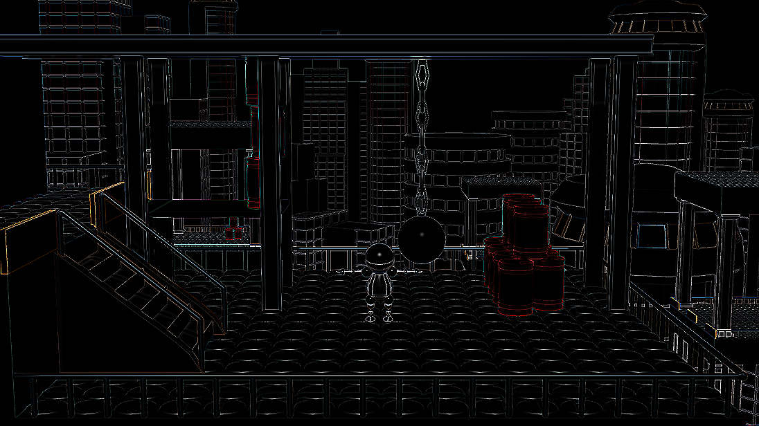
Laplace operator
Approximates second derivative
Note: sum of weights is zero
⇒ do NOT normalize the weighted sum if running only a Laplace
Details: see next week
0
-1
0
-1
4
-1
0
-1
0

Slide 49
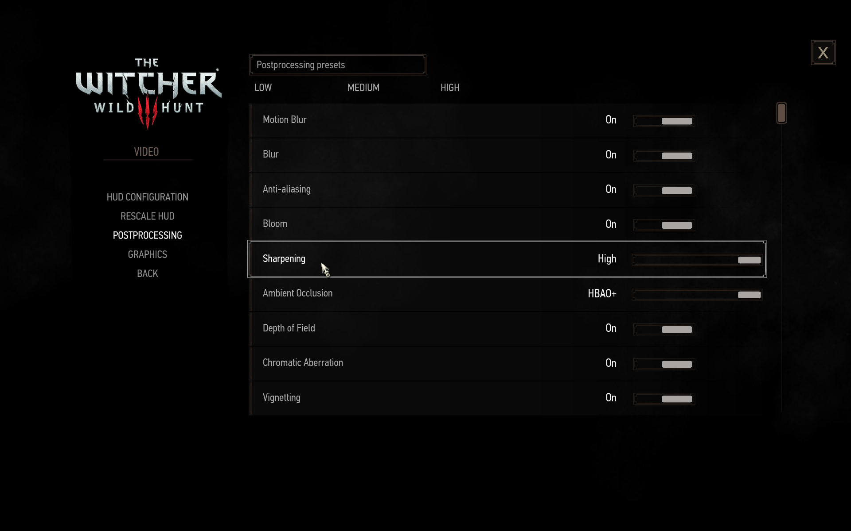
Example from games: Witcher 3

Slide 50
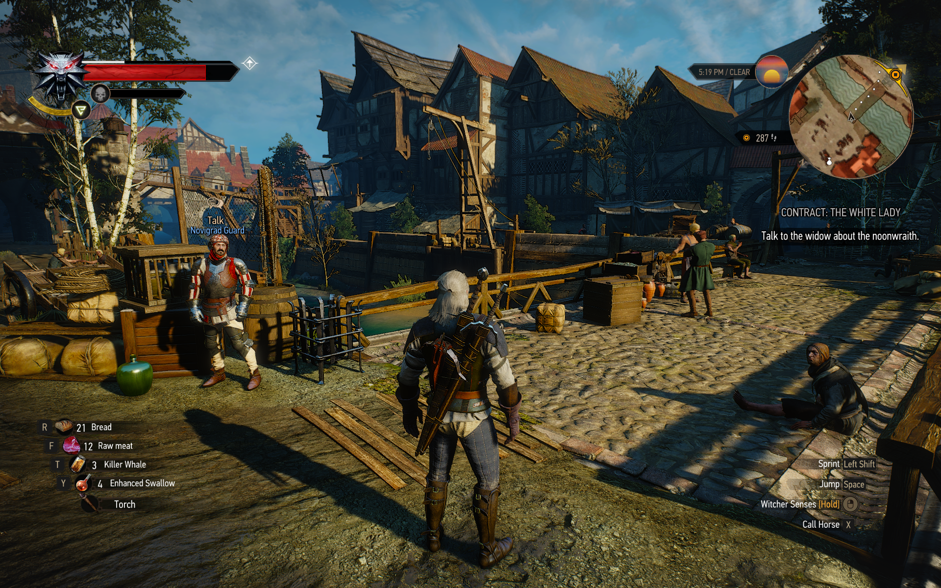
Example from games: Witcher 3 with sharpen

Slide 51
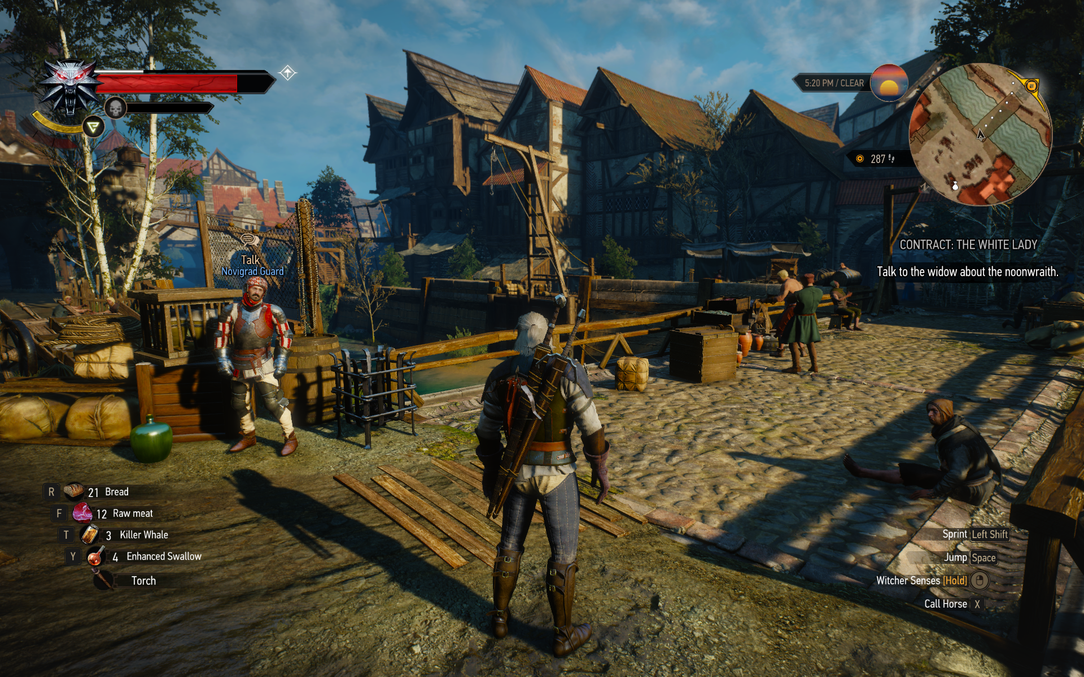
Example from games: Witcher 3 w/o sharpen

Slide 52
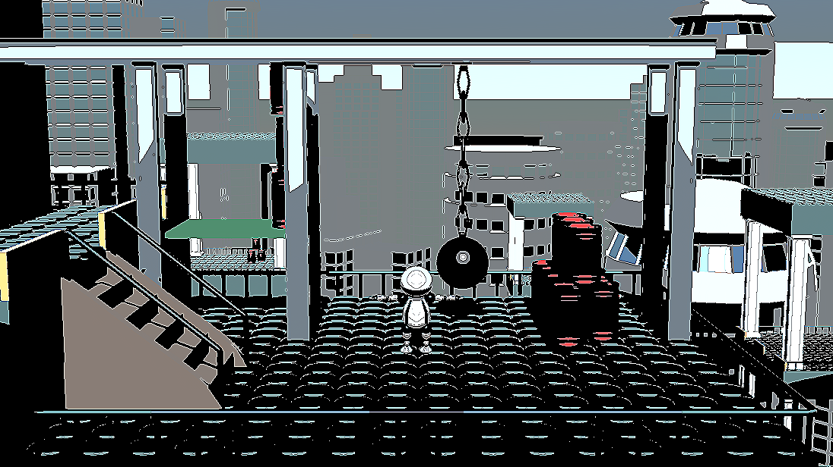
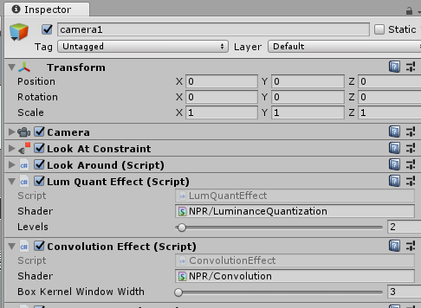
Multiple effects
We can add multiple effects to the camera
They are applied sequentially, top to bottom

Slide 53
Convolution shader – Box filter
Average the neighbouring pixels
Results in a blur
All weights are the same – no need to store the weight matrix
Not really used by itself
Can be part of the computations for some effects
Here we only use it to demonstrate the performance of the graphics card

Slide 54
Convolution shader – Box filter
Write a new fragment shader function and make it active
Create a uniform parameter for the kernel window width
#pragma fragment frag
#pragma fragment frag_box
sampler2D _MainTex;
float4 _MainTex_TexelSize;
int boxKernelWidth; // width of the filter window, set from script
float4 frag_box(v2f i) : SV_Target{
float4 col = float4(0,0,0,0);
float weight = 1.0 / (float)boxKernelWidth / (float)boxKernelWidth; // weight is constant
for (int u = -boxKernelWidth / 2; u <= boxKernelWidth / 2; ++u) { // visit neighbours (horizontal)
for (int v = -boxKernelWidth / 2; v <= boxKernelWidth / 2; ++v) { // visit neighbours (vertical)
col += weight * tex2D(_MainTex, i.uv + float2(u*_MainTex_TexelSize.x, v*_MainTex_TexelSize.y));
}
}
return col;
}

Slide 55
Kernel window width in C#
public class ConvolutionEffect : PostEffectsBase {
[Range(3, 301)]
public int boxKernelWindowWidth = 3;
// ...
void OnRenderImage(RenderTexture source, RenderTexture destination) {
if (CreateMaterial()) {
material.SetInt("boxKernelWidth", boxKernelWindowWidth);
Graphics.Blit(source, destination, material);
}
else {
Graphics.Blit(source, destination);
}
}
}

Slide 56
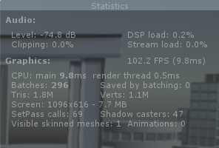
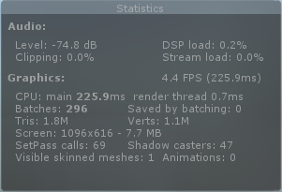
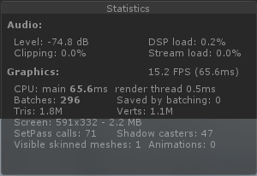
How fast is the graphics card?
Play width the box filter radius and see what happens to the FPS
Box filter time cost is O(kernelWidth²)
Resize the Game window size and see what happens to the FPS
Post processing time is linear in the number of pixels
Be careful, the operating system might shut down the video driver if any of the shaders runs for more than a few seconds

Slide 57
Multi-pass effects
Some effects cannot be implemented in a single fragment shader
Example: separable filters
Solutions:
Single C# script, multi-pass shader
Call the passes manually – requires temporary render textures
Or use GrabPass in the shader
Multiple C# scripts, each with single or multi-pass shaders

Slide 58
Have a multi-pass shader
Create a new Image Effect Shader, call it ConvolutionMultipass
Change name to NPR/ConvolutionMultipass
Shader "NPR/ConvolutionMultipass"
{
Properties
{
_MainTex ("Texture", 2D) = "white" {}
}

Slide 59
Have a multi-pass shader
Have two passes, one of them doing a vertical box filter, the other a horizontal
Pass // first pass: horizontal filtering
{
CGPROGRAM
// ... same as before, appdata, v2f, vert etc.
}
Pass // second pass: vertical filtering
{
CGPROGRAM
// ... same as before, appdata, v2f, vert etc.
}

Slide 60
Have a multi-pass shader
sampler2D _MainTex;
float4 _MainTex_TexelSize;
int boxKernelWidth;
float4 frag(v2f i) : SV_Target {
float4 col = fixed4(0,0,0,0);
float weight = 1.0 / (float)boxKernelWidth; // weight is constant
for (int u = -boxKernelWidth / 2; u <= boxKernelWidth / 2; ++u) {
col += weight *tex2D(_MainTex, i.uv + float2(u*_MainTex_TexelSize.x, 0));
}
return col;
}
Have two passes, one of them doing a vertical box filter, the other a horizontal
Pass // first pass: horizontal filtering
{
CGPROGRAM
// ... same as before, appdata, v2f, vert etc.
}
Pass // second pass: vertical filtering
{
CGPROGRAM
// ... same as before, appdata, v2f, vert etc.
}
sampler2D _MainTex;
float4 _MainTex_TexelSize;
int boxKernelWidth;
float4 frag(v2f i) : SV_Target {
float4 col = float4(0,0,0,0);
float weight = 1.0 / (float)boxKernelWidth; // weight is constant
for (int v = -boxKernelWidth / 2; v <= boxKernelWidth / 2; ++v) {
col += weight *tex2D(_MainTex, i.uv + float2(0, v*_MainTex_TexelSize.y));
}
return col;
}

Slide 61
Multi-pass effect in a single C# script, v. 1
void Start() {
shader = Shader.Find("NPR/Convolution");
shader = Shader.Find("NPR/ConvolutionMultipass");
CreateMaterial();
}
void OnRenderImage(RenderTexture source, RenderTexture destination) {
if (CreateMaterial()) {
material.SetInt("boxKernelWidth", boxKernelWindowWidth);
RenderTexture tmp =
RenderTexture.GetTemporary(source.width, source.height, 0, RenderTextureFormat.DefaultHDR);
Graphics.Blit(source, destination, material);
Graphics.Blit(source, tmp, material, 0);
Graphics.Blit(tmp, destination, material, 1);
tmp.Release();
}
else {
Graphics.Blit(source, destination);
}
}

Slide 62
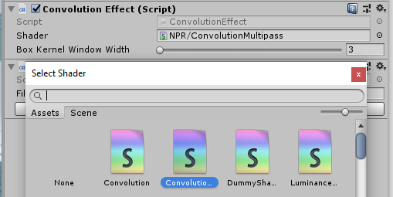
Multi-pass effect in a single C# script, v. 1
void Start() {
shader = Shader.Find("NPR/Convolution");
shader = Shader.Find("NPR/ConvolutionMultipass");
CreateMaterial();
}
void OnRenderImage(RenderTexture source, RenderTexture destination) {
if (CreateMaterial()) {
material.SetInt("boxKernelWidth", boxKernelWindowWidth);
RenderTexture tmp =
RenderTexture.GetTemporary(source.width, source.height, 0, RenderTextureFormat.DefaultHDR);
Graphics.Blit(source, destination, material);
Graphics.Blit(source, tmp, material, 0);
Graphics.Blit(tmp, destination, material, 1);
tmp.Release();
}
else {
Graphics.Blit(source, destination);
}
}
Note: Start is not called again in editor mode when you change the script, so also change it manually

Slide 63
Multi-pass effect in a single C# script, v. 1
void Start() {
shader = Shader.Find("NPR/Convolution");
shader = Shader.Find("NPR/ConvolutionMultipass");
CreateMaterial();
}
void OnRenderImage(RenderTexture source, RenderTexture destination) {
if (CreateMaterial()) {
material.SetInt("boxKernelWidth", boxKernelWindowWidth);
RenderTexture tmp =
RenderTexture.GetTemporary(source.width, source.height, 0, RenderTextureFormat.DefaultHDR);
Graphics.Blit(source, destination, material);
Graphics.Blit(source, tmp, material, 0);
Graphics.Blit(tmp, destination, material, 1);
tmp.Release();
}
else {
Graphics.Blit(source, destination);
}
}
Create a (HDR) texture to store intermediate results.
Unity maintains a pool for temporary render textures, so calling GetTemporary in every frame is still efficient, Unity will not allocate a new texture in every frame

Slide 64
Multi-pass effect in a single C# script, v. 1
void Start() {
shader = Shader.Find("NPR/Convolution");
shader = Shader.Find("NPR/ConvolutionMultipass");
CreateMaterial();
}
void OnRenderImage(RenderTexture source, RenderTexture destination) {
if (CreateMaterial()) {
material.SetInt("boxKernelWidth", boxKernelWindowWidth);
RenderTexture tmp =
RenderTexture.GetTemporary(source.width, source.height, 0, RenderTextureFormat.DefaultHDR);
Graphics.Blit(source, destination, material);
Graphics.Blit(source, tmp, material, 0);
Graphics.Blit(tmp, destination, material, 1);
tmp.Release();
}
else {
Graphics.Blit(source, destination);
}
}
Last parameter is the index of the pass to call (in the order they appear in the shader file).

Slide 65
Multi-pass effect in a single C# script, v. 2
Use the original OnRenderImage, no need to call the passes manually
Put a GrabPass pass in the shader
void OnRenderImage(RenderTexture source, RenderTexture destination) {
if (CreateMaterial()) {
material.SetInt("boxKernelWidth", boxKernelWindowWidth);
Graphics.Blit(source, destination, material); // calls all passes
}
else {
Graphics.Blit(source, destination);
}
}

Slide 66
Multi-pass effect in a single C# script, v. 2
Use the original OnRenderImage, no need to call the passes manually
Put a GrabPass pass in the shader
Pass // first pass: horizontal filtering
{
CGPROGRAM
// ... same as before, appdata, v2f, vert etc.
}
// The result of the previous pass is grabbed and passed as _GrabTexture to the next pass
GrabPass{}
Pass // second pass: vertical filtering
{
CGPROGRAM
// ... same as before, appdata, v2f, vert etc.
}

Slide 67
Multi-pass effect in a single C# script, v. 2
Use the original OnRenderImage, no need to call the passes manually
Put a GrabPass pass in the shader
sampler2D _GrabTexture;
float4 _GrabTexture_TexelSize;
int boxKernelWidth;
float4 frag(v2f i) : SV_Target{
float4 col = float4(0,0,0,0);
float weight = 1.0 / (float)boxKernelWidth; // weight is constant
for (int v = -boxKernelWidth / 2; v <= boxKernelWidth / 2; ++v) {
col += weight *tex2D(_GrabTexture, i.uv +
float2(0, v*_GrabTexture_TexelSize.y));
}
return col;
}
Pass // first pass: horizontal filtering
{
CGPROGRAM
// ... same as before, appdata, v2f, vert etc.
}
// The result of the previous pass is grabbed and passed as _GrabTexture to the next pass
GrabPass{}
Pass // second pass: vertical filtering
{
CGPROGRAM
// ... same as before, appdata, v2f, vert etc.
}
Replace _MainTex with _GrabTexture and _MainTex_TexelSize with _GrabTexture_TexelSize in the pass after the GrabPass

Slide 68
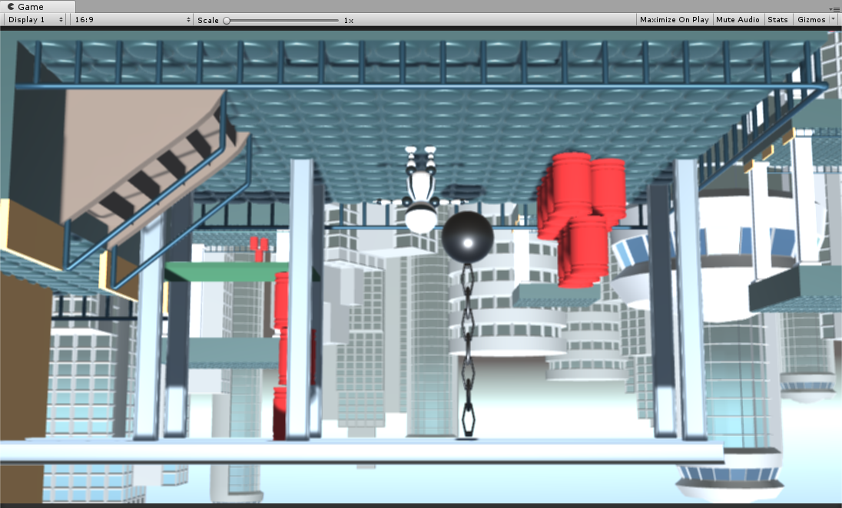
Vertical flip
GrabPass might flip the texture vertically
This is due to the UV origin differences between platforms
If this happens, we need to invert the vertical texture coordinate in the shader
#if UNITY_UV_STARTS_AT_TOP
if (_GrabTexture_TexelSize.y < 0)
i.uv.y = 1 - i.uv.y;
#endif

Slide 69
Separable filter performance
Compare the FPS values of the new, separable box filter to the original, naive implementation
O(kernelWidth²) versus O(2*kernelWidth)

Slide 70
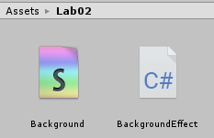
Background effect (with showerdoor artifact)
Create a new C# script and a new Image Effect Shader
Call them BackgroundEffect and Background, respectively
Change the shader name
Shader "NPR/Background"
{
Properties
{
_MainTex ("Texture", 2D) = "white" {}
}

Slide 71
Background effect – C# script
Similar to the previous scripts
Also has a texture parameter that we can set through the inspector
[ExecuteInEditMode]
[RequireComponent(typeof(Camera))]
public class BackgroundEffect : PostEffectsBase {
public Texture2D backgroundTex;
void Start() {
shader = Shader.Find("NPR/Background");
CreateMaterial();
}
void OnRenderImage(RenderTexture source, RenderTexture destination) {
if (CreateMaterial()) {
// SetTexture binds a texture to the shader uniform Texture Sampler
material.SetTexture("backgroundTex", backgroundTex);
Graphics.Blit(source, destination, material);
}
else {
Graphics.Blit(source, destination);
}
}
}

Slide 72
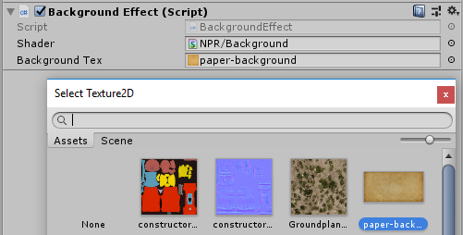
Background effect – C# script
Similar to the previous scripts
Also has a texture parameter that we can set through the inspector
[ExecuteInEditMode]
[RequireComponent(typeof(Camera))]
public class BackgroundEffect : PostEffectsBase {
public Texture2D backgroundTex;
void Start() {
shader = Shader.Find("NPR/Background");
CreateMaterial();
}
void OnRenderImage(RenderTexture source, RenderTexture destination) {
if (CreateMaterial()) {
// SetTexture binds a texture to the shader uniform Texture Sampler
material.SetTexture("backgroundTex", backgroundTex);
Graphics.Blit(source, destination, material);
}
else {
Graphics.Blit(source, destination);
}
}
}

Slide 73
Background effect – C# script
Similar to the previous scripts
Also has a texture parameter that we can set through the inspector
[ExecuteInEditMode]
[RequireComponent(typeof(Camera))]
public class BackgroundEffect : PostEffectsBase {
public Texture2D backgroundTex;
void Start() {
shader = Shader.Find("NPR/Background");
CreateMaterial();
}
void OnRenderImage(RenderTexture source, RenderTexture destination) {
if (CreateMaterial()) {
// SetTexture binds a texture to the shader uniform Texture Sampler
material.SetTexture("backgroundTex", backgroundTex);
Graphics.Blit(source, destination, material);
}
else {
Graphics.Blit(source, destination);
}
}
}
// shader counterpart
sampler2D backgroundTex;

Slide 74
Background effect – fragment shader
Sample the rendered color and the background texture and blend them
sampler2D _MainTex;
sampler2D backgroundTex;
float4 frag (v2f i) : SV_Target
{
float4 col = tex2D(_MainTex, i.uv);
float4 bg = tex2D(backgroundTex, i.uv);
// linear interpolation between col and bg
// result = 0.6*col + (1.0 – 0.6)*bg
return lerp(col, bg, 0.6);
}

Slide 75
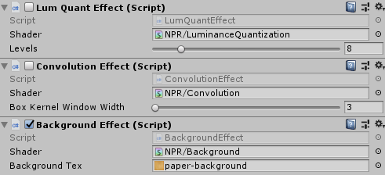
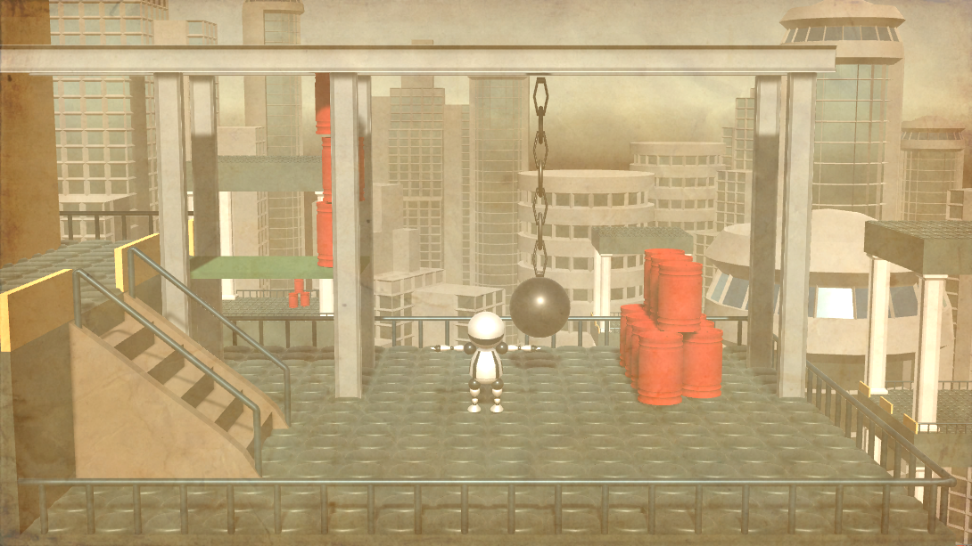
Background effect
Only the background effect

Slide 76
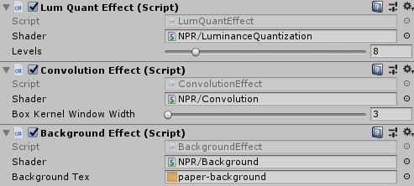
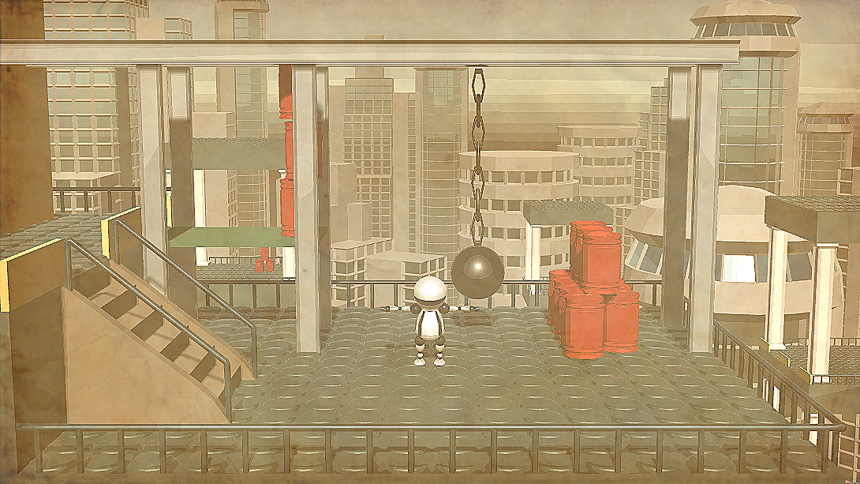
Background effect
Combined with quantization and sharpen
Use the ”Sharpen”
shader variant
0
-1
0
-1
5
-1
0
-1
0

Slide 77
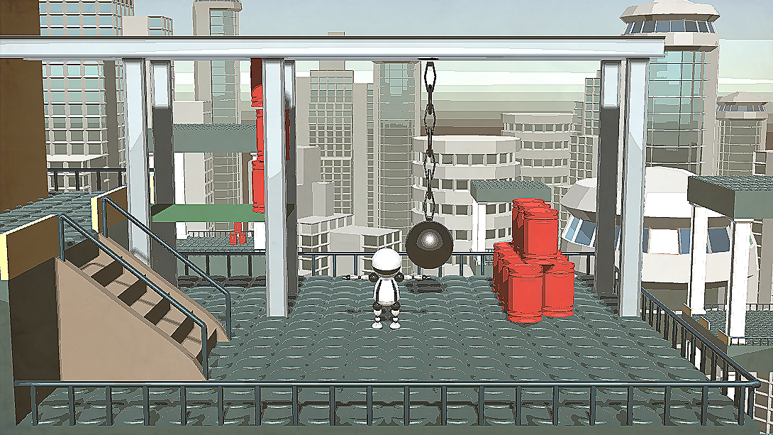
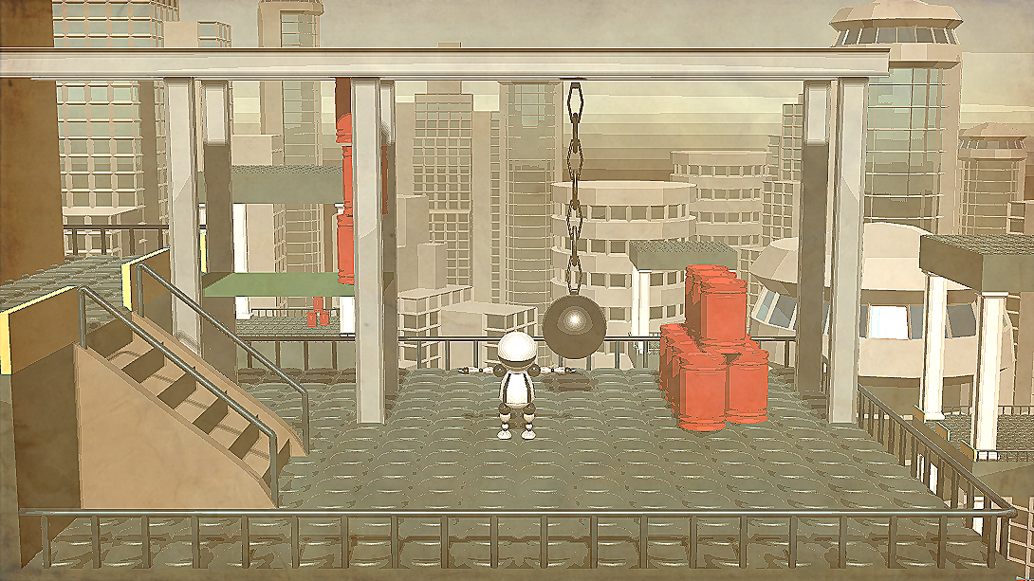
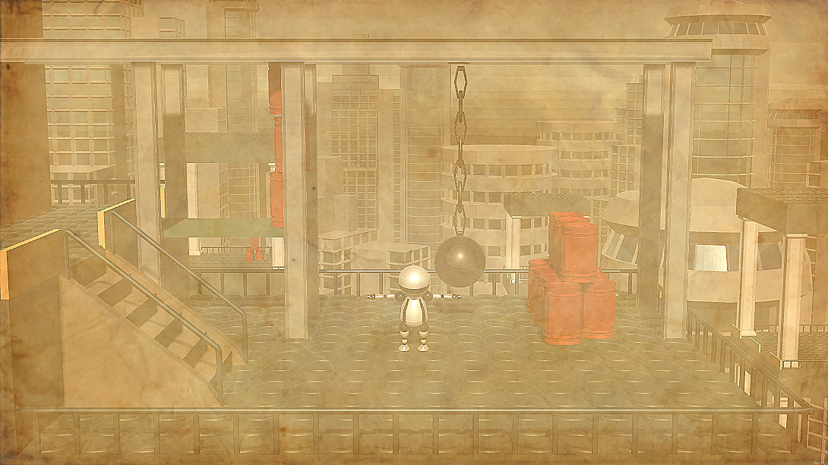
Task
Have a parameter in the background shader to control the blend factor
0.2
0.5
0.8

