Slide 1
Unity shader basics

Slide 2
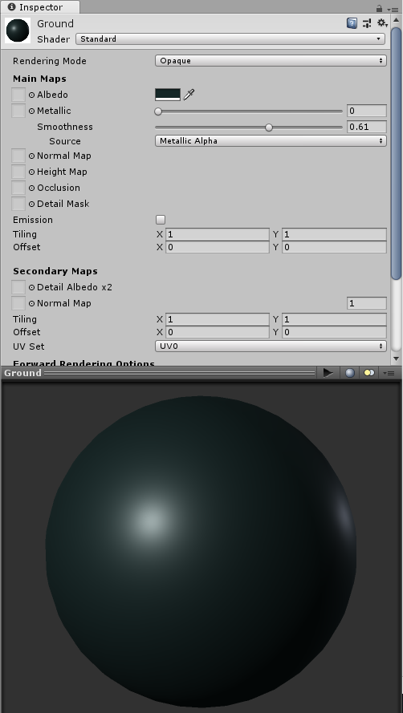
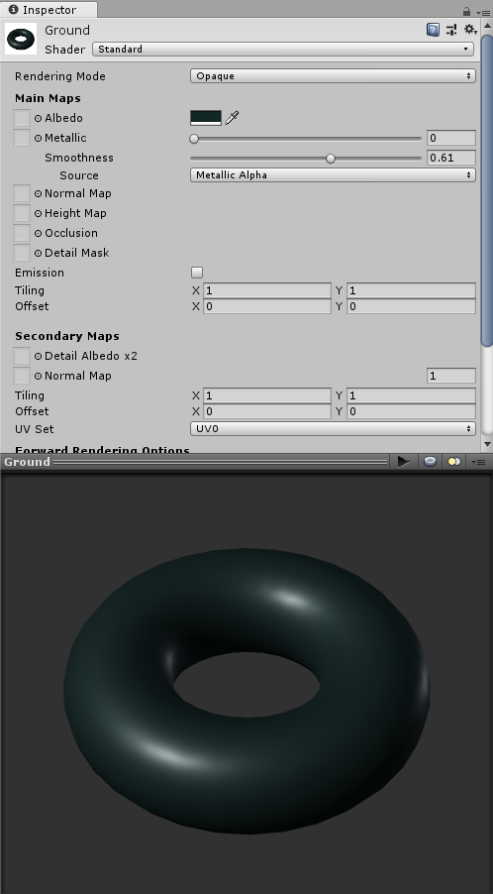
Materials
From the artists’ point of view these define how an object looks like
How its surface interacts with light
Might add more geometrical details
The inspector window of a material shows how a basic shape (sphere, torus etc.) would look like with the material

Slide 3
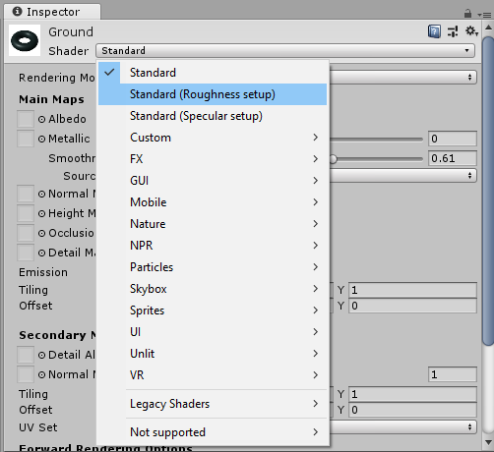
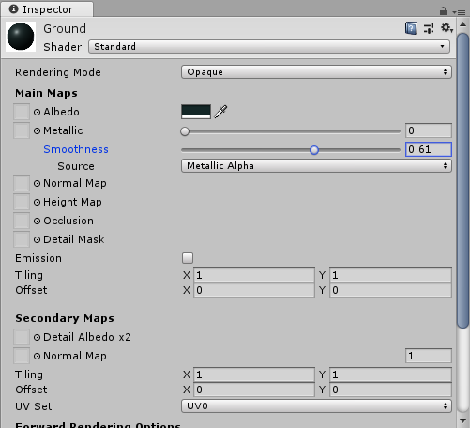
Materials
From the technical point of view a material defines which shader has to be used to render an object
Selects the shader and also sets its parameters
Which shader
Actual shader parameters

Slide 4
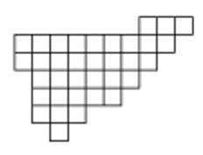
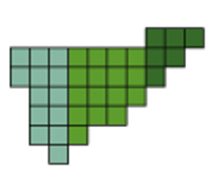
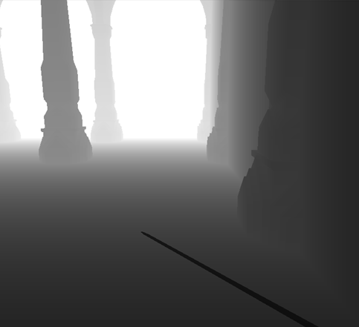
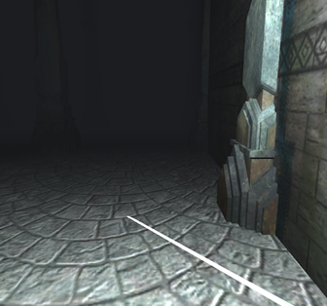
3D rendering pipeline
Rendering is hidden in Unity, we can control the shader programs and certain parameters (Z-buffer mode, blending, culling etc.) through Unity shaders
Depth buffer
Vertex shader
Geometry shader
Rasterization
Fragment shader
Compositing
Color buffer
Normal buffer

Slide 5
New material for a custom effect
Select the Materials folder
Assets menu → Create → Material
Call it “test”

Slide 6
My first Unity shader
Select the Materials folder
Assets menu → Create → Shader → Unlit Shader
Call it “test”
Double click to edit the shader source

Slide 7
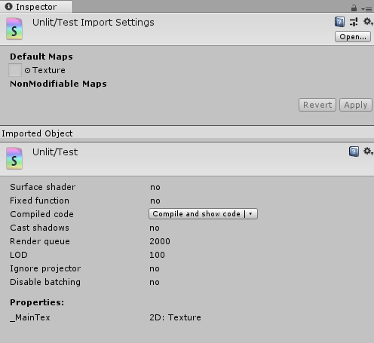
My first Unity shader
The name that appears in the inspector view of the shader
Shader "Unlit/Test"
{
Properties
{
_MainTex ("Texture", 2D) = "white" {}
}
SubShader
{
Tags { "RenderType"="Opaque" }
LOD 100
Pass
{
// ...
}
}
}

Slide 8
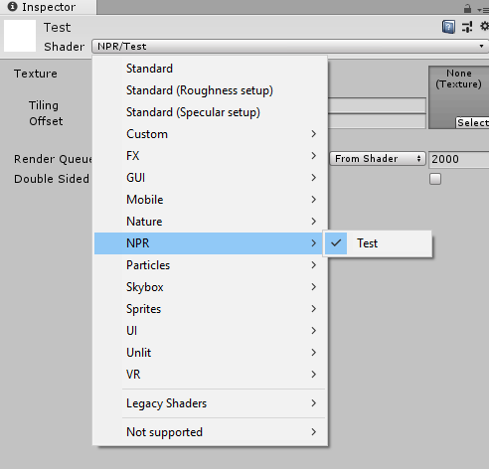
My first Unity shader
Menu entry in a material’s inspector view
The material will use the shader if we select it from the list
(Alternative: drag and drop the shader to the material in the Asset view)
Shader "NPR/Test"
{
Properties
{
_MainTex ("Texture", 2D) = "white" {}
}
SubShader
{
Tags { "RenderType"="Opaque" }
LOD 100
Pass
{
// ...
}
}
}

Slide 9
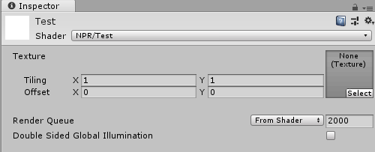
My first Unity shader
These parameters can be set through the material’s inspector view
Shader "NPR/Test"
{
Properties
{
_MainTex ("Texture", 2D) = "white" {}
}
SubShader
{
Tags { "RenderType"="Opaque" }
LOD 100
Pass
{
// ...
}
}
}

Slide 10
My first Unity shader
These parameters can be set through the material’s inspector view
Shader "NPR/Test"
{
Properties
{
_MainTex ("Texture", 2D) = "white" {}
_ParamNameInShaderCode("ParamNameInInspector", float) = 0
}
SubShader
{
Tags { "RenderType"="Opaque" }
LOD 100
Pass
{
// ...
}
}

Slide 11
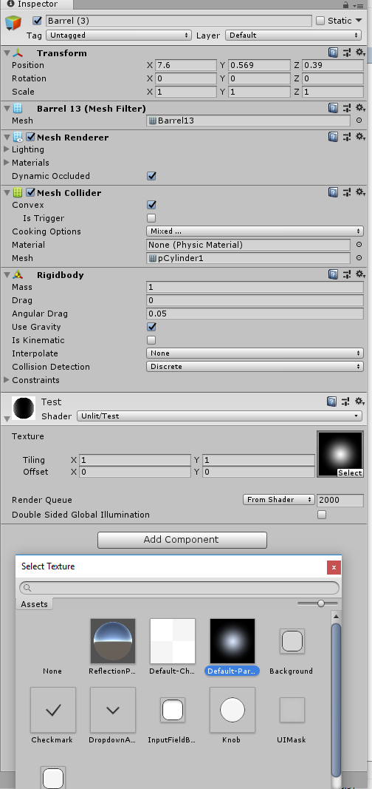
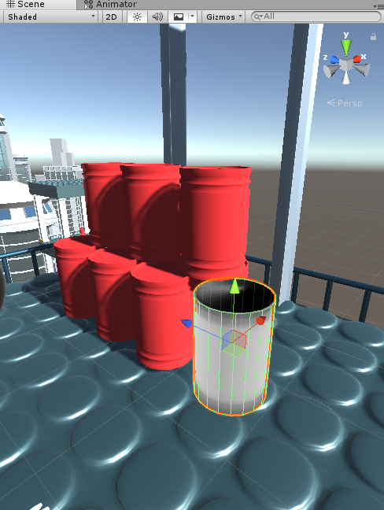
My first Unity shader
Try it: attach the material (with this shader set) to an object, set the texture parameter and see what happens!
Shader "NPR/Test"
{
Properties
{
_MainTex ("Texture", 2D) = "white" {}
}
SubShader
{
Tags { "RenderType"="Opaque" }
LOD 100
Pass
{
// ...
}
}
}

Slide 12
My first Unity shader
Shader "NPR/Test"
{
Properties
{
_MainTex ("Texture", 2D) = "white" {}
}
SubShader
{
Tags { "RenderType"="Opaque" }
LOD 100
Pass
{
// ...
}
}
}
Subshaders are variants of an effect for different platforms.
E.g. we can implement a very costly but more realistic lighting model for PC and a cheap but less realistic one for mobile.
When rendering with a shader, Unity tries all subshaders (in the order they appear in the file) and uses the first one that can run on the current hardware.
We can define a fallback shader in the form:
Fallback "name of the other shader"
This runs when no other subshader can run on the current hardware.

Slide 13
My first Unity shader
Shader "NPR/Test"
{
Properties
{
_MainTex ("Texture", 2D) = "white" {}
}
SubShader
{
Tags { "RenderType"="Opaque" }
LOD 100
Pass
{
// ...
}
}
}
Tags to control how the object is rendered (e.g. during the “Opaque” rendering pass, which uses no blending)

Slide 14
My first Unity shader
Shader "NPR/Test"
{
Properties
{
_MainTex ("Texture", 2D) = "white" {}
}
SubShader
{
Tags { "RenderType"="Opaque" }
LOD 100
Pass
{
// ...
}
}
}
This can be used to enable/disable shaders
A Maximum LOD level can be set, Unity will simply skip the rendering of objects having a higher LOD level than a user defined maximum (performance tuning for slower hardware)
(We won’t touch this one.)

Slide 15
My first Unity shader
Shader "NPR/Test"
{
Properties
{
_MainTex ("Texture", 2D) = "white" {}
}
SubShader
{
Tags { "RenderType"="Opaque" }
LOD 100
Pass
{
// ...
}
}
}
Shaders may have multiple passes to implement complex effects

Slide 16
My first Unity shader
Shader "NPR/Test"
{
Properties
{
_MainTex ("Texture", 2D) = "white" {}
}
SubShader
{
Tags { "RenderType"="Opaque" }
LOD 100
Pass
{
// ...
}
}
}
The implementation of the pass (Cg, HLSL or GLSL languages)

Slide 17
My first Unity shader
Write CG language shader code between CGPROGRAM and ENDCG
CGPROGRAM
#pragma vertex vert
#pragma fragment frag
// make fog work
#pragma multi_compile_fog
#include "UnityCG.cginc"
struct appdata
{
float4 vertex : POSITION;
float2 uv : TEXCOORD0;
};
struct v2f
{
float2 uv : TEXCOORD0;
UNITY_FOG_COORDS(1)
float4 vertex : SV_POSITION;
};
sampler2D _MainTex;
float4 _MainTex_ST;
v2f vert (appdata v)
{
// ...
}
fixed4 frag (v2f i) : SV_Target
{
// ...
}
ENDCG
Shader compiler macros:
#pragma vertex programname sets the vertex shader to use
#pragma fragment programname sets the fragment shader to use
Unity has many useful shader include files under [path_to_unity]/Editor/Data/CGIncludes

Slide 18
My first Unity shader
Write CG language shader code between CGPROGRAM and ENDCG
CGPROGRAM
#pragma vertex vert
#pragma fragment frag
// make fog work
#pragma multi_compile_fog
#include "UnityCG.cginc"
struct appdata
{
float4 vertex : POSITION;
float2 uv : TEXCOORD0;
};
struct v2f
{
float2 uv : TEXCOORD0;
UNITY_FOG_COORDS(1)
float4 vertex : SV_POSITION;
};
sampler2D _MainTex;
float4 _MainTex_ST;
v2f vert (appdata v)
{
// ...
}
fixed4 frag (v2f i) : SV_Target
{
// ...
}
ENDCG
Shader compiler macros:
#pragma vertex programname sets the vertex shader to use
#pragma fragment programname sets the fragment shader to use
Unity has many useful shader include files under [path_to_unity]/Editor/Data/CGIncludes

Slide 19
My first Unity shader
We need to tell what data the vertex shader accepts. Usually it is more comfortable to define a struct for it.
With every vertex of the mesh, Unity sends position, normal, texture coordinates, etc. to the rendering pipeline, here we can select which of these we want to use.
(See UnityCG.cginc → appdata_full struct for the complete list)
CGPROGRAM
#pragma vertex vert
#pragma fragment frag
// make fog work
#pragma multi_compile_fog
#include "UnityCG.cginc"
struct appdata
{
float4 vertex : POSITION;
float2 uv : TEXCOORD0;
};
struct v2f
{
float2 uv : TEXCOORD0;
UNITY_FOG_COORDS(1)
float4 vertex : SV_POSITION;
};
sampler2D _MainTex;
float4 _MainTex_ST;
v2f vert (appdata v)
{
// ...
}
fixed4 frag (v2f i) : SV_Target
{
// ...
}
ENDCG
Data to pass between the vertex and fragment shader
(NOTE: everything is interpolated inside the triangle by the rasterization hardware!)
Uniform (global) shader variables. Use these to pass parameters to the shader from C# scripts.
Implementation of the vertex and fragment shader.
Recall: vertex shader transforms vertices of the object (may do e.g. some lighting calculations), fragment shader computes the final pixel color

Slide 20
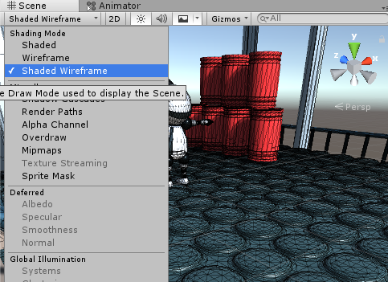
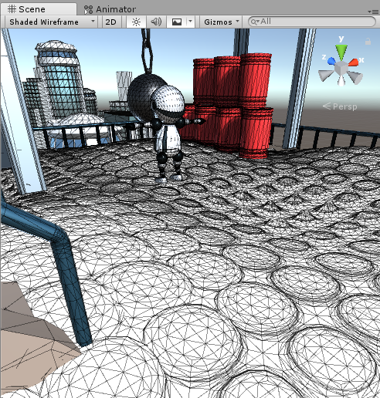
Let’s code
Recall: vertex shader transforms vertices of the object
Write a simple vertex shader that simulates water waves
Attach it to a planar object in the scene (or create a new Plane)
Hint: use wireframe rendering to see the result better

Slide 21
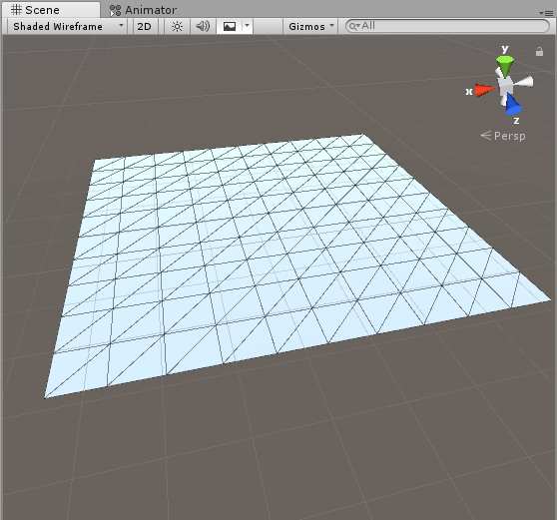
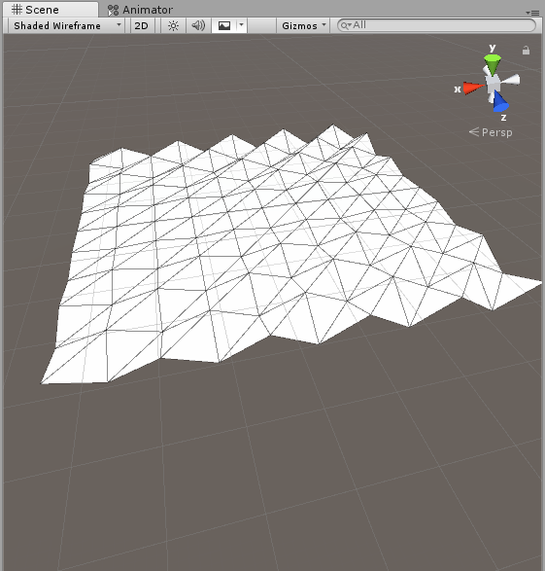
Let’s code
Idea: shift vertices along the surface normal
(u,v) = (1,1)
Texture v
Vertex shader is applied to every vertex of every triangle
Normal is defined for every vertex
Texture u
(u,v) = (0,0)

Slide 22
Let’s code
Idea: shift vertices along the surface normal
Need to use the normal of the object
struct appdata
{
float4 vertex : POSITION;
float2 uv : TEXCOORD0;
};
struct appdata
{
float4 vertex : POSITION;
float3 normal : NORMAL;
float2 uv : TEXCOORD0;
};

Slide 23
Let’s code
Idea: shift vertices along the surface normal
Need to use the normal of the object
v2f vert (appdata v)
{
v2f o;
o.vertex = UnityObjectToClipPos(v.vertex);
o.uv = TRANSFORM_TEX(v.uv, _MainTex);
UNITY_TRANSFER_FOG(o,o.vertex);
return o;
}
Transforms the vertex from object space to clip space
Multiplies the vector with the model-view-projection matrix
Equivalent to
o.vertex = mul(UNITY_MATRIX_MVP, v.vertex);
Try to translate the vertex (in object space) along the normal!

Slide 24
Let’s code
Idea: shift vertices along the surface normal
Use some time-dependent function of the texture coordinates
#pragma vertex vert
#pragma vertex vert_wavy
_Time: built-in shader variable, contains the game time and its functions
https://docs.unity3d.com/Manual/SL-UnityShaderVariables.html
v2f vert_wavy (appdata v)
{
v2f o;
o.vertex = UnityObjectToClipPos(v.vertex);
float waveAmplitude = 0.3f;
float waveFrequency = 30.0f;
o.vertex = UnityObjectToClipPos(v.vertex + waveAmplitude*sin(_Time.y + v.uv.x * waveFrequency)*
cos(_Time.z + v.uv.y * 2.8 * waveFrequency)* v.normal);
o.uv = TRANSFORM_TEX(v.uv, _MainTex);
UNITY_TRANSFER_FOG(o,o.vertex);
return o;
}
Notes:
In order to use a new vertex (or fragment) shader, replace the existing #pragma vertex (or #pragma frag)

Slide 25
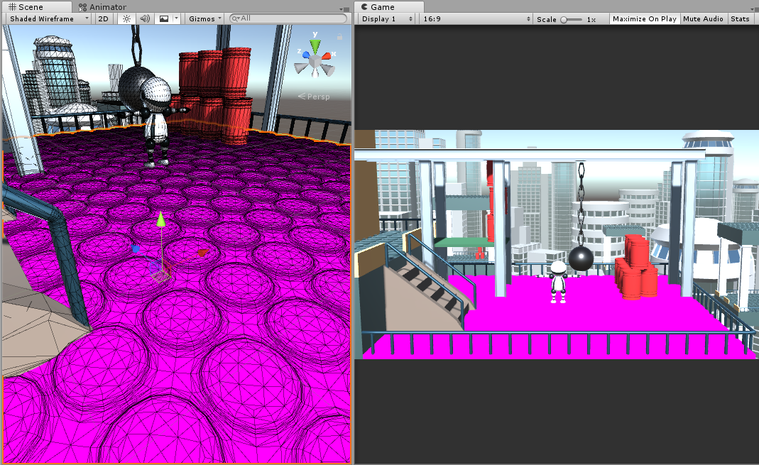
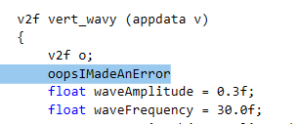
Shader Error
Purple means shader compilation error ☺

Slide 26
Let’s code
Next step: use global parameters to control the wave
Properties
{
_MainTex ("Texture", 2D) = "white" {}
waveAmplitude("Wave amplitude", float) = 0.3
waveFrequency("Wave frequency", float) = 30
}
CGPROGRAM
// ...
sampler2D _MainTex;
float4 _MainTex_ST;
float waveAmplitude;
float waveFrequency;

Slide 27
Let’s code
Next step: use global parameters to control the wave
Properties
{
_MainTex ("Texture", 2D) = "white" {}
waveAmplitude("Wave amplitude", float) = 0.3
waveFrequency("Wave frequency", float) = 30
}
CGPROGRAM
// ...
sampler2D _MainTex;
float4 _MainTex_ST;
float waveAmplitude;
float waveFrequency;
The names and types have to match!

Slide 28
Let’s code
Next step: use global parameters to control the wave
v2f vert_wavy (appdata v)
{
v2f o;
float waveAmplitude = 0.3f; // these are now taken from the uniform parameters
float waveFrequency = 30.0f;
o.vertex = UnityObjectToClipPos(v.vertex + waveAmplitude*sin(_Time.y + v.uv.x * waveFrequency)*
cos(_Time.z + v.uv.y * waveFrequency)* v.normal);
o.uv = TRANSFORM_TEX(v.uv, _MainTex);
UNITY_TRANSFER_FOG(o,o.vertex);
return o;
}

Slide 29
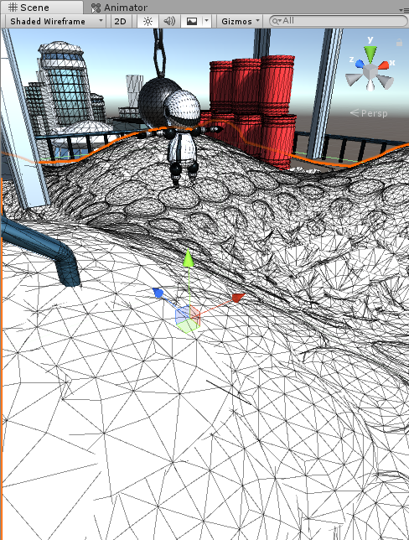
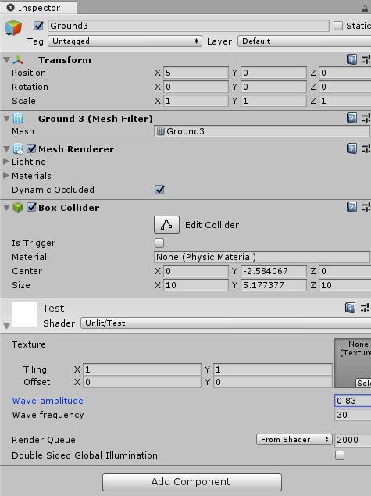
Let’s code
Result: shader parameters can be controlled through the material

Slide 30
Let’s do NPR
Cel shading (Toon shading): sample a 1D color ramp (1D texture) with the dot product of the surface normal and the vector pointing to the light source (the cosine of their angle)
Light source
N
L
Texture
Dark
Bright
Notes:
Note: the dot product (the cosine) determines the brightness of a diffuse object

Slide 31
Let’s do NPR
Cel shading (Toon shading): sample a 1D color ramp (1D texture) with the dot product of the surface normal and the vector pointing to the light source (the cosine of their angle)
Tasks:
Add new Material and Shader (or use the previously created “Test” ones)
Transform the normal to world space in the vertex shader and compute the light direction vector
Have a 1D color map (material property and uniform parameter)
Compute the dot product in the fragment shader
Sample the texture in the fragment shader

Slide 32
Let’s do NPR
Cel shading (Toon shading): sample a 1D color ramp (1D texture) with the dot product of the surface normal and the vector pointing to the light source (the cosine of their angle)
First step: compute the normal vector and light dir. in the vertex shader
Note: this will be interpolated and passed to the fragment shader
v2f_toon vert_toon(appdata v)
{
v2f_toon o;
o.vertex = UnityObjectToClipPos(v.vertex);
o.normal = UnityObjectToWorldNormal(v.normal);
float3 wPos = mul(unity_ObjectToWorld, v.vertex).xyz; // vertex pos. in world space
o.lightDir = normalize(_WorldSpaceLightPos0.xyz –
wPos * _WorldSpaceLightPos0.w);
return o;
}

Slide 33
Let’s do NPR
Cel shading (Toon shading): sample a 1D color ramp (1D texture) with the dot product of the surface normal and the vector pointing to the light source (the cosine of their angle)
First step: compute the normal vector and light dir. in the vertex shader
Note: this will be interpolated and passed to the fragment shader
_WorldSpaceLightPos0: Builtin shader variable, denotes the position of the first light source
w coordinate is 0 for directional light sources and 1 for others
This expression returns the light direction for directional light, and the vector pointing from wPos to the position of the light source for positional light sources (so it works for all light types)
v2f_toon vert_toon(appdata v)
{
v2f_toon o;
o.vertex = UnityObjectToClipPos(v.vertex);
o.normal = UnityObjectToWorldNormal(v.normal);
float3 wPos = mul(unity_ObjectToWorld, v.vertex).xyz; // vertex pos. in world space
o.lightDir = normalize(_WorldSpaceLightPos0.xyz –
wPos * _WorldSpaceLightPos0.w);
return o;
}

Slide 34
Let’s do NPR
Cel shading (Toon shading): sample a 1D color ramp (1D texture) with the dot product of the surface normal and the vector pointing to the light source (the cosine of their angle)
First step: compute the normal vector and light dir. in the vertex shader
Note: this will be interpolated and passed to the fragment shader
v2f_toon vert_toon(appdata v)
{
v2f_toon o;
o.vertex = UnityObjectToClipPos(v.vertex);
o.normal = UnityObjectToWorldNormal(v.normal);
float3 wPos = mul(unity_ObjectToWorld, v.vertex).xyz;
o.lightDir = normalize(_WorldSpaceLightPos0.xyz –
wPos * _WorldSpaceLightPos0.w);
return o;
}
struct v2f_toon
{
float3 normal : NORMAL;
float3 lightDir : TEXCOORD1;
float4 vertex : SV_POSITION;
};

Slide 35
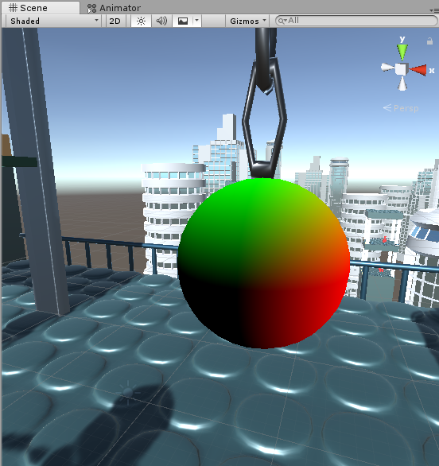
Let’s do NPR
Cel shading (Toon shading): sample a 1D color ramp (1D texture) with the dot product of the surface normal and the vector pointing to the light source (the cosine of their angle)
Test the first step: render the normal
Apply the material e.g. to the sphere
#pragma vertex vert_toon
#pragma fragment frag_normals
fixed4 frag_normals(v2f_toon i) : SV_Target
{
float3 N = normalize(i.normal);
return float4(N, 1);
}

Slide 36
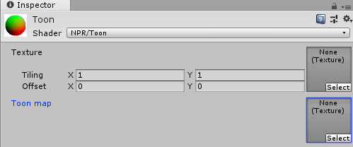
Let’s do NPR
Cel shading (Toon shading): sample a 1D color ramp (1D texture) with the dot product of the surface normal and the vector pointing to the light source (the cosine of their angle)
Have a 1D color map parameter
Properties
{
_MainTex ("Texture", 2D) = "white" {}
// NOTE: Unity does not support 1D texture here
// so we have to use 2D
// [NoScaleOffset] : disable tiling and offset parameters
[NoScaleOffset] _ToonTex("Toon map", 2D) = "" {}
}

Slide 37
Let’s do NPR
Cel shading (Toon shading): sample a 1D color ramp (1D texture) with the dot product of the surface normal and the vector pointing to the light source (the cosine of their angle)
Have a 1D color map parameter
Set the texture to a color ramp (see later)
Also define the sampler in the shader
sampler2D _MainTex;
float4 _MainTex_ST;
sampler2D _ToonTex;

Slide 38
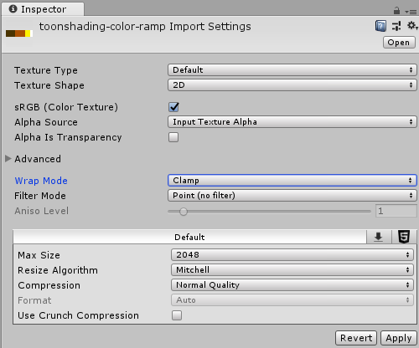
Let’s do NPR
Cel shading (Toon shading): sample a 1D color ramp (1D texture) with the dot product of the surface normal and the vector pointing to the light source (the cosine of their angle)
Import a color ramp image file
This defines what color corresponds to a brightness level (dot product)
Important to set after importing the file:
Wrap mode: Clamp
Filter mode: Point
This forces the shader to apply nearest sampling (no interpolation) and allows zero-cost handling of negative dot product in the shader
Notes:
Note: there is a color ramp file “toonshading-color-ramp.png” among the assets (separate zip file)

Slide 39
Let’s do NPR
Cel shading (Toon shading): sample a 1D color ramp (1D texture) with the dot product of the surface normal and the vector pointing to the light source (the cosine of their angle)
Fragment shader: retrieve color by the dot of the normal and light dir.
#pragma fragment frag_toon
Light source
fixed4 frag_toon (v2f_toon i) : SV_Target
{
float3 N = normalize(i.normal);
float3 L = normalize(i.lightDir);
float NdL = dot(N, L);
fixed4 col = tex2D(_ToonTex, float2(NdL, 0.5));
return col;
}
N
L
Texture

Slide 40
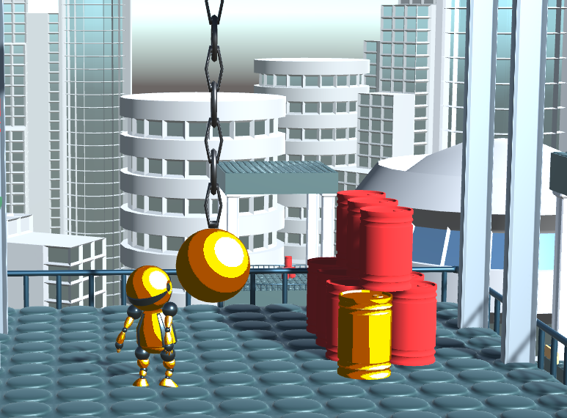
Result
Note that the colors follow the main light source
Try: have different toon-shaded objects with different colors

Slide 41
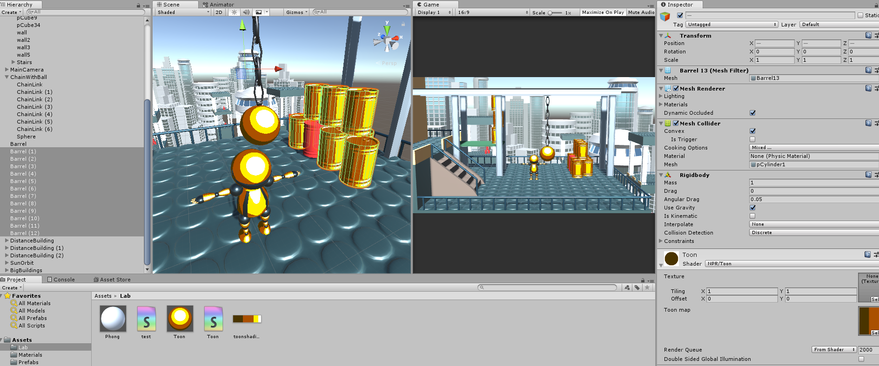
Drawbacks of toon shading
Have to create the color ramps manually for every different object
Have to apply the materials to every object
Note: we can apply a material to multiple objects at once in Unity

Slide 42
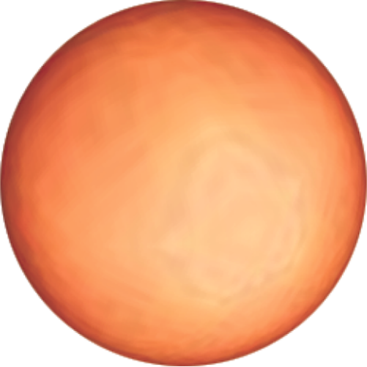
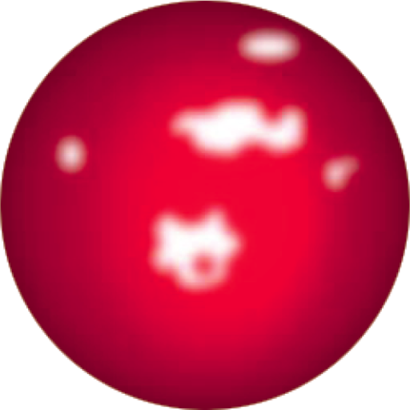
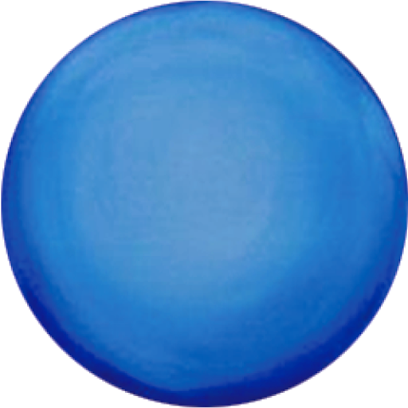
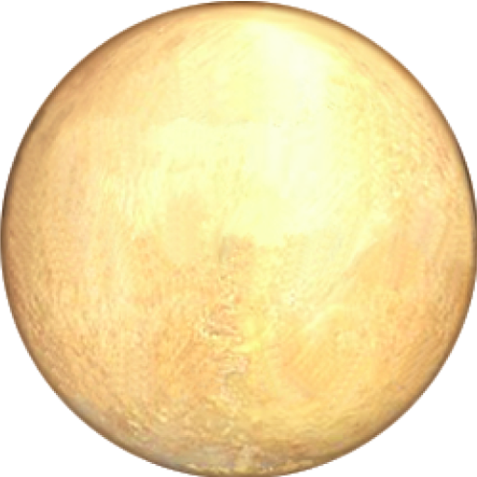
Lit sphere map
Basic idea: let an artist draw how a sphere would look like in the desired style
Sloan, Peter-Pike J., et al. "The lit sphere: A model for capturing NPR shading from art." Graphics interface. Vol. 2001. 2001.

Slide 43
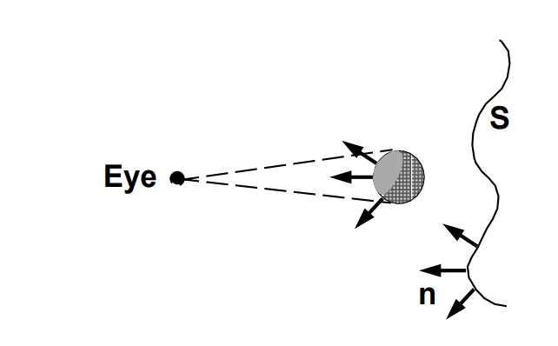
Lit sphere map
Basic idea: let an artist draw how a sphere would look like in the desired style
How to use the style images? Sample them with the normal direction!
When looking straight at a sphere, the vertical and horizontal (x,y) coordinates of the camera-space normal identify the point we see
Surface normals in camera-space
(only (x,y) coordinates count as z points towards the camera)

Slide 44
Lit sphere map
Basic idea: let an artist draw how a sphere would look like in the desired style
How to use the style images? Sample them with the normal direction!
The normal defines how the sphere reacts to light coming from the camera (like a headlight)
Surface normals in camera-space
(only (x,y) coordinates count as z points towards the camera)

Slide 45
Lit sphere map
The vertex shader transforms the normal
No other data is needed by the fragment shader
struct appdata
{
float4 vertex : POSITION;
float3 normal : NORMAL;
};
struct v2f
{
float4 vertex : SV_POSITION;
float3 normal : NORMAL;
};
v2f vert (appdata v)
{
v2f o;
o.vertex = UnityObjectToClipPos(v.vertex);
o.normal = normalize(mul(UNITY_MATRIX_IT_MV,
float4(v.normal, 0)).xyz);
return o;
}

Slide 46
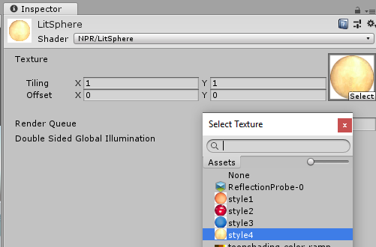
Lit sphere map
The fragment shader samples the style texture with the normal
The image center (with (0.5, 0.5) texture coordinates) corresponds to the (0,0) normal direction
fixed4 frag (v2f i) : SV_Target
{
float3 N = normalize(i.normal);
float3 litColor = tex2D(_MainTex,
float2(0.5,0.5) + N.xy*0.49).rgb;
return float4(litColor, 1);
}
Notes:
Look for style images among the assets (separate zip file)

Slide 47
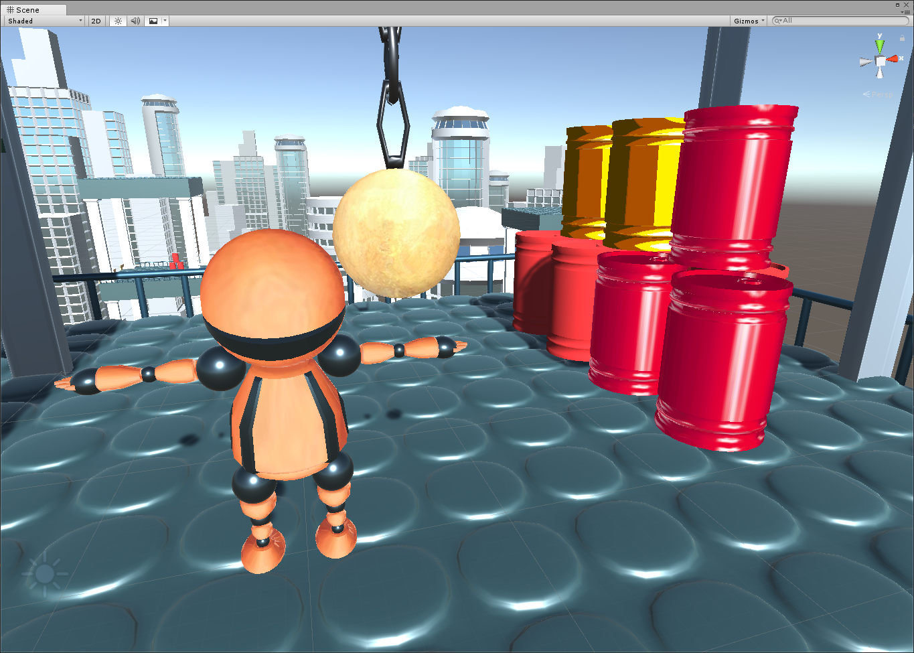
Result

Slide 48
Task
See what happens with the lit sphere map if we transform the normal to world-space instead of camera space
o.normal = UnityObjectToWorldNormal(v.normal);
Alternative: transform the normal to the space of the light source

