Slide 1
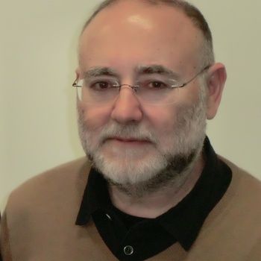
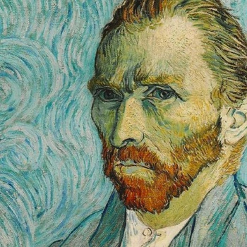
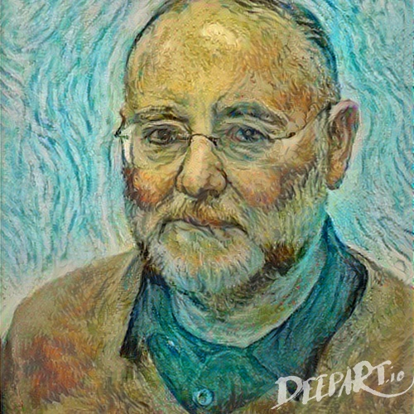
Style transfer and example-based techniques

Slide 2
Outline
Types of style transfer methods
Color transfer between images
Texture transfer, image analogies
Neural network-based methods

Slide 3
Goal of style transfer
Transfer the artistic “style” of one medium/media to other media
  How my selfie photograph would look like if it had been painted by Van Gogh? Algorithm: transfer the style of a Van Gogh self-portrait to my photo!
In most methods “media” mean images
  Few algorithms target geometry
  In this course we focus on images

Slide 4
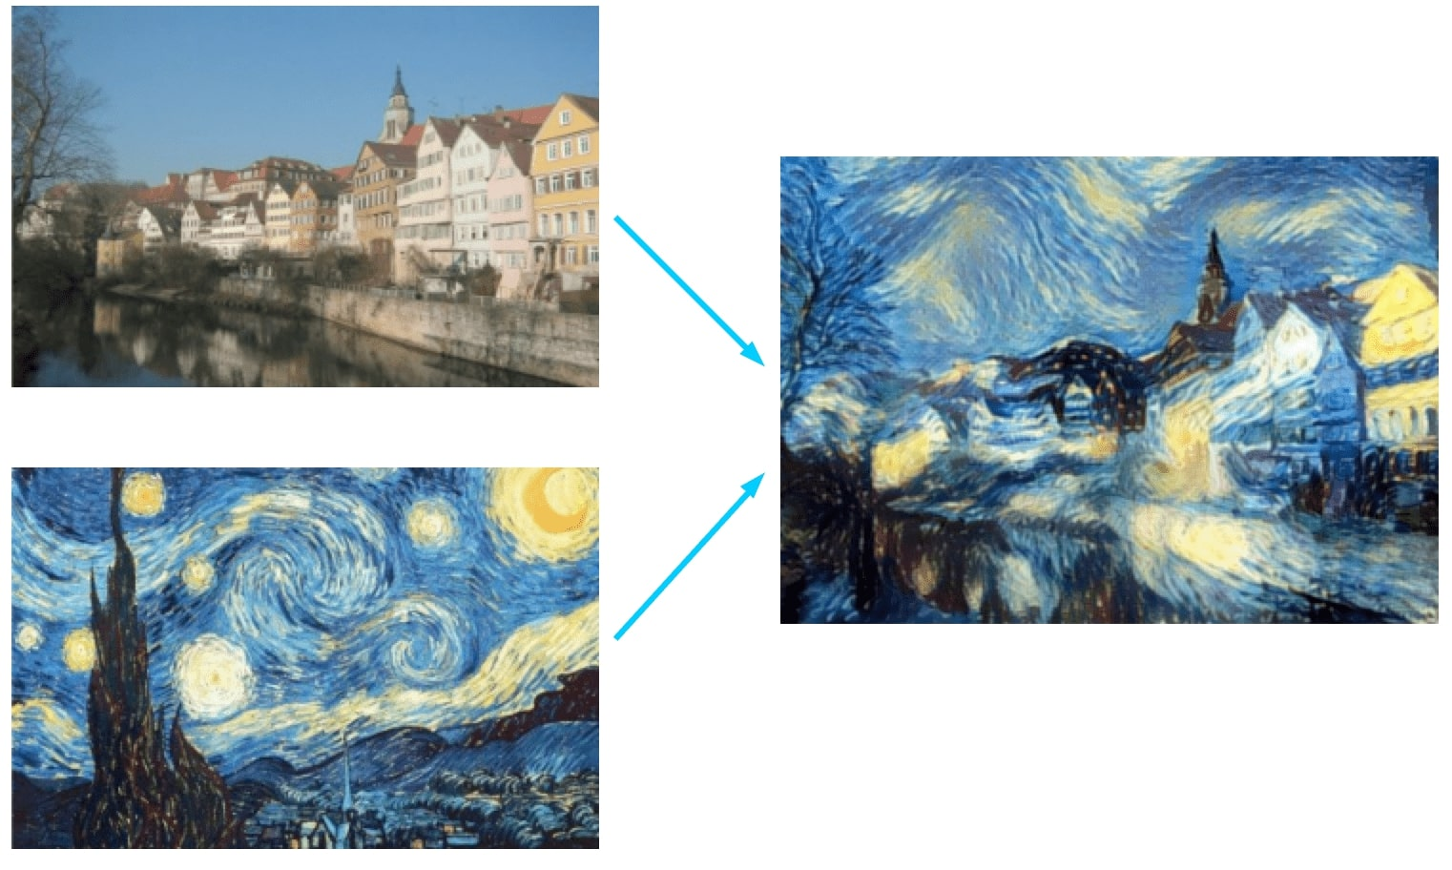
Goal of image style transfer
How does this image look like…
This is called
the target image
Transform the target
Using any kind of image statistics extracted from the exemplar
…in this "style"?
This is called source image
or exemplar

Slide 5
What to “transfer”?
Transfer the artistic “style” of one image/images to other image(s)
What is “style”?
Typical approches:
  Style is Color only: transfer the color distribution or mood
  Style is Texture only: transfer local patterns, variations in color
  Style is whatever the artificial intelligence gives as style: Use neural networks to figure out what information describes the style of the exemplar, or what separates content from the style
We shall have a look at these categories in more details

Slide 6
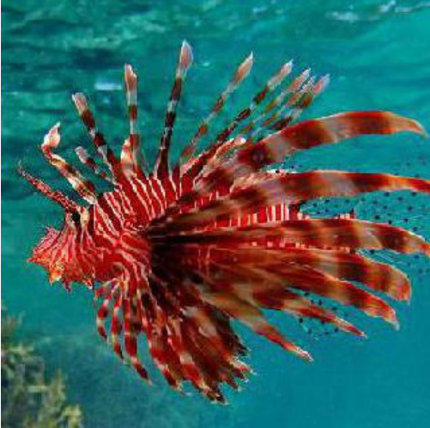
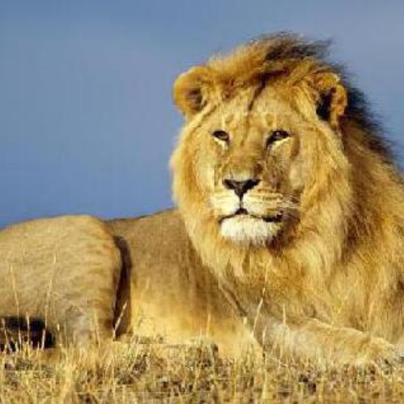
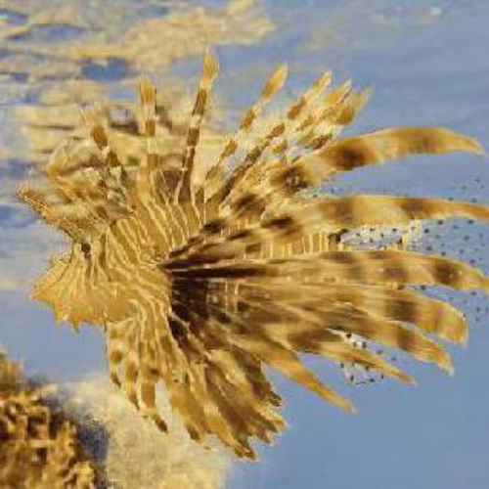
Color transfer
Extract color statistics from the exemplar
  Histogram, color mean, variance, principal components of colors (PCA), etc…
Transform the pixels of the target such that the color statistics of the transformed target match the color statistics of the exemplar
  Note: shapes and in most cases textures are preserved
Target
Source
Result

Slide 7
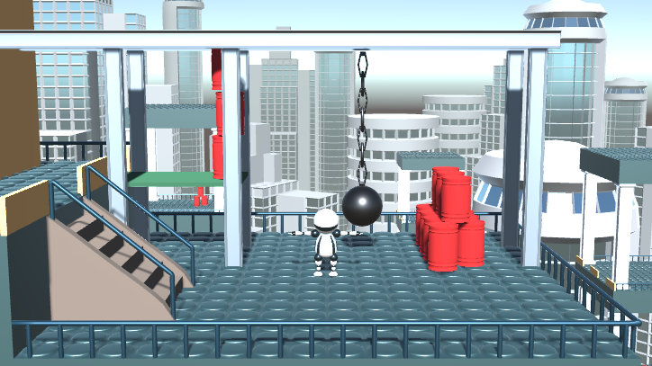
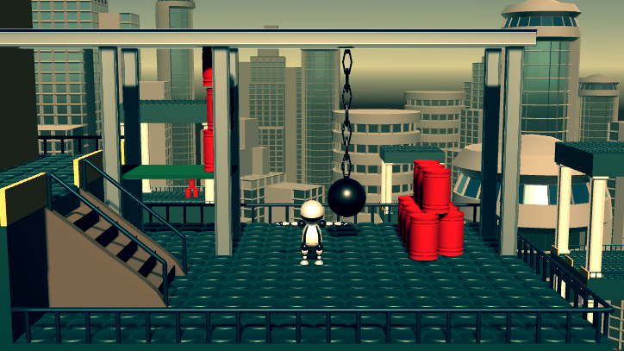


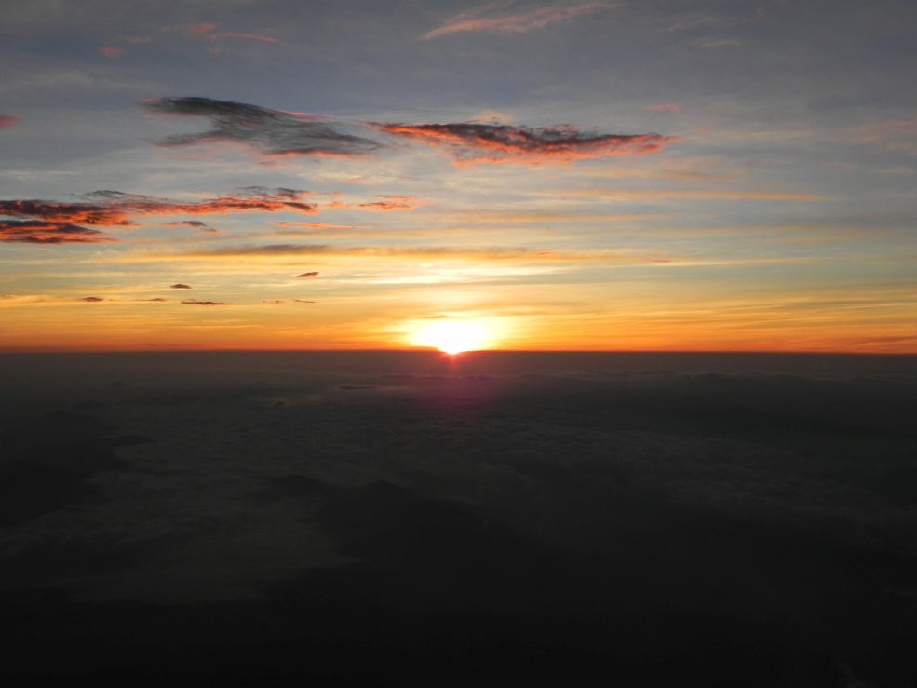
Color transfer
Extract
Apply
Match
Target
Extract
Source

Slide 8
Mean & Variance
Reinhard, Erik, et al. "Color transfer between images." IEEE Computer graphics and applications 21.5 (2001): 34-41.
The image statistics to match are the mean and variance of colors in the CIE-Lab color space (HSV, RGB, XYZ might produce nice results too)
The algorithm (assuming RGB images):
Transform both images to the desired color space (e.g. CIE-Lab)
Compute mean and variance of all pixel values, separately for the source and target images
Scale and shift the pixels of the target image
  NewColor := OldColor – TargetMean // Subtract the mean of the target image
  NewColor *= SourceStdDev / TargetStdDev // Scale to have the same std. deviation as the source
  NewColor += SourceMean // Add the mean of the source image
Transform the modified target image back to RGB

Slide 9
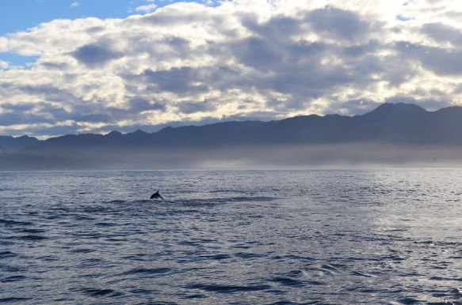
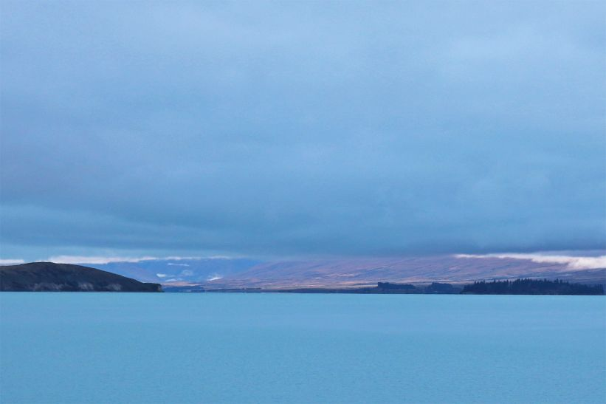
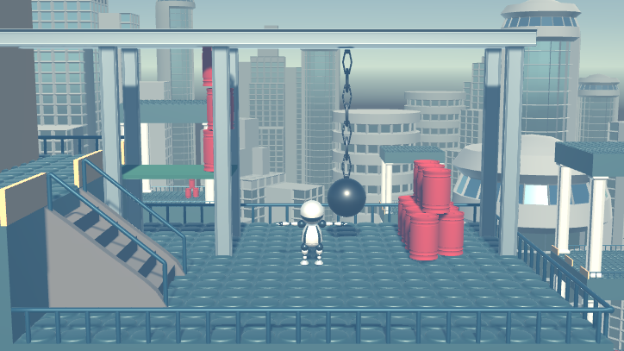
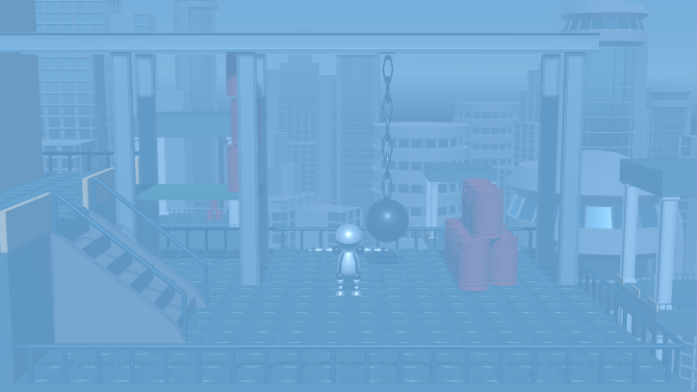
Mean & Variance
Advantages: simple and fast (see the practicals)
Drawbacks: sometimes too simple, result may look like as the original image was viewed through a constant-colored filter (having the same color as the source mean)
Source
Source
Result
Result

Slide 10
Mean & Variance – Reduction
We need to compute the average and variance of image pixels
How do it in real-time (>25 FPS) for millions of pixels?
Parallel reduction programming pattern!
  Average groups of pixels in parallel in a binary tree like pattern
1
5
2
6
3
1
6
0
3
4
2
3
3.5
2.5
3

Slide 11
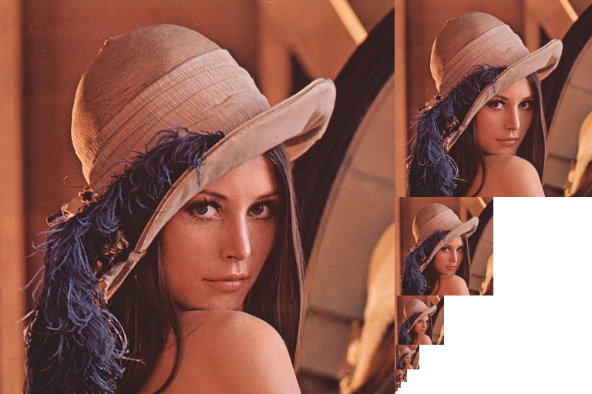
Mean & Variance – Mip-Mapping
The averaging parallel reduction is the same as what Mip-Mapping (or image pyramid generation) does: 1 pixel of the coarser level is the average of 4 pixels of the finer level
The coarsest Mip-Map level contains the pixel mean
1x1 pixel level: average of all pixels

Slide 12
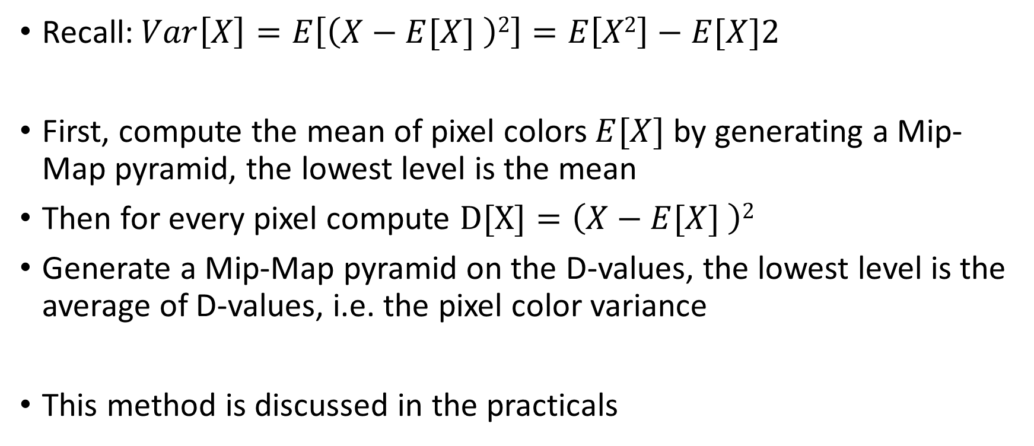
Variance computation – first method
Recall: $Var\left[X\right]=E\left[\left(X−E[X] \right)2\right]=E\left[X2\right]−E[X]2$
First, compute the mean of pixel colors $E[X]$ by generating a Mip-Map pyramid, the lowest level is the mean
Then for every pixel compute $D[X]=\left(X−E[X] \right)2$
Generate a Mip-Map pyramid on the D-values, the lowest level is the average of D-values, i.e. the pixel color variance
This method is discussed in the practicals

Slide 13
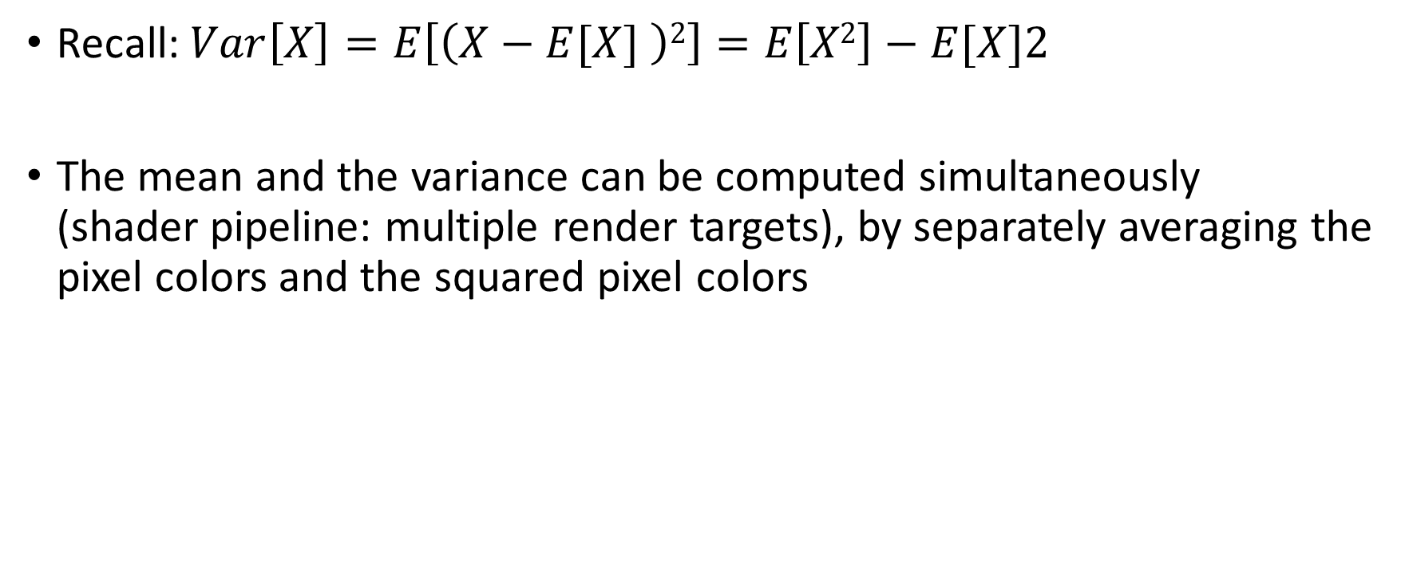
Variance computation – second method
Recall: $Var\left[X\right]=E\left[\left(X−E[X] \right)2\right]=E\left[X2\right]−E[X]2$
The mean and the variance can be computed simultaneously (shader pipeline: multiple render targets), by separately averaging the pixel colors and the squared pixel colors

Slide 14
More sophisticated color transfer methods
A single mean and variance value usually does not capture the color style of the image and it does not consider the content
Results may become unrealistic
  E.g. sky can transform to green, skin can become purple
Example approaches found in the literature to overcome these limitations:
  Clustering of image colors, match clusters by optimization
  Treat color distribution as a probability distribution, match PDF-s
  Use predefined color-palettes and optimize color harmony
  Data-driven approach: identify objects (e.g. faces) on the two images and transfer colors between identical or similar objects
    This can avoid unnatural colors like green sky or purple skin
    Can use labeled training data and machine learning to identify arbitrary objects
Algorithm details are out of scope of this course

Slide 15
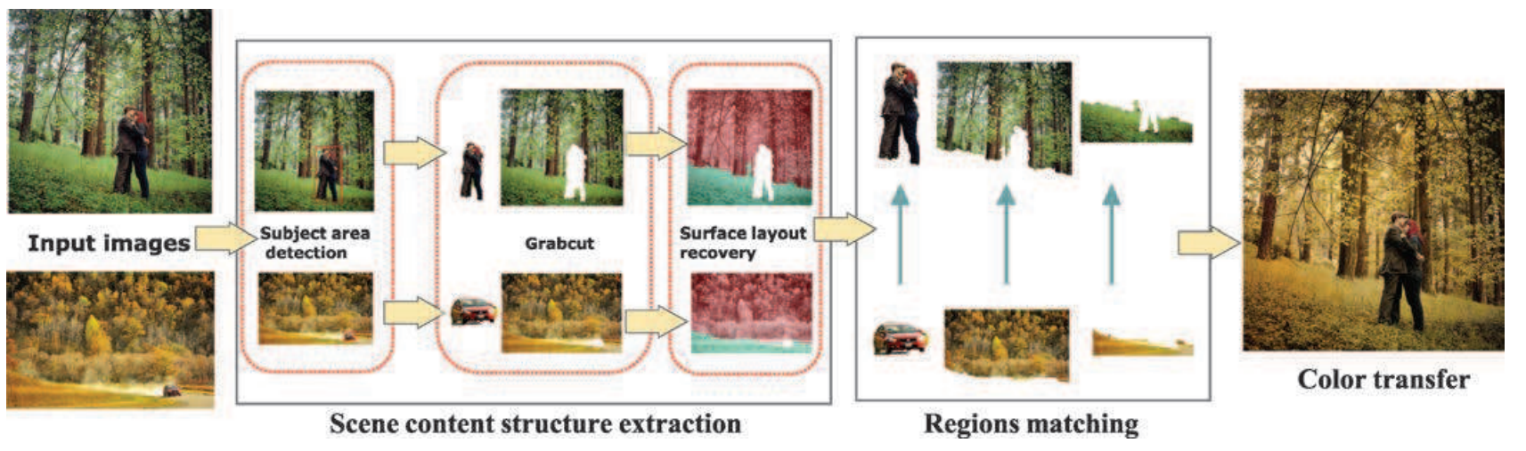
More sophisticated color transfer methods
Data-driven approach example:
Wu, Fuzhang, et al. "Content‐based colour transfer." Computer Graphics Forum. Vol. 32. No. 1. Oxford, UK: Blackwell Publishing Ltd, 2013.

Slide 16
Texture transfer – Image analogies
Hertzmann, Aaron, et al. "Image analogies." Proceedings of the 28th annual conference on Computer graphics and interactive techniques. ACM, 2001.
Goal: given a pair of source images A and A’, learn the mapping between A and A’ and apply it to a target image B
  The source is now an image pair instead of a single image, which describes how the “natural” image A looks like after we applied the desired style that transforms it to A’
  The mapping (i.e. the stylization) between A and A’ is considered to be an arbitrary filtering that changes the texture of the image
  ⇒ We aim to transfer texture

Slide 17
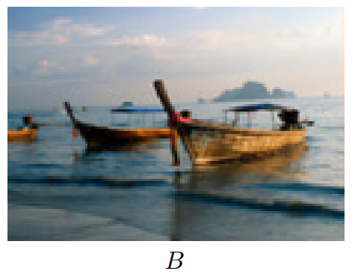
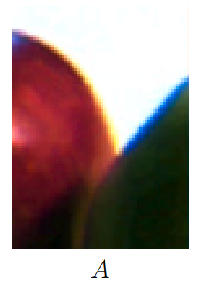
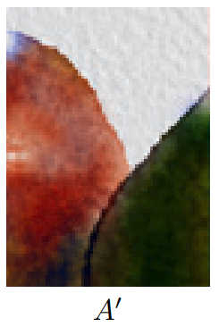
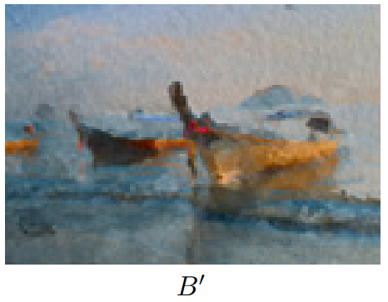
Image analogies
Target image, the aim is to apply the same transformation on it that created A’ from A
Extract the mapping between A and A’
Apply the same mapping to B
Unfiltered (A) and Filtered (A’) source images, specified
by the user

Slide 18
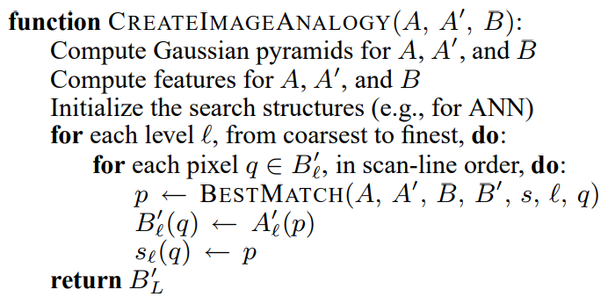
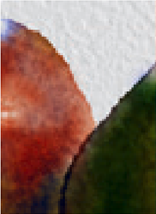
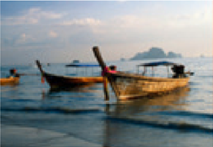
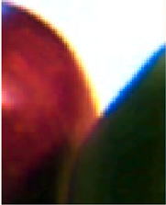
Image analogies implementation
A
A’
B

Slide 19






Image analogies implementation
A
A’
B
A_{L-1}
A’_{L-1}
B_{L-1}
A_{L-2}
A’_{L-2}
B_{L-2}
…
…
…
A₁
A’₁
B₁

Slide 20
Image analogies implementation
A
A’
B
Local (pixel-based) features,
a vector in every pixel
Usually only pixel luminance but can be anything
such as oriented gradients
A_{L-1}
A’_{L-1}
B_{L-1}
A_{L-2}
A’_{L-2}
B_{L-2}
…
…
…
A₁
A’₁
B₁

Slide 21
Image analogies implementation
A
A’
B
A pixel of the result B’ at the current level (from coarsest to finest) is will be the one that best matches a pixel in A and A’
Finding the best match is the
heart of the method
B_{L-1}
A_{L-1}
A’_{L-1}
A_{L-2}
A’_{L-2}
B_{L-2}
…
…
…
A₁
A’₁
B₁

Slide 22
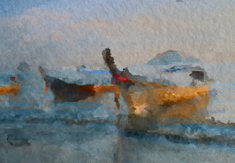

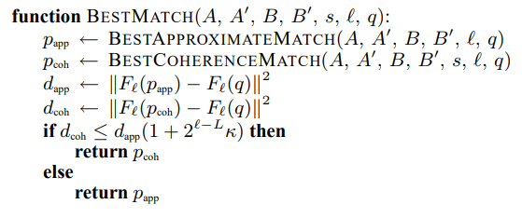

Image analogies implementation
A
A’
B
B’ (result)
p
p
At a certain level, fill B’ pixel by pixel in a scanline order
Find “best match”: the new value for a pixel p will be the pixel q in A’ for which the combined feature vector for all pixels of B and B’ in a neighbourhood around p is the closest to the combined feature vector for pixels in A and A’ around q in some metric, e.g. L₂
q
q
A_{L-1}
A’_{L-1}
B_{L-1}
A_{L-2}
A’_{L-2}
B_{L-2}
…
…
…
A₁
A’₁
B₁
B’ is computed from coarse to fine

Slide 23
Image analogies implementation
A
A’
B
B’ (result)
p
p
In other words find pixel q in (A, A’) that has the most similar neighbourhood to p in (B,B’)
(A , A’ ) is the closest to (B , B’ )
Note that the neighbourhood is L-shaped because it has to consider pixels in B’ that have already been computed
For a single pixel in B, scan the entire (A,A’) ⇒ slow!
Speedup: approximate nearest neighbours (ANN)
q
q
A_{L-1}
A’_{L-1}
B_{L-1}
A_{L-2}
A’_{L-2}
B_{L-2}
…
…
…
A₁
A’₁
B₁
B’ is computed from coarse to fine

Slide 24
Image analogies implementation
A
A’
B
B’ (result)
p
Best match can also consider self-coherence, i.e. similarity (in neighbourhood) with the already generated part in B’
The weighting between coherence match with B’ and the nearest neighbour match with (A, A’) seen on the previous slide is a parameter of the algorithm
A_{L-1}
A’_{L-1}
B_{L-1}
A_{L-2}
A’_{L-2}
B_{L-2}
…
…
…
A₁
A’₁
B₁
B’ is computed from coarse to fine

Slide 25
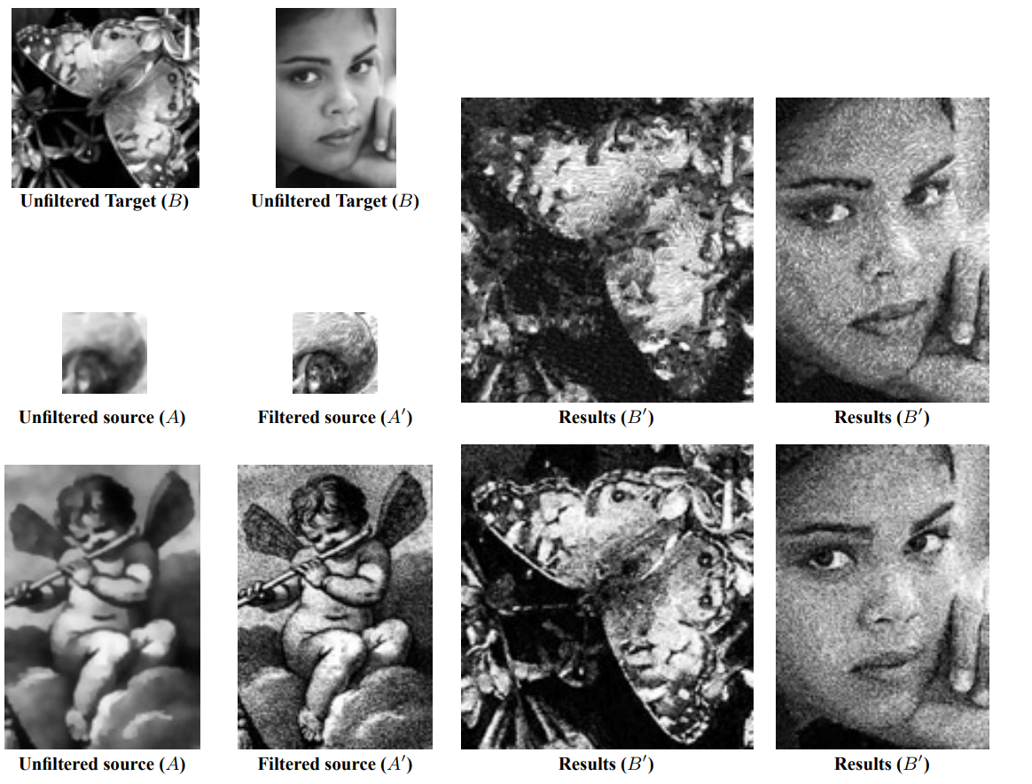
Example application: Texture Transfer
Learn stylization that can be described as some kind of image filtering (e.g. brush strokes, hatching)
Usually the filtered source (the desired style) is available, the “unfiltered” source is generated by edge preserving blurring of the filtered image
  Does not always work, blurring may not generate a natural, “photorealistic” image
Generate unfiltered version by blurring
Existing style sample

Slide 26
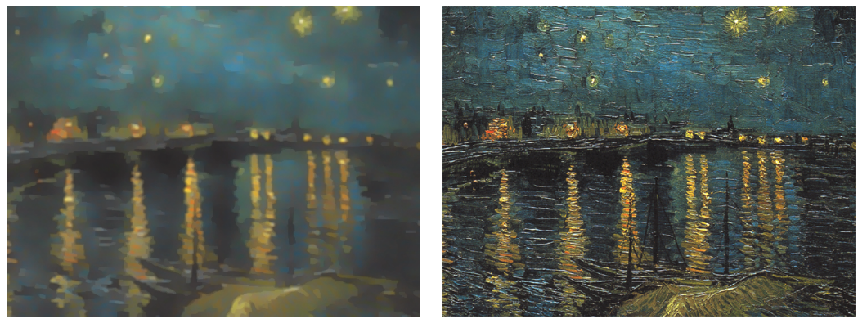
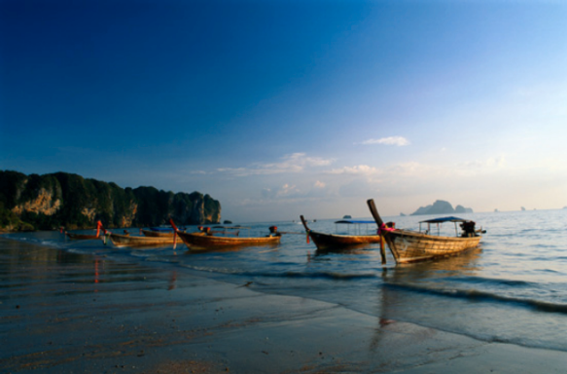
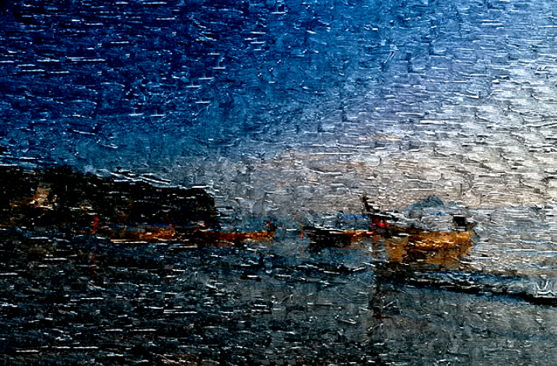
Example application: Texture Transfer
A
A’
B
Generate unfiltered version by blurring
Existing style sample
B’ (result)

Slide 27
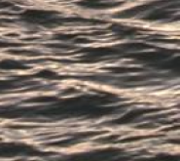
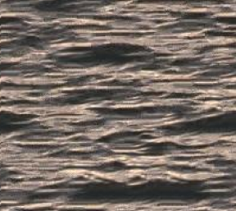
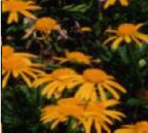

Example application: Texture Synthesis
Goal: generate a large texture from a small sample
  Many tricks of Image Analogies were taken from Texture Synthesis literature
Usage: the unfiltered source (A) and the target (B) are empty
A’
B’ (result)
A’
B’ (result)
A (empty)
A (empty)

Slide 28
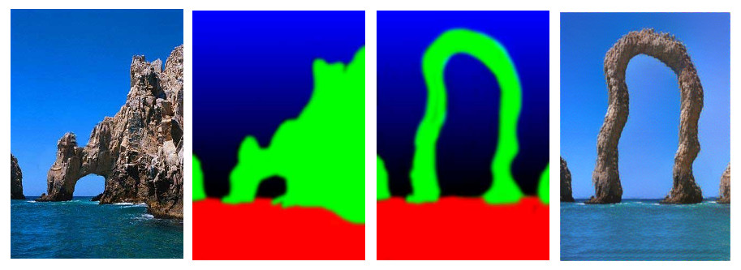
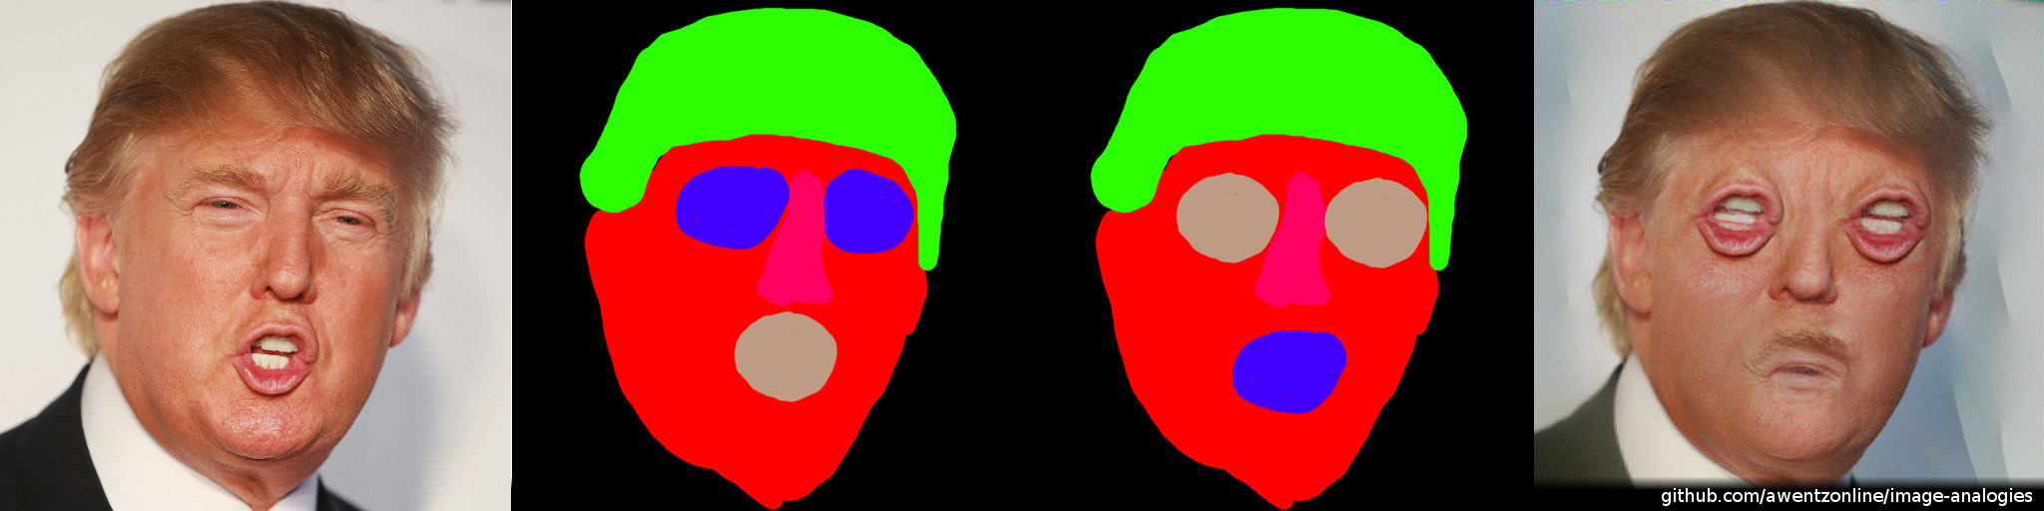
Example application: Texture-by-numbers
The “unfiltered source” (A) is a user-specified label map, the filtered source (A’) is a regular image
The target image is a modified label map
Image source: https://github.com/awentzonline/image-analogies

Slide 29
Image analogies summary
Advantages:
  Can transfer relatively complex textures, many different styles
  Usually artifact-free, nice results
Drawbacks:
  Slow
  Only low-level features are used (texture), shapes and structure are not captured by the mapping
  Not always possible to provide a pair of exemplars that defines the desired stylization
    Blurring a photo with the desired style may not be enough to create the unfiltered version (example: cubism)

Slide 30
Neural style transfer
Try to use the power of AI research, more specifically, Convolutional Neural Networks (ConvNets or CNNs) to transfer image style
  without requiring ground truth (i.e. the “unfiltered” source of image analogies) and
  by capturing shape and structures in addition to texture and color.
The use of CNNs for image style transfer is called neural style transfer
Became an extremely popular research topic in the past 3 years, dozens of papers were published
  Most NPR research these days is about neural style transfer…

Slide 31
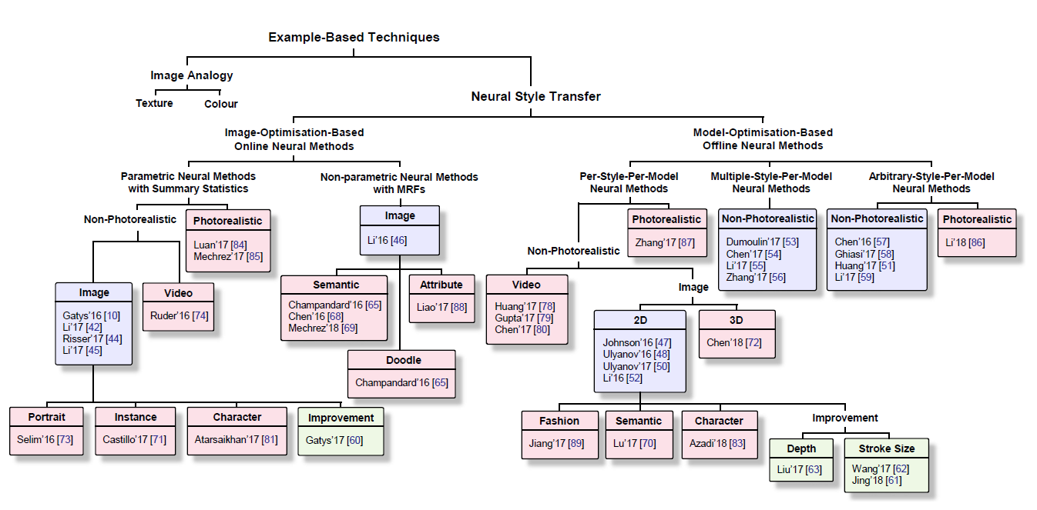
Neural style transfer
Jing, Yongcheng, et al. "Neural style transfer: A review." arXiv preprint arXiv:1705.04058 (2017).

Slide 32
Learning algorithms
Given:
  An input vector x and a result vector y
  A parametric model f(x) = f(x, p), where p is the set of parameters we seek
Goal:
  Fit the model to the data
  That is: obtain p such that y = f(x)
    Minimize distance between y and f(x) in some distance metric, or cost function in the learning process
Example: linear regression

Slide 33
Learning algorithms – key parts
Cost function
  How to determine that our fitting is close to the output y
  Example: L₂ metric
Optimization method
  From a given guess x^{(i)}, how to proceed to the next guess
  Examples: gradient search, Newton-method, Levenberg-Marquardt, genetic algorithms etc.

Slide 34
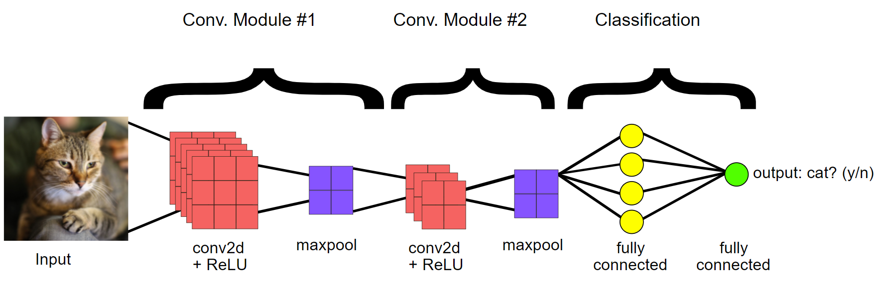
Learning algorithms – main uses
Classification
  Output is binary, or from a finite set
Regression
  Output is continuous
Source: Google

Slide 35
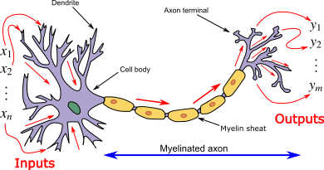
Artificial neural networks
Main idea taken from the human brain
  Complex computations by a large network of connected very simple neurons
Source: Wikipedia

Slide 36
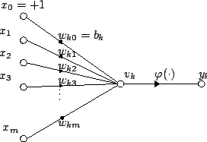
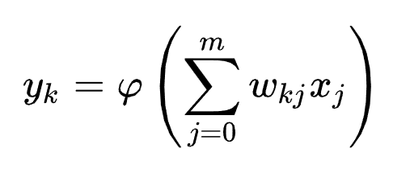
Artificial neural networks
Artificial neural network is a connected computation graph of artificial neurons
Artificial neurons take several inputs and produce one output by applying a simple activation function depending on weights
Weights are adjusted via learning
McCulloch–Pitts “unit” (1943)

Slide 37
Activation function examples
Logical functions
Adding non-linearity to the model: Step function
Adding non-linearity to the model: Sigmoid function
1
1

Slide 38
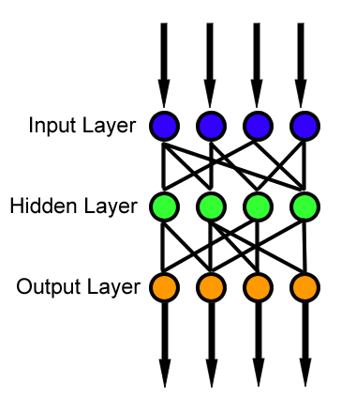
Layers
Modern applications usually use multi-layer networks
Neurons between layers are usually fully connected
Neurons inside layers are usually not connected
Source: Wikipedia

Slide 39
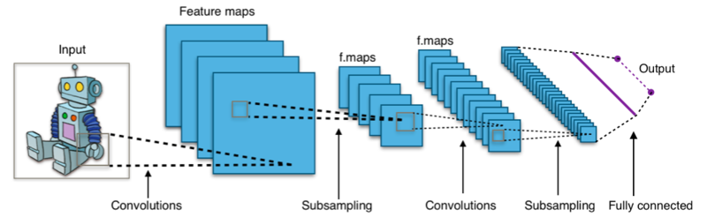
Convolutional neural networks
Designed for images
New type of layer: convolutional layer
  Applies a convolutional filter, its parameters are learned during training
Source: Wikipedia

Slide 40
Convolutional neural networks
From image processing we know that convolutions extract features
  Typical examples: edges, corners etc.
The neural network learns which features are important and how to combine them to solve our problem
Source: Wikipedia

Slide 41
Convolutional neural networks
Convolutional layers and additional subsampling layers allow to merge smaller regions into higher regions
⇒ The network can extract high-level features, built from low-level features
(e.g a face, as a high-level feature is composed of edges in a certain structure)
Source: Wikipedia

Slide 42
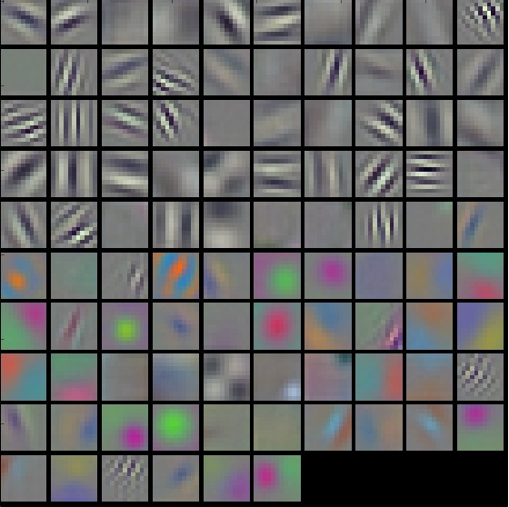
Learned filters
Typical filters learned by the network (the image shows filter weights)
Zeiler, Matthew D., and Rob Fergus. "Visualizing and understanding convolutional networks." European conference on computer vision. springer, Cham, 2014.

Slide 43
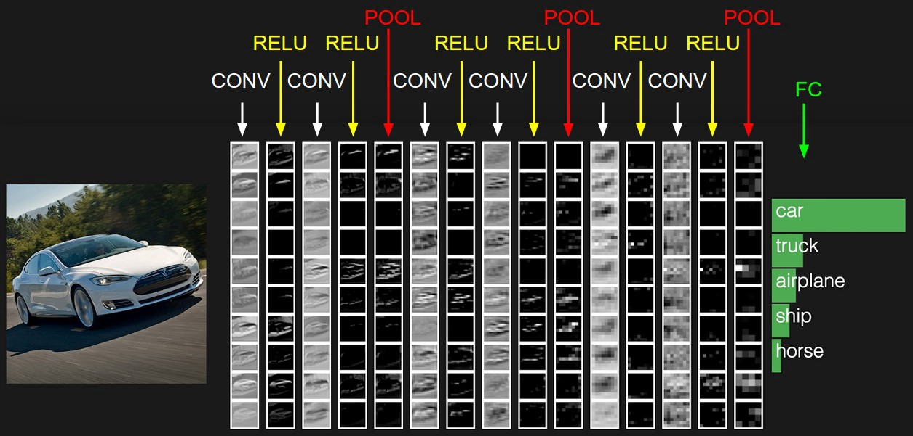
Feature map
The outputs of convolution layers are the feature maps

Slide 44
Feature map
The outputs of convolution layers are the feature maps
  Signal response to the convolution filter
  Approximate meaning: how strong are the different features (described by the convolution weights) at a certain region of an image
  For lower levels this could mean e.g. how strong is the edge in the small neighbourhood of that pixel
  For higher levels this could mean e.g. “how likely is that the neighbourhood of this pixel shows a car”
    Thanks to this, the neural network can be used as a classifier

Slide 45
Pooling
Linear or non-linear downsampling, to reduce the size of the learned features (build high-level features from low-level features)
  Linear functions: e.g. averaging (similar to Mip-Map generation)
  Non-linear functions: e.g. maximum
8
5
Maximum
2
3
1
5
6
9
8
7
2
2
4
3
8
4
6
1
3
9
5
2.5
Average
3.5
6

Slide 46
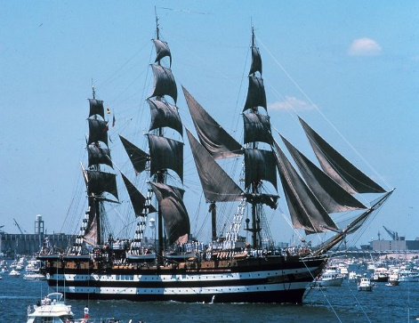
Application: image classification
An example architecture:
cat
ship
bird
car
…
Features
to vector
Fully connected layer
Input image
Convolutional layer
Max pooling layer
Feature extraction
Classifier

Slide 47
Application: image classification
Information about content AND style
An example architecture:
cat
ship
bird
car
…
Features
to vector
Fully connected layer
Input image
Convolutional layer
Max pooling layer
Feature extraction
Classifier

Slide 48
Neural Style Transfer
Basic idea:
  Use a classifier that was trained on a large training set
    Can identify many different objects
    Can extract relevant features, some of which describe content, others the style
  Given the target image and the exemplar image, generate an image that minimizes content loss w.r.t. the target image and style loss w.r.t. the exemplar image
    In neural style transfer literature, target image is called the content image and the exemplar the style image – here we will stick to source and exemplar

Slide 49
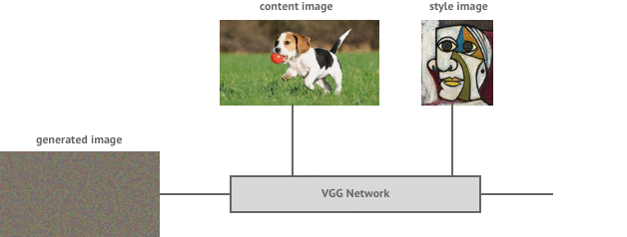
Neural Style Transfer
Target
(Content)
image
Exemplar
(Style)
image
Result
Convolutional Neural Network (example implementation: VGG)
Content
representation
Style
representation
Style
representation
Content
representation
Style loss
https://medium.com/data-science-group-iitr/artistic-style-transfer-with-convolutional-neural-network-7ce2476039fd
Content loss

Slide 50
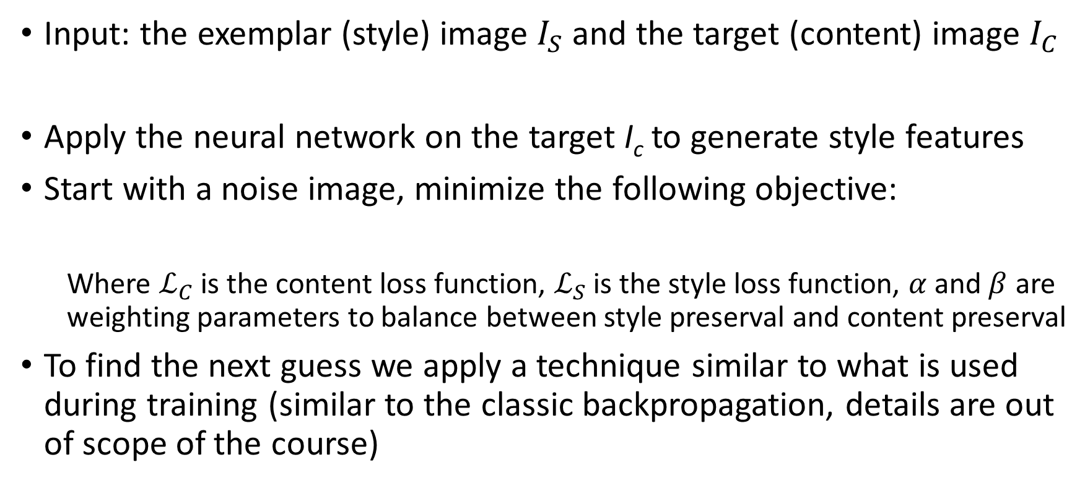
Neural Style Transfer
Input: the exemplar (style) image $I_{S}$ and the target (content) image $I_{C}$
Apply the neural network on the target I_{c} to generate style features
Start with a noise image, minimize the following objective:
  Where $ℒ_{C}$ is the content loss function, $ℒ_{S}$ is the style loss function, $α$ and $β$ are weighting parameters to balance between style preserval and content preserval
To find the next guess we apply a technique similar to what is used during training (similar to the classic backpropagation, details are out of scope of the course)
  $$I^{∗}= {argmin}_{I} αℒ_{C}\left(I_{C}, I\right) +βℒ_{S}\left(I_{S}, I\right)$$

Slide 51


Computation of loss functions $ℒ_{C}$ and $ℒ_{S}$
Applying the network to an image generates feature vectors for all levels of the network
Apply the network to the target (content) image and the exemplar (style) image
  Manually select certain levels of the network for the target, the features of these levels are used to compute content loss
  Manually select certain levels (usually not the same as for content) of the network for the exemplar, the features of these levels are used to compute style loss
The content loss function is the L₂ distance between the content feature vectors, summed for all levels selected for content, i.e.
  $ℒ_{C}(I)=\sum_{lε\{l_{c}\}}{{\left\|ℱ^{l}\left(I_{C}\right)−ℱ^{l}(I)\right\|}^{2}}$, where $\{l_{c}\}$ is the set of levels manually selected for content and $ℱ^{l}$ is the feature vector corresponding to level $l$, $I_{C}$ is the target image, $I$ is the current output
The style loss function is the L₂ distance between the Gram-matrices (similar to covariance matrix) of the style feature vectors, summed for all levels, i.e.
  $ℒ_{S}(I)=\sum_{lε\{l_{S}\}}{{\left\|𝒢(ℱ^{l}\left(I_{S}\right))−{𝒢(ℱ}^{l}(I))\right\|}^{2}}$, where $\{l_{S}\}$ is the set of levels manually selected for style and $𝒢$ is the Gram matrix, $I_{S}$ is the exemplar image
Selection of levels $\{l_{c}\}$ and $\{l_{S}\}$is performed manually before running the method

Slide 52




Levels
Target
(Content)
image
$$ℱ^{l}\left(I_{C}\right)$$
$$\{l_{c}\}$$
Features
Features
Features
Features
Features
Exemplar
(Style)
image
$$ℱ^{l}\left(I_{S}\right)$$
Features
Features
Features
Features
Features
$$\{l_{S}\}$$
Content loss
Style loss
Result
Features
Features
Features
Features
Features

Slide 53

Gatys, Leon A., Alexander S. Ecker, and Matthias Bethge. "Image style transfer using convolutional neural networks." Proceedings of the IEEE conference on computer vision and pattern recognition. 2016.

Slide 54

Alternative loss functions
The loss function we have seen previously (Gatys et al. 2015):
  $I^{∗}= {argmin}_{I} αℒ_{C}\left(I_{C}, I\right) +βℒ_{S}\left(I_{S}, I\right)$
  $ℒ_{C}(I)=\sum_{lε\{l_{c}\}}{{\left\|ℱ^{l}\left(I_{C}\right)−ℱ^{l}(I)\right\|}^{2}}$
  $ℒ_{S}(I)=\sum_{lε\{l_{S}\}}{{\left\|𝒢(ℱ^{l}\left(I_{C}\right))−{𝒢(ℱ}^{l}(I))\right\|}^{2}}$
Some other choices from the literature to include in the cost function $I^{∗}$:
(instead of or in addition to the Gram-matrix term):
  Distance of mean and variance of the feature vectors
  Activation histogram of feature vectors
  Distance between the Laplace-filtered target and the exemplar
  Distance of local patches of the feature vectors

Slide 55

Example results
Results from Gatys, Leon A., Alexander S. Ecker, and Matthias Bethge. "A neural algorithm of artistic style." arXiv preprint arXiv:1508.06576(2015).
Note that color, texture and shapes are also transferred

Slide 56
Trained CNNs for a different style
The optimization-based method we have just seen is very slow
Once we have some results for a fixed, single style, we can train a neural network that learns how to apply this particular style
  The application (i.e. forward evaluation) of the network is fast (even can be real-time for videos!), we simply need to send the input through the convoution and pooling layers
Research results showed that we can also train neural networks for a small set of styles ⇒ it is possible to interpolate between styles

Slide 57

Interpolation between styles

Slide 58

Working examples
AI drawing by NVIDIA: http://digg.com/video/nvidia-ai-drawing
AI fills complete regions with details if the region has a semantic label
Video from youtube

Slide 59

Working examples
https://deepart.io
Browser interface to the first neural network style transfer method
Upload your photo, choose style, wait some minutes and voilá!

Slide 60
Working examples
Collection of links to the implementations of state-of-the-art methods:
  https://github.com/ycjing/Neural-Style-Transfer-Papers
  Usually Torch, TensorFlow, Caffee or Matlab implementations
Commercial applications based on neural style transfer:
  Prisma: https://prisma-ai.com
  Ostagram: https://www.ostagram.me

