Slide 1
Stroke Based Rendering

Slide 2
Outline
What is stroke based rendering
Greatest issues of stroke rendering
Stroke rendering using textures
Stroke rendering in object space
Stroke rendering in image space
Additional notes

Slide 3
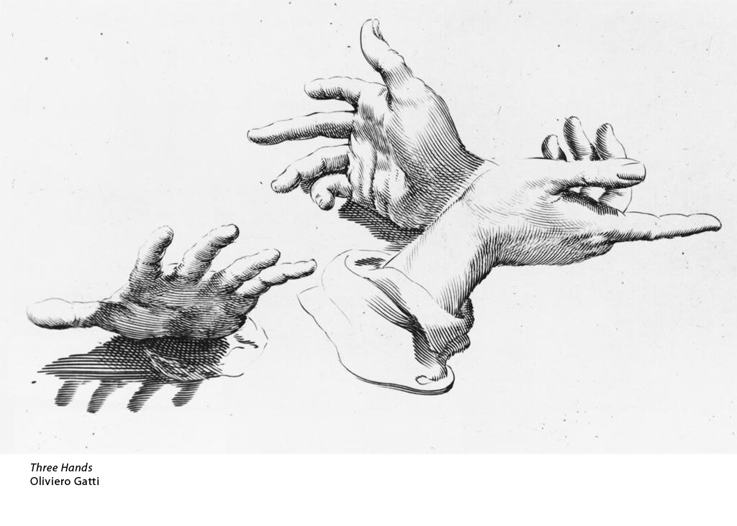
Stroke Based Rendering
Image tones and shape of the objects are represented with oriented lines with varying density
Lighter areas have fever line strokes
Darker areas have more line strokes
Strokes are oriented according to some feature that depicts geometric shape

Slide 4
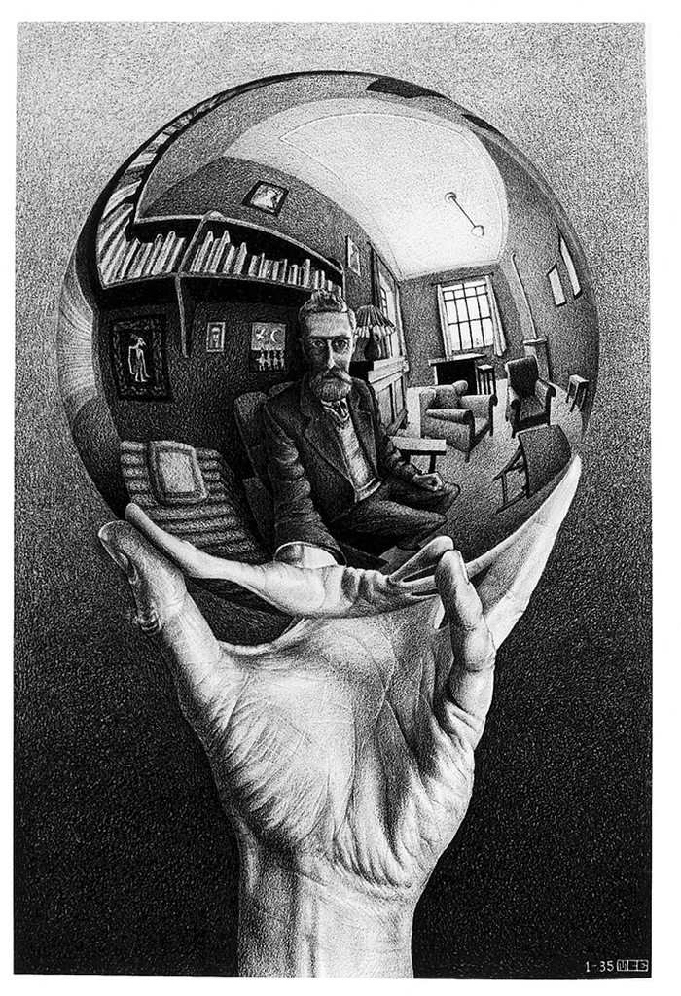
Different styles from the same artist
Left: short dense strokes
Right: long, straight, less dense strokes
Mano con esfera reflectante. M.C. Escher, 1935.
Relatividad - M.C. Escher

Slide 5
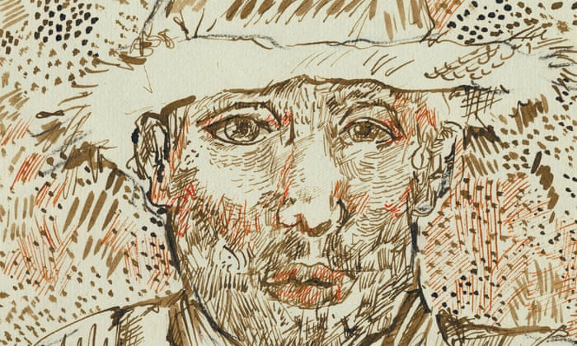
Tools of an artist: Lines and line styles
Recall from Introduction …
Line style: thickness, ink/pencil color and texture, curvature, shape
Vincent Van Gogh (?), Self portrait, discovered in 2013

Slide 6
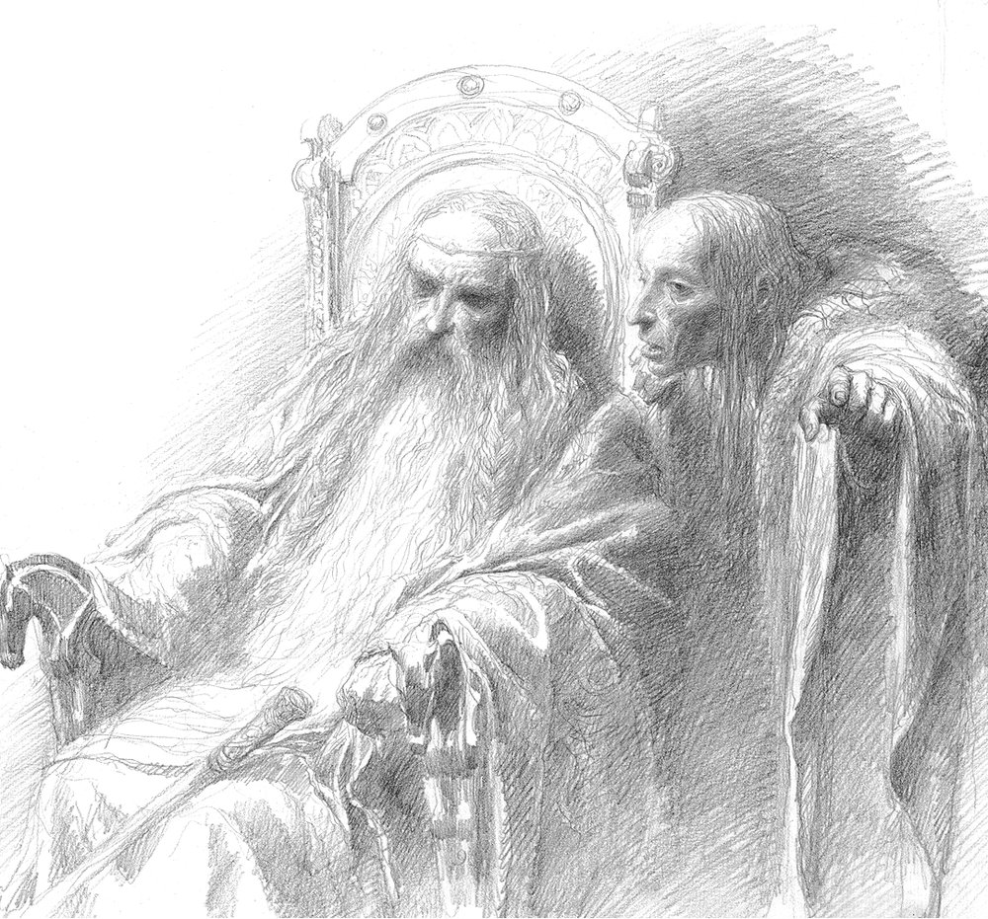
Tools of an artist: Lines and line styles
Recall from Introduction …
Texture: pencil texture
Curvature: no bending
Shape: straight lines
Line style: texture, curvature, shape
Texture: small scale
Curvature/bending: large scale
Shape: medium scale
Texture: pencil texture
Curvature: no bending
Shape: wavy lines
Line Texture Example:
Alan Lee: Concept art for Lord of the Rings

Slide 7
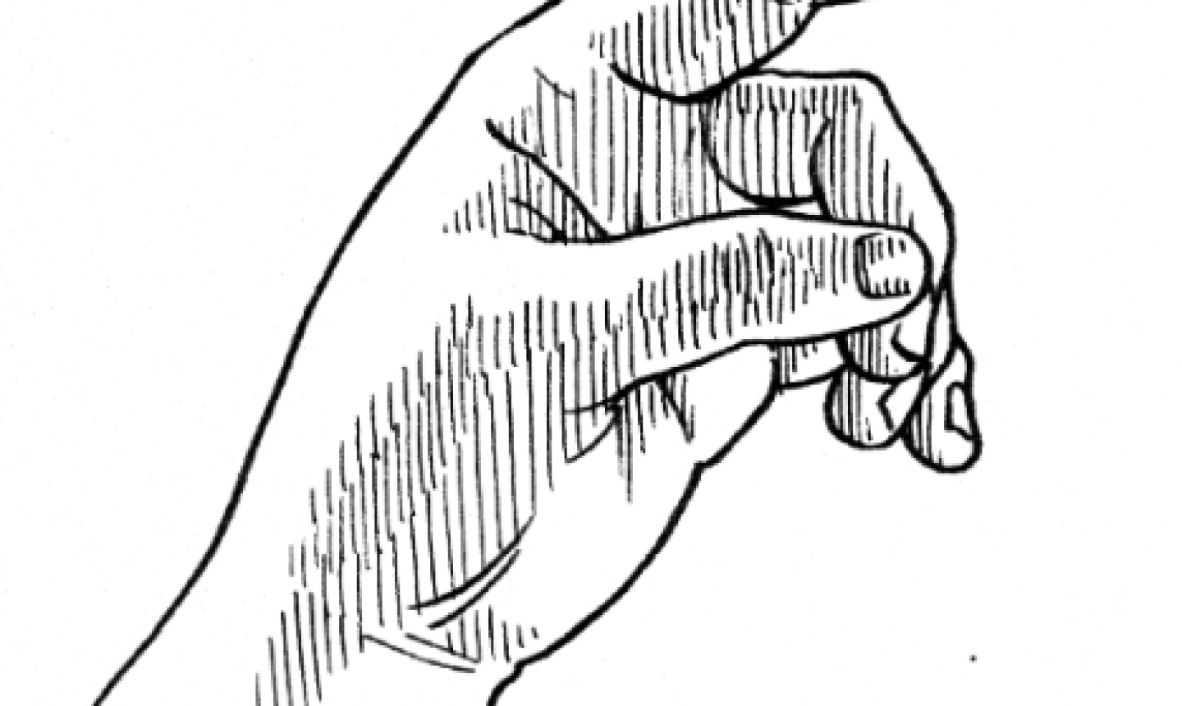
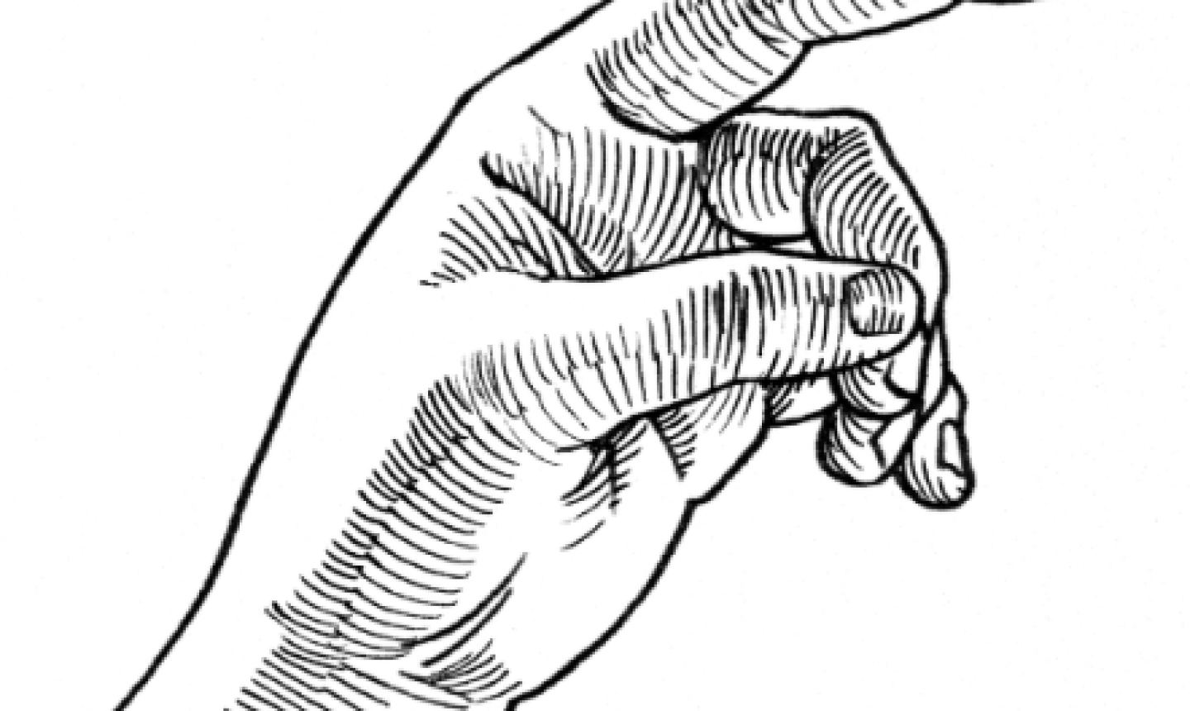
Tools of an artist: Lines and line styles
Recall from Introduction …
Line style: texture, curvature, shape
Texture: small scale
Curvature/bending: large scale
Shape: medium scale
Curvature: no bending
Shape: straight lines
Curvature: curved lines
Shape: straight lines
Images from:
https://www.mybluprint.com/article/this-hatching-exercise-will-make-your-drawings-better

Slide 8
Stroke Based Rendering Issues
In traditional illustrations stroke density is only affected by tone and not affected by object distance
This is hard to achieve if we not define our stroke positions in sceen space
Strokes should follow the underlying geometry
This is easier if we still have geometry information (we are not working in image space)
Temporal coherence issues
Strokes should be „glued” to the surfaces: they should not slide or rotate frame by frame
Strokes should not appear and disappear suddenly between frames
This is easier if we have geometry and animation information

Slide 9
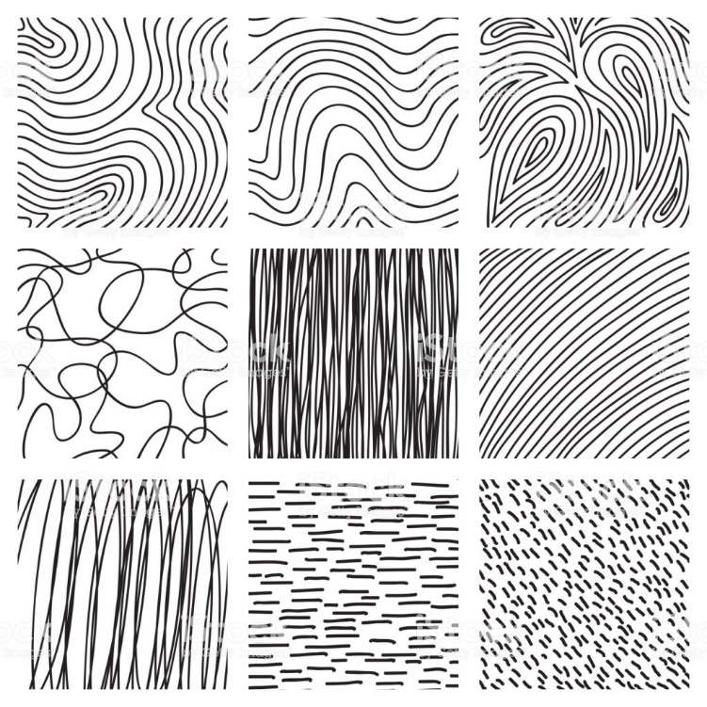
Texture Based Methods
Create a texture that shows the desired line pattern
Use this texture when rendering the object
We can use arbitrary styles
Need good texture parameterization!
UV mapping defines how lines follow the geometry
UV mapping guarantees that lines are fixed to the surface
Questions
How to vary line density according to tone
How to implement uniform screen space density (line density does not depend on object distance)

Slide 10
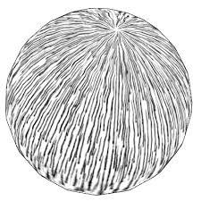
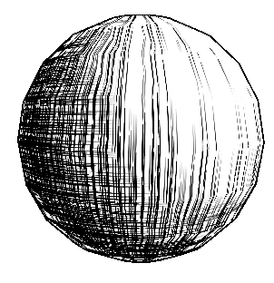
Texture Based Methods
How to implement tones?
A single texture can not represent tones
We need several texture versions: versions for each tone level we want to illustrate
Switch texture according to pixel luminance (quantize luminance first)
Texture change can be smooth (blend textures) or abrupt
Can be efficiently implemented with a 3D texture

Slide 11
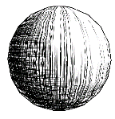
Texture Based Methods
How to implement uniform screen space density?
Using our tonal hatching textures objects at larger distance will cover smaller pixel area
The effect is that the texture is scaled in image space
Scaling affects stroke density and stroke length/width too
For distant objects individual strokes are blurred together and indistinguishable from each other

Slide 12
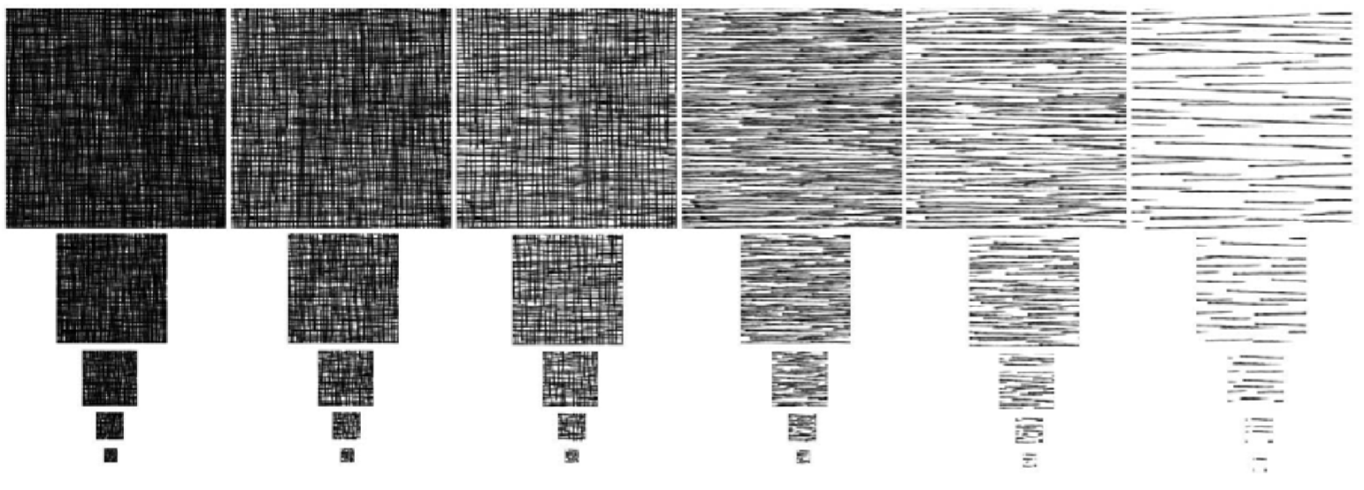
Texture Based Methods
How to implement uniform screen space density?
Solution: Tonal Art Maps (TAM)
Create lower resolution versions for each tone texture
Can be implemented with mip-mapping
Emil Praun, Hugues Hoppe, Matthew Webb, Adam Finkelstein, “Real-time Hatching,” Computer Graphics (SIGGRAPH 2001 Proceedings), pages 581-586.

Slide 13
Texture Based Methods
How to implement uniform screen space density?
Create lower resolution versions for each tone texture
Hand drawing these textures are hard
Automatic generation is used
Needs a generator tool

Slide 14
Texture Based Methods
How to implement uniform screen space density?
Create lower resolution versions for each tone texture
Automatic generation
Start with the lowest resolution of the lightest tone and draw lines in it
For a higher level keep the line positions from previous level and add new ones (line width is fixed in pixels, thus lines get relatively thinner when moving to higher resolutions)
For a darker tone keep the line positions from the previous tone and add new ones
Tone 1
Tone 2
Keep line
Level 0
New line in Tone 2
New line in Tone 2, Level 2
Keep line
Level 1
New line in Level 1
Keep line

Slide 15
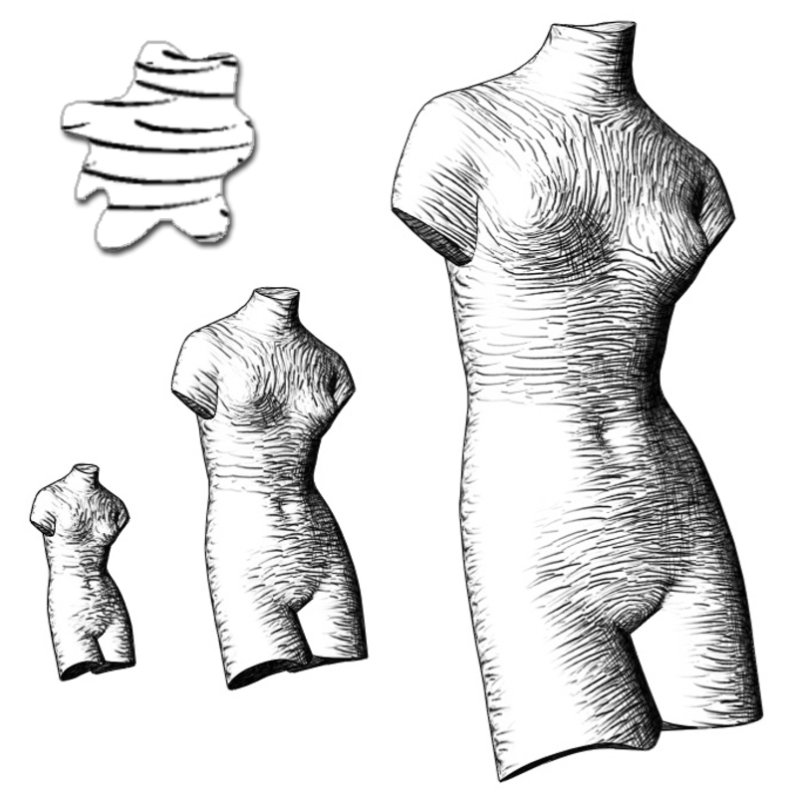
Tonal Art Maps
Results
Lines are not blending together on distant objects
Line width is not changing
Screen space density is uniform
Emil Praun, Hugues Hoppe, Matthew Webb, Adam Finkelstein, “Real-time Hatching,” Computer Graphics (SIGGRAPH 2001 Proceedings), pages 581-586.

Slide 16
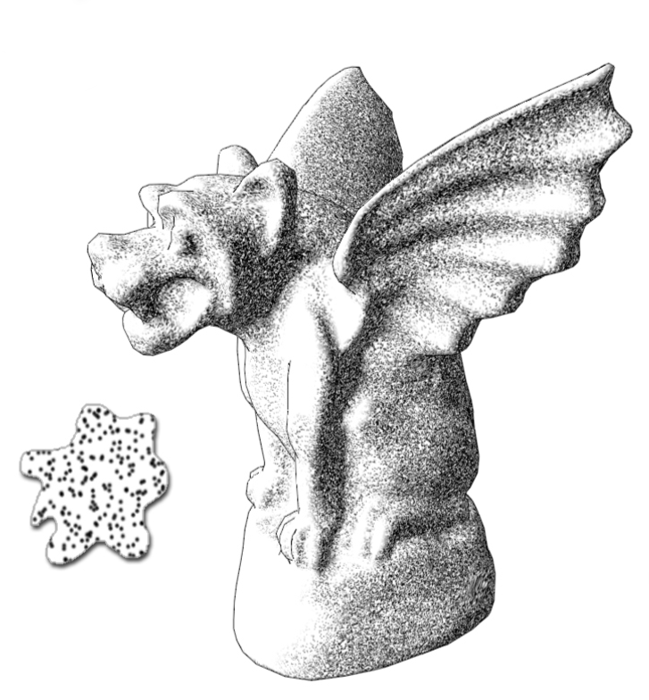
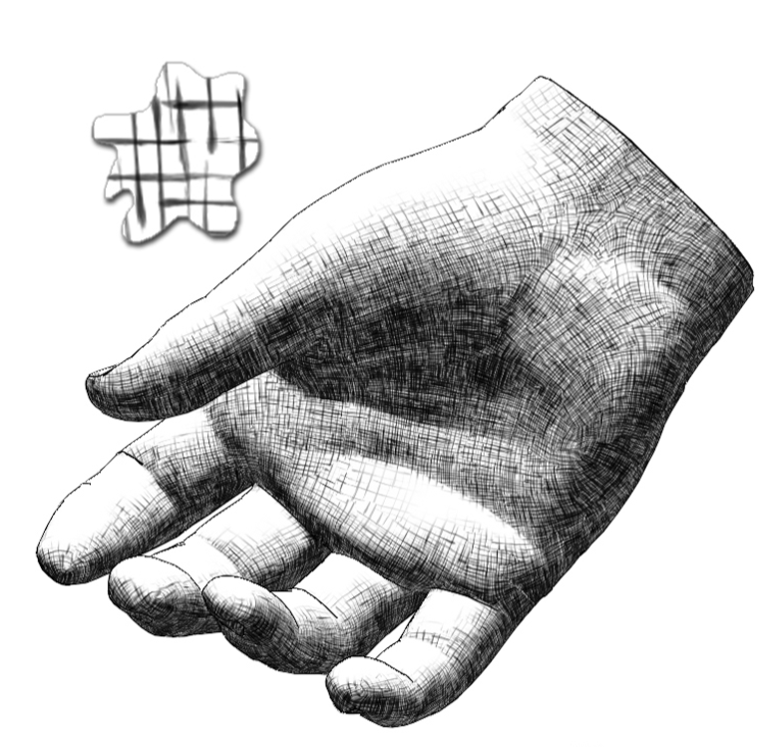
Tonal Art Maps
Other styles
Emil Praun, Hugues Hoppe, Matthew Webb, Adam Finkelstein, “Real-time Hatching,” Computer Graphics (SIGGRAPH 2001 Proceedings), pages 581-586.

Slide 17
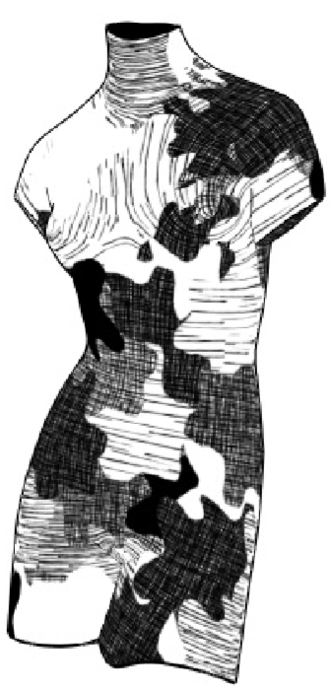
Texture Based Methods
Even with Tonal Art Maps one problem remains
Good UV mapping should be provided!
Distortion in the mapping is visible on hatching
Triangles should have similar scaling in UV space
Triangles should not distort too much in UV space
We should avoid UV seams
E.g. original TAM paper solved this with covering the surface with overlapping patches (this process is not a usual technique in 3D animation and game pipelines)
Emil Praun, Hugues Hoppe, Matthew Webb, Adam Finkelstein, “Real-time Hatching,” Computer Graphics (SIGGRAPH 2001 Proceedings), pages 581-586.

Slide 18
Object space methods
Create geometry for each individual stroke
Geometry is usually a textured line strip
Define stroke positions in object space
Extrude strokes to line strips in object space
Render strokes like other 3D geometry

Slide 19
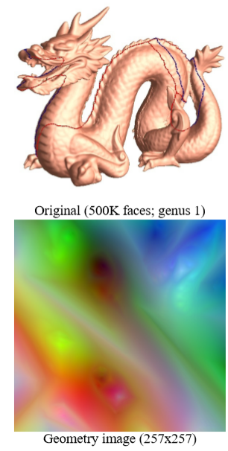
Object space methods
How to define stroke positions on object surface?
I. Simplest method:
Use texture parameterization
Define stroke positions in UV space with uniform distribution
Render a geometry image that flattens triangles in a UV atlas, and renders 3D position to each texel (similar to a normal map, but stores object space surface positions instead of normals)
For each sample read back the object space position from the geometry image
Needs good UV parameterization!
GU X., GORTLER S. J., HOPPE H.: Geometry images. In SIGGRAPH ’02 (2002), pp. 355–361.

Slide 20
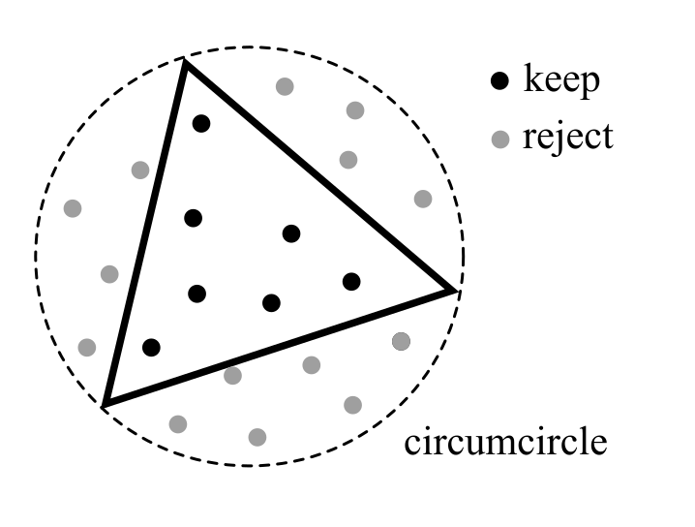
Object space methods
How to define stroke positions on object surface?
II. Simple method:
Find circumcircle of each triangle
Generate uniform sample distribution within circle (Halton sequences, or Poisson disk sampling)
Keep samples that are inside triangle
How many particle to generate per triangle?
It should be proportional to surface area
We can define the maximum number of particles in a scene and distribute it based on triangle surface area ratios
Good for static, simple scenes
Limits particle count: predictable performance
Or we can define the number of particles to use for unit surface area
Better for dynamic scenes
Predictable object space density but particle count can go high

Slide 21
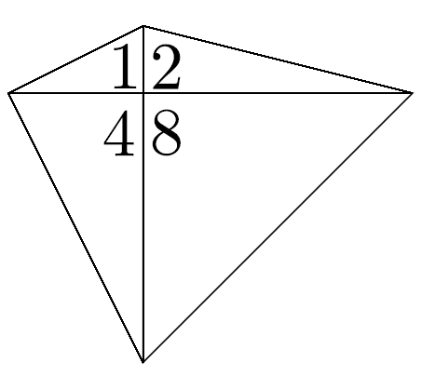
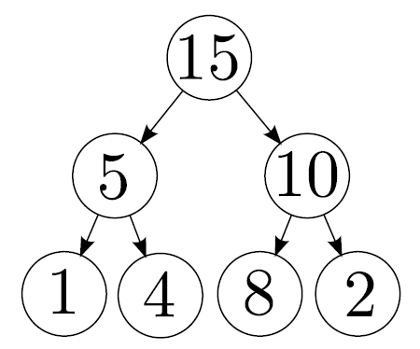
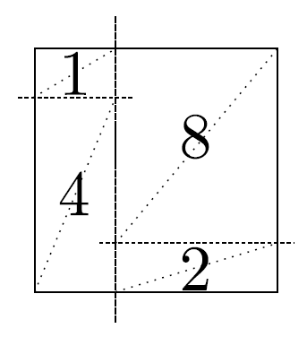
Object space methods
How to define stroke positions on object surfaces?
III. More complicated method:
Define samples in sample space: uniformly in a 2D rectangle
Transform from sample space to object space
Create a Kd tree from all triangles of the scene
In each division step divide proportional to surface area
Example: triangle 2 and 8 has larger surface area than 1 and 4, thus the first division will leave more space to 8,2 than to 1,4. Etc. …
The leaves of the kd tree correspond to one triangle and a rectangular area in sample space
To use all samples in sample space, triangles are doubled in sample space to form a rectangle
To transform a 2D sample position to object space, identify the triangle it is bound to (Kd tree leaf), barycentric coordinates are straightforward using the doubled triangle
Triangles
Kd tree
Sample space
Umenhoffer, T., Szecsi, L., Szirmay-Kalos, L.: Hatching for motion picture production. Computer Graphics Forum 30(2), 533{542 (2011)

Slide 22
Object space methods
How to define stroke positions on object surface?
III. More complicated method
Why this method is better?
No samples are wasted!
The biggest advantage is not computational efficiency as building the tree is a complex process
Biggest advantage will be exploited during stroke rejection for representing tones (more on this later …)
Distortion can occur, but still not too high
Triangles
Kd tree
Sample space

Slide 23
Object space methods
How to orient strokes?
I. Simplest method:
Use texture parameterization directions
Basically tangent and binormal vectors (binormals for cross hatching)
These vectors are widely used and built in features of graphics engines
Easy to calculate
Needs good UV parameterization!

Slide 24
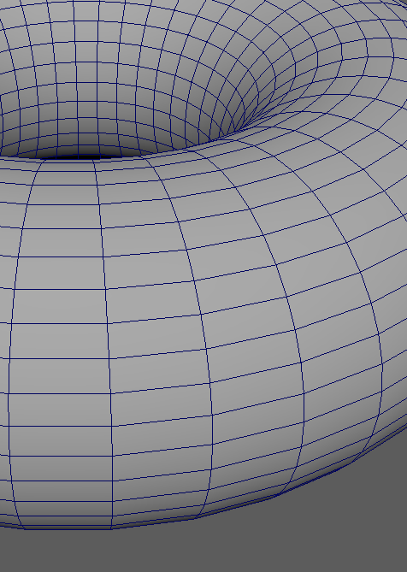
Object space methods
How to orient strokes?
II. Most widely used
Use principal curvature directions
Principal curvature value also defines the bending of the stroke
The strokes are extruded along the circular arc defined by the stroke position, surface normal, curvature direction and curvature radius
Principal curvature direction
Stroke position
Normal vector
Stroke curve

Slide 25
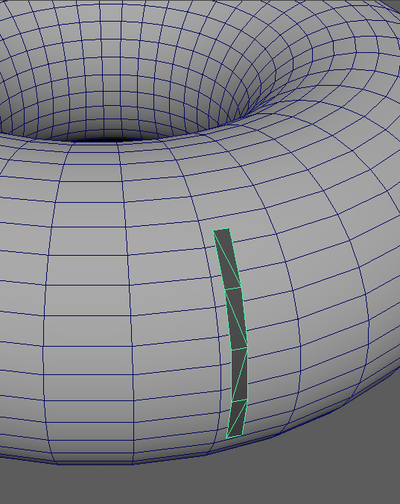
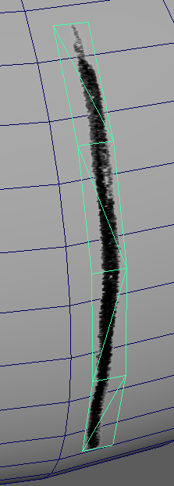
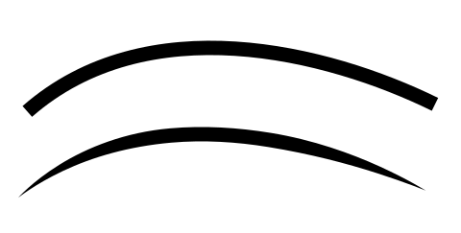
Object space methods
How to render strokes?
Tessellate stroke curve and
Extrude stroke curve to triangle strip
Triangle strip ends can be tapered or rounded
Triangle strip can also be textured and alpha blended

Slide 26
Object Space Methods
How to implement tones?
Strokes should be rejected according to lighting information
Outgoing radiance (visible tone) can be calculated for each surface point, thus for each stroke position
How to decide which strokes to reject?
For efficiency reasons it would be good to make this decision independently from other strokes
(verifying rendered image tone after each rendered stroke is not feasible)

Slide 27
Object Space Methods
Sample space
How to decide which strokes to reject?
Recall our complicated stroke generation method
We used 2D Halton series to generate sample positions in sample space
Halton sequence is a low-discrepancy sequence:
Taking any portion of the sequence fills the space uniformly
The first N number of samples is just as uniform as the first 2N samples, but the latter has higher density
The idea is to reject lines based on their generation sequence number
Simply speaking: if we need a medium tone, we reject the second half of the sequence

Slide 28
Object Space Methods
Sample space
How to implement uniform screen space density?
Object space methods generate uniform sample distribution in object space
However, screen space density will not be uniform
Distant objects will show higher density
Surfaces with normal directions nearly perpendicular to view direction (grazing angle) will show higher density
The solution is to take screen space surface area into account when rejecting strokes and not only tone
Details are described here:
Umenhoffer, T., Szecsi, L., Szirmay-Kalos, L.: Hatching for motion picture production. Computer Graphics Forum 30(2), 533{542 (2011)

Slide 29
Object Space Methods
Advantages
High quality strokes
Customizable strokes (with textures or perturbing stroke curves)
Strokes are fixed to surfaces (no sliding or rotating between frames in an animation)
Strokes are fixed even with deforming (skeletal animated) geometries
Rendering uses the same pipeline as other geometries
Disadvantages
Need geometry processing (curvature calculation, kd tree build)
Z fighting artifacts can appear (strokes need an offset along surface normals)
Uniform screen space density is harder to achieve
Many strokes can be rejected (distance or grazing angle surfaces)
Many strokes are overdrawn (visibility)
Stroke generation is usually a preprocess as it is computationally intensive
Stroke position buffers can use a lot of memory in case of complex scenes
Maximal object space density is defined during sample generation, infinite zooming to a surface can not be implemented

Slide 30
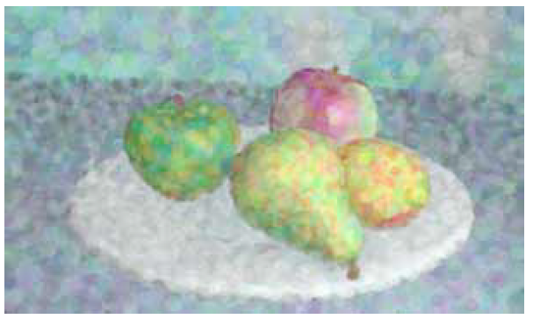
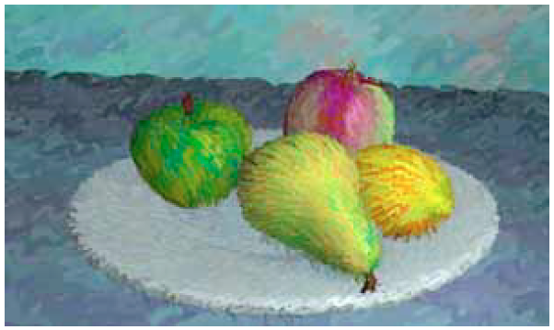
Object Space Methods Examples
MEIER B. J.: Painterly rendering for animation. In SIGGRAPH’96 (1996), pp. 477–484.
Not used for hatching but for brush paintings
Tones are not created with rejecting but with coloring the brush strokes
Stroke samples are generated on triangle surfaces (method II.)
Strokes are not rejected at grazing angles nor at distance objects (but brush size can be controlled by these values)
Stroke direction is given by projected surface normal directions

Slide 31
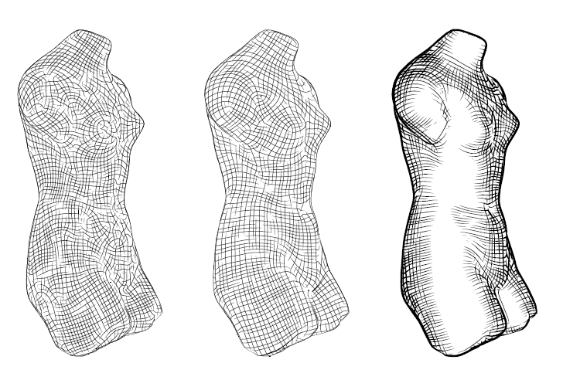
Object Space Methods Examples
HERZMANN A., ZORIN D.: Illustrating smooth surfaces. In SIGGRAPH ’00 (2000), pp. 433–438.
(Not purely object space, stroke rejection is done in image space examining stroke by stroke)
Line direction is defined by principal curvature directions as a base step
Geometry is smoothed
Line orientation is optimized on geometry surface
Original curvature directions
Smoothed curvature directions
Strokes after rejection

Slide 32
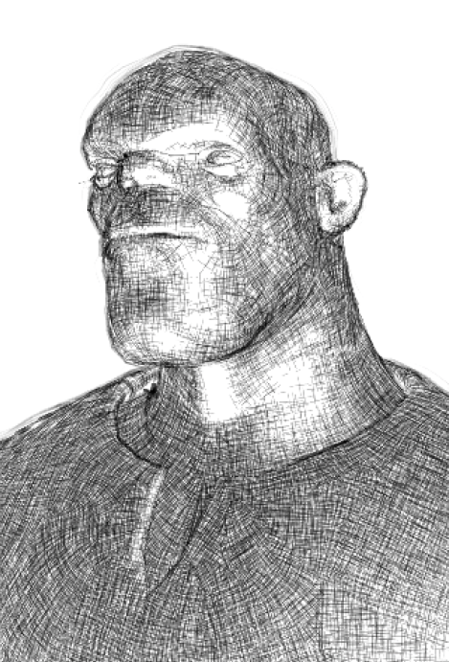
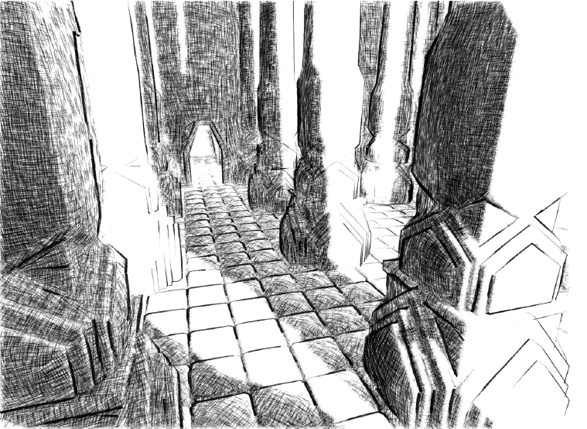
Object Space Methods Examples
Umenhoffer, T., Szecsi, L., Szirmay-Kalos, L.: Hatching for motion picture production. Computer Graphics Forum 30(2), 533{542 (2011)
Samples are generated with Halton sequences in sample space (method III)
Strokes are rejected by visible surface area
Strokes are further rejected by tone
Algorithm optimized for production pipeline
Can be run interactively on GPU

Slide 33
Video
Umenhoffer, T., Szecsi, L., Szirmay-Kalos, L.: Hatching for motion picture production. Computer Graphics Forum 30(2), 533{542 (2011)

Slide 34
Image Space Methods
Create geometry for each individual stroke
Geometry is usually a textured line strip
Define stroke positions in image space
Extrude strokes to line strips in image space
Render stroke geometry in image space (2D projection, no Z testing)

Slide 35
Image Space Methods
Halton
How to define stroke positions?
Much simpler than in object space
Generate uniform random sample positions all over the image
Using 2D Halton, Poisson disk sampling, or other techniques
Distribution matters!
rand()

Slide 36
Image Space Methods
How to orient strokes?
Depends on what image space information we have
We always have image tone information -> can use its gradient
We can render additional buffers
Camera space normal vectors
Camera space principal curvature directions
Normal and depth buffers are common features of render engines, but principal curvatures are not
This can have a great impact in integration complexity (geometry processing and curvature calculation)
Principal curvature directions can be calculated from the normal buffer using its gradient tensor
As normals are linearly interpolated within a triangle, curvatures (gradient of normals) will be constant within a triangle, which can make tessellation visible

Slide 37
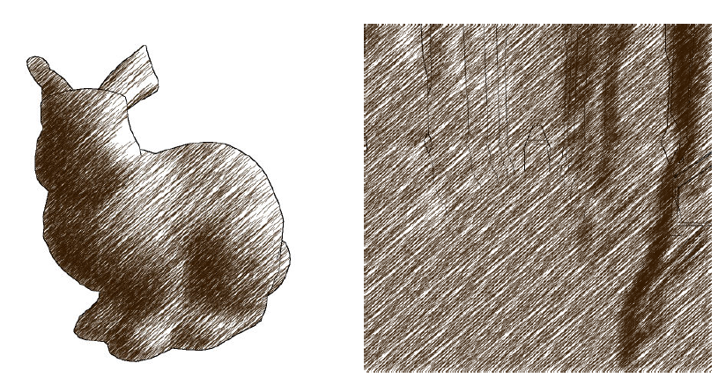
Line orientations – constant direction
Flattened look
Surface features are hard to detect

Slide 38
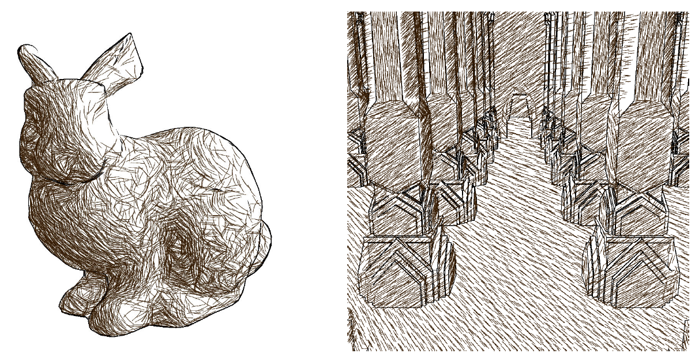
Line orientations – tone gradient
Shape can be well expressed
Flat surfaces with directional lighting does not have a gradient
Orientation can change if lighting changes

Slide 39
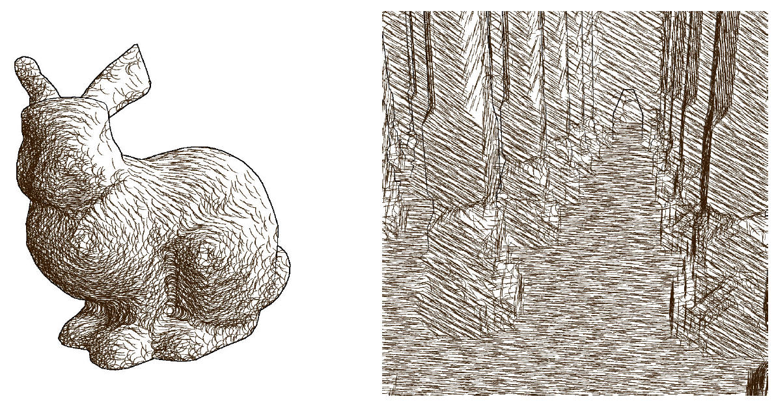
Line orientations – depth gradient (projected normal vectors)
Shape is well expressed
Flat areas are handled robustly
Annoying concentric patterns may appear
Orientation changes with camera movement

Slide 40
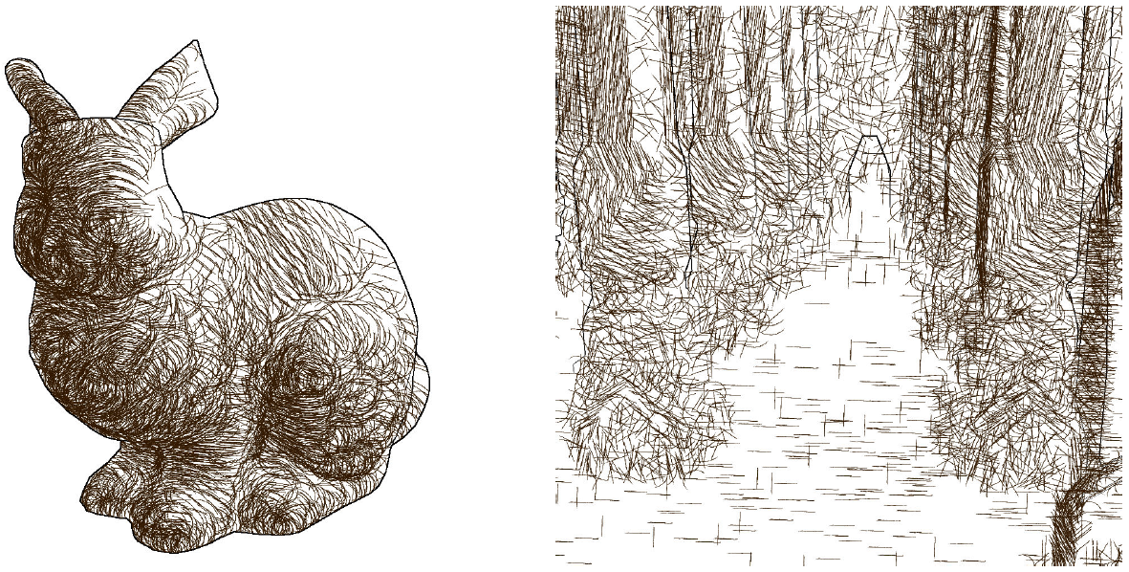
Line orientations – principal curvature directions
Shape is well preserved in case of smooth objects with well defined principal curvature directions.
Flat areas and sphere like areas (with no exact principal curvature direction) are unpredictable

Slide 41
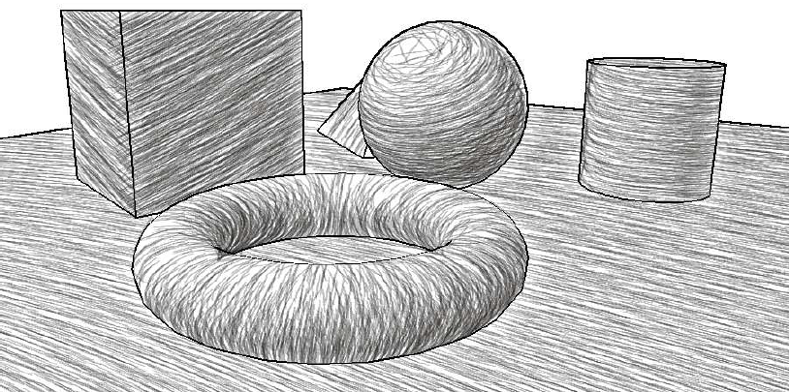
Line orientations – Conclusions
There is no BEST stroke direction choice
Depends on scene geometry, lighting, animation
This holds both for image and object space methods
We can mix these strategies:
Use principal curvature directions as base but use tone gradient of no principal curvature direction can be defined
In some cases we use user defined stroke directions (like horizontal lines for water surfaces)

Slide 42
Screen Space Methods
Final rendering
Similar to object space version
Sample position
Sample positions are extruded to line strips
Strips are oriented and blent
Strips are textured
3.
4.
1.
2.

Slide 43
Image Space Methods
How to reject strokes?
Easier than in object space
Stroke density is naturally uniform in image space (no rejection is needed to achieve uniform density)
Reject strokes based on tone similarly as in object space version
Process each stroke independently and parallel using Halton sequences and generation id. Fast, GPU friendly solution
Verify image tone stroke after stroke. High quality but very slow method.

Slide 44
Image Space Methods – main steps
Generate uniformly distributed stroke positions
Extrude, orient and bend strokes
(reject strokes on background)
Reject strokes based on tone

Slide 45
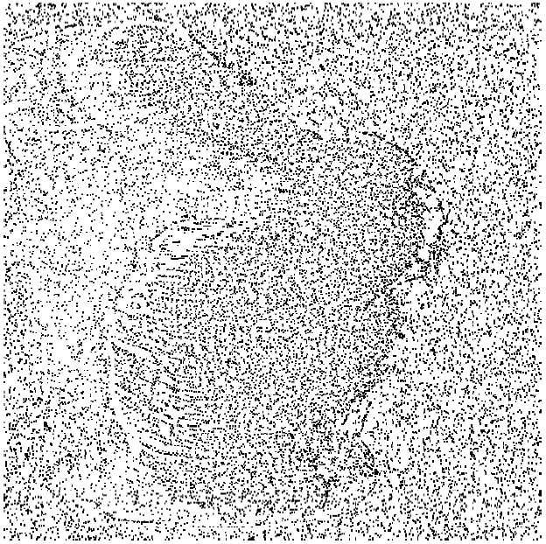
Image Space Methods
Frame 1.
How to fix strokes to surfaces?
This is a problem in image space
Strokes should move with the surfaces
We can render an image space velocity buffer in each frame
Move stroke positions based on this buffer
Uniform density is ruined
strokes can accumulate or attenuate
Special rejection and insertion techniques can handle this problem
Details can be found here:
Frame 2.
Tamás Umenhoffer, László Szirmay-Kalos, László Szécsi, Zoltán Lengyel, and Gábor Marinov: An image-based method for animated stroke rendering. The Visual Computer, June 2018, Volume 34, Issue 6–8, pp 817–827.

Slide 46
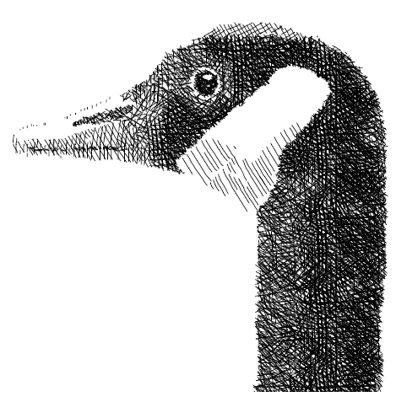
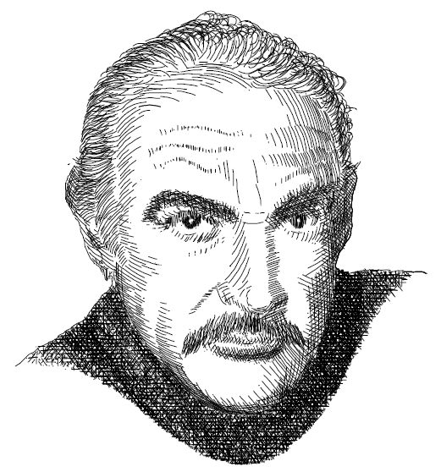
Image Space Methods – Examples
Direction is based on image gradient
Image tone is verified after each rendered stroke
Still images
Slow, but high quality
Salisbury, M.P., Anderson, S.E., Barzel, R., Salesin, D.H.: Interactive penandink illustration. In: Proceedings of SIGGRAPH '94, pp. 101{108 (1994)

Slide 47
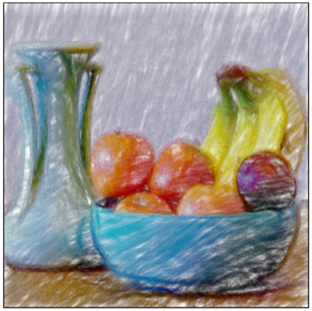
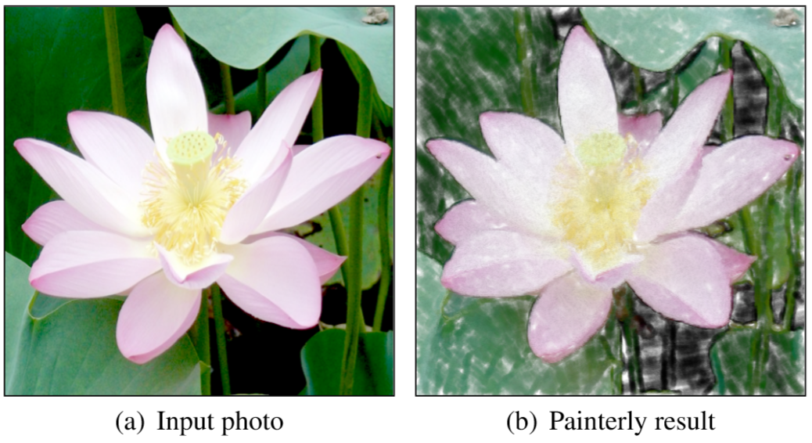
Image Space Methods – Examples
Used to process images and videos too
Strokes are moved with an optical flow or rendered image space velocity field
Particles are rejected based on tone
Particles are oriented according to image gradient
Uses 3 stroke layers
GPU friendly real-time method
Lu, J., Sander, P.V., Finkelstein, A.: Interactive painterly stylization of images, videos and 3D animations. In: Proceedings of I3D 2010 (2010)

Slide 48
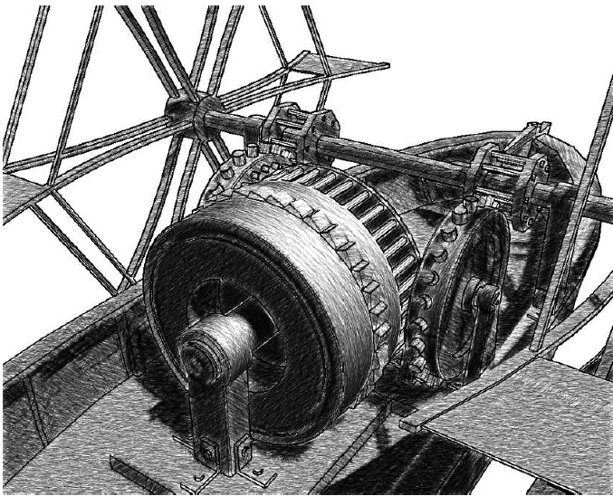
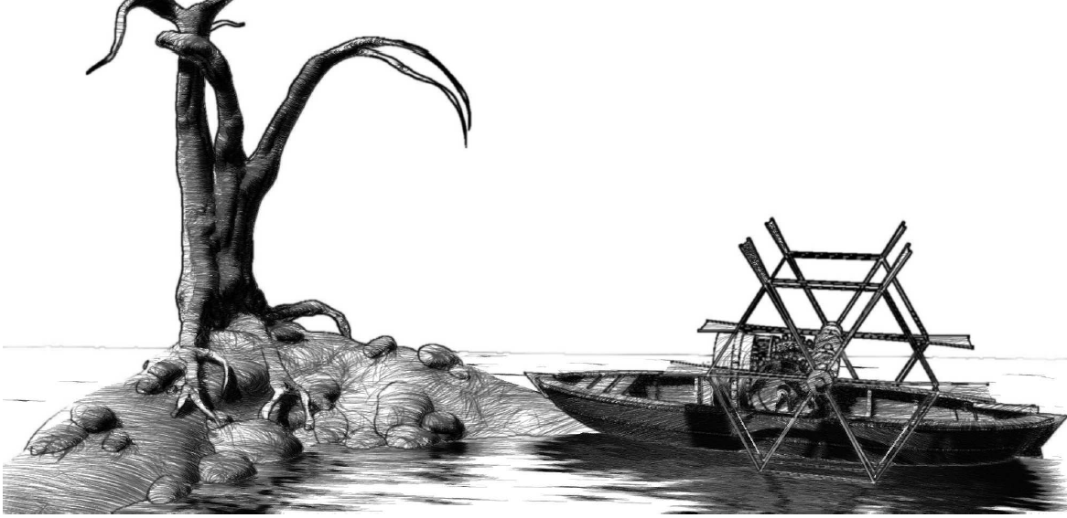
Image Space Methods - Examples
Uses rendered buffers (can also work on videos)
Strokes are moved with rendered image space velocity field (or optical flow)
Particles are rejected based on tone
Particle orientation can use different features
Multiple stroke layers
GPU friendly real-time method
Tamás Umenhoffer, László Szirmay-Kalos, László Szécsi, Zoltán Lengyel, and Gábor Marinov: An image-based method for animated stroke rendering. The Visual Computer, June 2018, Volume 34, Issue 6–8, pp 817–827.

Slide 49
Video
Tamás Umenhoffer, László Szirmay-Kalos, László Szécsi, Zoltán Lengyel, and Gábor Marinov: An image-based method for animated stroke rendering. The Visual Computer, June 2018, Volume 34, Issue 6–8, pp 817–827.

Slide 50
Image Space Methods
Advantages
High quality strokes
Customizable strokes (with textures or perturbing stroke curves)
Uniform screen space density
No depth test issues
Needs no geometry information and preprocessing
No unnecessary rejecting caused by visibility or distance or grazing angles
Can be implemented in a post processing phase (not integrated into the 3D render phase)
Infinite object space stroke density (we can infinitely zoom on a surface)
Disadvantages
Time coherency is a problem
Geometric information like normals and curvature should be rendered
Smooth line orientation field is hard to compute (usually works well with many small lines, but long sparse hatching is hard to achieve)

Slide 51
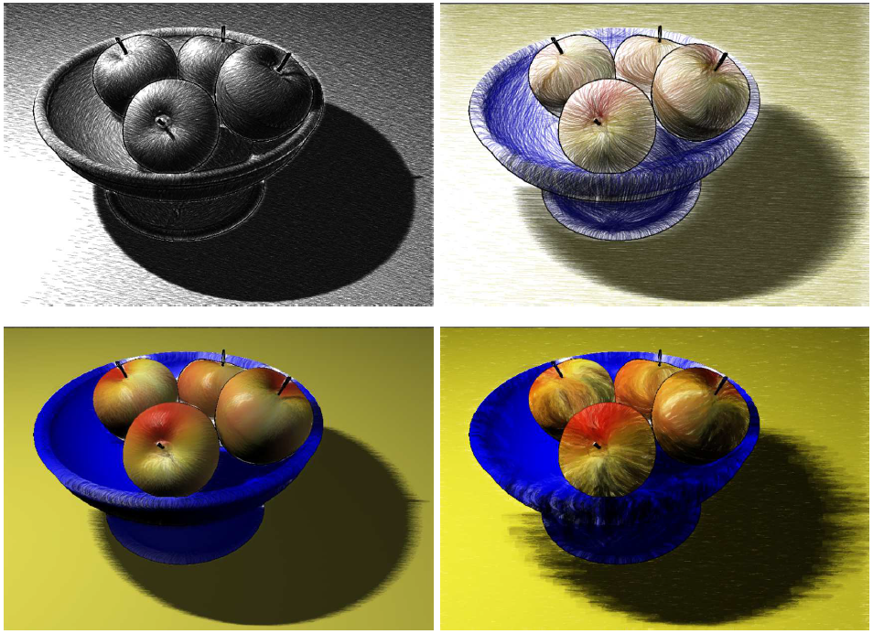
Additional Notes - Different Styles
Both in object and image space different styles can be achieved with varying stroke shape, texture, color and rejection

Slide 52
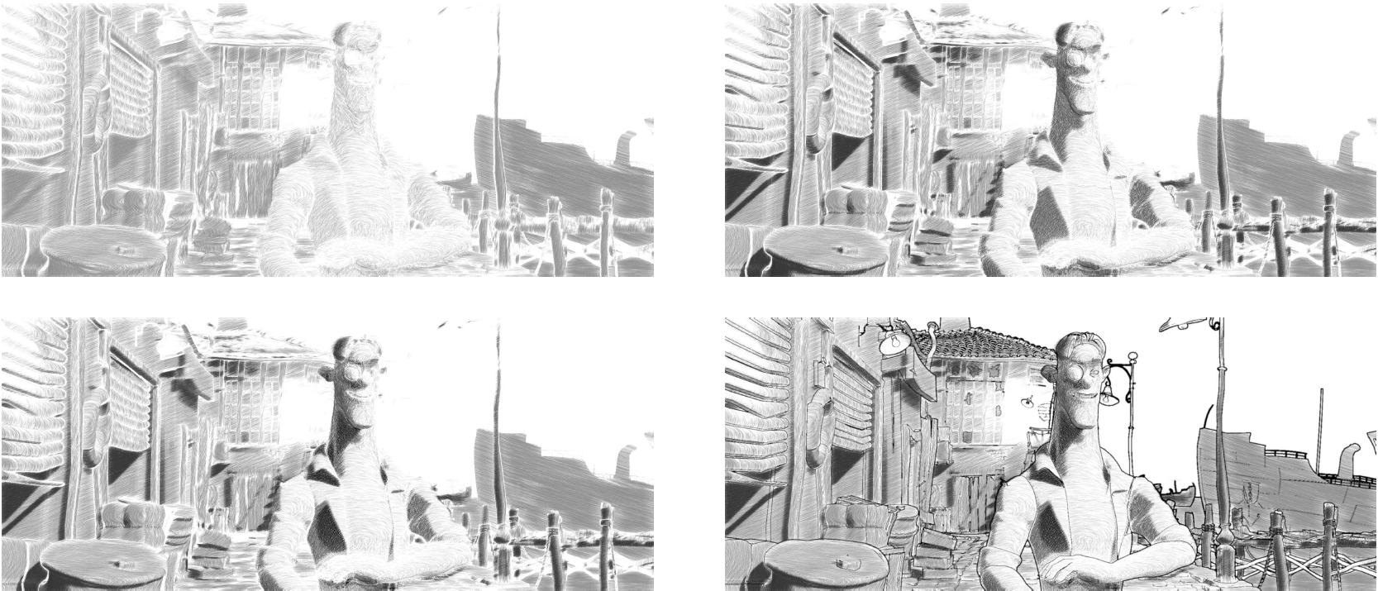
Additional Notes - Stroke Layers
Usually several layers of strokes with different settings can highly enhance quality and detail
1 Layer
2 Layers
3 Layers
3 Layers + contours
Art Deco Ltd. and The Dirty Fred Strikes Back Ltd.

Slide 53
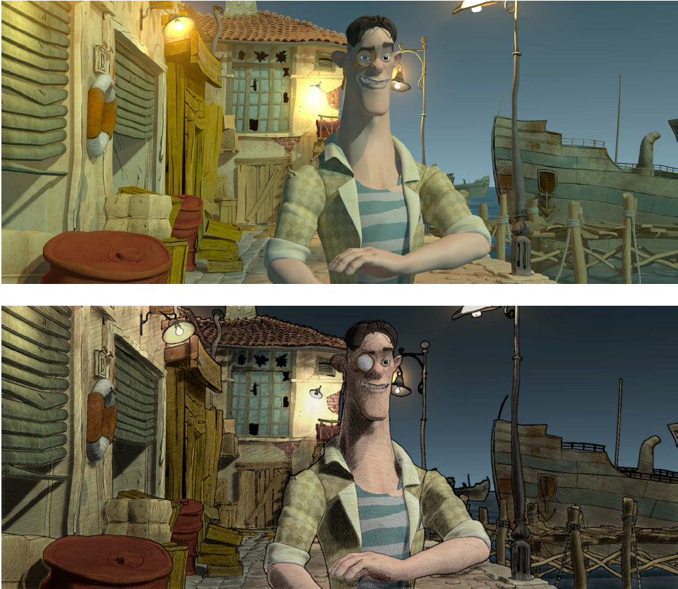
Additional Notes
Stroke layers can be used as a supplement layer above realistically or non-photorealistically shaded layers
Art Deco Ltd. and The Dirty Fred Strikes Back Ltd.

Slide 54
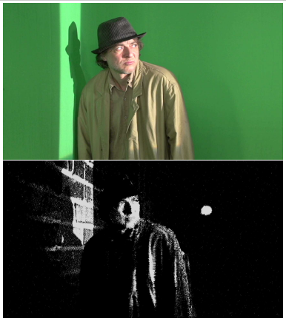
Additional Notes – RGBZ cameras
Depth cameras are getting better and better
Scene geometry can be reconstructed from real world footage
From depth image normal vectors and even curvatures can be calculated
Today it has high noise
Image space techniques could be used efficiently in the future

