Slide 1
Image Simplification

Slide 2
Outline
What is image simplification and why use it
Color simplification
  Edge preserve blurring
  Bilateral filter
  Separable bilateral filter
  Symmetric nearest neighbor filter
  Kuwahara filter
Color quantization
Flow based filtering
  Tangent flow
  Flow based bilateral

Slide 3
Image abstraction
What information is important on image?
How long does it take to recognize the important information?
RYAN, T. A., AND SCHWARTZ, C. B. 1956. Speed of perception as a function of mode of presentation. American Journal of Psychology 69, 60–69.

Slide 4
Image abstraction
What information is important on image?
How long does it take to recognize the important information?
We immediately see that this is a hand
We can see the form of the fingers
We can see the wrinkles, texture of the skin
We can guess the gender and age of the person
We can see the lighting, and tell its direction. Even guess further:
  the image was not taken outside on a cloudy day (as we exactly can tell light direction due to shadows)
  It was not taken under bright sunlight, as the shadows are soft
  The background is uniformly bright, maybe it is a wall
  …
Examining the pose of the fingers we can see that this is a finger snapping
Among all these information we don’t know what is the most important, what the creator of this image wanted to tell us (we can just pick one, which makes important information subjective)
RYAN, T. A., AND SCHWARTZ, C. B. 1956. Speed of perception as a function of mode of presentation. American Journal of Psychology 69, 60–69.

Slide 5
Image abstraction
What information is important on image?
How long does it take to recognize the important information?
We immediately see that this is a hand
We can see the form of the fingers
We can maybe guess the gender and age of the person
Examining the pose of the fingers we can see that this is a finger snapping
The author probably wanted to show us the main anatomy of the human hand and the spatial relationship between fingers during a snap
RYAN, T. A., AND SCHWARTZ, C. B. 1956. Speed of perception as a function of mode of presentation. American Journal of Psychology 69, 60–69.

Slide 6
Image abstraction
What information is important on image?
How long does it take to recognize the important information?
We immediately see that this is a hand
Examining the pose of the fingers we can see that this is a finger snapping
Finger snapping is used to get someone’s attention, probably because:
  We have a great idea!
  The job is done right!
RYAN, T. A., AND SCHWARTZ, C. B. 1956. Speed of perception as a function of mode of presentation. American Journal of Psychology 69, 60–69.

Slide 7
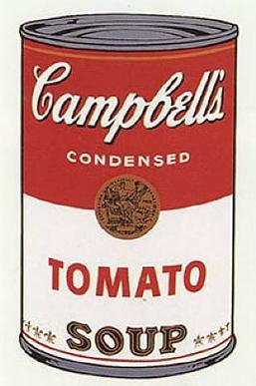
Image abstraction – why use it?
Enhance important information/Hide not important information
  Benefits:
    Faster visual recognition (recognitions of persons on abstract images is faster than on photographs)
    Better memorization (memory games using abstract images are easier to solve than games using photographs)
Simulate a classic technique
  Lithograph
  Serigraph
  Painting
  Cartoons, comics
  …
H. Winnemoller, S. C. Olsen, B. Gooch: Real-Time Video Abstraction. SIGGRAPH conference; 2006; Boston, MA
  Campbell's Soup Cans (I), Andy Warhol (1961)

Slide 8
Faster perception
User study in H. Winnemoller, S. C. Olsen, B. Gooch: Real-Time Video Abstraction. SIGGRAPH conference; 2006; Boston, MA
Recognition of photos of 25 movie stars
  One group using the original photo and the other using the abstracted images
  Result: 13% faster average recognition speed, same accuracy with abstracted images
Memory game with 24 cards
  One group playing with photographs and the other group with abstract images
  Result: 26% faster completion with abstract images

Slide 9
Color simplification
In 3D rendering, abstracting shapes is not straightforward
Color abstraction is easier
Color abstraction is:
  Limit the tone of shades (luminance) on the image
  Limit the number of colors (chroma) on the image
  Limit both color and tone

Slide 10
Color simplification in 3D rendering
Color simplification can be incorporated into the material definition (simplification is done during shading)
  E.g. Toon shading
  Using simplified/artistic textures
Can be done after rendering in a post processing phase
  Higher level of simplification
  Need to simplify fine shading and texture detail
  Does not seem effective (why render a detailed image if details will be simplified?)
  When to use it:
    If renderer does not support implementing toon shading or similar
    If simplification should be turned on/off

Slide 11

Color simplification in post process
How to reduce image details?
Blur!
Box, Gauss, …
Details are smoothed out but
Object edges are also blurred

Slide 12
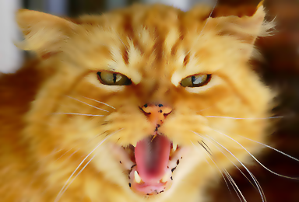
Color simplification in post process
Solution: edge preserve smoothing
  Bilateral, Kuwahara, SNN filter …
Details are smoothed out but
Object edges are preserved

Slide 13
Bilateral filter
Pixel weights not only depend on distance from center pixel, but also
Depend on pixel value difference
Pixel value difference can be:
  Intensity difference (need grayscale conversion)
  RGB Euclidian distance
  Euclidian distance in a perceptually uniform space like CIELab
P(x₀-2,y₀+2) | P(x₀-1,y₀+2) | P(x₀,y₀+2) | P(x₀+1,y₀+2) | P(x₀+2,y₀+2)
P(x₀-2,y₀+1) | P(x₀-1,y₀+1) | P(x₀,y₀+1) | P(x₀+1,y₀+1) | P(x₀+2,y₀+1)
P(x₀-2,y₀) | P(x₀-1,y₀) | P(x₀,y₀) | P(x₀+1,y₀) | P(x₀+2,y₀)
P(x₀-2,y₀-1) | P(x₀-1,y₀-1) | P(x₀,y₀-1) | P(x₀+1,y₀-1) | P(x₀+2,y₀-1)
P(x₀-2,y₀-2) | P(x₀-1,y₀-2) | P(x₀,y₀-2) | P(x₀+1,y₀-2) | P(x₀+2,y₀-2)
C. Tomasi and R. Manduchi. Bilateral Filtering for gray and color images. In Proc. of ICCV, pages 839.846, USA, 1998.

Slide 14
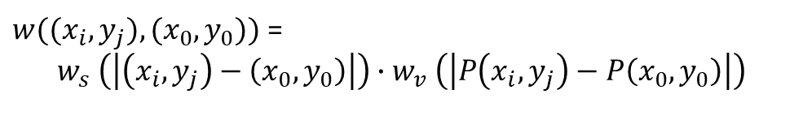
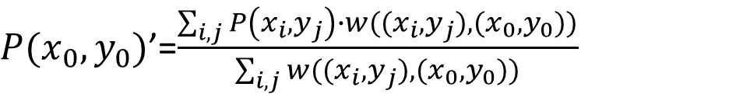
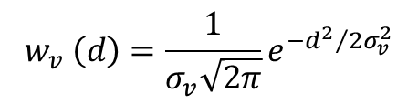
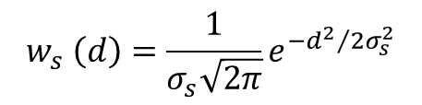
Bilateral filter
Pixel weights not only depend on distance from center pixel, but also
Depend on pixel value difference
P(x₀-2,y₀+2) | P(x₀-1,y₀+2) | P(x₀,y₀+2) | P(x₀+1,y₀+2) | P(x₀+2,y₀+2)
P(x₀-2,y₀+1) | P(x₀-1,y₀+1) | P(x₀,y₀+1) | P(x₀+1,y₀+1) | P(x₀+2,y₀+1)
P(x₀-2,y₀) | P(x₀-1,y₀) | P(x₀,y₀) | P(x₀+1,y₀) | P(x₀+2,y₀)
P(x₀-2,y₀-1) | P(x₀-1,y₀-1) | P(x₀,y₀-1) | P(x₀+1,y₀-1) | P(x₀+2,y₀-1)
P(x₀-2,y₀-2) | P(x₀-1,y₀-2) | P(x₀,y₀-2) | P(x₀+1,y₀-2) | P(x₀+2,y₀-2)
pixel value at (x_{i},y_{i})
pixel weight at (x_{i},y_{i})
$P(x_{0},y_{0})$’=$\frac{\sum_{i,j}{P\left(x_{i},y_{j}\right)∙w((x_{i},y_{j}),(x_{0},y_{0}))}}{\sum_{i,j}{w((x_{i},y_{j}),(x_{0},y_{0}))}}$
Normalization with sum weight
$w((x_{i},y_{j}),(x_{0},y_{0}))$ =
$$w_{s} \left(\left|\left(x_{i},y_{j}\right)−\left(x_{0},y_{0}\right)\right|\right)∙w_{v} \left(\left|P\left(x_{i},y_{j}\right)−P\left(x_{0},y_{0}\right)\right|\right)$$
spatial weight
value weight
$$w_{s} \left(d\right)=\frac{1}{σ_{s}\sqrt{2π}}e^{{−d^{2}}/{2σ_{s}^{2}}}$$
$$w_{v} \left(d\right)=\frac{1}{σ_{v}\sqrt{2π}}e^{{−d^{2}}/{2σ_{v}^{2}}}$$
Two Gaussian kernels working on different distances with different $σ$
C. Tomasi and R. Manduchi. Bilateral Filtering for gray and color images. In Proc. of ICCV, pages 839.846, USA, 1998.

Slide 15
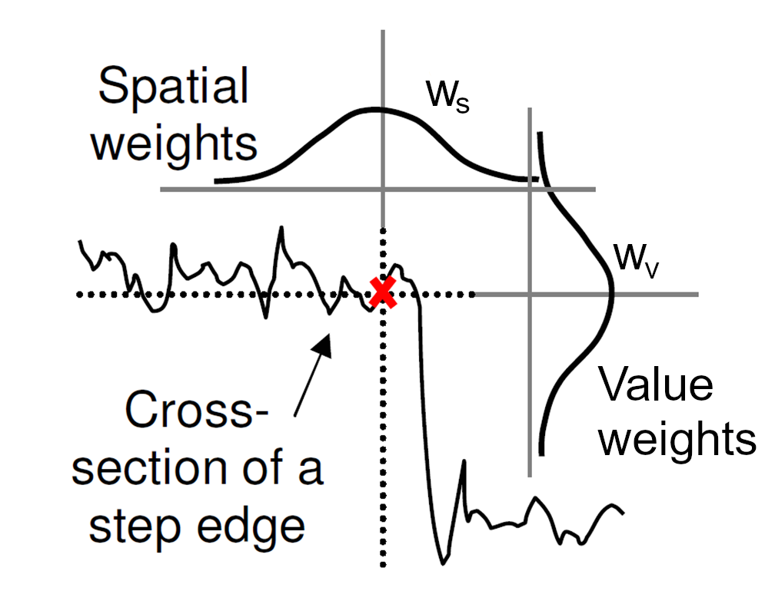
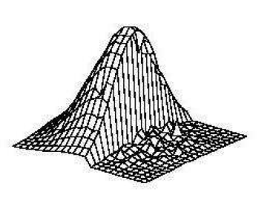
Bilateral filter
The two Gaussians will produce this combined weight at the pixel denoted with red cross:
Image from: PHAM, T. Q., AND VLIET, L. J. V. 2005. Separable bilateral filtering for fast video preprocessing. In IEEE Internat. Conf. on Multimedia & Expo, CD1–4.

Slide 16
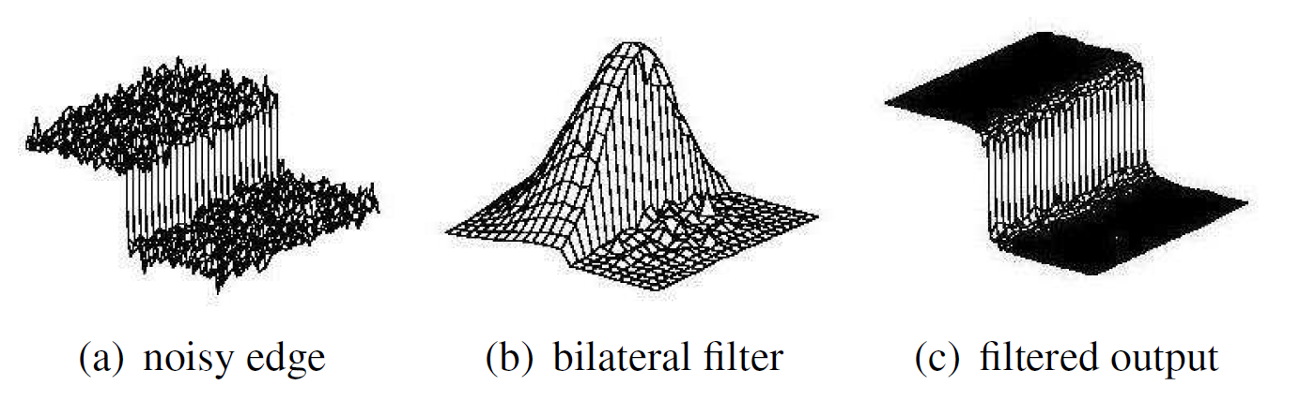
Bilateral filter
Image from: PHAM, T. Q., AND VLIET, L. J. V. 2005. Separable bilateral filtering for fast video preprocessing. In IEEE Internat. Conf. on Multimedia & Expo, CD1–4.

Slide 17



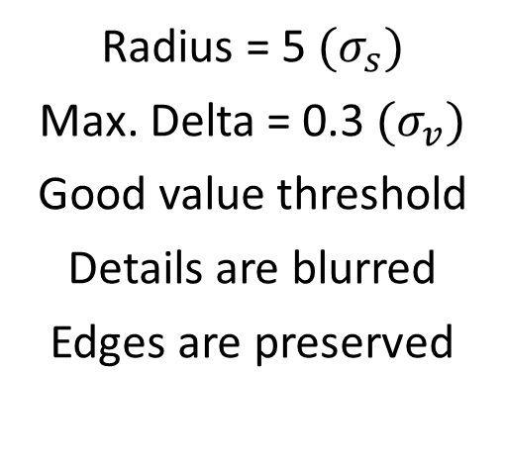
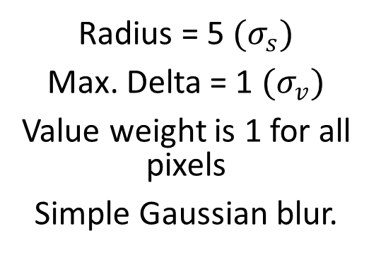
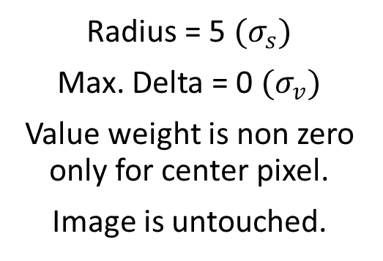
Bilateral filter
Examples produced with Gimp
Radius = 5 ${(σ}_{s})$
Max. Delta = 0 ${(σ}_{v})$
Value weight is non zero only for center pixel.
Image is untouched.
Radius = 5 ${(σ}_{s})$
Max. Delta = 1 ${(σ}_{v})$
Value weight is 1 for all pixels
Simple Gaussian blur.
Radius = 5 ${(σ}_{s})$
Max. Delta = 0.3 ${(σ}_{v})$
Good value threshold
Details are blurred
Edges are preserved

Slide 18

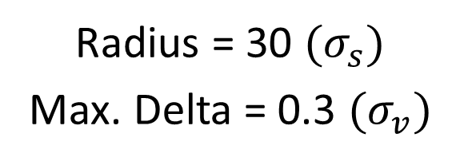
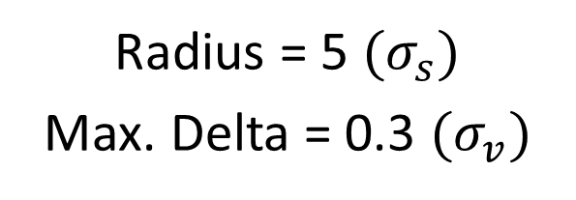
Bilateral filter
Radius = 5 ${(σ}_{s})$
Max. Delta = 0.3 ${(σ}_{v})$
Radius = 30 ${(σ}_{s})$
Max. Delta = 0.3 ${(σ}_{v})$

Slide 19
Bilateral Filter
Common edge preserving smoothing filter
  Photoshop: „Surface Blur” filter
  Gimp: „Selective Gaussian Blur” filter
Can be used for noise reduction in image processing
  Digital camera images (nice smooth skin on cellphone selfies)
  Broadcasting
  Medical image processing
Relatively high computational costs
Though a single 2D Gaussian kernel is separable, the Bilateral kernel is not separable!
Can be run iteratively (faster large smoothing)

Slide 20

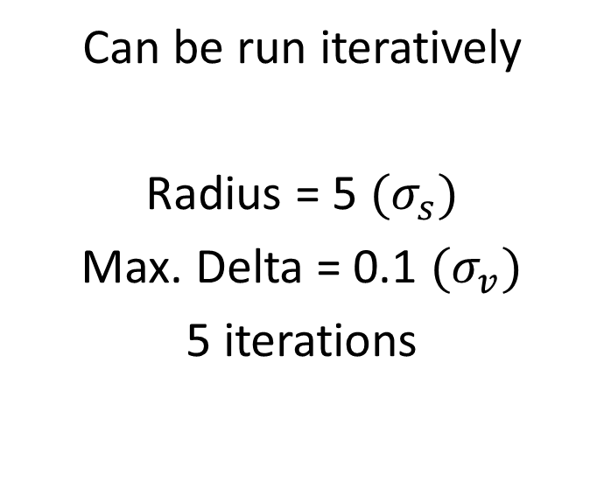
Bilateral Filter
Notes:
  Iterating with smaller kernel does not have the same effect as using a larger kernel once
Can be run iteratively
Radius = 5 ${(σ}_{s})$
Max. Delta = 0.1 ${(σ}_{v})$
5 iterations

Slide 21
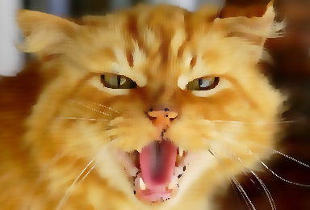
Separable bilateral filter
Radius = 4, no iterations
Separable version
Neglect that Bilateral filter kernel is not separable, and do it in two steps:
  Use 1D Bilateral filter in X direction
  Use 1D Bilateral filter in Y direction (on X filtered image)
The quality is usually acceptable
PHAM, T. Q., AND VLIET, L. J. V. 2005. Separable bilateral filtering for fast video preprocessing. In IEEE Internat. Conf. on Multimedia & Expo, CD1–4.

Slide 22
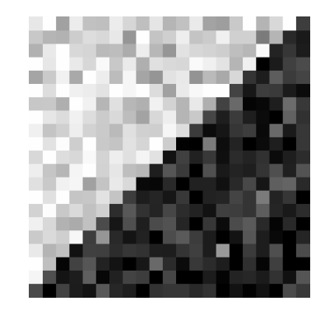
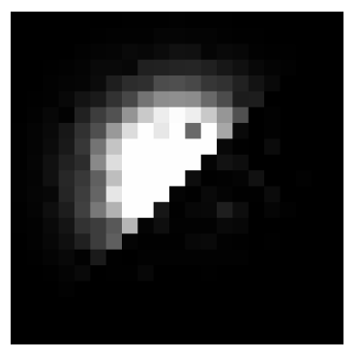
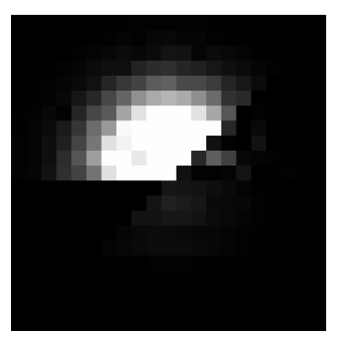
Separable bilateral filter
Errors can occur on diagonal edges
True 2D kernel for center pixel
Separable kernel for center pixel
Image
PHAM, T. Q., AND VLIET, L. J. V. 2005. Separable bilateral filtering for fast video preprocessing. In IEEE Internat. Conf. on Multimedia & Expo, CD1–4.

Slide 23
Symmetric nearest neighbor filter (SNN)
P1 | P2 | P3 | P4 | P5
P6 | P7 | P8 | P9 | P10
P11 | P12 | P13 | P14 | P15
P16 | P17 | P18 | P19 | P20
P21 | P22 | P23 | P24 | P25
P1 | P2 | P3 | P4 | P5
P6 | P7 | P8 | P9 | P10
P11 | P12 | P13 | P14 | P15
P16 | P17 | P18 | P19 | P20
P21 | P22 | P23 | P24 | P25
Visit pixel pairs on opposite directions
Choose the pixel from the pair, which is closer (in value) to center pixel (P13)
Take the average of closer pixels for all pairs
D. Harwood, M. Subbarao, H. Hakalahti, and L.S. Davis: A New Class Of Edge-Preserving Smoothing Filters PRL Vol. 6, pp. 155-162, 1987.

Slide 24
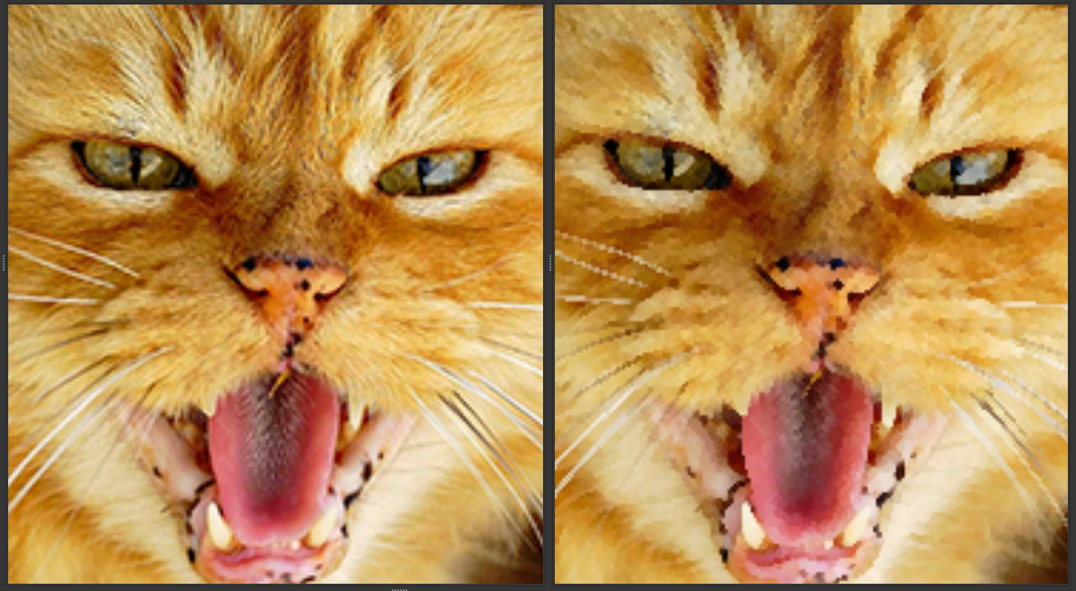
Symmetric nearest neighbor filter
Filter size:
3x3

Slide 25
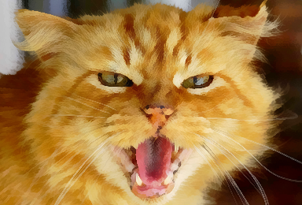
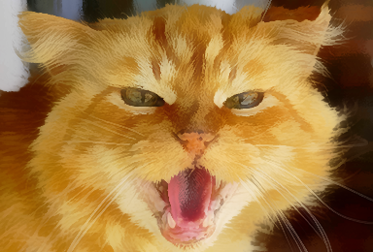
SNN filter
Notes:
  Not separable
  Iterating with smaller kernel does not have the same effect as using a larger kernel once (iterating cannot produce large flat regions)
Filter size: 7x7
Filter size: 15x15

Slide 26
Kuwahara filter
P1 | P2 | P3
P4 | P5 | P6
P7 | P8 | P9
P1 | P2 | P3
P4 | P5 | P6
P7 | P8 | P9
P1 | P2 | P3
P4 | P5 | P6
P7 | P8 | P9
P1 | P2 | P3
P4 | P5 | P6
P7 | P8 | P9
P1 | P2 | P3
P4 | P5 | P6
P7 | P8 | P9
R1 = {P1,P2,P4,P5}
R2 = {P2,P3,P5,P6}
R3 = {P4,P5,P7,P8}
R4 = {P5,P6,P8,P9}
Divide pixel neighborhood to four rectangular sub regions: R1,R2,R3,R4
Compute expected value and variance for all regions
  E_{R1} = ¼ * (P1+P2+P4+P5)
  Var_{R1} = ¼ * (P1²+P2²+P4²+P5²) - E_{R1}²
Find region with minimum variance and replace P5 with the expected value of this region

Slide 27
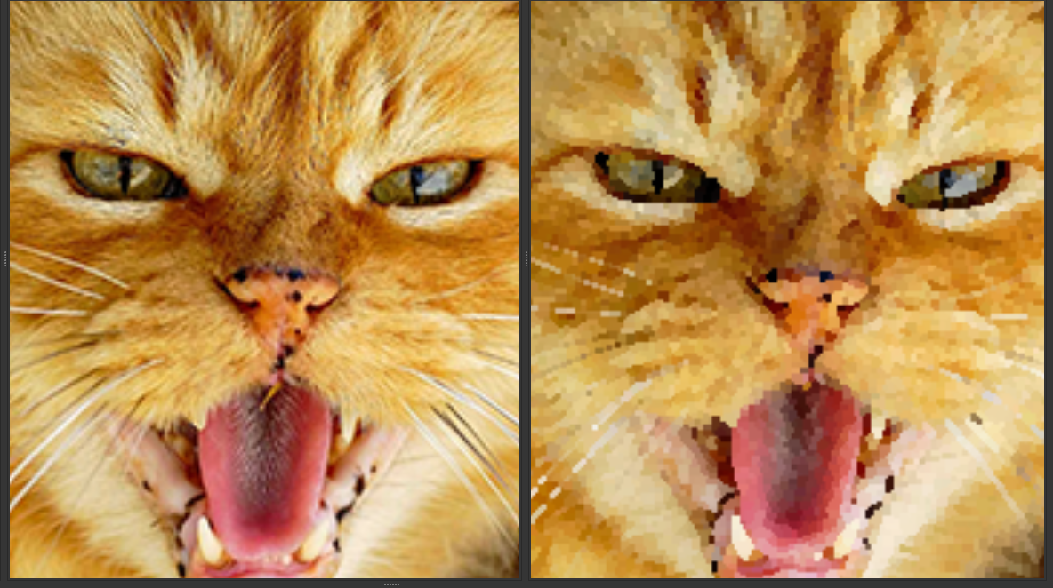
Kuwahara filter
Filter size:
3x3

Slide 28
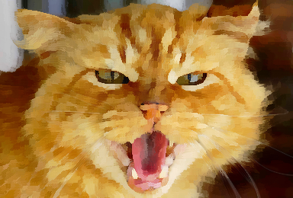
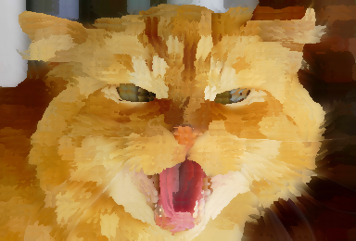
Kuwahara filter
Notes:
  Not separable
  Iterating with smaller kernel does not have the same effect as using a larger kernel once (iterating cannot produce large flat regions)
Filter size: 7x7
Filter size: 15x15

Slide 29
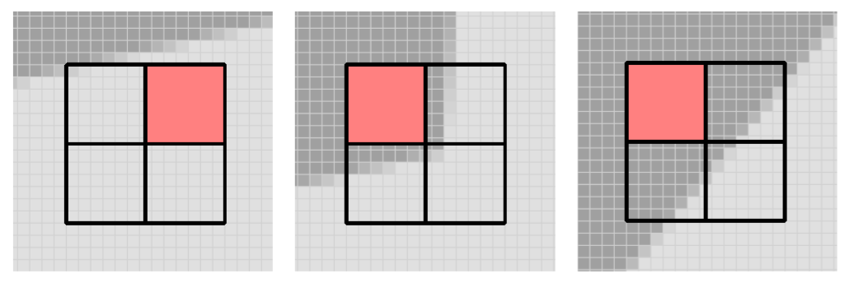
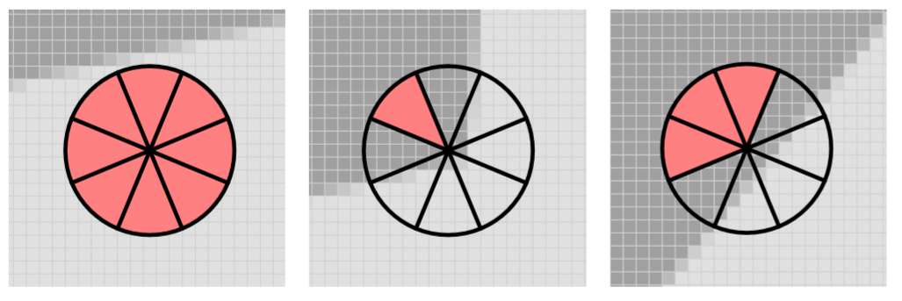
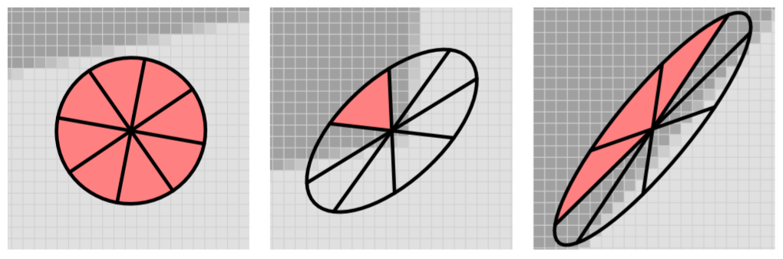
Kuwahara extensions
Original
Kuwahara M., Hachimura K., Eiho S., Kinoshita M.:
Digital processing of biomedical images. Plenum Press, 1976, pp. 187–203.
Disk shaped regions
Papari G., Petkov N., Campisi P.:
Artistic edge and corner enhancing smoothing. IEEE Transactions on Image Processing 16, 10 (2007), 2449–2462.
Anisotropic disk regions based on local image structure
Kyprianidis J. E., Kang H., Döllner J.:
Image and Video Abstraction by Anisotropic Kuwahara Filtering. Computer Graphics Forum 28, 7 (2009), 1955–1963.

Slide 30
Anisotropic Kuwahara
Original
Anisotropic

Slide 31
Color quantization
Edge preserve blurring smooths out fine details, but
Image still has gradients
Some traditional techniques can’t mix colors, has no color gradients
  Lithography
  Cel paintings for traditional animation
  ...
We have to limit the number of tones on our images

Slide 32
Luminance quantization
Define N bins of luminance, and replace pixel luminance value with bin luminance
Need to convert to a color space with luminance channel (e.g. YCbCr or CIELab)
After quantization convert back to RGB
Original luminance values
3 luminance bins
can be implemented with floor() or step()
3 luminance with smooth transition
can be implemented with smoothstep()

Slide 33
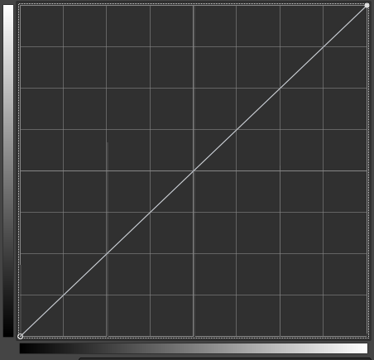
Luminance quantization as luminance transfer curves

Slide 34
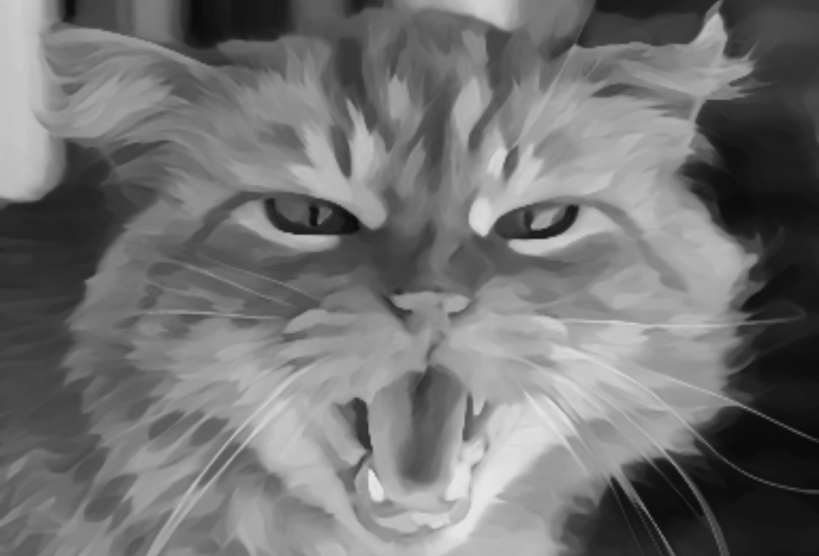
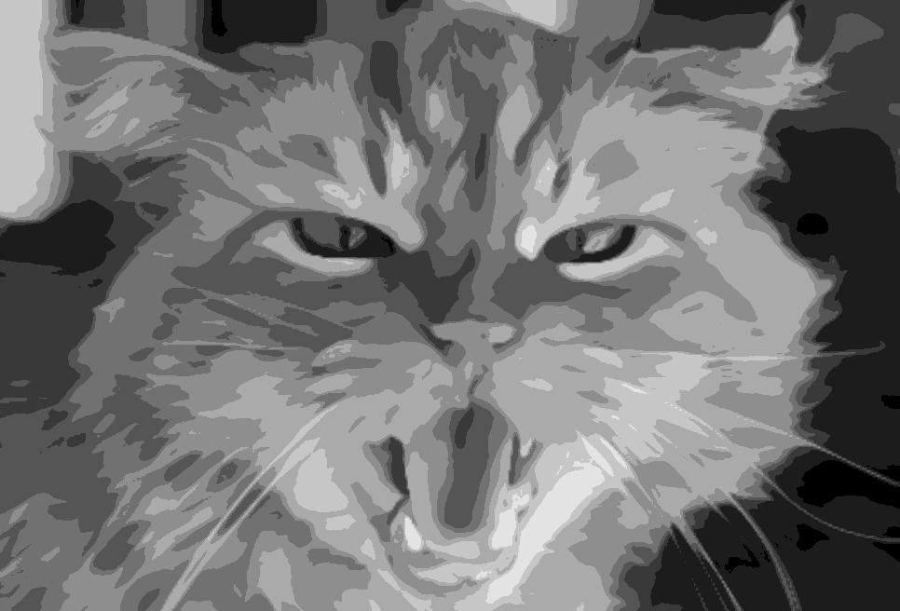
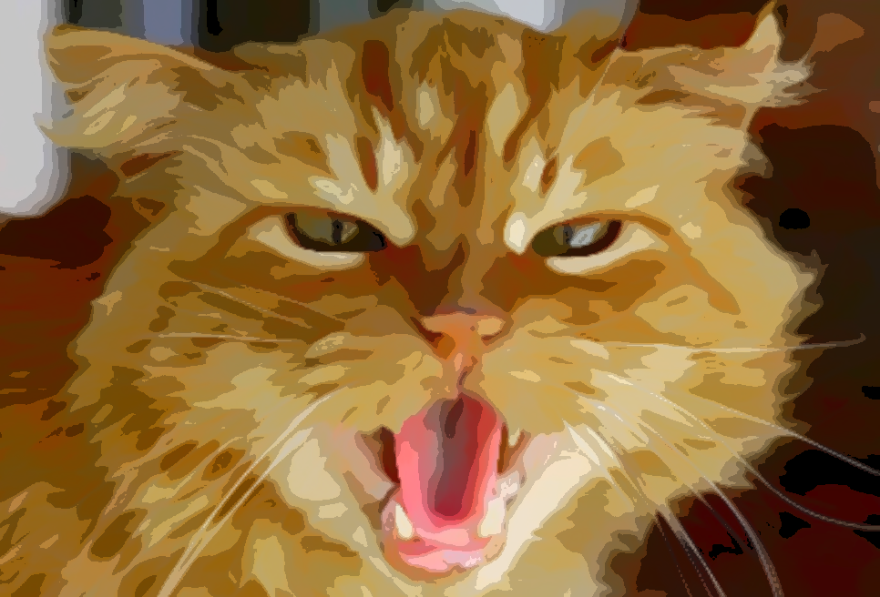

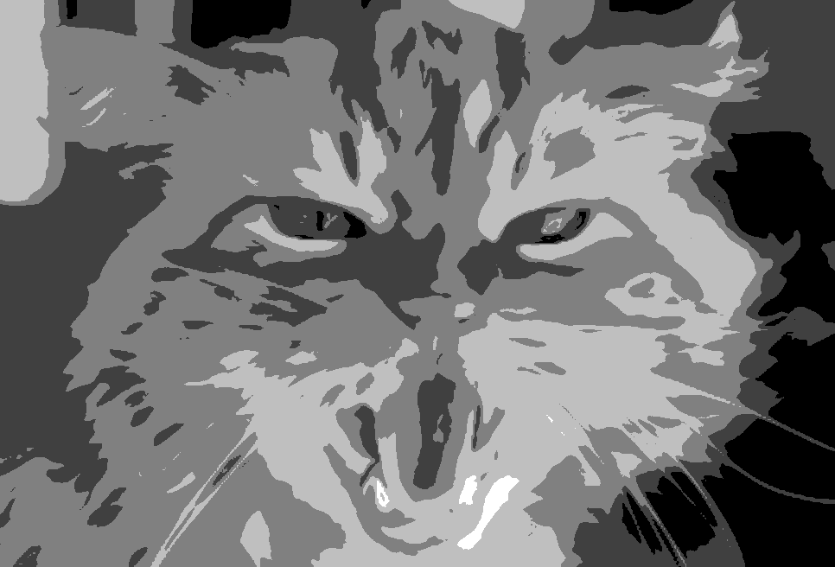
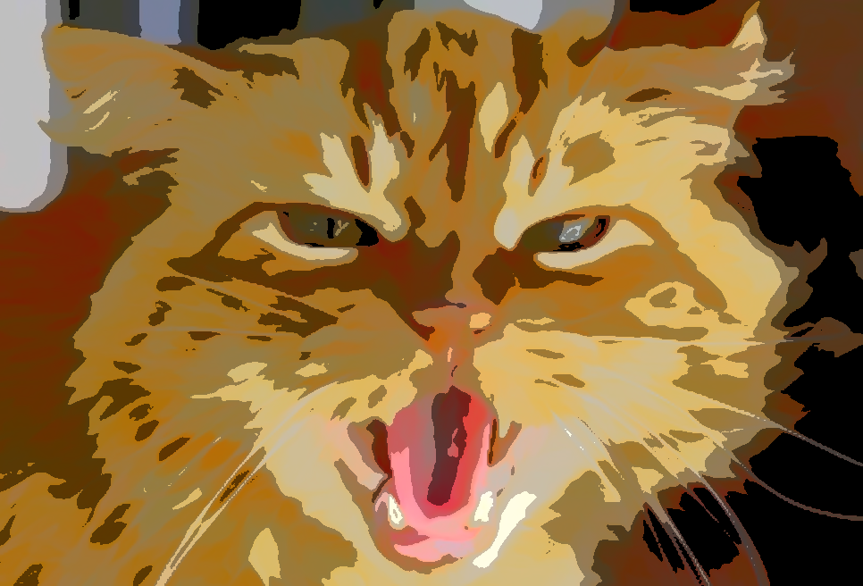
Luminance quantization
Luminance
Quantize to 10 luminance bins
Final image with 10 luminance bins
Quantize to 5 luminance bins
Final image with 5 luminance bins
Anisotropic Kuwahara filtered image

Slide 35
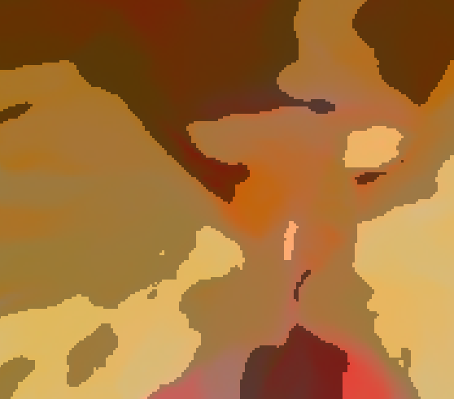
Color quantization
With luminance quantization the luminance channel has no gradient, but chroma channels still have
We still have smooth color changes within a luminance bin
Chroma can also be quantized
We assign a color palette to the image
For each pixel we choose the closest color from the palette

Slide 36
Color quantization questions
Choosing nearest palette pixel needs pixel value difference. How to calculate it?
  Difference should be calculated in a perceptually even color space like CIELab
  For efficiency reasons we can choose YCbCr too
  Using RGB space Euclidian distance is usually not sufficient
How to construct color palette?
  It can be defined by artist (should match image content)
  We can define it automatically from the image. It needs the preprocessing of the input image and clustering its pixels. It is time consuming for real-time applications.

Slide 37
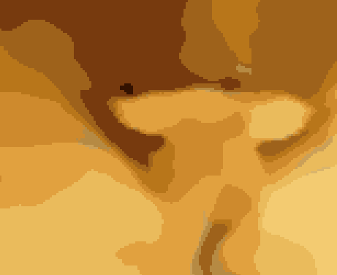
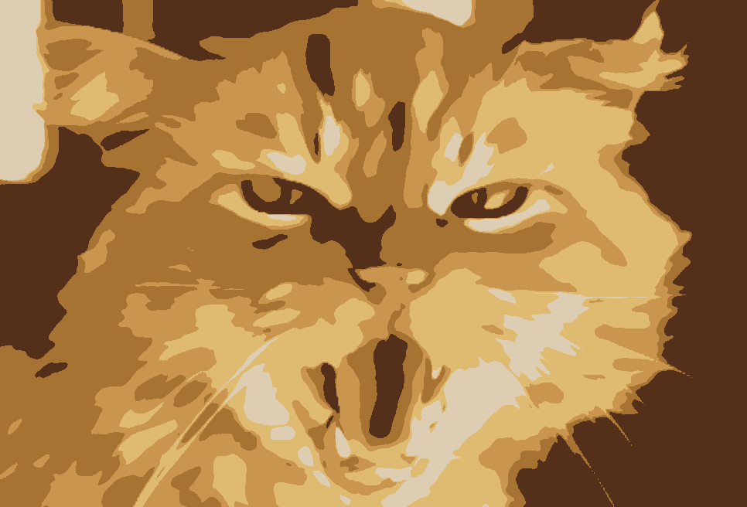
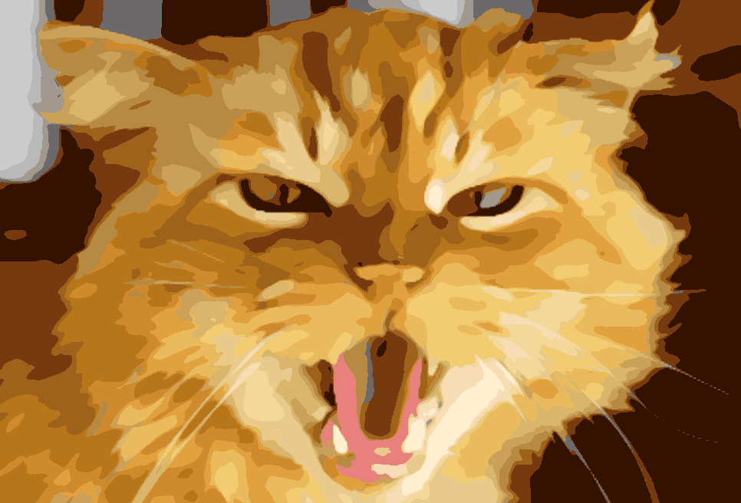
Color quantization with automatic palette generation
Anisotropic Kuwahara filtered image
No color gradients
Quantize to 5 colors
Quantize to 20 colors

Slide 38
Image simplification workflow
Using what we learnt so far and from lecture about edge detection we can build up the main components of an image simplification workflow:
Convert image to CIELab or YCbCr
Apply edge preserve smoothing (Bilateral/SNN/Kuwahara)
Extract edges (contours) from smooth image (Sobel/LoG/DoG)
Quantize luminance or color of smooth image
Combine quantized image with contours

Slide 39
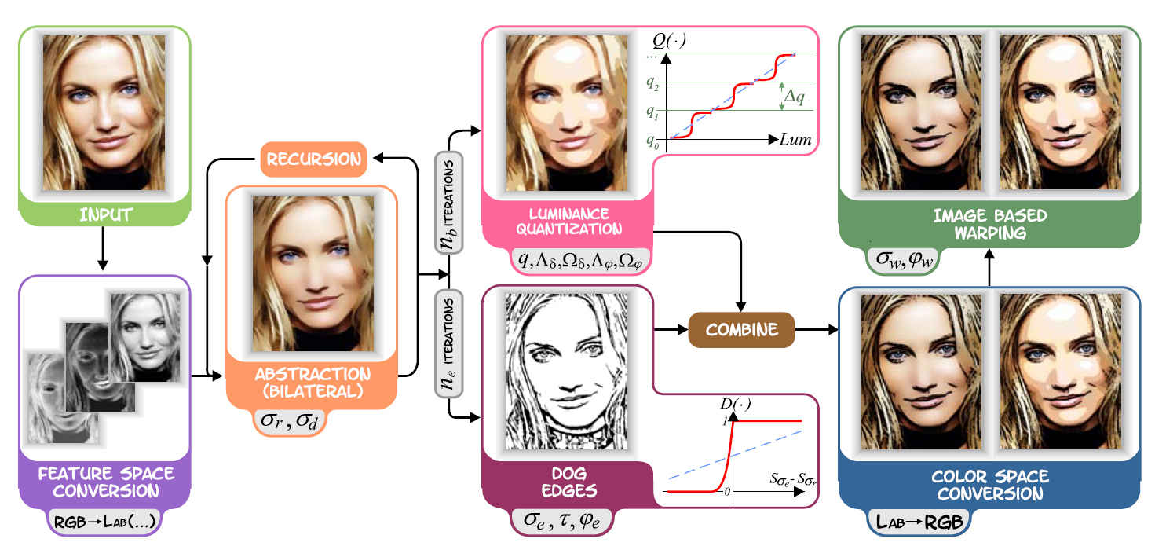
Image simplification workflow
Quantization turned off
Quantization turned on
Winnemöller H., Olsen S. C., Gooch B.: Real-time video abstraction. In SIGGRAPH ’06: ACM SIGGRAPH 2006 Papers (2006), pp. 1221–1226.

Slide 40
Tangent flow based filters
Applying non separable filter in a separable way can cause artifacts
But separable execution is much faster
Reduce artifacts by aligning the filter axes to image features
Filter kernels are rotated in the direction of image tangent flow
Image tangent flow: a vector pointing in the direction of minimum rate of change
Intuitively: a vector field following contour directions
Not to be confused with optical flow : temporal movement direction of pixels

Slide 41
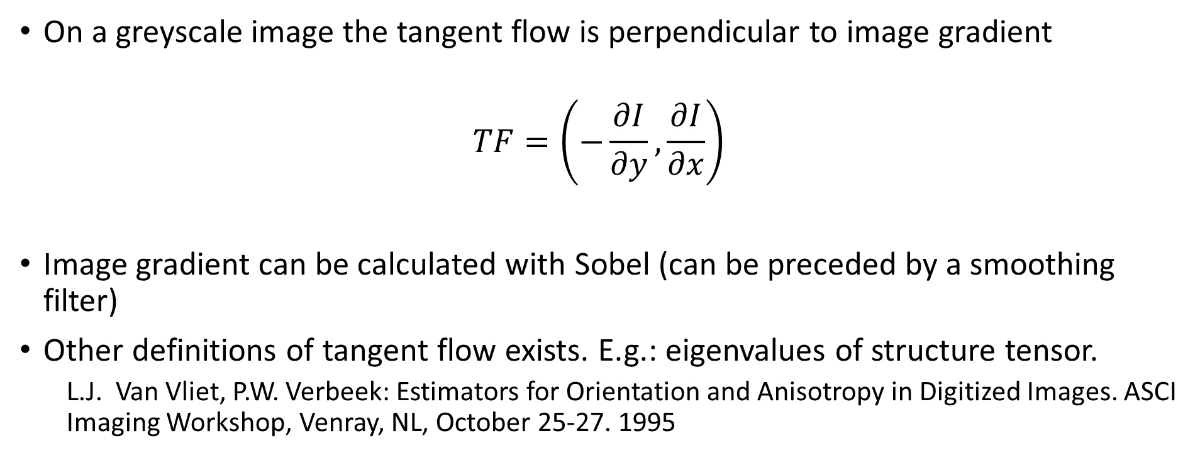
Tangent flow calculation
On a greyscale image the tangent flow is perpendicular to image gradient
$$TF=\left(−\frac{∂I}{∂y},\frac{∂I}{∂x}\right)$$
Image gradient can be calculated with Sobel (can be preceded by a smoothing filter)
Other definitions of tangent flow exists. E.g.: eigenvalues of structure tensor.
  L.J. Van Vliet, P.W. Verbeek: Estimators for Orientation and Anisotropy in Digitized Images. ASCI Imaging Workshop, Venray, NL, October 25-27. 1995

Slide 42
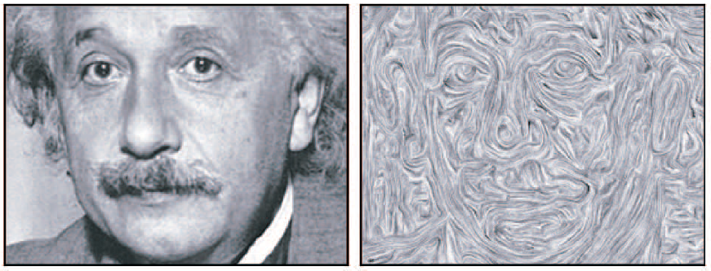
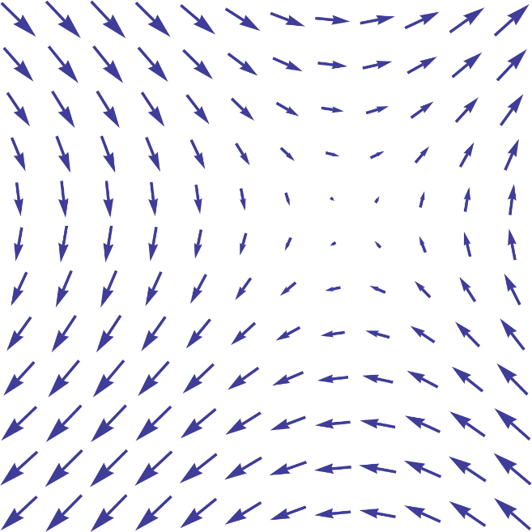
Tangent flow
Tangent flow is a vector field
How to visualize it?
  Line Integral Convolution
    Start from a random noise grayscale image and smooth it with an 1D filter along the tangent direction. Resulting grayscale values have no real meaning, just visualize the flow.
  Draw the direction vectors

Slide 43
Using the tangent flow
Separable bilateral filter is oriented to the tangent direction
  Produces fewer artifacts
  Important features are better preserved
  Unimportant features are better smoothed
Separable difference of Gaussians kernels are also oriented to the tangent direction
  Produces more coherent contour lines
1st filter pass
Along gradient direction
2nd filter pass
Along tangent flow

Slide 44
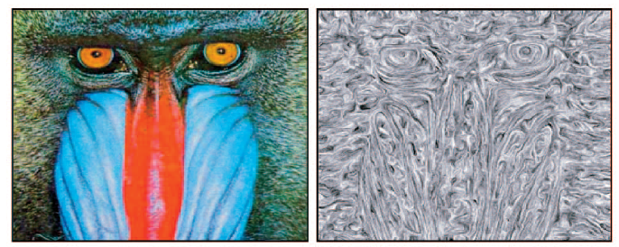
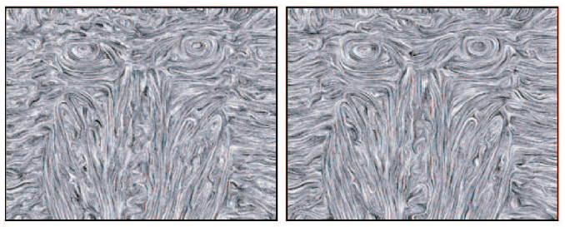
Tangent flow smoothing
After gradient calculation the tangent flow is not smooth enough
It can be smoothed with a Gaussian blur
Better smooth it with an edge preserving filter, typically bilateral filter
  Details of bilateral filter weights used in tangent flow smoothing is described in:
Kang H., Lee S., Chui C. K.: Flow-based image abstraction. IEEE Transactions on Visualization and Computer Graphics 15, 1 (2009), 62–76.
Image
Tangent flow after 1st smooth iteration
Tangent flow after 2nd smooth iteration
Tangent flow after 3rd smooth iteration

Slide 45
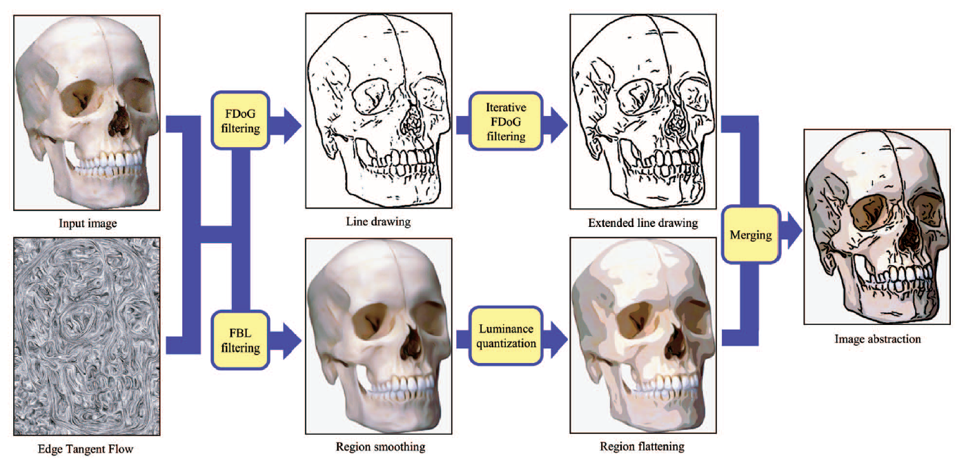
Tangent flow based image simplification workflow
Similar to our previous workflow, but uses Edge Tangent Flow in bilateral and DoG filtering
(FBL: flow based bilateral, FDoG: flow based difference of Gaussians)
Kang H., Lee S., Chui C. K.: Flow-based image abstraction. IEEE Transactions on Visualization and Computer Graphics 15, 1 (2009), 62–76.

Slide 46
Kang H., Lee S., Chui C. K.: Flow-based image abstraction. IEEE Transactions on Visualization and Computer Graphics 15, 1 (2009), 62–76.

Slide 47
Diffusion based methods
Diffusion processes based on partial differential equations can regularize the flow field on a global manner
The diffusion process (Mean Curvature Flow) not only smoothens colors, but also simplifies shape boundaries
Diffusion can lead to too much smoothing, thus after a few diffusion iterations a de-blurring shock filter should be used

Slide 48
Diffusion based methods
Shape-simplifying image abstraction
Coherence-enhancing filtering
H. Kang and S. Lee, “Shape-simplifying image abstraction,”
Comput. Graph. Forum, vol. 27, no. 7, pp. 1773–1780, 2008.
J. E. Kyprianidis and H. Kang, “Image and video abstraction
by coherence-enhancing filtering,” Comput. Graph. Forum,
vol. 30, no. 2, pp. 593–602, 2011.

