Slide 1
Contour drawing / Edge detection

Slide 2
Outline
Contour drawing in art
Silhouette / outline
Definition of outlines
Image space
Object space
Image space methods
Edge detection
First order methods
Second order methods
Edge detection using non color buffers
Object space methods
Rendering object space contours
Occluding contours
Suggestive Contours
Ridges/valleys
Other GPU based methods
2pass drawing
Occluding edge extraction
Occluding contour detection in pixel shader

Slide 3
Contour drawing in art
„The purpose of contour drawing is to emphasize the mass and volume of the subject rather than the detail; the focus is on the outlined shape of the subject and not the minor details.”
https://en.wikipedia.org/wiki/Contour_drawing
In classic art several contour drawing techniques and exercises exist:
Blind Contour Drawing
Timed Drawing
Continuous Line Drawing
Contour drawing
Cross contour drawing
Etc..
For computer graphics, contour drawing technique is the most revelant.
It shows the main shape and edges of the scene omitting tone and fine geometric details. Compared to Blind/Timed drawings, contour drawings provide realistic representation of the subjects.

Slide 4
Contour drawing in art
„The purpose of contour drawing is to emphasize the mass and volume of the subject rather than the detail; the focus is on the outlined shape of the subject and not the minor details.”
https://en.wikipedia.org/wiki/Contour_drawing
In classic art several contour drawing techniques and exercises exist.
For details see:
https://www.studentartguide.com/articles/line-drawings

Slide 5
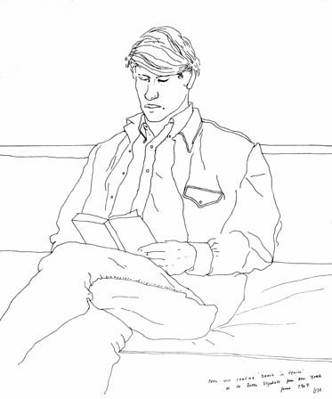
Contour drawing
Some features that can be expressed with contours
Silhouette
Color change
Object boundaries
Plane changes
Occlusion
Sharp edges
(Ridges/valleys)
Works of David Hockney

Slide 6
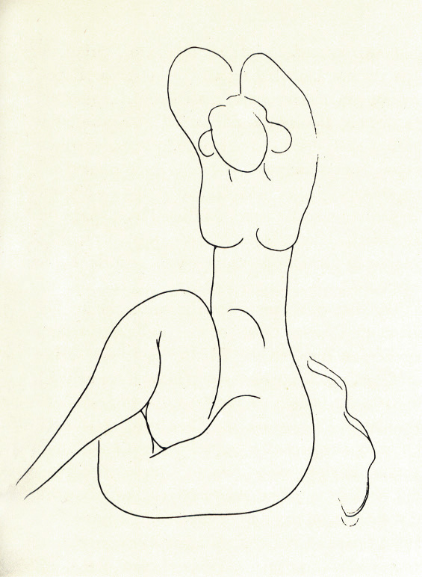
Abstract contour drawing
Many fine art contour drawings are not realistic but abstract
These are hard to reproduce with computer graphics
Recent solutions use neural networks and machine learning
Leon A. Gatys, Alexander S. Ecker, Matthias Bethge: A Neural Algorithm of Artistic Style. Published in ArXiv 2015
Henri Matisse „...la torsem et native nue...” 1932

Slide 7
Definition of outlines in 3D graphics
Image space
Search for features on images
RGB image is always present
Additional images can be rendered:
Depth
Normal
Object ID
Edge detection algorithms used in image processing and computer vision
Pro
Can be done in a post process
Original geometry is not needed
We work on visible information only: occlusion is not a problem
Con
Line stylization is harder
Time coherency can be a problem
Hard to define „good” edges (false edges, missed edges)
Sensitive to noise
Object space
Search for features on the geometry (triangles)
Use vertex data: position and normal
Use topology data: triangle adjacency
Based on differential geometry
Pro
High quality can be achieved
Less false edges and edge misses
Line stylization is easier
Con
Occlusion can be a problem
Need geometry processing (deformable objects can not be preprocessed!)
Color change contours can not be handled
High quality lines need fine tessellation
Most contour extracting methods assume smooth geometry (no hard edges)

Slide 8
Image space methods
Detect edges on rendered images.
Edge: significant local change in image intensity.
Basic edge profile types (real edge can be a combination too):
step
ramp
line
roof
Ramesh Jain, Rangachar Kasturi, Brian G. Schunck: Machine Vision. Published by McGraw-Hill, Inc., ISBN 0-07-032018-7, 1995
http://www.cse.usf.edu/~r1k/MachineVisionBook/MachineVision.pdf

Slide 9
Example edge profile

Slide 10
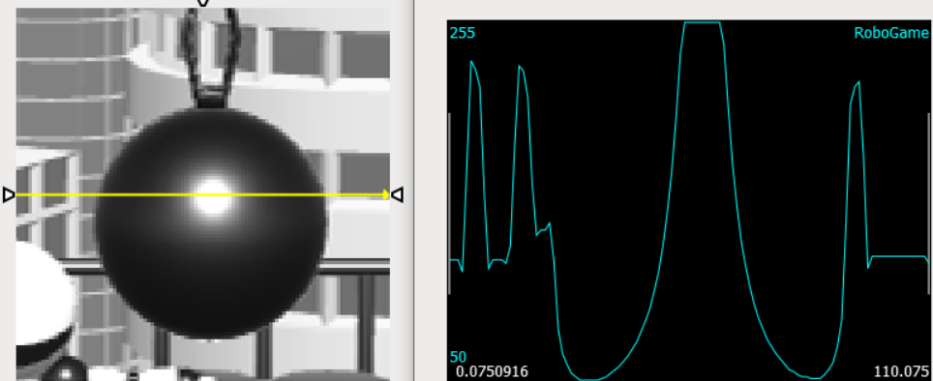

Slide 11
Edge detection
In computer vision contour detection usually has the following tasks:
Identify edge pixels on image
Try to form line segments or curve segments from distinct edge points
Merge segments into continuous contour lines
In NPR rendering we usually stop at the first step: find edge pixels
Analyzing edge pixels, cleaning and merging them usually have too high costs

Slide 12
Finding edge pixels
Detect significant local changes: find local peaks in first derivative
Two example edge profiles in 1D:
OR
F(x)
DF(x)
F(x)
DF(x)
Edges are where the absolute value of the first derivative is „high enough”

Slide 13
Finding edge pixels
Detect significant local changes: find local peaks in first derivative
Question: Rendered image is 2D, what is the first gradient, and what is „high enough”?
Answer:
Use partial derivatives: $DF=\left(\frac{∂F}{∂x},\frac{∂F}{∂y}\right)$
Examine the magnitude of this vector: $\sqrt{{\frac{∂F}{∂x}}^{2}+{\frac{∂F}{∂y}}^{2}}$. Is it high enough?
In practice the sum of the absolute values of the partial derivatives can be used:$\left|\frac{∂F}{∂x}\right|+\left|\frac{∂F}{∂y}\right|$

Slide 14
Finding edge pixels
Question: Rendered image is vector valued (RGB), how to handle this?
Answer I.
Compute partial derivatives of color channels separately:
$$DF=\left[ \begin{matrix}\frac{∂R}{∂x} & \frac{∂G}{∂x} & \frac{∂B}{∂x} \\ \frac{∂R}{∂y} & \frac{∂G}{∂y} & \frac{∂B}{∂y}\end{matrix}\right]$$
Examine this: $\sqrt{{\frac{∂R}{∂x}}^{2}+{\frac{∂R}{∂y}}^{2}}+\sqrt{{\frac{∂G}{∂x}}^{2}+{\frac{∂G}{∂y}}^{2}}$+$\sqrt{{\frac{∂B}{∂x}}^{2}+{\frac{∂B}{∂y}}^{2}}$.
Or this: $\left|\frac{∂R}{∂x}\right|+\left|\frac{∂R}{∂y}\right|+\left|\frac{∂G}{∂x}\right|+\left|\frac{∂G}{∂y}\right|$+$\left|\frac{∂B}{∂x}\right|+\left|\frac{∂B}{∂y}\right|$
Answer II.
Compute luminance of image -> scalar value image (prev. slide)
Some color contours could be missed!

Slide 15
How to calculate derivatives on image
$\frac{∂I(x,y)}{∂x}≅I\left(x+1,y\right)−I(x,y)$
$\frac{∂I(x,y)}{∂y}≅I\left(x,y+1\right)−I\left(x,y\right)$
Convolution matrix:
$$\frac{∂}{∂x}=\left[\begin{matrix}0 & 0 & 0 \\ 0 & −1 & 1 \\ 0 & 0 & 0\end{matrix}\right],\frac{∂}{∂y}=\left[\begin{matrix}0 & 1 & 0 \\ 0 & −1 & 0 \\ 0 & 0 & 0\end{matrix}\right]$$
Problem: dx, and dy approximates the derivatives at different pixel positions ((x+0.5,y) and (x,y+0.5) respectively)

Slide 16
How to calculate derivatives on image
Roberts operator
$\left|∂I(x,y)\right|≅\left|I\left(x,y\right)−I\left(x+1,y+1\right)\right|+\left|I\left(x+1,y\right)−I(x,y+1)\right|$
Convolution matrix:
$$\frac{∂}{∂x}=\left[\begin{matrix}0 & 0 & 0 \\ 0 & 1 & 0 \\ 0 & 0 & −1\end{matrix}\right],\frac{∂}{∂y}=\left[\begin{matrix}0 & 0 & 0 \\ 0 & 0 & 1 \\ 0 & −1 & 0\end{matrix}\right]$$
dx, and dy approximates the derivatives at the same pixel positions: (x+0.5, y+0.5), but not at (x, y)!

Slide 17
How to calculate derivatives on image
Central differences
Convolution matrix:
$$\frac{∂}{∂x}=\left[\begin{matrix}0 & 0 & 0 \\ −1 & 0 & 1 \\ 0 & 0 & 0\end{matrix}\right], \frac{∂}{∂y}=\left[\begin{matrix}0 & 1 & 0 \\ 0 & 0 & 0 \\ 0 & −1 & 0\end{matrix}\right]$$
dx, and dy approximates the derivatives at (x, y), but discards pixel value at (x, y)!

Slide 18
How to calculate derivatives on image
Sobel operator
Convolution matrix:
$$\frac{∂}{∂x}=\left[\begin{matrix}−1 & 0 & 1 \\ −2 & 0 & 2 \\ −1 & 0 & 1\end{matrix}\right], \frac{∂}{∂y}=\left[\begin{matrix}1 & 2 & 1 \\ 0 & 0 & 0 \\ −1 & −2 & −1\end{matrix}\right]$$
Less sensitive to noise.
Combination of a box blur and central differences.
One of the most commonly used differential operator

Slide 19
How to calculate derivatives on image
Prewitt operator
Convolution matrix:
$$\frac{∂}{∂x}=\left[\begin{matrix}−1 & 0 & 1 \\ −1 & 0 & 1 \\ −1 & 0 & 1\end{matrix}\right], \frac{∂}{∂y}=\left[\begin{matrix}1 & 1 & 1 \\ 0 & 0 & 0 \\ −1 & −1 & −1\end{matrix}\right]$$
Similar to Sobel, but closer pixels do not have higher influence.

Slide 20
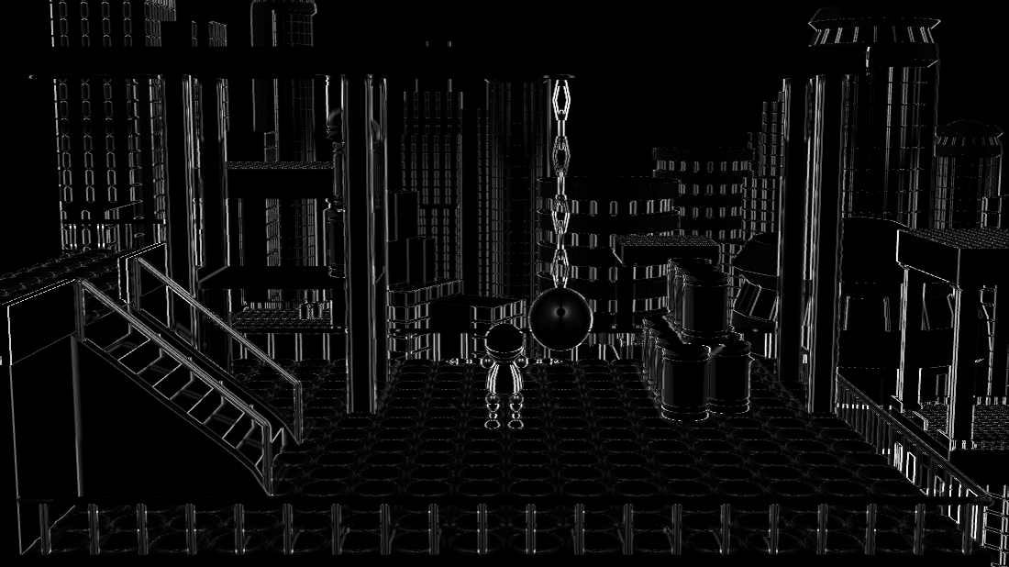
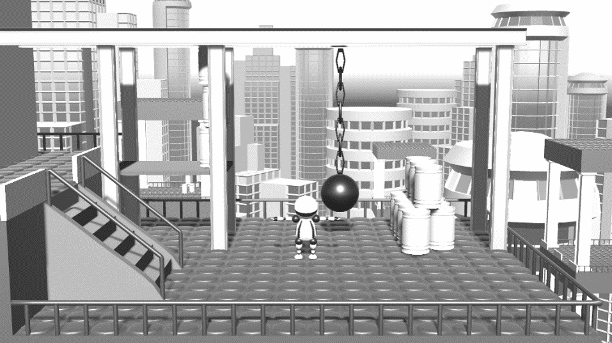
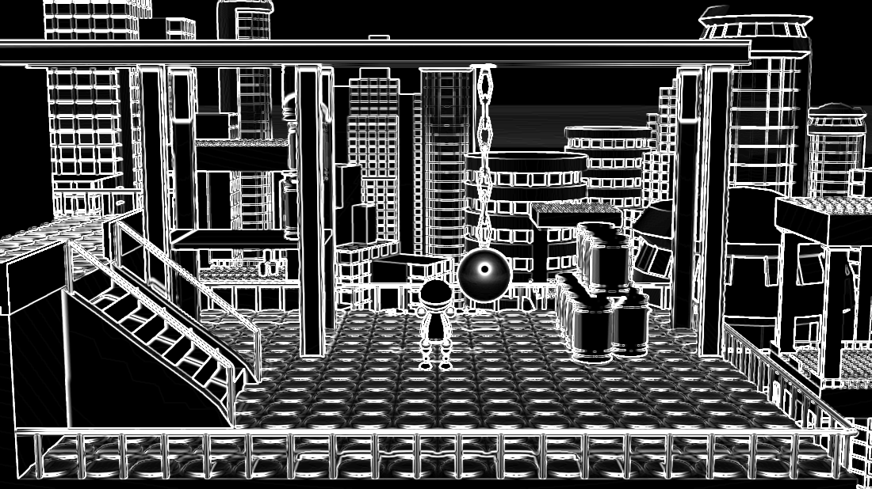
Example
Grayscale image
Derivative in x direction
Gradient magnitude
Derivative in y direction

Slide 21
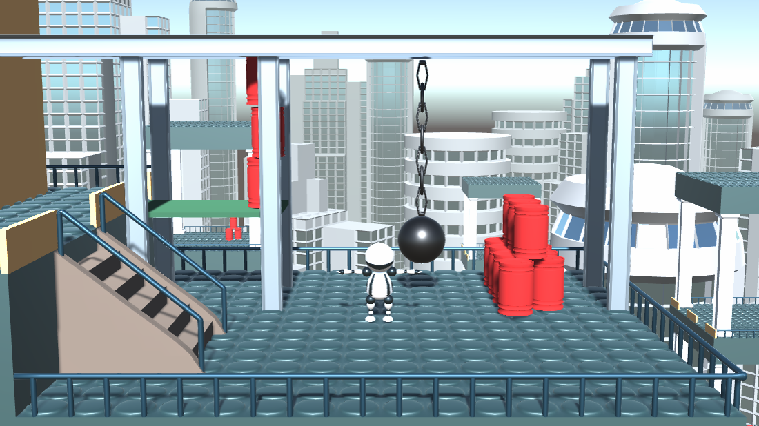
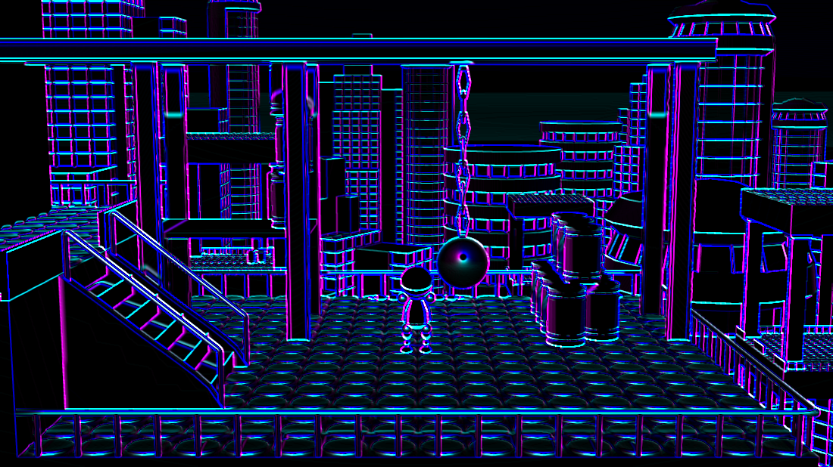
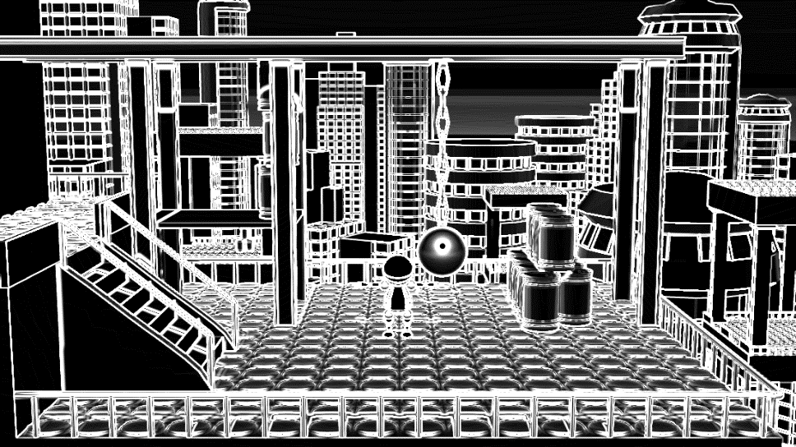
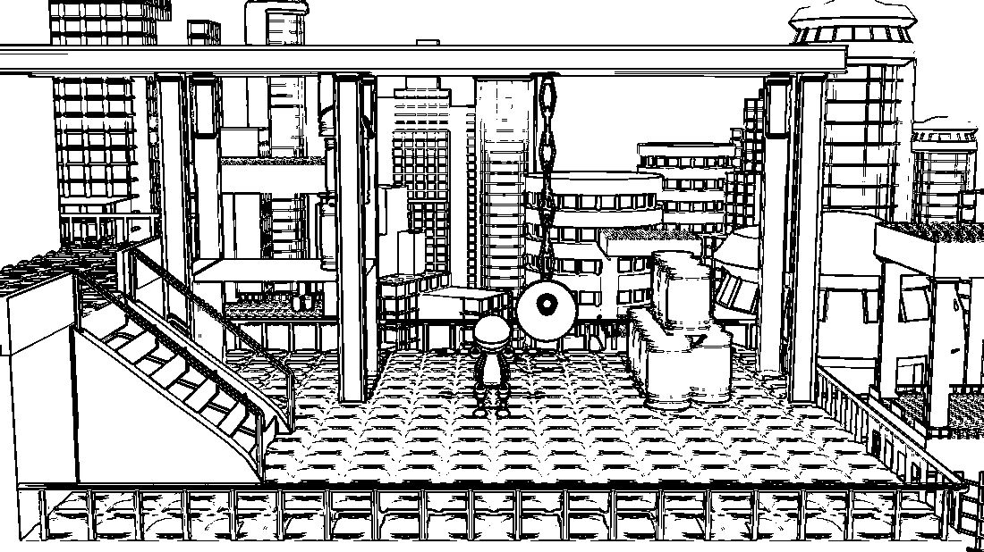
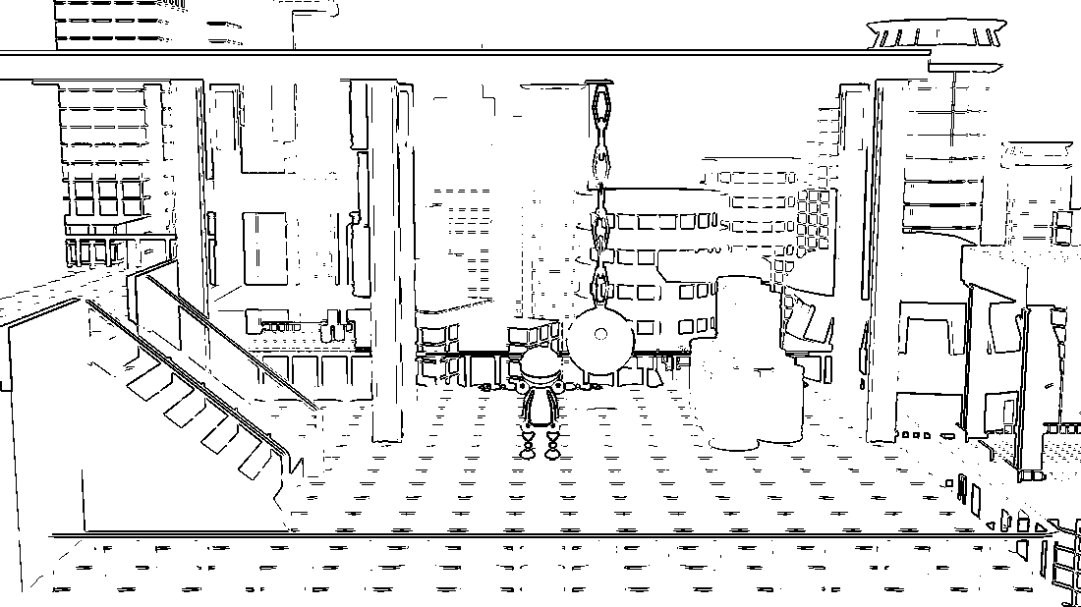
Example
RGB image
Gradient magnitude of R,G and B channels
Sum of gradient magnitudes
Threshold at 0.8 and invert
Threshold at 3.0 and invert

Slide 22
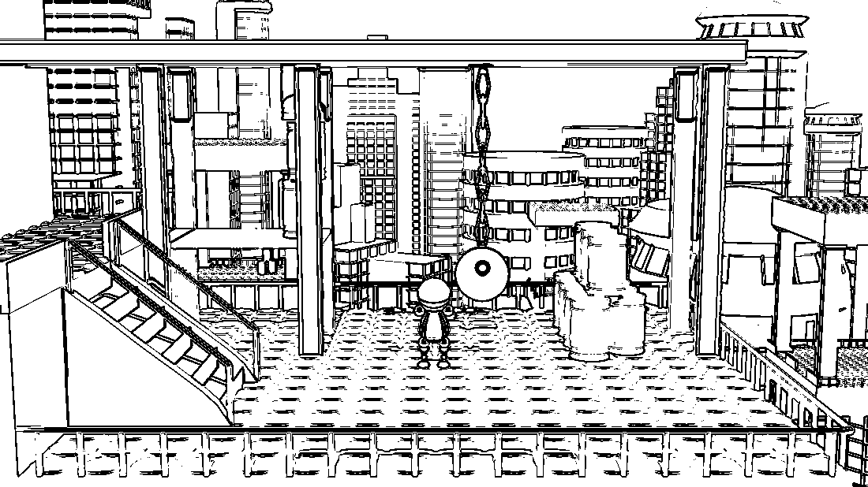
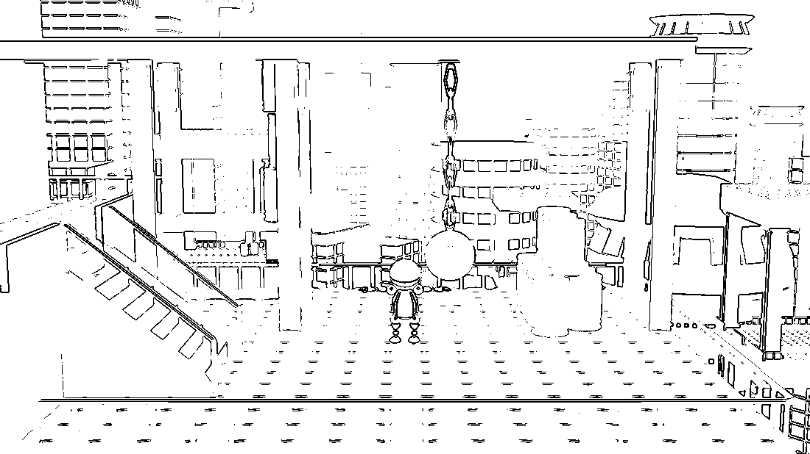
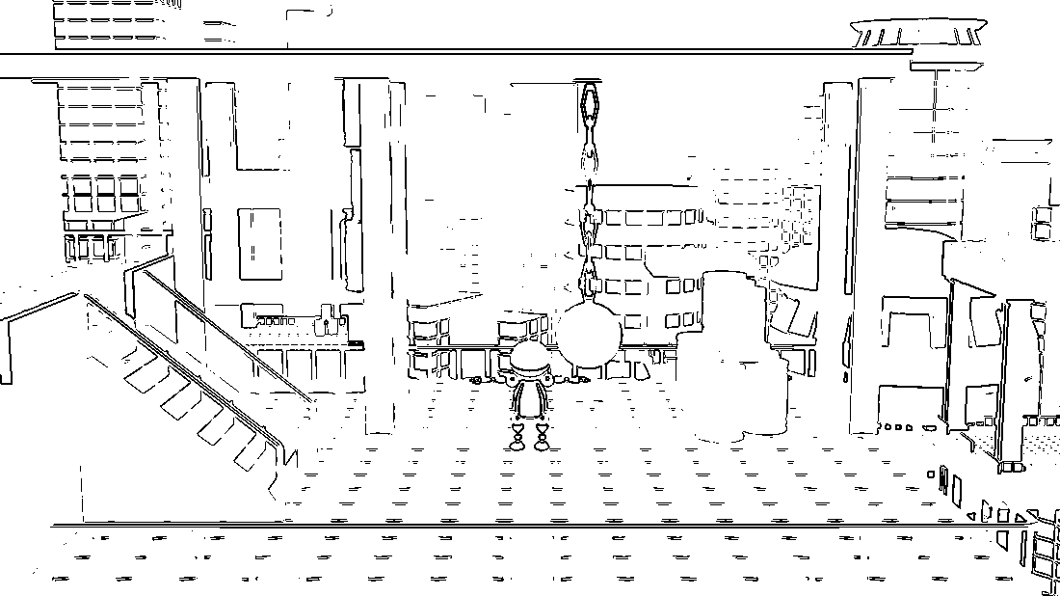
Comparison
The two methods are similar but Sobel has less noise e.g. here
Central Differences
Sobel
Threshold = 0.3
Threshold = 0.9

Slide 23
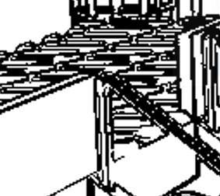
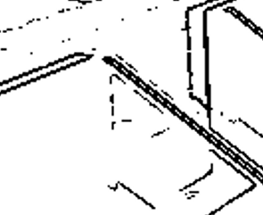
Threshold
Finding the right threshold value is hard
Depends on the image itself
Depends on the gradient operator
E.g. in previous slide Sobel operator was normalized with a factor of 0.25 to match the central differences operator
If low threshold is used, thick lines and noise will appear
If high threshold is used, important lines will disappear

Slide 24
Threshold problem
Too wide edge
Low threshold
Disappeared edge
High threshold
Function
Function derivative absolute value
A solution can be adaptive thresholding: adjust threshold value based on average gradient magnitude around the pixel
Con: multipass solution, needs preprocessing of gradient image

Slide 25
Higher order derivatives
Function
First derivative
Edges at high (absolute) values
Second derivative
Edges at zero crossings
First and second derivatives can be combined:
Keep zero crossings where first derivative has high peak (threshold again ☹, but edge width won’t grow as zero crossings positions can be calculated even at subpixel precision)

Slide 26
Second order derivative
Laplace operator
Divergence of the gradient
$$∇^{2}F= \frac{∂^{2}F}{∂x^{2}}+\frac{∂^{2}F}{∂y^{2}}$$
Convolution matrix
$$∇^{2}≈\left[\begin{matrix}0 & 1 & 0 \\ 1 & −4 & 1 \\ 0 & 1 & 0\end{matrix}\right]$$
Or a smoothed version less sensitive to noise:
$$∇^{2}≈\left[\begin{matrix}1 & 4 & 1 \\ 4 & −20 & 4 \\ 1 & 4 & 1\end{matrix}\right]$$

Slide 27
Laplacian example I
Consider a pixel row:
First derivative:
Laplacian:
2 | 2 | 2 | 2 | 5 | 8 | 8 | 8 | 8 | 8
0 | 0 | 0 | 3 | 6 | 3 | 0 | 0 | 0 | 0
0 | 0 | 0 | 3 | 0 | -3 | 0 | 0 | 0 | 0
Zero crossing with high first derivative
Zero crossings with low first derivative

Slide 28
Laplacian example II
Consider a pixel row:
First derivative:
Laplacian:
2 | 2 | 2 | 2 | 2 | 8 | 8 | 8 | 8 | 8
0 | 0 | 0 | 0 | 6 | 6 | 0 | 0 | 0 | 0
0 | 0 | 0 | 0 | 6 | -6 | 0 | 0 | 0 | 0
Zero crossing is between pixels: harder to detect!
Laplacian works better on smooth edges.
Laplace operator is usually not used on its own, as second order derivatives are sensitive to noise.
Now we have two good reasons to prefilter (blur) image before using Laplace operator!

Slide 29
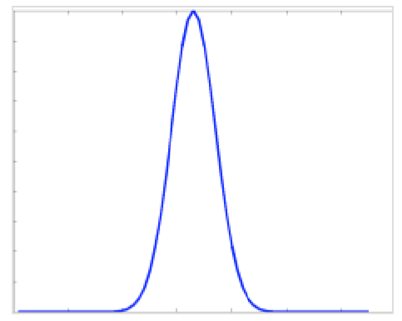
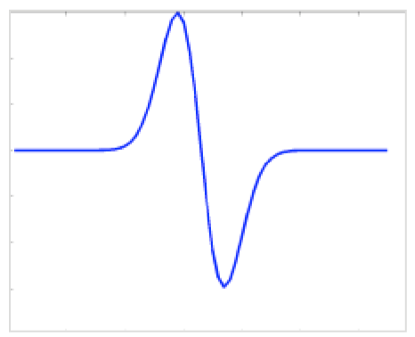
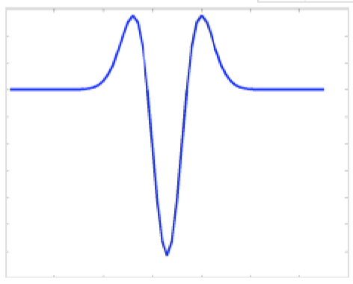
Laplacian of Gaussian (LoG)
Gaussian
Steps:
Smooth the image with Gaussian. (Can be a two pass separable filter.)
Apply Laplace operator.
Detect zero crossing with high first derivatives.
Optional: edge location can even be estimated with subpixel resolution.
First
derivative
Second
Derivative,
Laplacian of Gaussian
(Mexican hat)

Slide 30
Laplacian of Gaussian result
We have three parameters that should be fine tuned:
Threshold for first derivative high peak
Threshold for zero crossing (if searching for pixels with near zero values, as an alternative more sophisticated zero crossing search can be used at higher cost)
Gaussian kernel width

Slide 31
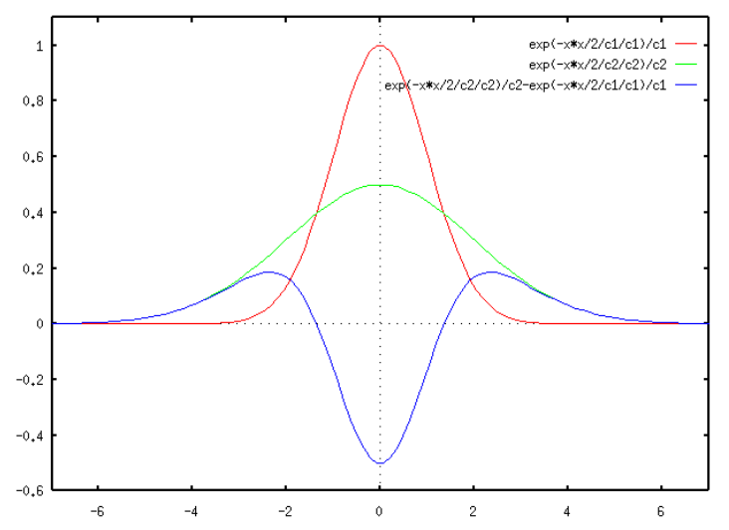
Difference of Gaussians (DoG)
Approximation of Laplacian of Gaussians
Use the difference of two Gaussian blurs
A Gaussian blur is a low pass filter
A difference of two low pass filter is a band pass filter, just like the Laplacian
This is how the retinal cells are believed to extract details and transfer them to the brain
Details: Theory of edge detection, D. Marr, E. Hildreth, 1980. https://royalsocietypublishing.org/doi/pdf/10.1098/rspb.1980.0020
More efficient implementation (Gaussians are separable)
Steps:
Smooth the image with Gaussian.
Smooth the image with Gaussian with different width.
Compute difference of two smooth image.
Detect zero crossing on difference image.

Slide 32
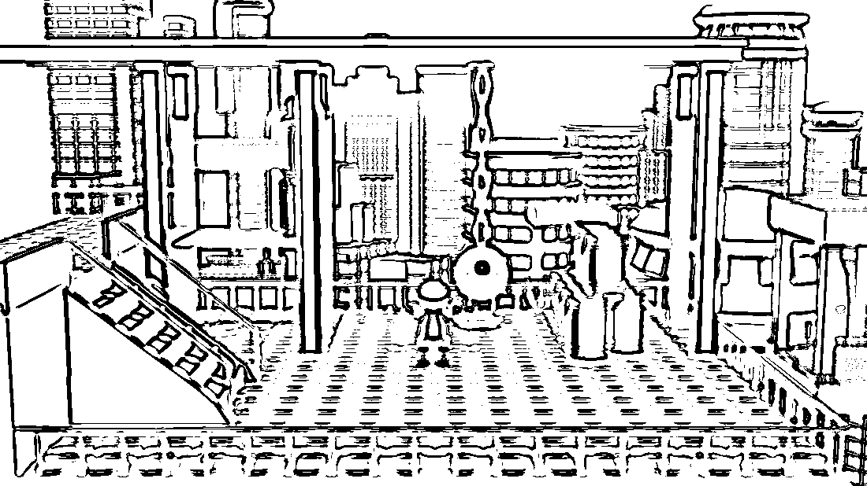
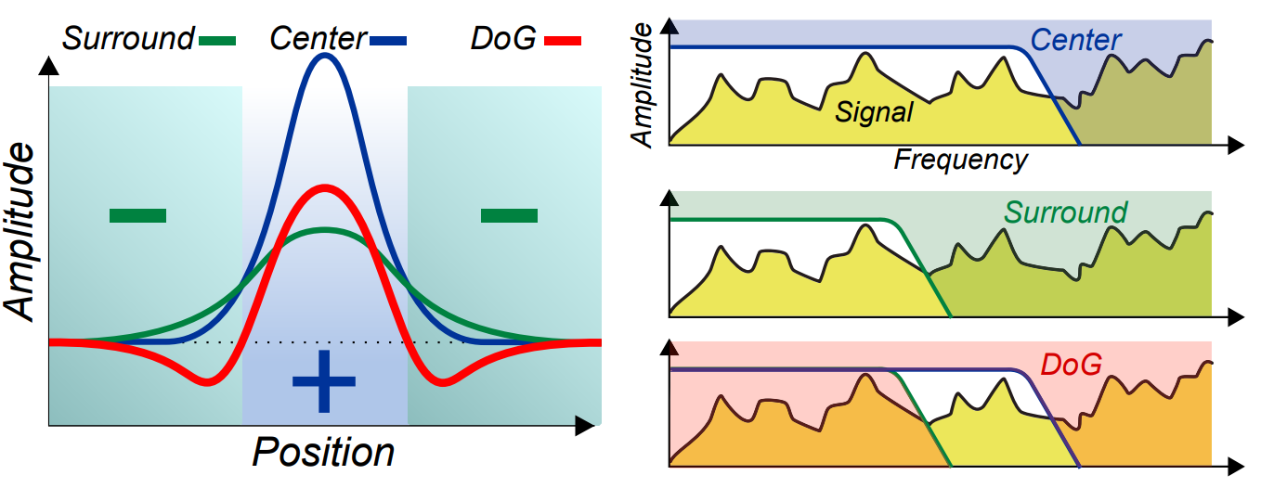
Difference of Gaussians Result
Using wider Gaussians extracts main structures (lower frequency band is kept)
Using narrower Gaussians extracts fine details (high frequency band is kept)
XDoG: advanced image stylization with eXtended Difference-of-Gaussians, H. Winnemöller, NPAR11

Slide 33
Smooth thresholding: XDoG
XDoG: Advanced Image Stylization with Extended Difference-of-Gaussians. H. Winnemöller NPAR, 2011.
XDoG: Extended Difference-of-Gaussians
Idea: use a smoothstep function instead of a step function for thresholding
Edges are not binary anymore, so the edge map becomes softer
$$1 if=u>treshold$$
$$1 if=u>treshold$$
$$Tthreshold(u)=$$
$$Tthreshold(u)=$$
$$0 otherwise$$
$$1+tanh\left(sharpness∗\left(u−threshold\right)\right) otherwise$$

Slide 34
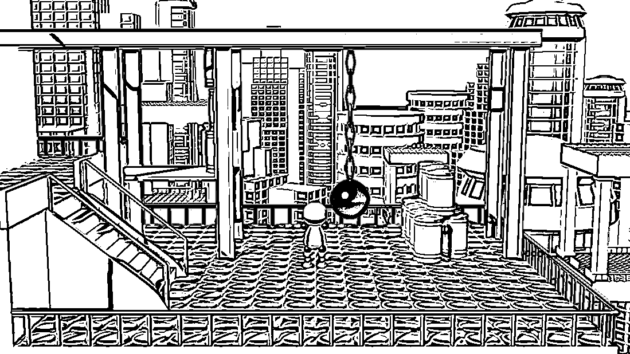
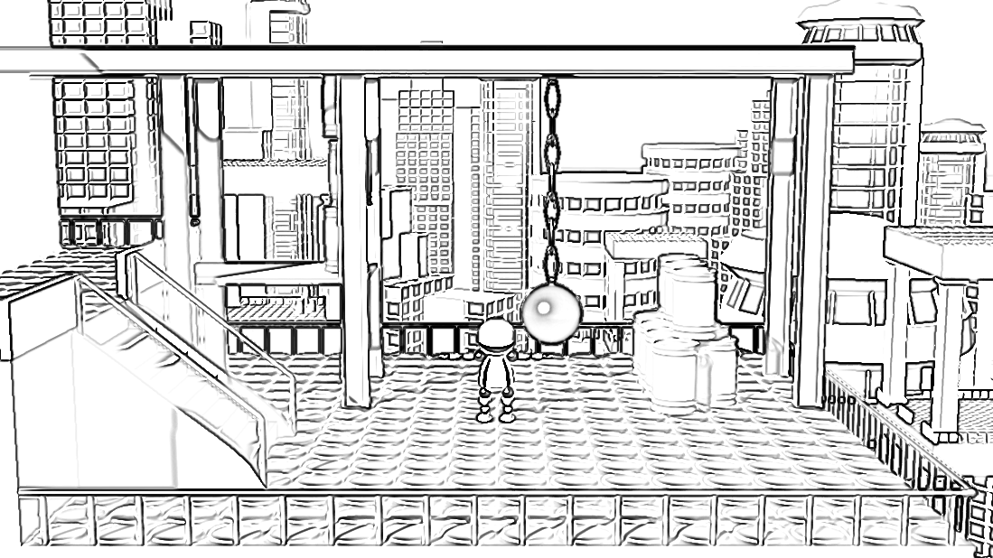
Smooth thresholding: XDoG
DoG
Thresholding with step
XDoG
Thresholding with smoothstep

Slide 35
Non color buffers
RGB image stores color information.
Edges appear at significant color differences.
Color difference can be caused by lighting and texture. These edges are not always wanted.
Object boundaries can have the same color: important edges will be lost.
We can use images storing non color information as the basis of edge detection:
Camera space normals
Camera space depth
Object ID (not always available in render engines)
They can provide much cleaner edges
Method: Calculate gradient for depth, normal, color, etc. maps separately and use the maximum or sum of these gradients for edge detection.
We have to find a good weighting for the separate gradients (normal gradients are probably in a smaller range than depth gradients)

Slide 36
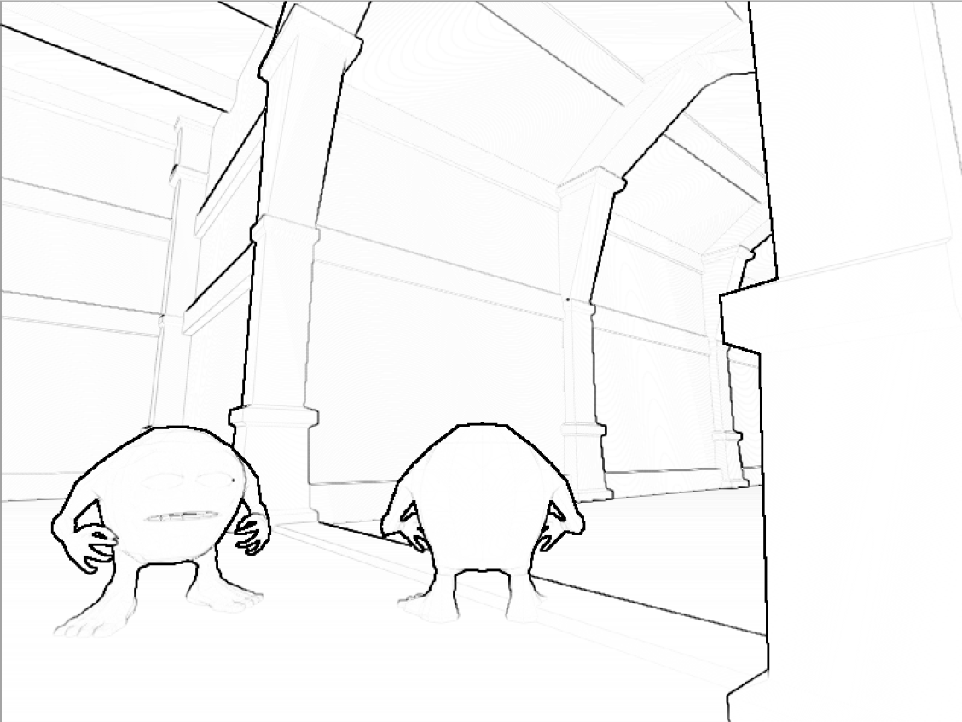
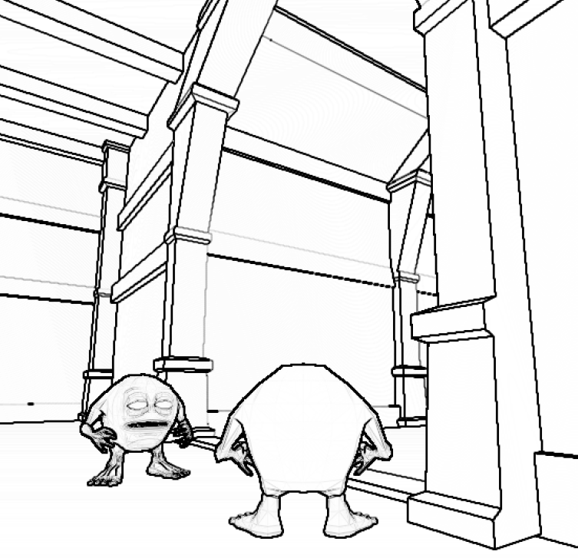
Example
Depth based contours
Lost edges due to small depth difference
Normal based contours
Lost edges due to same orientation of surfaces
Combined depth and normal contours
Keep both features

Slide 37
Object space methods
Main workflow
Process triangle geometry
Extract polylines or curves describing the contours from the geometry
Send the lines through the graphics pipeline just like any other 3D objects
Lines can be rendered as line primitives or
Lines are converted to line strips/ribbons (in camera space to face the camera)
Strips can be textured with artist given line texture
Texture is typically semi-transparent (alpha blending)

Slide 38
How to extract contours from triangle geometry?
Contours are related to specific geometric features
Extracting contours uses the theory of differential geometry
Very basics:
The first order approximation of a surface is its tangent plane, defined by its normal vector (normals = first order derivatives of the surface)
The derivatives of normal vectors define second order features: curvature
Curvature = 1/R
Curvature at a point is the reciprocal of the radius of the circle that can tightly fit onto the curve at the given point.
R
N
R
N
N
R
Positive curvature
Positive curvature
Negative curvature

Slide 39
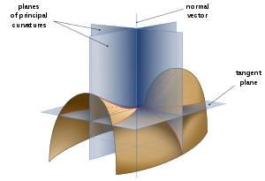
Curvatures and Principal curvatures
Curvature on a 3D surface is defined with respect to a direction in its tangent plane (normal curvature)
Two special directions exists
The direction where the surface has largest curvature
The direction where the surface has smallest curvature
These directions are called principal curvature directions
The corresponding curvatures are the principal curvatures
These two vectors are perpendicular
Principal curvature directions and values are important geometric features that are commonly used in NPR techniques
Not all geometries have principal curvature directions
Planes have zero curvature, and no principal directions
A sphere has the same curvature in all directions, thus has no principal direction
Source: Wikipedia

Slide 40
Extracting occluding contours
Occluding contours are the contours which represent depth discontinuities perceived at the rendered image
As they depend on the viewpoint, they can not be preprocessed: must be recalculated if the viewpoint changes
Assuming a smooth, closed surface depth discontinuities can only happen where the surface turns away from the camera

Slide 41
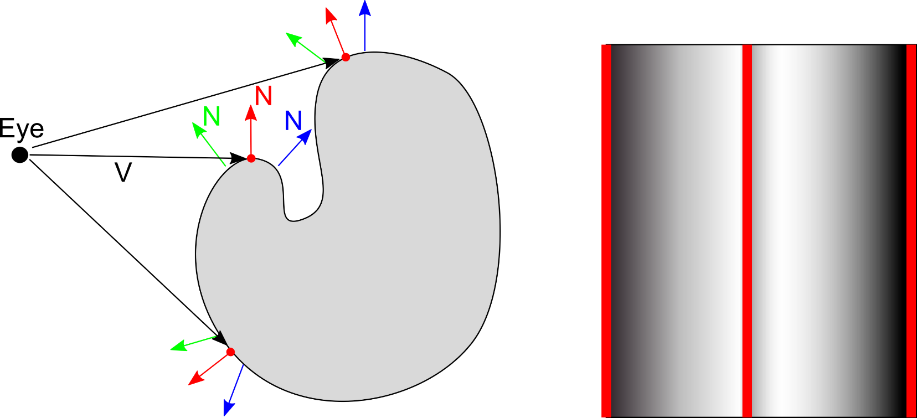
Extracting occluding contours
Assuming a smooth, closed surface depth discontinuities can only happen where the surface turns away from the camera
Surfaces with green normals: facing toward the camera (front facing)
Surfaces with blue normals: facing away the camera (back facing)
Surface points with red normals: perpendicular to view direction $N∙V=0$
Surfaces with red normals are occluding contours
Occluding
contour lines
Object seen
from camera

Slide 42
Extracting occluding contours
Method I:
Visit all edges of the triangle mesh
If the edge connects a front and a back facing polygon it is part of an occluding contour
Uses triangle normals
Can produce „zigzag”-ed, messy lines:

Slide 43
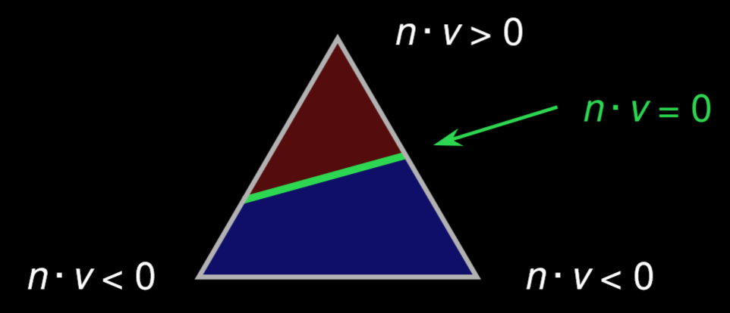
Extracting occluding contours
Method II:
Use smooth vertex normals
Interpolate them along triangle edges
Find zero crossing of $N∙V$
Can produce cleaner lines,
but lines can run through back facing triangles, which makes occlusion handling more difficult
Assumes smooth surface, hard edges are not possible
Geometry should be finely tessellated, as lines go through triangles: large polygons are not good

Slide 44
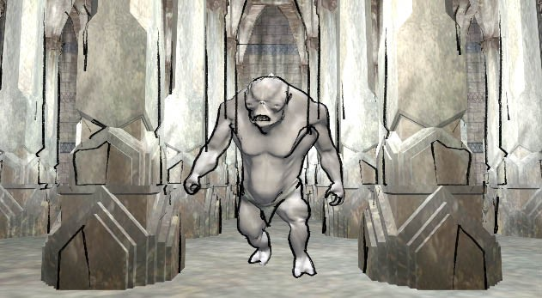
Bad examples
Occlusion problems
Lines go through large polygons (needs finer tessellation, and no sharp edges)

Slide 45
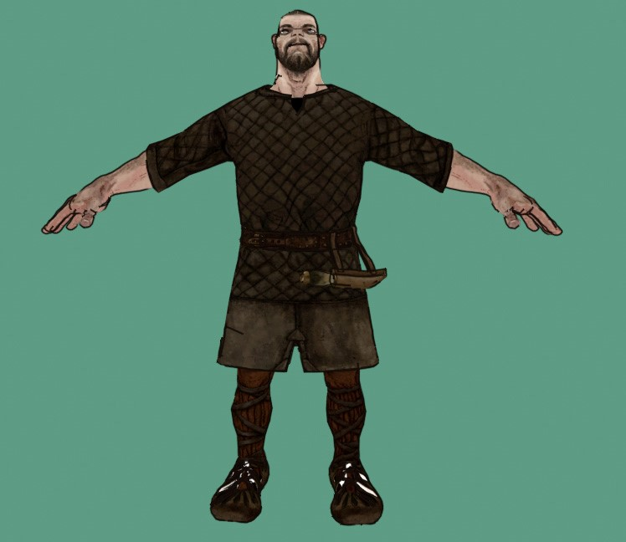
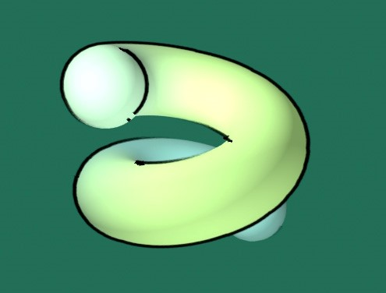
Examples

Slide 46
Suggestive contours
Surface points that are not occluding contours but are close to them:
changing view direction a little would make them occluding contours
$N∙V$ is not zero, but close to zero, it has a local minimum
Local minimum is where the derivative is zero
We are examining the derivative of $N∙V$, the derivative of N is curvature, so suggestive contours are related to curvature
Radial curvature: curvature along the view direction projected to the tangent plane
Suggestive contours are zero values of radial curvatures

Slide 47
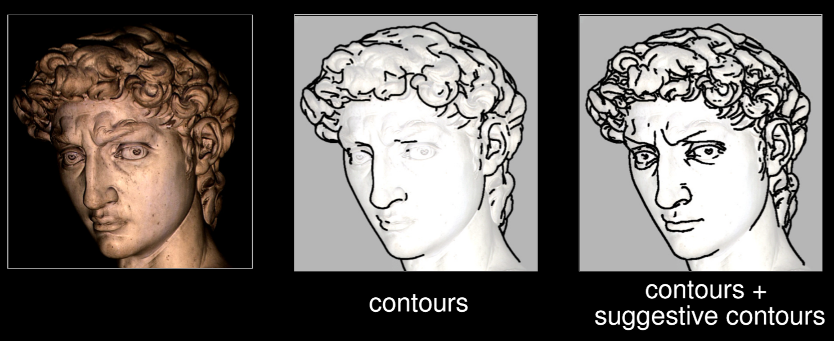
Suggestive contours
Detailed description of extracting suggestive contours is beyond the scope of this course.
Examples:

Slide 48
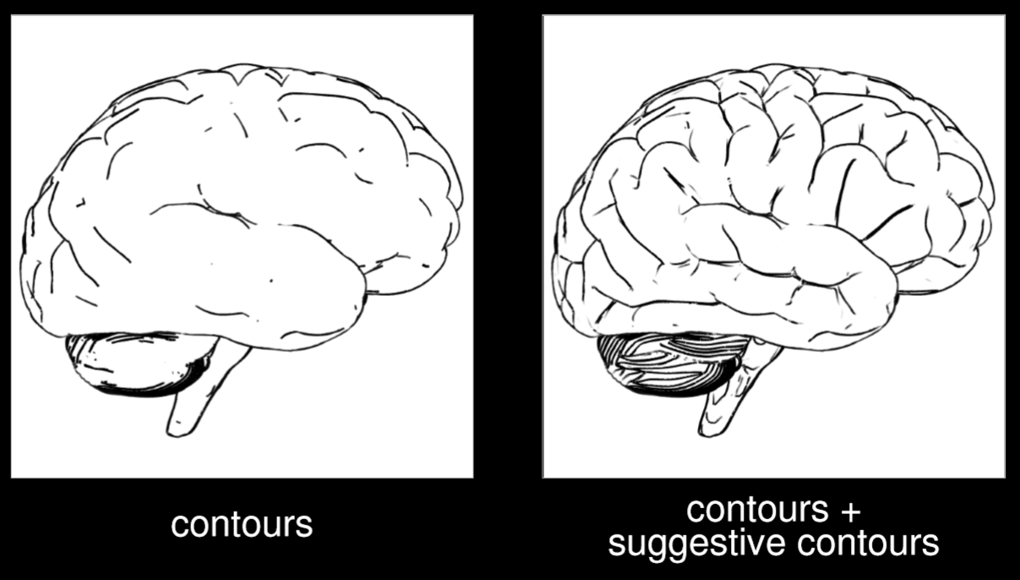
Suggestive contours
Doug DeCarlo, Adam Finkelstein, Szymon Rusinkiewicz, Anthony Santella. Suggestive Contours for Conveying Shape ACM Transactions on Graphics (Proc. SIGGRAPH 2003), Vol. 22, No. 3, pp. 848-855, July 2003.

Slide 49
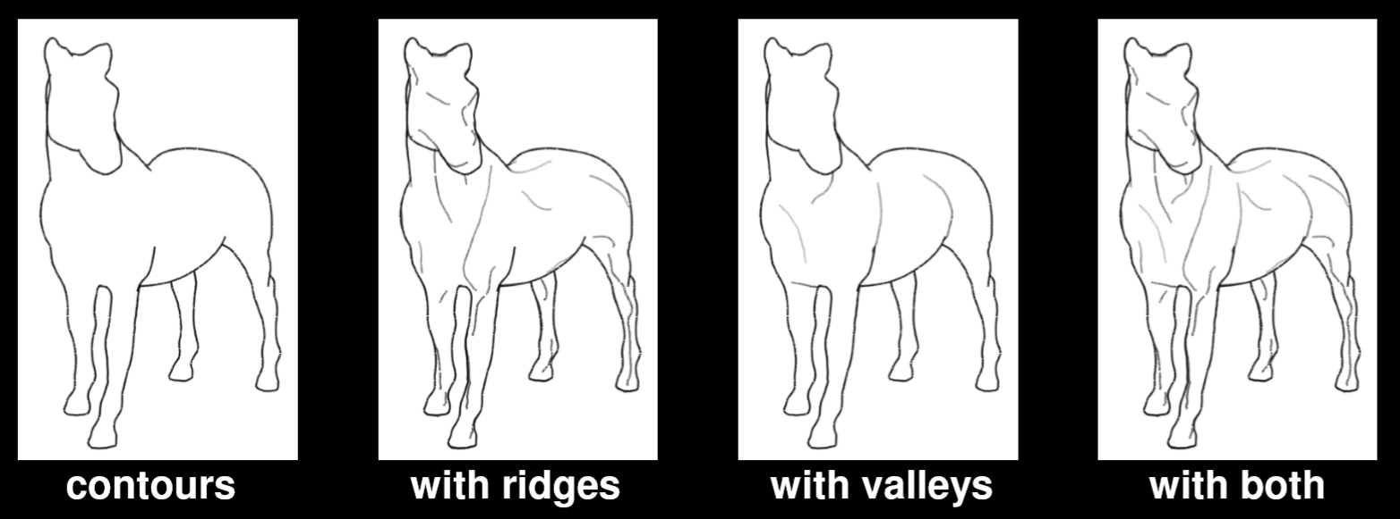
Ridges and Valleys
Local minima/maxima of curvature, in principal curvature directions.
Detailed description of extracting ridges and valleys is beyond the scope of this course. Example:

Slide 50
Line strip generation
Curves are first subdivided into polylines
For each line segment of the polyline define its normal vector
Extrude the line segment along its normal
Each line segment is rendered as quad: two triangles
The subdivision detail of curves affects line quality, especially at sharp corners

Slide 51
Line strip textured rendering
Line strip vertices can have texture coordinates
Line texture is possible
Here three different texture was used to render the same contour line strip
Assigning UV coordinates to vertices is not trivial
If the contour is given as a series of connected line segments the UV coordinates can be assigned according to the arc length of the line
If contours are extracted from the geometry as separate line segments, they should be preprocessed: we should reconnect them to form a continuous line arc

Slide 52
Line stylization
If lines are highly tessellated we can add unique stroke style to them
This can be random displacement along line normal
It can be given by an example (see image)
Both stylization and texturing have time coherency issues:
UV coordinates and random displacements should be coherent between adjacent frames
The problem is that lines can be split up or merged between two frames, thus arc length changes
Tamás Umenhoffer, Milán Magdics, Károly Zsolnai: Procedural Generation of Hand-drawn like Line Art
https://www.researchgate.net/publication/228916295_Procedural_Generation_of_Hand-drawn_like_Line_Art

Slide 53
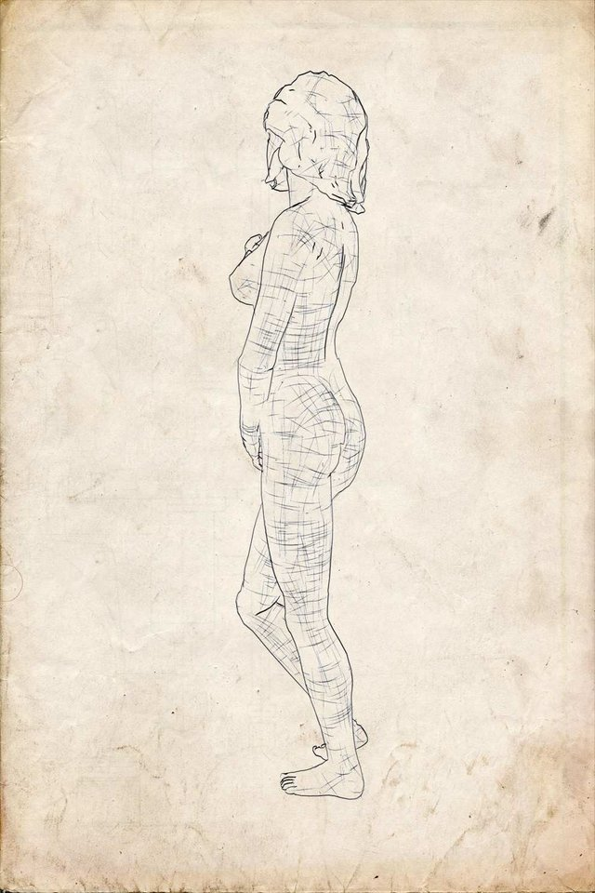
Object space contouring
(rendering of hatching lines will be introduced later)

Slide 54
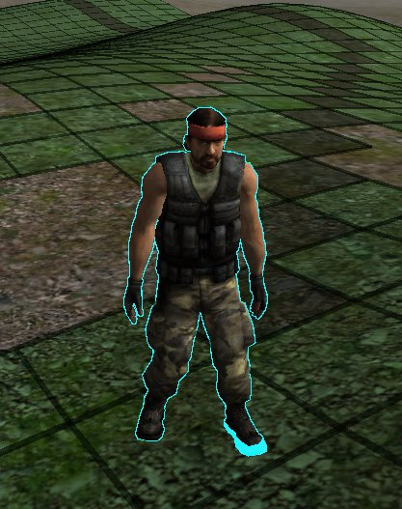
Other GPU friendly methods I.
Render silhouette outline around a specific object
Two pass rendering
First render with outline color
Depth write turned off
Object slightly scaled up (this scaling controls line width)
Render the object as usual
Depth write on
No additional scaling
http://wiki.unity3d.com/index.php/Silhouette-Outlined_Diffuse

Slide 55
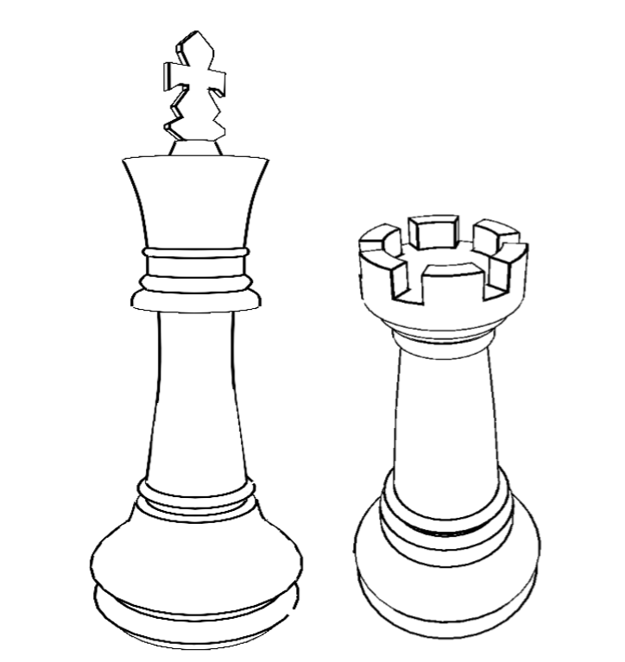
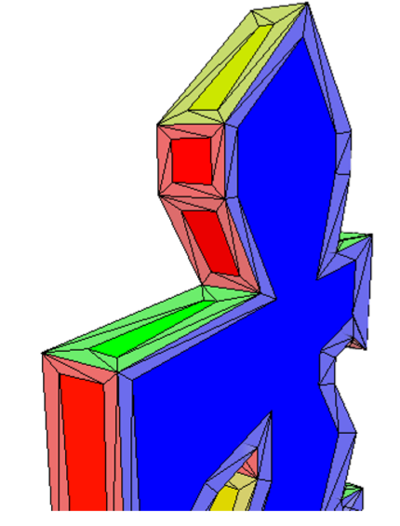
Other GPU friendly methods II.
Triangle adjacency information can be stored in vertex buffers
Occluding contours can be extracted in geometry shader (edges connecting back and front facing polygons)
Contour edges can be extruded to line strips in geometry shader
Line texturing is tricky

Slide 56
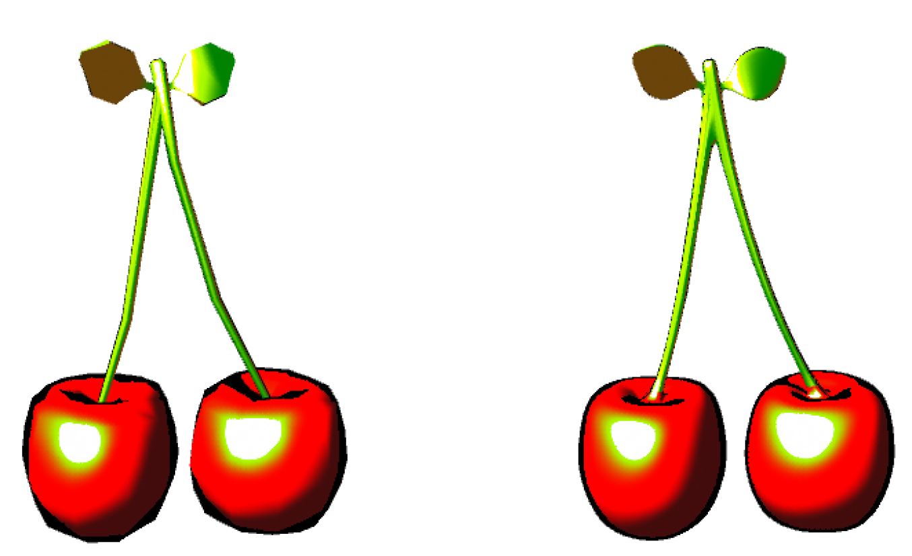
Other GPU friendly methods III.
Occluding contour detection in pixel shader
Check $N∙V$ in each fragment, return contour color if below threshold
Quality depends on tessellation
Low poly
High poly

