Slide 1
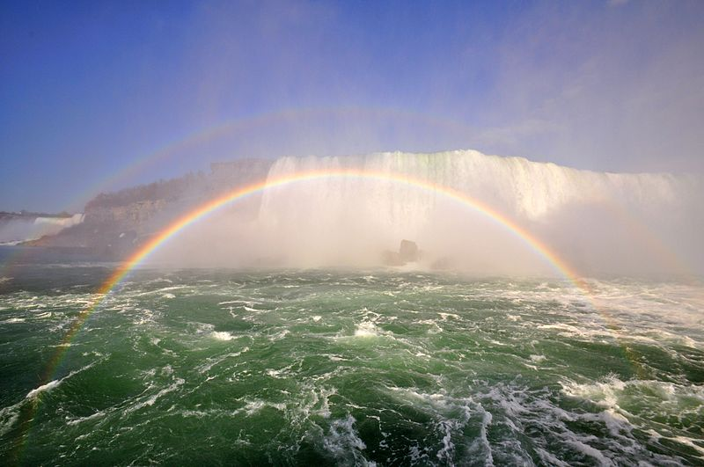
Colors

Slide 2
Light propagation in the real world
Our eyes and visual system create the perception of colors from the incident wavelength
Light sources emit radiation with a certain spectrum
Objects reflect certain wavelengths, absorb the rest of the spectrum
λ
λ

Slide 3
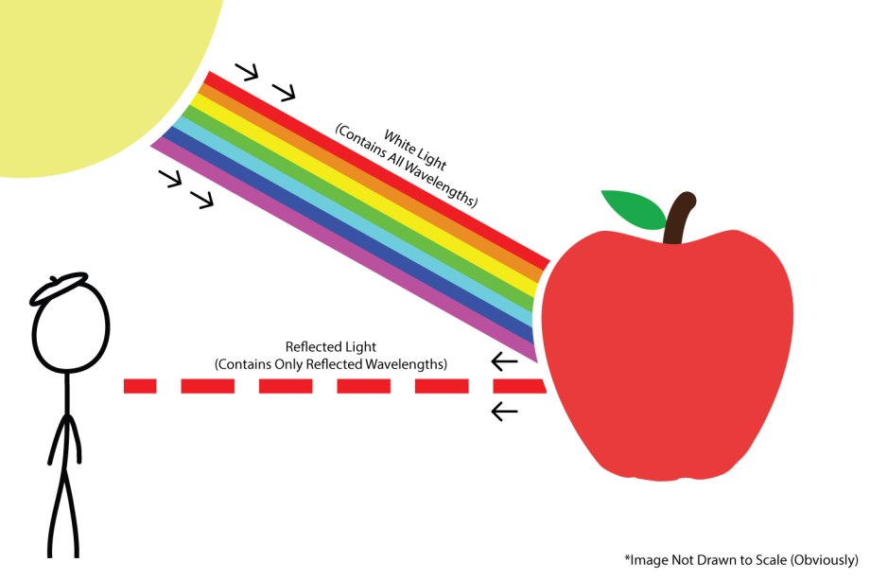
Light propagation in the real world
https://springsemester2015artz363.wordpress.com/color/

Slide 4
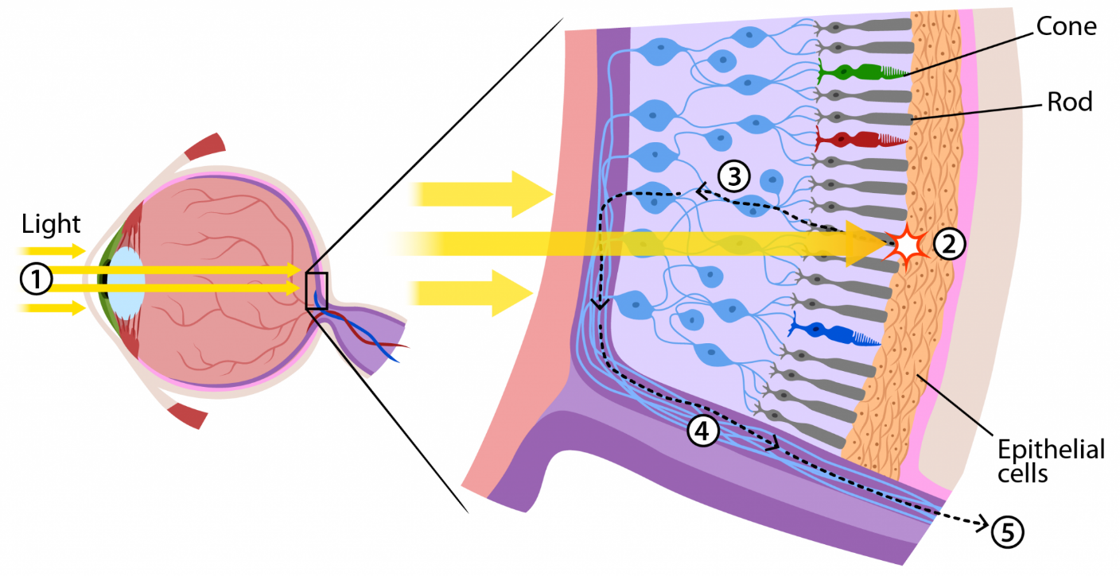
Color: Visual perception
Photopigments in the retina
A response of our visual perception to light

Slide 5
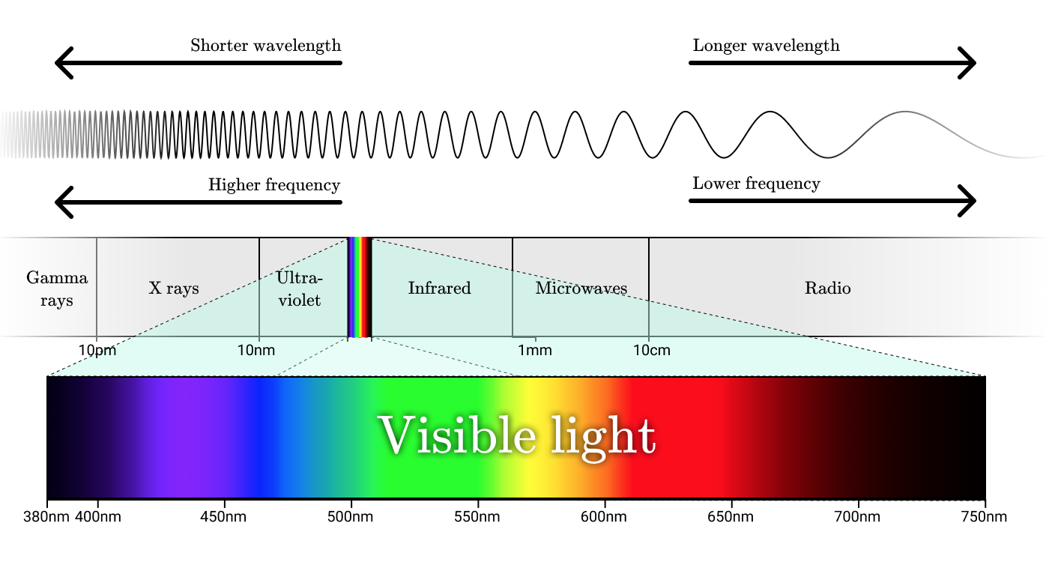
Sensitivity of our eyes
The human eye is trichromatic: healthy people have 3 types of cones
http://jamie-wong.com/post/color/
Color matching function

Slide 6
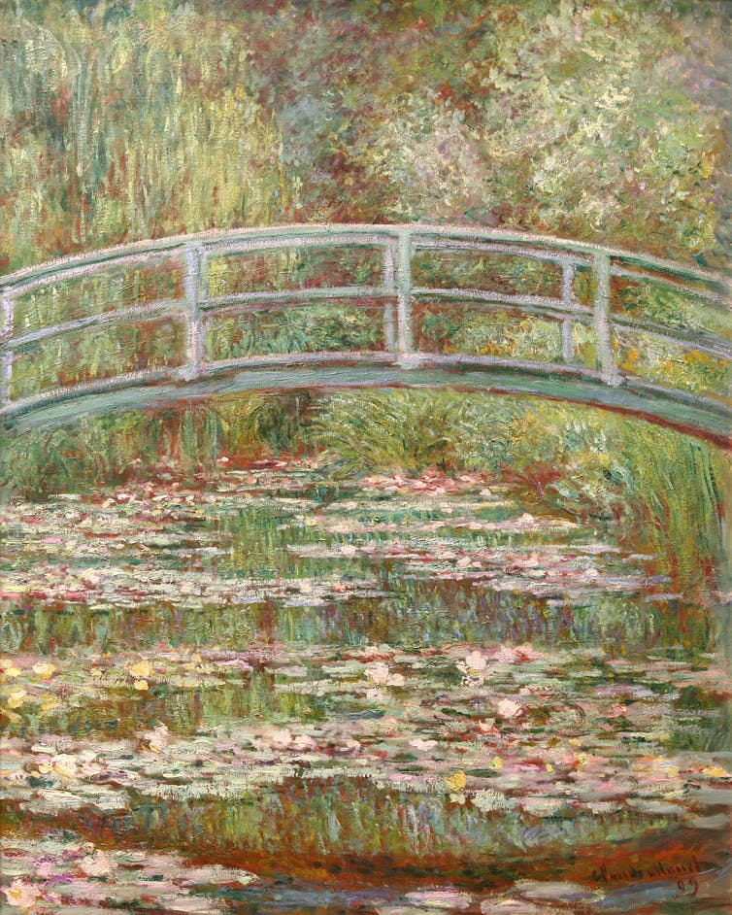
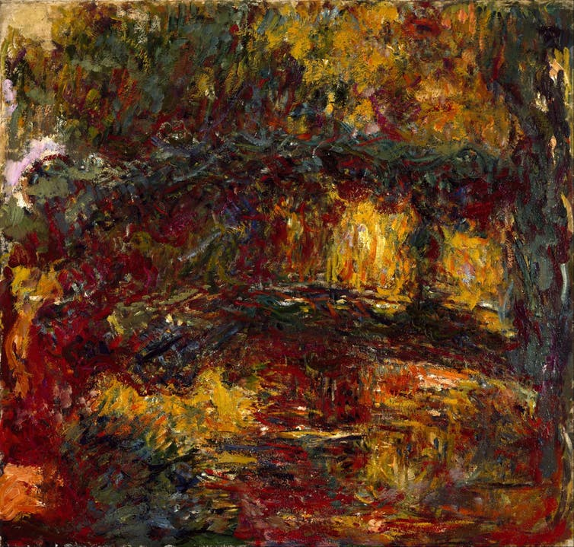
Story of an ill painter
Claude Monet was diagnosed with cataracts
  Cataract filters blue light, colors become dark and murky
Bridge Over a Pond of Water Lilies, 1899, before visual disorder
The Japanese Footbridge, 1922, 10 years after the diagnosis

Slide 7


Color perception is relative
Depends on the environment and eye adaptation
  Chubbs illusion: the small squares have the same color

Slide 8
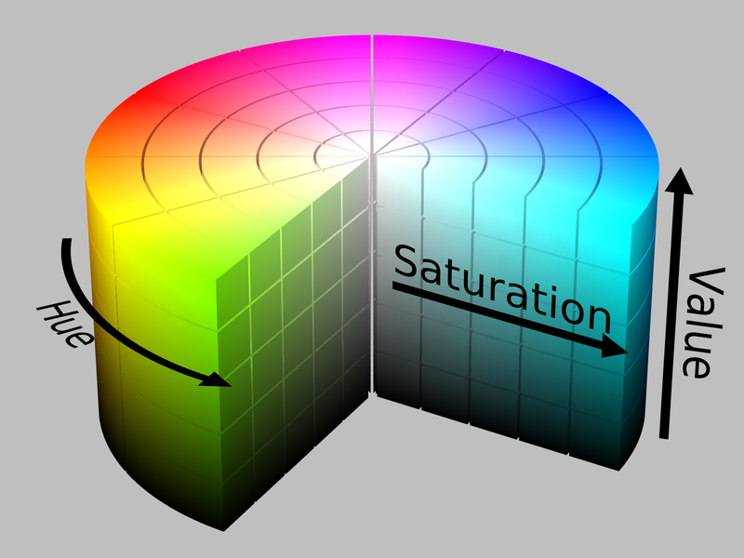
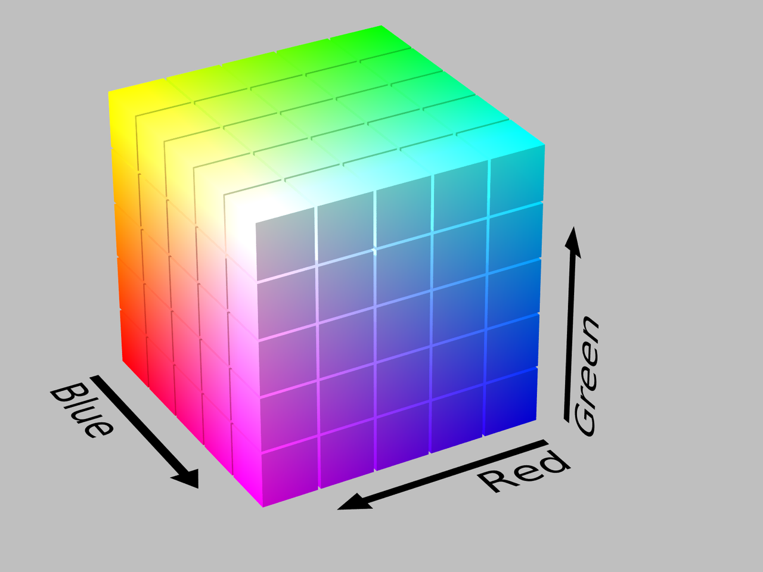
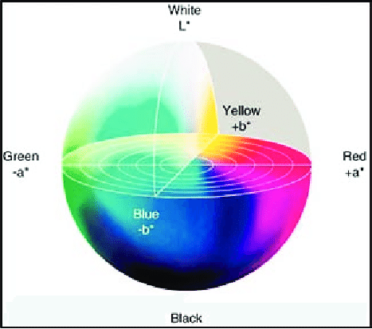
How to represent colors?
Aim: represent colors as tuples – we call these color models
  Typically 3 or 4 coordinates
When a precise description about the interpretation of the components (e.g. viewing condition) is given we call it color space

Slide 9
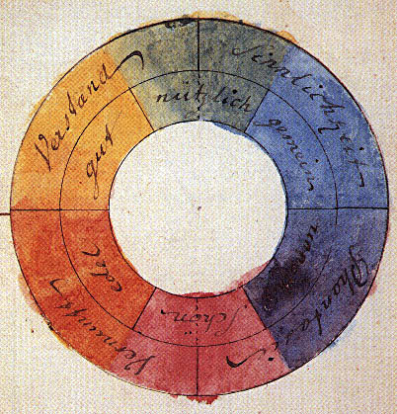
Color models
Goethe: Theory of Colours (Zur Farbenlehre), 1810

Slide 10
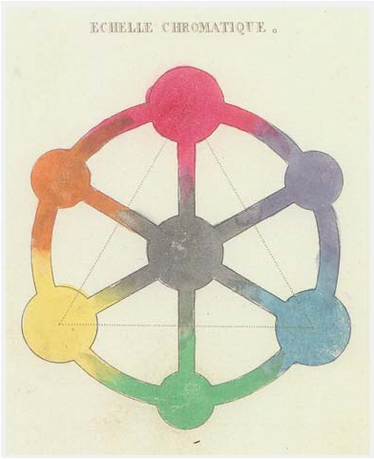
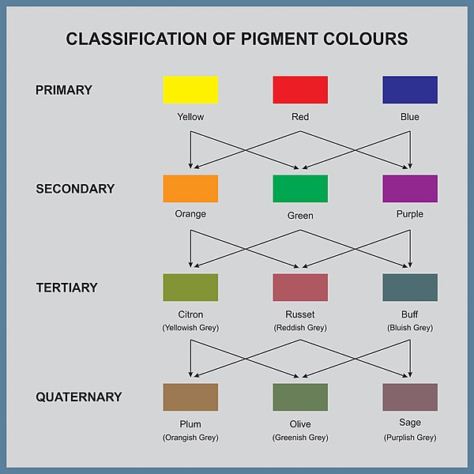
RYB model
Red Yellow Blue: primary colors
  Additive: secondary, tertiary etc. colors by combination of the previous level
One of the first color models used in art theory (18-19th century)

Slide 11
Color models for NPR
Dozens of color models exist
For NPR algorithms, the most important ones are:
  RGB: default color space of almost every software
  HSL/HSV/HSB: easy to change ”natural” properties of colors
  XYZ: intermediate color space for some color space conversions
  CIE Lab: perceptually uniform

Slide 12

RGB model
b
g
r
λ
nm
444
526
645
Additive color model
Motivation: dominant wavelengths of color perception
g(λ)
r(λ)
b(λ)
400
500
600
700

Slide 13
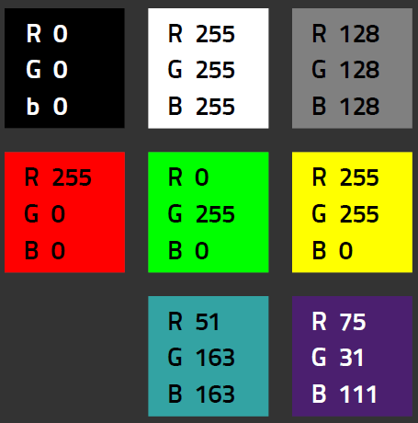
RGB model
The main color model used in almost every computer programs, including games
8 bits per channel: [0,255] or normalized to [0.0, 1.0]
Need to define other parameters like illuminant, gamma etc. to get an exact color space
  Adobe RGB, sRGB etc.

Slide 14
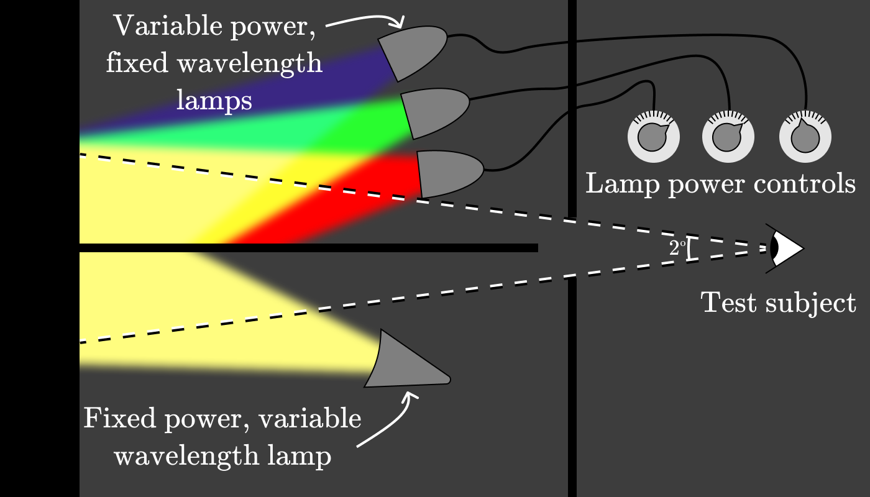
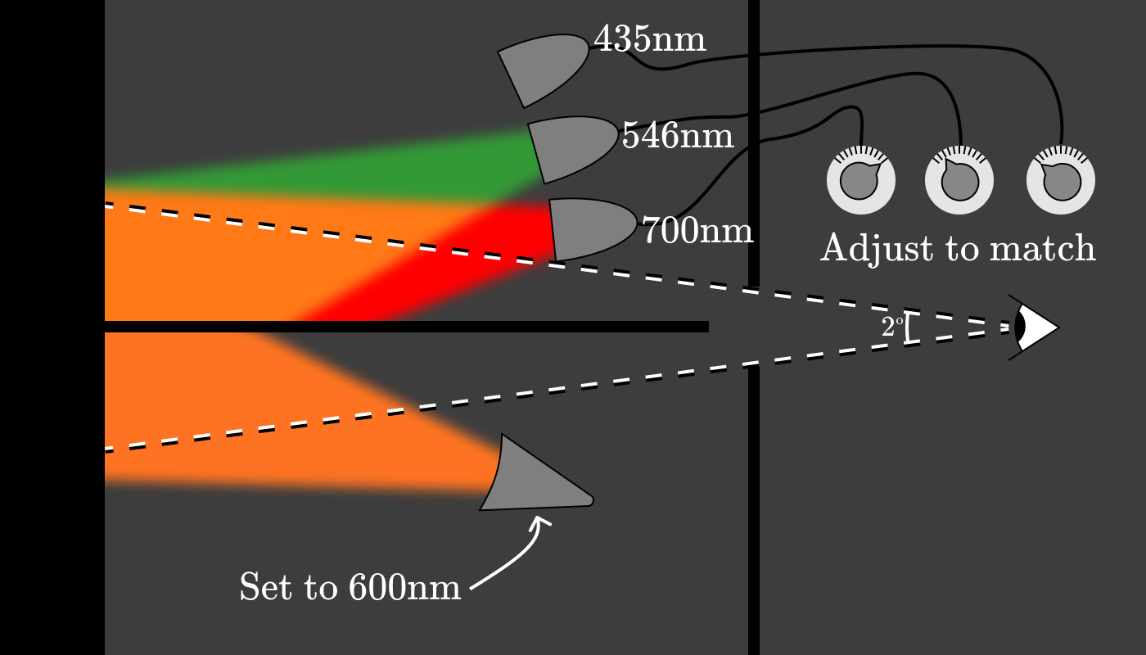
Measuring the color matching function
CIE RGB, 1932: adjust red, green and blue lamps until their combined color is perceived identical to a monochrome light of certain wavelength for the observer
http://jamie-wong.com/post/color/

Slide 15
When to use RGB?
In almost all software (photo/video editors, game engines etc.) when we load an image/texture the pixel values will be stored in RGB
  Example: when we sample a texture in a Unity shader, the color is RGB
Leave the image in RGB if
  The desired color manipulation is easy to achieve in this color space
    Brightness/contrast, luminance conversion etc.
  Doing image processing that assumes an additive color model
    Convolution, filters, etc.

Slide 16
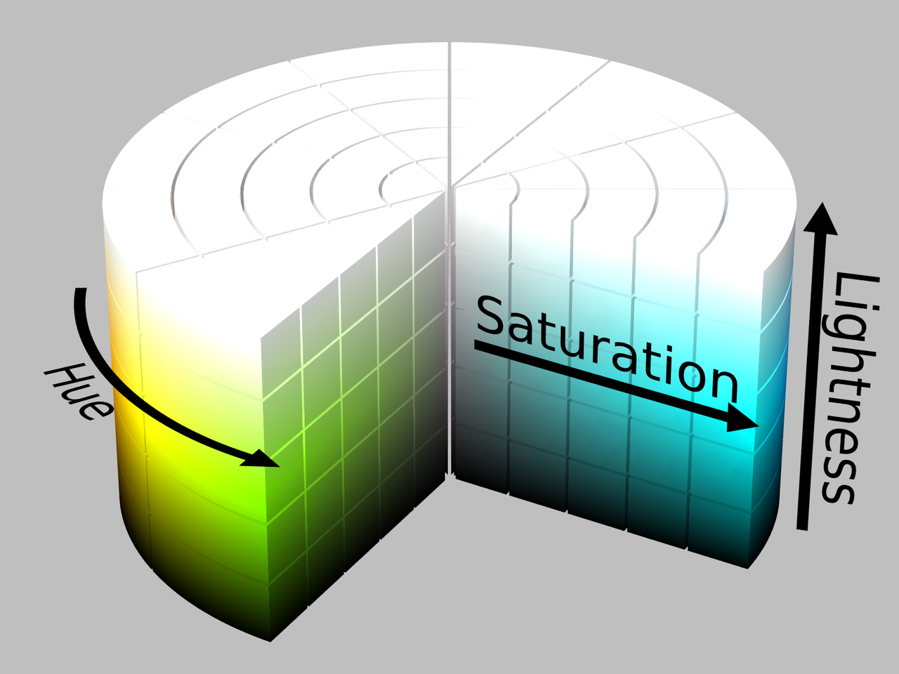

HSV and HSL models
Motivation: coordinates represent attributes that we use to describe colors in everyday life
  Hue, Saturation, Brightness (Value/Lightness, a.k.a Tone, luminance)

Slide 17
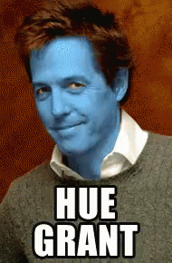
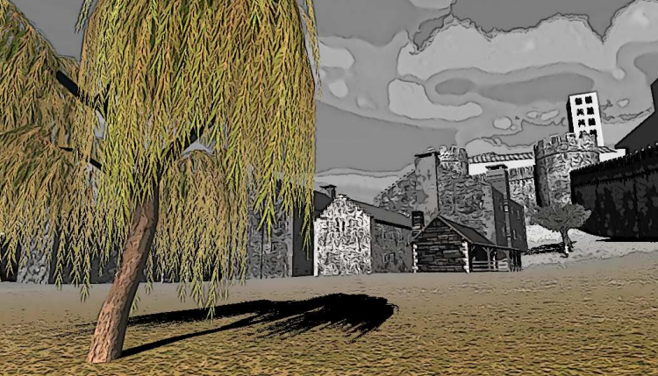
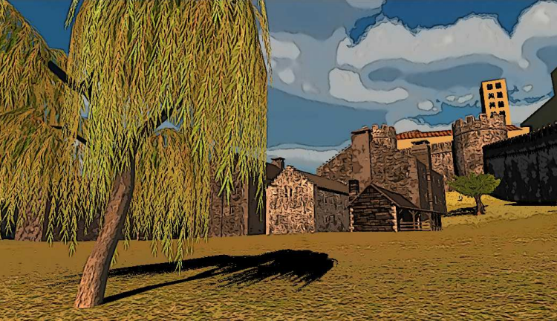
When to use HSV/HSL?
When changing an attribute of colors that is a coordinate of HSV/HSL
  Hue shift – e.g. complementary colors, see later
  Saturation change

Slide 18
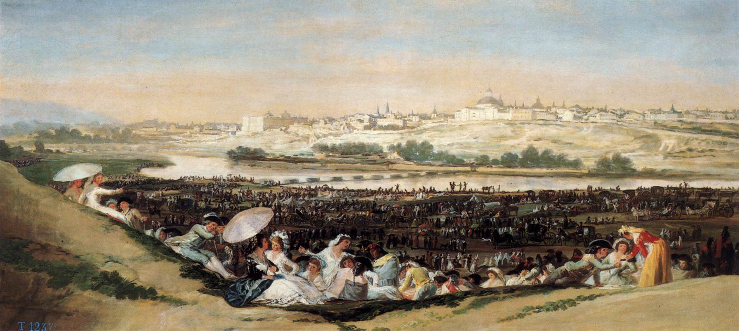
Example: saturation manipulation
Francisco José de Goya y Lucientes, The Meadow of San Isidro on his Feast Day (1788)

Slide 19
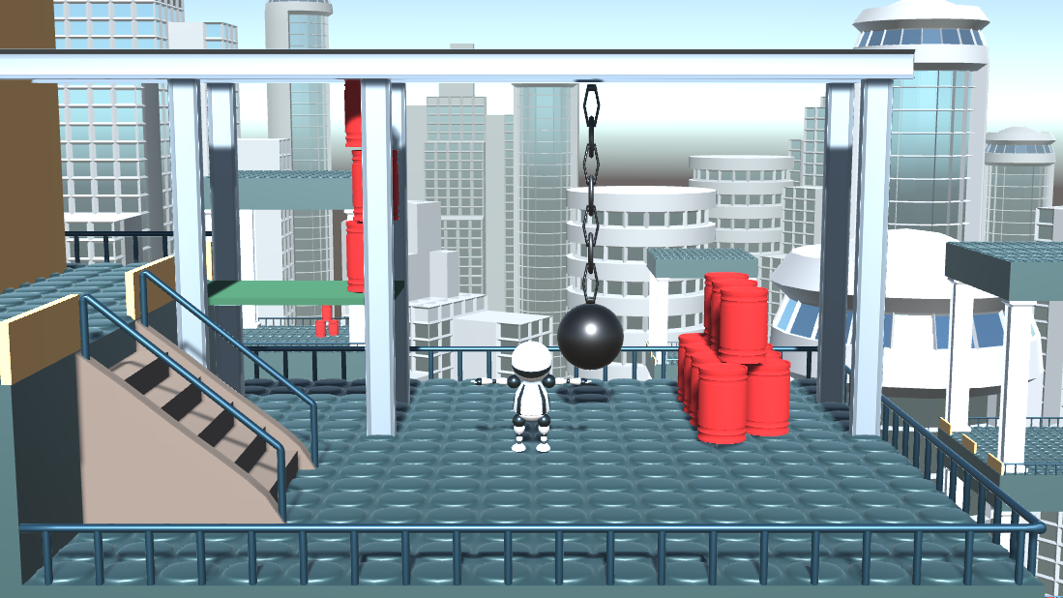
Example: saturation manipulation

Slide 20
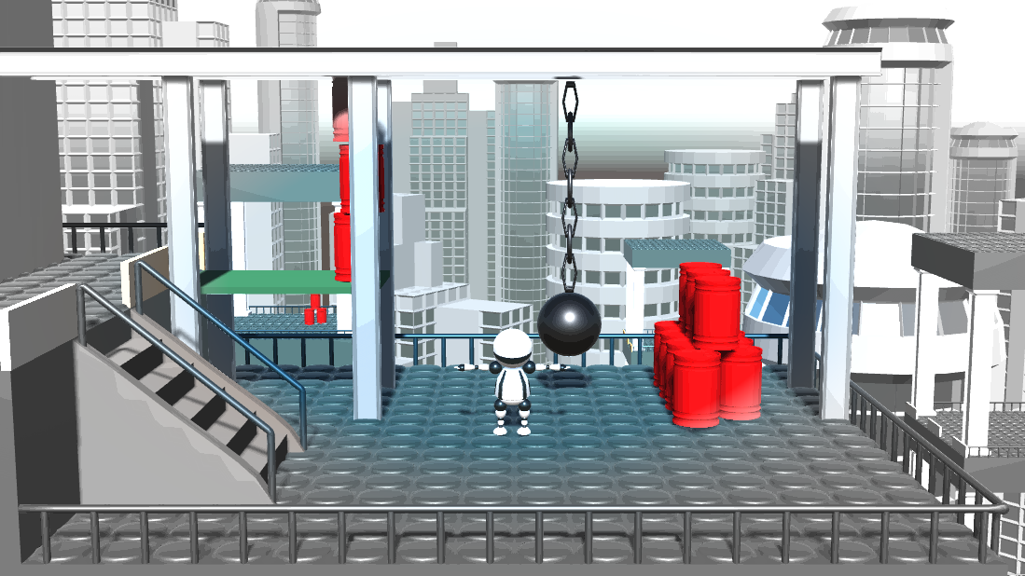
Example: saturation manipulation

Slide 21
Example: saturation manipulation
Reduce saturation based on the distance from the image center
saturation
distance

Slide 22
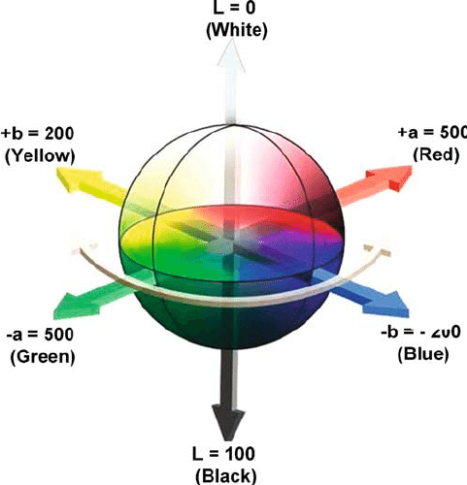
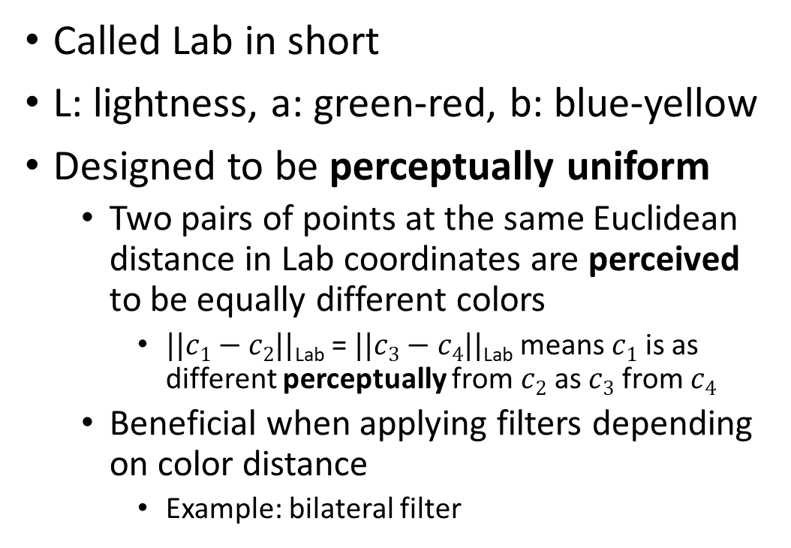
CIE L*a*b*
Called Lab in short
L: lightness, a: green-red, b: blue-yellow
Designed to be perceptually uniform
  Two pairs of points at the same Euclidean distance in Lab coordinates are perceived to be equally different colors
    $||c1−c2||$_{Lab} = $||c3−c4||$_{Lab} means $c1$ is as different perceptually from $c2$ as $c3$ from $c4$
  Beneficial when applying filters depending on color distance
    Example: bilateral filter

Slide 23
When to use CIE L*a*b*?
When the image processing method takes distance/difference of colors

Slide 24
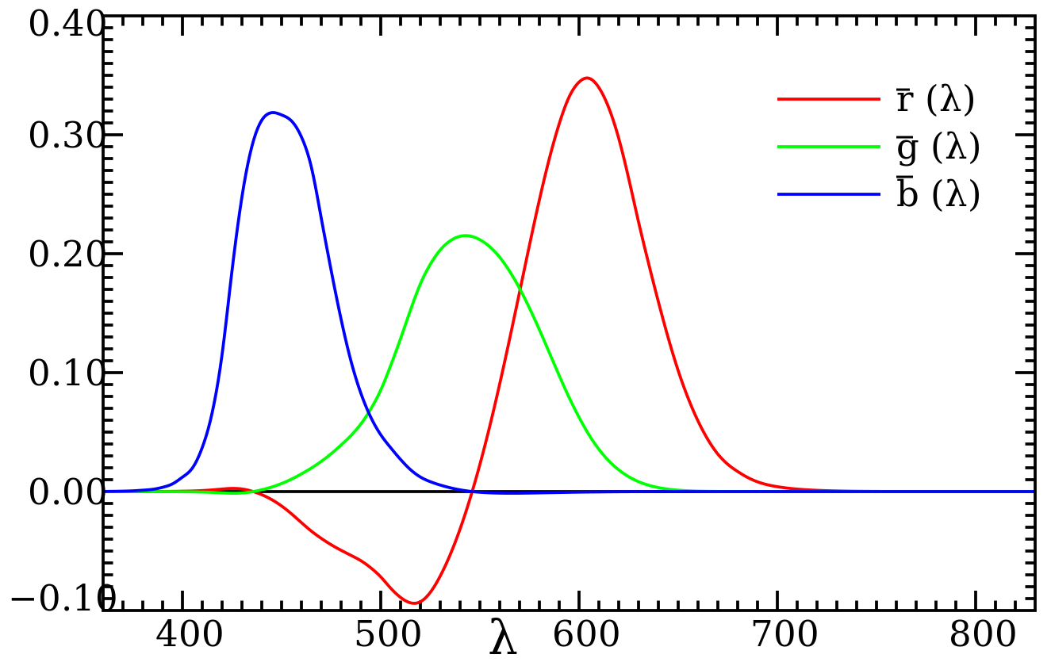
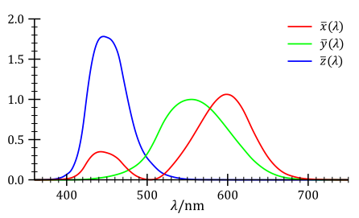
XYZ color space
CIE XYZ
  The curve must be nonnegative everywhere
  One of the coordinates (Y) corresponds to the brightness
  The white point has equal coordinates X=Y=Z

Slide 25


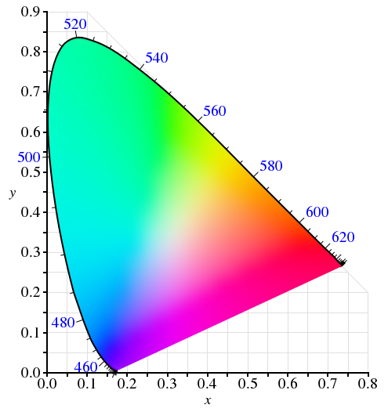

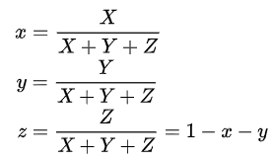
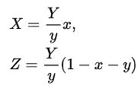
RGB to XYZ, XYZ to RGB - xyY

Slide 26
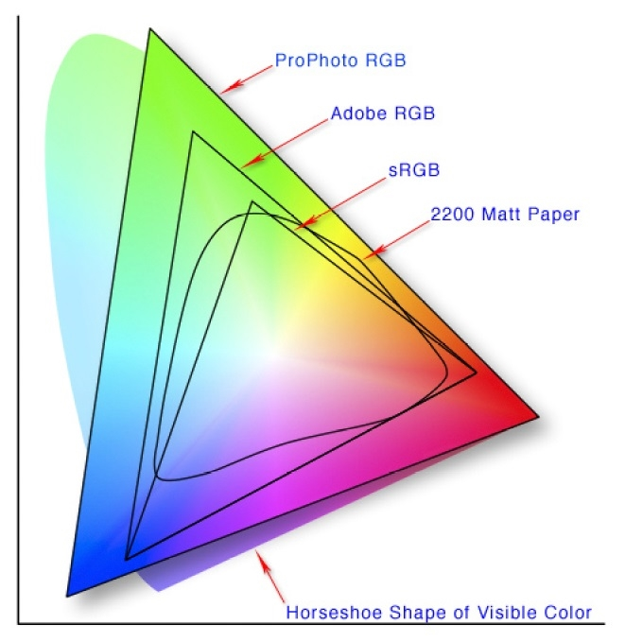
Color domain of color spaces (Gamut)
Typical color spaces are not capable of representing all visible colors

Slide 27
Color space conversions
Usually a few arithmetic operations, involving matrix-vector products
  Relatively fast in shaders, so we can change color spaces in a post processing effect several times without noticeable performance degradation
Some conversions first convert to XYZ and then to the target space
See e.g. https://www.easyrgb.com/en/math.php for formulae

Slide 28
More on colors
Color corrections
  Brigthness, contrast, gamma
  White balance
Color bit depth
Complementary colors
Shadows

Slide 29
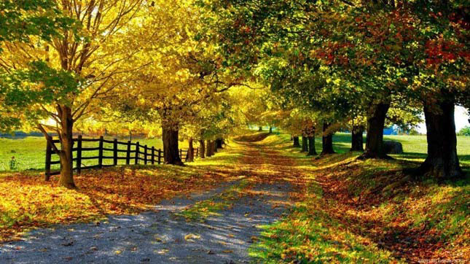
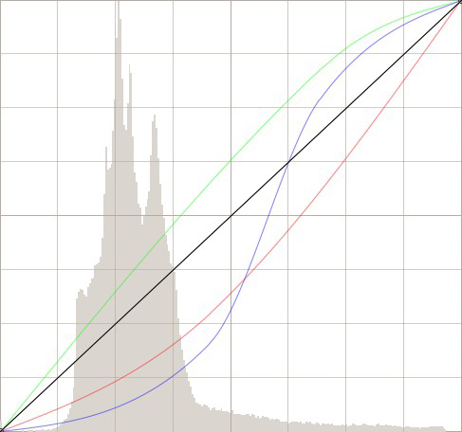
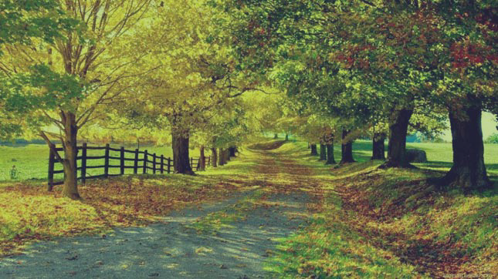
Color corrections
Basic tool in every photo editor sw
Transfer curve on the color channels
Usually done in RGB

Slide 30
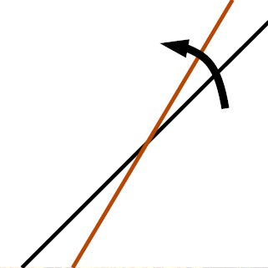
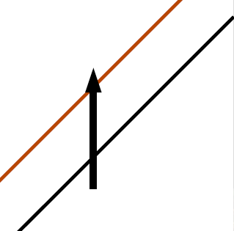
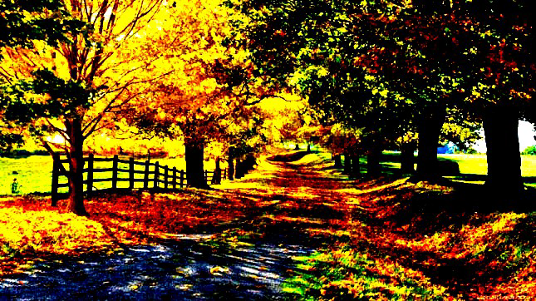
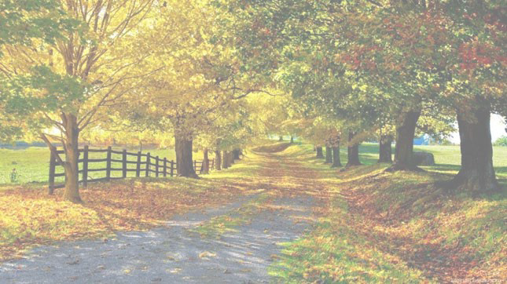
Contrast
Brightness

Slide 31
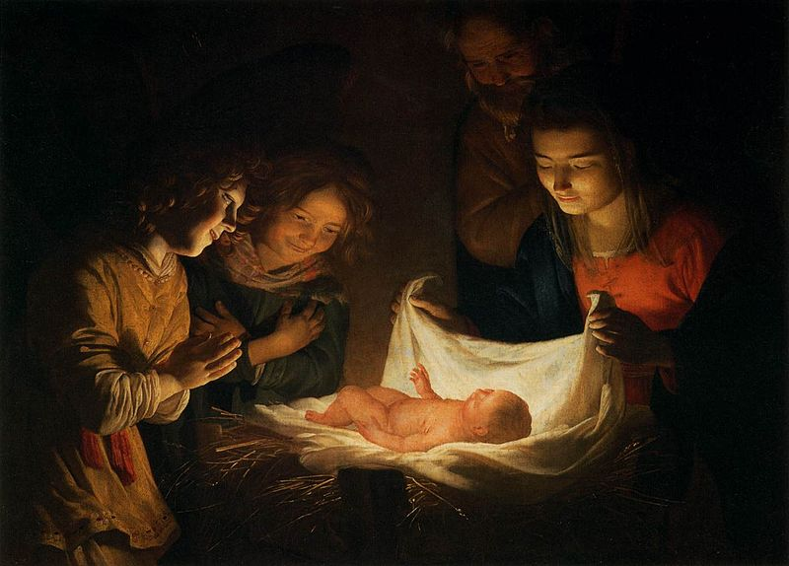
Chiaroscuro
Large contrast to guide attention to a certain part of the image
Higher brightness main part of the image, low brightness elsewhere
Gerard van Honthorst, Adoration of the Child (cca 1620)

Slide 32
Chiaroscuro post processing effect

Slide 33
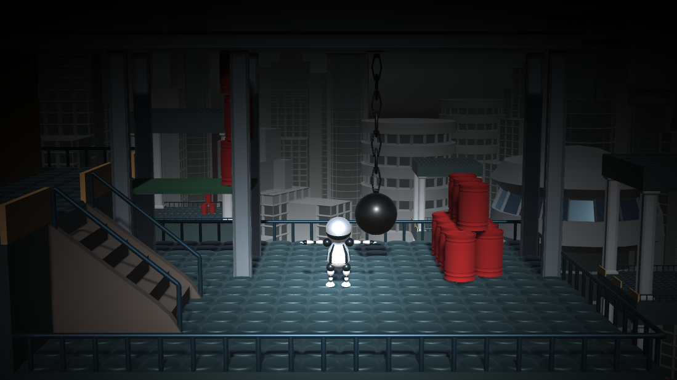
Chiaroscuro post processing effect

Slide 34
Chiaroscuro post processing effect
Reduce brigthness based on the distance from a ”center” pixel (e.g. the player)
brightness
distance

Slide 35


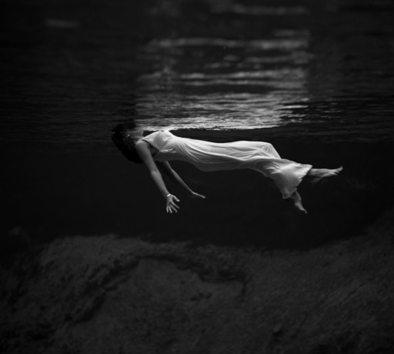
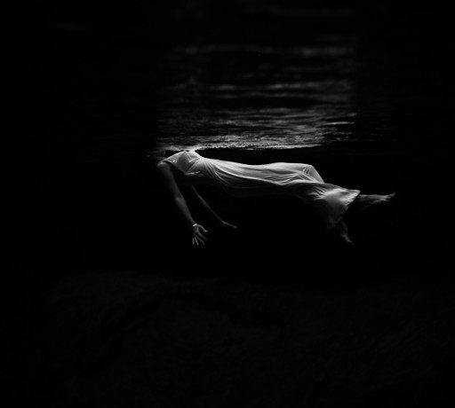
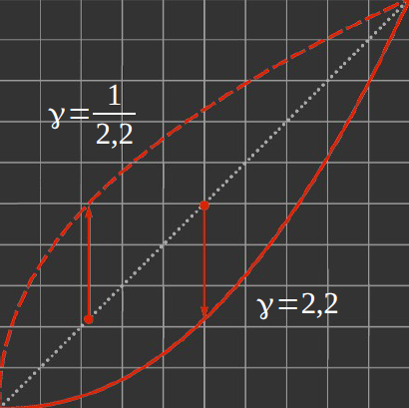
Gamma correction
Better use of precision
Builds on the non-linearity of the human eye
  We do not necessarily perceive a two times brighter light (in terms of physical light intensity) twice as bright (in terms of perceived color)
We can distinguish smaller intensity differences for darker colors
Without gamma correction we would use unnecessarily high precision for bright colors

Slide 36
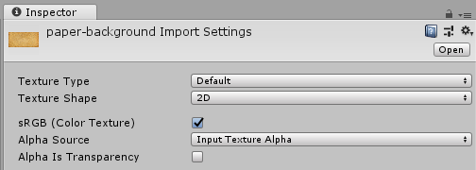
Gamma correction – Unity
Image files are usually gamma corrected
  Most image files on the internet are in sRGB space, which uses γ = 2.4
  Image processing methods assume linear RGB space
In Unity, when loading an image (texture) we can select whether our file had gamma correction or not
  Default: sRGB (gamma corrected), so no need to change it if you use a regular image file

Slide 37
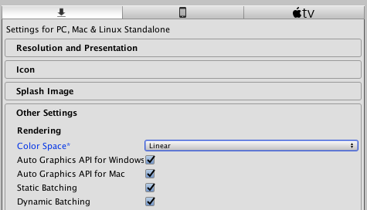
Gamma correction – Unity
Textures are stored in gamma color spaces, but image processing in the shaders should be computed in linear color space
We can tell Unity to automatically do the sRGB → linear RGB conversion when sampling from the texture
  Edit menu → Project settings → Other settings tab
  When linear is set, no need to do anything in the shader, just read from the texture normally, values will be linear

Slide 38

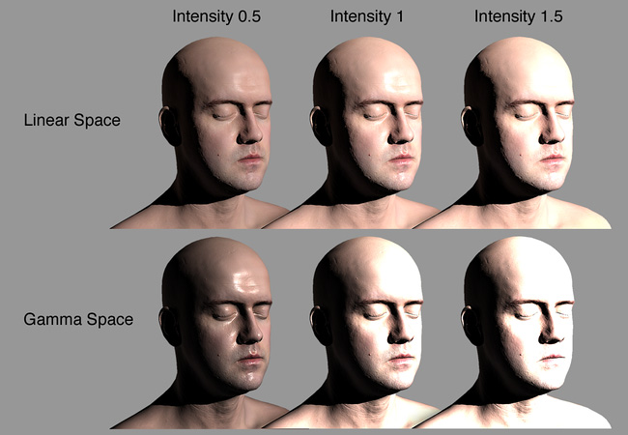
Shading with gamma vs linear textures
Linear space: correct
Gamma space: too bright, halo at transitions
Shading
Blending

Slide 39
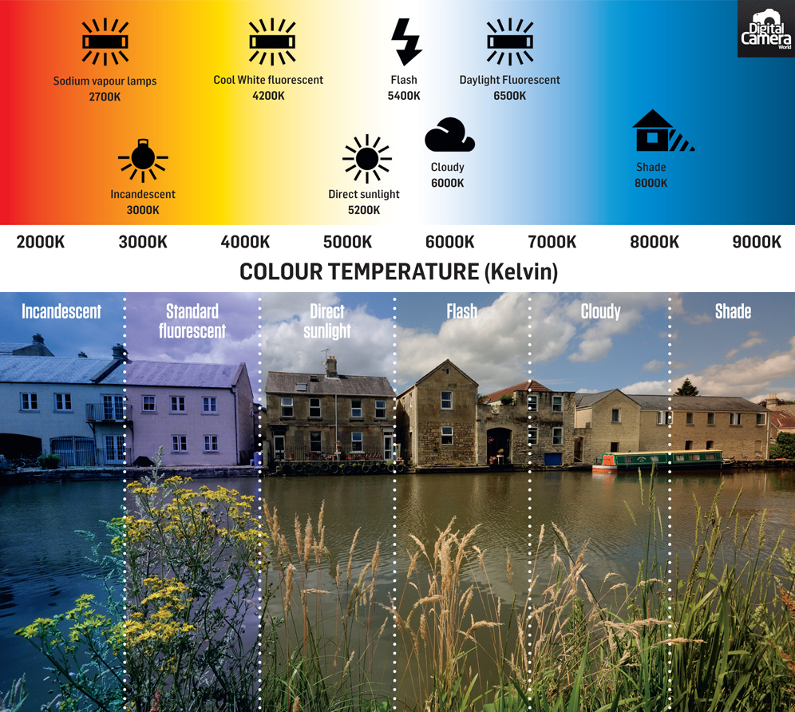
White balance
Compensation for the spectrum of the light source

Slide 40
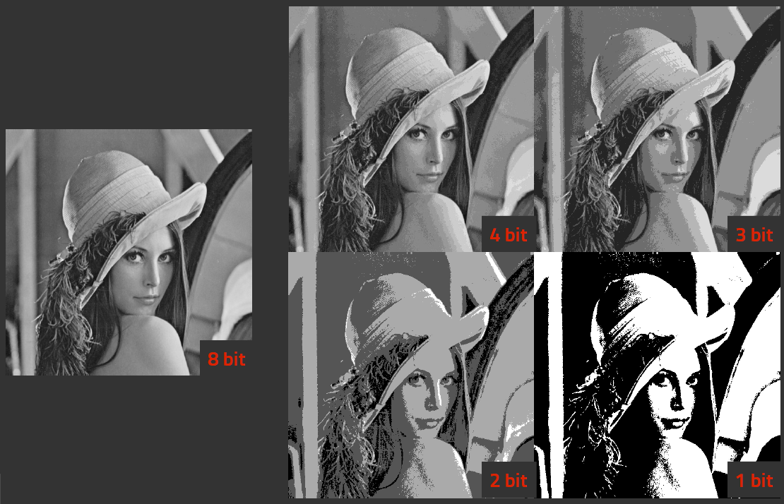
Color bit depth
Human eye can distinguish about a hundred different tones
  1 byte is enough
Recall: for computations, we may need more than 1 byte precision

Slide 41
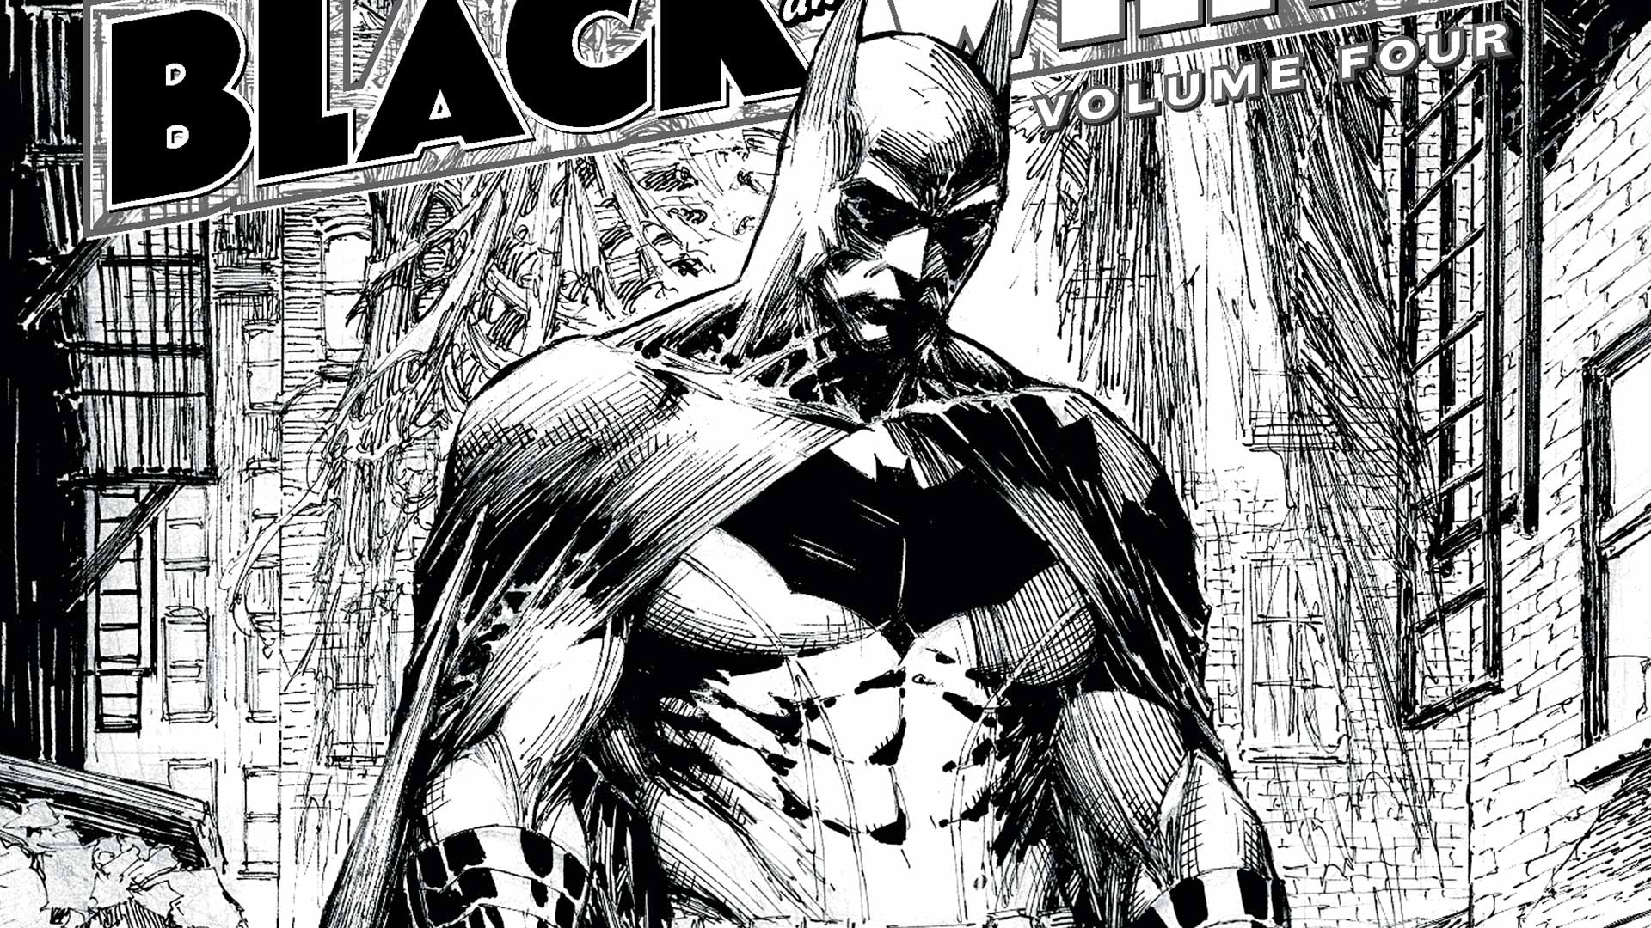
Black & white art: two colors

Slide 42
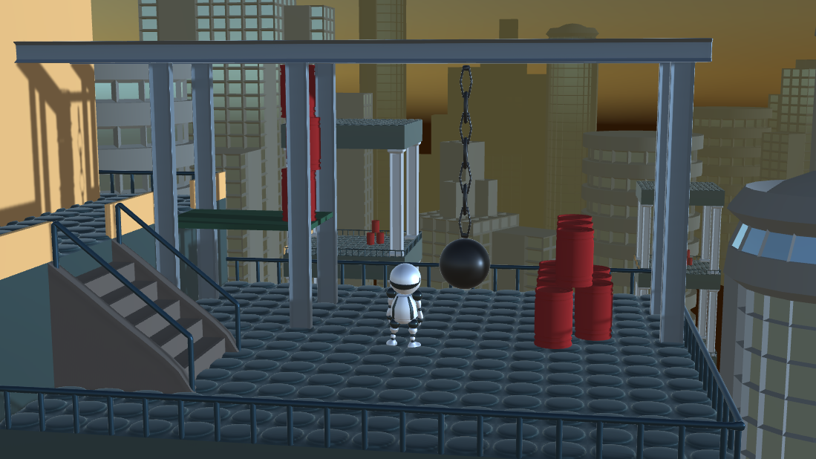
Example: global luminance thresholding

Slide 43
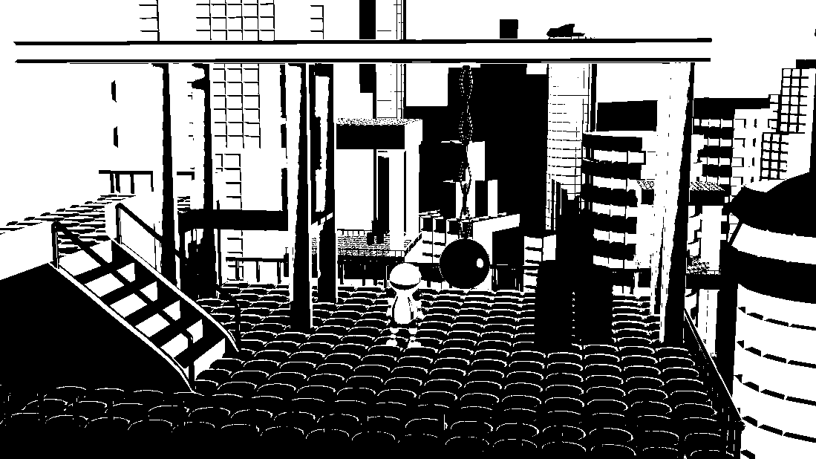
Example: global luminance thresholding
if (luminance(pixelColor) < threshold) pixelColor = float3(0,0,0);
else pixelColor = float3(1,1,1);

Slide 44

More sophisticated thresholding
Problems with global thresholding
  Hard to find a good threshold
  A single global value is usually not sufficient, may loose local contrast
Artistic thresholding, J. Xu and C. S. Kaplan. NPAR '08

Slide 45

More sophisticated thresholding
Artistic thresholding, J. Xu and C. S. Kaplan. NPAR '08
  Segmentation of the image to identify similar regions
  Region adjacency graph: connections and the number of border pixels
  Region color selection by optimization
    Cost functions: similarity to original region color, contrast between neighbouring regions, user controlled ratio of black regions

Slide 46

Color comics: limited number of colors

Slide 47




Luminance quantization
Reduce the number of tones
Levels = 2
Levels = 4
Levels = 8
Levels = 30

Slide 48



Complementary color
Pairs of colors which cancel out (loose hue, become gray) when combined
  Combination and thus complementary color depends on the color space
RGB
RYB

Slide 49

Complementary color
Claude Monet: "color makes its impact from contrasts rather than from its inherent qualities...the primary colors seem more brilliant when they are in contrast with their complementary colors."
Impression, sunrise, Claude Monet, 1872

Slide 50

Complementary color
Vincent Van Gogh: "searching for oppositions of blue with orange, of red with green, of yellow with purple, searching for broken colors and neutral colors to harmonize the brutality of extremes, trying to make the colors intense, and not a harmony of greys."
Starry night, Vincent Van Gogh, 1889

Slide 51
Implementation
RGB and HSV/HSL have the same complementary colors
In HSV/HSL we just need to rotate the hue by 180◦

Slide 52

Special case: shadows
Constant black shadows
https://www.walesonline.co.uk/whats-on/whats-on-news/limited-edition-marvel-comic-book-11737180

Slide 53


Special case: shadows
Complementary color shadows
Maxfield Parrish, Daybreak (2017)
Henri Matisse, André Derain (1905)

Slide 54




Shadow recolorization
Black
Complementary

Slide 55

Shadow recolorization
Original image

Slide 56

Shadow recolorization
Pixels in shadow (white = in shadow, black = lit)

Slide 57

Shadow recolorization
Shadowed pixels set to the complementer color of the original image

Slide 58

Shadow recolorization
Result with complementary shadow colors

Slide 59
Shadow recolorization
Key: how to find which pixels are in shadow
  Given this information we simply need to change the pixel color
Possible solutions in games:
  Use the shadow algorithm of the game engine (usually shadow mapping)
    Need to have access to the shadow algorithm part of the graphics engine
    E.g. in older Unity versions the shadow map was completely hidden, there was no way to access it
  Brute force: render the scene twice, with and without lights and compare
    Pixels that do not change their values when lights are turned on are in shadow
    No need to have access to the graphics engine
    Need to render everything twice ⇒ can be slow!
  Purely intensity based: use image processing (advanced thresholding)
    May not find true shadows

Slide 60

Shadow mapping
P is in shadow if its distance from the light source is higher than the corresponding shadow map value (Q)
Shadow map: depth map from the light source

Slide 61

Shadow mapping
Light source

Slide 62


Shadow mapping
Scene from the light source’s point of view
Scene from the camera’s point of view

Slide 63


Shadow mapping
Depth from the light source’s point of view (shadow map)
Shadow map projected to the scene

Slide 64


Shadow detection in image space
Sauvaget, Catherine, and Vincent Boyer. "Stylization of lighting effects for images." 2010 Sixth International Conference on Signal-Image Technology and Internet Based Systems. IEEE, 2010.
Global thresholding in the lightness coordinate of the HSL color space
  Threshold is the median lightness – unable distinguish black objects from shadows

