Slide 1
Object space and image space

Slide 2
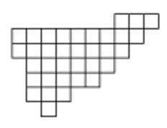
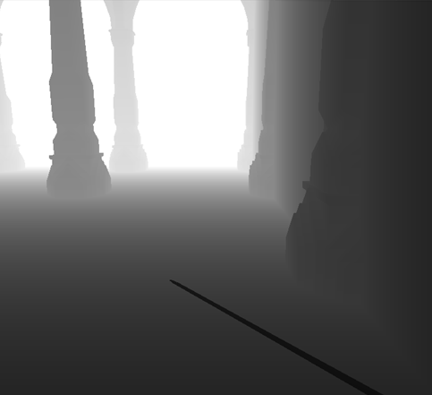
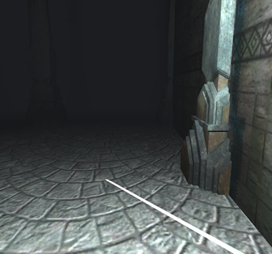
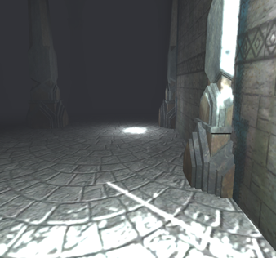
Rendering pipeline
3D pipeline
Post processing pipeline
Depth buffer
Vertex shader
Geometry shader
Rasterization
Fragment shader
Compositing
Color buffer
Image processing
Color buffer
Normal buffer

Slide 3
Object vs image space
Object-space:
The appearance or material properties of objects is stylized
Stylized lighting (cel-shading, lit sphere map – see previous practical)
Object contours based on geometry
Hatching textures
Etc.
We have full knowledge about the scene (geometry, materials, etc.)
Individual objects can easily have different styles
Unity: just assign different materials with different shaders to the objects
Can be very tedious to replace the style of the entire scene
Have to assign new materials/shaders to each object

Slide 4
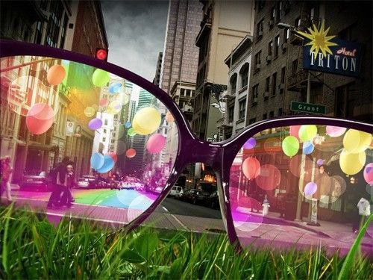
Object vs image space
Image-space
The rendering of the camera is stylized
Can be considered as watching the scene through non-photorealistic glasses / camera
Objects have a coherent style
Still possible to assign different visual style to objects, but more complicated
Very easy to replace the style of the scene
Unity: just replace the post processing effect on the main camera, it takes a few seconds
Limited or no information is available about the scene geometry and material properties
https://medium.com/@keshadeveloper/looking-at-the-world-through-colorful-
glasses-115784f8e9b0

Slide 5
Rendering pipeline
3D pipeline
Post processing pipeline
Depth buffer
Vertex shader
Geometry shader
Rasterization
Fragment shader
Compositing
Color buffer
Image processing
Color buffer
Object space methods: can access the whole 3D scene description
Can use the geometry, materials, lights, etc.
Image space methods
Input: 2D images
Normal buffer

Slide 6
Example: hatching in object-space
Real-time hatching, Praun et al., Siggraph 2001.
Preprocessing: create MIP-MAP pyramids of hatching textures
Rendering: blend between different levels of hatching textures, based on the distance from the camera

Slide 7
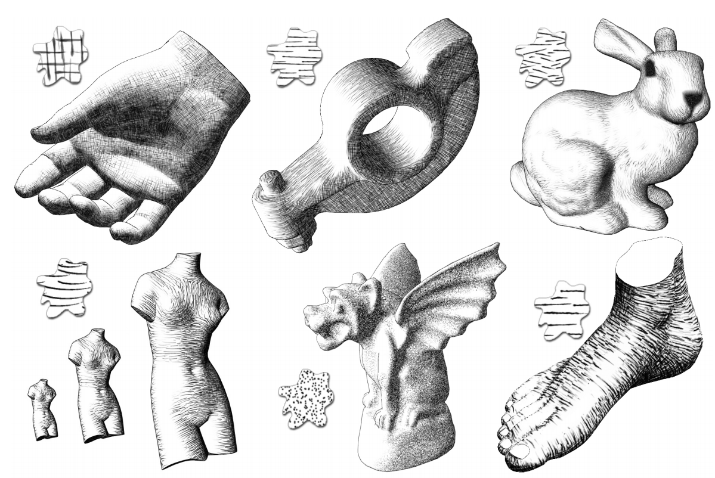
Example: hatching in object-space
Advantage: uses standard texture mapping techique
Very fast
The texture is fixed to the surface, no showerdoor effect (see later)
Drawback: difficult to maintain a uniform line density in image-space
Hatching density is limited, may be too sparse when zoomed
Aliasing issues

Slide 8
Rendering pipeline
3D pipeline
Works purely on images
Applies standard image processing methods
Similar to what post-production does in the movie industry
(Software like Adobe After Effects, Nuke etc.)
Post processing pipeline
Depth buffer
Vertex shader
Geometry shader
Rasterization
Fragment shader
Compositing
Color buffer
Image processing
Color buffer
Normal buffer
Image space methods
Input: 2D images

Slide 9
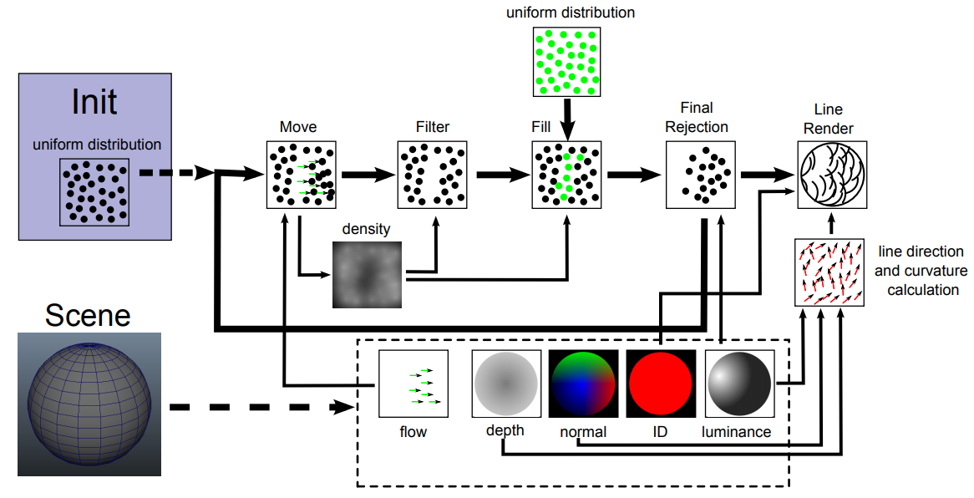
Example: image-space hatching
Screen space hatching, Lengyel et. al, 2014
Advantage: uniform density in image-space, no problem with zooming
Drawback: requires sophisticated methods to avoid showerdoor effect
Much more on hatching in the stroke-based rendering lecture

Slide 10
Image-space NPR: Just another taxonomy
State of the "Art”: A Taxonomy of Artistic Stylization Techniques for Images and Video, Kyprianids et al, 2013, IEEE TVCG
Classification based on what kind of image processing technique is used

Slide 11
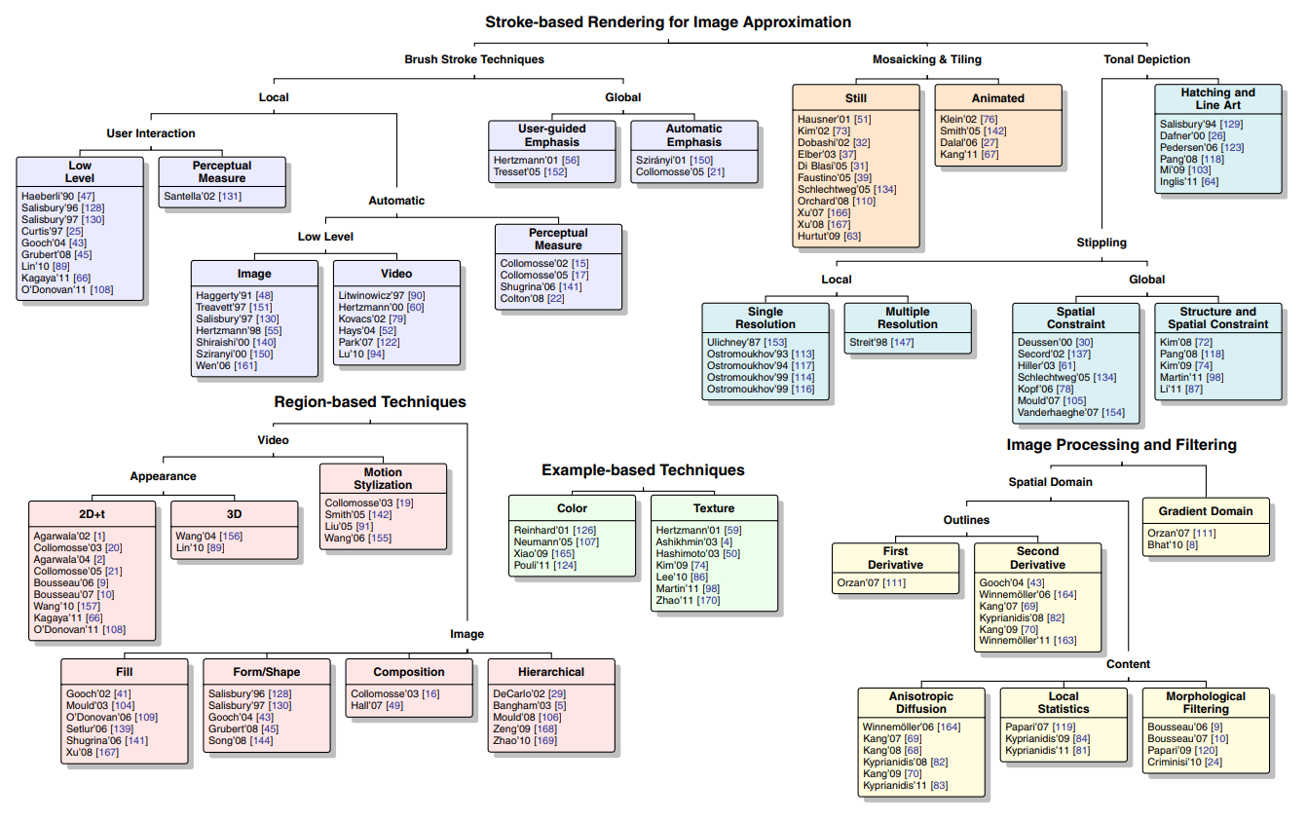
State of the "Art”: A Taxonomy of Artistic Stylization Techniques for Images and Video, Kyprianids et al, 2013, IEEE TVCG

Slide 12
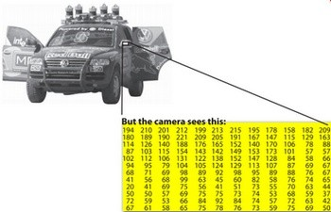
Image processing
Image: 2D array of pixel values
In computer games we work with RGB images
Each pixel stores a red, green and blue channel
More about colors in the next lecture
https://docs.opencv.org

Slide 13
Image processing in general
Loop through all output pixels and compute their color
for (int i = 0; i < image_width; ++i)
for (int j = 0; j < image_height; ++i)
{
Compute the color of Image[i][j]
}

Slide 14
Image processing in general
On the GPU, pixels are processed in parallel
Fast
One pixel per thread, parallel threads are independent
⇒ cannot directly reuse results of another pixel
for (int i = 0; i < image_width; ++i)
for (int j = 0; j < image_height; ++i)
{
Compute the color of Image[i][j]
}

Slide 15
Simplest image processing routines
Apply a function on the image pixels
Output pixel depends only on one pixel of the input
Very effective, but also limited to simple effects
for (int i = 0; i < image_width; ++i)
for (int j = 0; j < image_height; ++i)
{
Output[i][j] = f(Input[i][j], i, j);
}

Slide 16
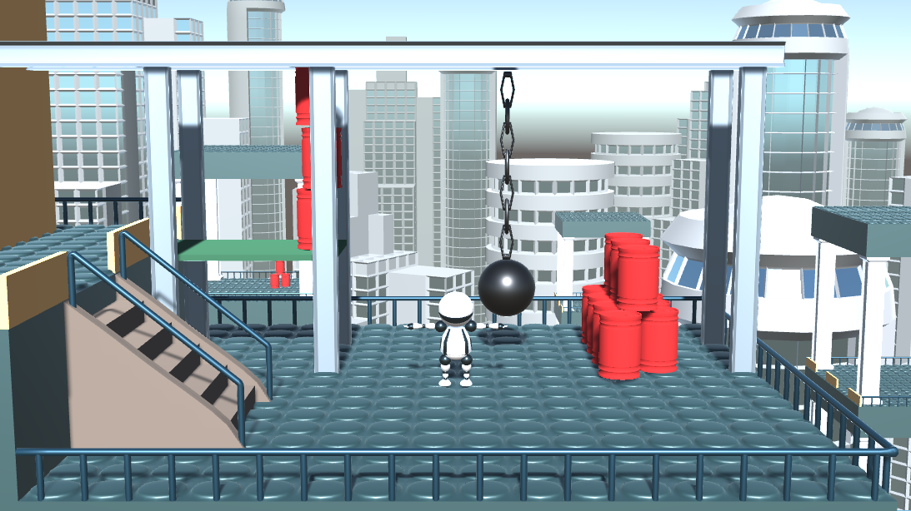
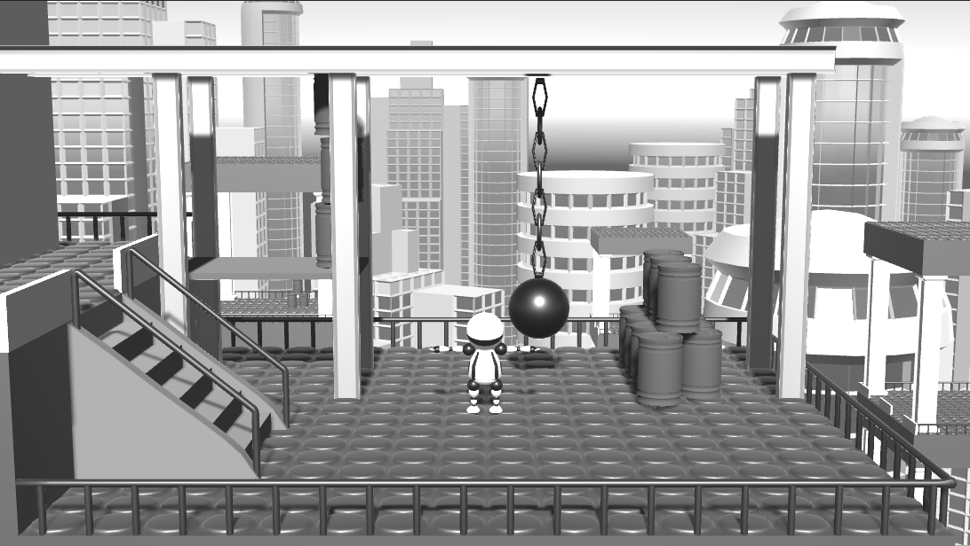
Example: luminance transform
f(pixel) = 0.2126*pixel.r + 0.7152*col.g + 0.0722*pixel.b

Slide 17
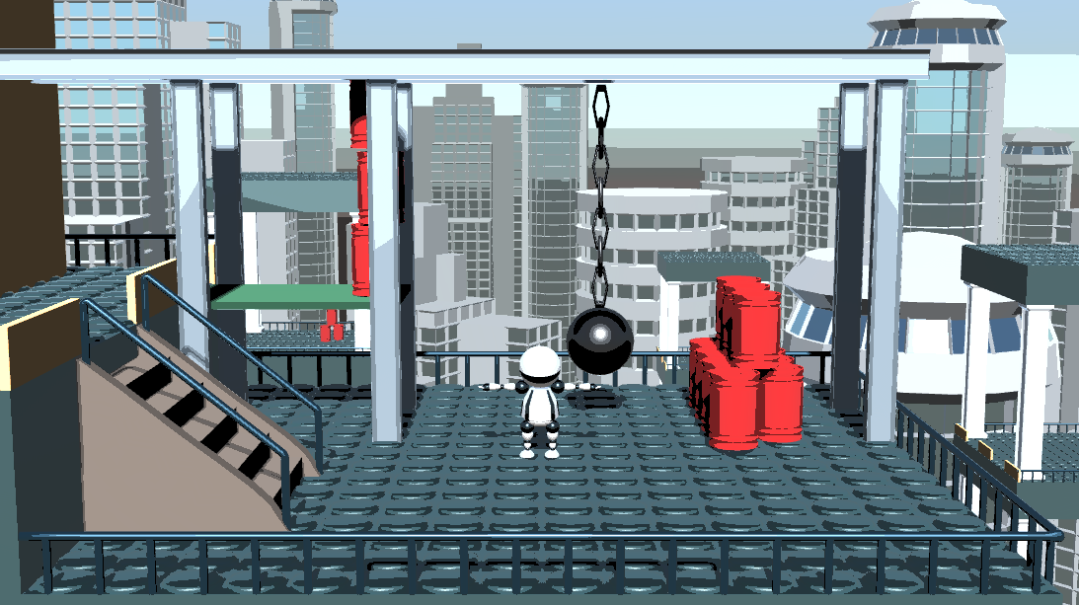
NPR example: luminance quantization
f(pixel) = pixel / luminance(pixel) * quantize(luminance(pixel))
A very simple stylized lighting effect. Compare it to tone-mapping!

Slide 18
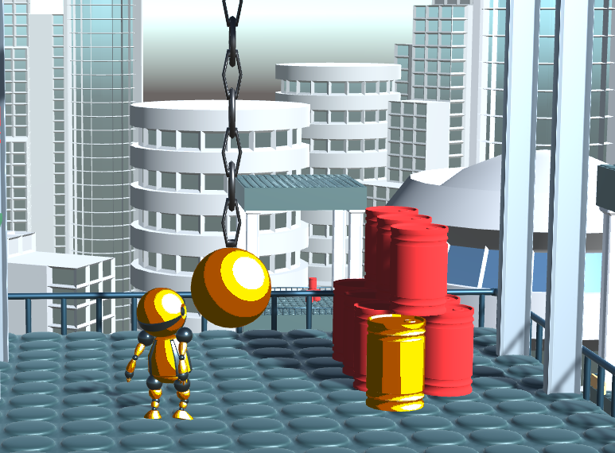
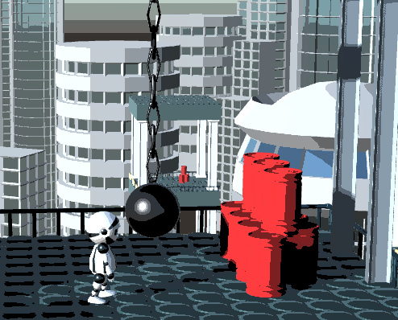
NPR example: luminance quantization
f(pixel) = pixel / luminance(pixel) * quantize(luminance(pixel))
A very simple stylized lighting effect. Compare it to tone-mapping!
Tone mapping (object space)
Luminance quantization (image space)

Slide 19
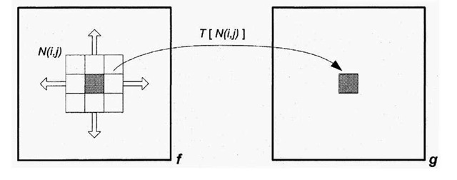
Image filtering
Output depends on the input pixel and its neighbours
Usually a rectangular neighbourhood
A.k.a. filter window or kernel
for (int i = 0; i < image_width; ++i)
for (int j = 0; j < image_height; ++i)
{
Output[i][j] = T(Neighbourhood(Input[i][j]));
}

Slide 20
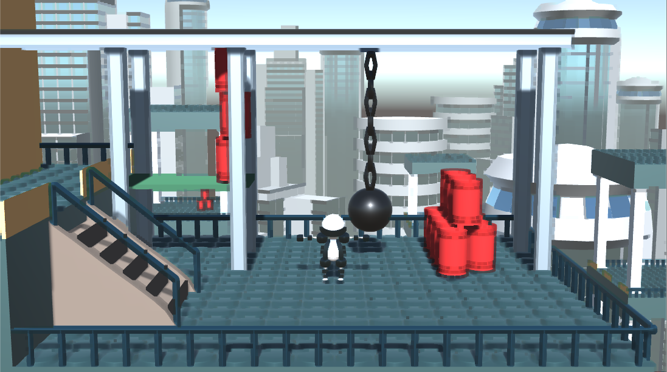
NPR example: minimum filter
Output[i][j] = minimum(Neighbourhood(Input[i][j]));
A bit more sophisticated filter is used in animation movies for the background

Slide 21
Minimax filter
Non‐Photorealistic Rendering for Motion Picture Production, Umenhoffer et al. 2010
Return the minimum or the maximum (varies)
Varying window width and shape (user-defined brush size and shape)

Slide 22
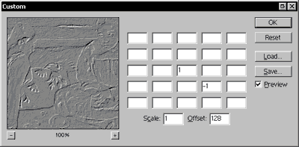
Convolution
Result is the weighted average of neighbouring pixels
Weights are usually the same throughout the image

Slide 23
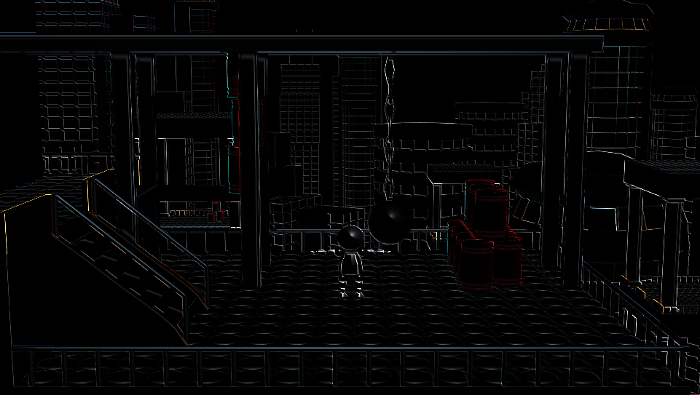
Well-known (non-NPR) examples: Emboss
weights = {
1, 0, 0,
0, 0, 0,
0, 0, -1};

Slide 24
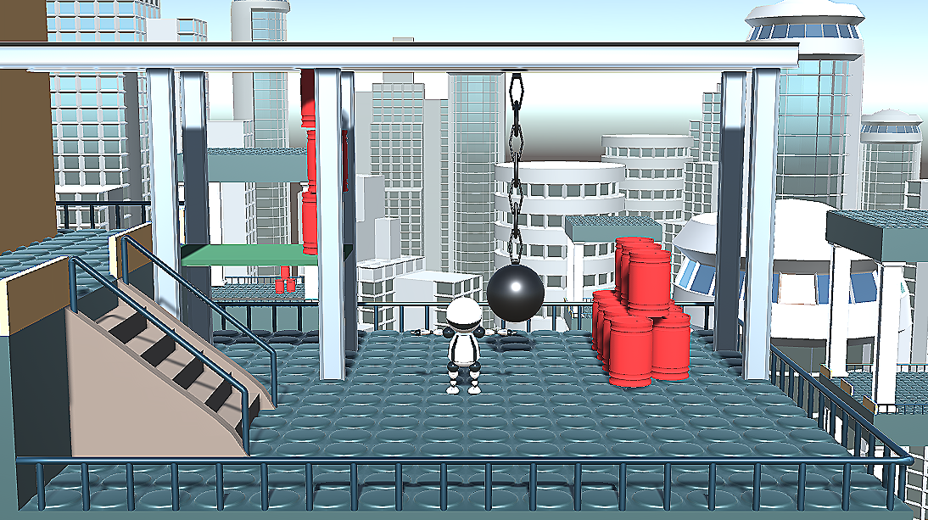
Well-known (non-NPR) examples: Sharpen
weights = {
0, -1, 0,
-1, 5, -1,
0, -1, 0};

Slide 25
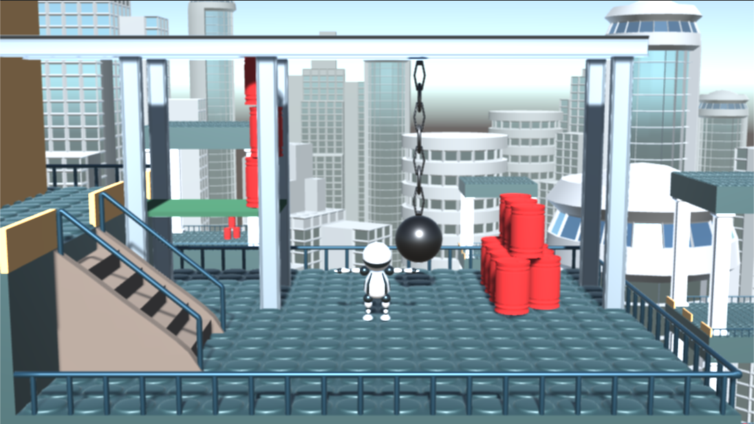
Well-known (non-NPR) examples: Box-blur
weights = {
1, 1, 1,
1, 1, 1,
1, 1, 1};

Slide 26
Well-known (non-NPR) examples: Box-blur
weights = {
1, 1, 1, 1, 1,
1, 1, 1, 1, 1,
1, 1, 1, 1, 1,
1, 1, 1, 1, 1,
1, 1, 1, 1, 1
};

Slide 27
Well-known (non-NPR) examples: Box-blur
Larger window: stronger blur
Larger window: also slower computation
Filtering is bandwidth limited: the GPU needs to fetch a lot of pixels and perform only a very low number of arithmetic computations
The GPU is very slow in reading memory compared to arithmetic computations
Note that window width N means N*N texture fetch for every pixel
Large window width should be avoided
Practically a filter with window larger than 50x50 may not run in real-time

Slide 28
Separable filters
When the rank of the weight matrix is 1, the 2D convolution can be separated to two 1D convolution
One horizontal and then one vertical 1D convolution filter on the result
Only vertical / horizontal neighbours are considered in the filter
Order does not matter
2*N texel fetch instead of N*N

Slide 29
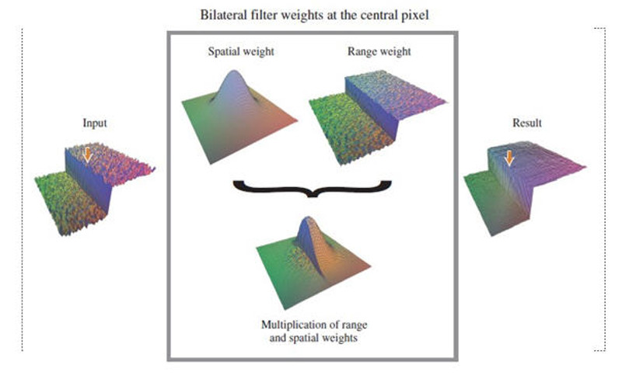
Example: non-separable filter
Bilateral filter: combination of spatial and intensity range Gaussian
Source: http://www.coldvision.io/

Slide 30
Example: bilateral filter
Basis for some image simplification methods
Blurs image regions where the gradient is small but keeps strong edges

Slide 31
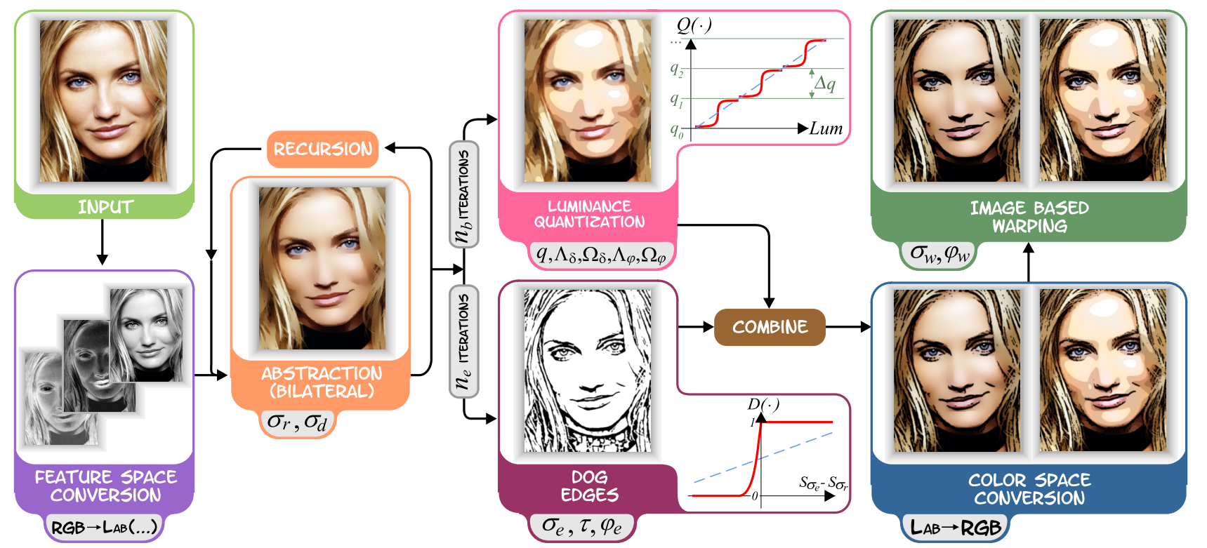
Example: bilateral filter
Basis for some image abstraction methods
More on this in the lecture about image abstraction

Slide 32
Image-space effects in a video game
Important differences compared to classical image processing:
We can use extra information from the rendering pipeline
Object ID map, depth map, screen-space normals and curvature etc.
Performance
We need to render 30-60+ images in a second, usually over Full HD resolution
Precision
Standard texture format is 1 byte / channel
Temporal coherency
The game is not still
Stereo coherency
E.g. for VR games

Slide 33
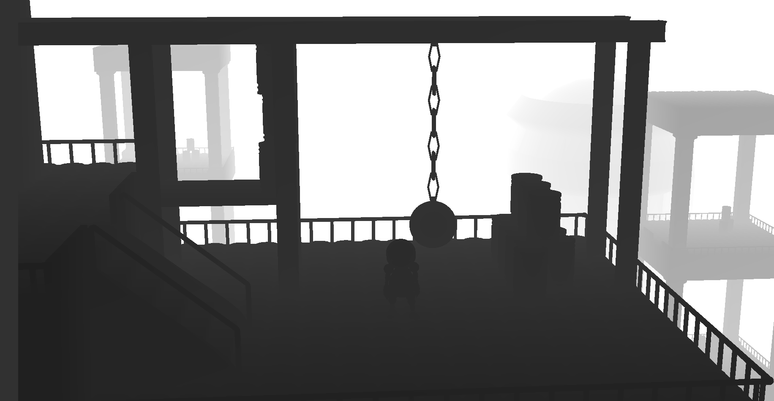
Depth map
Each pixel stores the distance between the camera and the nearest visible surface in that pixel
It is a 2D image, but gives us information about the scene geometry

Slide 34
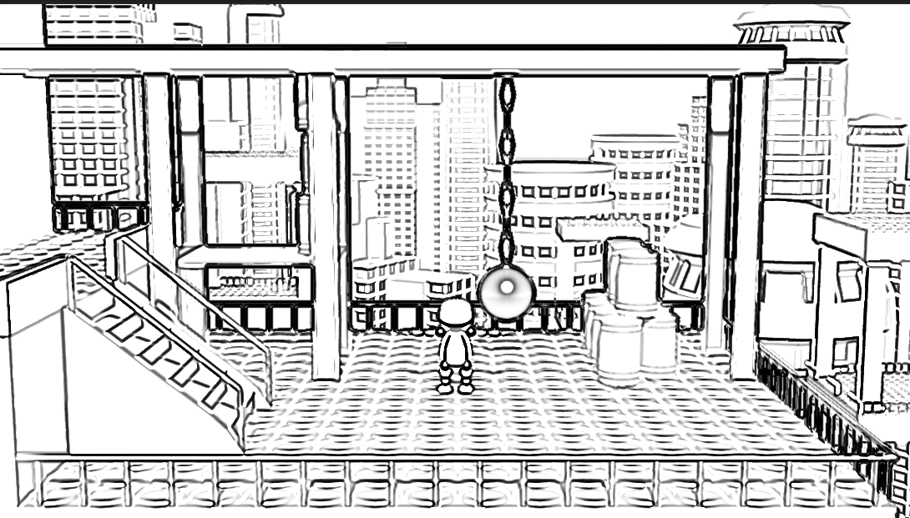
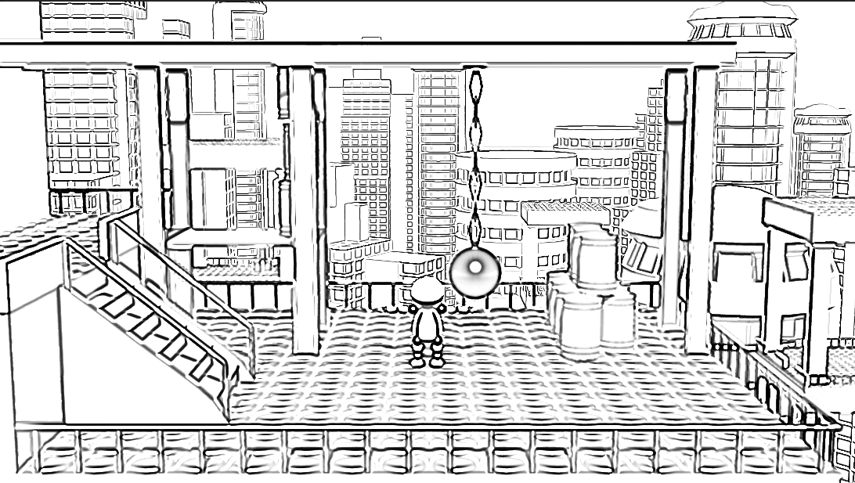
Example depth-based effects
Very difficult (or impossible) to do these for a photo (no depth map)
Depth-based line-thickness
Uniform
Thinner in the background

Slide 35
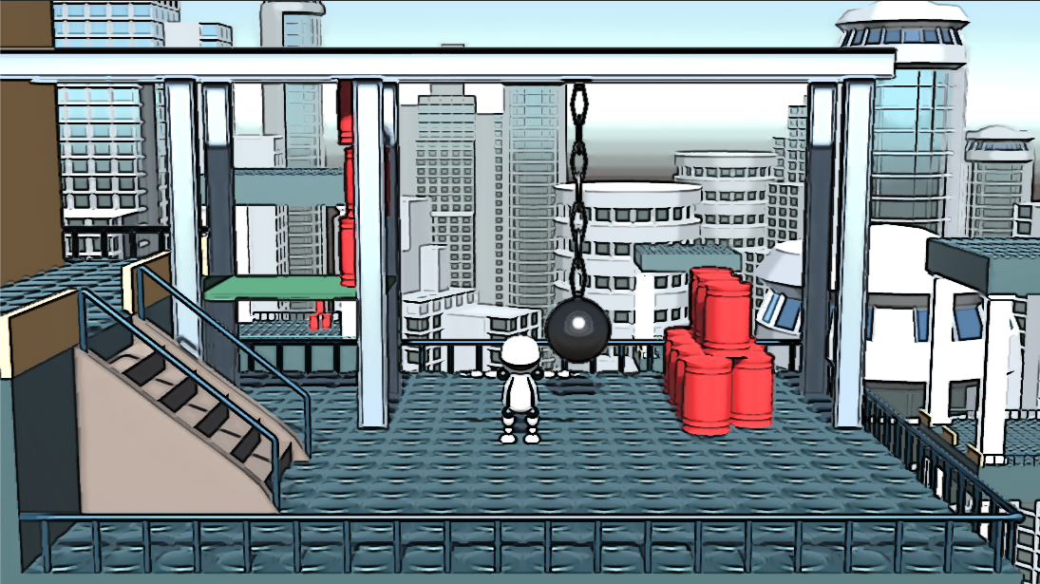
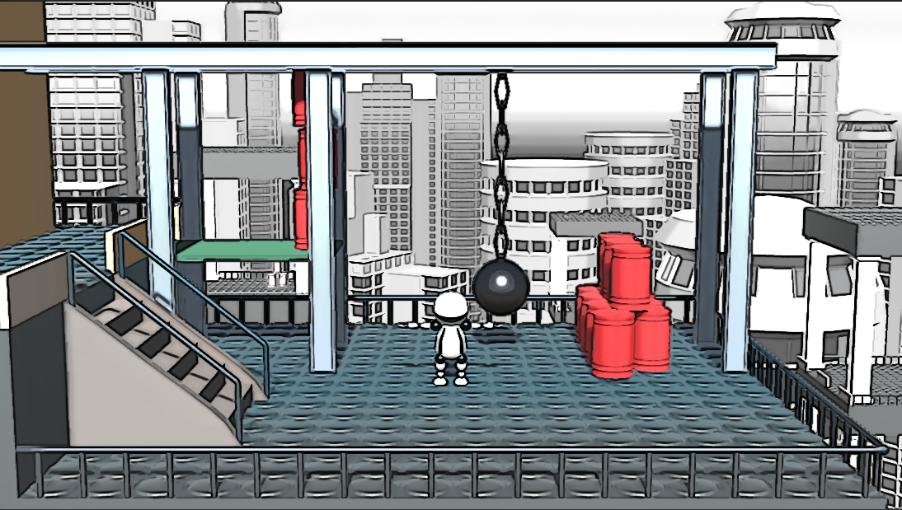
Example depth-based effects
Very difficult (or impossible) to do these for a photo (no depth map)
Depth-based desaturation
Original colors
Depth-based desaturation

Slide 36
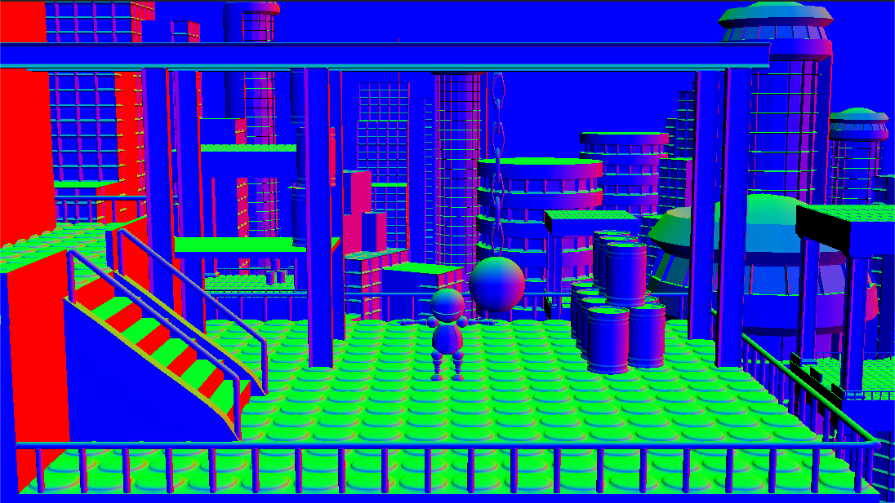
Normal map
Each pixel stores the view-space normal of the nearest surface
Unity can render it for us

Slide 37
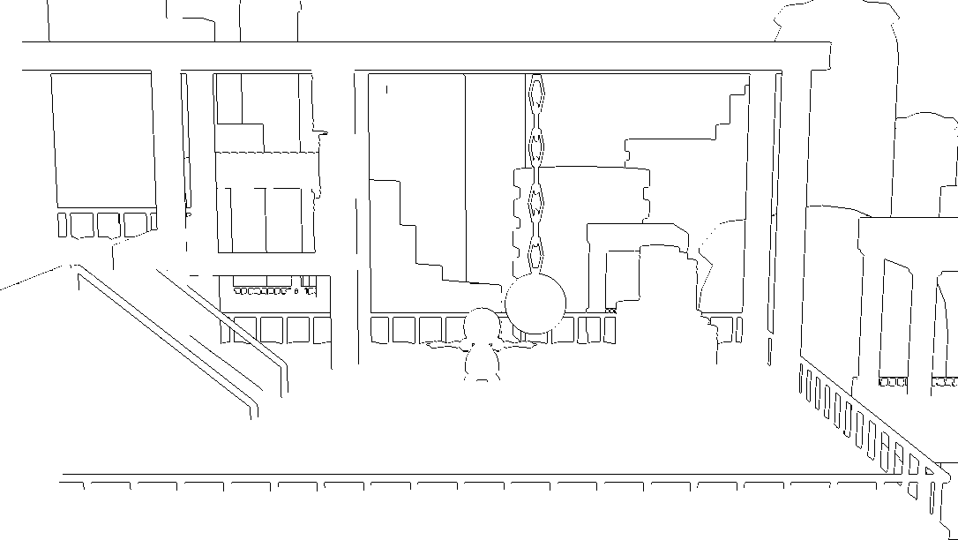
Normal map example uses
Edges based on depth and normal (edge: large jump in the depth or the normal)
Curvature is computed from the normal map
Stroke-based effects, e.g. hatching direction can be guided by the curvature
(More details later in the lecture about hatching)

Slide 38
Performance
Assume 4k resolution (approx. 4 million pixels), 100 FPS, RGB = 3 channels
4 x 10⁶ x 3 x 100 ≈ 10⁹ pixel channels to fill in a second
Current top GPU peak performance: 5-10 TFlops = 10¹² floating point operations/s
We can implement rather complex effects but have to do it smart
Top mobile GPUs ≈ 100-500 Gflops
Mobiles are significantly slower but still can handle simpler effects

Slide 39
Precision
In regular image processing (not games) we use single or double precision variables: 4 or 8 bytes per color channel, so precision is usually not an issue
In shader programming (games), we may have problem in two places
Inside the shader, when doing the computations
OK, we can use float i.e. single precision, it is still fast
Old GPUs (around 10 years ago) had precision issues with float, nowadays they follow the IEEE 754 float standard. Latest GPUs also support double precision.
When saving intermediate results to textures
In shader programming, the standard texture format is 1 byte/channel
https://docs.unity3d.com/ScriptReference/RenderTextureFormat.Default.html
”Typically this is ARGB32 format.” (meaning: 32 bits for the 4 channels = 1 byte / channel)
We have to be careful with this one and use high precision textures when necessary!
Unity allows high precision textures: RenderTextureFormat.DefaultHDR (2 or 4 bytes/channel)
Some older mobile phones do not support floating point textures at all!

Slide 40
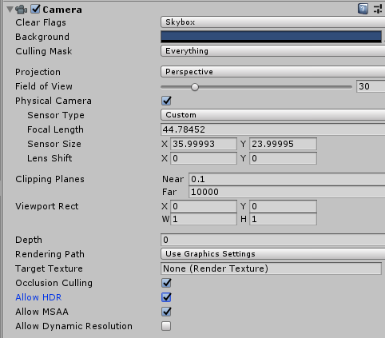
Precision – Dynamic range
Historically, high-precision textures are called HDR (high dynamic range)
Low dynamic range (LDR) rendering: intensities are simply clamped to the allowed maximum and result is stored in a small precision texture (usually 1 byte / channel)
High dynamic range (HDR) rendering: we allow large differences in illumination
Rendering result is stored in a higher precision texture (2 or 4 bytes / channel), no clamp
Tone-mapping is applied as post-processing to scale the insensities to the allowed domain
In Unity we can set the camera to store its result in higher precision

Slide 41
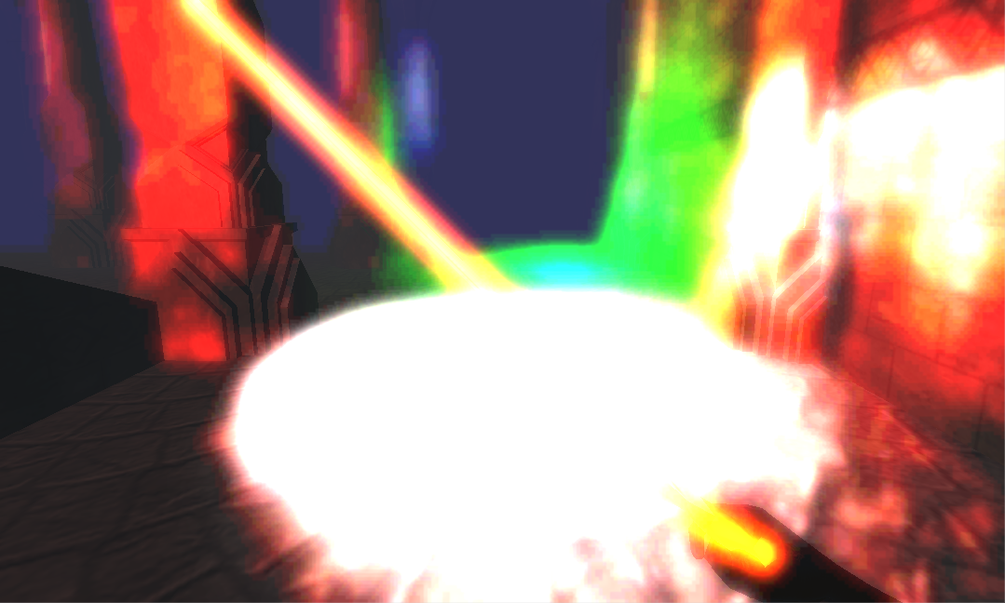
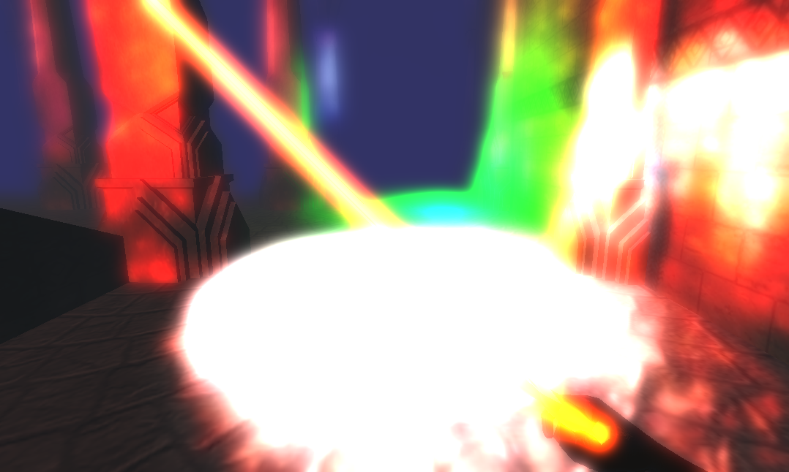
Precision – Example
Bloom effect (photorealistic rendering)
Simulates how strong light is scattered in the camera’s lense
Implementation: filter out bright pixels and smooth them
LDR
HDR

Slide 42
Precision – Example
Bloom effect (photorealistic rendering)
Implementation: filter out bright pixels and smooth them
2 passes, intermediate result (bright pixels) are stored in a temporary texture
Notice the quantization artefacts when the intermediate result is stored in LDR
LDR
HDR

Slide 43
Temporal coherency – Flickering
The image processing may produce significantly different results for small changes of the input
Often happens with stroke-based rendering: the positions of strokes jump too much between frames
Typical solutions:
Fix some inputs (e.g. stroke positions) to object surfaces
Reuse information (e.g. stroke positions) from previous frames
Blur certain inputs, intermediate results – flickering is less noticeable
Analogy: motion blur effect is often used in video games to hide imperfections of the rendering
See detailed examples in the lecture about hatching

Slide 44
Temporal coherency – Object-Screen mismatch
The texture generated by the post processing effect (e.g. brush-strokes, hatching) does not follow the objects
Typical example: showerdoor effect for background texture

Slide 45
Algorithm against shower-door effect
Dynamic canvas for immersive non-photorealistic walkthroughs. Cunzi, Matthieu, et al. Proc. Graphics Interface. AK Peters, LTD., 2003.

Slide 46
Algorithm against shower-door effect
Idea: animate the background canvas
Its 2D motion should match the 3D camera movement and rotation
Camera movement corresponds to texture zoom, rotation to ”sphere rolling”
Texture is infinitely zoomable using a fractal like texture addressing

Slide 47
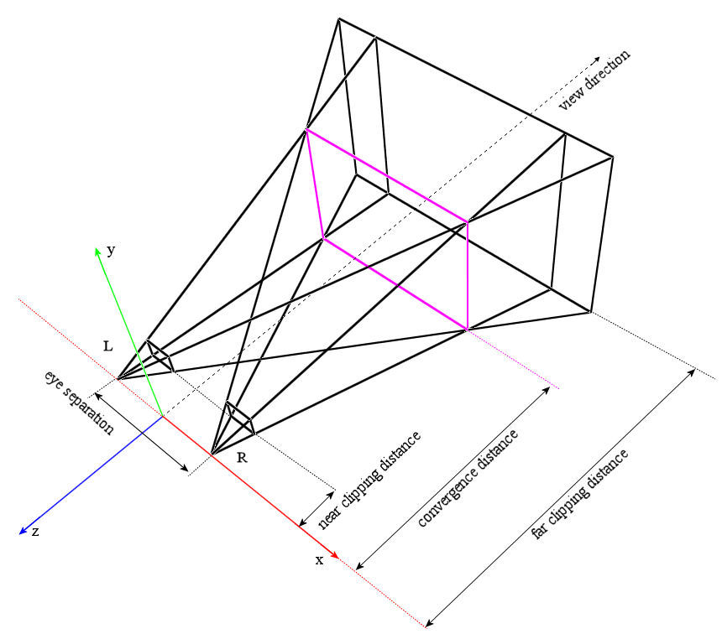
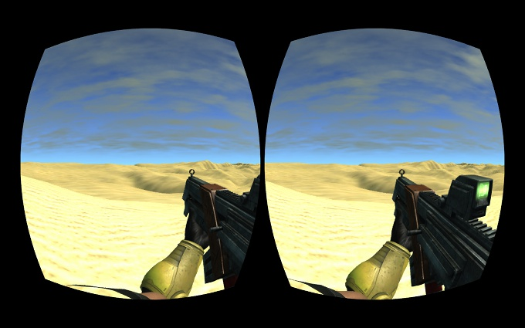
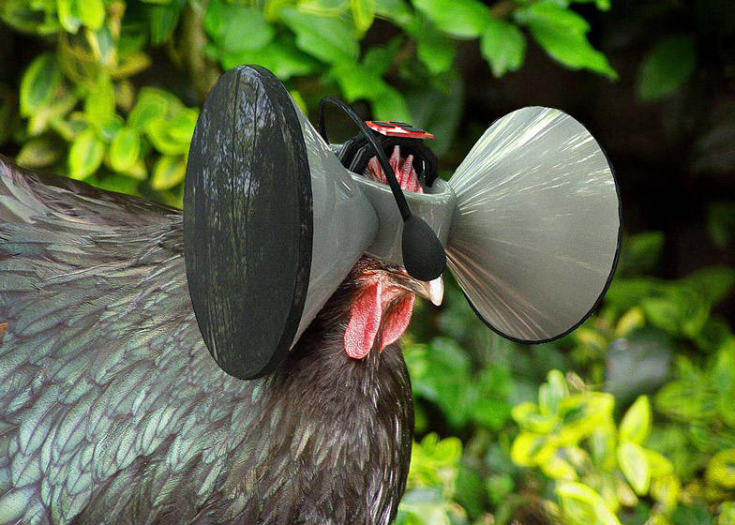
Stereo rendering
Cheat the human eye: sensation of depth
Show two different images for the two eyes
Rendered from two different viewpoints
All VR games are based on this principle

Slide 48
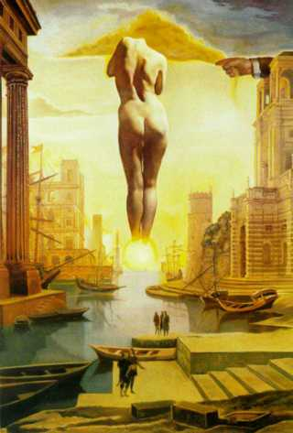
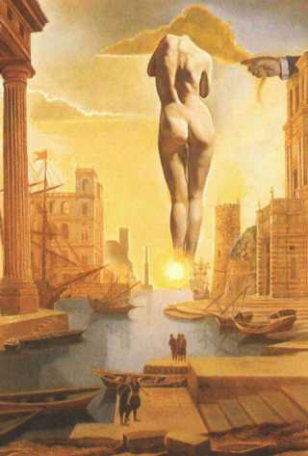
Stereo in art
The chair, Salvador Dalí, 1975
'Dalí's Hand Drawing Back the Golden Fleece in the Form of a Cloud to Show Gala the Dawn, Completely Nude, Very, Very Far Away Behind the Sun; 1977

Slide 49
Stereo rendering + NPR
Need to apply the image processing on the two images (left and right eye) separately
Image space effects: texture, contours, edges, brushes may cause problems if they are not consistent for the two eyes
Object space effects: the same scene is rendered from two different viewpoints, these two images are not modified so consistency is easier to achieve
”Binocular rivalry”: there is a mismatch between the two eyes
Can completely ruin depth sensation and even cause motion sickness
Not much research has been done in stereo + NPR
Basic idea behind methods: warp the image corresponding to one of the eyes until it becomes consistent with the other eye

Slide 50
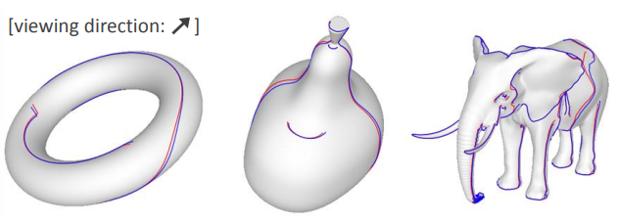
Stereo rendering + NPR
Example for inconsistencies: contour lines are different from different viewpoints
Red lines denote the contours drawn for the left-eye image, blue lines are the contours drawn for the right eye (the should coincide)
(The figure is from another perspective than the viewpoint)
Figure from Kim et al., Stereoscopic 3D line drawing, Siggraph 2013

Slide 51
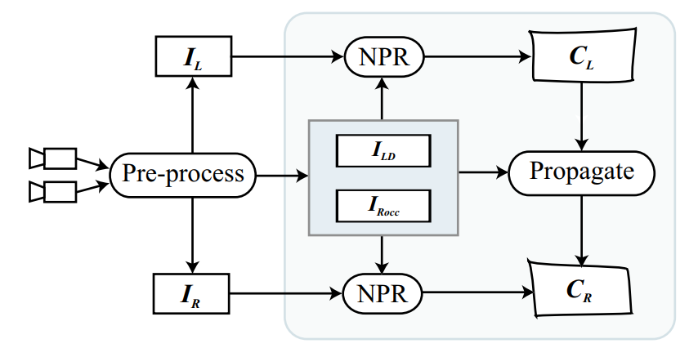
Stereo rendering + NPR
Stereoscopic Non-Photorealistic Rendering, Efstathios Stavrakis, 2008
Basic idea: compute the disparity map I_{LD} (similar to the depth map) and the occlusion maps I_{ROCC} from the left and right images, apply NPR separately and then warp them based on I_{LD} and I_{ROCC}
The occlusion map contains the surfaces seen by only one of the eyes due to occlusion

Slide 52
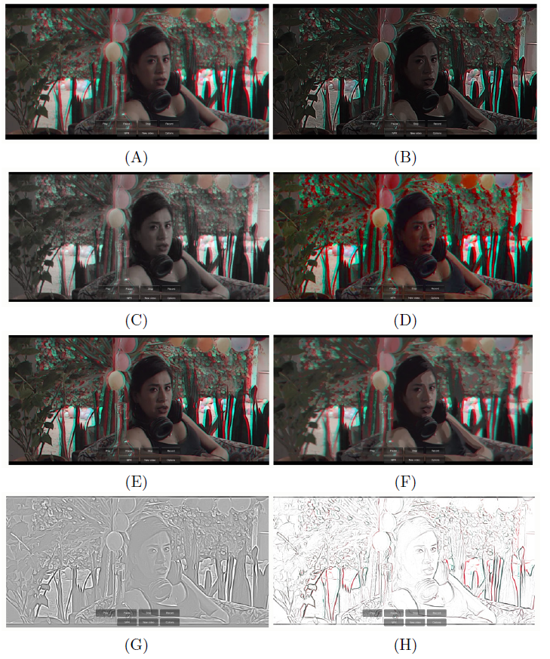
Stereo rendering + NPR
Another strategy: do not care about inconsistency and see what happens
Not much research has been done about the user responses to stereo + NPR
From 2D to 3D: A Case Study of NPR and Stereoscopic Cinema, Fajnzylber et al, Smart Graphics 2017.

Slide 53
Post processing in a video game
First pass: render the scene normally (photorealistic pipeline, standard lighting etc.)
Render into texture ⇒ can apply image processing on it
3D pipeline
Post processing pipeline
Depth buffer
Vertex shader
Geometry shader
Rasterization
Fragment shader
Compositing
Color buffer
Image processing
Color buffer
Normal buffer

Slide 54
Post processing in a video game
Second pass: configure and run the 3D pipeline such that it performs an image processing on the result of the previous pass
3D pipeline
Post processing pipeline
Depth buffer
Vertex shader
Geometry shader
Rasterization
Fragment shader
Compositing
Color buffer
Image processing
Color buffer
Normal buffer

Slide 55
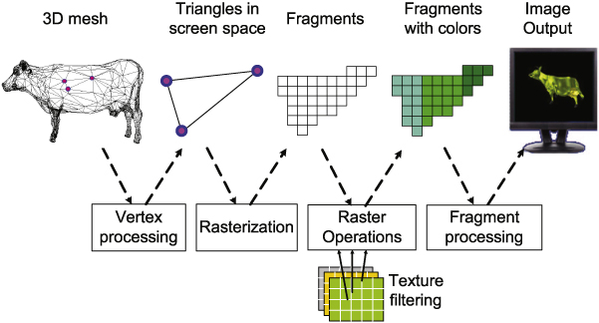
Image processing in the graphics pipeline
Normal 3D pipeline: input are the meshes/materials
Vertex shaders transforms the geometry, fragment shader computes the shading

Slide 56
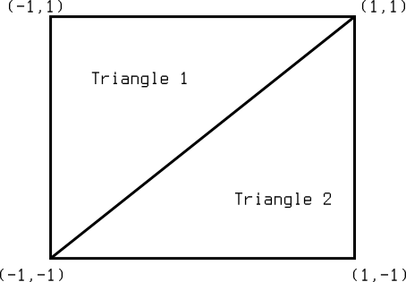
Image processing in the graphics pipeline
2D pipeline is implemented in the 3D graphics pipeline
Goal: perform the image processing in the fragment shader

Slide 57
Image processing in the graphics pipeline
2D pipeline, emulated in the 3D pipeline: input geometry is a full-screen quad, the vertex shader is pass-through (applies an identity transform), the image processing is done in the fragment shader
Full-screen quad (quad/triangle that covers the screen)
Pass-through

Slide 58
Fullscreen-quad
Two triangles that are already in normalized device coordinates (NDC)
NDC: X and Y, i.e. the horizontal and vertical screen directions are in [-1,1]
Vertex shader simply needs to pass through the vertex coordinates
Texture coordinates (a.k.a. ”uv”) cover the [0,1] domain
Vertex = (-1,1)
uv = (0,1)
Vertex = (1,1)
uv = (1,1)
v2f vert(appdata v)
{
v2f o;
o.vertex = v.vertex;
o.uv = v.uv;
return o;
}
Triangle 1
Vertex = (-1,-1)
uv = (0,0)
Triangle 2
Vertex = (1,-1)
uv = (1,0)
Screen origin

Slide 59
Fullscreen-quad
Note: the screen origin may differ between platforms (OpenGL, DirectX, Metal etc.), it can be either the lower left or upper left corner
If you ever experience a vertical flip of images in Unity, this is the reason behind it. (There are ways to handle it.)
Two triangles that are already in normalized device coordinates (NDC)
NDC: X and Y, i.e. the horizontal and vertical screen directions are in [-1,1]
Vertex shader simply needs to pass through the vertex coordinates
Texture coordinates (a.k.a. ”uv”) cover the [0,1] domain
Vertex = (-1,1)
uv = (0,1)
Vertex = (1,1)
uv = (1,1)
v2f vert(appdata v)
{
v2f o;
o.vertex = v.vertex;
o.uv = v.uv;
return o;
}
Screen origin
uv = (0,0)
Triangle 1
uv = (1,0)
Vertex = (-1,-1)
uv = (0,0)
Triangle 2
Vertex = (1,-1)
uv = (1,0)
uv = (0,1)
Screen origin
uv = (1,1)

Slide 60
Image processing in the graphics pipeline
2D pipeline, emulated in the 3D pipeline: input geometry is a full-screen quad, the vertex shader is pass-through (applies an identity transform), the image processing is done in the fragment shader
Rasterizer generates exactly one fragment for each pixel of the screen

Slide 61
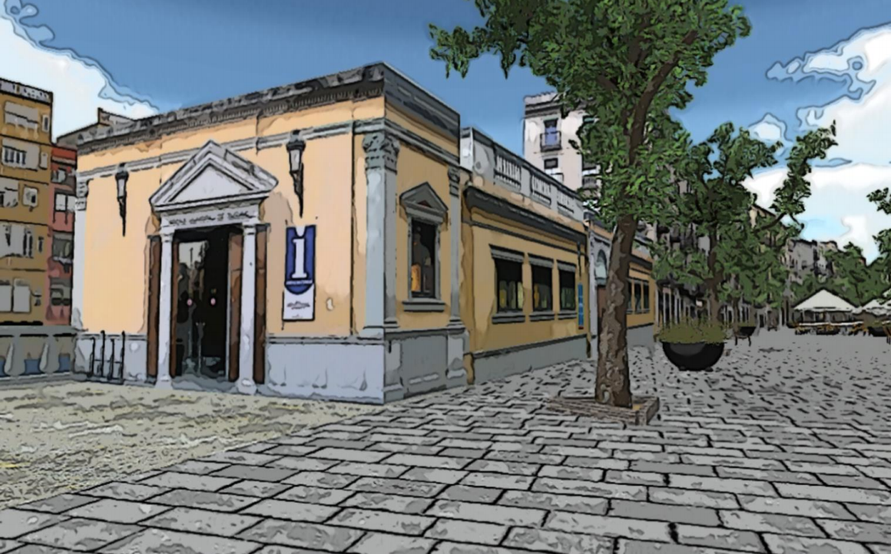
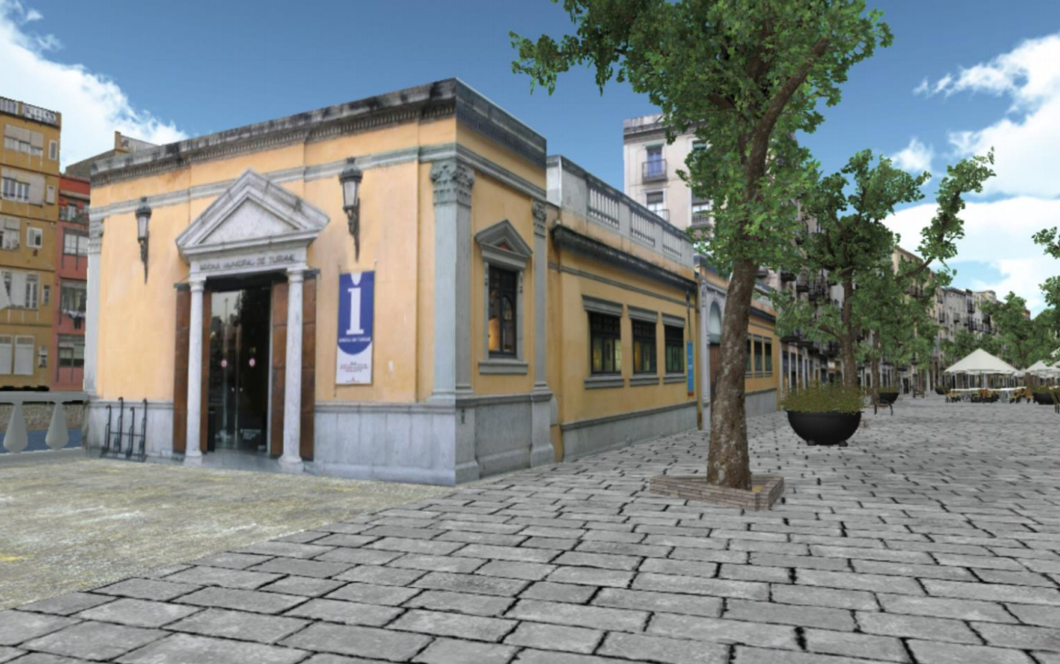
Image processing in the graphics pipeline
2D pipeline, emulated in the 3D pipeline: input geometry is a full-screen quad, the vertex shader is pass-through (applies an identity transform), the image processing is done in the fragment shader
Fragment shader is invoked once per each screen pixel
The corresponding pixel of the result texture of the photorealistic pass is fetched and processed

Slide 62
Post processing in Unity
99% of the time we want to modify only the fragment shader
The input geometry is a fullscreen quad
The vertex shader is pass-through
We can’t use a shader by itself in Unity, we have to assign it to a Material object
The only purpose of the material is to be able to call and pass parameters to the shader
That’s why in Unity we usually create the Material object from script for post-processing effects

Slide 63
My first post processing effect in Unity
[ExecuteInEditMode]
[RequireComponent(typeof(Camera))]
public class DummyPostEffect : MonoBehaviour {
public Shader shader = null;
protected Material material = null;
bool CreateMaterial() {
if (shader == null) return false;
if (material == null || material.shader != shader) {
material = new Material(shader);
material.hideFlags = HideFlags.DontSave;
}
return material != null;
}
void Start() {
CreateMaterial();
}
// ...
}

Slide 64
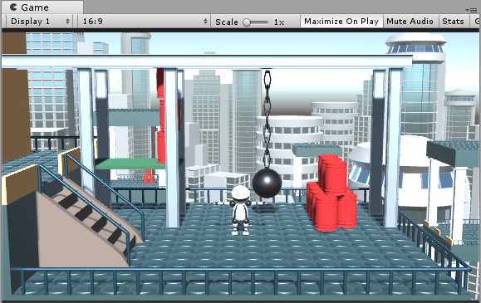
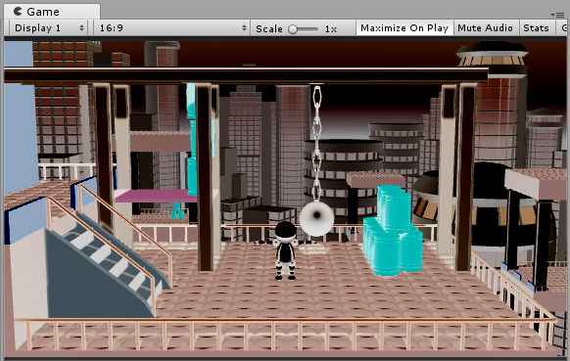
My first post processing effect in Unity
The script will be applied also in editor mode
(The result of the effect is visible in the Game window without pressing the ”Play” button)
[ExecuteInEditMode]
[RequireComponent(typeof(Camera))]
public class DummyPostEffect : MonoBehaviour {
public Shader shader = null;
protected Material material = null;
bool CreateMaterial() {
if (shader == null) return false;
if (material == null || material.shader != shader) {
material = new Material(shader);
material.hideFlags = HideFlags.DontSave;
}
return material != null;
}
void Start() {
CreateMaterial();
}
// ...
}

Slide 65
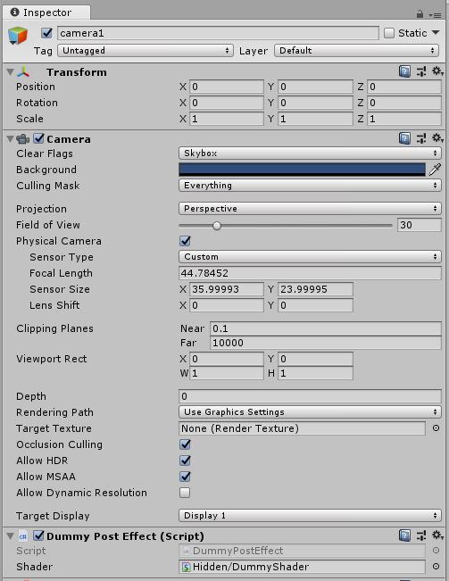
My first post processing effect in Unity
Post processing effects work on the image rendered by the camera, so we require our object to have a Camera component
[ExecuteInEditMode]
[RequireComponent(typeof(Camera))]
public class DummyPostEffect : MonoBehaviour {
public Shader shader = null;
protected Material material = null;
bool CreateMaterial() {
if (shader == null) return false;
if (material == null || material.shader != shader) {
material = new Material(shader);
material.hideFlags = HideFlags.DontSave;
}
return material != null;
}
void Start() {
CreateMaterial();
}
// ...
}

Slide 66
My first post processing effect in Unity
[ExecuteInEditMode]
[RequireComponent(typeof(Camera))]
public class DummyPostEffect : MonoBehaviour {
public Shader shader = null;
protected Material material = null;
bool CreateMaterial() {
if (shader == null) return false;
if (material == null || material.shader != shader) {
material = new Material(shader);
material.hideFlags = HideFlags.DontSave;
}
return material != null;
}
void Start() {
CreateMaterial();
}
// ...
}
Our shader may be replaced through the inspector.
The material is created automatically, there is now reason to show it (so it is protected)

Slide 67
My first post processing effect in Unity
[ExecuteInEditMode]
[RequireComponent(typeof(Camera))]
public class DummyPostEffect : MonoBehaviour {
public Shader shader = null;
protected Material material = null;
bool CreateMaterial() { // function to create Material from the Shader
if (shader == null) return false; // if no shader is set in the inspector do nothing
if (material == null || material.shader != shader) { // lazy creation: only when the Shader changes
material = new Material(shader); // this is where we actually create the Material
material.hideFlags = HideFlags.DontSave; // don’t save the Material to the project
}
return material != null; // ''new Material(shader)'' returns null if there is an error in the shader
}
void Start() {
CreateMaterial();
}
// ...
}

Slide 68
My first post processing effect in Unity
[ExecuteInEditMode]
[RequireComponent(typeof(Camera))]
public class DummyPostEffect : MonoBehaviour {
// ...
void OnRenderImage(RenderTexture source, RenderTexture destination) {
if (CreateMaterial()) {
Graphics.Blit(source, destination, material);
}
else {
Graphics.Blit(source, destination);
}
}
}
This is the callback function (exactly with this parameter list) to implement the C# part of the post processing effect

Slide 69
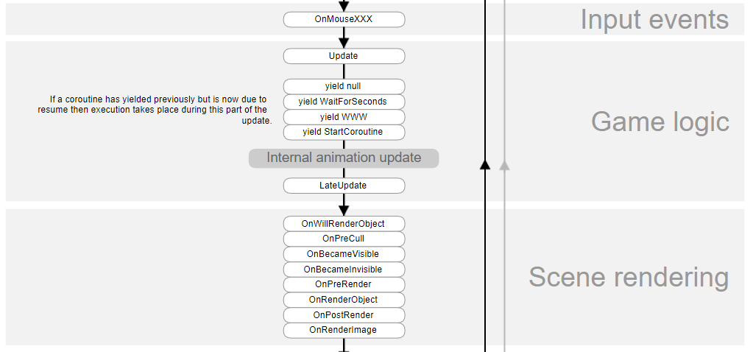
OnRenderImage
Runs when there is a Camera attached to the GameObject
Runs after the Camera rendered the scene (executed the 3D pipeline)

Slide 70
My first post processing effect in Unity
[ExecuteInEditMode]
[RequireComponent(typeof(Camera))]
public class DummyPostEffect : MonoBehaviour {
// ...
void OnRenderImage(RenderTexture source, RenderTexture destination) {
if (CreateMaterial()) {
Graphics.Blit(source, destination, material);
}
else {
Graphics.Blit(source, destination);
}
}
}
Input texture of the post processing
Result of the rendering with the camera or the result of the previous post processing effects (when more than one is attached to the GameObject) is stored in this texture
Output texture of the post processing.
We should write the result of our effect here.
NOTE: we cannot use this as a temporal texture, i.e. when we have a multipass effect, we are allowed to write to this texture only once (in the last pass).

Slide 71
Fullscreen rendering in Unity
Graphics.Blit(Texture source, RenderTexture destination, Material mat, int pass = -1);
This function performs a render call with full-screen quad as geometry
It handles the geometry (full-screen quad) creation, pipeline parameter bindings, sets the shaders stored in the material active
Also binds some parameters to the shader (e.g. the source texture can be accessed from the texture via the name _MainTex – see later)
We can select which pass to use from the shader (-1: every pass is executed).
The material parameter (mat) can be empty, which means we simply copy the source texture to destination (equivalent a pass-through vertex and fragment shader)
Don’t be afraid of texture copying, its pretty fast on modern GPUs

Slide 72
My first post processing effect in Unity
[ExecuteInEditMode]
[RequireComponent(typeof(Camera))]
public class DummyPostEffect : MonoBehaviour {
// ...
void OnRenderImage(RenderTexture source, RenderTexture destination) {
if (CreateMaterial()) { // We call this in every frame so we can change the shader at any time
Graphics.Blit(source, destination, material); // Render full-screen quad, use our material
}
else {
// When no Shader is set or there was a compilation error we simply copy source to destination
// If we don’t do this in our script but attach this script to a GameObject (with a Camera) the
// Camera won’t render anything
Graphics.Blit(source, destination);
}
}
}

Slide 73
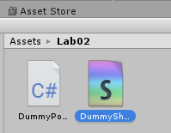
My first post processing shader in Unity
Unity has a nice template for it
Assets menu → Create → Shader → Image Effect Shader
Call it e.g. DummyShader
Double click to edit the shadersource

Slide 74
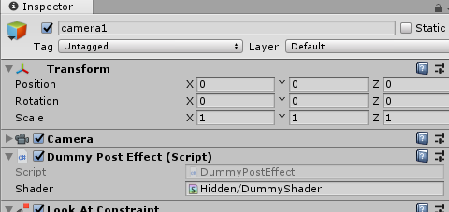
My first post processing shader in Unity
Try it!
Attach the previous C# script (DummyPostEffect) to the camera
Drag the new Unity shader to the shader parameter of the DummyPostEffect

Slide 75
My first post processing shader in Unity
Try it!
Attach the previous C# script (DummyPostEffect) to the camera
Drag the new Unity shader to the shader parameter of the DummyPostEffect
Colors are inverted!
This is the default behaviour of the
template
Let’s have a look at the shader

Slide 76
My first post processing shader in Unity
Shader "Hidden/DummyShader"
{
Properties
{
_MainTex ("Texture", 2D) = "white" {}
}
SubShader
{
// No culling or depth
Cull Off ZWrite Off ZTest Always
Pass
{
// ...
}
}
}
See first practical
Graphics.Blit(source, ...) binds source to this parameter.
With the full-screen quad rendering exactly one fragment is generated for each pixel of the destination texture in Graphics.Blit(source, destination).
We want to make sure that the full-screen quad survives the triangle culling and all fragments survive the depth test (Z-test), so we disable triangle culling and Z-test.

Slide 77
My first post processing shader in Unity
Pass {
CGPROGRAM
#pragma vertex vert
#pragma fragment frag
#include "UnityCG.cginc"
struct appdata
{
float4 vertex : POSITION;
float2 uv : TEXCOORD0;
};
struct v2f
{
float2 uv : TEXCOORD0;
float4 vertex : SV_POSITION;
};
See first practical: we define which vertex and fragment shader programs to use and we define the input/output data for the vertex shader

Slide 78
My first post processing shader in Unity
v2f vert (appdata v)
{
v2f o;
// could be o.vertex = v.vertex
// (recall: Graphics.Blit sets all matrices to the identity)
o.vertex = UnityObjectToClipPos(v.vertex);
o.uv = v.uv;
return o;
}
Pass-through vertex shader
Output vertex and UV coordinates are the same as the input

Slide 79
My first post processing shader in Unity
sampler2D _MainTex;
fixed4 frag (v2f i) : SV_Target
{
fixed4 col = tex2D(_MainTex, i.uv);
// just invert the colors
col.rgb = 1 - col.rgb;
return col;
}
The actual effect (image processing) is implemented in the fragment shader
For this template it is a simple color inversion, we subtract the colors of the texture from pure white
Graphics.Blit(source, ...) binds source to _MainTex
So in our case _MainTex contains the image that the camera has rendered

Slide 80
My first post processing shader in Unity
sampler2D _MainTex;
fixed4 frag (v2f i) : SV_Target
{
fixed4 col = tex2D(_MainTex, i.uv);
// just invert the colors
col.rgb = 1 - col.rgb;
return col;
}

Slide 81
My first post processing shader in Unity
Every instance of the fragment shader has a unique uv, corresponding to one pixel of the texture.
tex2D reads this corresponding pixel of _MainTex and applies some function.
So the fragment shader should tell how to compute a single pixel of the output.
Note: fragment shader instances run in parallel, that is why the GPU is so fast (also: fragments have to be independent)
sampler2D _MainTex;
fixed4 frag (v2f i) : SV_Target
{
fixed4 col = tex2D(_MainTex, i.uv);
// just invert the colors
col.rgb = 1 - col.rgb;
return col;
}
Fragment shader transforms a pixel of the input texture

Slide 82
Unity Post Processing stack
https://github.com/Unity-Technologies/PostProcessing/wiki
Collection of (mainly photorealistic) post processing effects
Developed by Unity, worth have a look
Many useful stuff
Base classes for effect implementation
Coding guidelines for maximum portability
Can add your own custom effect
We won’t be using it
Still under development
Not yet integrated to Unity (separate package)
Too complex for education

