Slide 1
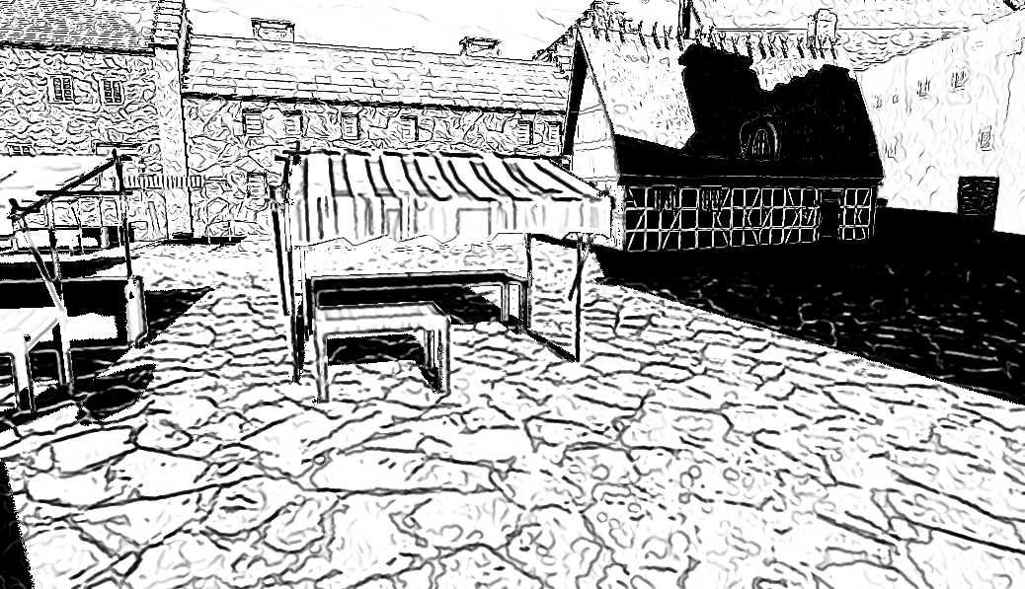
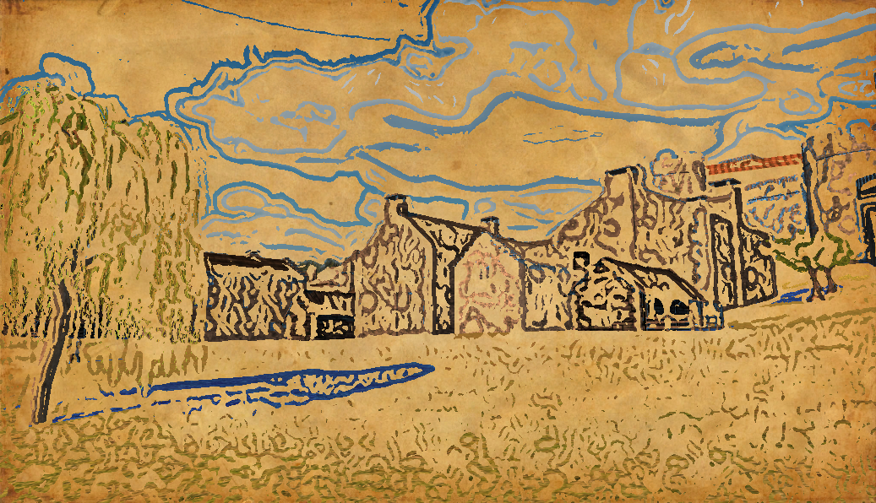
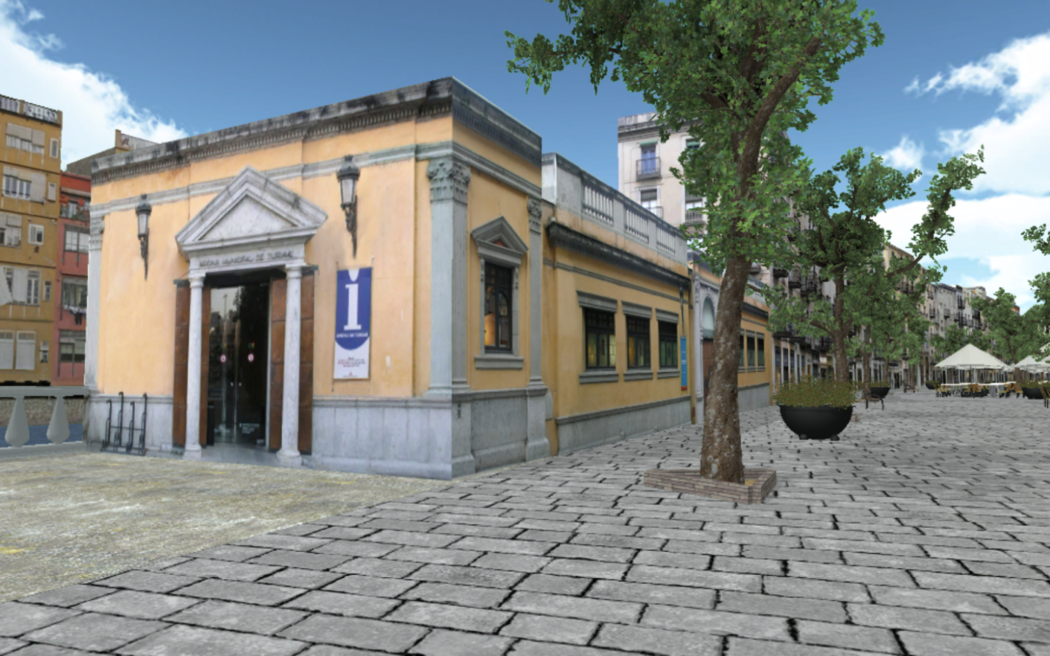
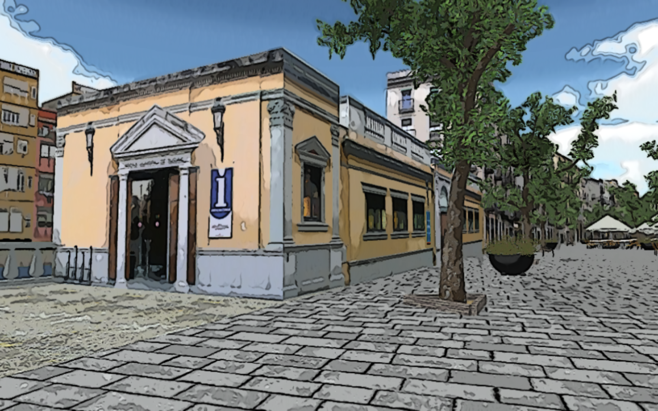
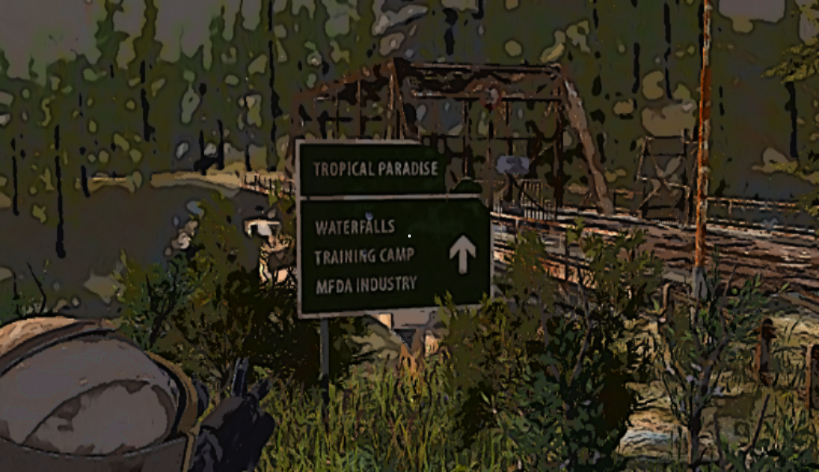
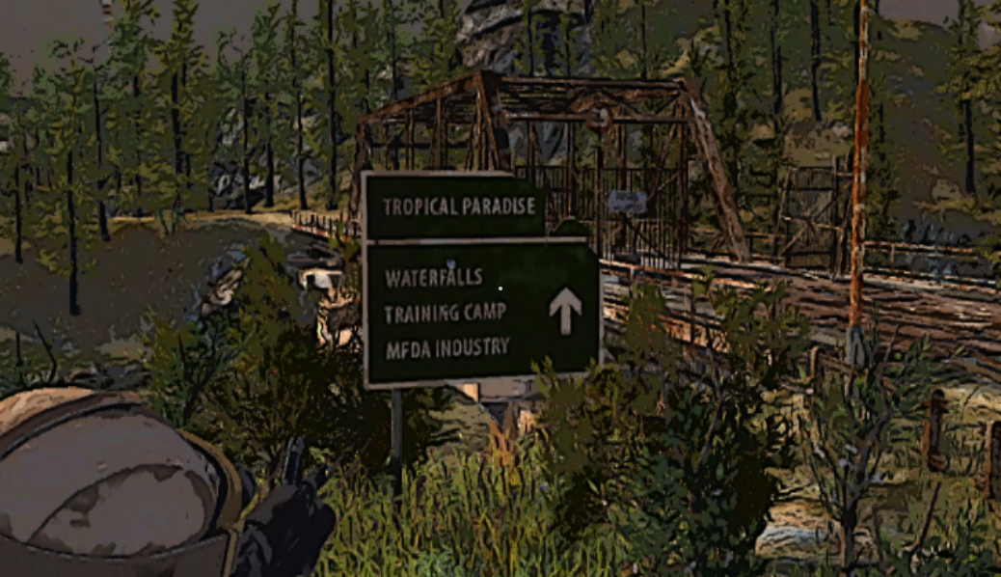
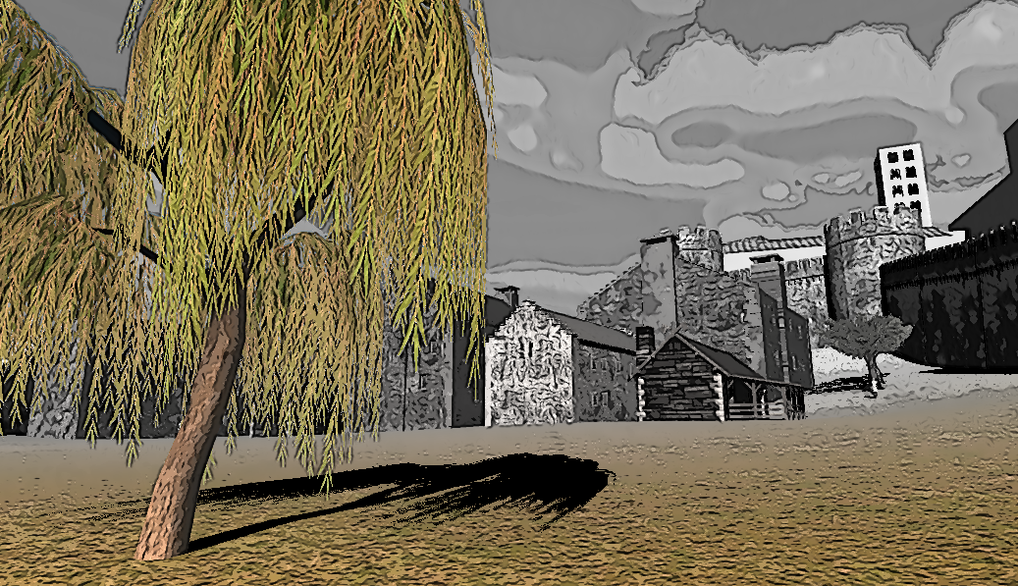
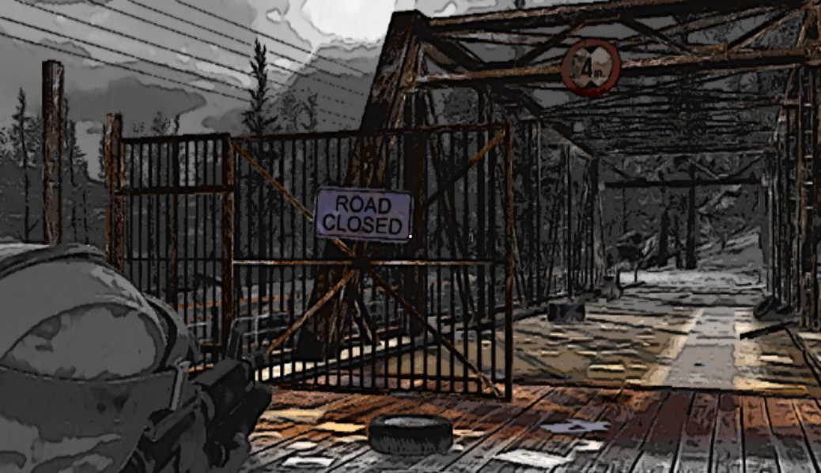
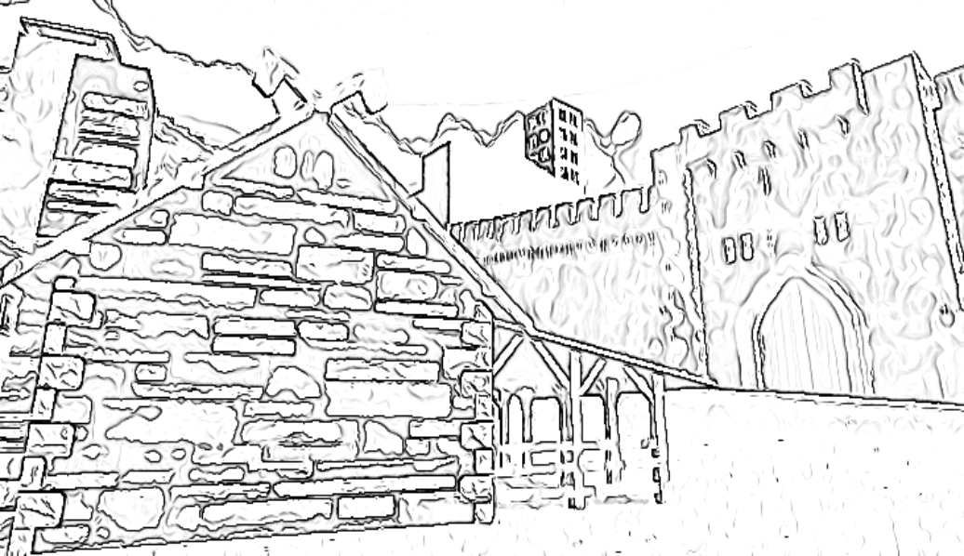
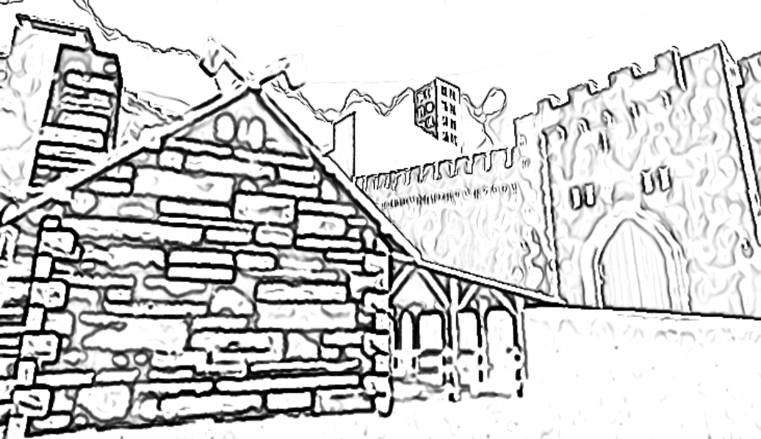
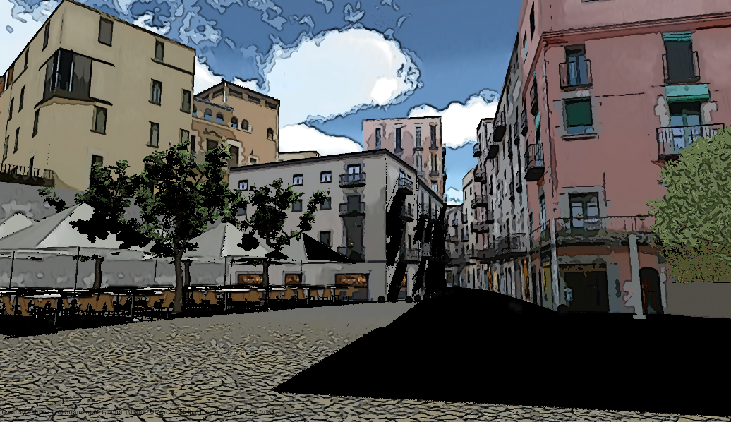
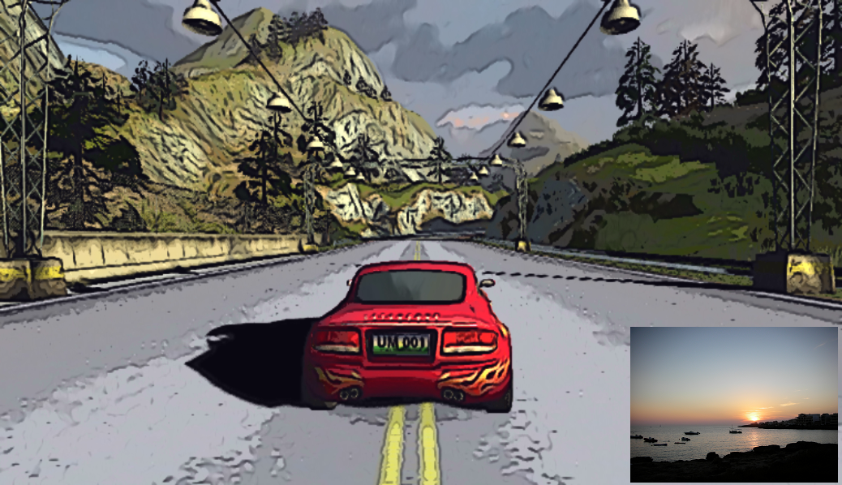
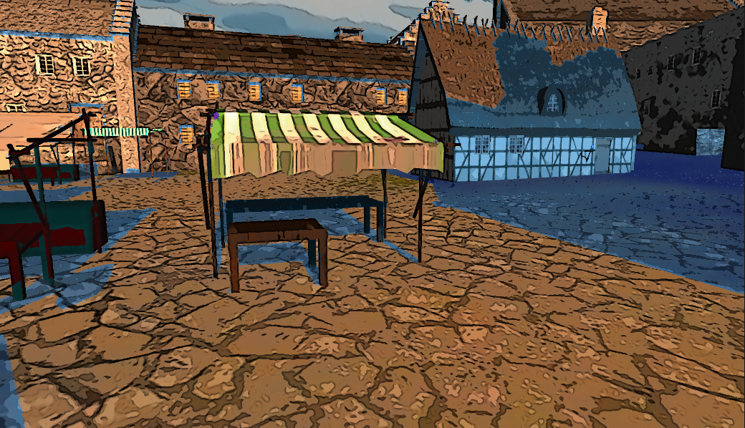
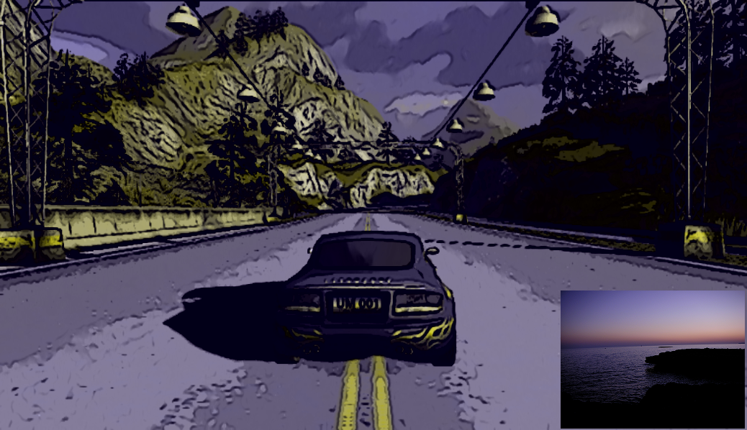
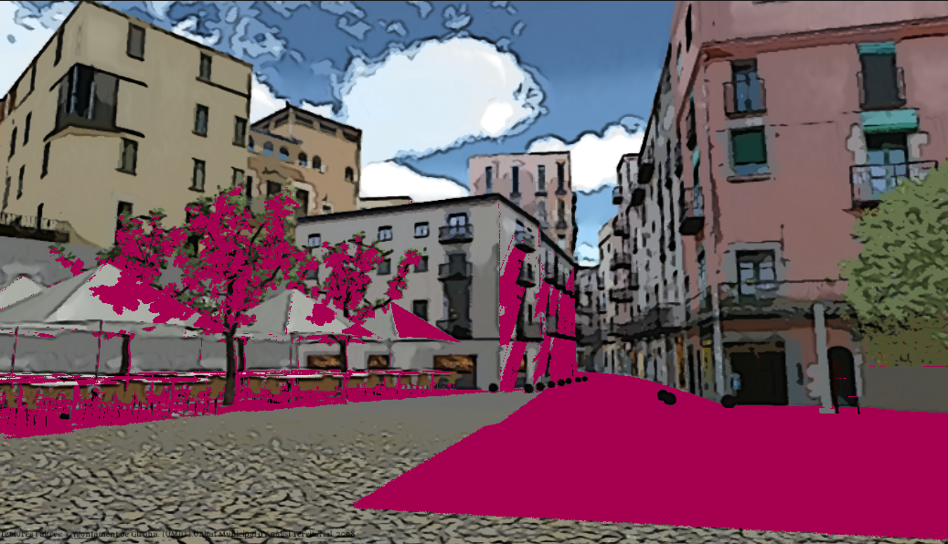
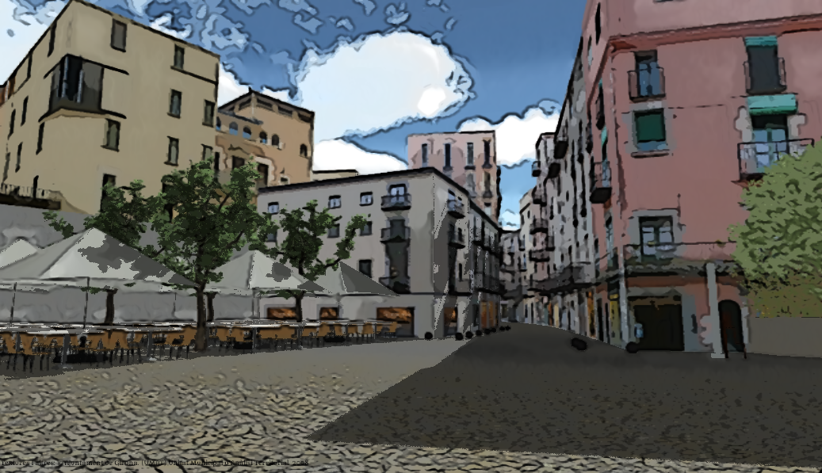
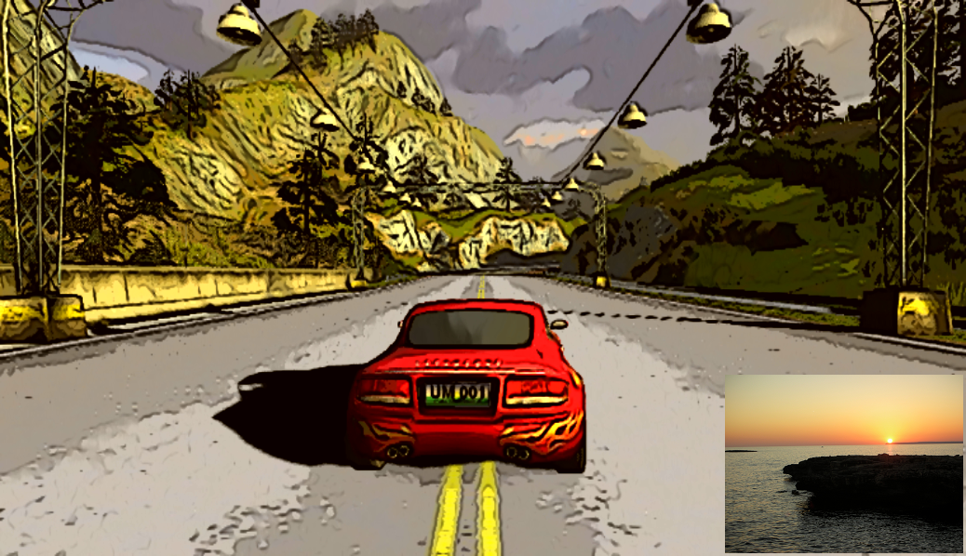
Post-Processing NPR Effects for Video Games: a Case Study
Milán Magdics ^{1,2)} , Catherine Sauvaget, Ruben García ¹⁾ , Mateu Sbert ¹⁾
¹⁾ Institute of Informatics and Applications, University of Girona, Girona, Spain
²⁾ Department of Control Engineering and Informatics, Budapest University of Tecnology and Economics, Budapest, Hungary
Motivation
In visual communication, the proper style depends on the message we want to deliver to the observers and the emotions we want to evoke in them. This may change from time to time and scene to scene in a game.
In CGI, post production is far more efficient for changing and fine-tuning the style in terms of man-hours. Post production stylization tools should exist for video games.
Providing multiple choices to players that give different game experience increases replayability. Rendering style definitely affects game experience, thus, a collection of styles may improve replay value.
All in all: we need for easy to apply, easy to parameterize and reusable stylization effects that may be changed real-time
NPR Effects for Games
In video games, post-processing effects can serve these purposes, since they are very easy to apply to any games (including existing ones) and as they are computed in real-time, their parameters (and thus the rendering style) may change dynamically.
Important requirements for the effects: online post-processing + image stream = real-time performance + temporal coherence
In this work, we tried to give a proof of concept:
Preliminary survey: gathered a collection of effects. State of the art and a few new ideas.
Implementation in a widely used game engine: reusable effects in the Unity game engine, designed to be put after the realistic rendering pipeline.
Application to existing games: Unity demos and our own development. Each application took only a few minutes.
Edge enhancement
Texture Simplification
1. Geometric edges: what artists do. Lines follow object silhouettes and main geometric features, ridges and valleys.
The standard post-processing implementation looks for discontinuities in the depth and normal maps.
2. Texture edges: how human visual perception works. Searches for abrupt changes in the light intensity.
State-of-the-art, producing artistic results and various effects:
XDoG by Winnemöller et al [9]
1+2: preserves advantages: better shape depiction while texture details are not lost (Redmond et al. [4]).
Variable thickness, sensitivity.
Greater detail control with pre-filtering [8]
Edge color driven by the original color map: works especially well for the background.
“Negative” edges in shadows: B&W comics.
The real world (and thus, realistic rendering) is too complex.
Too many disturbing details, hard to extract relevant information.
While edge enhancement emphasizes important details, texture simplification dampens less important ones.
Level of abstraction is increased.
Similar tricks by comic artists, so results are often comic-like.
Two orthogonal ways of reducing image complexity:
Colors: lumimance quantization,
Detailedness: detail preserving smoothing (bilateral filters, Kuwahara filter etc.).
Our implementation is based on the works of Winnemöller et al . [8] and Kyprianidis et al. [2].
Depth Sensation by Varying Abstraction Level
Realistic depth-effects are often used in games: depth of field, atmospheric effects, fog, etc.
Artists often create the sensation of depth by increasing the level of the abstraction with the distance from the viewer: decreasing richness in colors and details, and object contours are less and less emphasized by drawing increasingly thinner lines.
Desaturation: decreasing richness in colors: more important parts are more vivid.
Studies show that saturation can guide the user’s gaze [3,4].
Easy to implement in HSV or HSL color spaces: various mappings of the depth to saturation (S).
Image to the right: Unity Bootcamp demo
Decreasing edge thickness by depth: less emphasis on less important (background) objects.
Artists indeed use thinner lines to depict farther objects [1].
The implemented edge enhancement methods allow parameterization of thickness.
Here: guided by the depth.
Texture simplification can remove richness in details.
Parameters control the strength of details to preserve.
Mapping the depth to these parameters can create increased abstraction level for the background.
Images: Unity Bootcamp demo.
Shadow Recoloring
Example-based Color Palette
In arts, shadows play an important role in increasing (or decreasing) contrast:
Contrast between shadowed and lit regions,
Painting: e.g. Chiaroscuro, impressionism [7],
Comics: e.g. black shadows, complementary colors [7].
These can be implemented by applying different color transforms in the HSV (HSL) components.
Color palette determines the mood of an image.
Setting the color palette “by hand” is very tedious.
Color-transfer methods require exemplar image(s) , the target image is modified to have a similar color histogram.
Our implementation is based on Reinhard et al. [5] and Zhao et al. [10].
Images: Unity Car Tutorial.
References
[1] GOODWIN, T., VOLLICK, I., AND HERTZMANN, A. 2007. Isophote distance: a shading approach to artistic stroke thickness. In Proceedings of the 5th international symposium on Nonphotorealistic animation and rendering, ACM, New York, NY, USA, NPAR ’07, 53–62.
[2] KYPRIANIDIS, J. E., AND DÖLLNER, J. 2008. Image abstraction by structure adaptive filtering. In Proc. EG UK Theory and Practice of Computer Graphics, 51–58.
[3] REDMOND, N., AND DINGLIANA, J. 2007. Adaptive Abstraction of 3D Scenes in Real-Time. In EUROGRAPHICS ’07: Proceedings of the Short Paper Programme, 77–80.
[4] REDMOND, N., AND DINGLIANA, J. 2009. A Hybrid Approach to Real-Time Abstraction. In Proceedings of Eurographics Ireland, 2009.
[5] REINHARD, E., ASHIKHMIN, M., GOOCH, B., AND SHIRLEY, P. 2001. Color transfer between images. IEEE Comput. Graph. Appl. 21, 5 (Sept.), 34–41.
[6] SAUVAGET, C., AND BOYER, V. 2009. Abstraction of photographs: a comics style approach. In Proceedings of the 3rd international conference on European computing conference, World Scientific and Engineering Academy and Society (WSEAS), Stevens Point, Wisconsin, USA, ECC’09, 215–220.
[7] SAUVAGET, C., AND BOYER, V. 2010. Stylization of lighting effects for images. 2010 Sixth International Conference on Signal-Image Technology and Internet-Based Systems (SITIS), 43–50.
[8] WINNEMÖLLER, H., OLSEN, S. C., AND GOOCH, B. 2006. Real-time video abstraction. ACM Trans. Graph. 25, 3 (July), 1221–1226.
[9] WINNEMÖLLER, H. 2011. Xdog: advanced image stylization with eXtended Difference-of-Gaussians. In NPAR ‘11, ACM, J. P. Collomosse, P. Asente, and S. N. Spencer, Eds., 147–156.
[10] ZHAO, H., JIN, X., SHEN, J., AND WEI, F. 2009. Real-time photo style transfer. In CAD/Graphics, IEEE, 140–145.
Acknowledgements
This work has been supported by the research projects coded TIN2010-21089-C03-01, IPT-2011-1516-370000 and IPT-2011-0885-430000 (Spanish Commission for Science and Technology), and by grant 2009SGR643 (Catalan Government)

