Slide 1
GPGPU labor IV.
Scatter és gather

Slide 2
Kezdeti teendők
Tantárgy honlapja, Scatter és gather
A labor kiindulási alapjának letöltése (lab4_base.zip), kitömörítés a GPGPU\Labs könyvtárba

Slide 3
Hisztogram
Szükséges osztálypéldányok:
Quad* fullscreenQuad = new Quad();
Shader* histogramShader = new Shader("histogram.vert", "histogram.frag");
Shader* visualizeShader = new Shader("passthrough.vert", "visualize.frag");
Texture2D* texture = new Texture2D();
texture->loadFromFile(std::string("lena.jpg"));
int windowWidth = texture->getWidth();
int windowHeight = texture->getHeight();
PointGrid* grid = new PointGrid(texture->getWidth(), texture->getHeight());
Framebuffer* histogramBuffer = new Framebuffer(255, 1, 1);

Slide 4
Hisztogram
// TODO
//
// histogramBuffer->clear
//
// Setup the blending stage
// glEnable(GL_BLEND)
// glBlendEquation(GL_FUNC_ADD)
// glBlendFunc(GL_ONE, GL_ONE)
//
// render target := histogramBuffer
// inputBuffer := texture->getTextureHandle()
// grid->render
// disable histogramShader
// disable histogramBuffer
// glDisable(GL_BLEND);
//
void histogram(){
// ----- Your code here! -------
// -----------------------------
…
}

Slide 5
Hisztogram visszaolvasása
glFinish();
float histogram[255] = {0.0f};
glBindFramebuffer(GL_FRAMEBUFFER,
histogramBuffer->getHandle());
glReadBuffer(GL_COLOR_ATTACHMENT0);
glReadPixels(0, 0, 255, 1, GL_RED, GL_FLOAT, histogram);
glBindFramebuffer(GL_FRAMEBUFFER, 0);
std::cout << "Histogram:\n----------" << std::endl;
int maxValue = 0;
for(int i = 0; i < 255; ++i){
maxValue = maxValue > histogram[i] ? maxValue : histogram[i];
std::cout << i << " : " << histogram[i] << std::endl;
}
std::cout << "-----------------\nMaximum: " << maxValue << std::endl;

Slide 6
histogram.vert
#version 130
uniform sampler2D inputBuffer;
in vec4 position;
out vec4 color;
float I (vec2 coord){
vec4 color = texture(inputBuffer, coord);
return(dot(color.rgb, vec3(0.21, 0.39, 0.4)));
}
// TODO
//
// luminance := I(vertex position)
// gl_Position := histogram[bucket]
// color := 1
void main(void){
}

Slide 7
histogram.frag
#version 130
out vec4 outColor;
void main(){
outColor = vec4(1.0);
}

Slide 8
passthrough.vert
#version 130
in vec4 position;
in vec2 texCoord;
out vec2 fTexCoord;
void main(void){
gl_Position = position;
fTexCoord = texCoord;
}

Slide 9
visualize.frag
#version 130
uniform sampler2D inputBuffer;
uniform sampler2D original;
uniform int maxValue;
in vec2 fTexCoord;
out vec4 outColor;
float I (vec2 coord){
vec4 color = texture(original, coord);
return(dot(color.rgb, vec3(0.21, 0.39, 0.4)));
}
void main() {
float data = texture(inputBuffer, fTexCoord).x;
if(data / float(maxValue) > fTexCoord.y){
outColor = vec4(0.5f + 0.5f * I(fTexCoord));
} else {
outColor = vec4(I(fTexCoord));
}
}

Slide 10
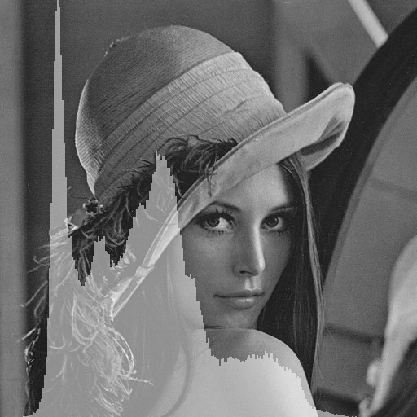
Próba

Slide 11
Kvantálás
Szükséges osztálypéldányok:
Shader* quantizeShader = new Shader("passthrough.vert", "quantize.frag");
Framebuffer* quantizedBuffer = new Framebuffer(texture->getWidth(), texture->getHeight(), 1);

Slide 12
Kvantálás
int levels = 16;
// TODO
//
// render target := quantizedBuffer
// quantizeShader shader parameters:
// inputBuffer := texture->getTextureHandle()
// levels := levels
// render fullscreen quad
// disable shader
// disable render target
void quantizeAndHistogram(){
// ----------- Your code ----------------
// --------------------------------------
...
}

Slide 13
quantize.frag
#version 130
uniform sampler2D inputBuffer;
uniform int levels;
in vec2 fTexCoord;
out vec4 outColor;
float I (vec2 coord){
vec4 color = texture(inputBuffer, coord);
return(dot(color.rgb, vec3(0.21, 0.39, 0.4)));
}
// TODO
//
// data := I(sample_position)
// bin := nearest_histogram_bin(data)
// outColor := bin
void main(){
}

Slide 14
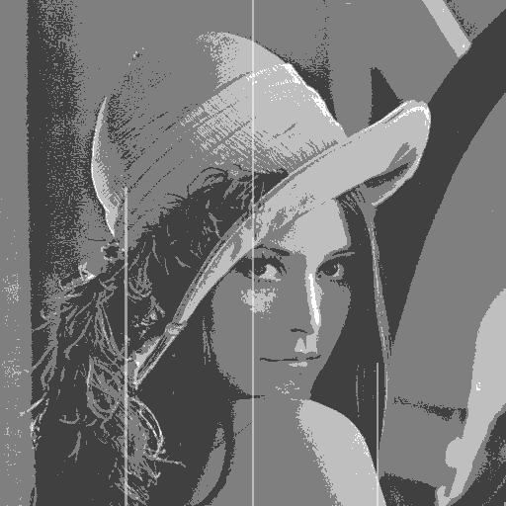
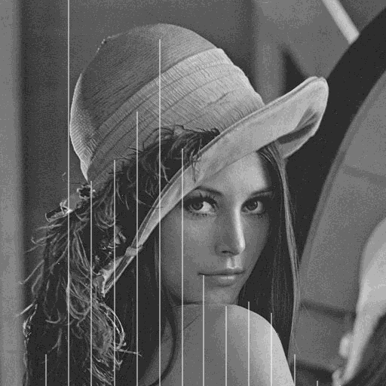
Próba

Slide 15
Hisztogram kiegyenlítés
Szükséges osztálypéldányok:
Framebuffer* U_histogramBuffer = NULL;
Framebuffer* U_cumulatedHistogramBuffer[2] = {NULL};
Framebuffer* U_equalizedBuffer = NULL;
Shader* computeHistogram = NULL;
Shader* computeCumulativeHistogram = NULL;
Shader* computeEqualizedHistogram = NULL;
Shader* histogramShader = NULL;
Shader* visualizeShader = NULL;
const int histogramLevels = 256;

Slide 16
Hisztogram kiegyenlítés
// TODO
//
// Generate histogram:
// histogramBuffer->clear
//
// Setup the blending stage
// glEnable(GL_BLEND)
// glBlendEquation(GL_FUNC_ADD)
// glBlendFunc(GL_ONE, GL_ONE)
//
// render target := histogramBuffer
// histogramShader parameters:
// inputBuffer := texture->getTextureHandle()
// incr := 1.0
// histogramLevels := histogramLevels
// grid->render
// disable histogramShader
// disable histogramBuffer
// glDisable(GL_BLEND);
void histogramEqualization(){
...
}

Slide 17
Hisztogram kiegyenlítés
// TODO
//
// Compute cumulative histogram
//
// offset := 1 / histogramLevels
// LOOP I = 0 .. log2(histogramLevels):
// render target := U_cumulatedHistogramBuffer[(inputBuffer + 1) % 2]
// computeCumulativeHistogram shader parameters:
// inputMap := (I == 0) ? U_histogramBuffer->getColorBuffer(0) :
// U_cumulatedHistogramBuffer[inputBuffer]->getColorBuffer(0)
// offset := -offset
// render fullscreenQuad
// disable shader
// disable render target
// inputBuffer = (inputBuffer + 1) % 2;
// offset := 2 * offset
void histogramEqualization(){
...
}

Slide 18
Hisztogram kiegyenlítés
// TODO
//
// Histogram equalization
//
// clear U_equalizedBuffer
// render target := U_equalizedBuffer
// computeEqualizedHistogram shader parameters:
// inputMap := texture->getTextureHandle()
// histogram := U_cumulatedHistogramBuffer[inputBuffer]->getColorBuffer(0)
// level := (texture->getWidth() * texture->getHeight() / (histogramLevels / 8))
// numLevel := histogramLevels / 8
// render fullscreen quad
// disable shader
// disable render target
void histogramEqualization(){
...
}

Slide 19
computeCumulativeHistogram.frag
#version 130
uniform sampler2D inputMap;
uniform float offset;
in vec2 fTexCoord;
out vec4 outColor;
// TODO
//
// outColor = texture(samplePos) + texture(samplePos + offset)
void main(void){
}

Slide 20
computeCumulativeHistogram.frag
#version 130
uniform sampler2D inputMap;
uniform sampler2D histogram;
in vec2 fTexCoord;
out vec4 outColor;
float I (vec2 coord){
vec4 color = texture(inputMap, coord);
return(dot(color.rgb, vec3(0.21, 0.39, 0.4)));
}
void main(void){
vec2 size = textureSize(inputMap, 0);
float current = I(fTexCoord);
float accum = texture(histogram, vec2(current, 0.0)).x;
float bin = accum / size.x / size.y;
outColor = vec4(bin) ;
}

Slide 21
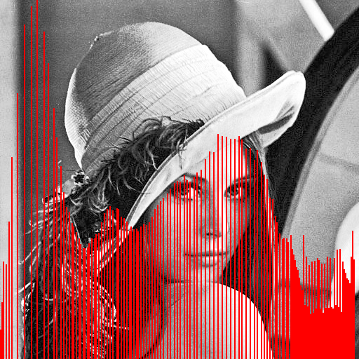
Próba

Slide 22
Summed Area Table
Szükséges osztálypéldányok:
Shader* satXShader;
Shader* satYShader;
Shader* satVisShader;
Framebuffer* satBuffer[2];

Slide 23
Summed Area Table
// TODO
//
// offset := 1 / texture->getWidth()
// passes := ceil(log(texture->getWidth)/log(2.0))
// LOOP I = 0 .. passes:
// SatXPass
// SatYPass
// offset := 2 * offset
//
// SatXPass:
// render target := satBuffer[(inputBuffer + 1) % 2 ]
// satXShader shader parameters:
// inputMap := (I == 0) ? texture->getTextureHandle() :
// satBuffer[inputBuffer]->getColorBuffer(0)
// offset := -offset
// render fullscreen quad
// disable shader
// disable render target
// inputBuffer := (inputBuffer + 1) % 2
void sat(){
...
}

Slide 24
satx.frag
#version 130
uniform sampler2D inputMap;
uniform float offset;
in vec2 fTexCoord;
out vec4 outColor;
// TODO
//
// outColor = texture(samplePos) + texture(samplePos + offset)
void main(void){
}

Slide 25
saty.frag
#version 130
uniform sampler2D inputMap;
uniform float offset;
in vec2 fTexCoord;
out vec4 outColor;
// TODO
//
// outColor = texture(samplePos) + texture(samplePos + offset)
void main(void){
}

Slide 26
Tone Mapping
Szükséges osztálypéldányok:
Texture2D* hdrTexture;
Framebuffer* satHDRBuffer[2] = {NULL, NULL};
Framebuffer* hdrLumBuffer = NULL;
Framebuffer* hdrRelLumBuffer = NULL;
Shader* hdrLuminanceShader = NULL;
Shader* hdrSatXShader = NULL;
Shader* hdrSatYShader = NULL;
Shader* hdrRelLumShader = NULL;
Shader* hdrToneMapShader = NULL;
float W = 0.9f;
float alpha = 0.5f;

Slide 27
Tone Mapping
satHDRBuffer[0] = new Framebuffer(hdrTexture->getWidth(), hdrTexture->getHeight(), 1);
satHDRBuffer[1] = new Framebuffer(hdrTexture->getWidth(), hdrTexture->getHeight(), 1);
hdrLumBuffer = new Framebuffer(hdrTexture->getWidth(), hdrTexture->getHeight(), 1);
hdrRelLumBuffer = new Framebuffer(hdrTexture->getWidth(), hdrTexture->getHeight(), 1);
hdrSatXShader = new Shader("passthrough.vert", "satx.frag");
hdrSatYShader = new Shader("passthrough.vert", "saty.frag");
hdrToneMapShader = new Shader("passthrough.vert", "tonemap.frag");
hdrLuminanceShader = new Shader("passthrough.vert", "luminance.frag");
hdrRelLumShader = new Shader("passthrough.vert", "rellum.frag");
hdrTexture = new Texture2D();
hdrTexture->loadFromFile(std::string("free_005.hdr"));

Slide 28
Tone Mapping
void toneMap(){
// generate luminance
hdrLumBuffer->clear();
hdrLumBuffer->setRenderTarget();
hdrLuminanceShader->enable();
hdrLuminanceShader->bindUniformTexture("hdr", hdrTexture->getTextureHandle(), 0);
fullscreenQuad->render(hdrLuminanceShader);
hdrLuminanceShader->disable();
hdrLumBuffer->disableRenderTarget();

Slide 29
Tone Mapping
// generate SAT
float offset = 1.0f / (float)hdrTexture->getWidth();
int passes = ceil(log(hdrTexture->getWidth()) / log(2));
int inputBuffer = 0;
for(int i = 0; i < passes; ++i){
satHDRBuffer[(inputBuffer + 1) % 2 ]->setRenderTarget();
hdrSatXShader->enable();
hdrSatXShader->bindUniformTexture("inputMap", i == 0 ? hdrLumBuffer->getColorBuffer(0) : satHDRBuffer[inputBuffer]->getColorBuffer(0), 0);
hdrSatXShader->bindUniformFloat("offset", -offset);
fullscreenQuad->render(hdrSatXShader);
hdrSatXShader->disable();
satHDRBuffer[(inputBuffer + 1) % 2 ]->disableRenderTarget();
inputBuffer = (inputBuffer + 1) % 2;
satHDRBuffer[(inputBuffer + 1) % 2 ]->setRenderTarget();
hdrSatYShader->enable();
hdrSatYShader->bindUniformTexture("inputMap", satHDRBuffer[inputBuffer]->getColorBuffer(0), 0);
hdrSatYShader->bindUniformFloat("offset", -offset);
fullscreenQuad->render(hdrSatYShader);
hdrSatYShader->disable();
satHDRBuffer[(inputBuffer + 1) % 2 ]->disableRenderTarget();
inputBuffer = (inputBuffer + 1) % 2;
offset *= 2.0f;
}

Slide 30
Tone Mapping
hdrRelLumBuffer->clear();
hdrRelLumBuffer->setRenderTarget();
hdrRelLumShader->enable();
hdrRelLumShader->bindUniformTexture("luminanceMap", hdrLumBuffer->getColorBuffer(0), 0);
hdrRelLumShader->bindUniformTexture("sat", satHDRBuffer[inputBuffer]->getColorBuffer(0), 1);
hdrRelLumShader->bindUniformFloat("alpha", alpha);
fullscreenQuad->render(hdrRelLumShader);
hdrRelLumShader->disable();
hdrRelLumBuffer->disableRenderTarget();

Slide 31
Tone Mapping
hdrToneMapShader->enable();
hdrToneMapShader->bindUniformTexture("hdr", hdrTexture->getTextureHandle(), 0);
hdrToneMapShader->bindUniformTexture("rellum", hdrRelLumBuffer->getColorBuffer(0), 1);
hdrToneMapShader->bindUniformFloat("W", W);
fullscreenQuad->render(hdrToneMapShader);
hdrToneMapShader->disable();}

Slide 32
luminance.frag
#version 130
uniform sampler2D hdr;
in vec2 fTexCoord;
out vec4 outColor;
void main(void){
vec4 color = texture(hdr, fTexCoord);
outColor = vec4(color.r * 0.2126, color.g * 0.7152, color.b * 0.0722, 1.0);
}

Slide 33
satX.frag
#version 130
uniform sampler2D inputMap;
uniform float offset;
in vec2 fTexCoord;
out vec4 outColor;
void main(void){
float c = texture(inputMap, fTexCoord).r;
vec2 sampleOff = fTexCoord + vec2(offset, 0);
float addValue = 0.0f;
if(sampleOff.x >= 0.0){
addValue = texture(inputMap, sampleOff).r;
}
outColor = vec4(c + addValue);
}

Slide 34
satY.frag
#version 130
uniform sampler2D inputMap;
uniform float offset;
in vec2 fTexCoord;
out vec4 outColor;
void main(void){
float c = texture(inputMap, fTexCoord).r;
vec2 sampleOff = fTexCoord + vec2(0.0, offset);
float addValue = 0.0f;
if(sampleOff.y >= 0.0){
addValue = texture(inputMap, sampleOff).r;
}
outColor = vec4(c + addValue);
}

Slide 35
rellum.frag
#version 130
uniform sampler2D luminanceMap;
uniform sampler2D sat;
uniform float alpha;
in vec2 fTexCoord;
out vec4 outColor;
void main(void){
vec2 mapSize = textureSize(sat, 0);
float avg = texture(sat, vec2(1.0, 1.0)).r / mapSize.x / mapSize.y;
outColor = alpha * texture(luminanceMap, fTexCoord) / avg;
}

Slide 36
tonemap.frag
#version 130
uniform sampler2D hdr;
uniform sampler2D rellum;
uniform float W;
in vec2 fTexCoord;
out vec4 outColor;
void main(void){
float Yr = texture(rellum, fTexCoord).x / 320000;
vec4 hdrColor = texture(hdr, fTexCoord);
outColor = hdrColor * ( Yr * ( 1 + Yr / W / W) / (1 + Yr) );
}

Slide 37
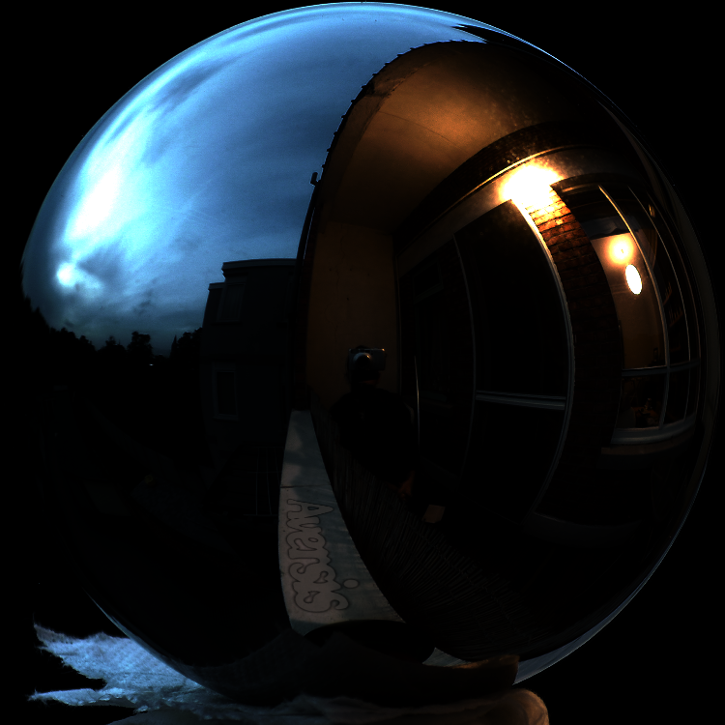
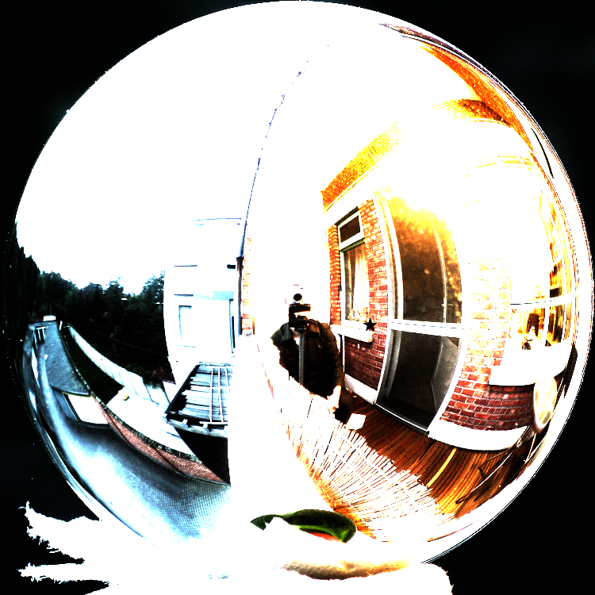
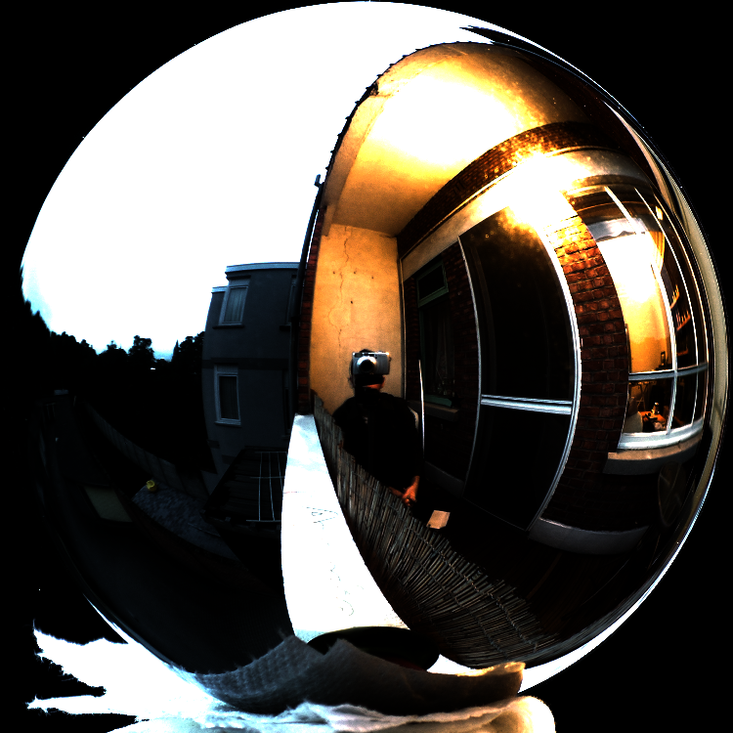
Próba

Slide 38
VÉGE

