Slide 1
GPGPU labor VI.
Rekurzív algoritmusok
labirintus

Slide 2
Kezdeti teendők
Tantárgy honlapja, rekurzív algoritmusok
A labor kiindulási alapjának letöltése (lab6_base.zip), kitömörítés a D:\GPGPU\ könyvtárba
D:\GPGPU\labs\lab6_glsl\lab6_glsl\lab6_glsl.sln indítása
Project tulajdonságai – Configuration Properties – Debugging – Working Directory = $(ProjectDir)\..\..\bin

Slide 3
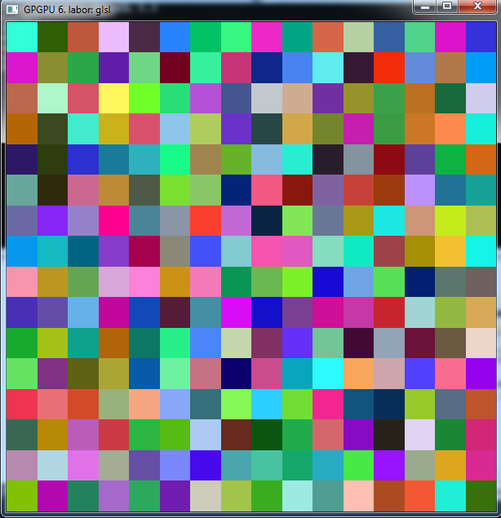
Próba

Slide 4
Adat buffer
Globális
Framebuffer* dataBuffer;
Shader* generateShader;
int labyrinthSize = 64;
bool recalcLabyrinth = true;
float noiseSeed = (float) rand() / (float) RAND_MAX;
float noiseStart = 0.5;
float noiseScale = 0.5;
Init
dataBuffer = new Framebuffer(labyrinthSize, labyrinthSize, 2, true, false);
generateShader = new Shader("passthrough.vert", "generate.frag");
glutReshapeWindow(labyrinthSize * windowScale,
labyrinthSize * windowScale);

Slide 5
Display
glClearColor(0.17f, 0.4f, 0.6f, 1.0f);
glClear(GL_COLOR_BUFFER_BIT | GL_DEPTH_BUFFER_BIT);
if(recalcLabyrinth){
int level = dataBuffer->getLevels() - 1;
dataBuffer->setRenderTarget(level);
GLenum ca = GL_COLOR_ATTACHMENT0; glDrawBuffers(1, &ca);
glClearColor(1,0,1,0); glClear(GL_COLOR_BUFFER_BIT);
ca = GL_COLOR_ATTACHMENT1; glDrawBuffers(1, &ca);
glClearColor(0.5,0.5,0.5,0.5); glClear(GL_COLOR_BUFFER_BIT);
float scale = noiseStart;
for(level = level - 1; level >= 0; level--){
dataBuffer->setRenderTarget(level);
generateShader->enable();
generateShader->bindUniformInt("level", level);
generateShader->bindUniformFloat("noiseScale", scale);
generateShader->bindUniformFloat("noiseSeed", noiseSeed * 16.0);
generateShader->bindUniformTexture("inputTex1", dataBuffer->getColorBuffer(0),0);
generateShader->bindUniformTexture("inputTex2", dataBuffer->getColorBuffer(1),1);
generateShader->bindUniformTexture("noiseTex", noiseTexture->getTextureHandle(),2);
fullscreenQuad->render(generateShader);
generateShader->disable();
scale *= noiseScale;
}
dataBuffer->disableRenderTarget();
recalcLabyrinth = false;
}

Slide 6
Display folyt:
glViewport(0,0,windowWidth, windowHeight);
simpleShader->enable();
simpleShader->bindUniformTexture("inputTex", dataBuffer->getColorBuffer(1),0);
fullscreenQuad->render(simpleShader);
simpleShader->disable();
glutSwapBuffers();

Slide 7
Keyboard
case 'q':
noiseScale *= 1.01;
recalcLabyrinth = true;
std::cout<<"noiseScale: "<<noiseScale<<" noiseScaleStart: "<<noiseStart<<std::endl;
break;
case 'a':
noiseScale *= 0.99;
recalcLabyrinth = true;
std::cout<<"noiseScale: "<<noiseScale<<" noiseScaleStart: "<<noiseStart<<std::endl;
break;
case 'w':
noiseStart *= 1.01;
recalcLabyrinth = true;
std::cout<<"noiseScale: "<<noiseScale<<" noiseScaleStart: "<<noiseStart<<std::endl;
break;
case 's':
noiseStart *= 0.99;
recalcLabyrinth = true;
std::cout<<"noiseScale: "<<noiseScale<<" noiseScaleStart: "<<noiseStart<<std::endl;
break;

Slide 8
generate.frag
#version 130
out vec4 outcolor[2];
in vec2 fTexCoord;
uniform sampler2D inputTex1;
uniform sampler2D inputTex2;
uniform sampler2D noiseTex;
uniform int level;
uniform float noiseScale;
uniform float noiseSeed;
void main()
{
ivec2 coord = ivec2(gl_FragCoord.xy);
vec4 R = textureLod(inputTex2, fTexCoord, level + 1);
vec4 rand = texelFetch(noiseTex, ivec2(mod(coord + ivec2(noiseSeed, 0), ivec2(16))), 0);
outcolor[1] = R + noiseScale * (rand - 0.5);
}

Slide 9
Próba

Slide 10
Generate.frag
outcolor[1] = R + noiseScale * (rand - 0.5);
ivec2 coordBase = coord / 2;
ivec2 coordRel = ivec2(mod(vec2(coord), vec2(2)));
int index = coordRel.x + coordRel.y * 2;
vec4 V;
vec4 P = texelFetch(inputTex1, coordBase, level + 1);
V = P; //szülő cella öröklése
outcolor[0] = V;

Slide 11
Display:
simpleShader->bindUniformTexture("inputTex", dataBuffer->getColorBuffer(1),0);
helyett
simpleShader->bindUniformTexture("inputTex", dataBuffer->getColorBuffer(0),0);

Slide 12
Próba
Nem elég informatív!!

Slide 13
Labirintus vizualizációja
Globális
Shader* visualizeShader;
Framebuffer* visualizeTex;
Init:
visualizeTex = new Framebuffer(
dataBuffer->getWidth() * 2 + 1,
dataBuffer->getHeight() * 2 + 1,
1,
false,
false);
visualizeShader = new Shader("passthrough.vert", "visualize.frag");

Slide 14
Display
visualizeTex->setRenderTarget();
visualizeShader->enable();
visualizeShader->bindUniformTexture("inputTex",dataBuffer->getColorBuffer(0),0);
fullscreenQuad->render(visualizeShader);
visualizeShader->disable();
visualizeTex->disableRenderTarget();
glViewport(0,0,windowWidth, windowHeight);
simpleShader->enable();
simpleShader->bindUniformTexture("inputTex", visualizeTex
->getColorBuffer(0),0);
fullscreenQuad->render(simpleShader);
simpleShader->disable();
glutSwapBuffers();

Slide 15
visualize.frag
#version 130
out vec4 outcolor;
in vec2 fTexCoord;
uniform sampler2D inputTex;
void main()
{
outcolor = vec4(0);
ivec2 coord = ivec2(gl_FragCoord.xy);
if(coord.x == 0){
if(texelFetch(inputTex, coord / 2, 0).z == 1 && mod(coord.y, 2) == 1)
outcolor = vec4(1);
}
else if(coord.y == 0){
if(texelFetch(inputTex, coord / 2, 0).w == 1 && mod(coord.x, 2) == 1)
outcolor = vec4(1);
}
else{
coord = coord - ivec2(1);
ivec2 coordBase = coord / 2;
ivec2 coordRel = ivec2(mod(vec2(coord), vec2(2)));
vec4 Vp = texelFetch(inputTex, coordBase, 0);
if(coordRel.x == 0 && coordRel.y == 0)
outcolor = vec4(1);
else if(coordRel.x == 1 && coordRel.y == 0 && Vp.x == 1)
outcolor = vec4(1);
else if(coordRel.x == 0 && coordRel.y == 1 && Vp.y == 1)
outcolor = vec4(1);
}
}

Slide 16
Próba

Slide 17
Csak az átjárók felét tartsuk meg! generate.frag
vec4 M[4] = vec4[4](vec4(1,1,0,0),
vec4(0,1,1,0),
vec4(1,0,0,1),
vec4(0,0,1,1));
vec4 D[4] = vec4[4](vec4(1,1,0,1),
vec4(0,1,1,0),
vec4(1,1,1,1),
vec4(1,0,1,1));
vec4 inv(vec4 v){return vec4(1.0) - v;}
vec4 uni(vec4 v1, vec4 v2){ return min(vec4(1.0), v1 + v2);}

Slide 18
generate.frag
V = P
helyett
V = P * D[index];

Slide 19
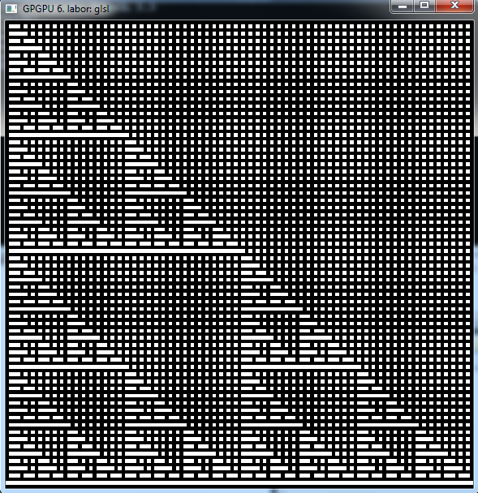
Próba

Slide 20
Belső falakat tüntessük el! generate.frag
V = P * D[index];
V = uni(V, M[index]);

Slide 21
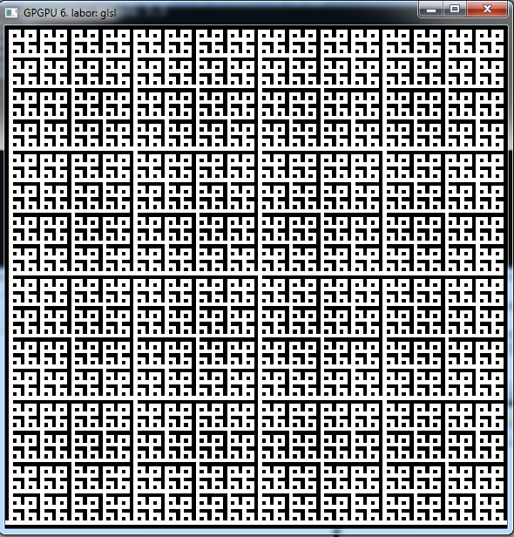
Próba

Slide 22
Cella felosztás generate.frag
vec4 W1; // fuggoleges v. vizszintes
vec4 W2; // bal/lenn - jobb/fenn
if(R.x < 0.25){ // right
W1 = vec4(1,0,1,0);
W2 = vec4(M[index].x == 1);
}
else if(R.x < 0.5) { // top
W1 = vec4(0,1,0,1);
W2 = vec4(M[index].y == 1);
}
else if(R.x < 0.75){ // left
W1 = vec4(1,0,1,0);
W2 = vec4(M[index].z == 1);
}
else{ // bottom
W1 = vec4(0,1,0,1);
W2 = vec4(M[index].w == 1);
}
V = V * uni(uni(W1, W2), inv(M[index]));

Slide 23
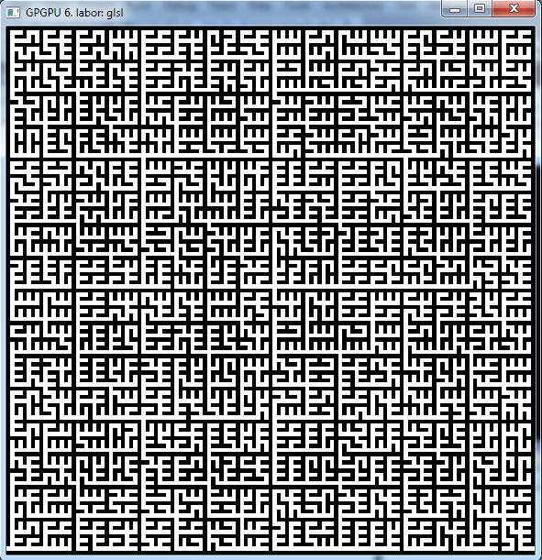
Próba
Labirintus kész!

Slide 24
Legrövidebb út keresés
Globális
Shader* searchShader;
Framebuffer* shortestPath;
GLuint streamoutBufffer[2];
GLuint outputQuery;
bool startPointChanged = true;
bool endpointChanged = true;
float startX = 0;
float startY = labyrinthSize -1;
float endX = labyrinthSize - 1;
float endY = labyrinthSize - 1;

Slide 25
Init
shortestPath = new Framebuffer(labyrinthSize, labyrinthSize, 1, false, true);
glGenBuffers(2,streamoutBufffer);
glBindBuffer(GL_ARRAY_BUFFER_ARB,streamoutBufffer[0]);
glBufferData(GL_ARRAY_BUFFER_ARB, labyrinthSize*labyrinthSize*4*sizeof(float)*2,0,GL_DYNAMIC_DRAW);
glBindBuffer(GL_ARRAY_BUFFER_ARB,streamoutBufffer[1]);
glBufferData(GL_ARRAY_BUFFER_ARB, labyrinthSize*labyrinthSize*4*sizeof(float)*2,0,GL_DYNAMIC_DRAW);
searchShader = new Shader("search.vert", "search.frag", "search.geom");
glGenQueries(1, &outputQuery);

Slide 26
void recursion( float startX, float startY, float startZ, float startW)
{
glBindBufferBase(GL_TRANSFORM_FEEDBACK_BUFFER,0,streamoutBufffer[0]);
glBeginTransformFeedback(GL_POINTS);
glBeginQuery(GL_TRANSFORM_FEEDBACK_PRIMITIVES_WRITTEN, outputQuery);
glPointSize(1);
glBegin(GL_POINTS);
glVertex4f(startX, startY, startZ, startW);
glEnd();
glEndQuery(GL_TRANSFORM_FEEDBACK_PRIMITIVES_WRITTEN);
glEndTransformFeedback();
GLint outPointCount = 0;
GLint succ = 0;
while(!succ)
glGetQueryObjectiv(outputQuery, GL_QUERY_RESULT_AVAILABLE, &succ);
glGetQueryObjectiv(outputQuery, GL_QUERY_RESULT, &outPointCount);
//std::cout << "points written: " << outPointCount << std::endl;
succ = 0;

Slide 27
glEnableClientState(GL_VERTEX_ARRAY);
int bb = 0;
while(outPointCount > 0)
{
glBindBufferBase(GL_TRANSFORM_FEEDBACK_BUFFER,0,streamoutBufffer[(bb+1)%2]);
glBeginTransformFeedback(GL_POINTS);
glBeginQuery(GL_TRANSFORM_FEEDBACK_PRIMITIVES_WRITTEN, outputQuery);
glBindBufferARB(GL_ARRAY_BUFFER_ARB, streamoutBufffer[bb]);
glVertexPointer(4,GL_FLOAT,0,NULL);
glDrawArrays(GL_POINTS, 0, outPointCount);
glEndTransformFeedback();
glEndQuery(GL_TRANSFORM_FEEDBACK_PRIMITIVES_WRITTEN);
while(!succ)
glGetQueryObjectiv(outputQuery, GL_QUERY_RESULT_AVAILABLE, &succ);
glGetQueryObjectiv(outputQuery, GL_QUERY_RESULT, &outPointCount);
succ = 0;
bb = (bb + 1) % 2;
}
glDisableClientState(GL_VERTEX_ARRAY);
}

Slide 28
Display
if(recalcLabyrinth)
{
..
startPointChanged = true;
}
if(startPointChanged)
{
endpointChanged = true;
shortestPath->setRenderTarget();
glClearColor(0,0,0,0);
glClear(GL_COLOR_BUFFER_BIT);
searchShader->enable();
searchShader->bindUniformTexture("inputTex1", dataBuffer->getColorBuffer(0), 0);
searchShader->bindUniformTexture("inputTex2", shortestPath->getColorBuffer(0), 1);
recursion(startX, startY, 0, 5);
searchShader->disable();
shortestPath->disableRenderTarget();
startPointChanged = false;
}
...
simpleShader->bindUniformTexture("inputTex", shortestPath->getColorBuffer(0),0);

Slide 29
Mouse
if(GLUT_LEFT_BUTTON == button && GLUT_UP == state)
{
startX = x/windowScale;
startY = y/windowScale;
startPointChanged = true;
}
else if(GLUT_RIGHT_BUTTON == button && GLUT_UP == state)
{
endX = x/windowScale;
endY = y/windowScale;
endpointChanged = true;
}

Slide 30
simple.frag
void main()
{
outcolor = texture(inputTex, fTexCoord);
outcolor = outcolor.bbbb / 400;
}

Slide 31
search.vert
#version 130
in vec4 position;
//out vec4 celldata;
void main(void)
{
gl_Position = gl_Vertex;
}

Slide 32
search.geom
#version 130
#extension GL_EXT_geometry_shader4 : enable
uniform sampler2D inputTex1; //neighbour information
uniform sampler2D inputTex2; //celldata texture (shortest path + path dir)
out vec4 celldata;
void main(void){
vec2 windowSize = textureSize(inputTex2, 0);
vec4 vertexdata = gl_PositionIn[0];
//read neighbour information
vec4 neighInf = texelFetch(inputTex1, ivec2(vertexdata.xy), 0);
vec4 storedCelldata = texelFetch(inputTex2, ivec2(vertexdata.xy), 0);
if(storedCelldata.z > vertexdata.z || storedCelldata.w == 0){
celldata = vertexdata;
vec2 wCoord = vertexdata.xy / windowSize * 2.0 - 1.0;
gl_Position = vec4(wCoord,0,1);
EmitVertex();
}
...

Slide 33
search.geom
//emit neighbours if connected
//right
if(neighInf.r == 1)
{
celldata = vertexdata;
celldata.x += 1;
celldata.z += 1;
celldata.w = 3;
storedCelldata = texelFetch(inputTex2, ivec2(celldata.xy), 0);
if((storedCelldata.z > celldata.z || storedCelldata.w == 0) && celldata.x < windowSize.x)
{
vec2 wCoord = celldata.xy / windowSize * 2.0 - 1.0;
gl_Position = vec4(wCoord,0,1);
EmitVertex();
}
}
... Többi irányra is
EndPrimitive();
}

Slide 34
search.frag
#version 130
out vec4 outcolor;
in vec4 celldata;
void main()
{
outcolor = celldata;
}

Slide 35
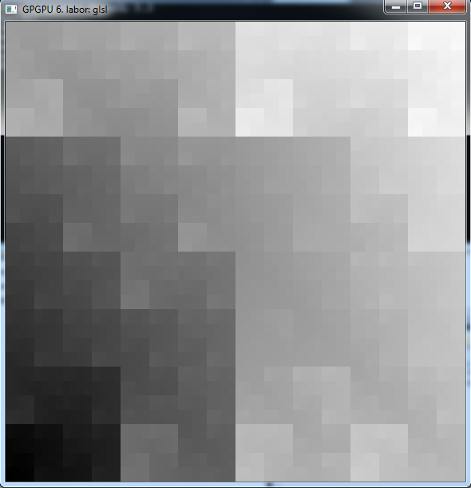
Próba

Slide 36
Bejárás
Globális
Shader* walkPathShader;
Init
walkPathShader =
new Shader("search.vert", "red.frag",
"walkpath.geom");

Slide 37
Bejárás
if(endpointChanged)
{
labyrinthTex->setRenderTarget();
visualizeShader->enable();
visualizeShader->bindUniformTexture("inputTex",buffer->getColorBuffer(0),0);
fullscreenQuad->render(visualizeShader);
visualizeShader->disable();
walkPathShader->enable();
walkPathShader->bindUniformTexture("inputTex1", shortestPath->getColorBuffer(0), 0);

Slide 38
Display
visualizeTex->setRenderTarget();
visualizeShader->enable();
visualizeShader->bindUniformTexture("inputTex",dataBuffer->getColorBuffer(0),0);
fullscreenQuad->render(visualizeShader);
visualizeShader->disable();
visualizeTex->disableRenderTarget();
Helyett....

Slide 39
if(endpointChanged)
{
visualizeTex->setRenderTarget();
visualizeShader->enable();
visualizeShader->bindUniformTexture("inputTex",
dataBuffer->getColorBuffer(0),0);
fullscreenQuad->render(visualizeShader);
visualizeShader->disable();
walkPathShader->enable();
walkPathShader->bindUniformTexture("inputTex1",
shortestPath->getColorBuffer(0), 0);
recursion(endX, endY, 0, 5);
walkPathShader->disable();
...

Slide 40
glBegin(GL_POINTS);
glColor3f(0,0,1);
glVertex3f((float)(startX * 2 + 1) / (float)(2 * labyrinthSize) * 2.0f - 1.0f,
(float)(startY * 2 + 1) / (float)(2 * labyrinthSize) * 2.0f - 1.0f,
0);
glColor3f(0,1,0);
glVertex3f((float)(endX * 2 + 1) / (float)(2 * labyrinthSize) * 2.0f - 1.0f,
(float)(endY * 2 + 1) / (float)(2 * labyrinthSize) * 2.0f - 1.0f,
0);
glEnd();
visualizeTex->disableRenderTarget();
endpointChanged = false;
}

Slide 41
Display
glViewport(0,0,windowWidth, windowHeight);
simpleShader->enable();
simpleShader->bindUniformTexture("inputTex", visualizeTex->getColorBuffer(0),0);
fullscreenQuad->render(simpleShader);
simpleShader->disable();

Slide 42
simple.frag
void main()
{
outcolor = texture(inputTex, fTexCoord);
outcolor = outcolor.bbbb / 400;
}

Slide 43
walkpath.geom
#version 130
#extension GL_EXT_geometry_shader4 : enable
uniform sampler2D inputTex1; //cell information
out vec4 celldata;
void main(void)
{
vec2 windowSize = textureSize(inputTex1, 0);
vec4 vertexdata = gl_PositionIn[0];
vec4 storedCelldata = texelFetch(inputTex1, ivec2(vertexdata.xy), 0);
if(storedCelldata.z == 0)
return;
...

Slide 44
if(storedCelldata.w == 1) // right
{
celldata = vertexdata;
celldata.x += 1;
vec2 wCoord = (celldata.xy * 2 + 1) / (windowSize * 2 + 1) * 2.0 - 1.0;
gl_Position = vec4(wCoord,0,1);
EmitVertex();
}
...többi irányra is
EndPrimitive();
}

Slide 45
red.frag
#version 130
out vec4 outcolor;
in vec4 celldata;
void main()
{
outcolor = vec4(1,0,0,1);
}

Slide 46
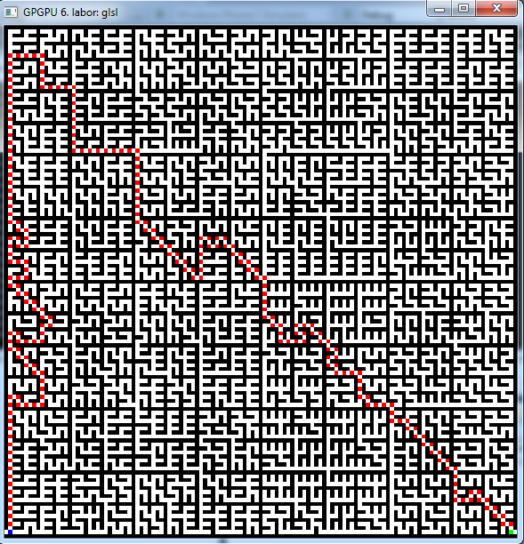
Próba

Slide 47
Vége

