Slide 1
GPGPU labor XIII.
Folyadék szimuláció

Slide 2
Kezdeti teendők
Tantárgy honlapja, Folyadék szimuláció
A labor kiindulási alapjának letöltése (lab13_base.zip), kitömörítés a GPGPU\Labs könyvtárba

Slide 3
Sebesség vektormező létrehozása
Main.cpp, globális:
int inputVelocityBuffer = 0;
cl_mem velocityBuffer[2];
InitSimulation():
// simulation
velocityBuffer[0] = clCreateBuffer(context,
CL_MEM_READ_WRITE,
sizeof(cl_float2) * gridResolution * gridResolution,
NULL, NULL);
velocityBuffer[1] = clCreateBuffer(context,
CL_MEM_READ_WRITE,
sizeof(cl_float2) * gridResolution * gridResolution,
NULL, NULL);
...
// visualization kernels
visualizationVelocityKernel = createKernel(simulationProgram, "visualizationVelocity");

Slide 4
Reset
Globális:
cl_kernel resetSimulationKernel;
initSimulation()
resetSimulationKernel = createKernel(simulationProgram, "resetSimulation");
keyUp():
case 'r':
resetSimulation();
break;

Slide 5
Reset
void resetSimulation()
{
CL_SAFE_CALL( clSetKernelArg(resetSimulationKernel, 0, sizeof(int), &gridResolution) );
CL_SAFE_CALL( clSetKernelArg(resetSimulationKernel, 1, sizeof(cl_mem), &velocityBuffer[inputVelocityBuffer]) );
CL_SAFE_CALL( clEnqueueNDRangeKernel(commands, resetSimulationKernel, 2, NULL, problemSize, NULL, 0, NULL, NULL) );
clFinish(commands);
}

Slide 6
Programs.cl
__kernel
void resetSimulation(const int gridResolution,
__global float2* velocityBuffer)
{
int2 id = (int2)(get_global_id(0), get_global_id(1));
if( id.x < gridResolution && id.y < gridResolution){
velocityBuffer[id.x + id.y * gridResolution] = (float2)(0.0f);
}
}

Slide 7
Kezdeti reset
initSimulation()
{
…
resetSimulation();
}

Slide 8
Jelenítsük meg!
Globális:
cl_kernel visualizationVelocityKernel;
visualizationStep():
CL_SAFE_CALL( clSetKernelArg(visualizationVelocityKernel, 0, sizeof(int), &width) );
CL_SAFE_CALL( clSetKernelArg(visualizationVelocityKernel, 1, sizeof(int), &height) );
CL_SAFE_CALL( clSetKernelArg(visualizationVelocityKernel, 2, sizeof(cl_mem),
&visualizationBufferGPU) );
CL_SAFE_CALL( clSetKernelArg(visualizationVelocityKernel, 3, sizeof(int), &gridResolution) );
CL_SAFE_CALL( clSetKernelArg(visualizationVelocityKernel, 4, sizeof(cl_mem),
&velocityBuffer[inputVelocityBuffer]) );
CL_SAFE_CALL( clEnqueueNDRangeKernel(commands, visualizationVelocityKernel, 2, NULL, visualizationSize, NULL, 0, NULL, NULL) );
clFinish(commands);
//...
//drawing

Slide 9
Programs.cl
// TODO
// MAP velocityBuffer TO visualizationBuffer
// visualizationBuffer[x,y] := (1.0 + velocity) / 2.0
__kernel
void visualizationVelocity(const int width, const int height, __global float4* visualizationBuffer,
const int gridResolution, __global float2* velocityBuffer){
int2 id = (int2)(get_global_id(0), get_global_id(1));
if( id.x < width && id.y < height){
// TODO
}
}

Slide 10
Próba

Slide 11
Erő hozzáadása
void addForce(int x, int y, cl_float2 force){
float fx = (float)x / width;
float fy = (float)y / height;
CL_SAFE_CALL( clSetKernelArg(addForceKernel, 0, sizeof(float), &fx) );
CL_SAFE_CALL( clSetKernelArg(addForceKernel, 1, sizeof(float), &fy) );
CL_SAFE_CALL( clSetKernelArg(addForceKernel, 2, sizeof(cl_float2), &force)) ;
CL_SAFE_CALL( clSetKernelArg(addForceKernel, 3, sizeof(int), &gridResolution) );
CL_SAFE_CALL( clSetKernelArg(addForceKernel, 4, sizeof(cl_mem),
&velocityBuffer[inputVelocityBuffer]) );
CL_SAFE_CALL( clEnqueueNDRangeKernel(commands, addForceKernel,2, NULL,
problemSize, NULL, 0, NULL, NULL) );
clFinish(commands);
}

Slide 12
Erő hozzáadása
Gloabális.
cl_kernel addForceKernel;
initSimulation()
// simulation kernels
addForceKernel = createKernel(simulationProgram, "addForce");

Slide 13
Programs.cl
// TODO
//
// Add force to velocityBuffer
// Add matter to densityBuffer
//
// Example:
// dx := global_id(0) / gridResolution - x
// dy := global_id(1) / gridResolution - y
// radius := 0.001
// c := e^(-(dx^2 + dy^2) / radius) * dt
//
// velocityBuffer[x,y] += c * force
// densityBuffer[x,y] += c * density
__kernel
void addForce(const float x, const float y, const float2 force,
const int gridResolution, __global float2* velocityBuffer,
const float4 density, __global float4* densityBuffer){
int2 id = (int2)(get_global_id(0), get_global_id(1));
// TODO
}

Slide 14
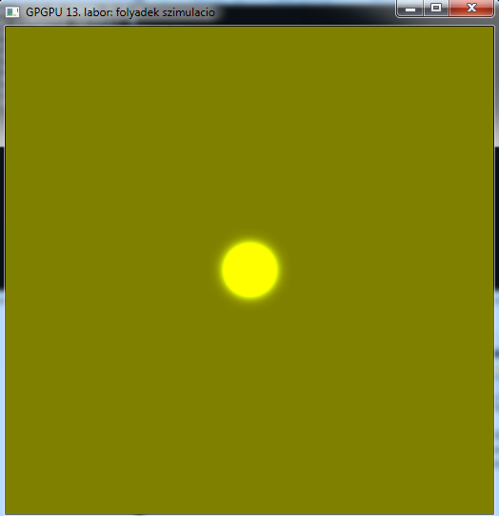
Próba

Slide 15
Advekció
Global:
cl_kernel advectionKernel;
initSimulation():
advectionKernel = createKernel(simulationProgram, "advection");
simulationStep():
simulateAdvection();

Slide 16
Advekció
void simulateAdvection()
{
CL_SAFE_CALL( clSetKernelArg(advectionKernel, 0, sizeof(int), &gridResolution) );
CL_SAFE_CALL( clSetKernelArg(advectionKernel, 1, sizeof(cl_mem), &velocityBuffer[inputVelocityBuffer]) );
CL_SAFE_CALL( clSetKernelArg(advectionKernel, 2, sizeof(cl_mem), &velocityBuffer[(inputVelocityBuffer + 1) % 2]) );
CL_SAFE_CALL( clEnqueueNDRangeKernel(commands, advectionKernel, 2, NULL, problemSize, NULL, 0, NULL, NULL) );
clFinish(commands);
inputVelocityBuffer = (inputVelocityBuffer + 1) % 2;
}

Slide 17
Programs.cl
// TODO
//
// Inner parts:
// velocity := inputVelocityBuffer[x,y]
// p := id.xy - velocity.xy * dt
// outputVelocity[x,y] = getBil(p, gridResolution, inputVelocityBuffer)
//
// Border:
// outputVelocity = -inputVelocity (nearest neighbour)
__kernel
void advection(const int gridResolution,
__global float2* inputVelocityBuffer,
__global float2* outputVelocityBuffer){
int2 id = (int2)(get_global_id(0), get_global_id(1));
// TODO
}

Slide 18
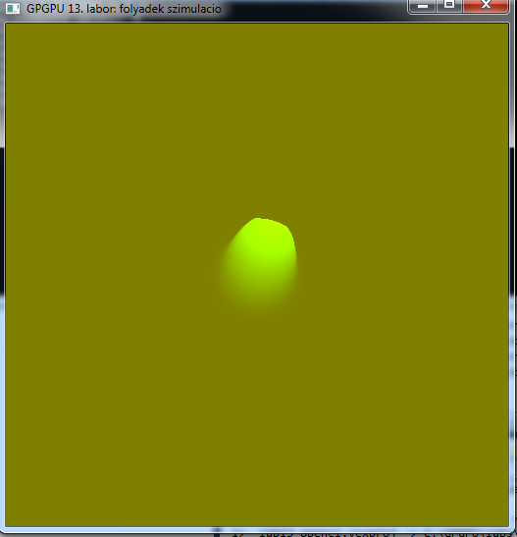
Próba

Slide 19
Diffúzió
void simulateDiffusion(){
for(int i = 0; i < 10; ++i){
CL_SAFE_CALL( clSetKernelArg(diffusionKernel, 0, sizeof(int), &gridResolution) );
CL_SAFE_CALL( clSetKernelArg(diffusionKernel, 1, sizeof(cl_mem), &velocityBuffer[inputVelocityBuffer]) );
CL_SAFE_CALL( clSetKernelArg(diffusionKernel, 2, sizeof(cl_mem), &velocityBuffer[(inputVelocityBuffer + 1) % 2]) );
CL_SAFE_CALL( clEnqueueNDRangeKernel(cl.cqueue(), diffusionKernel,
2, NULL, problemSize, NULL,
0, NULL, NULL) );
clFinish(cl.cqueue());
inputVelocityBuffer = (inputVelocityBuffer + 1) % 2;
}
}

Slide 20
Diffúzió
// TODO
//
// Inner parts:
// alpha := 1.0 / (viscousity * dt)
// beta := 1.0 / (4.0 + alpha)
//
// vL := inputVelocityBuffer[x - 1, y]
// vR := inputVelocityBuffer[x + 1, y]
// vB := inputVelocityBuffer[x, y - 1]
// vT := inputVelocityBuffer[x, y + 1]
//
// velocity := inputVelocityBuffer[x,y]
//
// outputVelocityBuffer[x,y] := (vL + vR + vB + vT + alpha * velocity) * beta
//
// Border:
// outputVelocityBuffer[x,y] := inputVelocityBuffer[x,y]
__kernel
void diffusion(const int gridResolution,
__global float2* inputVelocityBuffer,
__global float2* outputVelocityBuffer){
int2 id = (int2)(get_global_id(0), get_global_id(1));
// TODO
}

Slide 21
Divergencia, nyomás, projekció
Global:
int inputPressureBuffer = 0;
cl_mem pressureBuffer[2];
cl_mem divergenceBuffer;
cl_kernel divergenceKernel;
cl_kernel pressureJacobiKernel;
cl_kernel projectionKernel;
initSimulation():
pressureBuffer[0] = clCreateBuffer(context, CL_MEM_READ_WRITE, sizeof(float) * gridResolution * gridResolution, NULL, NULL);
pressureBuffer[1] = clCreateBuffer(context, CL_MEM_READ_WRITE, sizeof(float) * gridResolution * gridResolution, NULL, NULL);
divergenceBuffer = clCreateBuffer(context, CL_MEM_READ_WRITE, sizeof(float) * gridResolution * gridResolution, NULL, NULL);
divergenceKernel = createKernel(simulationProgram, "divergence");
pressureJacobiKernel = createKernel(simulationProgram, "pressureJacobi");
projectionKernel = createKernel(simulationProgram, "projection");

Slide 22
Nyomás-reset
resetSimulation():
CL_SAFE_CALL( clSetKernelArg(resetSimulationKernel, 2, sizeof(cl_mem), &pressureBuffer[inputPressureBuffer]) );
Reset kernel:
void resetSimulation(const int gridResolution,
__global float2* velocityBuffer,
__global float* pressureBuffer)
{
...
pressureBuffer[id.x + id.y * gridResolution] = 0.0f;
...

Slide 23
nyomás - reset
void resetPressure(){
CL_SAFE_CALL( clSetKernelArg(resetSimulationKernel, 0, sizeof(int), &gridResolution) );
CL_SAFE_CALL( clSetKernelArg(resetSimulationKernel, 1, sizeof(cl_mem), &velocityBuffer[(inputVelocityBuffer+1)%2]) );
CL_SAFE_CALL( clSetKernelArg(resetSimulationKernel, 2, sizeof(cl_mem), &pressureBuffer[inputPressureBuffer]) );
CL_SAFE_CALL( clEnqueueNDRangeKernel(commands, resetSimulationKernel, 2, NULL,problemSize, NULL,0, NULL, NULL) );
clFinish(commands);
}

Slide 24
Projekció
void simulationStep()
{
simulateAdvection();
projection();
}

Slide 25
Projekció- divergencia
void projection(){
CL_SAFE_CALL( clSetKernelArg(divergenceKernel, 0, sizeof(int), &gridResolution) );
CL_SAFE_CALL( clSetKernelArg(divergenceKernel, 1, sizeof(cl_mem), &velocityBuffer[inputVelocityBuffer]) );
CL_SAFE_CALL( clSetKernelArg(divergenceKernel, 2, sizeof(cl_mem), &divergenceBuffer) );
CL_SAFE_CALL( clEnqueueNDRangeKernel(commands, divergenceKernel,
2, NULL, problemSize, NULL,
0, NULL, NULL) );
clFinish(commands);
resetPressure();
...

Slide 26
Projekció- Jacobi iteráció
for(int i = 0; i < 10; ++i){
CL_SAFE_CALL( clSetKernelArg(pressureJacobiKernel, 0, sizeof(int), &gridResolution) );
CL_SAFE_CALL( clSetKernelArg(pressureJacobiKernel, 1, sizeof(cl_mem), &pressureBuffer[inputPressureBuffer]) );
CL_SAFE_CALL( clSetKernelArg(pressureJacobiKernel, 2, sizeof(cl_mem), &pressureBuffer[(inputPressureBuffer + 1) % 2]) );
CL_SAFE_CALL( clSetKernelArg(pressureJacobiKernel, 3, sizeof(cl_mem), &divergenceBuffer) );
CL_SAFE_CALL( clEnqueueNDRangeKernel(commands, pressureJacobiKernel,
2, NULL, problemSize, NULL,
0, NULL, NULL) );
clFinish(commands);
inputPressureBuffer = (inputPressureBuffer + 1) % 2;
}
...

Slide 27
Projekció
CL_SAFE_CALL( clSetKernelArg(projectionKernel, 0, sizeof(int), &gridResolution) );
CL_SAFE_CALL( clSetKernelArg(projectionKernel, 1, sizeof(cl_mem), &velocityBuffer[inputVelocityBuffer]) );
CL_SAFE_CALL( clSetKernelArg(projectionKernel, 2, sizeof(cl_mem), &pressureBuffer[inputPressureBuffer]) );
CL_SAFE_CALL( clSetKernelArg(projectionKernel, 3, sizeof(cl_mem), &velocityBuffer[(inputVelocityBuffer + 1) % 2]) );
CL_SAFE_CALL( clEnqueueNDRangeKernel(commands, projectionKernel,
2, NULL, problemSize, NULL,
0, NULL, NULL) );
clFinish(commands);
inputVelocityBuffer = (inputVelocityBuffer + 1) % 2;
}

Slide 28
Programs.cl
// TODO
//
// Inner parts:
// vL := velocityBuffer[x - 1, y]
// vR := velocityBuffer[x + 1, y]
// vB := velocityBuffer[x, y - 1]
// vT := velocityBuffer[x, y + 1]
// divergenceBuffer[x,y] := 0.5 * ((vR.x - vL.x) + (vT.y - vB.y))
//
// Border:
// divergenceBuffer[x,y] := 0.0
__kernel
void divergence(const int gridResolution, __global float2* velocityBuffer,
__global float* divergenceBuffer){
int2 id = (int2)(get_global_id(0), get_global_id(1));
// TODO
}

Slide 29
Programs.cl
// TODO
//
// Inner parts:
// alpha := -1.0
// beta := 0.25
// vL := inputPressureBuffer[x - 1, y]
// vR := inputPressureBuffer[x + 1, y]
// vB := inputPressureBuffer[x, y - 1]
// vT := inputPressureBuffer[x, y + 1]
// divergence := divergenceBuffer[x,y]
//
// ouputPressure := (vL + vR + vB + vT + divergence * alpha) * beta
//
// Border:
// ouputPressure[x,y] = inputPressureBuffer (nearest neighbour)
__kernel
void pressureJacobi(const int gridResolution,
__global float* inputPressureBuffer,
__global float* outputPressureBuffer,
__global float* divergenceBuffer){
int2 id = (int2)(get_global_id(0), get_global_id(1));
// TODO
}

Slide 30
Programs.cl
// TODO
//
// Inner parts:
// pL := pressureBuffer[x - 1, y]
// pR := pressureBuffer[x + 1, y]
// pB := pressureBuffer[x, y - 1]
// pT := pressureBuffer[x, y + 1]
// velocity := inputVelocityBuffer[x,y]
//
// outputVelocity[x,y] = velocity - (pR - pL, pT - pB)
//
// Border:
// outputVelocity = -inputVelocity (nearest neighbour)
__kernel
void projection(const int gridResolution,
__global float2* inputVelocityBuffer,
__global float* pressureBuffer,
__global float2* outputVelocityBuffer){
int2 id = (int2)(get_global_id(0), get_global_id(1));
// TODO
}

Slide 31
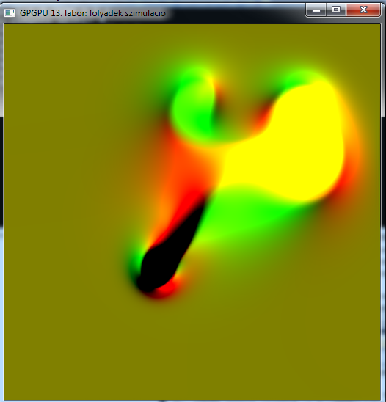
Próba

Slide 32
Denzitás
Globális
int inputDensityBuffer = 0;
cl_mem densityBuffer[2];
cl_float4 densityColor = {1,0,1,1};
cl_kernel advectionDensityKernel;
cl_kernel visualizationDensityKernel;
initSimulation()
densityBuffer[0] = clCreateBuffer(context, CL_MEM_READ_WRITE, sizeof(cl_float4) * gridResolution * gridResolution, NULL, NULL);
densityBuffer[1] = clCreateBuffer(context, CL_MEM_READ_WRITE, sizeof(cl_float4) * gridResolution * gridResolution, NULL, NULL);
advectionDensityKernel = createKernel(simulationProgram, "advectionDensity");
visualizationDensityKernel = createKernel(simulationProgram, "visualizationDensity");

Slide 33
Reset
resetSimulation()
CL_SAFE_CALL( clSetKernelArg(resetSimulationKernel, 3, sizeof(cl_mem), &densityBuffer[inputDensityBuffer]) );
resetPressure():
CL_SAFE_CALL( clSetKernelArg(resetSimulationKernel, 3, sizeof(cl_mem), &densityBuffer[(inputDensityBuffer+1)%2]) );
Reset kernel:
...
__global float4* densityBuffer
...
densityBuffer[id.x + id.y * gridResolution] = (float4)(0.0f);

Slide 34
Anyag hozzáadása
void addForce(int x, int y, cl_float2 force):
...
CL_SAFE_CALL( clSetKernelArg(addForceKernel, 5, sizeof(cl_float4), &densityColor) );
CL_SAFE_CALL( clSetKernelArg(addForceKernel, 6, sizeof(cl_mem), &densityBuffer[inputDensityBuffer]) );
addForce kernel:
const float4 density, __global float4* densityBuffer
...
densityBuffer[id.x + id.y * gridResolution] += c * density;

Slide 35
Denzitás advekció
simulation Step():
projection()
simulateDensityAdvection();
void simulateDensityAdvection()
{
CL_SAFE_CALL( clSetKernelArg(advectionDensityKernel, 0, sizeof(int), &gridResolution) );
CL_SAFE_CALL( clSetKernelArg(advectionDensityKernel, 1, sizeof(cl_mem), &velocityBuffer[inputVelocityBuffer]) );
CL_SAFE_CALL( clSetKernelArg(advectionDensityKernel, 2, sizeof(cl_mem), &densityBuffer[inputDensityBuffer]) );
CL_SAFE_CALL( clSetKernelArg(advectionDensityKernel, 3, sizeof(cl_mem), &densityBuffer[(inputDensityBuffer + 1) % 2]) );
CL_SAFE_CALL( clEnqueueNDRangeKernel(commands, advectionDensityKernel, 2, NULL, problemSize, NULL, 0, NULL, NULL) );
clFinish(commands);
inputDensityBuffer = (inputDensityBuffer + 1) % 2;
}

Slide 36
Programs.cl
// TODO
//
// Inner parts:
// velocity := velocityBuffer[x,y]
// p := id.xy - velocity.xy * dt
// outputDensityBuffer[x,y] := getBil4(p, gridResolution, inputDensityBuffer)
__kernel
void advectionDensity(const int gridResolution,
__global float2* velocityBuffer,
__global float4* inputDensityBuffer,
__global float4* outputDensityBuffer){
int2 id = (int2)(get_global_id(0), get_global_id(1));
// TODO
}

Slide 37
megjelenítés
void visualizationStep(){
switch(visualizationMethod){
case 0:
CL_SAFE_CALL( clSetKernelArg(visualizationDensityKernel, 0, sizeof(int), &width) );
CL_SAFE_CALL( clSetKernelArg(visualizationDensityKernel, 1, sizeof(int), &height) );
CL_SAFE_CALL( clSetKernelArg(visualizationDensityKernel, 2, sizeof(cl_mem), &visualizationBufferGPU) );
CL_SAFE_CALL( clSetKernelArg(visualizationDensityKernel, 3, sizeof(int), &gridResolution) );
CL_SAFE_CALL( clSetKernelArg(visualizationDensityKernel, 4, sizeof(cl_mem), &densityBuffer[inputDensityBuffer]) );
CL_SAFE_CALL( clEnqueueNDRangeKernel(commands, visualizationDensityKernel,
2, NULL, visualizationSize, NULL,
0, NULL, NULL) );
break;
case 1:
CL_SAFE_CALL( clSetKernelArg(visualizationVelocityKernel, 0, sizeof(int), &width) );
CL_SAFE_CALL( clSetKernelArg(visualizationVelocityKernel, 1, sizeof(int), &height) );
CL_SAFE_CALL( clSetKernelArg(visualizationVelocityKernel, 2, sizeof(cl_mem), &visualizationBufferGPU) );
CL_SAFE_CALL( clSetKernelArg(visualizationVelocityKernel, 3, sizeof(int), &gridResolution) );
CL_SAFE_CALL( clSetKernelArg(visualizationVelocityKernel, 4, sizeof(cl_mem), &velocityBuffer[inputVelocityBuffer]) );
CL_SAFE_CALL( clEnqueueNDRangeKernel(commands, visualizationVelocityKernel,
2, NULL, visualizationSize, NULL,
0, NULL, NULL) );
break;
}
clFinish(commands);…

Slide 38
megjelenítés
void keyUp(unsigned char key, int x, int y){
...
case 'd':
visualizationMethod = 0;
break;
case 'v':
visualizationMethod = 1;
break;

Slide 39
Programs.cl
// TODO
// MAP densityBuffer TO visualizationBuffer
// visualizationBuffer[x,y] := density
__kernel
void visualizationDensity(const int width, const int height, __global float4* visualizationBuffer,
const int gridResolution, __global float4* densityBuffer){
int2 id = (int2)(get_global_id(0), get_global_id(1));
if( id.x < width && id.y < height){
// TODO
}
}

Slide 40
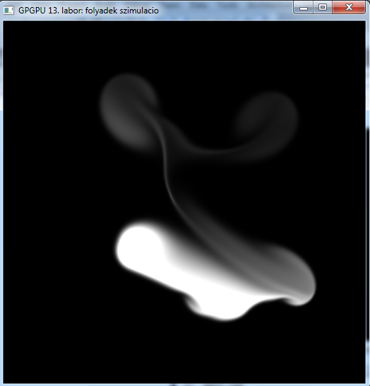
Próba

Slide 41
Önálló feladat
1,2,3,4 stb. gombokra más-más színű anyagot adjunk hozzá
Ne a középpontban, hanem az egér aktuális pozíciójában adjuk hozzá az erőt és az anyagot
(Megjeleníthetjük a nyomást, divergenciát is)
Sebesség diffúzió
Jacobi iteráció
A kernel hasonlít a nyomás számításánál használt Jacobi iterációs kernelre, csak a paraméterek mások (lásd elméleti anyag)

Slide 43
Vorticity
Global:
cl_mem vorticityBuffer;
cl_kernel vorticityKernel;
cl_kernel addVorticityForceKernel;
initSimulation():
vorticityBuffer = clCreateBuffer(context, CL_MEM_READ_WRITE, sizeof(float) * gridResolution * gridResolution, NULL, NULL);
vorticityKernel = createKernel(simulationProgram, "vorticity");
addVorticityForceKernel = createKernel(simulationProgram, "addVorticity");
simulationStep():
simulateVorticity();
projection();

Slide 44
Vorticity
void simulateVorticity()
{
CL_SAFE_CALL( clSetKernelArg(vorticityKernel, 0, sizeof(int), &gridResolution) );
CL_SAFE_CALL( clSetKernelArg(vorticityKernel, 1, sizeof(cl_mem), &velocityBuffer[inputVelocityBuffer]) );
CL_SAFE_CALL( clSetKernelArg(vorticityKernel, 2, sizeof(cl_mem), &vorticityBuffer) );
CL_SAFE_CALL( clEnqueueNDRangeKernel(commands, vorticityKernel,2, NULL, problemSize, NULL, 0, NULL, NULL) );
clFinish(commands);
CL_SAFE_CALL( clSetKernelArg(addVorticityForceKernel, 0, sizeof(int), &gridResolution) );
CL_SAFE_CALL( clSetKernelArg(addVorticityForceKernel, 1, sizeof(cl_mem), &vorticityBuffer) );
CL_SAFE_CALL( clSetKernelArg(addVorticityForceKernel, 2, sizeof(cl_mem), &velocityBuffer[inputVelocityBuffer]) );
CL_SAFE_CALL( clEnqueueNDRangeKernel(commands, addVorticityForceKernel, 2, NULL, problemSize, NULL,0, NULL, NULL) );
clFinish(commands);
}

Slide 45
Programs.cl
__kernel
void vorticity(const int gridResolution,
__global float2* velocityBuffer,
__global float* vorticityBuffer)
{
int2 id = (int2)(get_global_id(0), get_global_id(1));
if(id.x > 0 && id.x < gridResolution - 1 &&
id.y > 0 && id.y < gridResolution - 1){
float2 vL = velocityBuffer[id.x - 1 + id.y * gridResolution];
float2 vR = velocityBuffer[id.x + 1 + id.y * gridResolution];
float2 vB = velocityBuffer[id.x + (id.y - 1) * gridResolution];
float2 vT = velocityBuffer[id.x + (id.y + 1) * gridResolution];
vorticityBuffer[id.x + id.y * gridResolution] = (vR.y - vL.y) - (vT.x - vB.x);
}
else {
vorticityBuffer[id.x + id.y * gridResolution] = 0.0f;
}
}

Slide 46
Programs.cl
__kernel
void addVorticity(const int gridResolution, __global float* vorticityBuffer, __global float2* velocityBuffer)
{
int2 id = (int2)(get_global_id(0), get_global_id(1));
const float scale = 0.2f;
if(id.x > 0 && id.x < gridResolution - 1 &&
id.y > 0 && id.y < gridResolution - 1){
float vL = vorticityBuffer[id.x - 1 + id.y * gridResolution];
float vR = vorticityBuffer[id.x + 1 + id.y * gridResolution];
float vB = vorticityBuffer[id.x + (id.y - 1) * gridResolution];
float vT = vorticityBuffer[id.x + (id.y + 1) * gridResolution];
float2 force = (float2)(fabs(vT) - fabs(vB), fabs(vR) – fabs(vL));
force = normalize(force);
force *= scale * vorticityBuffer[id.x + id.y * gridResolution] * (float2)(1.0f, -1.0f);
velocityBuffer[id.x + id.y * gridResolution] += force.xy * dt;
}
}

Slide 47
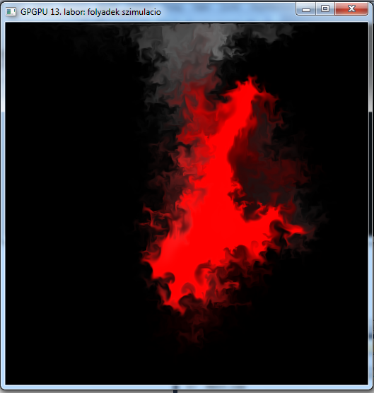
Próba

Slide 48
Vége

