Slide 1
GPGPU labor I.
OpenGL, Cg

Slide 2
Kezdeti teendők
Tantárgy honlapja, Bevezetés
Alap könyvtárak letöltése (GPGPU.zip), kitömörítés a D meghajtóra
Első labor kiindulási alapjának letöltése (lab1_cg_opengl_BASE.zip), kitömörítés a D:\GPGPU\labs könyvtárba
D:\GPGPU\labs\lab1_cg_opengl\lab1_cg_opengl\lab1_cg_opengl.sln indítása
Project tulajdonságai – Configuration Properties – Debugging – Working Directory = $(ProjectDir)\..\..\..\bin

Slide 3
Alapok
Glut init
Ablak létrehozás
Callback függvények
Clear color
Clear
Alap mátrix (identity) beállítások
Swap buffers

Slide 4
Main()
glutInit(&argc, argv);
glutInitDisplayMode(GLUT_RGBA | GLUT_DEPTH | GLUT_DOUBLE);
glutInitWindowSize(600, 600);
glutCreateWindow("GPGPU Lab1");
glutDisplayFunc(display);
glutKeyboardFunc(keyboard);
init();
glutMainLoop();

Slide 5
Billentyűzet
void keyboard(unsigned char key, int x, int y)
{
switch(key)
{
case 27:
exit(0);
break;
}
}

Slide 6
Inicializáció
void init()
{
glewInit();
}

Slide 7
Megjelenítés
void display()
{
glClearColor(0.17f, 0.4f, 0.6f, 1.0f);
glClear(GL_COLOR_BUFFER_BIT | GL_DEPTH_BUFFER_BIT);
glMatrixMode(GL_MODELVIEW);
glLoadIdentity();
glMatrixMode(GL_PROJECTION);
glLoadIdentity();
drawMyMesh();
glFinish();
glutSwapBuffers();
}

Slide 8
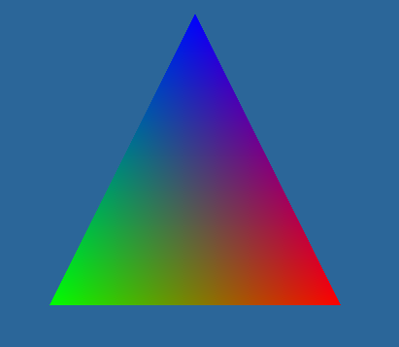
drawMyMesh()
void drawMyMesh()
{
glNormal3f(0,0,1);
glBegin(GL_TRIANGLES);
glColor3f(1,0,0);
glTexCoord2f(1,0);
glVertex3f( 0.5f, -0.5f, 0);
glColor3f(0,1,0);
glTexCoord2f(0,0);
glVertex3f(-0.5f, -0.5f, 0);
glColor3f(0,0,1);
glTexCoord2f(0.5,1);
glVertex3f( 0, 0.5f, 0);
glEnd();
}

Slide 9
Mátrixok
glMatrixMode(GL_PROJECTION);
glLoadIdentity();
gluPerspective(45,1,0.01,100); //(aspect = 1)
glMatrixMode(GL_MODELVIEW);
glLoadIdentity();
gluLookAt(0,1,2,0,0,0,0,1,0);

Slide 10
Textúra
Globális:
GLuint textureID;
Init
glEnable(GL_TEXTURE_2D);
glGenTextures(1, &textureID);
glBindTexture(GL_TEXTURE_2D, textureID);
int textureSize = 8;
GLubyte* pixelData = new GLubyte[textureSize * textureSize * 4];
for(int i = 0; i < textureSize; i++)
for(int j = 0; j < textureSize; j++)
{
pixelData[j * textureSize * 4 + i * 4] =
pixelData[j * textureSize * 4 + i * 4 + 1] =
pixelData[j * textureSize * 4 + i * 4 + 2] =
pixelData[j * textureSize * 4 + i * 4 + 3] =
(i+j)%2 * 255;
}
glTexImage2D(GL_TEXTURE_2D,0,GL_RGBA8, textureSize, textureSize,0,GL_RGBA,GL_UNSIGNED_BYTE, pixelData);
delete pixelData;
glTexParameteri(GL_TEXTURE_2D, GL_TEXTURE_MIN_FILTER, GL_LINEAR);
glTexParameteri(GL_TEXTURE_2D, GL_TEXTURE_MAG_FILTER, GL_LINEAR);
glBindTexture(GL_TEXTURE_2D, 0);
glDisable(GL_TEXTURE_2D);

Slide 11
Textúra
glEnable(GL_TEXTURE_2D);
glBindTexture(GL_TEXTURE_2D, textureID);
glTexEnvi(GL_TEXTURE_ENV, GL_TEXTURE_ENV_MODE, GL_REPLACE);
drawMyMesh();
glBindTexture(GL_TEXTURE_2D, 0);
glDisable(GL_TEXTURE_2D);

Slide 12
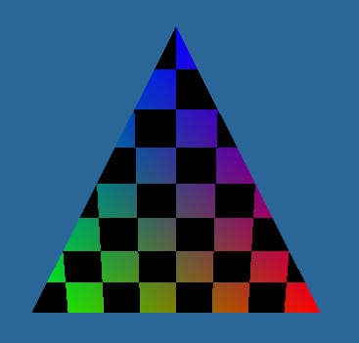
Textúra szűrés
glTexParameteri(GL_TEXTURE_2D, GL_TEXTURE_MIN_FILTER, GL_NEAREST);
glTexParameteri(GL_TEXTURE_2D, GL_TEXTURE_MAG_FILTER, GL_NEAREST);
glTexParameteri(GL_TEXTURE_2D, GL_TEXTURE_WRAP_S, GL_REPEAT);//GL_CLAMP
glTexParameteri(GL_TEXTURE_2D, GL_TEXTURE_WRAP_T, GL_REPEAT);

Slide 13
Önálló feladat
Több háromszög rajzolása
Négyzetek, pontok rajzolása
Játék a színekkel, textúra koordinátákkal

Slide 14
Gömb, teáskancsó
glutSolidSphere(0.5,20,20);
glutSolidTeapot(0.5);
glEnable(GL_DEPTH_TEST);
glClearDepth(1.0);

Slide 15
Anim
#include <ctime>
float dt = 0;
Display:
static float rot = 0;
rot += dt * 10;
glRotatef(rot,0,1,0);
glutSolidTeapot(0.5);
Idle:
void idle()
{
static clock_t currentTime;
currentTime = clock();
static clock_t lastTime = currentTime;
dt = (float)(currentTime - lastTime) / (float) CLOCKS_PER_SEC;
glutPostRedisplay();
lastTime = currentTime;
}
Main:
glutIdleFunc(idle);

Slide 16
Cg init (cg.lib, cggl.lib)
#include <CG/cg.h>
#include <CG/cggl.h>
//Globális paraméter:
CGprogram vertexProgram;
CGprogram fragmentProgram;
//Init:
CGcontext shaderContext = cgCreateContext(); // árnyaló kontextus
CGprofile vertexProf = cgGLGetLatestProfile(CG_GL_VERTEX);
cgGLEnableProfile(vertexProf);
vertexProgram = cgCreateProgramFromFile( shaderContext,
CG_SOURCE, "lab1.cg",
vertexProf, "vs", NULL);
if(vertexProgram == 0)
{
cerr<<"!!!!CG_ERROR: Unable to build vertex program.."<<endl;
const char* comM_PIlerError = cgGetLastListing(shaderContext);
if(comM_PIlerError)
cerr<<comM_PIlerError<<endl;
else
cerr<<"File not found?"<<endl;
}
cgGLLoadProgram(vertexProgram); // GPU-ra töltés

Slide 17
CgInit
CGprofile fragmentProf = cgGLGetLatestProfile(CG_GL_FRAGMENT);
cgGLEnableProfile(fragmentProf);
CGprogram fragmentProgram = cgCreateProgramFromFile(shaderContext,
CG_SOURCE, "lab1.cg",
fragmentProf, "fs", NULL);
if(fragmentProgram == 0)
{
cerr<<"!!!!CG_ERROR: Unable to build fragment program.."<<endl;
const char* comM_PIlerError = cgGetLastListing(shaderContext);
if(comM_PIlerError)
cerr<<comM_PIlerError<<endl;
else
cerr<<"File not found?"<<endl;
}
cgGLLoadProgram(fragmentProgram); // GPU-ra töltés

Slide 18
Cg bekapcs/kikapcs (Display)
cgGLEnableProfile(cgGLGetLatestProfile(CG_GL_VERTEX));
cgGLEnableProfile(cgGLGetLatestProfile(CG_GL_FRAGMENT));
cgGLBindProgram(vertexProgram); // ez legyen a futó program
cgGLBindProgram(fragmentProgram); // ez a program fusson
glutSolidTeapot(0.5);
cgGLDisableProfile(cgGLGetLatestProfile(CG_GL_VERTEX));
cgGLDisableProfile(cgGLGetLatestProfile(CG_GL_FRAGMENT));

Slide 19
Cg shader (lab1.cg létrehozása a bin könyvtárba)
struct VS_IN
{
float4 position : POSITION;
float4 texCoord : TEXCOORD;
float3 normal: NORMAL;
};
struct VS_OUT
{
float4 hPos : POSITION;
float2 texCoord : TEXCOORD;
};
VS_OUT vs(VS_IN In,
uniform float4x4 mvp : state.matrix.mvp)
{
VS_OUT Out = (VS_OUT) 0;
Out.hPos = mul(mvp, In.position);
Out.texCoord = In.texCoord.xy;
return Out;
}
float4 fs(VS_OUT In):COLOR
{
return float4(1,1,0,1);
}

Slide 20
Shader változók
Definíció (globális):
CGparameter LightDir;
CGparameter TextureShift;
Lekérdezés (Init):
LightDir = cgGetNamedParameter(vertexProgram, "lightdir");
TextureShift = cgGetNamedParameter(fragmentProgram, “shift");
Beállítás (Display):
cgGLSetParameter3f(LightDir, 10, 20, 30);

Slide 21
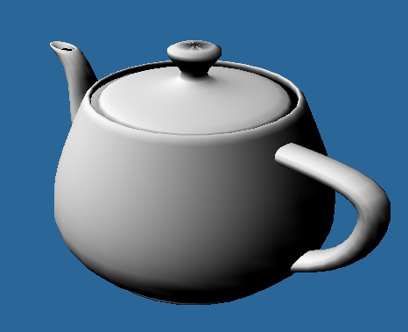
Shader változók
struct VS_OUT
{
float4 hPos : POSITION;
float2 texCoord : TEXCOORD;
float4 color:COLOR;
};
VS_OUT vs(VS_IN In,
uniform float4x4 mvp : state.matrix.mvp,
uniform float3 lightdir)
{
VS_OUT Out = (VS_OUT) 0;
Out.hPos = mul(mvp, In.position);
Out.texCoord = In.texCoord.xy;
Out.color = dot(In.normal, normalize(lightdir));
Out.color = saturate(Out.color);
return Out;
}
float4 fs(VS_OUT In):COLOR
{
return float4(In.color.rgb,1);
}

Slide 22
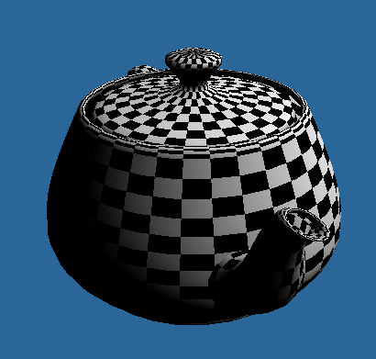
Textúra
float4 fs(VS_OUT In,
uniform sampler2D texture : register(s0)):COLOR
{
float4 textureColor = tex2D(texture, In.texCoord);
float4 lightingColor = float4(In.color.rgb,1);
return textureColor * lightingColor;
}

Slide 23
Textúra eltolása (Display)
Display:
static float shift = 0;
shift += dt* 0.1f;
cgGLSetParameter2f(TextureShift, shift, 2 * shift);
Shader:
float4 fs(VS_OUT In,
uniform sampler2D texture : register(s0),
uniform float2 shift):COLOR
{
float4 textureColor = tex2D(texture, In.texCoord + shift);
float4 lightingColor = float4(In.color.rgb,1);
return textureColor * lightingColor;
}

Slide 24
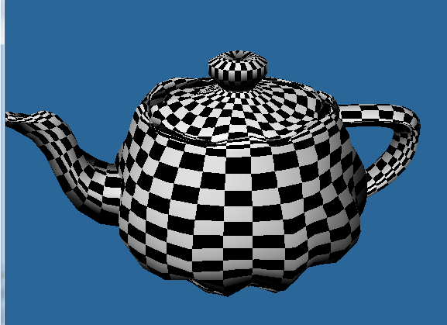
Önálló feladat
Játék a bemenő paraméterekkel, textúra címzéssel és árnyalással
Csúcspontok elmozgatása
( float dist = sin(t + In.position.x * In.position.y * 5.0 + In.position.z) * 0.1;
In.position.xyz += In.normal * dist;)

Slide 25
Vége

