Slide 1
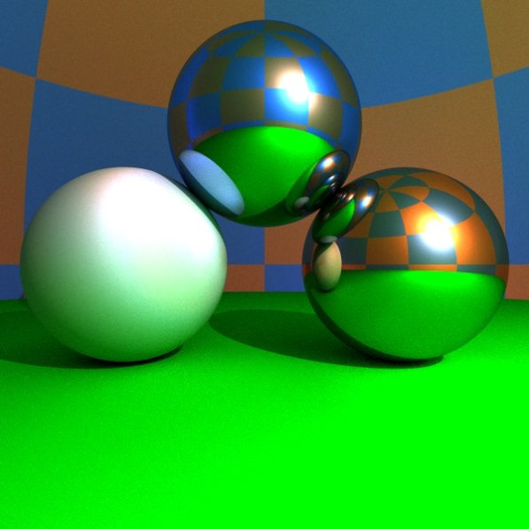
Sugárkövetés: ray-casting, ray-tracing, path-tracing
“As technology advances, the rendering time remains constant.”
Jim Blinn
Szirmay-Kalos László
Notes:
Ray-tracing is a fundamental algorithm to render 3D scenes in a realistic way. It is the basis of many photorealistic rendering methods and are used extensively in movie production rendering.

Slide 2
Lokális illumináció: rücskös felületek, absztrakt fényforrások
Csak absztrakt
fényforrások
direkt megvilágítása
$$Ll$$
pixel
$${in}_{l}$$
$${Lin}_{l}^{}$$
$$N$$
Fénysugarakat
visszafelé követjük!
$$V$$
$$L (V)≈\sum_{l}{{Lin}_{l}^{}∗fr(Ll ,N,V)⋅\cos^{+}{θin}_{l}}$$
Absztrakt fényforrásokból származó megvilágítás.
(Irányforrás = konstans; Pontforrás = távolság négyzetével csökken
Ha takart, akkor zérus)
Notes:
In rendering, first the surface visible through a pixel should be determined by computing the first intersection of the surfaces and the half line starting at the eye position and going in the direction of the pixel. In local illumination rendering, having identified the surface visible in a pixel, we have to compute the reflected radiance due to the direct illumination of the light sources. We prefer abstract light sources for the sake of simplicity since an abstract light source may illuminate a point just from a single direction. The intensity provided by the light source at the point is multiplied by the BRDF and the geometry term (cosine of the angle between the surface normal and the illumination direction). The intensity provided by the light source is zero if the light source is not visible from the shaded point. The visibility of light sources from the shaded point can be determined by sending a ray from here in the direction of the light source and checking whether or not this ray intersects any surface before reaching the light source.
For directional sources, the intensity and the direction are the same everywhere. For point sources, the direction is from the source to the shaded point and the intensity decreases with the square of the distance.

Slide 3
Lokális illumináció: rücskös felületek, absztrakt fényforrások
Csak absztrakt
fényforrások
direkt megvilágítása
pixel
$$Ll$$
$$Hl$$
$$N$$
Fénysugarakat
visszafelé követjük!
$$V$$
$$L (V)≈\sum_{l}{{Lin}_{l}^{}∗\{kd⋅{(Ll •N)}^{+}+ks ⋅({(Hl•N)}^{+})shine\} }$$
Absztrakt fényforrásokból származó megvilágítás.
(Irányforrás = konstans; Pontforrás = távolság négyzetével csökken
Ha takart, akkor zérus)
Notes:
The BRDF times the geometry factor equals to the following expression for diffuse + Phong-Blinn type materials. Here we use different product symbols for different data types; * for spectra, ⋅ for multiplying with a scalar, and • for the dot product of two vectors. The plus sign in the superscript indicates that negative dot products are replaced by zero since this corresponds to the situation when the considered object occludes the given point from the light source.

Slide 4
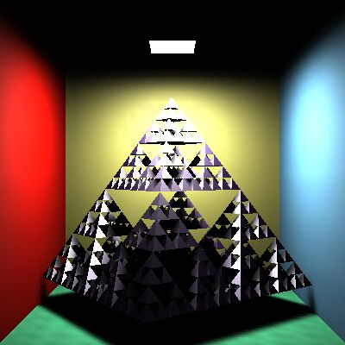
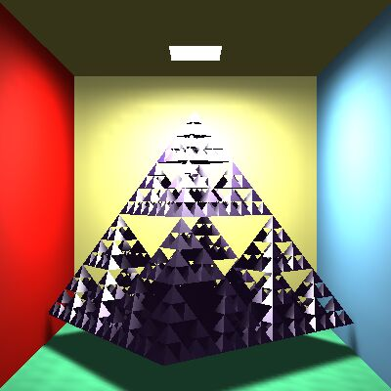
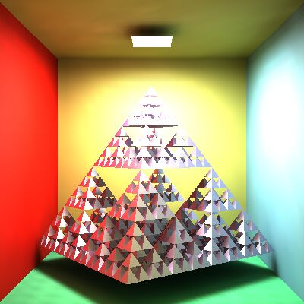
Ambiens tag
Lokális illumináció
+ ambiens tag
Globális illumináció
$$L (V) ≈\sum_{l}{{Lin}_{l}^{}∗fr(Ll,N,V)⋅\cos^{+}{θin}_{l}}+ka∗La$$
Notes:
In the local illumination model, all surfaces that are not directly visible from the light sources are completely back. However, this is against everyday experience when some light indirectly illuminates even hidden regions as well. So, we add an ambient term to the reflected radiance, where the intensity is uniform everywhere and in all directions, and the ambient reflection k_a is a material property (if a physically accurate model is applied, k_a = k_d * pi).
Note, however, that adding the ambient term is a very crude approximation of true indirect lighting, which can be obtained by global illumination algorithms (upper right image).

Slide 5
Láthatóság
struct Ray {
vec3 start;
vec3 dir; // egységvektor
bool out; // kívül? vagy ior
};
struct Hit {
float t;
vec3 position;
vec3 normal;
Material* material;
Hit() { t = -1; }
};
pixel
$$start$$
$$ray(t)=start+dir·t,$$
$$t > 0$$
Hit firstIntersect(Ray ray) {
Hit bestHit;
for(Intersectable * obj : objects) {
Hit hit = obj->intersect(ray); // hit.t < 0 ha nincs metszés
if(hit.t > 0 && (bestHit.t < 0 || hit.t < bestHit.t)) bestHit = hit;
}
if (dot(ray.dir, bestHit.normal) > 0) bestHit.normal *= -1;
return bestHit;
}
Nézzen felénk!
if ($N • dir>0$) { $N= −N;$ }
Notes:
A fundamental operation of ray tracing is the identification of the surface point hit by a ray. A ray is defined by its start and direction. When transparent objects are also considered, it is useful to store whether the ray is inside some object or outside in the air since the index of refraction should be dealt with accordingly.
The ray may be a primary ray originating at the eye and passing through the pixel, or it can be a shadow ray originating at the shaded point and going towards the light source, or even a secondary ray that also originates in the shaded point but goes into either the reflection or the refraction direction. The intersection with this ray is on the ray, thus it satisfies the ray equation, ray(t)=start + dir· t for some POSITIVE ray parameter t, and at the same time, it is also on the visible object, so point ray(t) also satisfies the equation of the surface. By emphasizing the constraint of positive ray parameters, we have a half line or restrict the visible objects to those that are in front of the eye. A ray may intersect more than one surface, when we need to obtain the intersection of minimal positive ray parameter since this is the closest surface that occludes others. Function firstIntersect finds this point by trying to intersect every surface with function Intersect and always keeping the minimum, positive ray parameter t. This implementation assumes that the existence of objects’ intersect function that returns a hit structure.
This hit structure contains the ray parameter of the intersection or a negative value when there is no intersection. In addition to the ray parameter t, the hit structure also stores the position of the intersection in the virtual world, and the normal and the material properties of the surface at the intersection point. So, intersection calculation should also determine the normal vector of the surface at the intersection point. Recall when we established formulas and implemented functions for the reflection or refraction direction computation, we assumed that the surface normal points towards the incoming ray, so the dot product of the ray direction and the surface normal is negative. To make sure that it always happens, it is worth checking this condition and flipping the surface normal if needed.

Slide 6
Objektum = Intersectable
struct Intersectable {
Material* material;
virtual Hit intersect(const Ray& ray) = 0;
};

Slide 7
Metszéspont számítás gömbbel
$$r$$
$$|r – c|2=R2$$
$$R$$
$$c$$
Nincs gyök 1 gyök 2 gyök
$$ray(t)=start+dir·t$$
$$|ray(t) – c|2=(start+dir·t−c)·(start+dir·t−c)=R2$$
$$(dir·dir)t2+2((start−c)·dir)t+(start−c)·(start−c)−R2 = 0$$
Wanted: a pozitív megoldások közül a kisebb
Felületi normális gömbre: $N=(ray\left(t\right)−c)/R$
Notes:
The implementation of function intersect depends on the actual type of the surface, since it means the inclusion of the ray equation into the particular equation of the surface. The first example is the sphere. Substituting the ray equation into the equation of the sphere and taking advantage of the distributivity of the scalar product, we can establish a second order equation for unknown ray parameter t. A second order equation may have zero, one or two real roots (complex roots have no physical meaning here), which correspond to the cases when the ray does not intersect the sphere, the ray is tangent to the sphere, and when the ray intersects the sphere in two points, entering then leaning it. From the existing roots, we need the smallest positive one.
Recall that we also need the surface normal at the intersection point. For a sphere, the normal is parallel to the vector pointing from the center to the surface point. It can be normalized, i.e. turned to a unit vector, by dividing by its length, which equals to the radius of the sphere.

Slide 8
Sphere mint Intersectable
class Sphere : public Intersectable {
vec3 center;
float radius;
public:
Hit intersect(const Ray& ray) {
Hit hit;
vec3 dist = ray.start - center;
float a = dot(ray.dir, ray.dir);
float b = dot(dist, ray.dir) * 2;
float c = dot(dist, dist) - radius * radius;
float discr = b * b - 4 * a * c;
if (discr < 0) return hit; else discr = sqrtf(discr);
float t1 = (-b + discr)/2/a, t2 = (-b - discr)/2/a;
if (t1 <= 0) return hit; // t1 >= t2 for sure
hit.t = (t2 > 0) ? t2 : t1;
hit.position = ray.start + ray.dir * hit.t;
hit.normal = (hit.position - center)/radius; // Only for sphere!!!
hit.material = material;
return hit;
}
};
Notes:
On the implementation level, the abstract definition of an object that can be rendered with ray tracing is provided by the Intersectable struct, which has material properties and an abstract function intersect that is supposed to compute the intersection of the ray and this surface. The intersect function can be given a real body if we know the equation of the surface. Therefore, specific types are inherited from the general abstract base class. Here, we present the Sphere inherited from Intersectable. The sphere has particular parameters like the center and the radius, and the intersection with a ray can be implemented.

Slide 9
Implicit felületek
A felület pontjai: $f\left(r\right)=0$
Sugár: $ray(t)=s+d·t$
Metszés paraméter $t^{∗}$: $f\left(s+d·t\right)=0$
Metszéspont: $r^{∗}=ray(t^{∗})=s+d·t^{∗}$
Normálvektor $=∇f\left(r^{∗}\right)$
Kvadratikus felületek: $f\left(r\right)=\left[r,1\right]∙Q∙{\left[r,1\right]}^{T}=0,$ ($Q$ szimmetrikus)
Metszés paraméter:
$\left[s+d·t,1\right]∙Q{∙[s+d·t,1]}^{T}=0$
$\left[d,0\right]∙Q∙{[d,0]}^{T}t^{2}+2\left[s,1\right]∙Q∙{\left[d,0\right]}^{T}t+\left[s,1\right]∙Q∙{\left[s,1\right]}^{T}=0$
Normálvektor: $∇f\left(r^{∗}\right)=Q{∙[r^{∗},1]}^{T}$ első három koord.
Notes:
The equation of the sphere is an example of a more general category, the implicit surfaces that are defined by an implicit equation of the x,y,z Cartesian coordinates of the place vectors r of surface points. Substituting the ray equation into this equation, we obtain a single, usually non-linear equation for the single unknown, the ray parameter t. Having solved this equation, we can substitute the ray parameter t* into the equation of the ray to find the intersection point.
The normal vector of the surface can be obtained by computing the gradient at the intersection point. To prove it, let us express the surface around the intersection point as a Taylor approximation. f(x*,y*,z*) becomes zero since the intersection point is also on the surface. What we get is a linear equation of form n\cdot(r – r0) = 0, which is the equation of the plane, where n=grad f.
So, the gradient is the normal vector of the plane that approximates the surface locally in the intersection point.

Slide 10
Háromszög (konvex sokszög)
$$n=(r2−r1)(r3−r1)$$
$$r3$$
$$r3$$
$$p$$
$$p$$
$$ray(t)=start+dir·t$$
$$r2$$
$$r1$$
$$(r−r1)·n = 0$$
$$r1$$
$$r2$$
1. Síkmetszés: $(ray(t)−r1)·n=0$, $t > 0$
$$t=\frac{(r1−start)·n}{dir·n}$$
2. A metszéspont a háromszögön belül van-e?
$((r2−r1)(p−r1))·n > 0$
$((r3−r2)(p−r2))·n > 0$
$((r1−r3)(p−r3))·n > 0$
Felületi normális: $n$
vagy árnyaló normálok
(shading normals)
Notes:
The triangle is the most important primitive because we often use it to approximate arbitrary surfaces. So effective ray-triangle intersection algorithms are still in the focus of research. Now, we present a very simple solution.
The algorithm consists of two steps, first the intersection with the plane of the triangle is found, then we determine whether or not the ray-plane intersection point is inside the triangle. Suppose that the triangle is given by its vertices r1, r2, r3. The equation of its plane is n\cdot(r-r0)=0 where n is the normal vector and r0 is a point of the plane. Position vector r0 can be any of the three vertices and normal vector n can be computed as the cross product of edge vectors r2-r1 and r3-r1. Substituting the ray equation into this linear equation, we get a linear equation for t, which can be solved. If t is negative, the intersection is behind the eye, so it must be ignored. The positive t is substituted back to the ray equation giving p as the intersection with the plane.
Now we should determine whether p is inside the triangle. An edge line separates the plane into two half planes, a “good” one (this is the left one if the edge vector points from r1 to r2) that contains the triangle, as well as the third vertex and a “bad” one that contains nothing. Point p must be on the good side, i.e. where the third vertex is located. Points on the left and right with respect to edge r1 to r2 can be separated using the properties of the cross product.
Assuming that we look at the plane from above, (r2 - r1) × (p - r1) will point towards us if p is on the left, and it will point down if p is on the right.
As n = (r2 - r1) × (r3 - r1) points towards us, we can check whether (r2 - r1) × (p - r1) has the same direction by computing their dot product and checking if the result is positive (the dot product of two vectors point into the same direction is positive, the dot product of two oppositely pointing vectors is negative). A single inequality states that the point is on the good side with respect to a given edge vector. If this condition is met for all three edge vectors, the point is inside the triangle.

Slide 11
Háromszög metszés baricentrikus koordinátákban
$$r3$$
γ
$$p(, , ) =·r1+·r2+·r3$$
$$++ = 1$$
$$, ,   0$$
$$p$$
$$r2$$
1 skalár egyenlet
$$r1$$
β
α
$$ray(t)=p(, , )$$
$$start+dir·t=·r1+·r2+ ·r3$$
3 skalár egyenlet
4 ismeretlen: $, , , t$
A megoldás után ellenőrzés, hogy mind nem negatív-e
Notes:
Another popular intersection algorithm is based on the recognition that a triangle is the convex combination of its vertices. Assume that we have unit mass sand, which is distributed into the three vertices putting weight α to r1, β to r2, and γ to r3. The center of mass of this system is
p(α, β, γ) = (αr1 +βr2 + γr3)/(α+β+γ)=αr1 +βr2 + γr3 as α+β+γ=1 since we distributed unit mass. Points p defined this way are called the combination of points r1, r2, r3. Clearly, such points are on the plane defined by the three points.
If we further assume that the weights are non-negative, the points must lie in the triangle of the three points. Such points are called convex combination.
Making the internal points expressed as convex combinations equal to the ray equation, we obtain a system of four scalar equations (three are the x,y,z components of the vector equation and the fourth is the α+β+γ = 1 requirement), and we have four unknowns. Having solved it, we have to check whether all parameters are non-negative, i.e. the intersection is inside the triangle and not behind the eye.

Slide 12
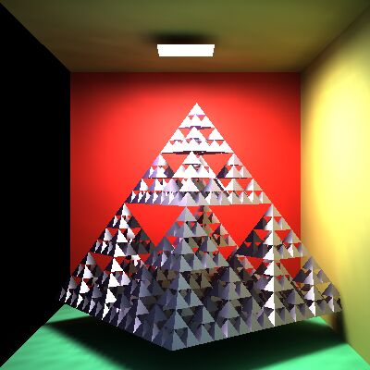
Sugárkövetés: Render
Virtuális világ: szem+ablak
Valós világ: néző+képernyő
ray
p
eye
Render( )
for each pixel p
Ray r = getRay( eye ➔ pixel p )
color = trace(ray)
WritePixel(p, color)
endfor
end
p
color
Notes:
On the top level, ray tracing rendering visits pixels one by one. For every pixel, the virtual camera has a point on its window (in real space we have the user and the screen; in virtual world one of the user’s eye is the virtual eye and the display surface is a rectangle). The origin of primary rays is always the eye position. The direction of a ray is from the eye to the center of the pixel on the window rectangle, which is calculated by the GetRay function. With this ray, function trace is called, which computes the radiance transferred back by this ray (i.e. the radiance of the point hit by this ray in the opposite of the ray direction). The radiance on the wavelengths of r,g,b is written into the current physical pixel.

Slide 13
Kamera: getRay
YM-1
fov/2
up
lookat
eye
right
Y
p
p
X
XM-1
Normalizált eszköz koordináták
p = lookat + α⋅right + β⋅up, α, β in [-1,1]
= lookat + (2(X+0.5)/XM-1)⋅right + (2(Y+0.5)/YM-1)⋅up
Ray: start = eye, dir =p – eye
Notes:
To implement the GetRay function, the virtual camera should be defined in the virtual space. The user’s location is specified by the position vector called eye. The display surface is represented by a 2D rectangle in the virtual world coordinates. The center of this rectangle is specified by the lookat point, and its orientation and size are defined by two vectors. Right points from the center of the window to the right edge, up from the center to the top edge. Any point on the window can be obtained as going to the center called lookat and then applying the combination of right and up where the combination parameters alpha and beta are in [-1,1], which are the normalized screen space coordinates. Physical pixels are mapped to normalized screen coordinates using the XM, YM screen resolutions.
If the resolution of the target image is XM x YM, then the center of pixel (X,Y) in world coordinates is p = lookat + (2X/XM-1)⋅right + (2Y/YM-1)⋅up.

Slide 14
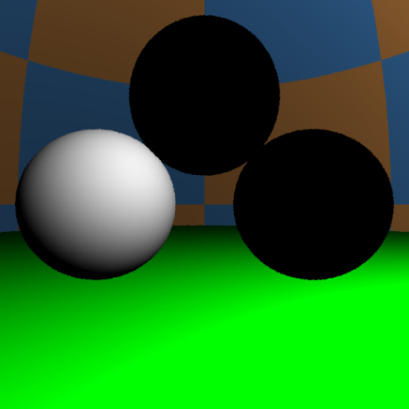
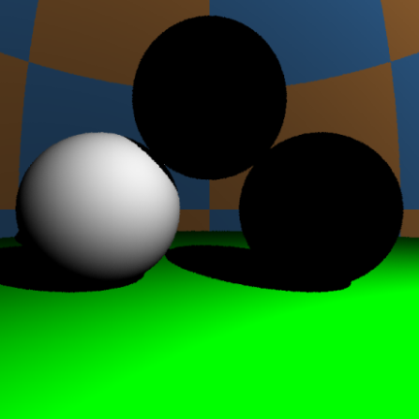
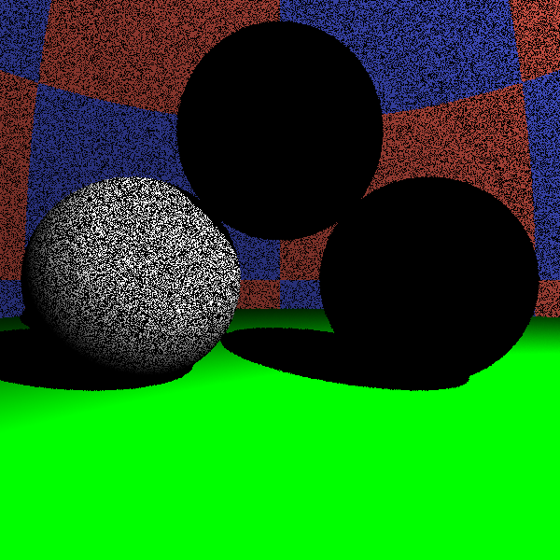
-ray.dir = $V$
$$N$$
$$yl$$
$$Lin$$
ray
$$N$$
$$Ll$$
$$r$$
No Shadow
Shadow
ε = 0: acne
vec3 trace(Ray ray) {
Hit hit = firstIntersect(ray);
if(hit.t < 0) return L_{a}; // nothing
[r , N , k_{a} , k_{d} , k_{s} , shine] ← hit;
vec3 outRad = k_{a} * L_{a};
for(each light source l){
Ray shadowRay(r + Nε, L_{l});
Hit shadowHit = firstIntersect(shadowRay);
if(shadowHit.t < 0 || shadowHit.t > $|r−yl|$)
outRad +=
}
return outRad;
}
DirectLight ()
Shadow
$${Lin}_{l}^{}∗\{kd{(Ll •N)}^{+}+ks ({(Hl•N)}^{+})shine\}$$
Notes:
The trace function gets the ray that involves its origin and direction vectors. First we compute the intersection that is in front of the eye and is closest to the eye. The already implemented solution is firstIntersect. This function indicates with a negative value if there is no intersection. In this case, trace returns with the radiance of the ambient illumination.
If some surface is seen, trace computes the contribution of the abstract light sources. To check the visibility of a particular light source, a ray, called shadow ray, is sent from the shaded point towards the light source. If this ray intersects an object and this intersection is closer than the light source, the object occludes the light source so this point is in shadow. Note that the start of the shadow ray is pushed a little in the direction of the surface normal N in order to avoid situations when numerical inaccuracies result in a intersection with the identified surface with not zero but some small positive ray parameter. This would produce ugly black dots on the surface as shown by the figure.

Slide 15
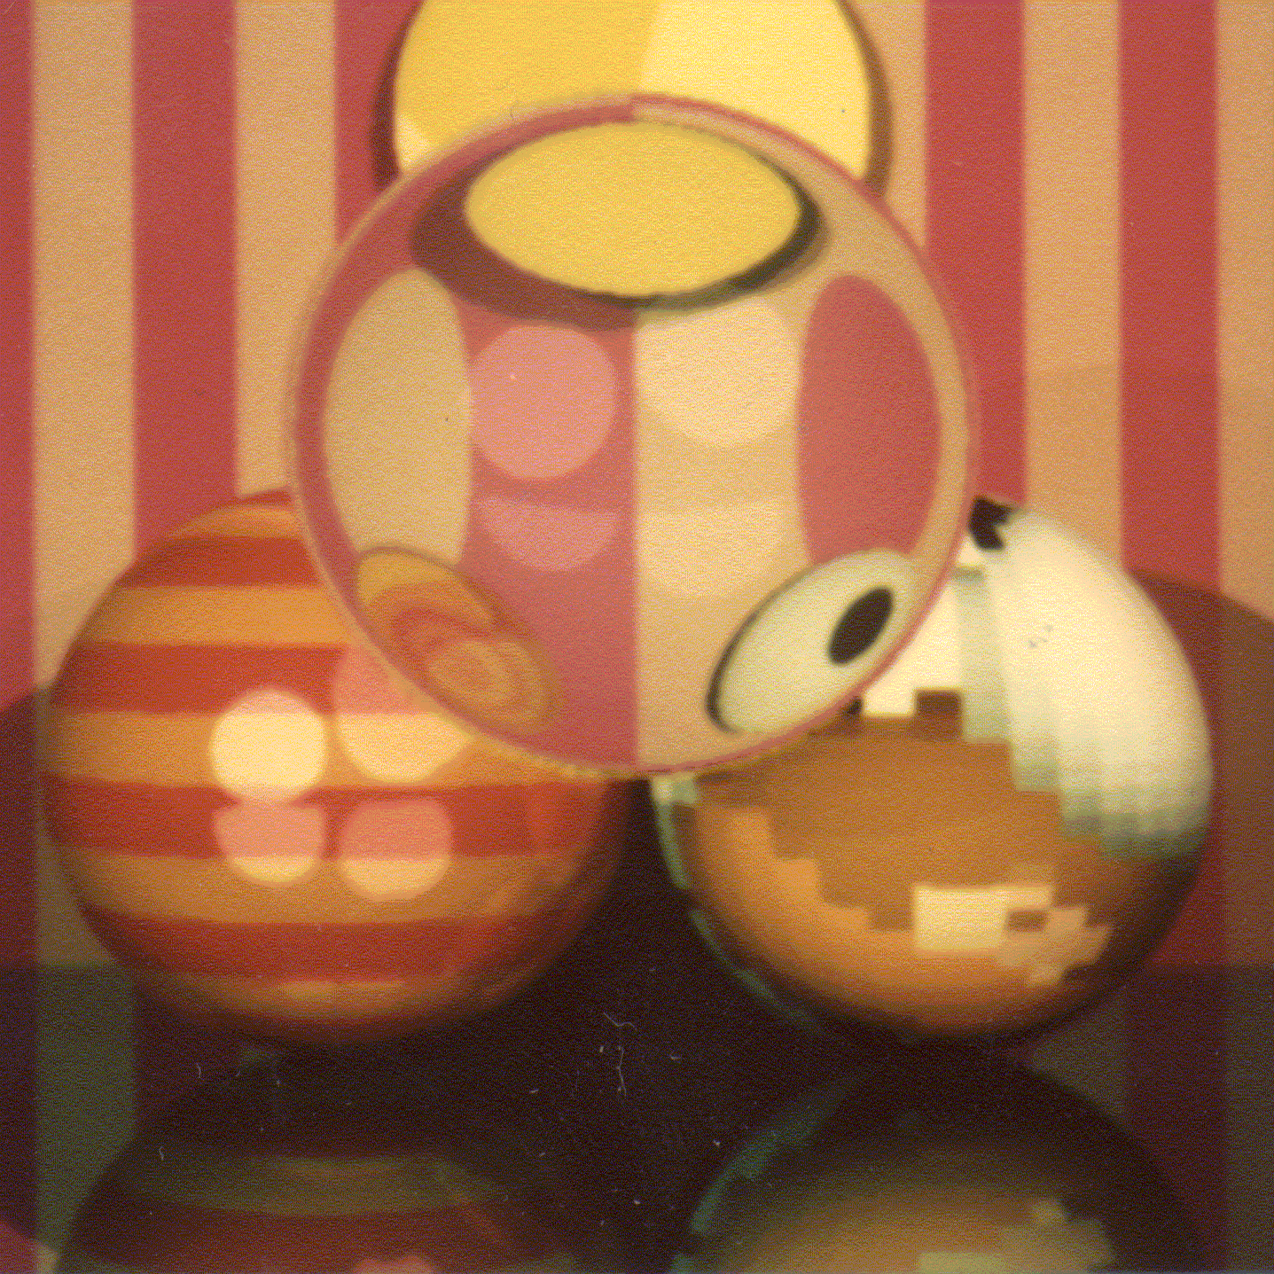
Rekurzív sugárkövetés
Tört sugár
$$T$$
$$V$$
$${Lin}_{l}^{}$$
$$N$$
$$Ll$$
$$R$$
Tükör sugár
Árnyék sugár
DirectLight()
$$L \left(V\right)≈\left\{\begin{aligned}ka∗La+\sum_{l}{{Lin}_{l}^{}∗\left\{kd⋅{\left(Ll •N\right)}^{+}+ks ⋅\left({\left(Hl•N\right)}^{+}\right)shine\right\} } \\ F(V•N)∗Lin(R)+(1−F(V•N))∗Lin(T) \end{aligned}\right.$$
Fresnel
Tükör irányból
érkező fény
1-Fresnel
Törési irányból
érkező fény
Notes:
To simulate also smooth surfaces responsible for mirroring and light refraction, the local illumination model should be extended. When the surface visible from the eye is identified, we calculate the radiance as the contribution from abstract light sources in case of rough surfaces. However, for optically smooth surfaces, the reflection of the radiance from the ideal reflection direction is computed, and for transparent objects, the refraction of the radiance coming from the ideal refraction direction is added. According physics, the scaling factors of the radiance values are the Fresnel and 1-Fresnel for reflection and refraction, respectively. However, we do not always insist on physical precision so may use other scaling factors that are set by an artist and not computed as the Fresnel function.
This equation expresses the radiance of a surface point in a given direction as the function of the direct light sources and the radiance coming from the ideal reflection and refraction directions. The question is how these extra terms can be computed.
Let us recognize, that the computation of the radiance delivered back by reflection and refraction rays is essentially the same computation what we are doing right now, just the ray origin and direction should be altered. So the solution of this problem is a recursive function.

Slide 16
trace
$$V$$
$$N$$
$$yl$$
ray
vec3 trace(Ray ray) {
Hit hit = firstIntersect(ray); //[r ,N ,n,κ,k_{a} ,k_{d} ,k_{s},shine] ← hit;
if(hit.t < 0) return L_{a}; // nothing
vec3 outRad(0, 0, 0);
if(hit.material->rough) outRad = DirectLight(hit);
if(hit.material->reflective){
Ray reflectRay(r + Nε, reflect(ray.dir, N), ray.out);
outRad += trace(reflectRay) * Fresnel(ray.dir, N);
}
if(hit.material->refractive) {
ior = (ray.out) ? n.x : 1/n.x;
vec3 refractionDir = refract(ray.dir,N,ior);
if (length(refractionDir) > 0) {
Ray refractRay(r - Nε, refractionDir, !ray.out);
outRad += trace(refractRay)*(vec3(1,1,1) – Fresnel(ray.dir, N));
}
}
return outRad;
}
$$Ll$$
$$r$$
Notes:
The trace function gets the ray that involves its origin and direction vectors. First we compute the intersection that is in front of the eye and is closest to the eye. The already implemented solution is firstIntersect. This function indicates with a negative value if there is no intersection. In this case, trace returns with the radiance of the ambient illumination.
If a rough surface is seen, trace computes the contribution of the abstract light sources, for which we implemented the DirectLight function.
If the surface is smooth and is ideally reflective, then the reflection direction is computed with the already implemented reflect function and the trace function is called recursively to compute the radiance of reflection direction. The same is done for the refraction direction if the surface is refractive.

Slide 17
trace
$$V$$
$$N$$
$$yl$$
ray
vec3 trace(Ray ray, int d=0) {
if (d > maxdepth) return L_{a};
Hit hit = firstIntersect(ray); //[r ,N ,n,κ,k_{a} ,k_{d} ,k_{s},shine] ← hit;
if(hit.t < 0) return L_{a}; // nothing
vec3 outRad(0, 0, 0);
if(hit.material->rough) outRad = DirectLight(hit);
if(hit.material->reflective){
Ray reflectRay(r + Nε, reflect(ray.dir, N), ray.out);
outRad += trace(reflectRay, d+1) * Fresnel(ray.dir, N);
}
if(hit.material->refractive) {
ior = (ray.out) ? n.x : 1/n.x;
vec3 refractionDir = refract(ray.dir,N,ior);
if (length(refractionDir) > 0) {
Ray refractRay(r - Nε, refractionDir, !ray.out);
outRad += trace(refractRay, d+1) * (vec3(1,1,1)–Fresnel(ray.dir, N));
}
}
return outRad;
}
$$Ll$$
$$r$$
Notes:
Recursion is a dangerous operation if we cannot make sure that it stops. Assume, for example, that this ellipsoid is made of glass. The ray is refracted into the glass and there can be infinite number of reflections on the internal surface. So our program will surely crash with a stack overflow error. We should limit the recursion depth for any price. This is possible with depth parameter d, which is incremented in each recursive call. If depth is greater than the limit, additional calculations are terminated.

Slide 18
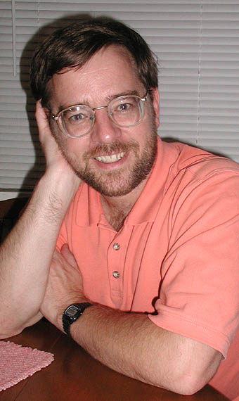
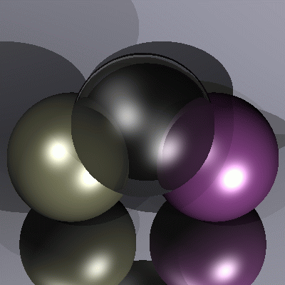
Paul Heckbert névjegye
typedef struct{double x,y,z}vec;vec U,black,amb={.02,.02,.02}; struct sphere{ vec cen,color;double rad,kd,ks,kt,kl,ir}*s,
*best,sph[]={0.,6.,.5,1.,1.,1.,.9, .05,.2,.85,0.,1.7,-1.,8.,-.5,1.,.5,.2,1.,.7,.3,0.,.05,1.2,1.,8.,-.5,.1,.8,.8, 1.,.3,.7,0.,0.,1.2,3.,-6.,15.,1.,
.8,1.,7.,0.,0.,0.,.6,1.5,-3.,-3.,12.,.8,1., 1.,5.,0.,0.,0.,.5,1.5,};yx; double u,b,tmin,sqrt(),tan();double vdot(A,B)vec A ,B;
{return A.x*B.x+A.y*B.y+A.z*B.z;}vec vcomb(a,A,B)double a;vec A,B; {B.x+=a* A.x;B.y+=a*A.y;B.z+=a*A.z;return B;}
vec vunit(A)vec A;{return vcomb(1./sqrt( vdot(A,A)),A,black);}struct sphere *intersect(P,D)vec P,D;{best=0;tmin=1e30;
s= sph+5;while(s-->sph)b=vdot(D,U=vcomb(-1.,P,s->cen)),u=b*b-vdot(U,U)+s->rad*s ->rad,u=u>0?sqrt(u):1e31,u=b-u>
1e-7?b-u:b+u,tmin=u>=1e-7&&u<tmin?best=s,u: tmin;return best;}vec trace(level,P,D)vec P,D;{double d,eta,e;vec N,color;
struct sphere*s,*l;if(!level--)return black;if(s=intersect(P,D));else return amb;color=amb;eta=s->ir;d= -vdot(D,N=vunit(vcomb
(-1.,P=vcomb(tmin,D,P),s->cen )));if(d<0)N=vcomb(-1.,N,black),eta=1/eta,d= -d;l=sph+5;while(l-->sph)if((e=l ->kl*vdot(N,
U=vunit(vcomb(-1.,P,l->cen))))>0&&intersect(P,U)==l)color=vcomb(e ,l->color,color);U=s->color;color.x*=U.x;color.y*=
U.y;color.z*=U.z;e=1-eta* eta*(1-d*d);return vcomb(s->kt,e>0?trace(level,P,vcomb(eta,D,vcomb(eta*d-sqrt (e),N,black))):
black,vcomb(s->ks,trace(level,P,vcomb(2*d,N,D)),vcomb(s->kd, color,vcomb(s->kl,U,black))));}
main(){printf("%d %d\n",32,32);while(yx<32*32) U.x=yx%32-32/2,U.z=32/2-yx++/32,U.y=32/2/tan(25/114.5915590261),
U=vcomb(255., trace(3,black,vunit(U)),black),printf("%.0f %.0f %.0f\n",U);}/*minray!*/
Notes:
Ray tracing is an elegant algorithm, the implementation fits just a business card, but can render rough surfaces, reflective and refractive objects, and shadows.

Slide 19
OO dekompozíció
heterogeneous
collection
Scene
La
build()
render()
firstIntersect()
trace()
Material
n, kappa
ka, kd, ks, shine
reflective?
refractive?
rough?
reflect()
refract()
Fresnel ()
shade()
Intersectable
Hit intersect()
objects
Sphere
center, radius
intersect()
Mesh
intersect()
Camera
eye, lookat, up, right, XM, YM
getRay()
Light
pos, Lout, type
getLightDir()
getInRad()
getDist()
CPU
GPU
Notes:
Object oriented decomposition identifies the objects representing the problem. These objects are defined in an abstract way by specifying what operations can be executed on these elements.
The virtual world is represented by the Scene class. A Scene can be built and rendered, which in turn requires the ability to trace a ray in the scene, which should find the first intersection with firstIntersect. Ambient light intensity La is a data member of the Scene. The Scene has embedded objects like the Camera and Light sources. The camera serves the rendering algorithm with its getRay member function. The Scene is also a collection of Intersectable objects. Intersectable is an abstract base class, so this is a heterogeneous collection. Any intersectable can be associated with a Material containing all possible material properties. Intersectable has a pure virtual function called intersect.
Specific geometric object types can be included in this virtual world by deriving their type from the general Intersectable and implementing the intersect method.

Slide 20
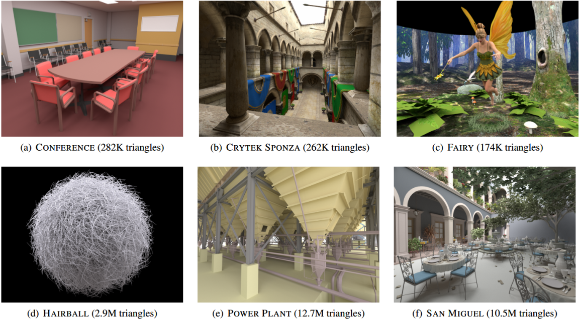
“Bad programmers worry about the code. Good programmes worry about data structures.”
Linus Torvalds
Térpartícionáló adatstruktúrák
Szirmay-Kalos László

Slide 21
Térpartícionáló módszerek
objektumok
Elő-
feldolgozás
Sugár
követés
Térpartícionáló
adatstruktúra
Első
metszéspont
Adatstruktúra:
Ha ismert a sugár, akkor a potenciális metszett objektumok számát csökkenti
Ha a potenciálisak közül találunk egyet, akkor a többi nem lehet közelebb
Notes:
Better complexity – at least in the average case - can be achieved with space partitioning schemes. Space partitioning schemes store information about the possibly intersectable objects for rays shot from arbitrary points and at directions. We have to pay some price for building them, but when they are available, we can ask them which objects are ”in the direction of the ray” so intersection is possible, or in which order they follow each other with respect to the distance from the ray origin.

Slide 22
Befoglaló térfogat (Bounding Volume)
AABB
double IntersectBV( ray, object ) // < 0 ha nincs
IF ( Intersect( ray, bounding volume of object) < 0) RETURN -1;
RETURN Intersect( ray, object );
END
Notes:
Complex objects may be enclosed in simple bounding volumes, such as spheres or AABBs (Axis Aligned Bounding Boxes). Then, before intersecting the complex object, we test the bounding volume. If the bounding volume is not intersected, neither the bounded object can be intersected.
This method speed up ray tracing by a linear factor, but does not change the inherent linear complexity with respect to the number of objects.

Slide 23
AABB metszés vágással
x > x_{min} x < x_{max} y > y_{min} y < y_{max} z > z_{min} z < z_{max}
(x, y, z)
t=0
Belül
x_{min}
Kívül
t≈∞

Slide 24
Reguláris térháló
Előfeldolgozás:
Minden cellára a metszett objektumok
komplexitás: O(n·c ) = O(n²)
Sugárkövetés:
FOR each cell of the line // line drawing
Metszés a cellában lévőkkel
IF van metszés RETURN
ENDFOR
átlagos eset komplexitás: O(1 )
Notes:
Regular grid encloses first the scene into an AABB, then this AABB is decomposed to cells of the same size obtaining a grid structure. During preprocessing, we check every object and every cell whether they overlap. To implement overlapping test, we usually check whether the cell AABB overlaps with the AABB of the object. In every cell, the ids of overlapping objects are stored, e.g. in a linked list or array.
During ray tracing, when the ray gets available we identify the cell that contains this ray. First, objects overlapping with this cell are tested for intersection. If no intersection is found, we traverse only those cells that are intersected by the ray.
Note that regular grid helps excluding most of the objects that are surely not hit by the ray. If an object overlaps with no cell that is pierced by the ray, then this object is never tested for intersection. On the other hand, regular grid also provides an order of potentially intersectable objects in which they should be tested. When we found an intersection in a cell, cell traversal can be stopped. Even if there are intersections in farther cells, those intersections cannot be closer to the ray origin than the already identified intersection.
To implement cell traversal, we should identify cells that are intersected by the ray. To find an efficient algorithm, we can exploit the incremental concept. Let us realize that the cell structure is defined by three sets of planes, a horizontal set, a vertical set and a depth set. The distance of intersections with the planes of a given set is constant. So we maintain three ray parameters, one for each plane set. From the three ray parameters, the minimum identifies the next ray cell intersection. Having stepped into the cell, the corresponding ray parameters is incremented by its constant increment.

Slide 25
Nyolcas (oktális) fa
Faépítés( cella ):
IF a cellában kevés objektum van
cellában regisztráld az objektumokat
ELSE
cellafelezés: c1, c2, …, c8
Faépítés(c1); … Faépítés(c8);
ENDIF
2
1
3
Sugárkövetés:
FOR összes sugár által metszett cellára
Metszés a cellában lévőkkel
IF van metszés RETURN
ENDFOR
1
2
3
3
Octree
Notes:
A drawback of regular grid is that we should make many cell steps even where the space is empty and there are no objects.
To speed up empty space traversal, we should use larger cells in these empty regions. Octree is based on this idea. It starts with a cell that contains the whole scene, and we check whether this cell has many overlapping objects. If it has, the cell is subdivided by three planes into 8 similar size cells, and we repeat this operation recursively. If the cell is empty or contains just a few objects, further subdivision is prevented.

Slide 26
Binary Space Partitioning fa (kd-fa)
Faépítés( cella ):
IF a cellában kevés objektum van
cellában regisztráld az objektumokat
ELSE
sík keresés
cella felezés a síkkal: c1, c2
Faépítés(c1); Faépítés(c2);
ENDIF
2
1
3
Sugárkövetés:
FOR each cell intersecting the line
Metszés a cellában lévőkkel
IF van metszés RETURN
ENDFOR
1
2
3
kd-tree
Notes:
Kd-tree (aka binary space partitioning tree) is even more adaptive than the octree. In a subdivision step it decomposes a cell into two cells, but selects the position of the subdivision carefully to guarantee that the probabilities of ray intersection in the two children will be similar.

Slide 27
kd-fa bejárása
while (stack nem üres) {
Pop(AABB)
while (nem levél) {
Ha van AABB-nek távoli
Push(távoli)
AABB = közeli
}
Regisztrált objektumok metszése
Ha van metszéspont return
}
közeli
távoli 2
távoli 1
közeli
Befoglaló AABB
távoli 1
távoli 2
távoli 1

Slide 28
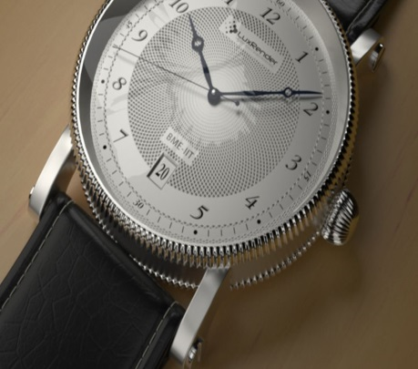
“Úgy szeretnék integrálni.”
Kockaéder
Globális illumináció: Path tracing
Szirmay-Kalos László

Slide 29
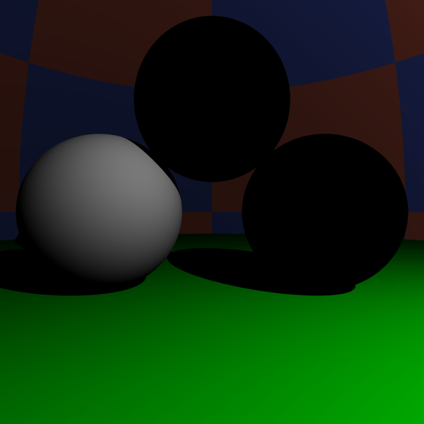
Képszintézis
Local
illumination
Global
illumination
pixel
Notes:
There are different tradeoffs between accuracy of the light transport computation and the speed of the computation.
In the local illumination setting, when the radiance of a surface is calculated, we consider only the direct contribution of the light sources and ignore all indirect illumination.
In recursive ray tracing, indirect illumination is computed only for smooth surfaces, in the ideal reflection and refraction directions.
In the global illumination model, indirect illumination is taken into account for rough surfaces as well. In engineering applications we need global illumination solutions since only these provide predictable results. However, in games and real time systems, local illumination or recursive ray tracing will also be acceptable.

Slide 30
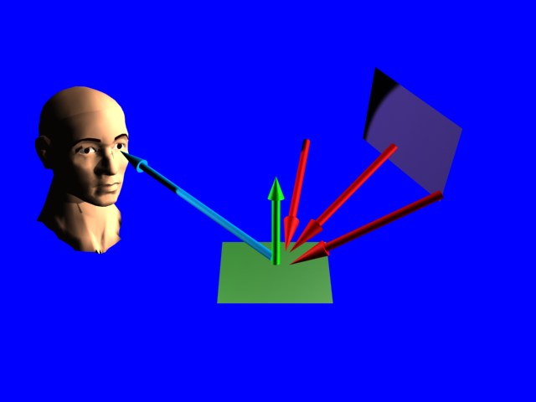
Rendering equation
OutRad = DirectLight + ∑ InRad * Reflection
$$L\left(r,ω\right)=D\left(r,ω\right)+\int_{Ω}{L\left(y,ω′\right)R\left(ω,ω′\right)}dω′$$
ω
y
ω’
r

Slide 31
A megoldás integrálok sorozata
pixel
y’
$$ω′′$$
r
y
$$ω′$$
$$L\left(y′,ω′′\right)=D\left(y′,ω′′\right)+\int_{Ω′′}{L\left(y′′,ω′′′\right)R\left(ω′′,ω′′′\right)}dω′′′$$
$$L\left(y,ω′\right)=D\left(y,ω′\right)+\int_{Ω′}{L\left(y′,ω′′\right)R\left(ω′,ω′′\right)}dω′′$$
$$L\left(r,ω\right)=D\left(r,ω\right)+\int_{Ω}{L\left(y,ω′\right)R\left(ω,ω′\right)}dω′$$

Slide 32
Numerikus integrálás
$$\int_{0}^{1}{f\left(z\right)dz≈\frac{1}{M}\sum_{i=1}^{M}{f(z_{i})}}$$
Δ f
M minta
$$z$$
0
$$z_{i}$$
1
Átlagos
magasság
Alap
Háromszögek
száma
Error $=\frac{Δf}{2M}∙\frac{1}{M}∙M=\frac{Δf}{2M}=O(M^{−1})$
Notes:
Let us consider the problem of dense samples used to estimate an integral. Suppose, for the sake of simplicity, that the integral is one-dimensional and the domain is the unit interval. The simplest integration rule place samples regularly in the domain, evaluates the integrand at these samples, and approximates the area below the function by the total area these bricks. This results in the following sum that approximates the integral.
The error of the integration is the total area of the triangle-like objects between the function curve and the bricks, which equals to the product of the average height of the triangles, the base, and the number of triangles.
We can conclude that the error is proportional to the total change, called variation of the function, and inversely proportional to the number of samples.

Slide 33
Magasabb dimenziók: Megátkozva
y
x
Véletlen minták
$n =\sqrt{M}$ minta egy dimenzióban
Hiba 2-dim $=O(n^{−1})$ $=O(M^{−0.5})$
Hiba D-dim $=O(n^{−1})$ $=O(M^{−1/D})$

Slide 34
Monte Carlo integrálás: Integrál = várható érték
$$\int{f\left(z\right)dz=\int{\frac{f\left(z\right)}{p\left(z\right)}p\left(z\right)dz=E\left[\frac{f\left(z\right)}{p\left(z\right)}\right]≈\frac{1}{M}\sum_{i=1}^{M}{\frac{f\left(z_{i}\right)}{p\left(z_{i}\right)}}}}$$
A becslő egy valószínűségi változó:
3 × szóráson belül
99.7% konfidenciával
$$Variancia=σ^{2}=D^{2}\left[\frac{f\left(z\right)}{p\left(z\right)}\right]\frac{1}{M}$$
$$Error<3σ=\frac{3}{\sqrt{M}}D\left[\frac{f\left(z\right)}{p\left(z\right)}\right]$$
3σ
3σ
Notes:
Monte-Carlo integration can also be understood in the following way. In order to evaluate an integral, let us divide and multiply the integrand by a probability density p. Obviously, it does not make any difference.
Looking at this formula, we can realize that this is the expected value of random variable f/p. According to the theorem of large numbers, expected values can be well approximated by averages. Thus taking M samples obtained with probability density p, this average will be a good estimate for the original integral.
The integration error will be proportional to the variation of f/p and inversely proportional to the square root of the number of samples.

Slide 35
Irányok generálása egyenletes valószínűséggel
float random() { return (float)rand()/RAND_MAX; }
+1,+1,+1
vec3 p;
do {
p.x = 2*random()-1;
p.y = 2*random()-1;
p.z = 2*random()-1;
} while(dot(p, p) > 1);
outDir = normalize(p);
pdf = 1.0/4.0/M_PI;
-1,-1,-1

Slide 36
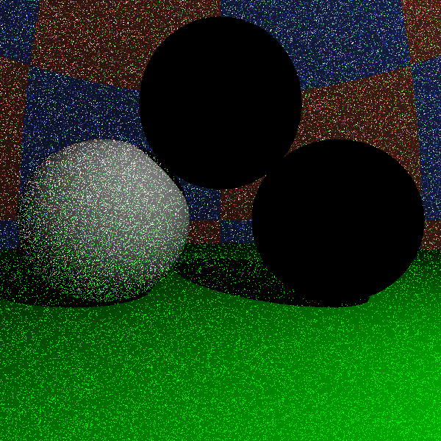
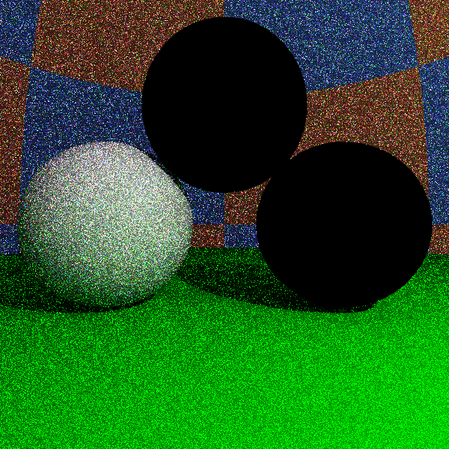
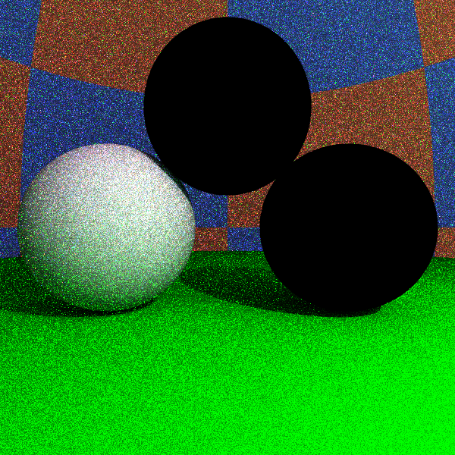
Uniform
1 sample/pixel
10 samples/pixel
100 samples/pixel

Slide 37
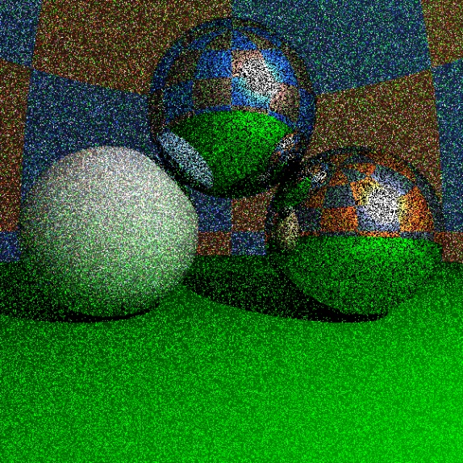
Fontosság szerinti mintavétel
$$\frac{1}{M}\sum_{i=1}^{M}{\frac{f\left(z_{i}\right)}{p\left(z_{i}\right)}}$$
Becslő:
$f(z)/p(z)$legyen lapos. Ahol $f$ nagy, $p$ is legyen nagy
f /p
f /p
f
f
p
p
i
i
jó
rossz
hasonló $f/p$ hozzájárulások
Ritka, nagy $f/p$ hozzájárulások
Notes:
In order to reduce the error, the variation of f/p should be small, that is where the integrand is large, the probability density should also be large. It means that the sampling with this probability density will place more samples where the integrand is large. This concept is called importance sampling.
This figure compares a good and a bad sampling densities. In the first case the f/p terms in the approximating average will be similar, thus the average remains nearly constant as we add new samples.
In the second case, the important region is sampled rarely, thus the approximating average contains many small values when a very large f/p value appears. The corresponding pixel color is dark and suddenly it becomes very bright and remains bright for a long time. This situation should be avoided.

Slide 38
Véletlen bolyongás
pixel
r
$$ω$$
$$\hat{ω}$$
y
$$\int_{Ω}{L\left(y,ω′\right)R\left(ω,ω′\right)}dω′≈\frac{L\left(y, \hat{ω}\right)R\left(ω,\hat{ω}\right)}{p(\hat{ω})}$$
$p(\hat{ω})$ –nak az integrandusra kell hasonlítania (fontosság)
A$L\left(y,ω′\right)$ nem ismerjük, mert éppen számoljuk
$p(\hat{ω})$ legyen arányos $R\left(ω,\hat{ω}\right)$

Slide 39
Tükör: Irány diszkrét eloszlású (Diract-delta)
N
cos α = - ($ω$·N)
$$\hat{ω}$$
$\hat{ω}$ = $ω$ + 2N cos α
$$ω$$
α
α
r
float SampleMirror(vec3 N, vec3 inDir, vec3& outDir) {
outDir = inDir - N * dot(N, inDir) * 2.0f;
return 1; // pdf
}

Slide 40
Diffúz: Irány cos eloszlással
N
$$\hat{ω}$$
$p(\hat{ω})$ d$ω=Prob\{\hat{ω} in \text{d}ω$}
θ
d$ω$
$=Prob\{q in \text{d}ωcos⁡(θ)$}
$$=\frac{\text{d}ω cos⁡(θ)}{kör területe}$$
Ha q egyenletes
eloszlású
$$q$$
$$=\frac{\text{d}ω cos⁡(θ)}{π}$$
$$\text{d}ωcos⁡(θ)$$
$$p\left(\hat{ω}\right)=\frac{cos⁡(θ)}{π}$$

Slide 41
Cos eloszlású minták
T
+1,+1
N
$$\hat{ω}$$
$$(x,y)$$
θ
B
-1,-1
$$(x,y)$$
B
Elvetett minták
T
float SampleDiffuse(vec3 N, vec3 inDir, vec3& outDir) {
vec3 T = normalize(cross(N, vec3(1,0,0)));
vec3 B = cross(N, T);
float x, y, z;
do { x = 2*random()-1; y = 2*random()-1; } while(x*x+y*y>1);
z = sqrtf(1 - x*x - y*y); // project to hemisphere
outDir = T * x + B * y + N * z;
return z/M_PI; // pdf
}

Slide 42
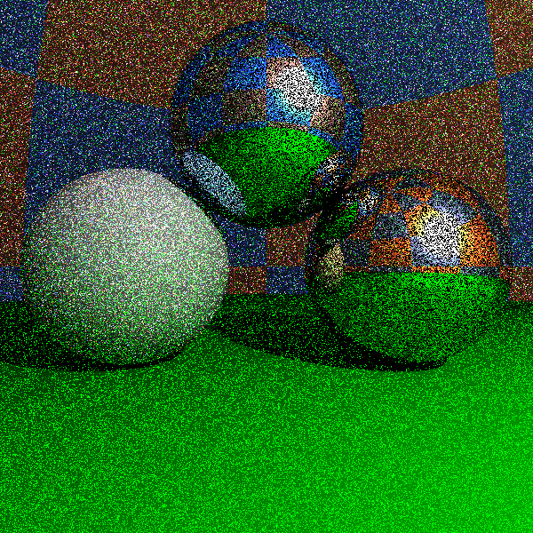
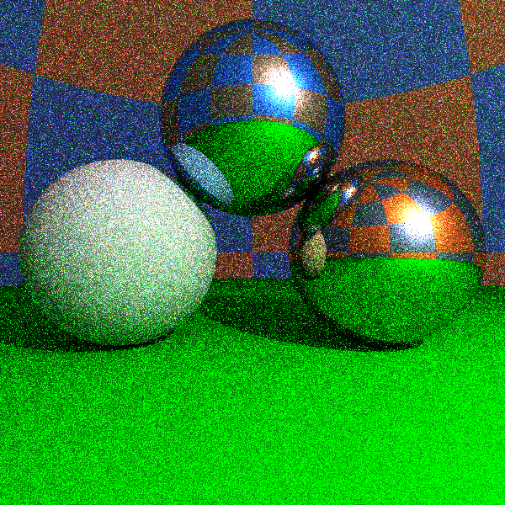
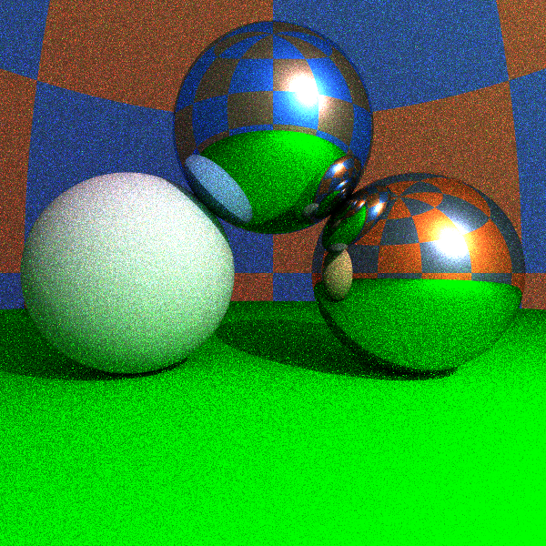
Fontosság szerinti mintavétel
egyenletes
cos + diszkrét
1 sample/pixel
10 samples/pixel
100 samples/pixel

Slide 43
Megállás és visszaverődés típus: Orosz rulett
1. Monte Carlo integrál:
2. Számold $E\left[L_{d}\right]$-t $s_{d}$ valószínűséggel, $E\left[L_{m}\right]$-t $s_{m}$ valószínűséggel, egyébként 0
3. K$ompenzálj s$-sel osztással
$$\int_{Ω}{L\left(y,ω′\right)R\left(ω,ω′\right)}dω^{′}=E\left[\frac{L\left(y, \hat{ω}\right)k_{d}⁡\cos^{+}(θ)}{p_{d}(\hat{ω})}\right]+E\left[\frac{L\left(y, \hat{ω}\right)Fδ\left(ω_{m},\hat{ω}\right)}{p_{m}(\hat{ω})}\right]$$
$R_{d}$+ $R_{m}$
$$E\left[L_{d}\right]$$
$$E\left[L_{m}\right]$$
Várható érték OK:
$s_{d}E\left[L_{d}/s_{d}\right]+s_{m}E\left[L_{m}/s_{m}\right]+\left(1−{s_{d}−s}_{m}\right)0=E\left[L_{d}\right]+$ $E\left[L_{m}\right]$

Slide 44
A visszaverődés típusának kiválasztása
$$\frac{L_{d}}{s_{d}}=\frac{L\left(y, \hat{ω}\right)k_{d}⁡\cos^{+}(θ)}{p_{d}(\hat{ω})s_{d}}=L\left(y, \hat{ω}\right)\frac{k_{d}⁡\cos^{+}(θ)}{\frac{cos⁡(θ)}{π}s_{d}}=L\left(y, \hat{ω}\right)\frac{k_{d}π}{s_{d}}$$
$$\frac{L_{m}}{s_{m}}=\frac{L\left(y, \hat{ω}\right)Fδ\left(ω_{m},\hat{ω}\right)}{p_{m}(\hat{ω})s_{m}}=L\left(y, \hat{ω}\right)\frac{F}{s_{m}}$$
Tükörirány valószínűsége: $s_{m}=F$ luminance
D$iffúz irány valószínűsége: s_{d}=k_{d}π$ luminance
M$egállás valószínűsége: 1−s_{m}−s_{d}$
0
1
$$s_{d}$$
$$s_{m}$$

Slide 45
Path Tracer
vec3 trace(Ray ray, int depth = 0) {
Hit hit = firstIntersect(ray);
if (hit.t < 0 || depth >= maxdepth) return vec3(0,0,0);
[r , N , k_{d} , n, κ] ← hit;
vec3 outRad = DirectLight(hit);
rnd = random(); // Russian roulette
s_{d} = Luminance(k_{d} π); s_{m} = Luminance(Fresnel(ray.dir,N));
if (rnd < s_{d}) { // diffuse
pdf = SampleDiffuse(N, ray.dir, outDir);
inRad = trace(Ray(r + Nε, outDir), depth+1);
outRad += inRad * k_{d} * dot(N, outDir) / pdf / s_{d};
} else if (rnd < s_{d} + s_{m}) { // mirror
pdf = SampleMirror(N, ray.dir, outDir);
inRad = trace(Ray(r + Nε, outDir), depth+1);
outRad += inRad * Fresnel(ray.dir,N) / pdf / s_{m};
}
return outRad;
}

