Slide 1
Grafikus hardver/szoftver alapok Építőelemek
”In theory, there is no difference between theory and practice. In practice, there is.”
Benjamin Brewster
Szirmay-Kalos László

Slide 2
Interaktív rendszer: Funkcionális modell
Éppen belemerül
a virtuális világba
Bemeneti csővezeték
Eszköz-
képtér
Inv.
Viewport
transzf
Inv.
kamera
transzf
Inv.
Modell
transzf.
CPU:
operációs
rendszer
Fejre
állítva!
kamera
Virtuális világ
Kép
frissítés
vektorizáció
CPU: app
fix hw
Pixel
proc
Raszteri-
záció
Viewport
transzf
Vágás
Kamera
transzf
Modell
transzf.
rasztertár
VAO
VBO
pixel shader+blending
vertex shader
Kimeneti csővezeték: GPU
Notes:
From system point of view, a graphics application handles the user input, changes the virtual world by modeling or animating it, and then immediately renders the updated model presenting the image to the user. This way, the user immerses into the virtual world, i.e. he feels that he is promptly informed about its current state.
The process from the input to the virtual world is called the input pipeline. Similarly, the process mapping the virtual world to the screen is the output pipeline.
The complete system is a (control) loop with two important points, the virtual world and the user. In the output pipeline, the virtual world is vectorized first since only points, lines and polygons can be transformed with homogeneous linear transformations. Then modeling, view and projection transformations are executed moving the current object to normalized device space. Here clipping is done, then the object is transformed to the screen, where it is rasterized. Before being written in the frame buffer, pixels can undergo pixel operations, needed, for example, to handle transparent colors. The frame buffer is read periodically to refresh the screen. The user can see the screen and interact with the content by moving the cursor with input devices and starting actions like pressing a button. Such actions generate events taking also the screen space position with them.
Screen space is the whole screen in full-screen mode or only the application window. The unit is the pixel. Note that screen space is different for the operating system and for OpenGL. For MsWindows and XWindow, axis y points downward while in OpenGL axis y points upward. Thus, y must be flipped, i.e. subtracted from the vertical resolution. The input pixel coordinate goes from the screen to modeling space, thus inverse transformations are applied in the reverse order. With input devices not only the virtual world can be modified but also the camera can be controlled.

Slide 3
Szoftver architektúra
glut…( )
Operációs
rendszer
onDisplay()
onMouse()
onKeyboard()
Applikáció
(CPU)
freeglut
Grafikus könyvtár: OpenGL
Rasztertár
gl…3dv( )
Rajzolás (GPU)
Notes:
Our graphics application runs under the control of an operating system together with other applications. The operating system handles shared resources like input devices and the frame buffer as well, so a pixel data in the frame buffer can be changed only via the operating system. Modifying pixels one by one from the application would be too slow, so a new hardware element, called the GPU, shows up that is responsible for many time consuming steps of rendering. The GPU is also a shared device that can be accessed via the operating system. Such accesses are calls to a library for the application program. We shall control the GPU through a C graphics library called OpenGL.
On the other hand, to catch input events handled by the operating system, we need another library. We shall utilize the freeGLUT for this purpose, due to its simplicity and the portability (it runs on MsWindows, Xwindow, etc.)
The operating system separates the hardware from the application. The operating system is responsible for application window management and also letting the application give commands to the GPU via OpenGL, not to mention the re-programming of the GPU with shader programs.
OpenGL is collection of C functions of names starting with gl. The second part of the name shows what the function does, and the final part allows to initiate the same action with different parameter numbers and types (note that there is not function overloading in C).
To get an access to the GPU via OpenGL, the application should negotiate this with the operating system, for which operating system dependent libraries, like the wgl for MsWindows and glX for Xwindow are available. Using them is difficult, and more importantly, it makes our application not portable. So, to hide operating system dependent features, we use GLUT, which translates generic commands to the operating system on which it runs. It is simple and our application will be portable. GLUT function names start with glut.

Slide 4
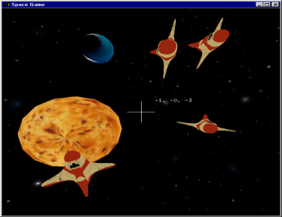
Esemény kezelés (GLUT)
Ablak létrehozás
callback regisztráció
main
Operációs
és ablakozó
rendszer
(Windows)
DisplayFunc
freeglut
KeyboardFunc
KeyboardUpFunc
SpecialFunc
callback-ek
Reshape
MouseFunc
grafikus
hardver
OpenGL
MotionFunc
IdleFunc
applikáció
Notes:
The graphics output is implemented by OpenGL. The application window management and the input are the responsibilities of GLUT. Our application consists of a main function and a set of event handlers (we use event driven programming paradigm in interactive systems). In main, our application program interacts with GLUT and specifies the properties of the application window (e.g. initial resolution and what a single pixel should store), and also the event handlers.
An event handler is a C function that should be programmed by us. This function is connected to a specific event of GLUT, and having established this connection we expect GLUT to call our function when the specific event occurs. A partial list of possible events are:
Display event that occurs when the application window becomes invalid and thus GLUT asks the application to redraw the window to restore its content.
Keyboard event occurs when the user presses a key having ASCII code.
Special event is like Keyboard event but is triggered by a key press having no ASCII code (e.g. arrows and function keys).
Reshape handler is called when the dimensions of the application window are changed by the user.
Mouse event means the pressing or releasing the button of the mouse.
Idle event indicates the time elapsed and our virtual world model should be updated to reflect the new time.
Event handler registration is optional with the exception of the Display event. If we do not register a handler function, nothing special happens when this event occurs.

Slide 5
OpenGL 3.3 … 4.6 (Modern OpenGL)
CPU program
VAO
VBO
Vertex
Buffer
Object
VBO
Vertex
Buffer
Object
Textúra
memória
glPointSize
glLineWidth
glTexparameter
glUniform
glUniform
glBlendFunc
glDrawArrays
glViewport
Sampler
Texel szín
reg1
reg2
reg3
reg4
…
gl_Position
Csúcspont árnyaló
(vertex shader)
reg1
reg2
reg3
reg4
…
gl_FragCoord
reg1, reg2, reg3 …: AttribArray
Pixel
árnyaló
(fragment
shader)
Vágás, homdiv
Viewport tr.
Raszterizáció
Pixel
szín
Kompozit
rasztertár
Normalizált
képernyő
Képernyő
pixel cím
Csúcspontok
Primitívek
Pixelek
Notes:
Primitives (e.g. a line or a triangle mesh) go down the pipeline, each having multiple vertices associated with their homogeneous coordinates and possible attributes (e.g. vertex color). Primitives must be transformed to normalized device space for clipping, which requires the transformation of its vertices with the modeling, viewing and projection transformation matrices. Clipping is done, so is homogeneous division if the fourth homogeneous coordinate is not 1. Then the primitive is transformed to screen space taking into account the viewport position and size. The primitive is rasterized in screen space.
For performance reasons, OpenGL 3 retained mode requires the application to prepare the complete data of the vertices and attributes of a single object rather than passing them one by one. These data are to be stored in arrays on the GPU, called Vertex Buffer Object (VBO). An object can have multiple VBOs, for example, we can put coordinates in a single array and vertex colors in another. Different VBOs are encapsulated into a Vertex Array Object (VAO) that also stores information about how the data should be fetched from the VBOs and sent to the input registers of the Vertex Shader. A single input register can store four 32 bit long words (4 floats called vec4, or four integers) and is called Vertex Attrib Array. The responsibility of the Vertex Shader is to transform the object to normalized device space. If the concatenation of model, view and projection matrices is given to the Vertex Shader, it is just a single matrix-vector multiplication. The output of the Vertex Shader goes to output registers including gl_Position storing the vertex position in normalized device space and other registers storing vertex attributes. Clipping, homogeneous division, viewport transformation and rasterization are performed by the fixed function hardware of the GPU, so these steps cannot be programmed. The output of the rasterization step is the sequence of pixels with pixel coordinates and interpolated vertex attributes. Pixel coordinates select the pixel that is modified in the frame buffer. From other vertex attributes and global variables, the pixel color should be computed by another programmable unit called the Fragment Shader.

Slide 6
Csúcspont adatfolyamok
VAO
interleaved
VAO
VBO 0
x1, y1
R1, G1, B1
x2, y2
R2, G2, B2
x3, y3
R3, G3, B3
VBO 0
x1, y1
x2, y2
x3, y3
VBO 1
R1, G1, B1
R2, G2, B2
R3, G3, B3
glVertexAttribPointer
Vertex shader
Input registers
AttribArray 0
AttribArray 1
AttribArray …
in var1
in var2
Vertex shader
Notes:
Let us zoom out the connection of the vertex buffer objects, vertex shader input registers called AttribArrays, and vertex shader input variables. The object is described in arrays called VBOs. For example, coordinates can be stored in one array, colors in another (this strategy is called Structure Of Arrays, or SOA for short). To allow the Vertex Shader to process a vertex, its input registers must be filled with the data of that particular vertex, one vertex at a time. Function glVertexAttribPointer tells the GPU how to interpret the data in VBOs, from where the data of a single vertex can be fetched, and in which AttribArray a data element should be copied. For example, coordinates can be copied to AttribArray0 while colors to AttribArray1 (a single register can store 4 floats).
When the Vertex Shader runs, it can fetch its input registers. It would not be too elegant if we had to refer to the name of the input register, e.g. AttribArray 0, so it is possible to assign variable names to it. For example, AttribArray0 can be the ”vertexPosition”.
Note that this was only one possibility of data organization. For example, it is also perfectly reasonable to put all data in a single array where coordinates and attributes of a single vertex are not separated (this strategy is the Array Of Structures, or AOS). In this case glVertexAttribPointer should tell the GPU where an attribute starts in the array and what the step size (stride) is.

Slide 7
Rajzolás: glDrawArrays, OpenGL primitívek
glBindVertexArray(vao);
glDrawArrays(primitiveType, startIdx, numOfElements);
Vektorizált parametrikus görbe
GL_POINTS
GL_LINES
GL_LINE_STRIP
GL_LINE_LOOP
Tesszellált 3D
parametrikus felület
Fülvágó kimenete
„Konvex” poligon
GL_TRIANGLES
GL_TRIANGLE_STRIP
GL_TRIANGLE_FAN
Notes:
This is the set of possible primitive types. Basically points, line segments and triangles, but in sophisticated options sharing vertices is also possible.
GL_LINE_STRIP assumes that the end point of a line segment is the start of the next, so shared points should be specified only once. GL_LINE_LOOP is similar to GL_LINE_STRIP, but adds one more edge between the last and first vertices. GL_TRIANGLES require vertices of multiples of three, and each three vertices define a new triangle. We use it, for example, when a polygon is decomposed to triangles with the ear clipping algorithm. GL_TRIANGLE_STRIP needs three vertices for the first triangle, then any additional vertex introduces a new triangle of the last, previous, and previous of the previous vertices. GL_TRIANGLE_FAN can be used for convex polygons. Here again the first three vertices define the first triangle and any new vertex adds a new triangle of the last vertex, previous vertex and first vertex.

Slide 8
OpenGL állapotgép + erőforrások
Gagyi grafikus könyvtár
OpenGL
fillOval(x1,y1,x2,y2, texture, color, width,…);
glPointSize(3);
glLineWidth(5);
glBindVertexArray(vao);
glBindBuffer(GL_ARRAY_BUFFER, vbo);
glBindTexture(GL_TEXTURE_2D, textureId);
glBufferData(GL_ARRAY_BUFFER, 10, v, GL_STATIC_DRAW);
glTexImage2D(GL_TEXTURE_2D, 0, GL_RGBA, w, h, …);
glDrawArrays(GL_TRIANGLES, 0, 3); // Mind!!!

Slide 9
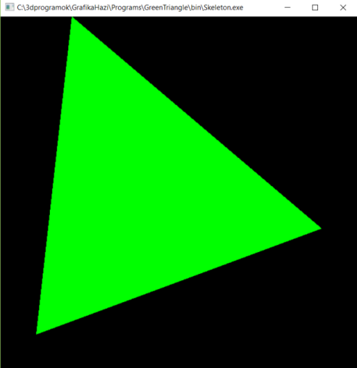
Grafikus hardver/szoftver alapok 2. Helló OpenGL/GLSL/GLUT
Szirmay-Kalos László

Slide 10
Az első OpenGL programom: Zöld háromszög
(100,100)
#include <windows.h> // Only in MsWin
#include <GL/glew.h> // MsWin/XWin, download (Ikits Milán, Hajrá IIT)
#include <GL/freeglut.h> // download (Mark Kilgard)
int main(int argc, char * argv[]) {
glutInit(&argc, argv); // init glut
glutInitContextVersion(3, 3); // OpenGL 3.3
glutInitWindowSize(600, 600);
glutInitWindowPosition(100, 100);
glutInitDisplayMode(GLUT_RGBA | GLUT_DOUBLE);
glutCreateWindow(“Hi Graphics");
glewExperimental = true; // magic
glewInit(); // NO OPENGL CALLS BEFORE THIS !!!
glViewport(0, 0, 600, 600);
onInitialization();
glutDisplayFunc(onDisplay); //event handler
glutMainLoop(); // message loop
return 1;
}
600
600
(1,1)
(-0.6,1)
(0.8,-0.2)
(-0.8,-0.8)
(-1,-1)
Notes:
In the main function of a graphics application, we set up the application window with the help of GLUT telling the initial position, size, what data should be stored in a pixel, and also what functions should be called when different events happen. At the end, the message loop is started, which checks whether any event occurred for which we have registered an event handler, and if this is the case, it calls the respective event handler.
The main function can also be used to initialize data in OpenGL (on the GPU), especially those which are needed from the beginning of the program execution and which do not change during the application. We need shader programs from the beginning, so this is a typical place to compile and link shader programs and upload them to the GPU.
Let us start with the main function. Two header files are needed.
GLEW is the opengl Extension Wrangler library that finds out what extensions are supported by the current GPU in run time. It is our interface to OpenGL, which works even if we select a higher OpenGL version that is supported by the header file in our computer (If you have a MsWindows system, it is very likely that your opengl header and library files support only OpenGL 1.0, while we work in OpenGL 3.3 or higher versions. The difference is made by GLEW).
GLUT is a windowing utility toolkit to set up the application window and to manage events.
In the main functions, first the application window is set up with glut calls:
- glutInit initializes glut and allows use to communicate with the GPU via OpenGL.
- glutInitContextVersion sets the required OpenGL version. In this case, we want OpenGL 3.3.
- glutInitWindowSize specifies the initial resolution of the application window.
- glutInitWindowPosition specifies where it is initially placed relative to the upper left corner of the screen.
- glutInitDisplayMode tells glut what to store in a single pixel. In the current case, we store 8 bit (default) R,G,B, and A (opacity) values, in two copies to support double buffering.
- glutCreateWindow creates the window, which shows up.
The Extension Wrangler is initialized
glewExperimental = true: GLEW obtains information on the supported extensions from the graphics driver, so if it is not updated, then it might not report all features the GPU can deliver. Setting glewExperimental to true gets GLEW to try the extension even if it is not listed by the driver. This is indeed magic.
glewInit makes the initialization
From here, we can ha an initialized OpenGL. Do not call any OpenGL functions before this point!
- glViewport sets the render target, i.e. the photograph inside the application window
- onInitialization is our custom initialization function discussed on the next slide.
The remaining functions register event handlers and start the message loop. For the time being, only the onDisplay is relevant, which is called whenever the application window becomes invalid. We use this function to render the virtual world, which consists of a single green triangle, directly given in normalized device space.

Slide 11
onInitialization()
vao
vbo
24 bytes
vbo
vbo
3 vertices
2 floats/vertex
unsigned int prog; // GPU program id
unsigned int vao, vbo; // virtual world on the GPU
void onInitialization() {
glGenVertexArrays(1, &vao); // Generate 1 vao
glBindVertexArray(vao); // make it active
glGenBuffers(1, &vbo); // Generate 1 buffer
glBindBuffer(GL_ARRAY_BUFFER, vbo); // make it active
float vertices[] = {-0.8f,-0.8f, -0.6f,1.0f, 0.8f,-0.2f}; // Geometry
glBufferData(GL_ARRAY_BUFFER, // Copy to GPU target
sizeof(vertices), // # bytes
vertices, // address
GL_STATIC_DRAW); // we do not change later
glEnableVertexAttribArray(0); // AttribArray 0
glVertexAttribPointer(0, // vbo -> AttribArray 0
2, GL_FLOAT, GL_FALSE, // two floats/attrib, not fixed-point
0, NULL); // stride, offset: tightly packed
AttribArray 0
Notes:
In onInitialization those OpenGL data are initialized that are typically constant during the application, so they do not have to be set in every drawing. In our program, this includes the constant geometry (the triangle), and the GPU shader programs. The shaderProgram and the vao are set here but also used in the onDisplay, therefore they are global variables.
First we allocate one vertex array object and its id is vao. With Binding, this is made active, which means that all subsequent operations belong to this vao until another vao is bound or the current one is unbound with binding 0.
In the second step, one vertex buffer object is allocated, which will be part of the active vao (we have just one, which is active). This vertex buffer object is made active, so all subsequent operations are related to this until another is bound.
Array ”vertices” stores the geometry of our triangle, and is obviously in the CPU memory. It contains 6 floats, i.e. 24 bytes. With glBufferData the 24 bytes are copied to the GPU. With the last parameter of glBufferData we can specify which type of GPU memory should be used (the GPU has different types of memory with different write and read speeds and capacity, so the driver may decide where to copy this 24 bytes based on our preference). We say that the 24 bytes will not be modified but it would be great if it could be fetched fast (constant memory would be an ideal choice). So far we said nothing about the organization and the meaning of the data, it is simply 24 bytes, the GPU does not know that it defines 3 vertices, each with 2 Cartesian coordinates, which are in float format.
glVertexAttribPointer() defines the interpretation of the data and also that the data associated with a single vertex goes to the input register (AttribArray) number 0. It specifies that a single vertex have two floats, i.e. 8 bytes. If it was non floating point value, it would also be possible to put the binary point to the most significant bit, but we set this parameter to GL_FALSE.
The last two parameters tell the GPU how many bytes should be stepped from one vertex to the other (if it is 0, it means that the step size is equal to the data size, 2 floats in this case), and where the first element is (at the beginning of the array, so the pointer offset is zero). Stride and offset are essential if interleaved vbos are used.

Slide 12
Folyt.
#version 330
precision highp float;
layout(location = 0) in vec2 vp;
void main() {
gl_Position = vec4(vp.x,vp.y,0,1);
}
#version 330
precision highp float;
uniform vec3 color;
out vec4 outColor;
void main() {
outColor = vec4(color,1);
}
C++11
const char * vertSource = R"( … )“; // OR from file
const char * fragSource = R"( … )“;
unsigned int vertShader = glCreateShader(GL_VERTEX_SHADER);
glShaderSource(vertShader, 1, &vertSource, NULL);
glCompileShader(vertShader);
unsigned int fragShader = glCreateShader(GL_FRAGMENT_SHADER);
glShaderSource(fragShader, 1, &fragSource, NULL);
glCompileShader(fragShader);
prog = glCreateProgram(); // global variable
glAttachShader(prog, vertShader); glAttachShader(prog, fragShader);
glBindFragDataLocation(shaderProgram, 0, "outColor");
glLinkProgram(shaderProgram);
glUseProgram(shaderProgram); // make it active
}
Notes:
The remaining part of the onInitialization gets the shader programs ready. The source of the shader programs can be read from a file or directly copied from a string. We use here the latter option. As programs are typically written in more than one line, the string cannot be simple “…” but should be special and hold new line characters, which is possible with the R”( … )” C++ feature.
The vertex shader source code starts with the version number that tells the compiler how matured GPU is assumed during execution.
Uniform parameters are like constants that cannot change during the drawing of a single primitive. MVP is a 4x4 matrix (type mat4), which represents the model-view-projection matrix. The vertex shader has one per-vertex attribute, defined with variable name vp and storing the x, y coordinates of the current vertex. The vertex shader code computes the multiplication of 4 element vector that is the conversion of vp to 3D homogeneous coordinates and the 4x4 MVP matrix, and the result is written into a specific output register called gl_Position, which should get the point transformed to normalized device space. The vertex shader could output other variables as well, which would follow the point during clipping and rasterization, and would be interpolated during these operations. Clipping, homogeneous division, viewport transform and rasterization are fixed function elements that cannot be programmed.
The output of the fixed function part is the sequence of pixels (called fragments) belonging to the current primitive and also the variables that are output by the vertex shader, having interpolated for the current pixel. The pixel address is in register gl_FragCoord, which cannot be modified, but from the other registers and uniform variables, the color of this fragment can be obtained by the fragment shader processor. It has one uniform input called the color, which will determine the output color stored in variable outColor.
The very beginning of the pipeline, vertex coordinate variable vp is connected to the vertex shader input register (AttribArray) number 0 as told by the layout(location = 0) statement. The output of the fragment shader goes to the frame buffer as requested by glBindFragDataLocation.
Finally, the shader program is linked, copied to the shader processors to be executed by them.

Slide 13
#version 330
precision highp float;
layout(location = 0) in vec2 vp;
void main() {
gl_Position = vec4(vp.x,vp.y,0,1);
}
#version 330
precision highp float;
uniform vec3 color;
out vec4 outColor;
void main() {
outColor = vec4(color,1);
}
void onDisplay( ) {
glClearColor(0, 0, 0, 0); // background color
glClear(GL_COLOR_BUFFER_BIT); // clear frame buffer
// Set color to (0, 1, 0) = green
int location = glGetUniformLocation(prog, “color");
glUniform3f(location, 0.0f, 1.0f, 0.0f); // 3 floats
glBindVertexArray(vao);
// Draw call
glDrawArrays(GL_TRIANGLES, 0 /*startIdx*/, 3 /*# Elements*/);
glutSwapBuffers( ); // exchange buffers for double buffering
}
Notes:
We have registered a single event handler (onDisplay) that reacts to the event occurring when the application window gets invalid (DisplayFunc).
In this function, the virtual world (consisting of the single green triangle) is rendered.
glClearColor sets the color with which the pixels of the application window is cleared. This color is black. The actual clearing is done by glClear. GL_COLOR_BUFFER_BIT stands for the frame buffer storing color values.
Drawing consists of setting the values of uniform variables of shaders and then forcing the geometry through the pipeline, which is called the draw call. Finally, the buffer used for drawing so far is swapped with the buffer the user could see so far by glutSwapBuffers, so the result will be visible to the user.
The fragment shader has a single uniform variable called color and of type vec3, which can be set with function glUniform3f(location, 0.0f, 1.0f, 0.0f) to value (0,1,0)=green. Note that ”3f” at the end of the function name indicates that this function takes 3 float parameters. Parameter location is the serial number of this uniform variable, which can be found with glGetUniformLocation(shaderProgram, “color") which returns the serial number of uniform variable called “color” in the shader programs.
The vertex shader has uniform variable MVP of type mat4, i.e. it is a 4x4 matrix. First, its serial number must be obtained, then its value can be set with glUniformMatrix4fv. Here fv means that matrix elements are floats (f) and instead of passing the 16 floats by value, the address of the CPU array is given (v) from which the values can be copied (pass by address). The second parameter of glUniformMatrix4fv says that 1 matrix is passed, the third parameter that this is a row-major matrix and should be kept this way.
This issue can cause a lot of confusion:
In C or C++ two-dimensional matrices are of row-major.
In GLSL two-dimensional matrices are of column-major.
So if we use them without caution, we might apply the transpose of the matrix and not what we wanted. There are many solutions for this problem:
Use an own 2D matrix class in C++ that follows the column-major indexing scheme, and consider vectors of points as row vectors both on the CPU and on the GPU.
Use an own 2D matrix class in C++ that follows the column-major indexing scheme, and consider vectors of points as column vectors both on the CPU and on the GPU. The matrices will be transposed with respect to the previous solution.
Use the standard 2D matrix indexing on the CPU (row-major) and the standard 2D matrix indexing on the GPU (column-major), but consider points as row vector in the CPU program (and therefore put on the left side of the transformation matrix) and column vector in the GPU program (and put on the right side of the matrix).
Use the standard 2D matrix indexing on the CPU (row-major) but transpose the matrix when passed to the GPU, and consider points as row vector both in the CPU program and in the GPU program.
We use option 4, and setting the third parameter of glUniformMatrix4fv to TRUE enables just the required transpose.
Vertex Array Objects are our virtual world objects already uploaded to the GPU. With glBindVertexArray(vao) we can select one object for subsequent operations (drawing) and finally glDrawArrays gets the current VAO to feed the pipeline, i.e. this object is rendered. We may not send all vertices of this object, so with startIdx and number of elements a subset can be selected. Setting startIdx to 0 and sending all 3 points, our whole triangle is rendered. The first parameter of glDrawArrays tells the GPU the topology of the primitive, that is, what the vertices define. In our case, triangles, and as we have only 3 vertices, a single triangle.

Slide 15
Grafikus hardver/szoftver alapok Program: Keret és zöld háromszög
”The GL in OpenGL stands for Good Luck because you are going to need it.”
Anonymous
Szirmay-Kalos László

Slide 16
OpenGL starters’ kit: Shader programs
glCreate[Shader|Program]() létrehozás
glShaderSource() forrás feltöltés
glCompileShader() fordítás
glAttachShader() shader hozzáadás programhoz
glBindFragDataLocation() rasztertárba mi megy?
glLinkProgram() szerkesztés
glUseProgram() kiválasztás futásra
glGetUniformLocation() uniform változó cím lekérdez
glUniform*() uniform változó értékadás
class GPUProgram { // shader management with error handling
…
bool create(char* vertShader, char * fragShader,
char * outputName, char * geomShader = 0);
void Use();
void setUniform(…);
};

Slide 17
OpenGL starters’ kit
Erőforrás létrehozás, feltöltés és aktivizálás
glGen[VertexArrays|Buffers|Textures](nIds, ids);
glBind[VertexArray|Buffer|Texture](type, id);
glBufferData(type, nBytes, source, target);
glTexImage2D(type, …);
Bufferek vertex shader bemeneti regiszterekhez kötése
glEnableVertexAttribArray() regiszter engedély
glVertexAttribPointer(reg, …) bufferből mely regiszterbe
Rajzolás és csővezeték management
glDrawArrays(type, start, n) vao bufferek felrajzolása
glClearColor(r, g, b, a) háttér törlési szín
glClear(buffer) háttér törlés
glViewport(l, b, w, h) fénykép méret
glPointSize(size) pont méret
glLineWidth(width) vonal vastagság

Slide 18
framework.h
include: <stdio.h>, <stdlib.h>, <math.h>, <vector>, <string>
if windows <windows.h>
<GL/glew.h>, <GL/freeglut.h> // must be downloaded
const unsigned int windowWidth = 600, windowHeight = 600;
struct vec2, vec3, vec4, mat4;
struct Texture {
unsigned int textureId;
void create(…);
};
class GPUProgram {
bool create(char * vertShader,
char * fragShader, char * outputName,
char * geomShader = nullptr);
void Use();
void setUniform(…);
};

Slide 19
framework.cpp
#include "framework.h"
void onInitialization(); // Init
void onDisplay(); // Redraw
void onKeyboard(unsigned char key, int pX, int pY); // Key pressed
void onKeyboardUp(unsigned char key, int pX, int pY); // Key released
void onMouseMotion(int pX, int pY); // Move mouse with key pressed
void onMouse(int button, int state, int pX, int pY); // Mouse click
void onIdle(); // Time elapsed
int main(int argc, char * argv[]) {
glutInit(&argc, argv); glutInitContextVersion(3, 3);
glutInitWindowSize(windowWidth, windowHeight); glutInitWindowPosition(100, 100);
glutInitDisplayMode(GLUT_RGBA | GLUT_DOUBLE | GLUT_DEPTH);
glutCreateWindow(argv[0]);
glewExperimental = true; glewInit();
onInitialization();
glutDisplayFunc(onDisplay); // Register event handlers
glutMouseFunc(onMouse);
glutIdleFunc(onIdle);
glutKeyboardFunc(onKeyboard);
glutKeyboardUpFunc(onKeyboardUp);
glutMotionFunc(onMouseMotion);
glutMainLoop(); return 1;
}

Slide 20
Skeleton.cpp
#include "framework.h"
char * vertexSource = R"(…)";
char * fragmentSource = R"(…)";
GPUProgram gpuProgram;
unsigned int vao, vbo;
void onInitialization() {
glViewport(0, 0, windowWidth, windowHeight);
glGenVertexArrays(1, &vao); glBindVertexArray(vao);
glGenBuffers(1, &vbo); glBindBuffer(GL_ARRAY_BUFFER, vbo);
float vtx[] = {-0.8f, -0.8f, -0.6f, 1.0f, 0.8f, -0.2f};
glBufferData(GL_ARRAY_BUFFER, sizeof(vtx), vtx, GL_STATIC_DRAW);
glEnableVertexAttribArray(0);
glVertexAttribPointer(0, 2, GL_FLOAT, GL_FALSE, 0, NULL);
gpuProgram.create(vertexSource, fragmentSource, "outColor");
}
void onDisplay() {
glClearColor(0, 0, 0, 0); // background color
glClear(GL_COLOR_BUFFER_BIT); // clear frame buffer
gpuProgram.setUniform(vec3(0, 1, 0), “color“);
glBindVertexArray(vao);
glDrawArrays(GL_TRIANGLES, 0, 3);
glutSwapBuffers(); // exchange buffers for double buffering
}

Slide 21
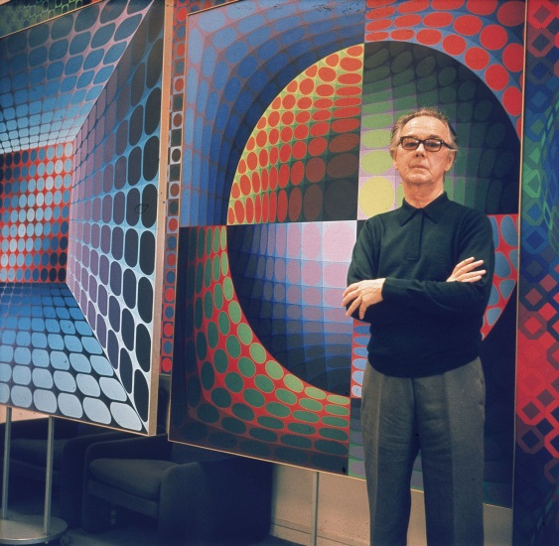
Grafikus hardver/szoftver alapok Program: Vasarely festmény
Szirmay-Kalos László

Slide 22
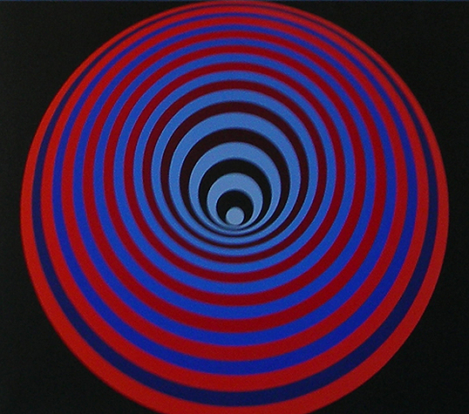
Mi ez?
Körök, kicsik fedik a nagyokat
20 kör vagy 1 kör transzformálva?
Középpont elindul felfelé, majd visszatér

Slide 23
onInitialization
#include "framework.h"
GPUProgram gpuProgram;
unsigned int vao, vbo;
const int nVertices = 100;
void onInitialization() {
glViewport(0, 0, windowWidth, windowHeight);
glGenVertexArrays(1, &vao); glBindVertexArray(vao);
glGenBuffers(1, &vbo); glBindBuffer(GL_ARRAY_BUFFER, vbo);
std::vector<vec2> vtx(nVertices);
for (int i = 0; i < nVertices; i++) {
float phi = i * 2.0f * M_PI / nVertices;
vtx[i] = vec2(cosf(phi), sinf(phi)); // unit radius circle
}
int nBytes = vtx.size() * sizeof(vec2);
glBufferData(GL_ARRAY_BUFFER, nBytes, vtx.data(), GL_STATIC_DRAW);
glEnableVertexAttribArray(0);
glVertexAttribPointer(0, 2, GL_FLOAT, GL_FALSE, 0, NULL);
gpuProgram.create(vertexSource, fragmentSource, "outColor");
}

Slide 24
Csúcspont és pixel árnyalók
Vertex shader:
uniform float radius, up;
layout(location = 0) in vec2 vp;
void main() {
gl_Position = vec4(vp.x * radius, vp.y * radius + up, 0, 1);
}
Fragment shader:
uniform vec3 color;
out vec4 outColor;
void main() {
outColor = vec4(color, 1);
}

Slide 25
onDisplay
float rmax = 1.0f, amplitude = 0.8f;
void onDisplay() {
glClearColor(0, 0, 0, 0); // background color
glClear(GL_COLOR_BUFFER_BIT); // clear frame buffer
const int nCircles = 20;
const float r0 = rmax, r1 = rmax / nCircles;
vec3 ce0(1, 0, 0), ce1(0, 0, 0), co0(0, 0, 0.5f), co1(0, 1, 1);
for (int i = 0; i < nCircles; i++) {
float t = (float)i / (nCircles - 1.0f);
gpuProgram.setUniform(r0 * (1 - t) + r1 * t, “radius“);
gpuProgram.setUniform(t * (1 - t) * amplitude, “up“);
vec3 c = (i%2 == 0) ? ce0*(1-t) + ce1*t : co0*(1-t) + co1*t;
gpuProgram.setUniform(c, “color“);
glDrawArrays(GL_TRIANGLE_FAN, 0, nVertices);
}
glutSwapBuffers(); // exchange buffers for double buffering
}

Slide 26
Vezérlés
bool pressed[256] = { false, }; // keyboard state
void onKeyboard(unsigned char key, int pX, int pY) {
pressed[key] = true;
}
void onKeyboardUp(unsigned char key, int pX, int pY) {
pressed[key] = false;
}
void onIdle() {
float time = glutGet(GLUT_ELAPSED_TIME) / 1000.0f;
if (pressed['s']) rmax = 0.7f + 0.3f * sinf(time);
if (pressed['h']) amplitude = 0.9f * sinf(3 * time);
glutPostRedisplay(); // redraw the scene
}

Slide 27
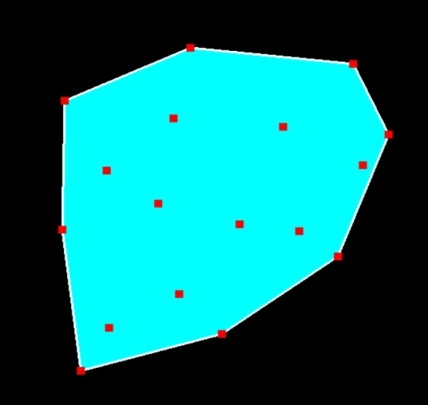
Grafikus hardver/szoftver alapok Program: Konvex burok, interakció
Szirmay-Kalos László

Slide 28
Konvex burok
Minimális, az adott pontokat tartalmazó konvex halmaz
Legalsó pontból indulunk, a kezdő irány balról jobbra.
While (vissza nem érünk) {
Következő pont, amelyhez minimálisat kell fordulni.
}

Slide 29
Csúcspont és pixel árnyalók
Vertex shader:
layout(location = 0) in vec2 vertexPosition;
void main() {
gl_Position = vec4(vertexPosition, 0, 1); // in NDC
}
Fragment shader:
uniform vec3 color;
out vec4 fragmentColor;
void main() {
fragmentColor = vec4(color, 1);
}

Slide 30
Constant color primitive object
class Object {
unsigned int vao, vbo; // GPU
vector<vec2> vtx; // CPU
public:
Object() {
glGenVertexArrays(1, &vao); glBindVertexArray(vao);
glGenBuffers(1, &vbo); glBindBuffer(GL_ARRAY_BUFFER, vbo);
glEnableVertexAttribArray(0); glVertexAttribPointer(0,2,GL_FLOAT,GL_FALSE,0,NULL);
}
vector<vec2>& Vtx() { return vtx; }
void updateGPU() { // CPU -> GPU
glBindVertexArray(vao); glBindBuffer(GL_ARRAY_BUFFER,vbo);
glBufferData(GL_ARRAY_BUFFER, vtx.size() * sizeof(vec2), &vtx[0], GL_DYNAMIC_DRAW);
}
void Draw(int type, vec3 color) {
if (vtx.size() > 0) {
glBindVertexArray(vao);
gpuProgram.setUniform(color, "color");
glDrawArrays(type, 0, vtx.size());
}
}
};

Slide 31
Convex hull
class ConvexHull {
Object points, hull; // points and hull
public:
void addPoint(vec2 p) { points.Vtx().push_back(p); }
void update() {
if (points.Vtx().size() >= 3) findHull(points.Vtx(), hull.Vtx());
points.updateGPU();
hull.updateGPU();
}
vec2 *pickPoint(vec2 pp, float threshold) {
for (auto& p : points.Vtx()) if (length(pp - p) < threshold) return &p;
return nullptr;
}
void Draw() {
hull.Draw(GL_TRIANGLE_FAN, vec3(0, 1, 1));
hull.Draw(GL_LINE_LOOP, vec3(1, 1, 1));
points.Draw(GL_POINTS, vec3(1, 0, 0));
}
};

Slide 32
Convex hull előállítás
void findHull(vector<vec2>& ps, vector<vec2>& hullps)
{
vec2 *pLow = &ps[0]; // Find lowest point
for(auto& p : ps) if (p.y < pLow->y) pLow = &p;
hullps.clear();
vec2 pCur = *pLow, *pNext, dir(1, 0);
do { // find convex hull points one by one
float maxCos = -1;
for(auto& p : ps) { // find minimal left turn
float len = length(p – pCur);
if (len > 0) {
float cosPhi = dot(dir, p – pCur) / len;
if (cosPhi > maxCos) { maxCos = cosPhi; pNext = &p;}
}
}
hullps.push_back(*pNext); // save as convex hull
dir = normalize(*pNext – pCur); // prepare for next
pCur = *pNext;
} while(pLow != pNext);
}

Slide 33
Virtuális világ és megjelenítése
ConvexHull * world;
vec2 * pickedPoint = nullptr;
GPUProgram gpuProgram;
void onInitialization() {
glViewport(0, 0, windowWidth, windowHeight);
glLineWidth(2);
glPointSize(10);
world = new ConvexHull;
gpuProgram.create(vertexSrc, fragmentSrc, "fragmentColor");
}
void onDisplay() {
glClearColor(0, 0, 0, 0);
glClear(GL_COLOR_BUFFER_BIT);
world->Draw();
glutSwapBuffers();
}

Slide 34
Controller
vec2 PixelToNDC(int pX, int pY) { // if full viewport!
return vec2(2.0f * pX / windowWidth – 1, 1 – 2.0f * pY / windowHeight);
}
void onMouse(int button, int state, int pX, int pY) {
if (button == GLUT_LEFT_BUTTON && state == GLUT_DOWN) {
world->addPoint(PixelToNDC(pX, pY));
world->update(); glutPostRedisplay(); // redraw
}
if (button == GLUT_RIGHT_BUTTON && state == GLUT_DOWN)
pickedPoint = world->pickPoint(PixelToNDC(pX, pY), 0.05f);
if (button == GLUT_RIGHT_BUTTON && state == GLUT_UP)
pickedPoint = nullptr;
}
void onMouseMotion(int pX, int pY) {
if (pickedPoint) {
*pickedPoint = vec2(PixelToNDC(pX, pY));
world->update(); glutPostRedisplay(); // redraw
}
}

Slide 35
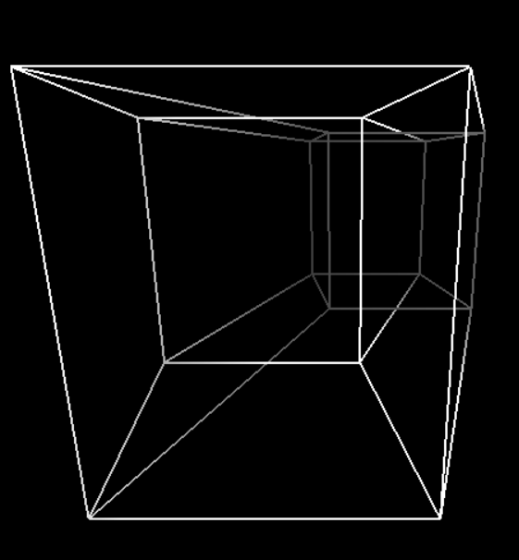
Grafikus hardver/szoftver alapok Program: Tesseract (4D kocka), animáció
Szirmay-Kalos László

Slide 36
N-dimenziós „kocka”
$$(−1,+1,+1)$$
$$(+1,+1,+1)$$
$$(−1,+1)$$
$$(+1,+1)$$
$$(−1,+1,−1)$$
$$(+1,+1,−1)$$
$$(+1,−1,+1)$$
$$(−1,−1,−1)$$
$$(+1,−1,−1)$$
$$−1$$
$$+1$$
$$(−1,−1)$$
$$(+1,−1)$$
Tesseract:
Csúcsok: $2^{4}=16$ darab
$$(±1,±1,±1,±1)$$
Élek: $\left({4 \atop 1}\right)2^{3}=32$ darab
1 csúcsból 4, 1 Hamming-ra
Lap: $\left({4 \atop 2}\right)2^{2}=24$
Határoló 3D test: $\left({4 \atop 3}\right)2=8$

Slide 37
#include "framework.h"
const char *vertexSrc = …, *fragmentSrc = …;
GPUProgram gpuProgram; // vertex and fragment shaders
class Tesseract {
void Animate(float t);
void Draw();
} *cube;
void onInitialization() {
glViewport(0, 0, windowWidth, windowHeight); glLineWidth(2);
cube = new Tesseract;
gpuProgram.create(vertexSrc, fragmentSrc, "fragColor");
}
void onDisplay() {
glClearColor(0, 0, 0, 0); glClear(GL_COLOR_BUFFER_BIT);
cube->Draw();
glutSwapBuffers();
}
void onIdle() {
cube->Animate(glutGet(GLUT_ELAPSED_TIME) / 1000.0f);
glutPostRedisplay();
}

Slide 38
Tesseract objektum
class Tesseract {
const int D = 4;
const int maxcode = (1 << D) - 1;
unsigned int vao, vbo; // GPU: vertex array object id
public:
Tesseract(); // copy edges to GPU
void Animate(float t); // set transformation
void Draw(); // trigger GPU
};

Slide 39
Élek a GPU-ra
Tesseract::Tesseract() {
vector<float> vtx; // CPU: vertices of the object
for (int code = 0; code <= maxcode; code++) {
for (int bit = 1; bit < maxcode; bit <<= 1) {
if ((code & bit) == 0) {
for (int b=1; b<maxcode; b<<=1) vtx.push_back((code&b)?1:-1);
for (int b=1; b<maxcode; b<<=1) vtx.push_back(!((code+bit)&b)?1:-1);
}
}
}
glGenVertexArrays(1, &vao); glBindVertexArray(vao);
glGenBuffers(1, &vbo); glBindBuffer(GL_ARRAY_BUFFER, vbo);
glBufferData(GL_ARRAY_BUFFER, 32*8*sizeof(float), &vtx[0], GL_STATIC_DRAW);
glEnableVertexAttribArray(0);
glVertexAttribPointer(0, 4, GL_FLOAT, GL_FALSE, 0, NULL);
}

Slide 40
Animáció és rajzolás
void Tesseract::Animate(float t) {
gpuProgram.setUniform(cosf(t/2), "cosfi");
gpuProgram.setUniform(sinf(t/2), "sinfi");
gpuProgram.setUniform(cosf(t/3), "costh");
gpuProgram.setUniform(sinf(t/3), "sinth");
}
void Tesseract:: Draw() {
glBindVertexArray(vao);
glDrawArrays(GL_LINES, 0, 32 * 2);
}

Slide 41
2D forgatás
$$(x′,y′)$$
$$(x,y)$$
$$φ$$
$$x^{′}=x\cos\left(φ\right)−y\sin\left(φ\right)$$
$$y^{′}=x\sin\left(φ\right)+y\cos\left(φ\right)$$

Slide 42
3D2D vetítés
$$\left(x^{′},y^{′},z^{′}\right)=\left(\frac{x}{z}, \frac{y}{z},1\right)$$
$$\left(x^{′},y^{′},z^{′}\right)=\left(x,y,0\right)$$
$$y$$
$$y$$
$$\left(x,y,z\right)$$
$$\left(x,y,z\right)$$
1
$$z$$
$$z$$
$$z=1$$
$$x$$
$$x$$
balkezes
koord.

Slide 43
4D2D vetítés
?

Slide 44
3D1D vetítés
$$y=z=1$$
$$y$$
$$\left(x,y,z\right)$$
$$z$$
1
$$x$$

Slide 45
3D2D1D vetítés
$$\left(x^{′},y^{′},z^{′}\right)=\left(\frac{x}{z}, \frac{y}{z},1\right)$$
$$\left(x^{′},y^{′},z^{′}\right)=\left(x,y,0\right)$$
$$y$$
$$y$$
$$\left(x^{′′},y^{′′},z^{′′}\right)=\left(\frac{x}{y}, 1,1\right)$$
$$\left(x,y,z\right)$$
$$\left(x,y,z\right)$$
$$z$$
$$z$$
1
$$\left(x^{′′},y^{′′},z^{′′}\right)=\left(x, 0,0\right)$$
$$x$$
$$x$$

Slide 46
4D3D2D vetítés
4D3D $\left(w=1\right)$: $\left(x^{′},y′,z′,w′\right)=\left(\frac{x}{w}, \frac{y}{w},\frac{z}{w},1\right)$
3D2D $\left(z=1\right)$: $\left(x^{′′},y′′,z′′\right)=\left(\frac{x^{′}}{z^{′}}, \frac{y^{′}}{z^{′}}, 1\right)$
4D2D $\left(w=z=1\right)$: $\left(x^{′′},y^{′′},z^{′′}, w′′\right)=\left(\frac{x}{z}, \frac{y}{z}, 1,1\right)$
Homogén koordináták: $\left(\frac{x}{z}, \frac{y}{z}, 1,1\right)\sim \left(x, y, z,z\right)$

Slide 47
Vertex és fragment árnyalók
uniform float cosfi, sinfi, costh, sinth;
layout(location = 0) in vec4 vtx;
out float depthCue;
void main() {
vec4 vr1 = vec4(vtx.xy, vtx.z*cosfi-vtx.w*sinfi, vtx.z*sinfi+vtx.w*cosfi);
vec4 vr2 = vec4(vr1.x*costh-vr1.w*sinth, vr1.yz, vr1.x*sinth+vr1.w*costh);
vec4 p4d = vr2 * 0.4f + vec4(0, 0, 1, 1); // scale and translate
depthCue = 1 / (dot(p4d, p4d) - 0.4f);
gl_Position = vec4(p4d.xyz, p4d.z);
}
in float depthCue;
out vec4 fragColor;
void main() {
fragColor = vec4(depthCue, depthCue, depthCue, 1);
}

