Slide 1

Grafikus hardver/szoftver alapok
Építőelemek
”In theory, there is no difference between theory and practice. In practice, there is.”
Benjamin Brewster
Szirmay-Kalos László

Slide 2
Interaktív rendszer: Funkcionális modell
Éppen belemerül
a virtuális világba
Bemeneti csővezeték
Eszköz-
képtér
Inv.
Viewport
transzf
Inv.
kamera
transzf
Inv.
Modell
transzf.
CPU:
operációs
rendszer
Fejre
állítva!
kamera
Virtuális világ
Kép
frissítés
vektorizáció
CPU: app
fix hw
Pixel
proc
Raszteri-
záció
Viewport
transzf
Vágás
Kamera
transzf
Modell
transzf.
rasztertár
VAO
VBO
pixel shader+blending
vertex shader
Kimeneti csővezeték: GPU
Notes:
From system point of view, a graphics application handles the user input, changes the virtual world by modeling or animating it, and then immediately renders the updated model presenting the image to the user. This way, the user immerses into the virtual world, i.e. he feels that he is promptly informed about its current state.
The process from the input to the virtual world is called the input pipeline. Similarly, the process mapping the virtual world to the screen is the output pipeline.
The complete system is a (control) loop with two important points, the virtual world and the user. In the output pipeline, the virtual world is vectorized first since only points, lines and polygons can be transformed with homogeneous linear transformations. Then modeling, view and projection transformations are executed moving the current object to normalized device space. Here clipping is done, then the object is transformed to the screen, where it is rasterized. Before being written in the frame buffer, pixels can undergo pixel operations, needed, for example, to handle transparent colors. The frame buffer is read periodically to refresh the screen. The user can see the screen and interact with the content by moving the cursor with input devices and starting actions like pressing a button. Such actions generate events taking also the screen space position with them.
Screen space is the whole screen in full-screen mode or only the application window. The unit is the pixel. Note that screen space is different for the operating system and for OpenGL. For MsWindows and XWindow, axis y points downward while in OpenGL axis y points upward. Thus, y must be flipped, i.e. subtracted from the vertical resolution. The input pixel coordinate goes from the screen to modeling space, thus inverse transformations are applied in the reverse order. With input devices not only the virtual world can be modified but also the camera can be controlled.

Slide 3
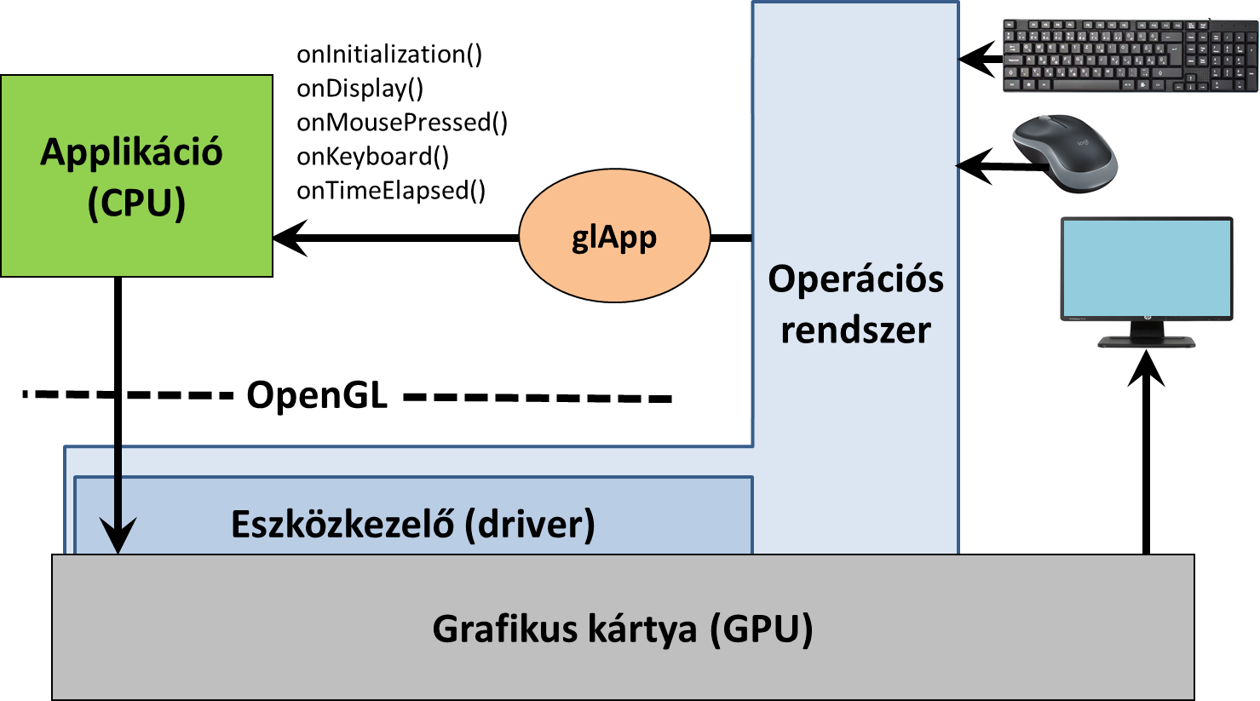
Szoftver architektúra
Notes:
Our graphics application runs under the control of an operating system together with other applications. The operating system handles shared resources like input devices and the frame buffer as well, so a pixel data in the frame buffer can be changed only via the operating system. Modifying pixels one by one from the application would be too slow, so a new hardware element, called the GPU, shows up that is responsible for many time consuming steps of rendering. The GPU is also a shared device that can be accessed via the operating system. Such accesses are calls to a library for the application program. We shall control the GPU through a C graphics library called OpenGL.
On the other hand, to catch input events handled by the operating system, we need another library. We shall utilize the freeGLUT for this purpose, due to its simplicity and the portability (it runs on MsWindows, Xwindow, etc.)
The operating system separates the hardware from the application. The operating system is responsible for application window management and also letting the application give commands to the GPU via OpenGL, not to mention the re-programming of the GPU with shader programs.
OpenGL is collection of C functions of names starting with gl. The second part of the name shows what the function does, and the final part allows to initiate the same action with different parameter numbers and types (note that there is not function overloading in C).
To get an access to the GPU via OpenGL, the application should negotiate this with the operating system, for which operating system dependent libraries, like the wgl for MsWindows and glX for Xwindow are available. Using them is difficult, and more importantly, it makes our application not portable. So, to hide operating system dependent features, we use GLUT, which translates generic commands to the operating system on which it runs. It is simple and our application will be portable. GLUT function names start with glut.

Slide 4
Applikáció és esemény kezelés
class glApp {
public:
glApp(const char* caption);
// glApp(int major, int minor, int winWidth, int winHeight, const char* caption);
void refreshScreen(); // Ablak érvénytelenítése
// Eseménykezelők
virtual void onInitialization() {} // Inicializáció
virtual void onDisplay() {} // Ablak érvénytelen
virtual void onKeyboard(int key) {} // Klaviatúra gomb lenyomás
virtual void onKeyboardUp(int key) {} // Klaviatúra gomb elenged
// Egér gomb lenyomás/elengedés
virtual void onMousePressed(MouseButton but, int pX, int pY) {}
virtual void onMouseReleased(MouseButton but, int pX, int pY) {}
// Egér mozgatás lenyomott gombbal
virtual void onMouseMotion(int pX, int pY) {}
virtual void onTimeElapsed(float startTime, float endTime) {} // Telik az idő
};
Notes:
The graphics output is implemented by OpenGL. The application window management and the input are the responsibilities of GLUT. Our application consists of a main function and a set of event handlers (we use event driven programming paradigm in interactive systems). In main, our application program interacts with GLUT and specifies the properties of the application window (e.g. initial resolution and what a single pixel should store), and also the event handlers.
An event handler is a C function that should be programmed by us. This function is connected to a specific event of GLUT, and having established this connection we expect GLUT to call our function when the specific event occurs. A partial list of possible events are:
Display event that occurs when the application window becomes invalid and thus GLUT asks the application to redraw the window to restore its content.
Keyboard event occurs when the user presses a key having ASCII code.
Special event is like Keyboard event but is triggered by a key press having no ASCII code (e.g. arrows and function keys).
Reshape handler is called when the dimensions of the application window are changed by the user.
Mouse event means the pressing or releasing the button of the mouse.
Idle event indicates the time elapsed and our virtual world model should be updated to reflect the new time.
Event handler registration is optional with the exception of the Display event. If we do not register a handler function, nothing special happens when this event occurs.

Slide 5
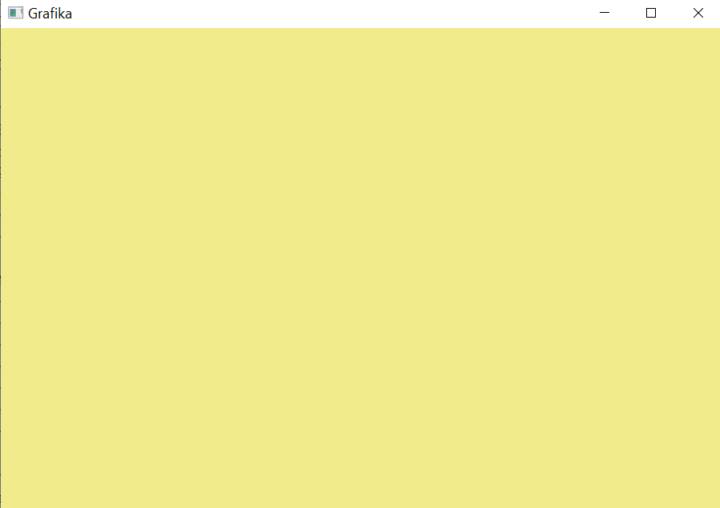
Színes háttér
#include "framework.h"
class MyApp : public glApp {
float red, green, blue, alpha; // színcsatornák
void setRandomColor() { // véletlen szín
red = (float)rand() / RAND_MAX;
green = (float)rand() / RAND_MAX;
blue = (float)rand() / RAND_MAX; alpha = 1.0f;
}
public:
MyApp() : glApp("Grafika") { } // Megfogócsík szöveg
void onInitialization() { setRandomColor(); } // véletlen szín
void onDisplay() {
glClearColor(red, green, blue, alpha); // háttér szín
glClear(GL_COLOR_BUFFER_BIT); // rasztertár törlés
}
void onKeyboard(int key) {
setRandomColor(); // véletlen szín
refreshScreen(); // onDisplay esemény
}
} app;
framework.h
framework.cpp
glad.c
lodepng.cpp
Lib: GLFW, GLM

Slide 6
OpenGL 3.3 … 4.6 (Modern OpenGL)
CPU program
VAO
VBO
Vertex
Buffer
Object
VBO
Vertex
Buffer
Object
Textúra
memória
glPointSize
glLineWidth
glTexparameter
glUniform
glUniform
glBlendFunc
glDrawArrays
glViewport
Sampler
Texel szín
reg1
reg2
reg3
reg4
…
gl_Position
Csúcspont árnyaló
(vertex shader)
reg1
reg2
reg3
reg4
…
gl_FragCoord
reg1, reg2, reg3 …: AttribArray
Pixel
árnyaló
(fragment
shader)
Vágás, homdiv
Viewport tr.
Raszterizáció
Pixel
szín
Kompozit
rasztertár
Normalizált
képernyő
Képernyő
pixel cím
Csúcspontok
Primitívek
Pixelek
Notes:
Primitives (e.g. a line or a triangle mesh) go down the pipeline, each having multiple vertices associated with their homogeneous coordinates and possible attributes (e.g. vertex color). Primitives must be transformed to normalized device space for clipping, which requires the transformation of its vertices with the modeling, viewing and projection transformation matrices. Clipping is done, so is homogeneous division if the fourth homogeneous coordinate is not 1. Then the primitive is transformed to screen space taking into account the viewport position and size. The primitive is rasterized in screen space.
For performance reasons, OpenGL 3 retained mode requires the application to prepare the complete data of the vertices and attributes of a single object rather than passing them one by one. These data are to be stored in arrays on the GPU, called Vertex Buffer Object (VBO). An object can have multiple VBOs, for example, we can put coordinates in a single array and vertex colors in another. Different VBOs are encapsulated into a Vertex Array Object (VAO) that also stores information about how the data should be fetched from the VBOs and sent to the input registers of the Vertex Shader. A single input register can store four 32 bit long words (4 floats called vec4, or four integers) and is called Vertex Attrib Array. The responsibility of the Vertex Shader is to transform the object to normalized device space. If the concatenation of model, view and projection matrices is given to the Vertex Shader, it is just a single matrix-vector multiplication. The output of the Vertex Shader goes to output registers including gl_Position storing the vertex position in normalized device space and other registers storing vertex attributes. Clipping, homogeneous division, viewport transformation and rasterization are performed by the fixed function hardware of the GPU, so these steps cannot be programmed. The output of the rasterization step is the sequence of pixels with pixel coordinates and interpolated vertex attributes. Pixel coordinates select the pixel that is modified in the frame buffer. From other vertex attributes and global variables, the pixel color should be computed by another programmable unit called the Fragment Shader.

Slide 7
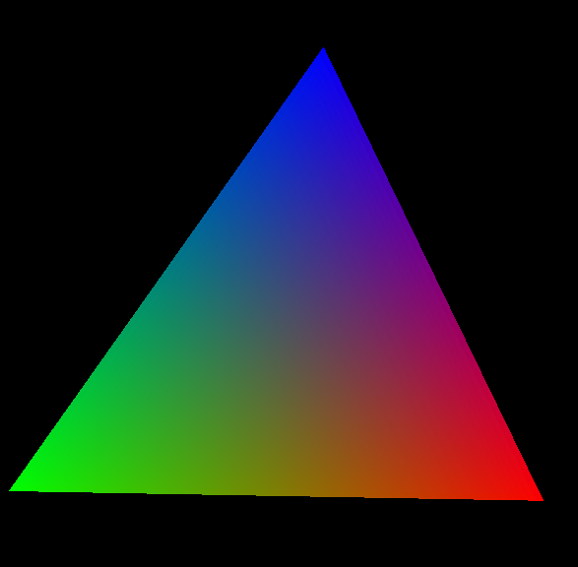
Csúcspont tulajdonságok interpolációja

Slide 8
Csúcspont adatfolyamok
VAO
interleaved
VAO
VBO 0
x1, y1
R1, G1, B1
x2, y2
R2, G2, B2
x3, y3
R3, G3, B3
VBO 0
x1, y1
x2, y2
x3, y3
VBO 1
R1, G1, B1
R2, G2, B2
R3, G3, B3
glVertexAttribPointer
Vertex shader
Input registers
AttribArray 0
AttribArray 1
AttribArray …
in var1
in var2
Vertex shader
Notes:
Let us zoom out the connection of the vertex buffer objects, vertex shader input registers called AttribArrays, and vertex shader input variables. The object is described in arrays called VBOs. For example, coordinates can be stored in one array, colors in another (this strategy is called Structure Of Arrays, or SOA for short). To allow the Vertex Shader to process a vertex, its input registers must be filled with the data of that particular vertex, one vertex at a time. Function glVertexAttribPointer tells the GPU how to interpret the data in VBOs, from where the data of a single vertex can be fetched, and in which AttribArray a data element should be copied. For example, coordinates can be copied to AttribArray0 while colors to AttribArray1 (a single register can store 4 floats).
When the Vertex Shader runs, it can fetch its input registers. It would not be too elegant if we had to refer to the name of the input register, e.g. AttribArray 0, so it is possible to assign variable names to it. For example, AttribArray0 can be the ”vertexPosition”.
Note that this was only one possibility of data organization. For example, it is also perfectly reasonable to put all data in a single array where coordinates and attributes of a single vertex are not separated (this strategy is the Array Of Structures, or AOS). In this case glVertexAttribPointer should tell the GPU where an attribute starts in the array and what the step size (stride) is.

Slide 9
Rajzolás: glDrawArrays, OpenGL primitívek
glBindVertexArray(vao);
glDrawArrays(primitiveType, startIdx, numOfElements);
Vektorizált parametrikus görbe
GL_POINTS
GL_LINES
GL_LINE_STRIP
GL_LINE_LOOP
Tesszellált 3D
parametrikus felület
Fülvágó kimenete
„Konvex” poligon
GL_TRIANGLES
GL_TRIANGLE_STRIP
GL_TRIANGLE_FAN
Notes:
This is the set of possible primitive types. Basically points, line segments and triangles, but in sophisticated options sharing vertices is also possible.
GL_LINE_STRIP assumes that the end point of a line segment is the start of the next, so shared points should be specified only once. GL_LINE_LOOP is similar to GL_LINE_STRIP, but adds one more edge between the last and first vertices. GL_TRIANGLES require vertices of multiples of three, and each three vertices define a new triangle. We use it, for example, when a polygon is decomposed to triangles with the ear clipping algorithm. GL_TRIANGLE_STRIP needs three vertices for the first triangle, then any additional vertex introduces a new triangle of the last, previous, and previous of the previous vertices. GL_TRIANGLE_FAN can be used for convex polygons. Here again the first three vertices define the first triangle and any new vertex adds a new triangle of the last vertex, previous vertex and first vertex.

Slide 10
OpenGL állapotgép + erőforrások
Gagyi grafikus könyvtár
OpenGL
fillOval(x1,y1,x2,y2, texture, color, width,…);
glPointSize(3);
glLineWidth(5);
glBindVertexArray(vao);
glBindBuffer(GL_ARRAY_BUFFER, vbo);
glBindTexture(GL_TEXTURE_2D, textureId);
glBufferData(GL_ARRAY_BUFFER, 10, v, GL_STATIC_DRAW);
glTexImage2D(GL_TEXTURE_2D, 0, GL_RGBA, w, h, …);
glDrawArrays(GL_TRIANGLES, 0, 3); // Mind!!!

Slide 11

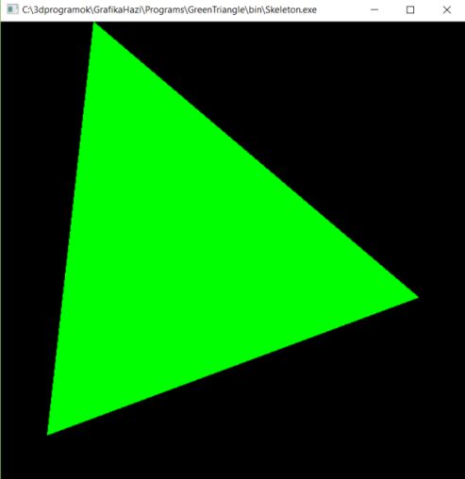
Grafikus hardver/szoftver alapok
2. Helló OpenGL/GLSL
Szirmay-Kalos László

Slide 12
Az első OpenGL programom: Zöld háromszög
vertSource
fragSource
Csúcsok
Vágás
Viewport
Raszteri-záció
#version 330
uniform vec3 color;
out vec4 outColor;
void main() {
outColor = vec4(color,1);
}
#version 330
layout(location = 0) in vec2 cP;
void main() {
gl_Position = vec4(cP.x,cP.y,0,1);
}
class GreenTriangApp : public glApp {
unsigned int vao; // geometria
unsigned int prog; // árnyalóprogramok
public:
MyApp() : glApp("Green triangle") { }
void onInitialization();
void onDisplay(); // Ablak újrarajzolás
} app;
Rasztertár
Notes:
In the main function of a graphics application, we set up the application window with the help of GLUT telling the initial position, size, what data should be stored in a pixel, and also what functions should be called when different events happen. At the end, the message loop is started, which checks whether any event occurred for which we have registered an event handler, and if this is the case, it calls the respective event handler.
The main function can also be used to initialize data in OpenGL (on the GPU), especially those which are needed from the beginning of the program execution and which do not change during the application. We need shader programs from the beginning, so this is a typical place to compile and link shader programs and upload them to the GPU.
Let us start with the main function. Two header files are needed.
GLEW is the opengl Extension Wrangler library that finds out what extensions are supported by the current GPU in run time. It is our interface to OpenGL, which works even if we select a higher OpenGL version that is supported by the header file in our computer (If you have a MsWindows system, it is very likely that your opengl header and library files support only OpenGL 1.0, while we work in OpenGL 3.3 or higher versions. The difference is made by GLEW).
GLUT is a windowing utility toolkit to set up the application window and to manage events.
In the main functions, first the application window is set up with glut calls:
- glutInit initializes glut and allows use to communicate with the GPU via OpenGL.
- glutInitContextVersion sets the required OpenGL version. In this case, we want OpenGL 3.3.
- glutInitWindowSize specifies the initial resolution of the application window.
- glutInitWindowPosition specifies where it is initially placed relative to the upper left corner of the screen.
- glutInitDisplayMode tells glut what to store in a single pixel. In the current case, we store 8 bit (default) R,G,B, and A (opacity) values, in two copies to support double buffering.
- glutCreateWindow creates the window, which shows up.
The Extension Wrangler is initialized
glewExperimental = true: GLEW obtains information on the supported extensions from the graphics driver, so if it is not updated, then it might not report all features the GPU can deliver. Setting glewExperimental to true gets GLEW to try the extension even if it is not listed by the driver. This is indeed magic.
glewInit makes the initialization
From here, we can ha an initialized OpenGL. Do not call any OpenGL functions before this point!
- glViewport sets the render target, i.e. the photograph inside the application window
- onInitialization is our custom initialization function discussed on the next slide.
The remaining functions register event handlers and start the message loop. For the time being, only the onDisplay is relevant, which is called whenever the application window becomes invalid. We use this function to render the virtual world, which consists of a single green triangle, directly given in normalized device space.

Slide 13
onInitialization()
vao
vbo
24 bytes
vbo
vbo
3 vertices
2 floats/vertex
void GreenTriangApp::onInitialization() {
glGenVertexArrays(1, &vao); // 1 vao id-t kérek
glBindVertexArray(vao); // aktiválom
unsigned int vbo; // Vertex Buffer Object
glGenBuffers(1, &vbo); // 1 vbo azonosítót kérek
glBindBuffer(GL_ARRAY_BUFFER, vbo);
// Geometria 24 bájtban (6 float vagy 3 x 2 koordináta)
float vertices[] = { -0.8f, -0.8f, -0.6f, 1.0f, 0.8f, -0.2f };
glBufferData(GL_ARRAY_BUFFER, // GPU-n a másolás célja
sizeof(vertices), // bájtok száma
vertices, // cím
GL_STATIC_DRAW); // nem változtatjuk
glEnableVertexAttribArray(0); // 0. bemeneti regiszter
glVertexAttribPointer(0, // vbo -> 0. bemeneti regiszter
2, GL_FLOAT, GL_FALSE, // két float/attrib
0, NULL); // szorosan pakolt
…
0. regiszter
(1,1)
(-0.6,1)
(0.8,-0.2)
(-0.8,-0.8)
(-1,-1)
Notes:
In onInitialization those OpenGL data are initialized that are typically constant during the application, so they do not have to be set in every drawing. In our program, this includes the constant geometry (the triangle), and the GPU shader programs. The shaderProgram and the vao are set here but also used in the onDisplay, therefore they are global variables.
First we allocate one vertex array object and its id is vao. With Binding, this is made active, which means that all subsequent operations belong to this vao until another vao is bound or the current one is unbound with binding 0.
In the second step, one vertex buffer object is allocated, which will be part of the active vao (we have just one, which is active). This vertex buffer object is made active, so all subsequent operations are related to this until another is bound.
Array ”vertices” stores the geometry of our triangle, and is obviously in the CPU memory. It contains 6 floats, i.e. 24 bytes. With glBufferData the 24 bytes are copied to the GPU. With the last parameter of glBufferData we can specify which type of GPU memory should be used (the GPU has different types of memory with different write and read speeds and capacity, so the driver may decide where to copy this 24 bytes based on our preference). We say that the 24 bytes will not be modified but it would be great if it could be fetched fast (constant memory would be an ideal choice). So far we said nothing about the organization and the meaning of the data, it is simply 24 bytes, the GPU does not know that it defines 3 vertices, each with 2 Cartesian coordinates, which are in float format.
glVertexAttribPointer() defines the interpretation of the data and also that the data associated with a single vertex goes to the input register (AttribArray) number 0. It specifies that a single vertex have two floats, i.e. 8 bytes. If it was non floating point value, it would also be possible to put the binary point to the most significant bit, but we set this parameter to GL_FALSE.
The last two parameters tell the GPU how many bytes should be stepped from one vertex to the other (if it is 0, it means that the step size is equal to the data size, 2 floats in this case), and where the first element is (at the beginning of the array, so the pointer offset is zero). Stride and offset are essential if interleaved vbos are used.

Slide 14
onInitialization() folytatás
…
// Csúcspont árnyaló: azonosító generálás, forrás feltöltés, fordítás
unsigned int vertShader = glCreateShader(GL_VERTEX_SHADER);
glShaderSource(vertShader, 1, &vertSource, NULL);
glCompileShader(vertShader);
// Pixel árnyaló: azonosító generálás, forrás feltöltés, fordítás
unsigned int fragShader = glCreateShader(GL_FRAGMENT_SHADER);
glShaderSource(fragShader, 1, &fragSource, NULL);
glCompileShader(fragShader);
// Program = csúcspont-pixelárnyaló pár létrehozása
prog = glCreateProgram();
glAttachShader(prog, vertShader);
glAttachShader(prog, fragShader);
glLinkProgram(prog); // a csúcspont-pixelárnyaló pár szerkesztése
glUseProgram(prog); // ez fusson
}

Slide 15
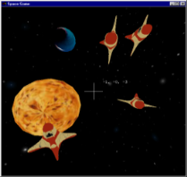
onDisplay()
vao
0. regiszter
vbo
(-0.6,1)
#version 330
layout(location = 0) in vec2 cP;
void main() {
gl_Position = vec4(cP.x,cP.y,0,1);
}
#version 330
uniform vec3 color;
out vec4 outColor;
void main() {
outColor = vec4(color,1);
}
(0.8,-0.2)
(-0.8,-0.8)
void GreenTriangApp::onDisplay() { // Ablak újrarajzolás
glClearColor(0, 0, 0, 0); // háttér szín
glClear(GL_COLOR_BUFFER_BIT); // törlés
glViewport(0, 0, windowWidth, windowHeight);
int location = glGetUniformLocation(prog, "color");
glUniform3f(location, 0.0f, 1.0f, 0.0f); // 3 float, zöld
glBindVertexArray(vao); // Rajzolás hívás
glDrawArrays(GL_TRIANGLES, 0 /*start*/, 3 /*Elemeszám*/);
}
600
600
Notes:
We have registered a single event handler (onDisplay) that reacts to the event occurring when the application window gets invalid (DisplayFunc).
In this function, the virtual world (consisting of the single green triangle) is rendered.
glClearColor sets the color with which the pixels of the application window is cleared. This color is black. The actual clearing is done by glClear. GL_COLOR_BUFFER_BIT stands for the frame buffer storing color values.
Drawing consists of setting the values of uniform variables of shaders and then forcing the geometry through the pipeline, which is called the draw call. Finally, the buffer used for drawing so far is swapped with the buffer the user could see so far by glutSwapBuffers, so the result will be visible to the user.
The fragment shader has a single uniform variable called color and of type vec3, which can be set with function glUniform3f(location, 0.0f, 1.0f, 0.0f) to value (0,1,0)=green. Note that ”3f” at the end of the function name indicates that this function takes 3 float parameters. Parameter location is the serial number of this uniform variable, which can be found with glGetUniformLocation(shaderProgram, “color") which returns the serial number of uniform variable called “color” in the shader programs.
The vertex shader has uniform variable MVP of type mat4, i.e. it is a 4x4 matrix. First, its serial number must be obtained, then its value can be set with glUniformMatrix4fv. Here fv means that matrix elements are floats (f) and instead of passing the 16 floats by value, the address of the CPU array is given (v) from which the values can be copied (pass by address). The second parameter of glUniformMatrix4fv says that 1 matrix is passed, the third parameter that this is a row-major matrix and should be kept this way.
This issue can cause a lot of confusion:
In C or C++ two-dimensional matrices are of row-major.
In GLSL two-dimensional matrices are of column-major.
So if we use them without caution, we might apply the transpose of the matrix and not what we wanted. There are many solutions for this problem:
Use an own 2D matrix class in C++ that follows the column-major indexing scheme, and consider vectors of points as row vectors both on the CPU and on the GPU.
Use an own 2D matrix class in C++ that follows the column-major indexing scheme, and consider vectors of points as column vectors both on the CPU and on the GPU. The matrices will be transposed with respect to the previous solution.
Use the standard 2D matrix indexing on the CPU (row-major) and the standard 2D matrix indexing on the GPU (column-major), but consider points as row vector in the CPU program (and therefore put on the left side of the transformation matrix) and column vector in the GPU program (and put on the right side of the matrix).
Use the standard 2D matrix indexing on the CPU (row-major) but transpose the matrix when passed to the GPU, and consider points as row vector both in the CPU program and in the GPU program.
We use option 4, and setting the third parameter of glUniformMatrix4fv to TRUE enables just the required transpose.
Vertex Array Objects are our virtual world objects already uploaded to the GPU. With glBindVertexArray(vao) we can select one object for subsequent operations (drawing) and finally glDrawArrays gets the current VAO to feed the pipeline, i.e. this object is rendered. We may not send all vertices of this object, so with startIdx and number of elements a subset can be selected. Setting startIdx to 0 and sending all 3 points, our whole triangle is rendered. The first parameter of glDrawArrays tells the GPU the topology of the primitive, that is, what the vertices define. In our case, triangles, and as we have only 3 vertices, a single triangle.

Slide 16
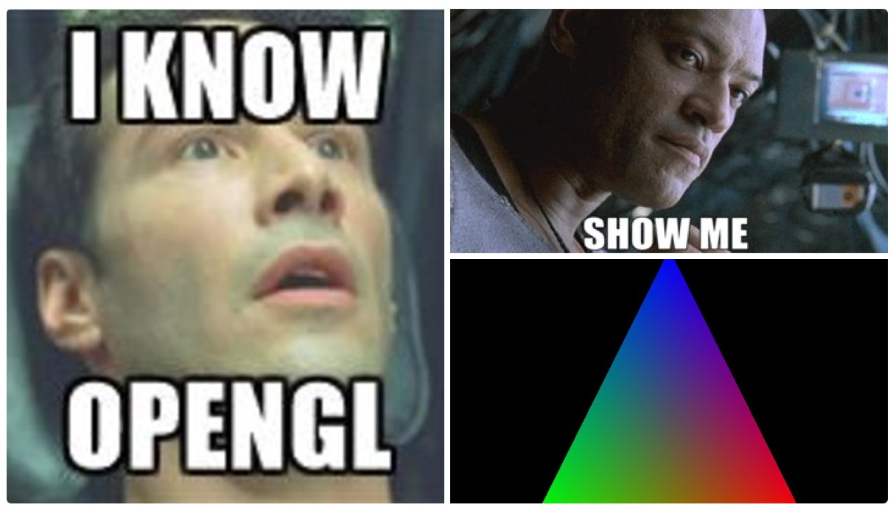


Slide 17
Grafikus hardver/szoftver alapok
Program: Keret és zöld háromszög
”The GL in OpenGL stands for Good Luck because you are going to need it.”
Anonymous
Szirmay-Kalos László

Slide 18
framework.h: GPUProgram
class GPUProgram {
unsigned int prog;
public:
GPUProgram();
GPUProgram(char * vertSrc, char * fragSrc);
void Use(); // Ez fusson
void setUniform(int i, const string& name);
void setUniform(float f, const string& name);
void setUniform(const vec2& v, const string& name);
void setUniform(const vec3& v, const string& name);
void setUniform(const vec4& v, const string& name);
void setUniform(const mat4& mat, const string& name);
};

Slide 19
framework.h: Geometry
template<class T> class Geometry {
protected:
unsigned int vao, vbo; // GPU
vector<T> vtx; // CPU
public:
Geometry() {
glGenVertexArrays(1, &vao); glBindVertexArray(vao);
glGenBuffers(1, &vbo); glBindBuffer(GL_ARRAY_BUFFER, vbo);
}
void updateGPU();
void Bind() { glBindVertexArray(vao); }
vector<T>& Vtx() { return vtx; }
void Draw(GPUProgram* gpuProgram, int type, vec3 color);
virtual ~Geometry() {
glDeleteBuffers(1, &vbo); glDeleteVertexArrays(1, &vao);
}
};

Slide 20
Geometry::updateGPU
void Geometry::updateGPU() { // CPU -> GPU
glBindVertexArray(vao);
glBindBuffer(GL_ARRAY_BUFFER, vbo);
glBufferData(GL_ARRAY_BUFFER, vtx.size()*sizeof(T), &vtx[0], GL_DYNAMIC_DRAW);
glEnableVertexAttribArray(0);
glVertexAttribPointer(0, sizeof(T)/sizeof(float), GL_FLOAT, GL_FALSE, 0, NULL);
}

Slide 21
Geometry::Draw
#version 330
layout(location = 0) in vec2 cP;
void main() {
gl_Position = vec4(cP.x,cP.y,0,1);
}
#version 330
uniform vec3 color;
out vec4 outColor;
void main() {
outColor = vec4(color,1);
}
void Geometry::Draw(GPUProgram* gpuProgram, int type, vec3 color) {
if (vtx.size() > 0) {
gpuProgram->setUniform(color, "color");
Bind();
glDrawArrays(type, 0, (int)vtx.size());
}
}

Slide 22
GreenTriangApp
class GreenTriangleApp : public glApp {
Geometry<vec2>* triangle; // geometria
GPUProgram* gpuProgram; // csúcspont és pixel árnyalók
public:
GreenTriangleApp() : glApp("Green triangle") { }
void onInitialization() { // Inicializáció,
triangle = new Geometry<vec2>;
triangle->Vtx() = { vec2(-0.8f, -0.8f), vec2(-0.6f, 1.0f), vec2(0.8f, -0.2f) };
triangle->updateGPU();
gpuProgram = new GPUProgram(vertSource, fragSource);
}
void onDisplay() { // Ablak újrarajzolás
glClearColor(0, 0, 0, 0); // háttér szín
glClear(GL_COLOR_BUFFER_BIT); // rasztertár törlés
glViewport(0, 0, winWidth, winHeight);
triangle->Draw(gpuProgram, GL_TRIANGLES, vec3(0.0f, 1.0f, 0.0f));
}
} app;

Slide 23

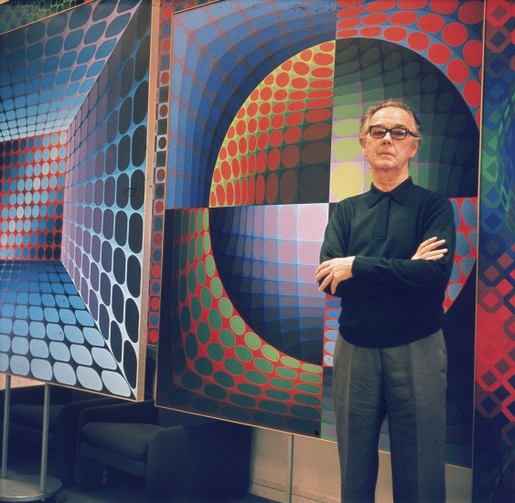
Grafikus hardver/szoftver alapok
Program: Vasarely festmény
Szirmay-Kalos László

Slide 24
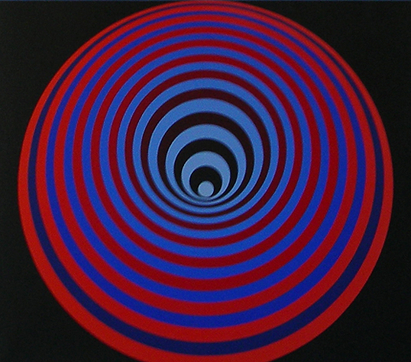
Mi ez?
Körök, kicsik fedik a nagyokat
20 kör vagy 1 kör transzformálva?
Középpont elindul felfelé, majd visszatér

Slide 25
Applikáció
class VasarelyApp : public glApp {
GPUProgram* gpuProgram; // árnyaló programok
Circle* circle; // egység sugarú kör
float amplitude = 0.8f; // betüremkedés illuzió nagysága
bool animate = false; // mozgassuk?
public:
VasarelyApp() : glApp("Vasarely") { }
void onInitialization() {
circle = new Circle();
gpuProgram = new GPUProgram(vertSource, fragSource);
}
void onDisplay();
void onKeyboard(int key) { if (key == 'a') animate = !animate; }
void onTimeElapsed(float startTime, float endTime) {
if (animate) {
amplitude = sinf(3 * endTime); // hullámzás
refreshScreen(); // újrarajzolás
}
}
} app;

Slide 26
Csúcspont és pixel árnyalók
Vertex shader:
uniform float radius, up;
layout(location = 0) in vec2 vp;
void main() {
gl_Position = vec4(vp.x * radius, vp.y * radius + up, 0, 1);
}
Fragment shader:
uniform vec3 color;
out vec4 outColor;
void main() {
outColor = vec4(color, 1);
}

Slide 27
onDisplay
void VasarelyApp::onDisplay() {
glClearColor(0, 0, 0, 0); // háttér szín
glClear(GL_COLOR_BUFFER_BIT); // alkalmazói ablak törlése
glViewport(0, 0, winWidth, winHeight); // keletkező fénykép mérete
const int nCircles = 20;
const float r0 = 1.0f, r1 = 1.0f / nCircles; // sugár tartománya
vec3 ce0(1, 0, 0), ce1(0, 0, 0), co0(0, 0, 0.5f), co1(0, 1, 1); // kezdő-vég szín
for (int i = 0; i < nCircles; i++) { // körök egyenként
float t = (float)i / (nCircles - 1.0f); // interpolációs változó
gpuProgram->setUniform(r0 * (1 - t) + r1 * t, "scaling"); // transzformáció
gpuProgram->setUniform(t * (1 - t) * amplitude, "up");
vec3 color = (i % 2 == 0) ? ce0 * (1 - t) + ce1 * t : co0 * (1 - t) + co1 * t;
circle->Draw(gpuProgram, GL_TRIANGLE_FAN, color);
}
}

Slide 28
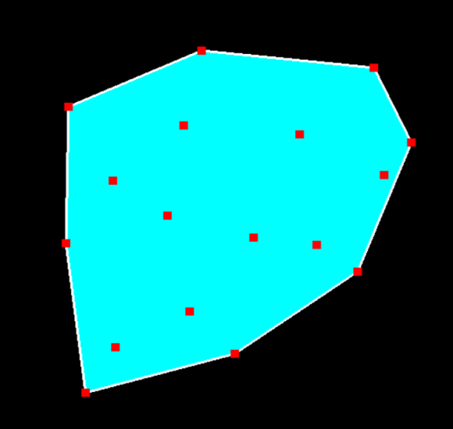
Grafikus hardver/szoftver alapok
Program: Konvex burok, interakció
Szirmay-Kalos László

Slide 29

Konvex burok
Minimális, az adott pontokat tartalmazó konvex halmaz
Legalsó pontból indulunk, a kezdő irány balról jobbra.
While (vissza nem érünk) {
Következő pont, amelyhez minimálisat kell fordulni.
}

Slide 30
Csúcspont és pixel árnyalók
Vertex shader:
layout(location = 0) in vec2 cP;
void main() {
gl_Position = vec4(cP, 0, 1);
}
Fragment shader:
uniform vec3 color;
out vec4 outColor;
void main() {
outColor = vec4(color, 1); // RGB -> RGBA
}

Slide 31
Convex hull
struct ConvexHull {
Geometry<vec2> setPoints, hullPoints;
void addPoint(vec2 p) { setPoints.Vtx().push_back(p); }
void update() {
if (setPoints.Vtx().size() >= 3) {
findHull();
hullPoints.updateGPU();
}
setPoints.updateGPU();
}
vec2 * pickPoint(vec2 p) {
for (auto& v : setPoints.Vtx()) if (length(p - v) < 0.05f) return &v;
return nullptr;
}
void findHull();
void Draw(GPUProgram * gpuProgram) {
if (hullPoints.Vtx().size() >= 3) {
hullPoints.Draw(gpuProgram, GL_TRIANGLE_FAN, vec3(0, 1, 1));
hullPoints.Draw(gpuProgram, GL_LINE_LOOP, vec3(1, 1, 1));
}
setPoints.Draw(gpuProgram, GL_POINTS, vec3(1, 0, 0));
}
};

Slide 32
Konvex burok előállítás
void ConvexHull::findHull()
{
vec2 *pLow = &setPoints.Vtx()[0]; // Find lowest point
for(auto& p : setPoints.Vtx())
if (p.y < pLow->y) pLow = &p;
hullPoints.Vtx().clear();
vec2 pCur = *pLow, *pNext, dir(1, 0);
do { // find convex hull points one by one
float maxCos = -1;
for(auto& p : setPoints.Vtx()) { // find minimal left turn
float len = length(p – pCur);
if (len > 0) {
float cosPhi = dot(dir, p – pCur) / len;
if (cosPhi > maxCos) { maxCos = cosPhi; pNext = &p;}
}
}
hullPoints.Vtx().push_back(*pNext); // save as convex hull
dir = normalize(*pNext – pCur); // prepare for next
pCur = *pNext;
} while(pLow != pNext);
}

Slide 33
Applikáció
class ConvexHullApp : public glApp {
ConvexHull* hull = nullptr;
vec2* pickedPoint = nullptr;
GPUProgram gpuProgram; // árnyaló programok
vec2 PixelToNDC(int pX, int pY);
public:
ConvexHullApp() : glApp("ConvexHull") { }
void onInitialization() {
glViewport(0, 0, winWidth, winHeight);
glLineWidth(3);
glPointSize(10);
hull = new ConvexHull;
gpuProgram.create(vertexSource, fragmentSource);
}
void onDisplay() {
glClearColor(0, 0, 0, 0);
glClear(GL_COLOR_BUFFER_BIT);
hull->Draw(&gpuProgram);
}
void onMousePressed(MouseButton button, int pX, int pY);
void onMouseReleased(MouseButton button, int pX, int pY);
void onMouseMotion(int pX, int pY);
} app;

Slide 34
Controller
vec2 ConvexHullApp:: PixelToNDC(int pX, int pY) {
return vec2(2.0f * pX / winWidth – 1, 1.0f - 2.0f * pY / winHeight);
}
void ConvexHullApp::onMousePressed(MouseButton button, int pX, int pY) {
if (button == MOUSE_LEFT) {
hull->addPoint(PixelToNDC(pX, pY));
hull->update();
refreshScreen();
}
if (button == MOUSE_RIGHT) {
pickedPoint = hull->pickPoint(PixelToNDC(pX, pY));
}
}
void ConvexHullApp::onMouseReleased(MouseButton button, int pX, int pY) {
if (button == MOUSE_RIGHT) pickedPoint = nullptr;
}
void ConvexHullApp::onMouseMotion(int pX, int pY) {
if (pickedPoint) {
*pickedPoint = PixelToNDC(pX, pY);
hull->update();
refreshScreen();
}
}

Slide 35
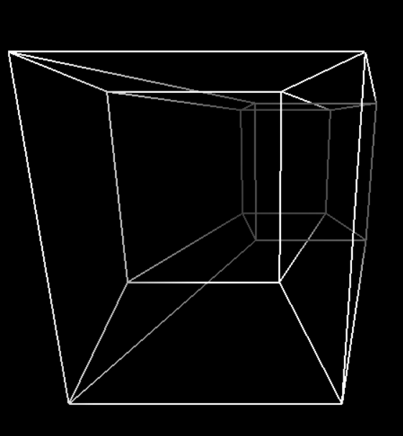
Grafikus hardver/szoftver alapok
Program: Tesseract (4D kocka), animáció
Szirmay-Kalos László

Slide 36





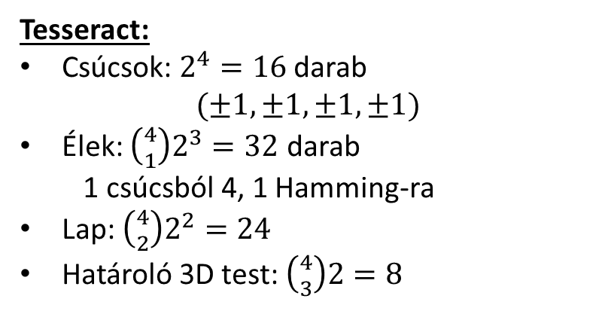








N-dimenziós „kocka”
$$(−1,+1,+1)$$
$$(+1,+1,+1)$$
$$(−1,+1)$$
$$(+1,+1)$$
$$(−1,+1,−1)$$
$$(+1,+1,−1)$$
$$(+1,−1,+1)$$
$$(−1,−1,−1)$$
$$(+1,−1,−1)$$
$$−1$$
$$+1$$
$$(−1,−1)$$
$$(+1,−1)$$
Tesseract:
Csúcsok: $2^{4}=16$ darab
$$(±1,±1,±1,±1)$$
Élek: $\left({4 \atop 1}\right)2^{3}=32$ darab
1 csúcsból 4, 1 Hamming-ra
Lap: $\left({4 \atop 2}\right)2^{2}=24$
Határoló 3D test: $\left({4 \atop 3}\right)2=8$

Slide 37
Tesseract
class Tesseract : public Geometry<vec4> {
float alpha, beta;
void addPoint(int c) {
vec4 p(c&1 ? 1 : -1, c&2 ? 1 : -1, c&4 ? 1 : -1, c&8 ? 1 : -1);
vtx.push_back(p);
}
public:
Tesseract() {
const int maxcode = 15;
for (int code = 0; code <= maxcode; code++) {
for (int bit = 1; bit <= maxcode; bit <<= 1) {
if ((code & bit) == 0) { addPoint(code); addPoint(code + bit); }
}
}
updateGPU();
}
void Animate(float t) { alpha = t / 2; beta = t / 3; }
void Draw(GPUProgram* gpuProgram) {
gpuProgram->setUniform(cosf(alpha), "cosa");
gpuProgram->setUniform(sinf(alpha), "sina");
gpuProgram->setUniform(cosf(beta), "cosb");
gpuProgram->setUniform(sinf(beta), "sinb");
Bind();
glDrawArrays(GL_LINES, 0, (int)vtx.size());
}
};

Slide 38



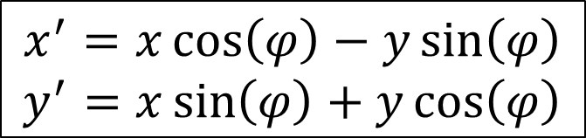
2D forgatás
$$(x′,y′)$$
$$(x,y)$$
$$φ$$
$$x^{′}=x\cos\left(φ\right)−y\sin\left(φ\right)$$
$$y^{′}=x\sin\left(φ\right)+y\cos\left(φ\right)$$

Slide 39




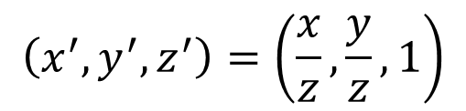






3D2D vetítés
$$\left(x^{′},y^{′},z^{′}\right)=\left(\frac{x}{z}, \frac{y}{z},1\right)$$
$$\left(x^{′},y^{′},z^{′}\right)=\left(x,y,0\right)$$
$$y$$
$$y$$
$$\left(x,y,z\right)$$
$$\left(x,y,z\right)$$
1
$$z$$
$$z$$
$$z=1$$
$$x$$
$$x$$
balkezes
koord.

Slide 40
4D2D vetítés
?

Slide 41





3D1D vetítés
$$y=z=1$$
$$y$$
$$\left(x,y,z\right)$$
$$z$$
1
$$x$$

Slide 42



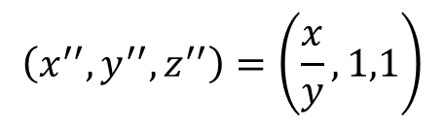
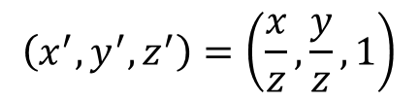



3D2D1D vetítés
$$\left(x^{′},y^{′},z^{′}\right)=\left(\frac{x}{z}, \frac{y}{z},1\right)$$
$$\left(x^{′},y^{′},z^{′}\right)=\left(x,y,0\right)$$
$$y$$
$$y$$
$$\left(x^{′′},y^{′′},z^{′′}\right)=\left(\frac{x}{y}, 1,1\right)$$
$$\left(x,y,z\right)$$
$$\left(x,y,z\right)$$
$$z$$
$$z$$
1
$$\left(x^{′′},y^{′′},z^{′′}\right)=\left(x, 0,0\right)$$
$$x$$
$$x$$

Slide 43
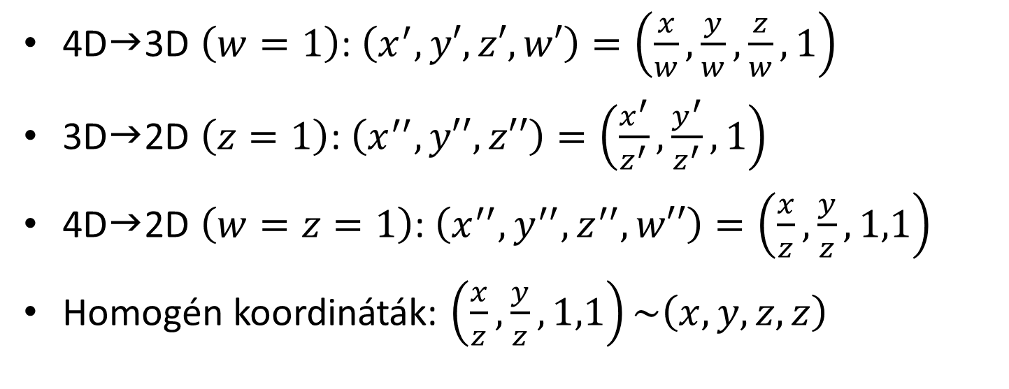
4D3D2D vetítés
4D3D $\left(w=1\right)$: $\left(x^{′},y′,z′,w′\right)=\left(\frac{x}{w}, \frac{y}{w},\frac{z}{w},1\right)$
3D2D $\left(z=1\right)$: $\left(x^{′′},y′′,z′′\right)=\left(\frac{x^{′}}{z^{′}}, \frac{y^{′}}{z^{′}}, 1\right)$
4D2D $\left(w=z=1\right)$: $\left(x^{′′},y^{′′},z^{′′}, w′′\right)=\left(\frac{x}{z}, \frac{y}{z}, 1,1\right)$
Homogén koordináták: $\left(\frac{x}{z}, \frac{y}{z}, 1,1\right)\sim \left(x, y, z,z\right)$

Slide 44
Vertex és fragment árnyalók
uniform float cosa, sina, cosb, sinb;
layout(location = 0) in vec4 vtx;
out float depthCue;
void main() {
vec4 vr1, vr2;
vr1 = vec4(vtx.xy, vtx.z*cosa-vtx.w*sina, vtx.z*sina+vtx.w*cosa);
vr2 = vec4(vr1.x*cosb-vr1.w*sinb, vr1.yz, vr1.x*sinb+vr1.w*cosb);
vec4 p4d = vr2 * 0.4f + vec4(0, 0, 1, 1);
depthCue = 1 / (dot(p4d, p4d) - 0.4f);
gl_Position = vec4(p4d.xyz, p4d.z);
}
in float depthCue;
out vec4 fragColor;
void main() {
fragColor = vec4(depthCue, depthCue, depthCue, 1);
}

