Slide 1
Affin transzformációk
”τὰ πάντα ῥεῖ καὶ οὐδὲν μένει.”
Ἡράκλειτος
Szirmay-Kalos László

Slide 2
Transzformációk (Euklideszi geometria, Descartes koordináták)
Ponthoz pontot (koordinátákhoz koordinátákat) rendel
$$\left(x^{′},y^{′}\right)=T(x,y)$$
$$\left(x^{′},y^{′}\right)=T(x,y)$$
$$x^{′}$$
$$T$$
$$y$$
$$y$$
$$T$$
$$\left(x^{′},y^{′}\right)$$
$$y^{′}$$
$$(x,y)$$
$$(x,y)$$
$$x$$
$$x$$
Tönkre tehetik reprezentációt és az egyenletet!
Legalább az egyenes (sík) maradjon meg.
Notes:
Geometric transformations assign a point to a point, so it is a point valued function of points. Geometric transformation may destroy the equation and the type of an object. Even simple scaling turns a sphere into an ellipsoid, so the equation, program, representation will change. To avoid this, we limit the allowed transformations and object types to those which guarantee that the object type is preserved. Linear elements, like points, line segments, and polygons may approximate any 0,1 or 2 dimensional object.
Affine transformations that can be expressed as linear functions of the Cartesian coordinates map lines to lines and also preserve parallel lines. This theorem can be proved by realizing that a line can have a linear equation and with linear equation only lines can be described. So, if a linear equation of a line is combined with the linear function of the transformation, we get a linear equation, which thus must be a line. If this transformation could make parallel lines intersecting or intersecting lines parallel, then this transformation would create a point out of nothing or would make a point disappear. A linear function is not able to do that..
Affine transformations are not the widest set of transformations preserving lines and polygons. The widest set is homogeneous linear transformations (homogeneous coordinates are multiplied by a matrix), which includes central projection as well. To find this wider set of transformations, we should understand that no transformation of the Euclidean plane can make two parallel lines intersecting, since that would create a point from nothing. The problem is the Euclidean geometry itself and its property that parallel lines do not intersect. To consistently discuss how lines can be transformed to lines without keeping the parallelism, we should step out of the Euclidean geometry. The proper geometry is the projective geometry.

Slide 3
Külső nézet: pontot pontba, egyenest egyenesbe
w
$$w$$
$$w=1$$
$$q$$
$$v$$
$$p$$
$$w=1$$
$w$ őrzés
$$y$$
y
Nulltér = nullvektor
x
$$x$$
Euklideszi: $w=1$
Projektív: origón kívüli
w
Altér altérbe:
Lineáris transzformáció
Mátrixszorzás
$$q$$
$$v$$
$$p$$
$$q$$
$$p$$
Skaláris (Lorentz) szorzat őrzés
y
Skaláris szorzat őrzés
$$w=1$$
$$v$$
y
x
x
Elliptikus: $x2+y2+w2 =1$
Hiperbolikus: $x2+y2−w2=−1$

Slide 4
Szeretjük a mátrixokat, mert szorzásuk asszociatív
Transzformációk konkatenációja: Asszociatív
Invertálható transzformációk csoportot alkotnak
$\left[x^{′},y^{′},z^{′},w^{′}\right]=(…(\left[x,y,z,w\right]∙T_{1}$) $∙T_{2})…∙T_{n}$
$=\left[x,y,z,w\right]∙(T_{1}∙T_{2}∙ …∙T_{n}$)
$=\left[x,y,z,w\right]∙T$

Slide 5
mat4 osztály
struct mat4 { // row-major matrix 4x4
vec4 rows[4];
mat4(vec4& it, vec4& jt, vec4& kt, vec4& ot) {
rows[0] = it; rows[1] = jt; rows[2] = kt; rows[3] = ot;
}
vec4& operator[](int i) { return rows[i]; }
};
inline vec4 operator*(vec4& v, mat4& m) {
return v.x * m[0] + v.y * m[1] + v.z * m[2] + v.w * m[3];
}
inline mat4 operator*(mat4& ml, mat4& mr) {
mat4 res;
for (int i = 0; i < 4; i++) res.rows[i] = ml.rows[i] * mr;
return res;
}
void GPUProgram::setUniform(const mat4& mat, char * name) {
int location = getLocation(name);
if (location >= 0) glUniformMatrix4fv(location, 1, GL_TRUE, mat);
}

Slide 6
Affin transzformációk: Euklideszi geometria egyenes (és párhuzamosság) tartó transzformációi
$$\left[\begin{matrix}{i′}_{x}^{} & {i′}_{y}^{} & 0 \\ {j′}_{x}^{} & {j′}_{y}^{} & 0 \\ {o′}_{x}^{} & {o′}_{y}^{} & 1\end{matrix}\right]$$
$$x^{′}=ax+by+c$$
$$y^{′}=dx+ey+f$$
$w$ őrzés
$$\left[x^{′},y^{′},w′\right]=[x,y,w]$$
Példák:
Eltolás, elforgatás, tükrözés = egybevágóság
Nagyítás/kicsinyítés = hasonlóság (szögtartás)
Irányfüggő nyújtás , nyírás , …
Notes:
Vectors are translations. However, we also need other transformations as well, like rotatin, scaling, shearing, mirroring, orthogonal projection, etc. All these transformations have the property that they map lines to lines and preserve parallel lines. Such transformations are called affine transformations.
So, our question is what algebraic form can represent general affine transformations. Let us consider the axis parallel rectangle of one corner in the origin and the other corner in the point to be transformed (x,y). This rectangle is transformed into a parallelogram by an affine transformation, since lines and parallels are preserved. The transformed point can be reached by walking the image of the origin and then along the two edges.
The next crucial question is how the edges depend on the length of the original rectangle. So examine this question, let us add a second congruent rectangle touching the first one. Its transformation is another parallelogram that touches the first one, but we are not sure whether it can be shorter or not. It cannot be shorter since diagonals of the two rectangles are parallel, so diagonals of the two parallelograms must also be parallel. Therefore, we can conclude that the two parallelograms are congruent, and generally the lengths of parallelogram edges linearly depend on the original coordinates. Putting all these together, the transformed coordinates and a 1 value can be obtained from the original coordinates with a 1 value by a matrix multiplication. Such coordinates with an extra 1 value are called homogeneous coordinates. We have just proven that any affine transformation is just a matrix multiplication with homogeneous coordinates.

Slide 7
2D forgatás
z tengely körüli 3D forgatás
$$−sin⁡(φ)$$
$$\left[\begin{matrix}\begin{matrix}cos⁡(φ) & sin⁡(φ) \\ −sin⁡(φ) & cos⁡(φ)\end{matrix} & \begin{matrix}0 & 0 \\ 0 & 0\end{matrix} \\ \begin{matrix}0 & 0 \\ 0 & 0\end{matrix} & \begin{matrix}1 & 0 \\ 0 & 1\end{matrix}\end{matrix}\right]$$
$$j$$
$$j′$$
$$i′$$
$$\left[x^{′},y^{′},z′,1\right]=[x,y,z,1]$$
$$φ$$
$$sin⁡(φ)$$
$$φ$$
$$−i$$
$$i$$
$$cos⁡(φ)$$
$$\left[\begin{matrix}cos⁡(φ) & sin⁡(φ) & 0 \\ −sin⁡(φ) & cos⁡(φ) & 0 \\ 0 & 0 & 1\end{matrix}\right]$$
$$\left[x^{′},y^{′},1\right]=[x,y,1]$$
Notes:
Matrices are good for representing affine transformations. If matrices multiply vectors from the right, then the meaning of the rows of a matrix is the image of the basis vectors, i.e. points (1, 0) and (0,1), as well as the origin.
This concept is very important to us since we wish to find matrices executing certain transformations. To do this, we have to figure out how the basis vectors are modified by the transformation and the transformed vectors form the rows of the transformation matrix. As an example, we build a matrix that rotates around axis z by angle phi.

Slide 8
3D eltolás
$$v$$
$$\left[\begin{matrix}\begin{matrix}1 & 0 \\ 0 & 1\end{matrix} & \begin{matrix}0 & 0 \\ 0 & 0\end{matrix} \\ \begin{matrix} 0 & 0 \\ v_{x} & v_{y}\end{matrix} & \begin{matrix}1 & 0 \\ v_{z} & 1\end{matrix}\end{matrix}\right]$$
$$\left[x^{′},y^{′},z′,1\right]=[x,y,z,1]$$
Notes:
The first elementary transformation considered is the 3D translation. This transformation computes the sum of the Cartesian coordinates of the point and of the translation vector p. This operation can be represented by a homogeneous transformation matrix, where the diagonal elements are 1, the last row contains the translation vector and all other elements are zero.

Slide 9
3D skálázás
$$\left[\begin{matrix}\begin{matrix}s_{x} & 0 \\ 0 & s_{y}\end{matrix} & \begin{matrix}0 & 0 \\ 0 & 0\end{matrix} \\ \begin{matrix} 0 & 0 \\ 0 & 0\end{matrix} & \begin{matrix}s_{z} & 0 \\ 0 & 1\end{matrix}\end{matrix}\right]$$
$$\left[x^{′},y^{′},z′,1\right]=[x,y,z,1]$$
Notes:
The second transformation is scaling along the coordinate axes. This scales x coordinates by Sx, y coordinates by Sy and z coordinates by Sz. Scaling is a diagonal homogeneous linear transformaiton, including the scaling factors and 1 in the diagonal.

Slide 10
Pivot (fix) pont
Forgatás és skálázás pivot pontja az origó

Slide 11
Pivot (fix) pont
Pivot az origóba
Forgatás vagy skálázás az origó körül
Origó vissza

Slide 12
mat4 „konstruktorok”
inline mat4 TranslateMatrix(vec3 t) {
return mat4(vec4(1, 0, 0, 0),
vec4(0, 1, 0, 0),
vec4(0, 0, 1, 0),
vec4(t.x, t.y, t.y, 1));
}
inline mat4 ScaleMatrix(vec3 s) {
return mat4(vec4(s.x, 0, 0, 0),
vec4(0, s.y, 0, 0),
vec4(0, 0, s.z, 0), vec4(0, 0, 0, 1));
}
inline mat4 RotationXYMatrix(float fi) {
return mat4(vec4( cos(fi), sin(fi), 0, 0),
vec4(-sin(fi), cos(fi), 0, 0),
vec4(0, 0, 1, 0),
vec4(0, 0, 0, 1));
}

Slide 13
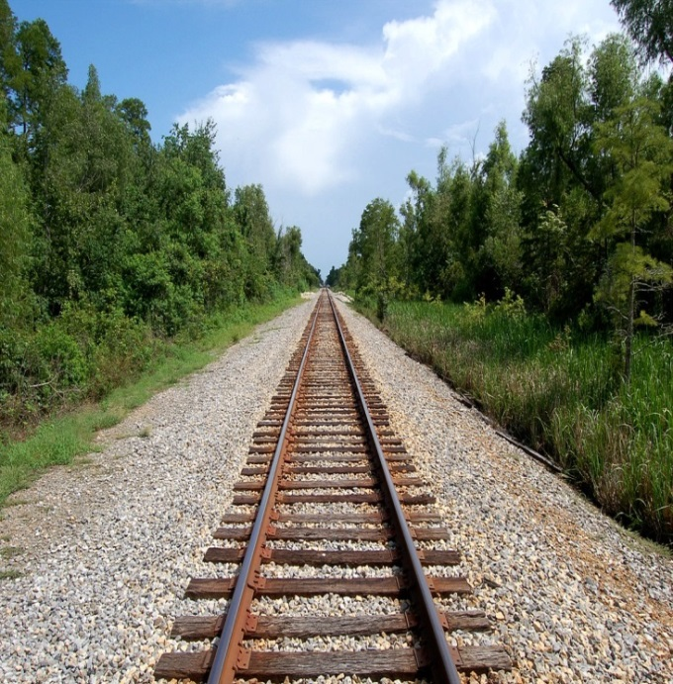
Homogén lineáris transzformációk
”μὴ εἶναι βασιλικὴν ἀτραπὸν ἐπί γεωμετρίαν”
Εὐκλείδης
Szirmay-Kalos László

Slide 14
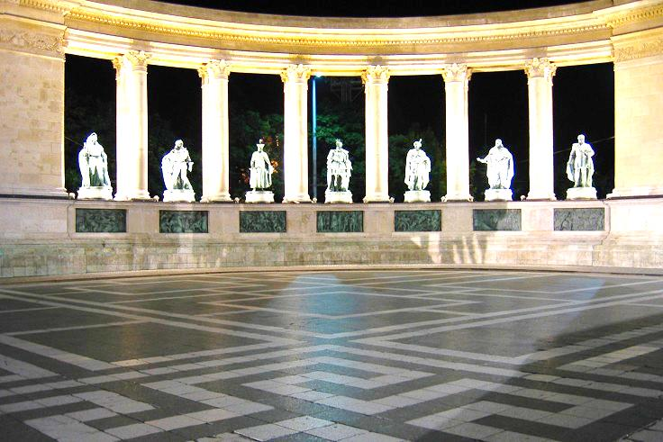
Perspektíva
tárgy
Vetítési
középpont
kép
képsík
Perspektíva
Egyenesből egyenest
Nem párhuzamostartó
Euklideszi geometria lyukas
Végtelen távoli pontok is kellenek
Projektív geometria

Slide 15
Analitikus geometriák: külső nézet
Ambiens tér
$$p=[x,y,w]$$
$$w$$
$$w$$
$$w=1$$
$$w=1$$
$$q$$
$$p=[x,y,1]$$
$$y$$
$$y$$
$$x$$
$$x$$
Euklideszi: $w=1$
Projektív
$$q=[x,y,0]$$
$$\left[\begin{matrix}\begin{matrix}{i′}_{x}^{} & {i′}_{y}^{} \\ {j′}_{x}^{} & {j′}_{y}^{}\end{matrix} & \begin{matrix}{i′}_{z}^{} & 0 \\ {j′}_{z}^{} & 0\end{matrix} \\ \begin{matrix}{k′}_{x}^{} & {k′}_{y}^{} \\ {o′}_{x}^{} & {o′}_{y}^{}\end{matrix} & \begin{matrix}{k′}_{z}^{} & 0 \\ {o′}_{z}^{} & 1\end{matrix}\end{matrix}\right]$$
$$\left[\begin{matrix}\begin{matrix}m_{11}^{} & m_{12}^{} \\ m_{21}^{} & m_{22}^{}\end{matrix} & \begin{matrix}m_{13}^{} & m_{14}^{} \\ m_{23}^{} & m_{24}^{}\end{matrix} \\ \begin{matrix}m_{31}^{} & m_{32}^{} \\ m_{41}^{} & m_{42}^{}\end{matrix} & \begin{matrix}m_{33}^{} & m_{34}^{} \\ m_{43}^{} & m_{44}^{}\end{matrix}\end{matrix}\right]$$
$$\left[x^{′},y^{′},z′,1\right]=[x,y,z,1]$$
$$\left[x^{′},y^{′},z′,w′\right]=[x,y,z,w]$$
Affin transzformáció
Homogén lineáris transzformáció

Slide 16
Homogén lineáris transzformációk tulajdonságai
Egyenest egyenesbe, szakaszt szakaszba, síkot síkba háromszöget háromszögbe, kombinációkat kombinációkba, konvex kombinációkat konvex kombinációkba
Egyenestartó ($t∈(−∞,+∞));$Szakasztartó ($t∈[0,1])$
$\left[X\left(t\right),Y\left(t\right),Z\left(t\right),w\left(t\right)\right]=[X_{1}$, $Y_{1},Z_{1},w_{1}]t+[X_{2}$,$Y_{2},Z_{2},w_{2}](1−t)$
$p\left(t\right)=p_{1}t+p_{2}(1−t)$ // $∙T$
$$p^{∗}\left(t\right)={(p}_{1}∙T)t+{(p}_{2}∙T)(1−t)$$
$$p^{∗}\left(t\right)=p_{1}t+p_{2}(1−t)$$
*
*
Notes:
Homogeneous linear transformations are matrix multiplications of 4 element vectors in 3D and 3 element vectors in 2D. Such linear operations preserve linear computations, so a line is transformed to a line or to a point if the line degenerates, which never happens if T is invertible.

Slide 17
Homogén lineáris transzformációk: síkot síkba
$$\left[\begin{matrix}\begin{matrix}n_{x} \\ n_{y}\end{matrix} \\ \begin{matrix}n_{z} \\ d\end{matrix}\end{matrix}\right]$$
$\left[X,Y,Z, w\right]$= 0
$$T$$
$$p^{∗}=p∙T$$
$p∙n^{T}$ = 0
$$p$$
$${T }^{−1}$$
$$p^{∗}{∙T }^{−1}=p$$
$${(p}^{∗}{∙T }^{−1})∙n^{T}=0$$
Sík transzformáltja:
$$p^{∗}{∙(T }^{−1}∙n^{T})=0$$
$n^{∗T}=$ ${T }^{−1}∙n^{T}$
$$p^{∗}{∙n}^{∗T}=0$$
Notes:
Invertible homogeneous transformations map planes to planes. If the transformation is not invertible, it may happen that the resulting plane degenerates to a line or to a point.
A plane is a collection of points P that satisfy the plane equation. Multiplying every point P by matrix T, we get a collection of points P*. To find an equation for P*, we transform P* back to get P since we know that P satisfies the original equation.
As matrix multiplication is associative, we express a similar equation for the transformed points as well, so they are also on a plane. We can even determine the parameters of the plane (e.g. normal vector). If the parameters are a column vector, the parameters of the original plane must be left-multiplied with the inverse of the transformation matrix.

Slide 18
Középpontos vetítés (projekció)
$$\left(x^{′},y^{′},z^{′}\right)=\left(x\frac{d}{z},y\frac{d}{z},d\right)$$
$$y$$
$$\left(x,y,z\right)$$
balkezes
koord.
d
$$z$$
$$x$$
$$\left[x^{′},y^{′},z^{′},1\right]=\left[x\frac{d}{z},y\frac{d}{z},d,1\right]\sim \left[x,y,z,\frac{z}{d}\right]$$
$$\left[x,y,z,1\right]\left[\begin{matrix}\begin{matrix}1 & 0 \\ 0 & 1\end{matrix} & \begin{matrix}0 & 0 \\ 0 & 0 \end{matrix} \\ \begin{matrix}0 & 0 \\ 0 & 0\end{matrix} & \begin{matrix}1 & 1/d \\ 0 & 0 \end{matrix}\end{matrix}\right]=\left[x,y,z,\frac{z}{d}\right]\sim \left[x^{′},y^{′},z^{′},1\right]$$

Slide 19
Átfordulási probléma
$$z_{2}>0$$
$$z_{1}>0$$
$$y$$
$$y$$
$$z_{1}>0$$
$$w_{2}>0$$
$$\left[\begin{matrix}\begin{matrix}1 & 0 \\ 0 & 1\end{matrix} & \begin{matrix}0 & 0 \\ 0 & 0 \end{matrix} \\ \begin{matrix}0 & 0 \\ 0 & 0\end{matrix} & \begin{matrix}1 & 1/d \\ 0 & 0 \end{matrix}\end{matrix}\right]$$
$$z_{2}<0$$
$$w_{1}>0$$
$$w_{1}>0$$
d
$$z$$
$$z$$
$$w=\frac{z}{d}$$
$$x$$
$$w_{2}<0$$
$$x$$
Projektív egyenes (topológia)
$\left[X\left(t\right),Y\left(t\right),Z\left(t\right),w\left(t\right)\right]=[X_{1}$, $Y_{1},Z_{1},w_{1}]t+[X_{2}$,$Y_{2},Z_{2},w_{2}](1−t)$
$$w\left(t\right)$$
$$w_{1}$$
Ideális pont
$$w_{2}$$
$$t$$
$$0$$
$$1$$
Szakasz ???
Notes:
Let us execute this transformation for line segments. We are happy because it is enough to transform the two endpoints and the transformed pair of points can be connected by a line segment according to the properties of homogeneous linear transformations. For the first example, this is indeed true. However, for the second example, the transformation is seemingly not a line segment but its complement on the line, i.e. two half lines.
This is just a virtual contradiction. These two half lines also form a line segment in projection plane. The ideal point at the ”end” of the line glues the two ends together. The conclusion is that we should be careful since two points on a line can define two line segments that complement each other, similarly as two points on a circle can define two complementing arcs (a line in projective plane is topologically equivalent to a circle, we can go around it).

