Slide 1
Geometriai modellezés
1. Pontok és klasszikus görbék
”A semmiből egy új, más világot teremtettem.”
Bolyai János
Szirmay-Kalos László

Slide 2
Cél: Euklideszi 2D és 3D világ
2D világ:
  Pont: 0D
  Síkgörbe: 1D
  Terület: 2D
  Fraktál: 0-2D
3D világ:
  Pont: 0D
  Térgörbe: 1D
  Felület: 2D
  Térfogat: 3D
  Fraktál: 0-3D

Slide 3
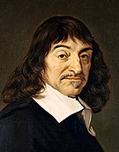













Pontok koordinátarendszerrel
$$z$$
$$r$$
$$z$$
$$θ$$
$$y$$
$$r$$
$$y$$
$$x$$
$$φ$$
$$y$$
$$x$$
$$φ$$
$$x$$
Descartes
Polár
Számokkal!
  Koordinátarendszer (=referencia geometria)
  Koordináták(=mérés)
Notes:
The goal is the definition of points with numbers and primitives with equations or functions.
The definition of points with numbers requires a coordinate system and then the measuring of the point with respect to this coordinate system. A Cartesian coordinate system contains two orthogonal lines or axes, and a unit on them, and we measure how far we should walk along them to arrive at the identified point.
A 2D polar coordinate system is a half line, and a point is defined by an angle and a distance. The angle specifies the direction in which we should go from the origin and the distance is interpreted between the origin and the identified point. Note that while we require that all points can be expressed by coordinates, this is not necessarily unambiguous, i.e. in a polar system the origin can be defined with arbitrary angle and with distance zero.
In computer graphics barycentric coordinate systems are also popular. Here, the coordinate system is a set of points (at least 3 in 2D) where we put weights. The resulting mechanical system has a center of mass somewhere, which are identified by the numbers of the weights. Barycentric coordinates are often called homogeneous, due to the property that if we multiply all weights with the same non-zero scalar, then the center of mass is not affected.
However, for such constructions we have already applied many non-trivial concepts like vectors, distance, angles. First, let us start from scratch and revisit these basic building blocks.

Slide 4
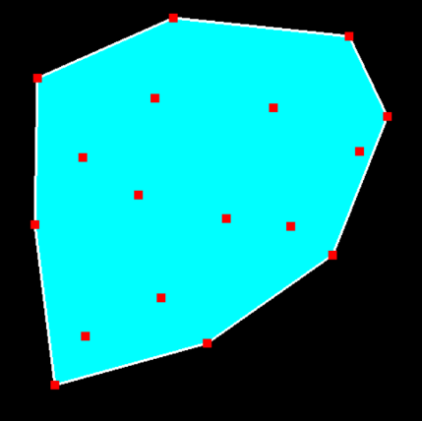

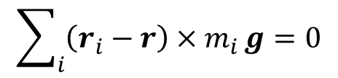
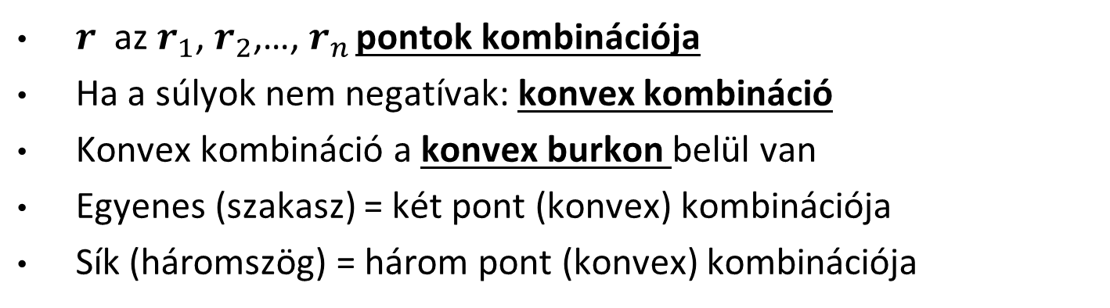







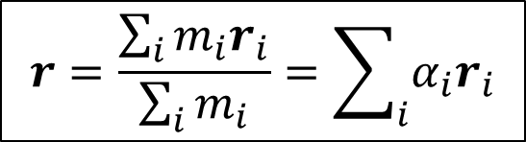
Baricentrikus (homogén) koordináták
$$r_{3}$$
Forgatónyomaték zérus
$$r_{2}$$
$$r_{n}$$
  $$\sum_{i}{\left(r_{i}−r\right)×m_{i}}g=0$$
$$r_{1}$$
r
$$m_{3}$$
$$m_{n}$$
  $$r=\frac{\sum_{i}{m_{i}r_{i}}}{\sum_{i}{m_{i}}}=\sum_{i}{α_{i}r_{i}}$$
$$m_{2}$$
$$m_{1}$$
$r$ az $r_{1}$, $r_{2}$,…, $r_{n}$ pontok kombinációja
Ha a súlyok nem negatívak: konvex kombináció
Konvex kombináció a konvex burkon belül van
Egyenes (szakasz) = két pont (konvex) kombinációja
Sík (háromszög) = három pont (konvex) kombinációja
Notes:
Defining a point as the center of mass of a system where masses placed at finite number of reference points is also called the combination of these points with barycentric coordinates equal to the weights.
Note that we can do this in real life without mathematics and coordinate systems, center mass exists and is real without mathematics and abstraction.
If all weights are non-negative, which has direct physical meaning, then we talk of convex combination since the points that can be defined in this way are in the convex hull of the reference points. By definition, the convex hull is the minimal set of points that is convex and includes the original reference points. For example, when presents are wrapped, the wrapping paper is on the convex hull of the presents.
Using the term combination or convex combination, we can define a line as a combination of two points and a line segment as a convex combination of two points. Similarly, the convex combination of three not collinear points is the triangle, the convex combination of four points not being in the same plane is a tetrahedron.

Slide 5

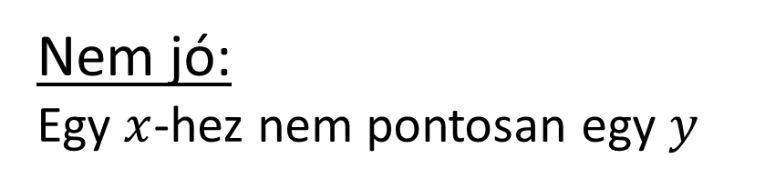
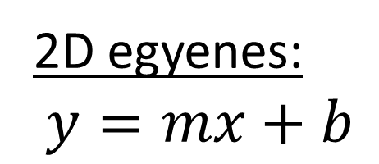








Görbék (1D): Explicit egyenlet
$$y$$
  $$y=F(x)$$
$$y$$
$$y$$
$$y$$
$$x$$
$$x$$
$$x$$
$$x$$
x₀
    2D egyenes:
    $$y=mx+b$$
    Nem jó:
    Egy $x$-hez nem pontosan egy $y$
Notes:
If we want to specify 1D objects, like curves, then we should simultaneously identify (uncountably) infinitely many points. Obviously, defining the points one by one with their Cartesian coordinates is not an option. Instead, we usually specify an equation that has infinitely many roots and these roots are considered as the Cartesian coordinates of points in a set defined by the equation. Assume that we are in 2D when the equation should contain Cartesian coordinates x and y (in 3D there would be a third coordinate as well).
The most obvious, but the least useful equation type is the explicit form, where we express y as a function of x. The problem with this representation is for each x there must be exactly one y. This is usually not the case, think of a circle or a vertical line, for example.

Slide 6

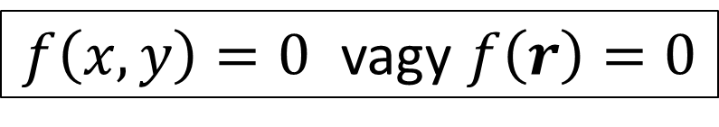


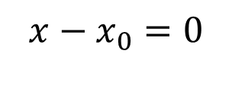

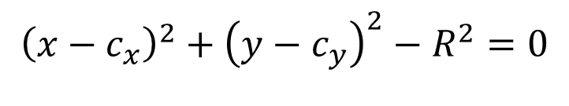


Görbe: Implicit egyenlet
  $f\left(x,y\right)=0$ vagy $f\left(r\right)=0$
$$y$$
$$y$$
$$y$$
$$x$$
$$x$$
$$x$$
x₀
$$x−x_{0}=0$$
$${\left(x−c_{x}\right)}^{2}+{\left(y−c_{y}\right)}^{2}−R^{2}=0$$
Notes:
The equation can have implicit form, which means that x and y are put into an algebraic expression that is made equal to zero. We have a single equation with two unknowns thus, we have the hope of having infinitely many roots, i.e. x,y pairs.
For example, a linear equation containing x and y identifies a line. A circle contains points that are at distance R from the reference point. Expressing this distance with the Pythagoras theorem, we can also develop and equation for the circle.

Slide 7



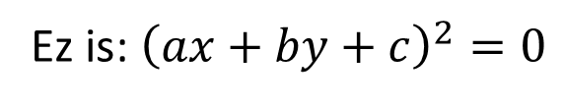







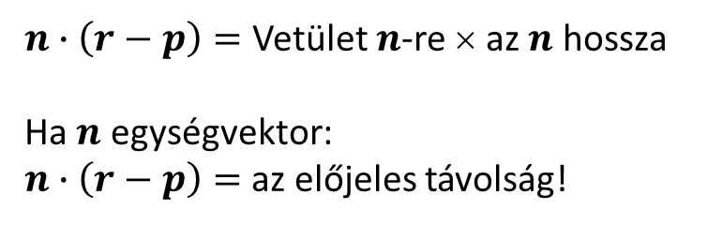

2D egyenes implicit egyenlete
$n$ normálvektor
  $$n∙\left(r−p\right)=0$$
$$y$$
$$p$$
$$r$$
$n_{x}\left(x−p_{x}\right)+n_{y}(y−p_{y})=0$
    $$ax+by+c=0$$
$$x$$
    Ez is: ${\left(ax+by+c\right)}^{2}=0$
2D egyenestől mért távolság:
$$n$$
$$r$$
$n∙\left(r−p\right)=$ Vetület $n$-re × az $n$ hossza
Ha $n$ egységvektor:
$n∙\left(r−p\right)=$az előjeles távolság!
vetület
$$p$$

Slide 8
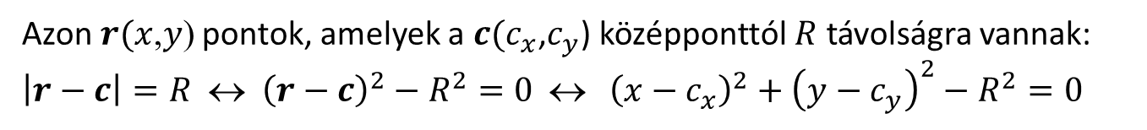



Kvadratikus görbék: Kör
Azon $r(x$,$y$) pontok, amelyek a $c(c_{x}$,$c_{y}$) középponttól $R$ távolságra vannak: $\left|r−c\right|=R$ ↔ ${\left(r−c\right)}^{2}−R^{2}=0 \text{↔} {\left(x−c_{x}\right)}^{2}+{\left(y−c_{y}\right)}^{2}−R^{2}=0$
$$r$$
$$R$$
$$c$$
Notes:
By definition, a circle is a set of points r of distance R (radius) from its center point c. Translating this geometric definition to the language of analytic geometry, we can establish the equation of the circle.
Distance of two points is the absolute value of the vector between them, which must be equal to R. Instead of the distance, we can work with the squared distance since both sides of this equation are positive, so taking the square does not modify the roots. The squared distance is the dot product of the difference vector with itself. Dot product can also be expressed with coordinates, so we can establish an implicit equation of the circle in Cartesian coordinates.
Circle has also a famous parametric equation, which is based on the definition of cos and sin: If we rotate a unit vector by φ around axis z, the x coordinate of the rotated vector is cos(φ) and the y coordinate is sin(φ).
Rotated vector of length R can be obtained by scaling by R. If the center is not in the origin but at point c, then we should translate the circle points by c.
As sine or cosine are usually irrational numbers, they cannot be precisely computed by a computer. So, sometimes another parametrization using only elementary operations is also useful (right hand side).

Slide 9

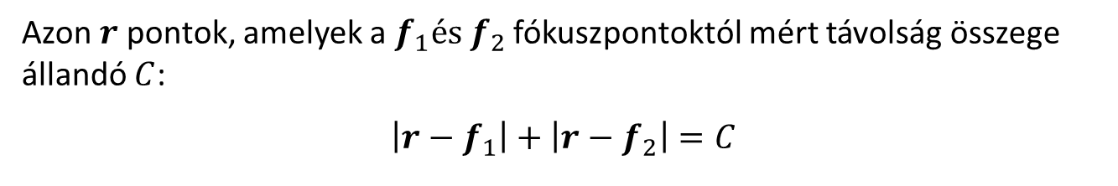


Kvadratikus görbék: Ellipszis
Azon $r$ pontok, amelyek a $f_{1}és{ f}_{2}$ fókuszpontoktól mért távolság összege állandó $C$:
$$\left|r−f_{1}\right|+\left|r−f_{2}\right|=C$$
$$r$$
$$f_{1}$$
$$f_{2}$$

Slide 10

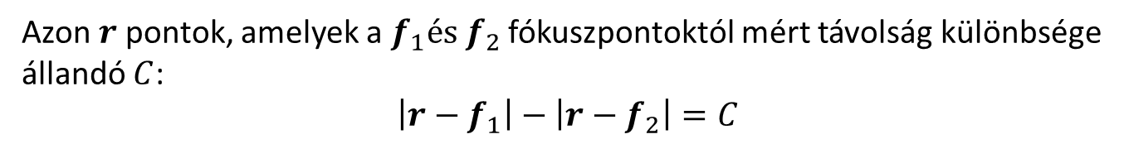


Kvadratikus görbék: Hiperbola
Azon $r$ pontok, amelyek a $f_{1}és{ f}_{2}$ fókuszpontoktól mért távolság különbsége állandó $C$:
$$\left|r−f_{1}\right|−\left|r−f_{2}\right|=C$$
$$r$$
$$f_{1}$$
$$f_{2}$$

Slide 11

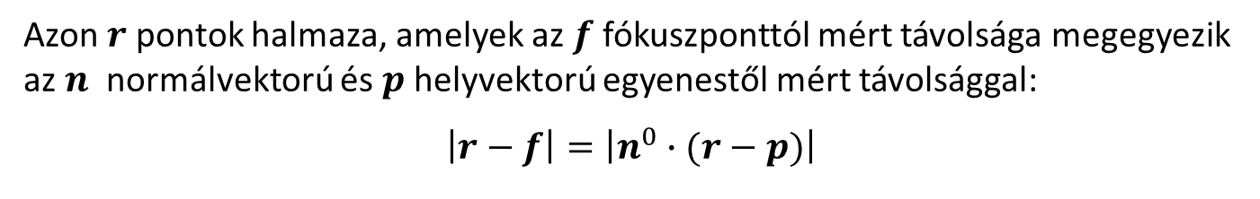


Kvadratikus görbék: Parabola
Azon $r$ pontok halmaza, amelyek az $f$ fókuszponttól mért távolsága megegyezik az $n$ normálvektorú és $p$helyvektorú egyenestől mért távolsággal:
$$\left|r−f\right|=\left|n^{0}∙(r−p)\right|$$
direktrix
egyenes
$f$ fókusz pont
$$p$$
$$n^{0}$$

Slide 12
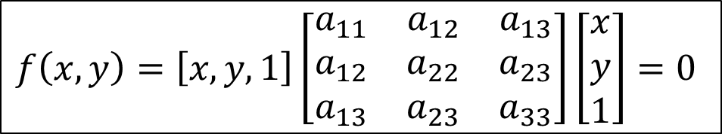
Kvadratikus görbék = kvadratikus alak
Implicit függvény négyzetgyökök nélkül:
Mátrixszal:
Bármely tengelyű ésnbármely típusú kvadratikus görbe → 3x3-as mátrix (Visszafelé???)
$f\left(x,y\right)=a_{11}x^{2}$+$a_{22}y^{2}+2a_{12}xy+2a_{13}x+2a_{23}y+a_{33}=0$
$$f\left(x,y\right)=\left[x,y,1\right]\left[\begin{matrix}a_{11} & a_{12} & a_{13} \\ a_{12} & a_{22} & a_{23} \\ a_{13} & a_{23} & a_{33}\end{matrix}\right]\left[\begin{matrix}x \\ y \\ 1\end{matrix}\right]=0$$

Slide 13
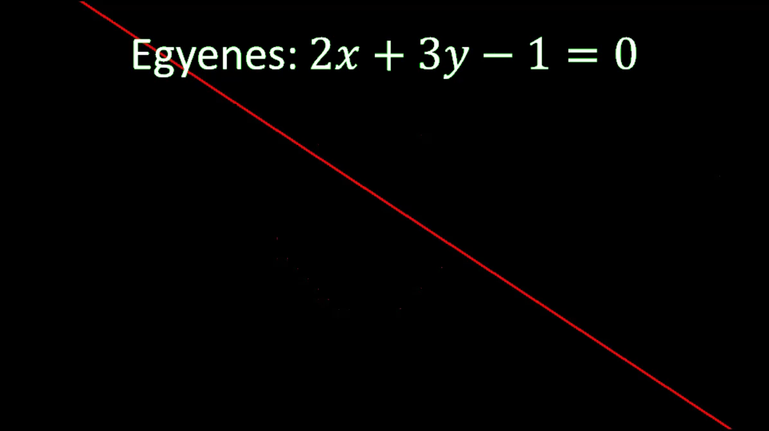
Állatkert

Slide 14
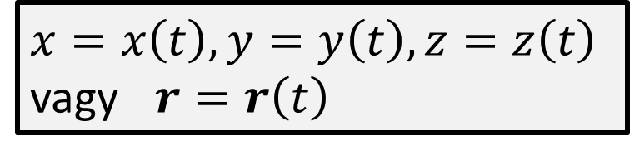

Görbe: Paraméteres egyenlet

  $x=x\left(t\right),y=y\left(t\right),z=z\left(t\right)$
  vagy $r=r\left(t\right)$
$$t$$
Notes:
The equation may also have parametric form, where we use a free parameter t that can run in an appropriate interval. Substituting t into two equations defining x and y (or z), we get the Cartesian coordinates of the point corresponding to t.

Slide 15

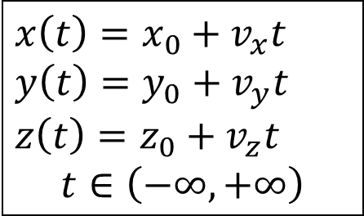



Egyenes
$$vt$$
$$r(t)$$
    $$x\left(t\right)=x_{0}+v_{x}t$$
$$y\left(t\right)=y_{0}+v_{y}t$$
$$z\left(t\right)=z_{0}+v_{z}t$$
$$t∈\left(−∞,+∞\right)$$
$$v$$
$$p$$

Slide 16





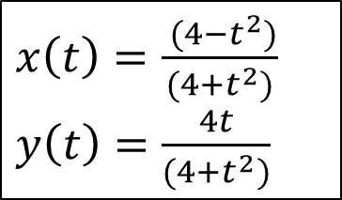

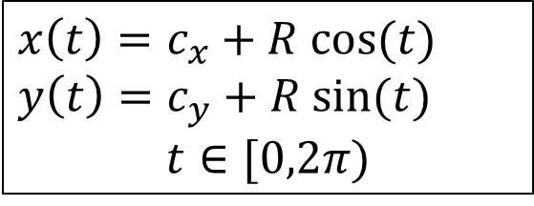



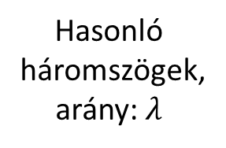




Kör
Hasonló
háromszögek,
arány: $λ$
$$(x\left(t\right), y\left(t\right))$$
$$(1, t)$$
$$R$$
$$(x, y)$$
$$Rsin(t)$$
$$(c_{x},c_{y})$$
$$t$$
$$t$$
$$x=−1+2λ$$
$$Rcos(t)$$
$$y=λt$$
$$−1$$
$$1$$
    $$x\left(t\right)=c_{x}+R cos⁡(t)$$
    $$y\left(t\right)=c_{y}+R sin⁡(t)$$
    $$t∈[0,2π)$$
    $x\left(t\right)=\frac{ (4−t^{2})}{(4+t^{2})}$
    $y\left(t\right)=\frac{4t}{(4+t^{2})}$

Slide 17

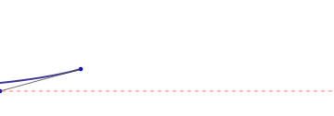
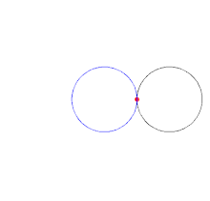
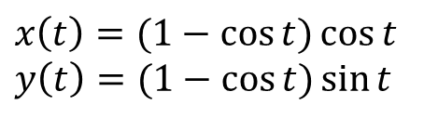
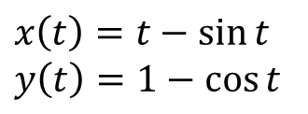

Klasszikus görbék
Cikloisz:
Tractrix:
Kardioid:
$$x\left(t\right)=t−\sin{t}$$
$$y\left(t\right)=1−\cos{t}$$
$$x\left(t\right)=\operatorname{sech}{t}$$
$$y\left(t\right)=t−\tanh{t}$$
$$x\left(t\right)=(1−\cos{t)\cos{t}}$$
$$y\left(t\right)=(1−\cos{t)\sin{t}}$$

Slide 18
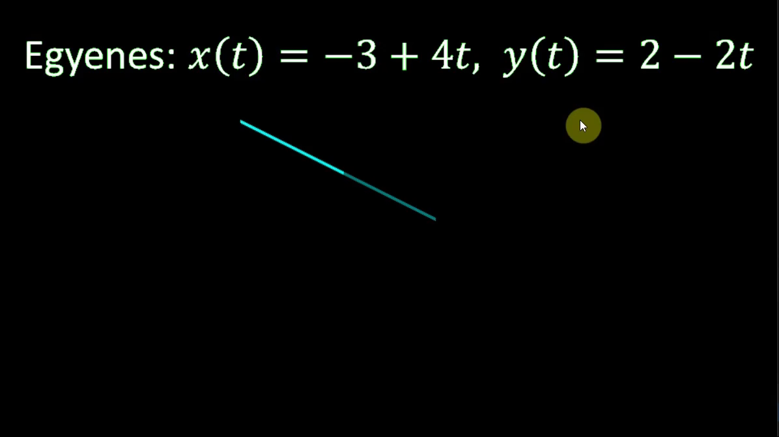
Állatkert

Slide 19
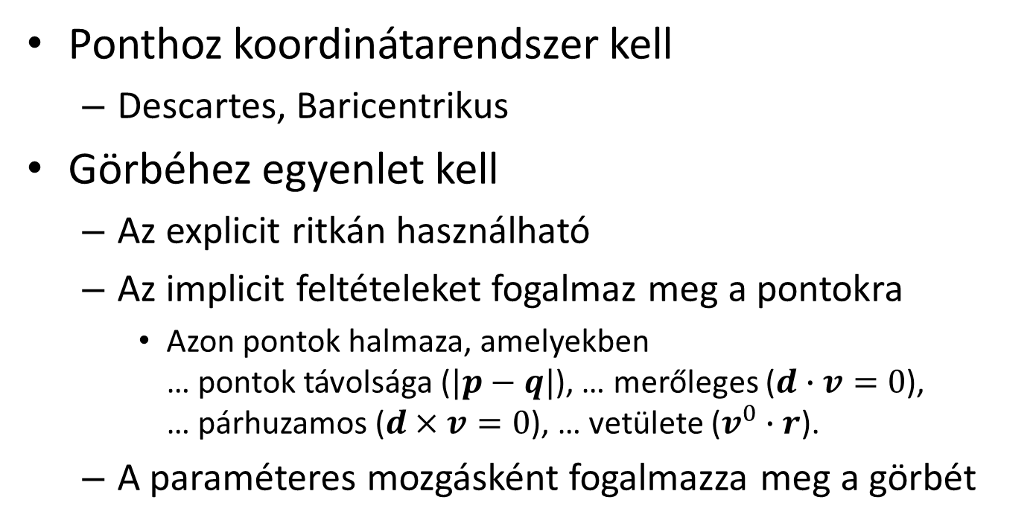
Pontok és klasszikus görbék
Ponthoz koordinátarendszer kell
  Descartes, Baricentrikus
Görbéhez egyenlet kell
  Az explicit ritkán használható
  Az implicit feltételeket fogalmaz meg a pontokra
    Azon pontok halmaza, amelyekben … pontok távolsága ($|p−q|$), … merőleges ($d∙v=0$), … párhuzamos ($d×v=0$), … vetülete ($v^{0}∙r$).
  A paraméteres mozgásként fogalmazza meg a görbét

Slide 20

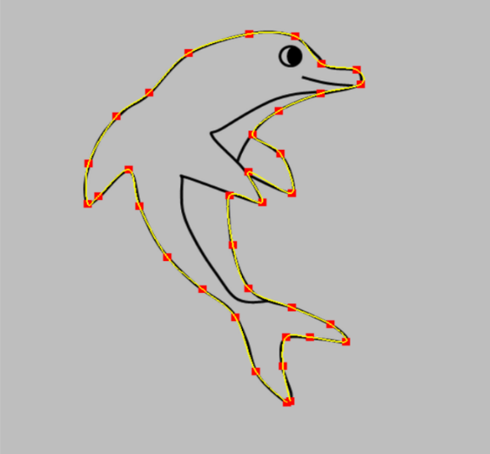
Geometriai modellezés
2. Szabadformájú görbék
Szirmay-Kalos László

Slide 21

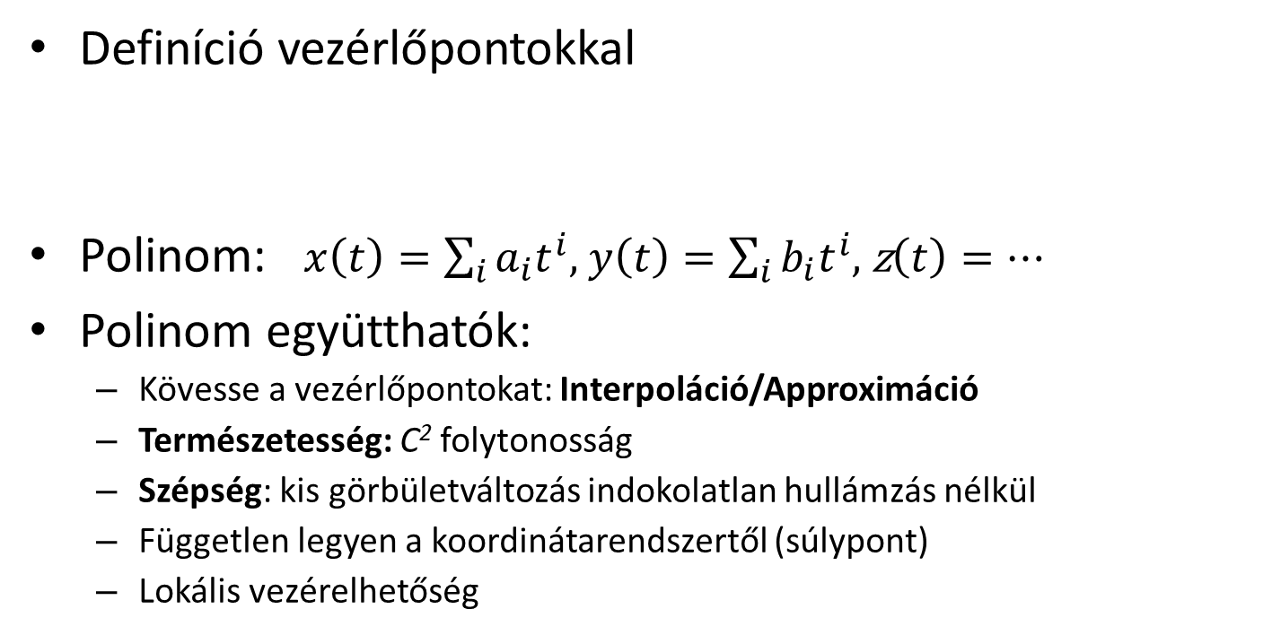

Szabadformájú görbék
Definíció vezérlőpontokkal
Polinom: $x\left(t\right)=\sum_{i}{a_{i}t^{i}}$, $y\left(t\right)=\sum_{i}{b_{i}t^{i}}$, z$\left(t\right)=…$
Polinom együtthatók:
  Kövesse a vezérlőpontokat: Interpoláció/Approximáció
  Természetesség: C² folytonosság
  Szépség: kis görbületváltozás indokolatlan hullámzás nélkül
  Független legyen a koordinátarendszertől (súlypont)
  Lokális vezérelhetőség
  $r\left(t\right)$
Notes:
For classic curves, like line, circle, parabola, ellipse, etc. we know their geometric definition, which can be translated to an equation, so the definition means the specification of the free parameters in the equation.
However, curves we meet usually do not belong to the category of classic curves, so we do not know their equation. These curves are free form curves.
As ”everything” can be approximated by polynomials, the unknown equations of free form curves are also attacked this way. We approximate their parametric equations with polynomials of parameter t. The problem is that the polynomial coefficients do not have intuitive interpretation, thus we cannot expect the modeler to specify the coefficients directly. Instead, we require the user to specify a finite number of control points, and the modeling program automatically computes the polynomial coefficients from the control points. This computation can be an interpolation when the resulting curve is expected to go through the control points. Or, the computation can also be an approximation, when the resulting curve should just somehow follow the control points, but it does not have to go through each of them. By requiring approximation instead of interpolation, we ease the fitting process so we can impose additional requirements concerning the ”quality” of the curve.

Slide 22
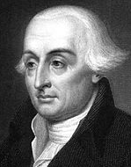
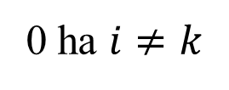

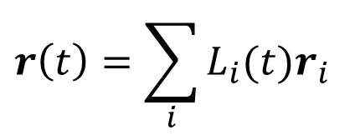
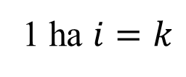

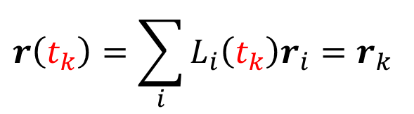
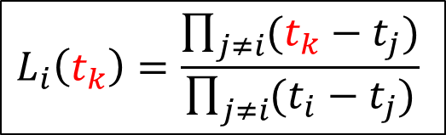
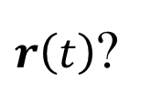


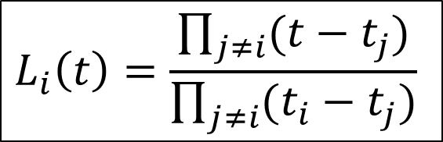

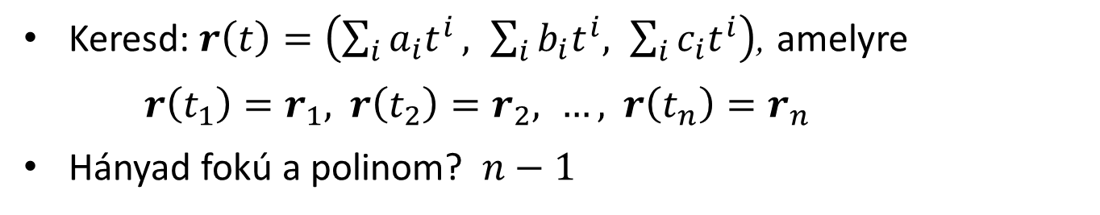

(Giuseppe) Lagrange interpoláció
$$r_{2}$$
$$r_{1}$$
$$r_{n}$$
  $r\left(t\right)$?
$$t_{1}$$
$$t_{2}$$
$$t_{n}$$
Keresd: $r\left(t\right)=\left(\sum_{i}{a_{i}t^{i}}, \sum_{i}{b_{i}t^{i}, \sum_{i}{c_{i}t^{i}}}\right)$, amelyre
${r\left(t_{1}\right)=r}_{1},{ r\left(t_{2}\right)=r}_{2}, …,{ r\left(t_{n}\right)=r}_{n}$
Hányad fokú a polinom? $n−1$
$$r\left(t\right)=\sum_{i}{L_{i}(t)r_{i}}$$
$$r\left(t_{k}\right)=\sum_{i}{L_{i}\left(t_{k}\right)r_{i}=r_{k}}$$
1 ha $i=k$
$$L_{i}\left(t\right)=\frac{\prod_{j≠i}{(t−t_{j})}}{\prod_{j≠i}{(t_{i}−t_{j})}}$$
$$L_{i}\left(t_{k}\right)=\frac{\prod_{j≠i}{(t_{k}−t_{j})}}{\prod_{j≠i}{(t_{i}−t_{j})}}$$
0 ha $i≠k$
Notes:
The first curve is of interpolation type and is known as the Lagrange interpolation. Suppose we specify a sequence of control points r1, …, rn, and search a parametric function r(t) (one polynomial for each of the x, y or x, y, z coordinates) that goes through them. More precisely, we expect the curve to give control point r1 for parameter value t1, r2 for t2, etc. The interpolation requirement means n constraints, thus the polynomials may have n unknown coefficients to make the number of unknowns equal to the number of equations, and thus obtaining a well defined problem with an unambiguous solution. To find the n unknown polynomial coefficients, we need to solve a linear equation generated by substituting t1,…,tn into the polynomial and requiring them to be equal to r1,…,rn, respectively. If we solve it, we obtain the coefficients, which allow the computation of the curve point for arbitrary parameter t.
Instead of solving the linear equation, the solution can be given directly as a combination of the control points with barycentric coordinates Li(t) that depend on parameter t. The algebraic form of these weight functions, aka basis functions or blending functions is shown here as the ratio of two products.
To prove that the combination of the control points with these functions satisfies the interpolation constraints, let us examine a basis function Li when we substitute tk into it. If i=k, the numerator and the denominator of Li will be similar, so Li(ti) = 1. However, when i !=k, there will be some j which equals to k, so one factor of the numerator will be tk-tk=0, making Li(tk) also zero. So Li is 1 for ti but is zero for all other discrete parameter values. This means that in sum Li(tk) ri, all control points ri get zero weight except rk, which gets weight 1, thus r(tk) = rk.
Note: A point of the Lagrange curve is the combination of control points with weights Li. According to the definition of combination, the reference points (which are the control points here) should be multiplied with the corresponding weights, the terms should be added them up, and finally the sum be divided with the total mass. Where is this division? The division can be ignored if the total mass is 1. Is the sum of the weight functions equal to 1 for any t??? (Yes).

Slide 23
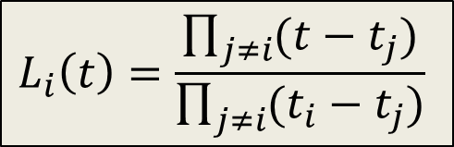

class LagrangeCurve {
vector<vec3> cps; // control pts
vector<float> ts; // knots
float L(int i, float t) {
float Li = 1.0f;
for(int j = 0; j < cps.size(); j++)
if (j != i) Li *= (t – ts[j])/(ts[i] – ts[j]);
return Li;
}
public:
void AddControlPoint(vec3 cp) {
float ti = cps.size(); // or something better
cps.push_back(cp); ts.push_back(ti);
}
vec3 r(float t) {
vec3 rt(0, 0, 0);
for(int i = 0; i < cps.size(); i++) rt += cps[i] * L(i,t);
return rt;
}
};
$$L_{i}\left(t\right)=\frac{\prod_{j≠i}{(t−t_{j})}}{\prod_{j≠i}{(t_{i}−t_{j})}}$$
$$r\left(t\right)=\sum_{i}{L_{i}(t)r_{i}}$$

Slide 24






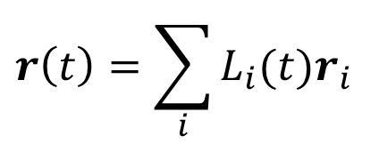


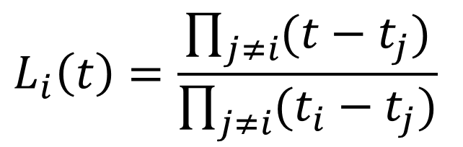


Lagrange interpoláció bázisfüggvényei
$$L_{1}\left(t\right)$$
$$L_{2}\left(t\right)$$
$$L_{3}\left(t\right)$$
$$L_{4}\left(t\right)$$
$$1$$
$$t$$
$$0$$
$$1$$
$$2$$
$$3$$
$$r\left(t\right)=\sum_{i}{L_{i}(t)r_{i}}$$
$$L_{i}\left(t\right)=\frac{\prod_{j≠i}{(t−t_{j})}}{\prod_{j≠i}{(t_{i}−t_{j})}}$$
Notes:
Let us take an example where there are four control points and we expect the curve to interpolate them for t=0, 0.33, 0.67, and 1, respectively. The basis functions are depicted in the Figure. When t=0, the weight of the green point is 1, and the weight of all other points is zero. The curve is then in the green point. When t increases, the weight of the red point gets larger and at t=0.33 only the red point has non-zero weight…
The basis functions oscillate between positive and negative values, thus a control point periodically attracts or repels the curve. This is bad since the curve will tend to oscillate.
The other disadvantage of Lagrange interpolation is that it cannot provide local control. Local control would mean that the modification of a control point modifies only a smaller part of the curve. However, as all basis functions are non-zero in the whole domain, the complete curve will change.

Slide 25
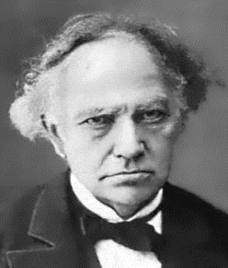


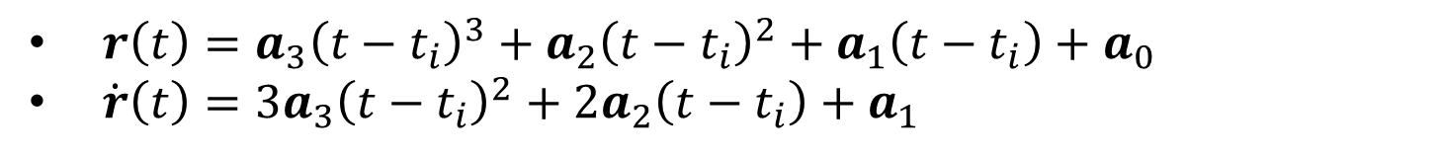


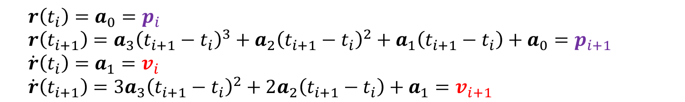
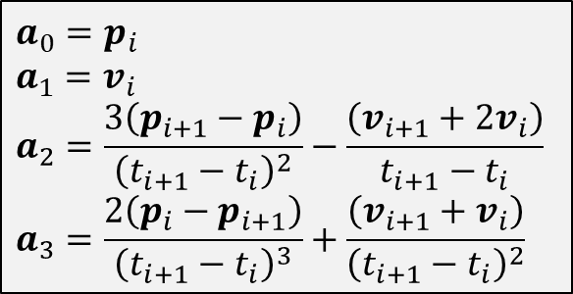






(Charles) Hermite interpoláció
$v_{i}$
$$=\dot{r}\left(t_{i}\right)$$
$$a_{0}=p_{i}$$
$$a_{1}=v_{i}$$
$$a_{2}=\frac{3\left(p_{i+1}−p_{i}\right)}{{\left(t_{i+1}−t_{i}\right)}^{2}}−\frac{\left(v_{i+1}+2v_{i}\right)}{t_{i+1}−t_{i}}$$
$$a_{3}=\frac{2\left(p_{i}−p_{i+1}\right)}{{\left(t_{i+1}−t_{i}\right)}^{3}}+\frac{\left(v_{i+1}+v_{i}\right)}{{\left(t_{i+1}−t_{i}\right)}^{2}}$$
$$p_{i+1}$$
$$\text{=}r\left(t_{i+1}\right)$$
$$t_{i+1}$$
$$t_{i}$$
$$p_{i}$$
$$\text{=}r\left(t_{i}\right)$$
$$v_{i+1}$$
$$=\dot{r}\left(t_{i+1}\right)$$
$r\left(t\right)=a_{3}{\left(t−t_{i}\right)}^{3}+a_{2}{\left(t−t_{i}\right)}^{2}+a_{1}\left(t−t_{i}\right)+a_{0}$
$\dot{r}\left(t\right)=3a_{3}{\left(t−t_{i}\right)}^{2}+2a_{2}\left(t−t_{i}\right)+a_{1}$
$$r\left(t_{i}\right)=a_{0}=p_{i}$$
$$r\left(t_{i+1}\right)=a_{3}{\left(t_{i+1}−t_{i}\right)}^{3}+a_{2}{\left(t_{i+1}−t_{i}\right)}^{2}+a_{1}\left(t_{i+1}−t_{i}\right)+a_{0}=p_{i+1}$$
$$\dot{r}\left(t_{i}\right)=a_{1}=v_{i}$$
$$\dot{r}\left(t_{i+1}\right)=3a_{3}{\left(t_{i+1}−t_{i}\right)}^{2}+2a_{2}\left(t_{i+1}−t_{i}\right)+a_{1}=v_{i+1}$$
Notes:
Hermite (H at the beginning and e at the end are silent because he was a Frenchman) interpolation is a generalization of Lagrange interpolation, where not only the points to be interpolated are given but also the derivatives. Here we discuss only the practically relevant special case, when the curve is defined by two control points and the first derivatives at these control points. We have four constraints, so the polynomial that is unambiguously determined by these constraints if a cubic (of four polynomical coefficients).
The strategy is (always) similar to that of the Lagrange interpolation. We take the polynomial with yet unknown coefficients, substitute the constraints, and get a linear equation for the unknown coefficients. This linear equation is solved.

Slide 26
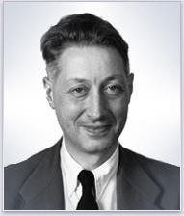










(Pierre) Bézier approximáció
Keresd: $r\left(t\right)=\sum_{i}{B_{i}(t)r_{i}}$
  $B_{i}(t)$: ne oszcilláljon
  Konvex burok tulajdonság
  $B_{i}(t)≥0$, $\sum_{i}{B_{i}\left(t\right)=1 }$
$$r_{1}$$
$$r_{2}$$
$$r_{0}$$
$$r\left(t\right)$$
$$r_{3}$$
$$B_{2}(t)$$
$$B_{1}(t)$$
$$B_{3}(t)$$
$$B_{0}(t)$$
Notes:
Lagrange (and Hermite) interpolation tends to oscillate. Let us find a better curve. We still use the center of mass analogy, i.e. the curve will be the composition of control points with weights placed at them. The weights are basis functions Bi(t) and we can ignore division with the total mass if the sum of weights is guaranteed to be equal to 1.
We do not want the oscillation of the Lagrange curve, so we allow only non-negative weights. Composition with non-negative weights is a convex combination, thus all points of the curve, i.e. the complete curve will be in the convex hull of the control points.

Slide 27




(Серге́й Ната́нович) Bernstein polinomok
Newton binomiális tétel
$$1^{n}={\left(t+(1−t)\right)}^{n}=\sum_{i=0}^{n}{\left({n \atop i}\right)t^{i}{(1−t)}^{n−i}}$$
$$B_{i}(t)$$
  $B_{i}(t)≥0$, $\sum_{i}{B_{i}\left(t\right)=1 }$: OK
Notes:
So, the task is to find a basis function system where each basis function is non-negative in the allowed domain (in [0,1]) and their sum is everywhere 1.
Such basis functions can be constructed by expressing 1 with the Newtonian binomial theorem. The terms are called Bernstein polynomials, which are indeed non-negative if t is in [0,1], and their creation guarantees that their sum is 1.

Slide 28











Bézier approximáció
$$B_{i}\left(t\right)$$
$$n=3$$
$$1$$
$${(1−t)}^{3}$$
$$t^{3}$$
$${3t(1−t)}^{2}$$
$$3t^{2}(1−t)$$
$$t$$
$$0$$
$$r\left(t\right)=\sum_{i=0}^{n}{B_{i}(t)r_{i}}$$
$$B_{i}\left(t\right)=\left({n \atop i}\right)t^{i}{(1−t)}^{n−i}$$
Notes:
If n = 3 (which is good for 4 control points), the basis functions are (1-t)^3, 3*(1-t)^2*t, 3*(1-t) *t^2, t^3. Note that the first basis function is 1 for t=0, while all others are zero, so the curve crosses the fist control points. Similarly, when t=1, the curve is at the last control point. However, other control points are not so lucky, they are usually not interpolated. This is an approximation curve.

Slide 29


BezierCurve
class BezierCurve {
vector<vec3> cps; // control pts
float B(int i, float t) {
int n = cps.size()-1; // n+1 pts!
float choose = 1;
for(int j = 1; j <= i; j++) choose *= (float)(n-j+1)/j;
return choose * pow(t, i) * pow(1-t, n-i);
}
public:
void AddControlPoint(vec3 cp) { cps.push_back(cp); }
vec3 r(float t) {
vec3 rt(0, 0, 0);
for(int i=0; i < cps.size(); i++) rt += cps[i] * B(i,t);
return rt;
}
};
$$B_{i}\left(t\right)=\left({n \atop i}\right)t^{i}{(1−t)}^{n−i}$$
$$r\left(t\right)=\sum_{i=0}^{n}{B_{i}(t)r_{i}}$$

Slide 30

















Catmull-Rom spline
Minden két vezérlőpont közé egy Hermite
$C^{1}$ simaság: a sebesség is legyen közös két egymás utánira
Közelítő $C^{2}$ simaság: A közös sebességet úgy válaszd meg, hogy a gyorsulás is közelítőleg folytonos legyen
$$v_{i+1}$$
$$r_{i−1}$$
$$r_{i+1}$$
$$v_{i}$$
$$r_{n}$$
$$r_{0}$$
$$r_{i}$$
$$t_{0}$$
$$t_{i−1}$$
$$t_{i}$$
$t_{i+1}$
$$t_{n}$$
Általánosítás:
Tenzió, Bias
$$v_{i}=\frac{1−τ}{2}\left(\frac{r_{i+1}−r_{i}}{t_{i+1}−t_{i}}+\frac{r_{i}−r_{i−1}}{t_{i}−t_{i−1}}\right)$$
$$v_{i}=\frac{1}{2}\left(\frac{r_{i+1}−r_{i}}{t_{i+1}−t_{i}}+\frac{r_{i}−r_{i−1}}{t_{i}−t_{i−1}}\right)$$
Notes:
Let us define a separate curve segments between every two control points applying Hermite interpolation. Hermite interpolation needs the start and end points (which are available) and the derivatives at these two points (which should be found somehow).
If the speed is uniform and the motion is linear in segment i, then its constant speed equals to (r{i}-r{i-1})/(t{i}-t{i-1}).
Similarly the constant speed in segment i+1 would be (r{i+1}-r{i})/(t{i+1}-t{i}). A good approximation is to set the velocity at the control point shared by the two segments to the average of these two velocities. This is the Catmull-Rom spline.
Kochanek and Bartels further generalized this spline and allowed an additional tension parameter that can scale up or down the average velocity. On the other hand, we can use a weighted average when the average of the two constant speeds is obtained.

Slide 31


CatmullRom
class CatmullRom {
vector<vec3> cps; // control points
vector<float> ts; // parameter (knot) values
vec3 Hermite(vec3 p0, vec3 v0, float t0, vec3 p1, vec3 v1, float t1,
float t) {
}
public:
void AddControlPoint(vec3 cp, float t) { … }
vec3 r(float t) {
for(int i = 0; i < cps.size() - 1; i++)
if (ts[i] <= t && t <= ts[i+1]) {
vec3 v0 = …, v1 = …;
return Hermite(cps[i], v0, ts[i],cps[i+1], v1, ts[i+1], t);
}
}
};
$$r\left(t\right)=a_{3}{\left(t−t_{0}\right)}^{3}+a_{2}{\left(t−t_{0}\right)}^{2}+a_{1}\left(t−t_{0}\right)+a_{0}$$
$a_{0}=p_{i}$ , $a_{1}=v_{i}$
$$a_{2}=\frac{3\left(p_{i+1}−p_{i}\right)}{{\left(t_{i+1}−t_{i}\right)}^{2}}−\frac{\left(v_{i+1}+2v_{i}\right)}{t_{i+1}−t_{i}}$$
$$a_{3}=\frac{2\left(p_{i}−p_{i+1}\right)}{{\left(t_{i+1}−t_{i}\right)}^{3}}+\frac{\left(v_{i+1}+v_{i}\right)}{{\left(t_{i+1}−t_{i}\right)}^{2}}$$
$$v_{i}=\frac{1}{2}\left(\frac{r_{i+1}−r_{i}}{t_{i+1}−t_{i}}+\frac{r_{i}−r_{i−1}}{t_{i}−t_{i−1}}\right)$$

Slide 32











Érintő, normál és görbület
$$a=\ddot{r}$$
$$acp$$
Normál: $N=T_{⊥}=(−T_{y}$, $T_{x})$
Centripetális gyorsulás:
$$a_{cp}=a∙N=\ddot{r}∙\frac{{\dot{r}}_{⊥}}{\left|\dot{r}\right|}=\frac{v^{2}}{R}$$
$$N$$
$$v=\dot{r}$$
$$r(t)$$
$$T=\frac{v}{|v|}=\frac{\dot{r}}{|\dot{r}|}$$
$$R$$
$$acp=\frac{v^{2}}{R}$$
Görbület: $κ=\frac{1}{R}=\frac{a_{cp}}{v^{2}}=\frac{\ddot{r}∙{\dot{r}}_{⊥}}{{|\dot{r}|}^{3}}$
$$v$$

Slide 33

Szabadformájú görbék
Paraméteres egyenlet (mozgás), polinomok
Kontrolpontokkal definiáljuk (approximációs, interpolációs)
Görbe = kontrolpontok kombinációja (súlypont)
Görbe tulajdonságait a súlyfüggvények határozzák meg
  Folytonosság ($C^{0}$, $C^{1}$, $C^{2})$
  Konvex burok: súlyfüggvények nem negatívak
  Lokális vezérelhetőség: súlyfüggvények a tartomány egy részében nem zérus értékűek

Slide 34

Geometriai modellezés
3. Felületek
”La semplicità è la sofisticazione finale.”
Leonardo da Vinci
Szirmay-Kalos László

Slide 35











Felületek
$$z$$
Felület a 3D tér 2D részhalmaza:
  Explicit: $z=h\left(x,y\right)$
  Implicit: $f\left(x,y,z\right)=0$; $f\left(r\right)=0$
    sík: $ax+by+cz+d=0$
  Parametrikus: $x=x\left(u,v\right),y=y\left(u,v\right),z=z\left(u,v\right)$; $r=r\left(u,v\right)$
    sík: $r\left(u,v\right)=p+au+bv$
$$y$$
$$x$$
$$bv$$
$$b$$
$$p$$
$$r(u,v)$$
$$a$$
$$au$$
Notes:
Surfaces are two dimensional subsets of the 3D space. Their definition is very similar to that of curves, but now the parametric equations have two free parameters (parametric equations of curves map a line segment onto the curve, parametric equations of surfaces map a square onto the surface).

Slide 36










Gömb
Implicit
Parametrikus
$$r$$
z
$$v$$
$$R$$
    $$cos⁡(v)$$
1
$$c$$
$$u$$
y
$$\sin\left(v\right)$$
x
$${\left(x−c_{x}\right)}^{2}+{\left(y−c_{y}\right)}^{2}{+\left(z−c_{z}\right)}^{2}−R^{2}=0$$
    $$x\left(u,v\right)=c_{x}+R\cos\left(u\right)sin⁡(v)$$
    $$y\left(u,v\right)=c_{y}+R\sin\left(u\right)sin⁡(v)$$
    $$z\left(u,v\right)=c_{z}+R cos⁡(v)$$
    $u∈\left[0,2π\right), v$ $∈\left[0,π\right)$

Slide 37





Implicit felületek normálvektora
Normál vektor = $grad f=\left(\frac{∂f}{∂x},\frac{∂f}{∂y},\frac{∂f}{∂z}\right)$
  $0=f\left(x,y,z\right)$
  $= f\left(X+\left(x−X\right),Y+\left(y−Y\right),Z+\left(z−Z\right)\right)$
  $≈f(X,Y,Z)+\frac{∂f}{∂x}(x−X)+\frac{∂f}{∂y}(y−Y)+\frac{∂f}{∂z}(z−Z)$
  $\left(\frac{∂f}{∂x},\frac{∂f}{∂y},\frac{∂f}{∂z}\right)∙\left(x−X,y−Y,z−Z\right)=0$
  $$0=f\left(x,y,z\right)$$
$$n$$
$$p(X,Y,Z)$$
$$n∙\left(r−p\right)=0$$

Slide 38








Parametrikus felületek normálvektora
$$n\left(U,V\right)=\frac{∂r\left(u,v\right)}{∂u}×\frac{∂r\left(u,v\right)}{∂v}$$
$$\frac{∂r\left(U,v\right)}{∂v}$$
$$u=U$$
$$v=V$$
$$r\left(u,v\right)$$
$$\frac{∂r\left(u,V\right)}{∂u}$$
$$r\left(U,V\right)$$
$$r\left(u,V\right)$$
$$r\left(U, v\right)$$

Slide 39







Implicit kvadratikus felületek: Henger
Azon $r$ pontok, amelyek a $v^{0}$ irányvektorú és $p$helyvektorú egyenestől mért távolsága $R$:
$\left|r−p−v^{0}({\left(r−p\right)∙v}^{0}) \right|=R$
$$r$$
$$r−p$$
$$p$$
$$v^{0}$$
$$v^{0}({\left(r−p\right)∙v}^{0})$$

Slide 40





Implicit kvadratikus felületek:
Ellipszoid és hiperboloid
Ellipszoid: Azon $r$ pontok, amelyek a $f_{1}és{ f}_{2}$ fókuszpontoktól mért távolság összege állandó $C$:
$$\left|r−f_{1}\right|+\left|r−f_{2}\right|=C$$
Hiperboloid: Azon $r$ pontok, melyek a $f_{1}és{ f}_{2}$ fókuszpontoktól mért távolság különbsége állandó $C$: $\left|r−f_{1}\right|−\left|r−f_{2}\right|=C$
$$r$$
$$f_{1}$$
$$f_{2}$$

Slide 41






Implicit kvadratikus felületek: Paraboloid
Azon$r$ pontok, amelyek az $f$ fókuszponttól mért távolsága megegyezik az $n$ normálvektorú és $p$helyvektorú síktól mért távolsággal:
$$\left|r−f\right|=\left|n^{0}∙(r−p)\right|$$
$$p$$
$$f$$
$$n^{0}$$
direktrix
sík
$$p$$

Slide 42










Implicit kvadratikus felületek
$$f\left(x,y,z\right)= \left[x,y,z,1\right]Q\left[\begin{aligned}x \\ y \\ z \\ 1\end{aligned}\right]=0$$
Mindig felírható úgy is, hogy $Q$ szimmetrikus
$$\frac{x^{2}}{a^{2}}+\frac{y^{2}}{b^{2}}+\frac{z^{2}}{c^{2}}−1=0$$
$$\frac{x^{2}}{a^{2}}+\frac{y^{2}}{b^{2}}−z=0$$
$$\frac{x^{2}}{a^{2}}+\frac{y^{2}}{b^{2}}−\frac{z^{2}}{c^{2}}−1=0$$
$$\frac{x^{2}}{a^{2}}+\frac{y^{2}}{b^{2}}−1=0$$
Ellipszoid
Paraboloid
Hiperboloid
Elliptikus
henger

Slide 43



Kvadratikus objektum
$$f\left(x,y,z\right)= \left[x,y,z,1\right]Q\left[\begin{aligned}x \\ y \\ z \\ 1\end{aligned}\right]$$
$$\frac{∂f}{∂x}=\left[1,0,0,0\right]Q\left[\begin{aligned}x \\ y \\ z \\ 1\end{aligned}\right]+\left[x,y,z,1\right]Q\left[\begin{aligned}1 \\ 0 \\ 0 \\ 0\end{aligned}\right]=\left[x,y,z,1\right]Q\left[\begin{aligned}2 \\ 0 \\ 0 \\ 0\end{aligned}\right]$$
struct Quadrics {
mat4 Q; // symmetric matrix
float f(vec4 r) { // r.w = 1
return dot(r * Q, r);
}
vec3 gradf(vec4 r) { // r.w = 1
vec4 g = r * Q * 2;
return vec3(g.x, g.y, g.z);
}
};

Slide 44




Parametrikus felületek: Kihúzás
$s(v)$: gerinc
$$r\left(u,v\right)=$$
$$s\left(v\right)+b(u)$$
$b(u)$: profil

Slide 45



Parametrikus felületek: Forgatás
Oldalnézet
Felülnézet
y
z
$$x=p_{x}\left(u\right)$$
$$z=p_{z}\left(u\right)$$
v
z
$$p_{x}\left(u\right)$$
x
x
$$x=p_{x}\left(u\right)\cos\left(v\right)$$
$$y=p_{x}\left(u\right)sin⁡(v)$$
$$z=p_{z}\left(u\right)$$

Slide 46

Forgatás

Slide 47








Henger
$$z$$
$x\left(u,v\right)=Rcos\left(u\right)$
y$\left(u,v\right)=Rsin\left(u\right)$
$$z\left(u,v\right)=v$$
$u∈\left[0,2π\right], v$ $∈\left[0,h\right]$
$$v$$
$$u$$
$$y$$
$$x$$
$$b\left(u\right)=(R\cos\left(u\right),R\sin\left(u\right),0)$$

Slide 48





(egyköpenyű) Hiperboloid
$$z$$
$$x\left(u,v\right)=Rcosh⁡(u)cos\left(v\right)$$
y$\left(u,v\right)=Rcosh⁡(u)sin\left(v\right)$
$$z\left(u,v\right)=Rsinh⁡(u)$$
$v∈\left[0,2π\right], u$ $∈\left[−h/2,h/2\right]$
$$x$$
$$p\left(u\right)=(R cosh\left(u\right), 0,R sinh{(u)})$$
Notes:
The construction of a parametric surface is general, the only specific thing is the GenVertexData. So, if we derive a Sphere class from ParamSurface, this virtual function should be implemented according to the equations of the sphere.

Slide 49








Tórusz
z
$$x\left(U\right)=R+r cos\left(U\right)$$
$z\left(U\right)=r sin\left(U\right)$
$$x(U)$$
$$r$$
$$V$$
$$U$$
x
$$R$$
$x\left(U,V\right)=\left(R+r cos\left(U\right)\right)cos\left(V\right)$
$y\left(U,V\right)=\left(R+r cos\left(U\right)\right)sin\left(V\right)$
$z\left(U,V\right)=r sin\left(U\right)$
$U∈\left[0,2π\right], V$ $∈\left[0,2π\right]$
y

Slide 50






Szabadformájú felület
Definíció kontroll pontokkal:
$$r_{i,j}$$
$$r\left(u,v\right)=\sum_{i}{{\sum_{j}{B_{j}(v)}B}_{i}(u)r_{i,j}}$$
$$r_{i}\left(v\right)$$
$$r\left(u,v\right)=r_{v}\left(u\right)=\sum_{i}{B_{i}(u)}r_{i}\left(v\right)$$
$$r_{i}\left(v\right)=\sum_{j}{B_{j}(v)}r_{i,j}$$
Notes:
The definition of curves traced back the problem to the specification of a few control points. We use the same approach here.
First, we trace back the definition of surfaces to curves. Let us fix one of the free variables of the surface, which results in a one-variable parametric form, a curve. This curve is on the surface and is called isoparametric curve. A curve can be well defined by control points. Now let us fix the isoparametric value differently, which leads to another isoparametric curve that can be defined with different control points. As the isoparametric value changes, the control points of the corresponding isoparametric curve also change. These changes are also curves, so we can express the path of the control point by blending other control points.
Substituting this into the equation of the isoparametric curve, we obtain the equation of the surface, which is a combination of control points forming a control cage or control polyhedron. The blending or weighting function of control point rij is the product of basis functions Bi parameterized with u, and Bj parameterized with v.

Slide 51

Poligonháló finomítása
$$Bij(u,v)$$
Notes:
So far we used the following strategy. We started with the control cage or control mesh. Using the center of mass analogy, a continuous and smooth parametric surface is developed. However, when we render this smooth surface, we should decompose it to small triangles since the GPU can handle only triangles and not smooth surfaces. So the very beginning of this process is a rough mesh and the very end is a fine mesh.
Can we get rid of the complicated mathematics of blending, splines, smooth interpolation etc. and obtain the fine mesh directly from the rough mesh?

Slide 52
Subdivision görbék
= 1/2 + 1/4 Σ
Notes:
Subdivision curves or surfaces are based exactly on this idea.
Let us consider a curve defined by a few control points. The polyline connecting the control points is a rough approximation of the desired smooth curve. This rough polyline is refined by subdividing it by inserting a point at the middle of each line segment and then moving the original vertices to the weighted average of their original location and the two middle points.
The new polyline looks smoother. If we are not satisfied, we can repeat the process recursively.

Slide 53



(Edwin) Catmull- (James) Clark subdivision felület
= 1/4Σ
i
= 1/2Σ
= 1/v²Σ +2/v²Σ +(v-3)/v
i
= 1/4Σ + 1/2
i
Notes:
The idea can be extended to surfaces. Here only one type of subdivision surfaces is introduced, which is called the Catmull-Clark surface. We assume that the original mesh is built of quadrilaterals. Although the algorithm can work with other meshes as well, after the first subdivision step, the mesh will always be a quadrilateral mesh.
The subdivision starts by the computation of face center and edge center points, which double the resolution but do not alter the shape yet. Then we first move the original vertices to the weighted average of the surrounding face centers, edge centers and of the point itself. The averaging scheme also depends on how many faces share this point, which is called the valence of this vertex. Having moved the original vertices, we find the final location of the edge centers as well.

Slide 54

Durva poligon modell

Slide 55

Subdivision 1

Slide 56

Subdivision 2

Slide 57
B-rep: határfelületek megadása
Test = érvényes (létrehozható): ne legyenek alacsonyabb dimenziós elfajuló részek: minden határpont környezetében kell belső pontnak is lennie.
Topológiai érvényesség:
  Élek (2,3,…) csúcspontban találkoznak
  Egy él két lapot választ el, és nem metsz élt
  Egy lapot él és csúcs sorozat határol
  A felület nem metszi saját magát
  Euler-Poincaré tétel:
csúcs – él + lap = 2(db-lyuk)
Notes:
Boundary representation defines a solid by the boundary surfaces or faces. Specifying the boundaries independently would not work since it would be possible to create something where the boundaries do not enclose a 3D solid or the enclosing is not watertight. We should specify edges, faces and vertices simultaneously to always guarantee that the object is topologically valid.
A famous equation that can be used to check topological validity is the Euler theorem. It can be applied for 3D objects that are isomorphic to a sphere (they turn to a sphere when pumped up). Objects with holes or consisting of multiple independent pieces do not belong this category (they are isomorphic to a torus or more than one sphere). The Euler equation can be generalized to cover these cases as well, when it is called Euler-Poincare equation.
With the Euler’s theorem, when we have an object, counting the vertices, faces and edges allows the determination whether or not this object is valid. However, when it turns out that it is invalid, it is usually too late. What we need is elementary operations that keep the validity of the Euler equation provided it was valid before the application of the operation. Such elementary operations are called Euler operations.

Slide 58
(Leonhard) Euler operátorok
Csúcsok Lapok Élek
+4 +4 = +8
+2 +1 = +3
-1 0 = -1
+1 0 = +1
Lap kihúzás
Lap felvágás
Él törlés
Csúcs szétvágás
Notes:
A few examples of Euler operators are shown here. Face extrude extrudes a face by automatically filling the holes between the original and extruded face with new faces and edges. Counting the numbers of new faces (4), edges (8) and vertices (8), we can prove that it is indeed an Euler operator.
Face split requires the user to select two edges of a fact and to specify two points on them. These new points are connected by a new edge.
Altogether, this operation introduces 2 vertices, 3 edges (one new and two that are obtained as the subdivision of the original edges with the new points) and a new face (the new edge subdivides the face into two).
Edge collapse removes an edge with one of its end points. Vertex split is the inverse of this operation.

Slide 59

Kezdet: érvényes téglatest
Notes:
To create a space ship, we can start with a topologically valid object, e.g. a transformed cube, then we execute a sequence of face extrusions. As face extrude is an Euler operator, the result will automatically be a topologically valid object.

Slide 60

Lap kihúzás

Slide 61

Lap kihúzás

Slide 62

Lap kihúzás

Slide 63
Lap kihúzás

Slide 64

Subdivision simítás

Slide 65
Felület modellezés
Explicit = magasságmező ritkán használható
Implicit: geometriai definíció vektoralgebrai fordítása
  Implicit felület normálvektor = gradiens
Paraméteres: paraméteres görbékre vagy a súlypont analógiára vezetjük vissza
  Paraméteres felület normálvektora = parciális deriváltak vektoriális szorzata
Felosztott: háromszögháló

