Slide 1
gg004-Mesh project
copy-paste-rename gg002-App folder
vcxproj, filters átnevezés
solution/add existing project
rename project
working dir: $(SolutionDir)
Project Properties/Configuration Properties/Debugging/Command Arguments
ugyanaz
build, run

Slide 2
gg004-Mesh project include
additional include
C:/Program Files/Assimp/Include;
linker
general/additional library directories
c:\Program Files\Assimp\lib\x86
input
assimp.lib

Slide 3
Game class
csak ezt az osztályt fogjuk átírni, hogy
betöltsön egy modellt
kirajzolja a sima idle technikával

Slide 4
Game.cpp
#include "DXUT.h"
#include "Game.h"
#include <assimp/importer.hpp>
#include <assimp/scene.h>
#include <assimp/postProcess.h>

Slide 5
Game.cpp
// continued from previous slide
Assimp::Importer importer;
const aiScene* assScene = importer.ReadFile(
App::getSystemEnvironment().
resolveMediaPath("giraffe.obj")
, 0);
// if the import failed
if( !assScene || !assScene->HasMeshes() || assScene->mNumMeshes == 0)
{
MessageBox();
return E_FAIL;
} // continued on next slide

Slide 6
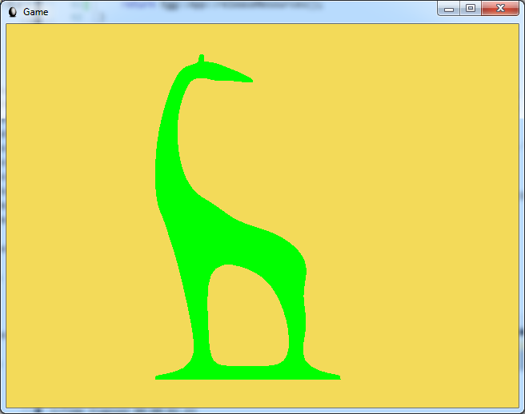
Eredmény

