Slide 1
Sudoku

Slide 2
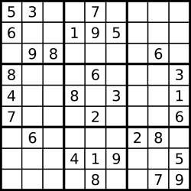
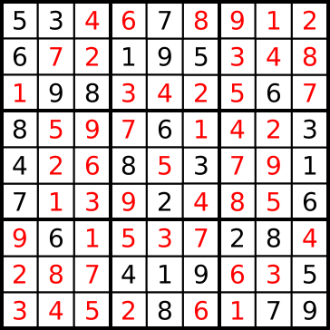
What is Sudoku?
A number based combinatorial puzzle
The objective is to fill a 9x9 grid
The allowed values are [1,9]
Different digits in each column
Different digits in each row
Every 3x3 subgrid contains all of the digits
A few cells are filled to start
https://en.wikipedia.org/wiki/Sudoku

Slide 3
Minimal Sudoku
No starting value can be removed without violating the unambiguousness.
Around $3.1 ×{10}^{37}$ minimal table exist.
$2.55×{10}^{25}$ are different.
Lots of minimal table collected at
http://staffhome.ecm.uwa.edu.au/~00013890/sudokumin.php

Slide 4
Solving strategies
Backtracking:
This is implemented in the example code.
Find an empty cell.
Find a value which is allowed in the cell.
Try to solve the new table.
If the new table cannot be solved then back track to a previous state.

Slide 5
Solving strategies
Stochastic search
Random based search
Fill the table randomly
Search for violations in the filled table
Permute the violating numbers
If the number of violations is zero then we found a real solution
Simulated annealing, genetic algorithms, etc.

Slide 6
Solving strategies
Other strategies
Constraint based algorithms
Humanistic strategy
Combination of simpler methods

Slide 7
Assignment
Implement an efficient Sudoku solver!
Minimum:
able to solve a 9x9 table
stop if the given table cannot be solved
if multiple solutions are available gather all of them
Be able to solve larger tables!
Be able to generate valid sudokus!

