Slide 1
Parallel programming laboratory

Slide 2
Iterated function attractors
F
z = x + iy
Converge into point p
Divergent
Evolve in a closed region: Attractor

Slide 3
z → z²
z = r e ^{iφ}
r → r ²
φ → 2φ
divergent
convergent
1
Attractor: H = F(H)

Slide 4
Attractor
The attractor is a boundary between the divergent and convergent region
Filled attractor = non divergent region
z _{n+1} = z _{n}² : if |z ∞|< ∞ then black

Slide 5
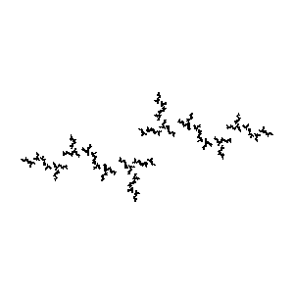
Julia set: z → z² + c

Slide 6
Filled Julia set: algorithm
Im z
(X,Y)
FilledJuliaDraw ( )
FOR Y = 0 TO Ymax DO
FOR X = 0 TO Xmax DO
ViewportWindow(X,Y → x, y)
z = x + j y
FOR i = 0 TO n DO z = z² + c
IF |z| > “infinity” THEN WRITE(X,Y, white)
ELSE WRITE(X,Y, black)
ENDFOR
ENDFOR
END
Re z

Slide 7
Mandelbrot set
Those C complex numbers, where the
z → z² + c Julia set is connected

Slide 8
Mandelbrot set, algorithm
MandelbrotDraw ( )
FOR Y = 0 TO Ymax DO
FOR X = 0 TO Xmax DO
ViewportWindow(X,Y → x, y)
c = x + j y
z = 0
FOR i = 0 TO n DO z = z² + c
IF |z| > “infinity” THEN WRITE(X,Y, white)
ELSE WRITE(X,Y, black)
ENDFOR
ENDFOR
END

