Slide 1
Discrete Fourier transform

Slide 2
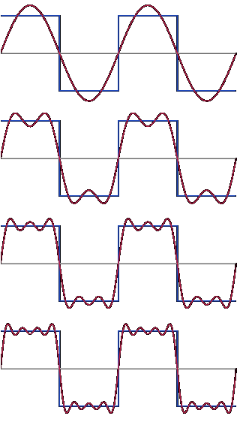
What is Fourier transform?
The discrete Fourier transform is a transformation between complex numbers:
$$X_{n}\underset{→}{F}X_{k}$$
$$X_{k}=\sum_{n=0}^{N−1}{x_{n}⋅e^{−\frac{i2π}{N}kn}}$$
$$X_{k}=\sum_{n=0}^{N−1}{x_{n}⋅\left[\cos\left(\frac{2πkn}{N}\right)−i⋅\left(\frac{2πkn}{N}\right)\right]}$$
Converts a finite sequence of equally-spaced samples of a function into a complex value function of frequency.

Slide 3
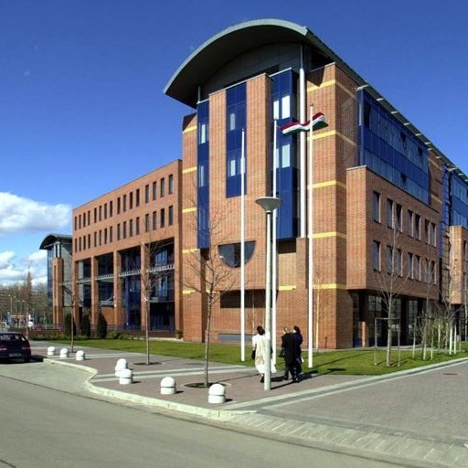
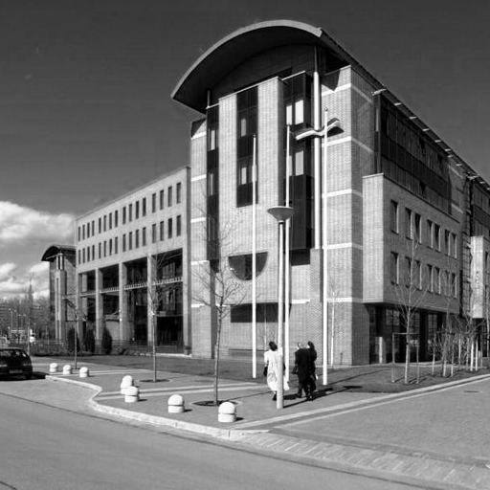
Why Fourier transform matters?
We are using it everywhere!
Analyzing complex signals like pressure of sound wave, radio signal or daily temperature.
Crucial for many image processing application.
Often used for data compression.

Slide 4
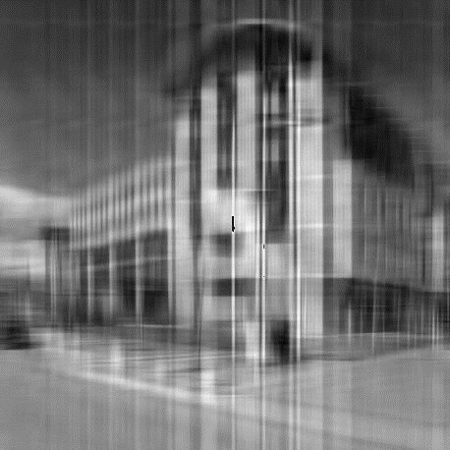
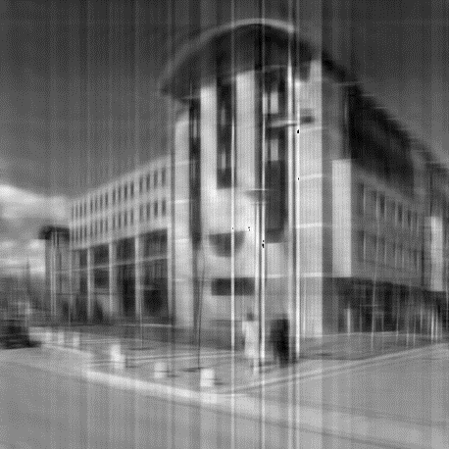
Filtering in frequency domain
1 component 2 components 3 components 4 components
10 components 20 components 30 components 100 components

Slide 5
Task
Implement an efficient version of discrete Fourier transform.
Implement a discrete convolution operator in frequency domain.

