Slide 1
Monte Carlo simulation

Slide 2
Isosurface raycasting (visualization.cl)
__kernel
void isosurface(const int width, const int height, __global float4* visualizationBuffer,
const int resolution, __global float* volumeData,
const float isoValue, const float16 invViewMatrix){
// Images space coordinates
int2 id = (int2)(get_global_id(0), get_global_id(1));
float2 uv = (float2)( (id.x / (float) width)*2.0f-1.0f, (id.y / (float) height)*2.0f-1.0f );
// Bounding box of the model in the 3D space
float4 boxMin = (float4)(-1.0f, -1.0f, -1.0f,1.0f);
float4 boxMax = (float4)(1.0f, 1.0f, 1.0f,1.0f);
// Ray in the 3D space
struct ray eyeRay;
eyeRay.origin = (float4)(invViewMatrix.sC, invViewMatrix.sD, invViewMatrix.sE, invViewMatrix.sF);
float4 temp = normalize(((float4)(uv.x, uv.y, -2.0f, 0.0f)));
eyeRay.direction.x = dot(temp, ((float4)(invViewMatrix.s0,invViewMatrix.s1,invViewMatrix.s2,invViewMatrix.s3)));
eyeRay.direction.y = dot(temp, ((float4)(invViewMatrix.s4,invViewMatrix.s5,invViewMatrix.s6,invViewMatrix.s7)));
eyeRay.direction.z = dot(temp, ((float4)(invViewMatrix.s8,invViewMatrix.s9,invViewMatrix.sA,invViewMatrix.sB)));
eyeRay.direction.w = 0.0f;
float4 color = (float4)(0.0f);
// Intersecting the bounding box with the ray
float tnear, tfar;
int hit = intersectBox(eyeRay.origin, eyeRay.direction, boxMin, boxMax, &tnear, &tfar);
if(hit){
// TODO
color = (float4)(1.0f);
}
// Writing the result color the image buffer
if(id.x < width && id.y < height){
visualizationBuffer[id.x + id.y * width] = color;
}
}

Slide 3
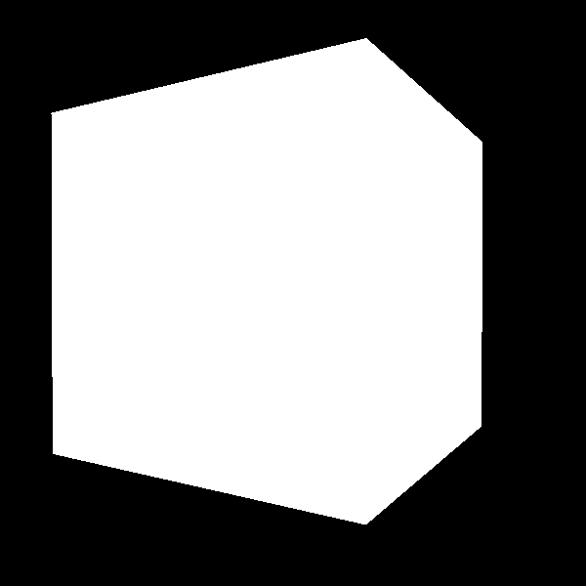

Slide 4
Isosurface raycasting
Step between tnear and tfar
Calculate the current position in the 3D space
Read the density (getDensityFromVolume)
If the density is greater than isoValue, than the color shall be (float4)(1.0f)
Exit from the loop

Slide 5
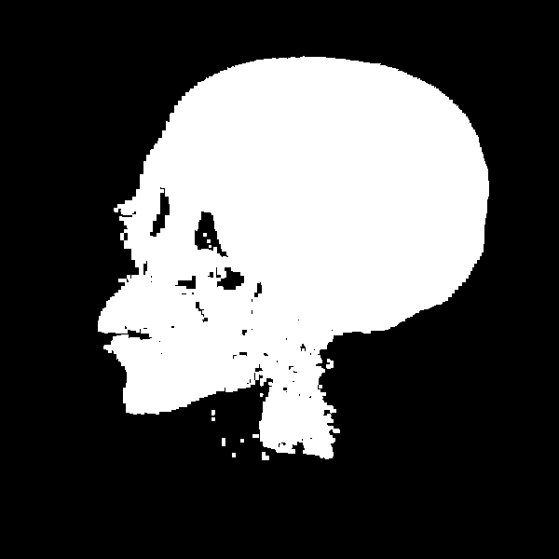

Slide 6
Isosurface raycasting
Let`s add shading
Light direction: 0.3, -2.0, 0.0, 0.0
To get the normal vector in the volumetric model, use the getNormalFromVolume function
Color is defined as: clamp(dot(lightDir, normal), 0.0, 1.0)

Slide 7
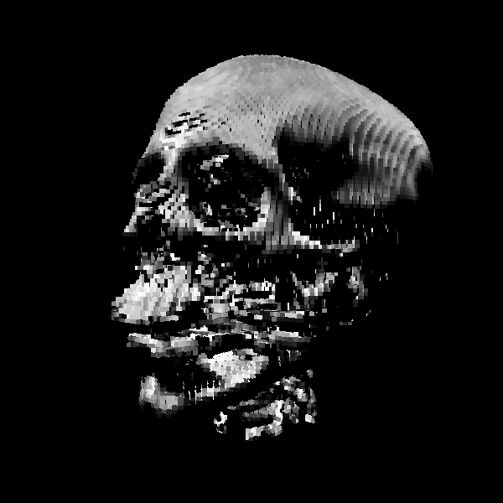

Slide 8
Isosurface raycasting
Hemisphere lighting
Color: 0.5f + 0.5f * dot(lightDir, normal)

Slide 9
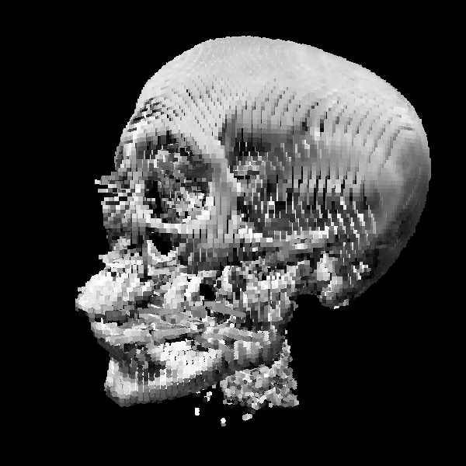

Slide 10
Alpha blended raycasting (visualization.cl)
__kernel
void alphaBlended(const int width, const int height, __global float4* visualizationBuffer,
const int resolution, __global float* volumeData,
const float alphaExponent, const float alphaCenter,
const float16 invViewMatrix){
int2 id = (int2)(get_global_id(0), get_global_id(1));
float2 uv = (float2)( (id.x / (float) width)*2.0f-1.0f, (id.y / (float) height)*2.0f-1.0f );
float4 boxMin = (float4)(-1.0f, -1.0f, -1.0f,1.0f);
float4 boxMax = (float4)(1.0f, 1.0f, 1.0f,1.0f);
// calculate eye ray in world space
struct ray eyeRay;
eyeRay.origin = (float4)(invViewMatrix.sC, invViewMatrix.sD, invViewMatrix.sE, invViewMatrix.sF);
float4 temp = normalize(((float4)(uv.x, uv.y, -2.0f, 0.0f)));
eyeRay.direction.x = dot(temp, ((float4)(invViewMatrix.s0,invViewMatrix.s1,invViewMatrix.s2,invViewMatrix.s3)));
eyeRay.direction.y = dot(temp, ((float4)(invViewMatrix.s4,invViewMatrix.s5,invViewMatrix.s6,invViewMatrix.s7)));
eyeRay.direction.z = dot(temp, ((float4)(invViewMatrix.s8,invViewMatrix.s9,invViewMatrix.sA,invViewMatrix.sB)));
eyeRay.direction.w = 0.0f;
float4 sum = (float4)(0.0f);
float tnear, tfar;
int hit = intersectBox(eyeRay.origin, eyeRay.direction, boxMin, boxMax, &tnear, &tfar);
if(hit){
sum = (float4)(1.0f);
}
if(id.x < width && id.y < height){
visualizationBuffer[id.x + id.y * width] = (float4)(sum);
}
}

Slide 12
Alpha blended raycasting
„X-Ray” image
Step from tfar to tnear
Sum the density according to the absorption
Alpha = pow(density, alphaExponent) * step
Sum = (1-alpha)*sum + alpha * (float4)(1.0)

Slide 13
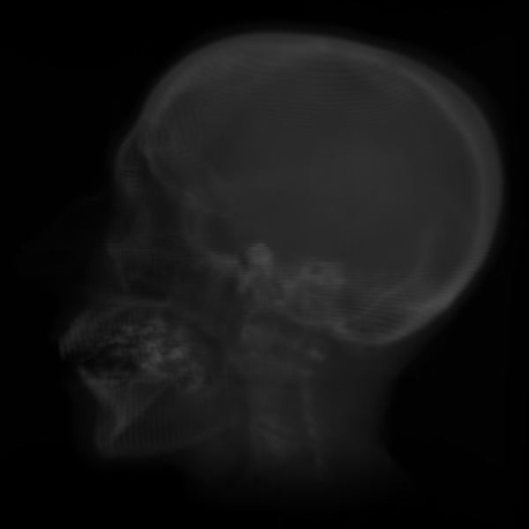

Slide 14
Alpha blended raycasting
Add shading
Step from tfar to tnear
Sum the lighting while taking the absorption into consideration
Density: getDensityFromVolume
Normal vector: getNormalFromVolume
Alpha: clamp(alphaExponent * (density – alphaCenter) + 0.5, 0.0, 1.0
Color: 0.5f + 0.5f * dot(lightDir, normal)
Color sum: (1-alpha) * sum + alpha * color

Slide 15
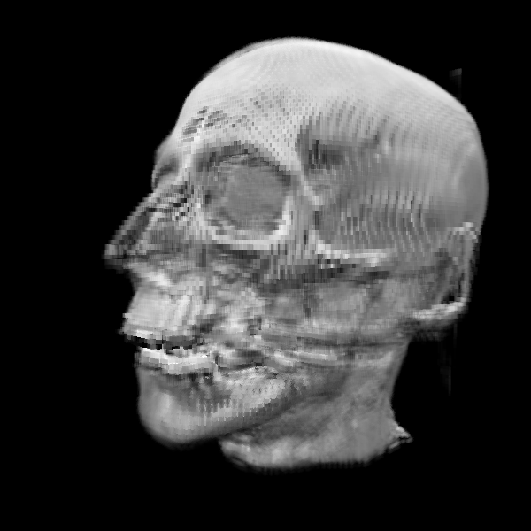

Slide 16
Alpha blended raycasting
Using a transfer function
color *= (float4)(density, density * density, density * density * density, 1.0f) + 0.1f;

Slide 17
