Slide 1
Monte Carlo simulation

Slide 2
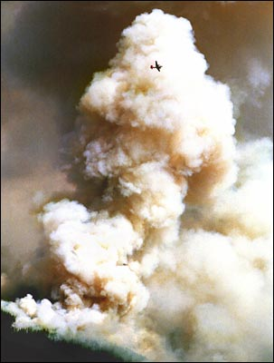
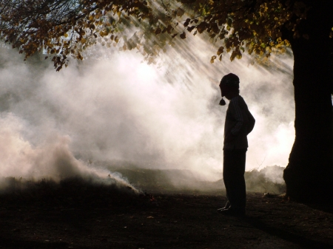
Scattering simulation
Simulation of normal light photons
Does not change its energy on scattering
Homogenous and inhomogeneous media

Slide 3
Scattering simulation
The problem to solve
Find the point of scattering
Free path in the media
Change of the energy
Calculating the new direction
Monte Carlo methods
Random samples
Decision based on the local attributes

Slide 4
Scattering simulation
Radiative transfer equation
screen
Camera
Outgoing radiancia:
L(s+ds)
Incident radiancia:
L(s)
path: ds

Slide 5
Scattering simulation
Probability of scattering
Probability of reflection
albedo

Slide 6
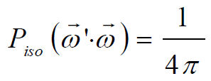
Scattering simulation
Direction of the reflection
Phase function
Isotropic scattering
Anisotropic scattering

Slide 7
Scattering simulation
Approximation of single scattering
Radiance
Direct part
Indirect (media) part
Volumetric representation

Slide 8
Scattering simulation
Stochastic solution
Contributions to the radiance of a point
Direct photon emission
Single scattering
Two-times scattered photons
...
N-times scattered photons

Slide 9
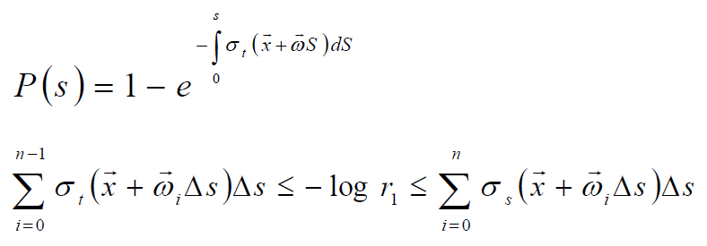
Scattering simulation
Monte Carlo simulation
Generating random light paths
A path contains many photons
Collecting the scattering points and their energy
Free path

Slide 10
Scattering simulation
Monte Carlo simulation
Weighting by probability
Converting scattering events into volumetric radiance
Gathering walks
Viewpoint dependent summation
Indirect and direct visualization methods

Slide 11
Scattering simulation
Implementation
Photon structure
Origin, direction, energy
Radiance buffer
3D array
Random number generator
Seed buffer

Slide 12
Scattering simulation
__kernel
void simulation(const int iteration, __global uint4* seed,
__global struct photon* photons,
const int resolution, __global float* simulationBuffer,
const float4 lightSourcePosition){
int id = get_global_id(0);
// random generator setup
uint rng1 = seed[id].s0;
uint rng2 = seed[id].s1;
uint rng3 = seed[id].s2;
uint rng4 = seed[id].s3;
// scatter simulation
if(0 == iteration || photons[id].energy < 0.2f){
photons[id].origin = lightSourcePosition;
photons[id].direction = getRandomDirection(&rng1, &rng2, &rng3, &rng4);
photons[id].energy = 1.0f;
} else {
photons[id].direction = getRandomDirection(&rng1, &rng2, &rng3, &rng4);
}
tracePhotonRM(&photons[id], getRandom(&rng1, &rng2, &rng3, &rng4));
storePhoton(&photons[id], resolution, simulationBuffer);
// random state store
seed[id].s0 = rng1;
seed[id].s1 = rng2;
seed[id].s2 = rng3;
seed[id].s3 = rng4;
}

Slide 13
Scattering simulation
float4 getRandomDirection(uint* rng1, uint* rng2, uint* rng3, uint* rng4){
float x, y, z;
bool inside = false;
while(!inside){
x = getRandom(rng1, rng2, rng3, rng4) * 2.0f - 1.0f;
y = getRandom(rng1, rng2, rng3, rng4) * 2.0f - 1.0f;
z = getRandom(rng1, rng2, rng3, rng4) * 2.0f - 1.0f;
if( (x*x + y*y + z*z) <= 1.0f){
inside = true;
}
}
if( x*x + y*y + z*z == 0.0){
x = 0.0f;
y = 1.0f;
z = 0.0f;
}
float vlen = sqrt(x*x + y*y + z*z);
return (float4)(x/vlen, y/vlen, z/vlen, 0);
}

Slide 14
Scattering simulation
void tracePhotonRM(__global struct photon* p, float rnd){
// simple linear
//p->origin = p->origin + p->direction * 0.1f;
float s = -log(rnd) / densityScale;
float t = 0.0f;
float dt = 1.0f / 256.0f;
float sum = 0.0f;
float sigmat = 0.0f;
while(sum < s){
float4 samplePos = p->origin + t * p->direction;
if(samplePos.x < 0.0f || samplePos.x > 1.0f ||
samplePos.y < 0.0f || samplePos.y > 1.0f ||
samplePos.z < 0.0f || samplePos.z > 1.0f){
p->energy = 0.0f;
break;
} else {
sigmat = getDensity(samplePos);
sum += sigmat * dt;
t += dt;
}
}
p->origin = p->origin + p->direction * t;
p->direction = p->direction;
p->energy = p->energy * albedo;
}

Slide 15
Scattering simulation
float getDensity(float4 p){
// roof
if(p.y > 0.78f && p.y < 0.83f &&
( (p.x - 0.5f) * (p.x - 0.5f) +
(p.z - 0.5f) * (p.z - 0.5f) ) > 0.001f)
return 100.0f;
// walls
if(p.x < 0.02f) return 100.0f;
if(p.y < 0.02f) return 100.0f;
if(p.z > 0.98f) return 100.0f;
// a more dense part near to the bottom
if(p.y < 0.2f) return (1.0f - p.y) * 5.0f;
return 0.5f * densityScale;
}

Slide 16
Scattering simulation
void storePhoton(__global struct photon* p,
const int resolution,
__global float* simulationBuffer){
if(p->energy < 0.1f) return;
int x = p->origin.x * resolution;
int y = p->origin.y * resolution;
int z = p->origin.z * resolution;
if(x > resolution -1 || x < 0) return;
if(y > resolution -1 || y < 0) return;
if(z > resolution -1 || z < 0) return;
simulationBuffer[x+y*resolution+z*resolution*resolution]
+= p->energy;
}

Slide 17
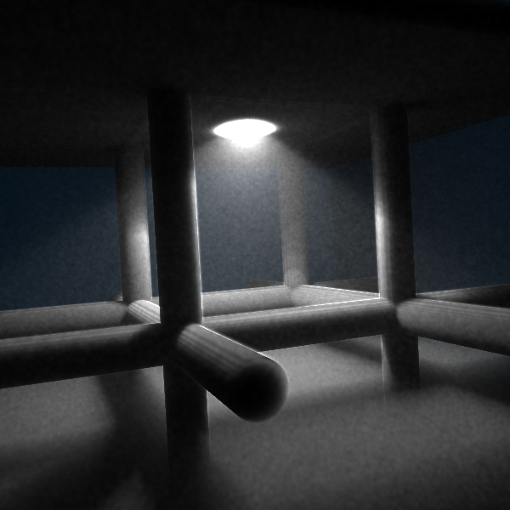
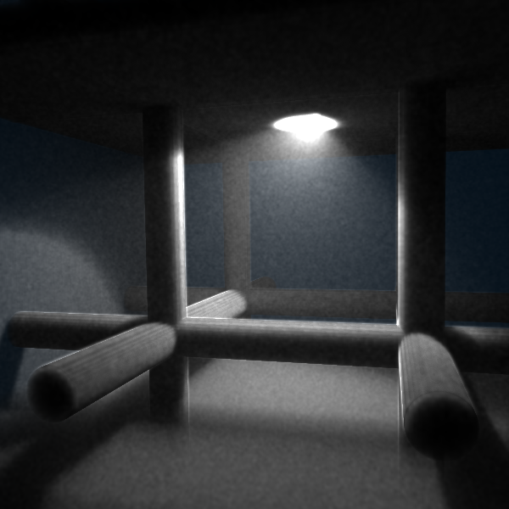
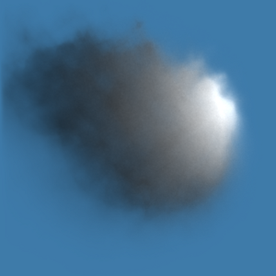
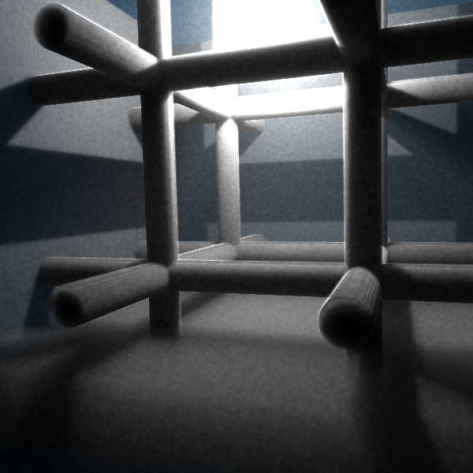
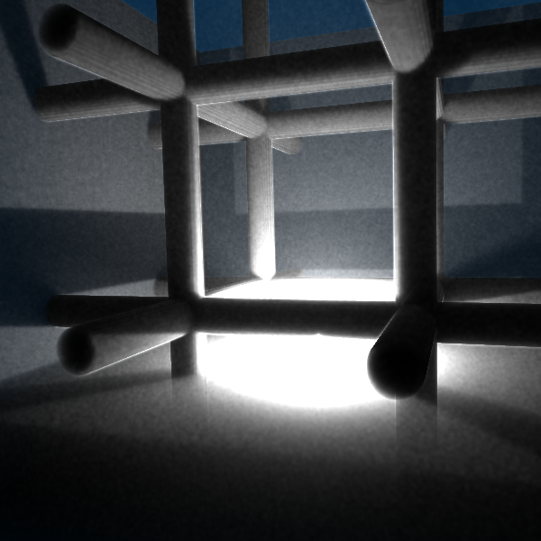
Scattering simulation

Slide 18
Volume rendering
Visualization of a volumetric representation
Temperature, pressure, density etc.
v(x,y,z)
v(x,y,z)
storage: 3D array

Slide 19
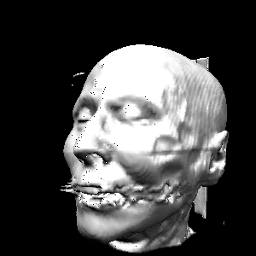
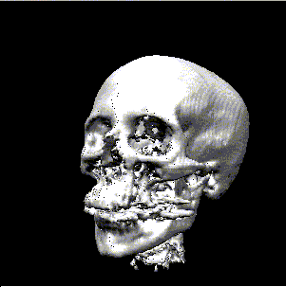
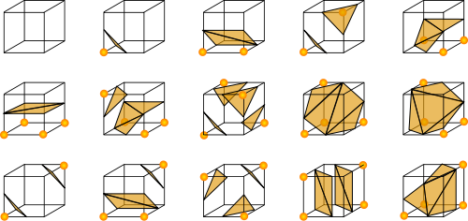
Volume rendering
Isosurface rendering
Indirect method
Marching cubes

Slide 20
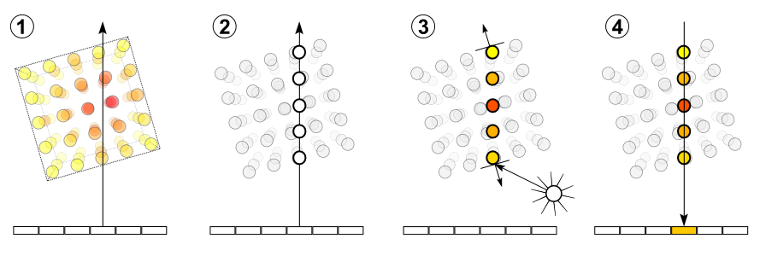
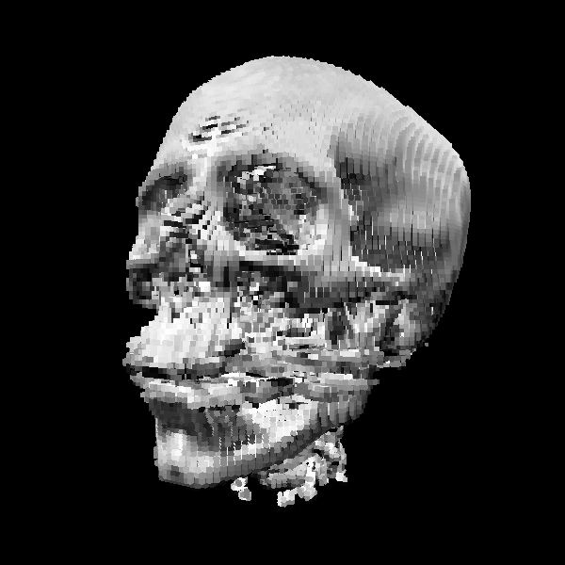
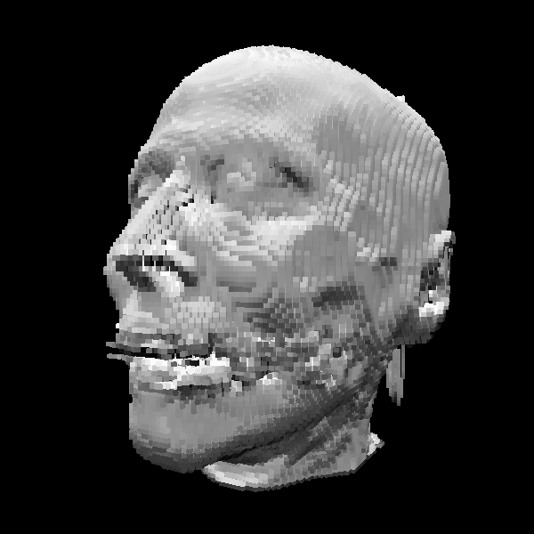
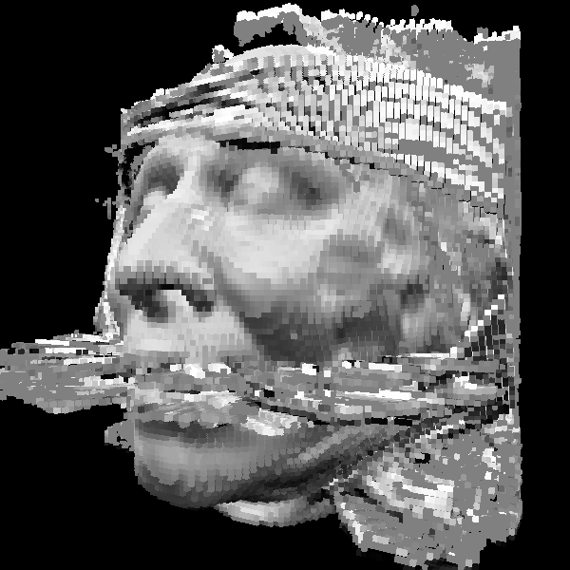
Volume rendering
Isosurface rendering
Direct method
Isosurface raycasting
Raycasting

Slide 21
Isosurface raycasting
right
up
lookat
eye
q
p
entry
exit
p = lookat + α right + β up
α, β are in [-1,1]
Unite cube with a 3D texture

Slide 22
Isosurface raycasting
__kernel
void isosurface(const int width, const int height, __global float4* visualizationBuffer,
const int resolution, __global float* volumeData,
const float isoValue, const float16 invViewMatrix){
int2 id = (int2)(get_global_id(0), get_global_id(1));
float2 uv = (float2)( (id.x / (float) width)*2.0f-1.0f, (id.y / (float) height)*2.0f-1.0f );
float4 boxMin = (float4)(-1.0f, -1.0f, -1.0f,1.0f);
float4 boxMax = (float4)(1.0f, 1.0f, 1.0f,1.0f);
// calculate eye ray in world space
struct ray eyeRay;
eyeRay.origin = (float4)(invViewMatrix.sC, invViewMatrix.sD, invViewMatrix.sE,
invViewMatrix.sF);
float4 temp = normalize(((float4)(uv.x, uv.y, -2.0f, 0.0f)));
eyeRay.direction.x = dot(temp, ((float4)(invViewMatrix.s0,invViewMatrix.s1,invViewMatrix.s2,invViewMatrix.s3)));
eyeRay.direction.y = dot(temp, ((float4)(invViewMatrix.s4,invViewMatrix.s5,invViewMatrix.s6,invViewMatrix.s7)));
eyeRay.direction.z = dot(temp, ((float4)(invViewMatrix.s8,invViewMatrix.s9,invViewMatrix.sA,invViewMatrix.sB)));
eyeRay.direction.w = 0.0f;
// ...

Slide 23
Isosurface raycasting
// ...
float4 color = (float4)(0.0f);
float tnear, tfar;
int hit = intersectBox(eyeRay.origin, eyeRay.direction, boxMin, boxMax, &tnear, &tfar);
if(hit){
if(tnear < 0.0f) tnear = 0.0f;
float maxStep = 256.0f;
float step = (tfar - tnear) / maxStep;
float t = tnear + 0.0001f;
for(int i=0; i < maxStep; ++i){
float4 pos = ((eyeRay.origin + t * eyeRay.direction) + 1.0f) / 2.0f;
float density = getDensityFromVolume(pos, resolution, volumeData);
// simple iso
if( density > isoValue ){
color = 0.5f + 0.5f * dot(normalize((float4)(0.3f, -2.0f, 0.0f, 0.0f)),
getNormalFromVolume(pos, resolution, volumeData));
break;
}
t += step;
if(t>tfar) break;
}
}
if(id.x < width && id.y < height){
visualizationBuffer[id.x + id.y * width] = color;
}
}

Slide 24
Isosurface raycasting
int intersectBox(float4 r_o, float4 r_d,
float4 boxmin, float4 boxmax,
float *tnear, float *tfar){
// compute intersection of ray with all six bbox planes
float4 invR = (float4)(1.0f,1.0f,1.0f,1.0f) / r_d;
float4 tbot = invR * (boxmin - r_o);
float4 ttop = invR * (boxmax - r_o);
// re-order intersections to find smallest and largest on each axis
float4 tmin = min(ttop, tbot);
float4 tmax = max(ttop, tbot);
// find the largest tmin and the smallest tmax
float largest_tmin = max(max(tmin.x, tmin.y), max(tmin.x, tmin.z));
float smallest_tmax = min(min(tmax.x, tmax.y), min(tmax.x, tmax.z));
*tnear = largest_tmin;
*tfar = smallest_tmax;
return smallest_tmax > largest_tmin;
}

Slide 25
Isosurface raycasting
float4 getNormalFromVolume(const float4 p,
const int resolution, __global float* volumeData){
float4 normal;
normal.x = getDensityFromVolume((float4)(p.x + 2.0f/resolution, p.y, p.z,
0.0f), resolution, volumeData) -
getDensityFromVolume((float4)(p.x - 2.0f/resolution, p.y, p.z,
0.0f), resolution, volumeData);
normal.y = getDensityFromVolume((float4)(p.x, p.y + 2.0f/resolution, p.z,
0.0f), resolution, volumeData) -
getDensityFromVolume((float4)(p.x, p.y - 2.0f/resolution, p.z,
0.0f), resolution, volumeData);
normal.z = getDensityFromVolume((float4)(p.x, p.y, p.z + 2.0f/resolution,
0.0f), resolution, volumeData) -
getDensityFromVolume((float4)(p.x, p.y, p.z - 2.0f/resolution,
0.0f), resolution, volumeData);
normal.w = 0.0f;
if(dot(normal, normal) < 0.001f){
normal = (float4)(0.0f, 0.0f, 1.0f, 0.0f);
}
return normalize(normal);
}

Slide 26
Isosurface raycasting
float getDensityFromVolume(const float4 p,
const int resolution,
__global float* volumeData){
int x = p.x * resolution;
int y = p.y * resolution;
int z = p.z * resolution;
if(x > resolution -1 || x < 0) return(0.0f);
if(y > resolution -1 || y < 0) return(0.0f);
if(z > resolution -1 || z < 0) return(0.0f);
return volumeData[x+y*resolution+z*resolution*resolution];
}

Slide 27
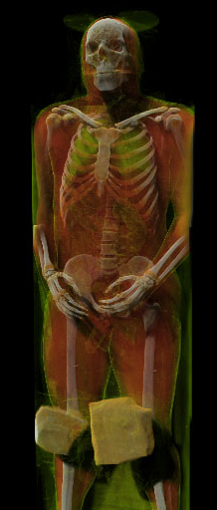
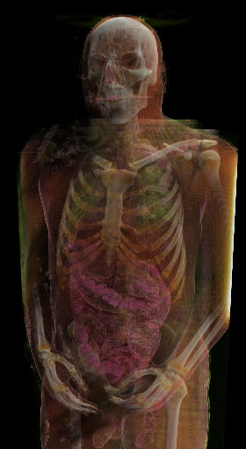
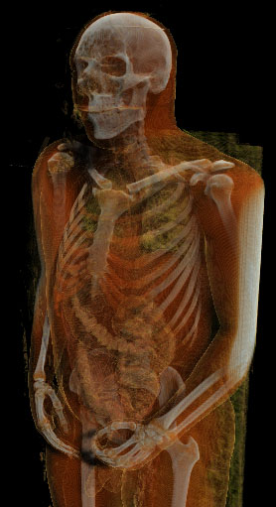
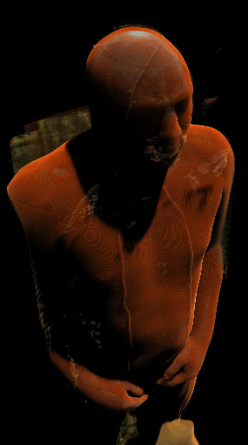
Volume rendering
Let’s look inside

Slide 28
Volume rendering
Transparent materials
L(s + ds)
L(s)
dL(s)/ds = - kt · L(s) + ka · Le + ∫ f(ω‘,ω) L^{i}(ω‘) dω‘
L(s + Δs)
L(s)
L(s + Δs) = L(s) - kt Δs · L(s) + Li(s) Δs
α(s)
C(s)

Slide 29
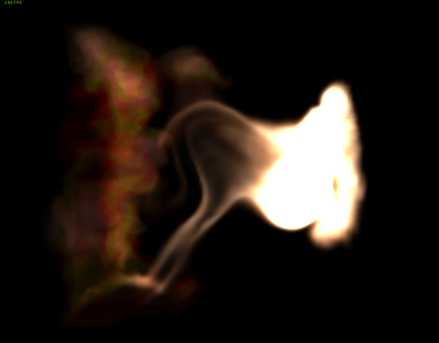
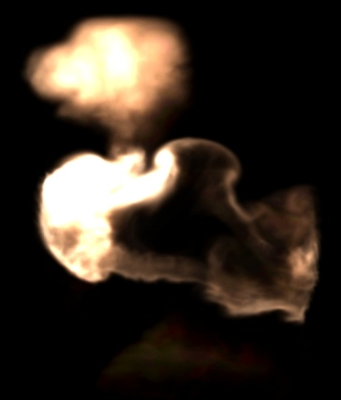
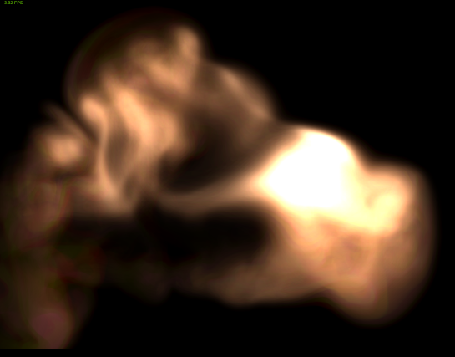
Volume rendering
Forward raycating
L’(s)
α’(s)

Slide 30
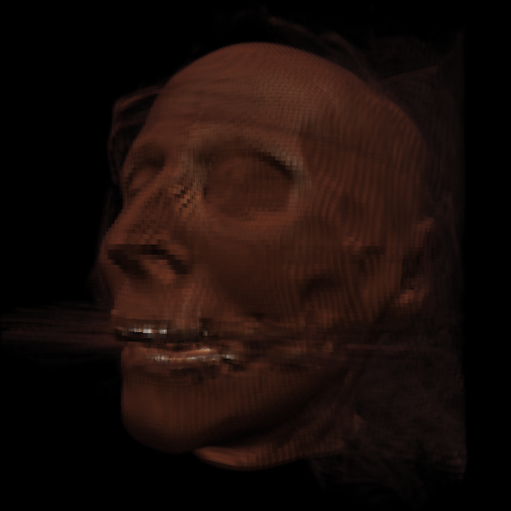
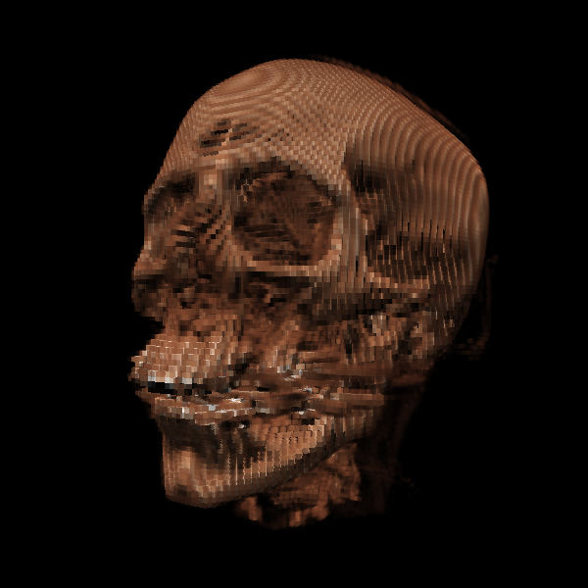
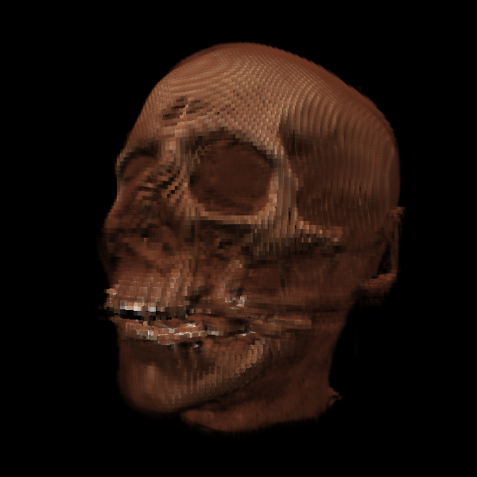
Volume rendering
Backward raycasting
L(s)
s=0

Slide 31
Volume ray casting
__kernel
void alphaBlended(const int width, const int height, __global float4* visualizationBuffer,
const int resolution, __global float* volumeData,
const float alphaExponent, const float alphaCenter,
const float16 invViewMatrix){
int2 id = (int2)(get_global_id(0), get_global_id(1));
float2 uv = (float2)( (id.x / (float) width)*2.0f-1.0f, (id.y / (float) height)*2.0f-1.0f );
float4 boxMin = (float4)(-1.0f, -1.0f, -1.0f,1.0f);
float4 boxMax = (float4)(1.0f, 1.0f, 1.0f,1.0f);
// calculate eye ray in world space
struct ray eyeRay;
eyeRay.origin = (float4)(invViewMatrix.sC, invViewMatrix.sD, invViewMatrix.sE, invViewMatrix.sF);
float4 temp = normalize(((float4)(uv.x, uv.y, -2.0f, 0.0f)));
eyeRay.direction.x = dot(temp, ((float4)(invViewMatrix.s0,invViewMatrix.s1,invViewMatrix.s2,invViewMatrix.s3)));
eyeRay.direction.y = dot(temp, ((float4)(invViewMatrix.s4,invViewMatrix.s5,invViewMatrix.s6,invViewMatrix.s7)));
eyeRay.direction.z = dot(temp, ((float4)(invViewMatrix.s8,invViewMatrix.s9,invViewMatrix.sA,invViewMatrix.sB)));
eyeRay.direction.w = 0.0f;
// ...

Slide 32
Volume ray casting
// ...
float4 sum = (float4)(0.0f);
float tnear, tfar;
int hit = intersectBox(eyeRay.origin, eyeRay.direction, boxMin, boxMax, &tnear, &tfar);
if(hit){
if(tnear < 0.0f) tnear = 0.0f;
float maxStep = 256.0f;
float step = (tfar - tnear) / maxStep;
float t = tfar - 0.0001f;
for(int i=0; i < maxStep; ++i){
float4 pos = ((eyeRay.origin + t * eyeRay.direction) + 1.0f) / 2.0f;
float density = getDensityFromVolume(pos, resolution, volumeData);
float alpha = clamp(alphaExponent * (density - alphaCenter) + 0.5f, 0.0f, 1.0f);
float4 color = (float4)(0.5f + 0.5f * dot(normalize((float4)(0.3f, -2.0f, 0.0f, 0.0f)), getNormalFromVolume(pos, resolution, volumeData)));
color *= (float4)(density, density * density, density * density * density, 1.0f) + 0.1f;
sum = (1.0f - alpha) * sum + alpha * color;
t -= step;
if(t<tnear) break;
}
}
if(id.x < width && id.y < height){
visualizationBuffer[id.x + id.y * width] = (float4)(sum);
}
}

Slide 33
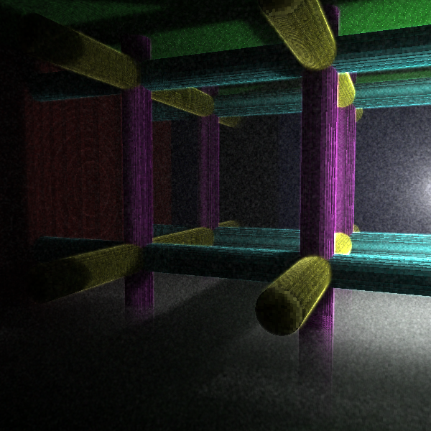

Slide 34
OpenCL texture
Image object
1D / 2D / 3D textures
Vector types
Linear interpolation
Addressing mode
Texture support
CL_DEVICE_IMAGE_SUPPORT
cl_int clGetDeviceInfo(...)

Slide 35
OpenCL texture
Creating an Image object
Image format
Pitch: memory required to store one row (bytes)
0 if the host pointer is NULL
>= width * size of one element
Required to load the data, the inner representation can differ
cl_mem clCreateImage2D(...)
cl_mem clCreateImage3D(...)

Slide 36
OpenCL texture
Texture format
Channel format
CL_R, CL_A
CL_INTENSITY
CL_LUMINANCE
CL_RG, CL_RA
CL_RGB
CL_RGBA, CL_ARGB, CL_BGRA
typedef struct _cl_image_format {
cl_channel_order image_channel_order;
cl_channel_type image_channel_data_type;
} cl_image_format;

Slide 37
OpenCL texture
Texture data format
CL_SNORM_INT8 / 16
CL_UNORM_INT8 / 16
CL_UNORM_SHORT_565 / 555
CL_UNORM_INT_101010
CL_SIGNED_INT8 / 16 / 32
CL_UNSIGNED_INT8 / 16 / 32
CL_HALF_FLOAT
CL_FLOAT

Slide 38
OpenCL texture
Querying supported texture formats
image_type: 2D / 3D image object
iamge_formats: list of the supported formats
cl_int clGetSupportedImageFormats(cl_context context,
cl_mem_flags flags,
cl_mem_object_type image_type,
cl_uint num_entries,
cl_image_format* image_formats,
cl_uint* num_image_formats)

Slide 39
OpenCL texture
Reading image objects
Writing image objects
Origin[3]: starting coordinates
Region[3]: size to copy
row_pitch / slice_pitch
cl_int clEnqueueReadImage(...)
cl_int clEnqueueWriteImage(...)

Slide 40
OpenCL textures
Copy between image objects
src_origin[3]: source coordinates
dst_origin[3]: destination coordinates
region[3]: size to copy
Copy between image and buffer object
cl_int clEnqueueCopyImage(...)
cl_int clEnqueueCopyImageToBuffer(...)
cl_int clEnqueueCopyBufferToImage(...)

Slide 41
OpenCL texture
Sampler object
normalized_coords: addressing mode
addressing_mode: handling of out of range coords
REPEAT, CLAMP_TO_EDGE, CLAMP, NONE
filter_mode: texture filtering
NEAREST, LINEAR
cl_sampler clCreateSampler(cl_context context,
cl_bool normalized_coords,
cl_addressing_mode addressing_mode,
cl_filter_mode filter_mode,
cl_int* errcode_ret)

Slide 42
OpenCL texture
Reference counter
Querying sampler info
Host side sampler
cl_int clRetainSampler(cl_sampler sampler)
cl_int clReleaseSampler(cl_sampler sampler)
cl_int clGetSamplerInfo(cl_sampler sampler,
cl_sampler_info param_name,
size_t param_value_size,
void* param_value,
size_t *param_value_size_ret)

Slide 43
OpenCL texture
Image object
Read only: __read_only
Write only: __write_only
Reading and writing at the same time is not supported
Sampler object
Created on the host side
Global constant sampler
const sampler_t samplerName = NORMALIZED_COORDS |
ADDRESS_MODE |
FILTER_MODE;

Slide 44
OpenCL texture
Reading from image objects
Vector of 4 matching to the type of the image
{f, i, ui}: float, int, unsigned int
coord: according to the sampler addressing
<o_type> read_image{f,i,ui}(image2d_t image,
sampler_t sampler,
<c_type> coord)

Slide 45
OpenCL texture
Writing an image object
{f, i, ui}: float, int, unsigned int
coord: destination coordinates
color: value vector to store
void write_image{f,i,ui}(image2d_t image,
<coord_type> coord,
<color_type> color)

Slide 46
OpenCL texture
Image object information
Image dimensions
Image format
int get_image_width(image{2,3}d_t image)
int get_image_height(image{2,3}d_t image)
int get_image_depth(image3d_t image)
int{2,4} get_image_dim(image{2,3}d_t image)
int get_image_channel_data_type(image{2,3}d_t image)
int get_image_channel_order(image{2,3}d_t image)

