Slide 1
GPGPU Applications
Introduction
Notes:
General Purpose Graphics Processing Unit – solving non graphics problems on the GPU

Slide 2
Why and How?
Why …
… do we write single threaded programs?
… is this a problem?
How …
… does this change?
… can we utilize it?
Does it worth writing parallel programs?

Slide 3
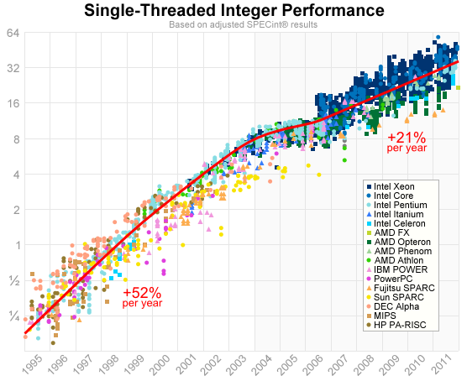
Single-Threaded Performance
Image courtesy of Jeff Preshing (preshing.com)

Slide 4
Single-Threaded Performance
Image courtesy of Jeff Preshing (preshing.com)

Slide 5
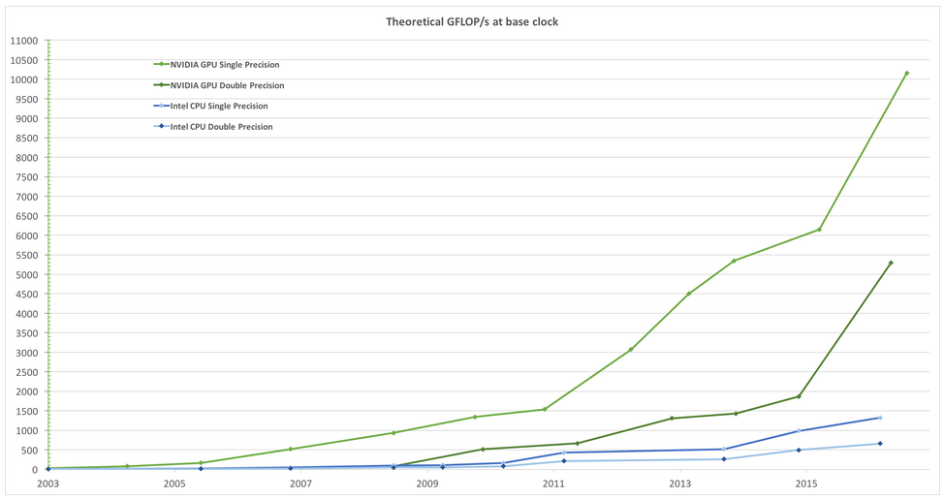
CPU vs GPU GFLOP/s
Image courtesy of NVIDIA Corporation

Slide 6
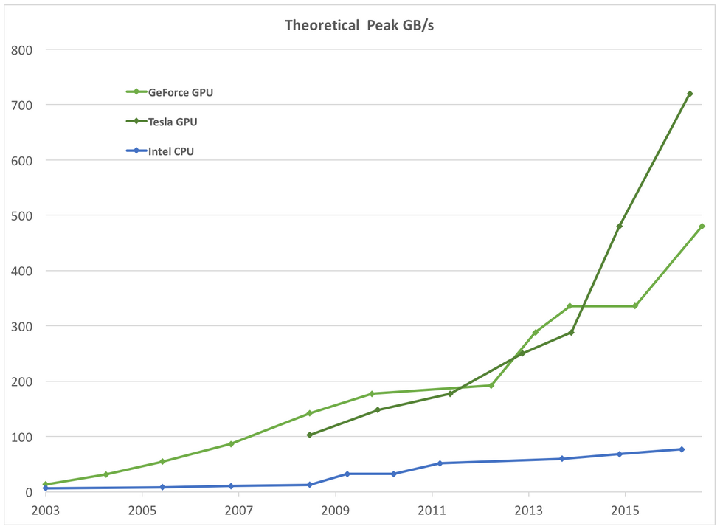
CPU vs GPU memory bandwidth
Image courtesy of NVIDIA Corporation

Slide 7
CPU vs GPU – The reason behind
Image courtesy of NVIDIA Corporation
Low number of cores(2-8)
Complex flow control
Large data and instruction cache
Optimized for serial computing
High number of cores (2048)
Simple distributed control
Minimal cache
Optimized for data-parallel processing
More transistor devoted to data processing

Slide 8
What are the possible benefits?
It can be difficult to parallelize a serial program
Does it worth the effort?
Amdahl’s law
TSerial - Serial execution time
Tparallel - Parallel execution time
P - Parallelizable part of the code
Image source - Wikipedia
Notes:
The workload is fixed, how much faster do we get the result is we increase the number of processing units

Slide 9
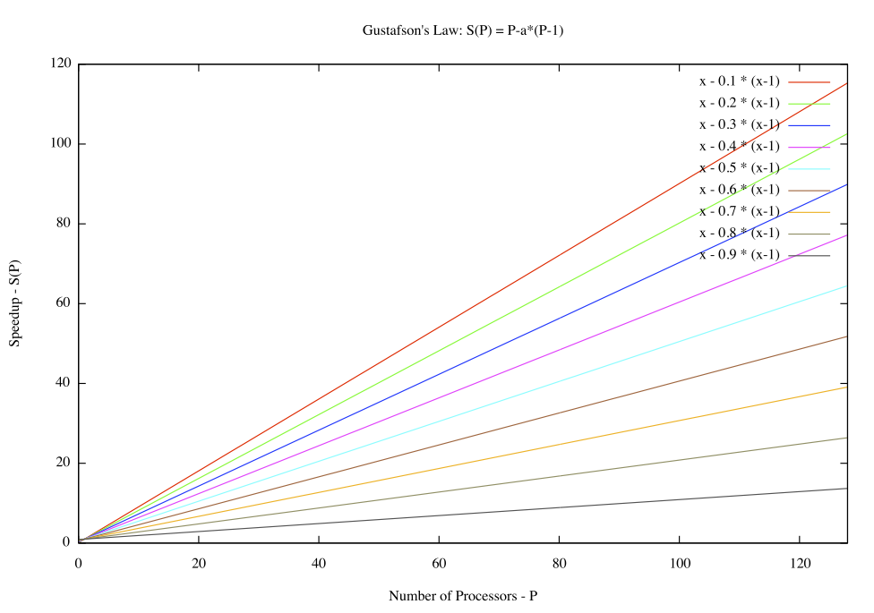
What are the possible benefits?
Gustafson’s law
W’ is the workload on an n-node machine (number of instructions to perform)
If the workload is scaled up to maintain fixed execution time, as the number of processors increases, the speedup increases linearly
true parallel power is only achievable when a large parallel problem is applied
Image source - Wikipedia
Notes:
The workload is scaled up to maintain fixed exeuction time as the number of processors are increased, steppness

Slide 10
GPU = Graphics Processing Unit
The hardware realization of the incremental rendering algorithm of computer graphics
Required performance:
Animation: few nsec / pixel
Massively parallel:
Pipeline (stream processor)
Parallel execution

Slide 11
Incremental rendering
MODELVIEW
PROJECTION
Perspective transform
Clipping with homogeneous coordinates
Camera transform,
illumination
Virtual World
2.
1.
color
depth
Final image
Viewport trans.+ Rasterization + Interpolation

Slide 12
Texture mapping
x3, y3, z3
(u3, v3)
(u1, v1)
x2, y2, z2
(u2, v2)
(u3, v3)
(u2, v2)
x1, y1, z1
Interpolation:
(u, v)
(u1, v1)
(u1, v1)
Texture object is located in the memory of the GPU image, filtering, addressing
(u2, v2)
(u3, v3)
color

Slide 13
Points: Homogeneous coordinates
Descartes: (x,y,z)
Homogeneous: [X,Y,Z,w] = [xw,yw,zw,w]
Why?
Translation, rotation, projection etc. can be written as a 4x4 matrix multiplication
Multiple transformation can be summarized in one matrix
Parallel lines can be handled
Linear transforms of homogeneous coordinates map triangles to triangles

Slide 14
Interpretation of homogeneous coords.
x, y, z are the direction
w inverse of the distance
[x,y,0]
[x,y,1/3]
[x,y,1]
[2x,2y,1] = [x,y,1/2]
y
x

Slide 15
Examples of Homogeneous Linear Transforms
Translation
Rotation
Scaling
1
1
1
px, py, pz, 1
px, py, pz
[x,y,z,1]
cosα sinα
-sinα cosα
1
1
[x,y,z,1]
Sx
Sy
Sz
1
[x,y,z,1]

Slide 16
Examples of Homogeneous Linear Transforms
Projection
Non linear
-f
Non linear
-b

Slide 17
Examples of Homogeneous Linear Transforms
Projection
1
1
-α -1
-β 0
[x,y,z,1]
Linear

Slide 18
Vertex processing
MODELVIEW
PROJECTION
Perspective transform
Camera transform
Virtual World
[x,y,z,1] ⋅T_{modelviewproj} = [X,Y,Z,w]
Z_{camera}

Slide 19
Clipping
(1, 1, 1)
-1 < x < 1
-1 < y < 1
-1 < z < 1
w > 0
-w < X < w
-w < Y < w
-w < Z < w
(-1,-1,-1)
[X,Y,Z,w] = [xw,yw,zw,w]

Slide 20
Clipping
(1, 1, 1)
(-1,-1,-1)

Slide 21
Clipping
(1, 1, 1)
(-1,-1,-1)

Slide 22
Viewport transform
(1, 1, 1)
1
(-1,-1,-1)
Screen coordinates
Z(-1,1)
(0,1)

Slide 23
Rasterization
(X₃,Y₃)
(X₂,Y₂)
(X₁,Y₁)

Slide 24
Interpolation inside of a triangle
(X₂,Y₂,Z₂)
Z
Z(X,Y) = aX + bY + c
(X₁,Y₁,Z₁)
Y
(X₃,Y₃,Z₃)
Z(X,Y)
X
Z(X+1,Y) = Z(X,Y) + a
Notes:
1 pixel / 1 sor = 1 összeadás

Slide 25
Interpolation hardware
X
Z(X,Y)
X counter
Z register
CLK
Σ
a

Slide 26
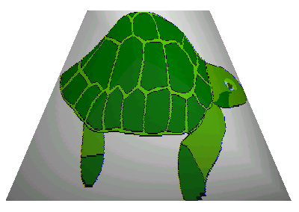
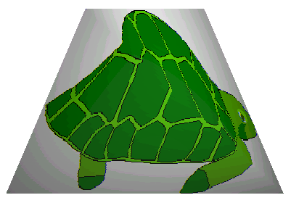
Perspective correct interpolation
v
Y
Perspective correct
u
X
a_{u} X+b_{u}Y+c_{u}
Linear
u/h =a_{u} X+b_{u}Y+c_{u}
v/h = a_{v} X+b_{v}Y+c_{v}
1/h =a_{h} X+b_{h}Y+c_{h}
u =
v =
a_{h} X+b_{h}Y+c_{h}
a_{v} X+b_{v}Y+c_{v}
a_{h} X+b_{h}Y+c_{h}

Slide 27
Homogeneous linear interpolation hardware
u
v
X
Div
Div
[u/h](X,Y)
[v/h](X,Y)
[1/h](X,Y)
X counter
[u/h] register
[v/h] register
[1/h] register
CLK
Σ
Σ
Σ
a_{u}
a_{v}
a_{h}

Slide 28
Compositing: The Z-buffer algorithm
2.
1.
3.
∞ = 1
z
0.6
0.3
0.6
0.3
0.8
Color buffer
Depth buffer
Z-buffer

Slide 29
Compositing: alpha blending
Interpolated color or read from texture
(R_{s},G_{s},B_{s},A_{s})
(R_{d},G_{d},B_{d},A_{d})
*
*
first
first
ALU
(R,G,B,A)
buffer
(R,G,B,A) =
(R_{s}A_{s}+R_{d}(1-A_{s}), G_{s}A_{s}+G_{d} (1-A_{s}), B_{s}A_{s}+B_{d} (1-A_{s}), A_{s}A_{s}+A_{d} (1-A_{s}))

Slide 30
Rendering pipeline
Vertex transform +
lighting
Viewport transform
Rasterization + Interpolation
Z-buffer
Frame buffer
Compositing
Clipping + homogeneous division
Triangle setup
Texture mapping

Slide 31
History of the GPU
Early systems (not PC)
Implements the whole pipeline
Workstation and Graphics Terminal
HP, Sun, Textronix
Vertex transform +
lighting
Viewport transform
Rasterization + Interpolation
Z-buffer
Frame buffer
Compositing
Clipping + homogeneous division
Triangle setup
Texture mapping

Slide 32
History of the GPU
1970-1990
Typical 2D
Sprites, primitives
Blitter, line, square drawing
Windowing speedup
Amiga, Atari, S3
Vertex transform +
lighting
Viewport transform
Rasterization + Interpolation
Z-buffer
Frame buffer
Compositing
Clipping + homogeneous division
Triangle setup
Texture mapping

Slide 33
History of the GPU
1990-1998
Vertex processing, texture filtering, Z-buffer
PlayStation, Nintendo64
S3 Virge, ATI Rage, Matrox Mystique
3dfx Voodoo
3dfx Glide
Microsoft DirectX 5.0
Vertex transform +
lighting
Viewport transform
Rasterization + Interpolation
Z-buffer
Frame buffer
Compositing
Clipping + homogeneous division
Triangle setup
Texture mapping

Slide 34
History of the GPU
1990-2000
The break-up of the pipeline
Transform & Lighting
Microsoft DirectX 7.0
OpenGL
NVIDIA GeForce 256 (NV10)
The first non-professional 3D accelerator
Vertex transform +
lighting
Viewport transform
Rasterization + Interpolation
Z-buffer
Frame buffer
Compositing
Clipping + homogeneous division
Triangle setup
Texture mapping

Slide 35
The history of the GPU
2000 –
The appearance of shader programs
Vertex and fragment shader (2001)
Geometry shader (2006)
Programmable tessellator (2010)
Vertex transform +
lighting
Viewport transform
Rasterization + Interpolation
Z-buffer
Frame buffer
Compositing
Clipping + homogeneous division
Triangle setup
Texture mapping

Slide 36
Modern GPU pipeline

Slide 37
Graphics API
General interface to the GPU
Pipeline control
Shaders
Define the geometry to be rendered
Define Textures
Framebuffer
Parallel rendering

Slide 38
Graphics API
Microsoft DirectX
Windows specific
DirectX7: Transform & Lighting
DirectX9: Vertex and pixel shader
DirectX10: Geometry shader
DirectX11: Tessellation, DirectCompute

Slide 39
Graphics API
OpenGL
OpenGL 2.0: Vertex and pixel shader
OpenGL 3.0: Framebuffer objects
OpenGL 3.1: OpenCL interop
OpenGL 3.2: Geometry Shader
OpenGL 3.3/4.0: Tessellation
OpenGL 4.3: Compute Shader

Slide 40
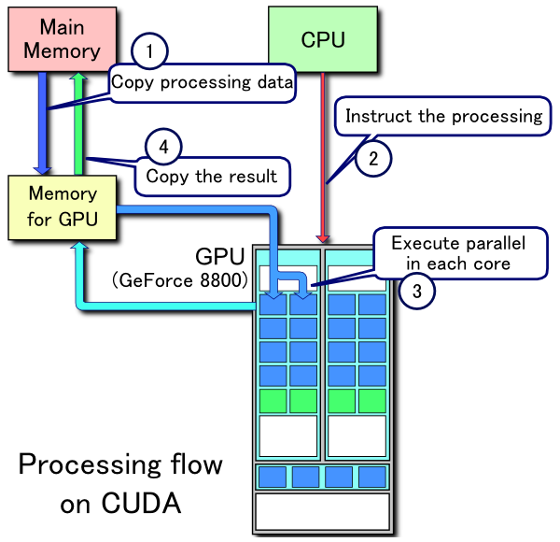
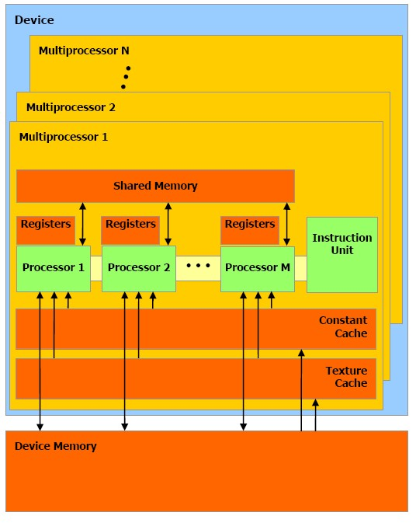
GPGPU API
CUDA
Compute Unified Device Architecture
2007. NVIDIA
High level, C like syntax
Atomic operations
Polling
Double precision computing
Synchronization

Slide 41
GPGPU API
OpenCL
2008 november, Khronos Group
Independent GPGPU API
Common platform for the CPU and the GPU
ATI, Intel, Apple, IBM és NVIDIA

Slide 42
Development of the OpenCL
1.0 – 2009
Support of heterogeneous environment
OpenCL virtual machine
Execution model
Memory model
Programming model
OpenCL C syntax for the kernel program
Support of linear and texture memory

Slide 43
Development of the OpenCL
1.1 – 2010
New data types
Vector with 3 components, new texture formats
Multi-threaded control
Multiple parallel device
Instructions limited to regions
Expanded event system
New OpenCL functions
Integer clamp, shuffle, synchron copy
Improved OpneGL interop.

Slide 44
Development of the OpenCL
1.2 – 2011
Device partitioning
A part of the device can be dedicated to critical operations
Separated compiling and linking
Improved texture support
Support of device integrated kernels
Video decoding, fixed function devices
Improved DirectX support
Full support of the IEEE 754 standard

Slide 45
Development of the OpenCL
2.0 – 2013
Distributed virtual memory
Embedded parallelism
Kernel launch from kernel
Global address space
Different memory regions mapped into the same address space
C11 atomic operations
FIFO objects in the kernels

Slide 46
Development of the OpenCL
2.1 – 2015
OpenCL C++ support
C++14 subset
New virtual machine
Based on SPIR-V, similar to Vulkan
Expended kernel objects
Sub-groups
Cloning
Improved profiler

