Slide 1
Parallel primitives

Slide 2
Task
SAXPY (Scaled Vector Addition)
y = a * x + y
BLAS (Basic Linear Algebra Subprograms)
?

Slide 3
MAP
SAXPY (Scaled Vector Addition)
y = ax + y
BLAS (Basic Linear Algebra Subprograms)
0
1
2
3
4
5
6
7
8
9
10
11
a
4
4
4
4
4
4
4
4
4
4
4
4
*
x
2
4
2
1
8
3
9
5
5
1
2
1
+
y
3
7
0
1
4
0
0
4
5
3
1
0
y
11
23
8
5
36
12
36
49
50
7
9
4
Introduction to Parallel Computing, University of Oregon, IPCC

Slide 4
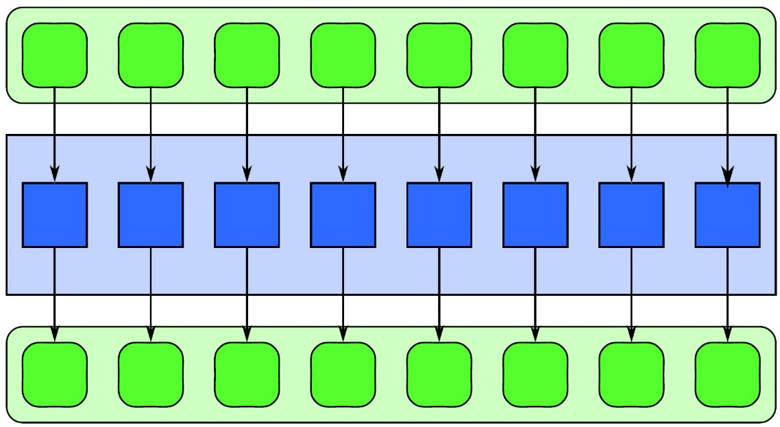
Map
Same operation on the input elements
Parallel execution of a serial iteration
Input
Elemental Function
Output
Introduction to Parallel Computing, University of Oregon, IPCC

Slide 5
Task
Find the largest or smallest element in an array
?

Slide 6
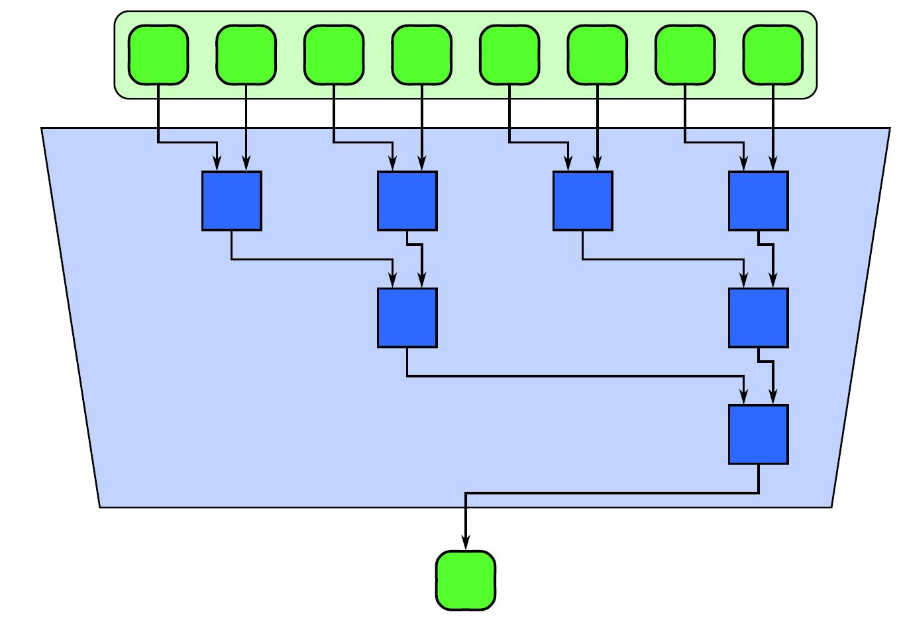
Reduce
A combination of input elements
Associative binary operations
Min, max, add, sub
Introduction to Parallel Computing, University of Oregon, IPCC

Slide 7
Task
What to do if we cannot start all the required threads at once?
?

Slide 8
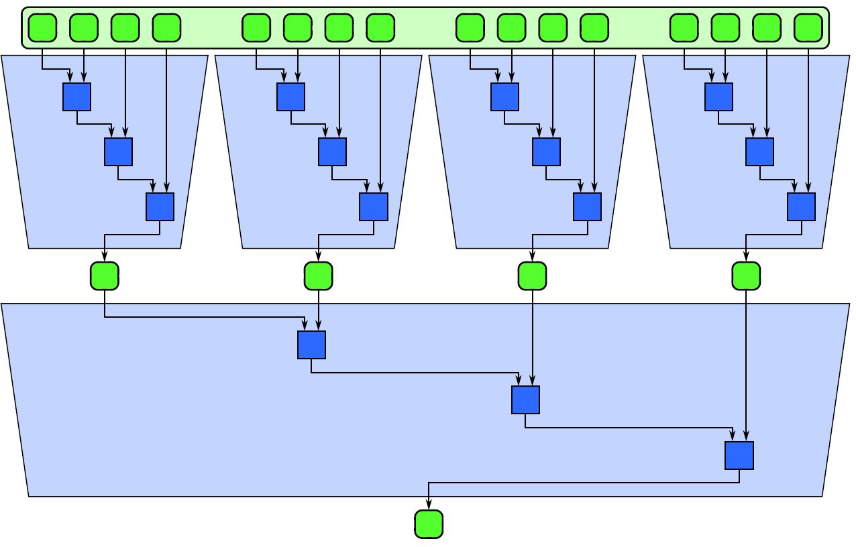
Reduce
Partitioned reduction
Introduction to Parallel Computing, University of Oregon, IPCC

Slide 9
Task
Calculate the sum of the elements in an array up to a given index
Do it for each index
A
B
C
D
E
?
A
A+B
A+B+C
A+B+C+D
A+B+C+D+E

Slide 10
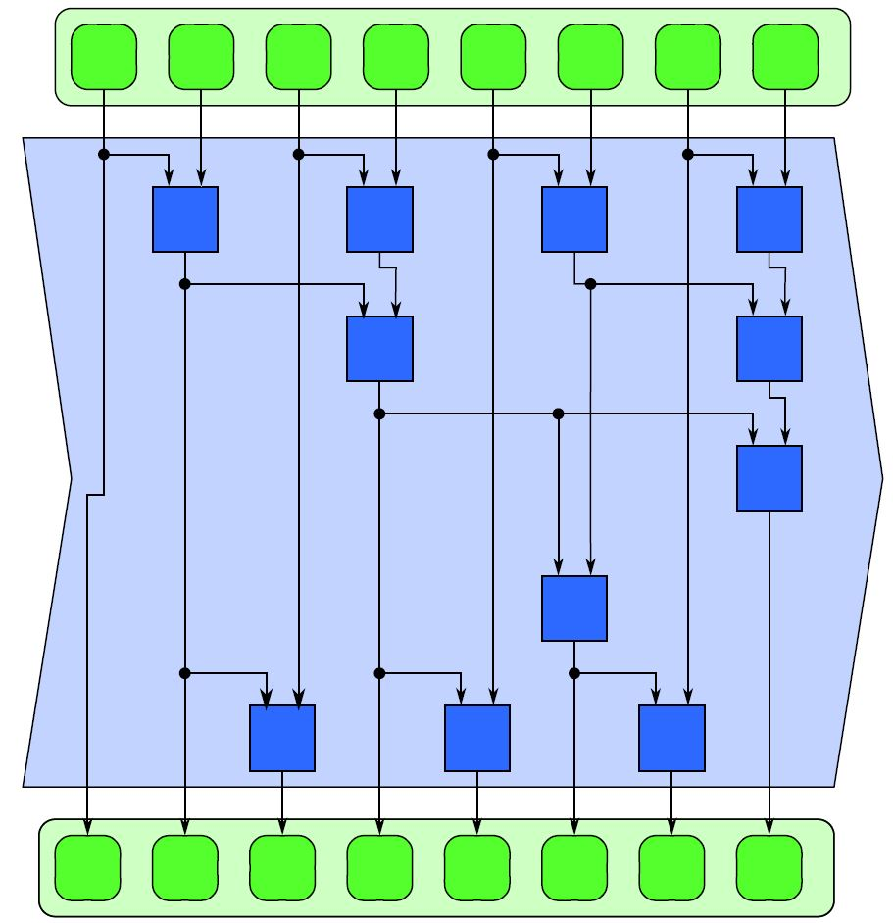
Scan
All possible partial reduction of the input elements
Each element of the output is the reduction of the input elements till that output element
Exclusive or inclusive
Introduction to Parallel Computing, University of Oregon, IPCC

Slide 11
Scan
Naive parallelization
A
B
C
D
E
A
A+B
B+C
C+D
D+E
A
A+B
A+B+C
A+B+C+D
B+C+D+E
A
A+B
A+B+C
A+B+C+D
A+B+C+D+E

Slide 12
Task
Select elements from the array that are greater than 50 and put them in a separate array
20
60
51
10
49
?
60
51

Slide 13
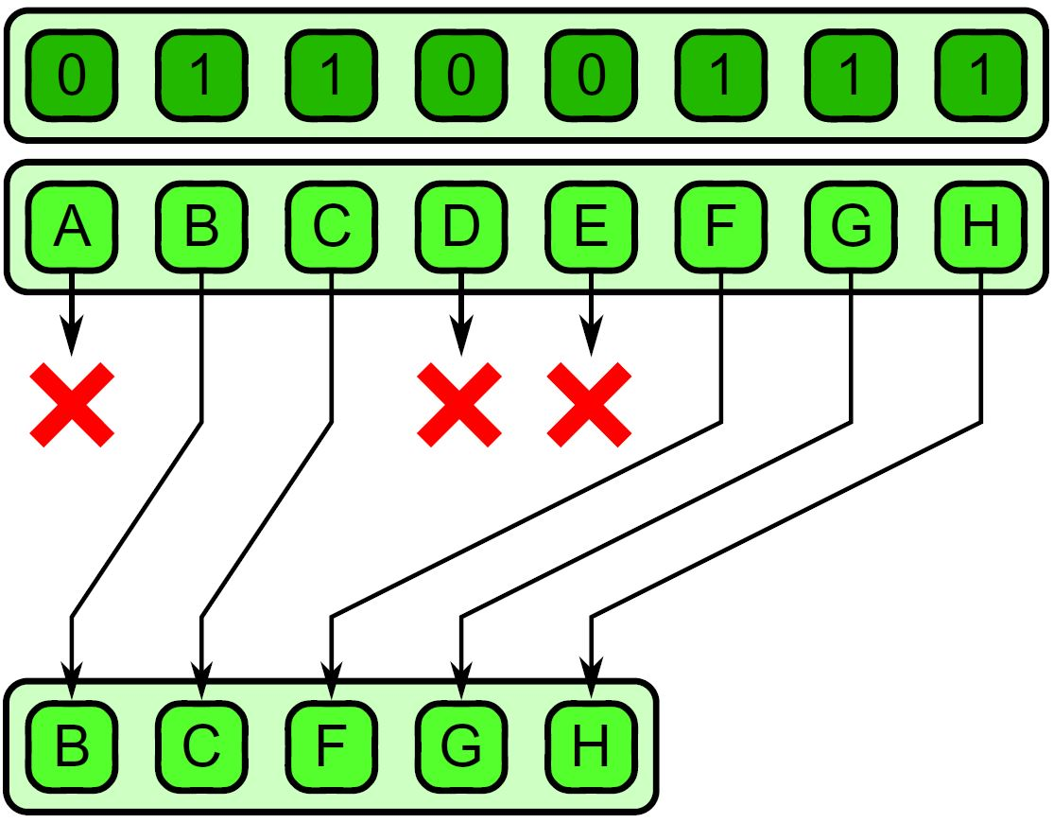
Compact
Conditional selection
Selecting elements that meet a criterion
Map, scan, map
Select elements according to the condition, mark them with 0 or 1
Calculate the positions in the result array, exclusive scan on the mask
Copy the element if the mask is 1
Introduction to Parallel Computing, University of Oregon, IPCC

Slide 14
Gather and scatter
Gather
Which element of the input shall be placed to the output
Scatter
Where to put the input elements in the output
Notes:
spread

Slide 15
Task
Put the elements into ascending order
5
1
4
2
3
?

Slide 16
Parallel Sorting
Bubble sort
5
1
4
2
3
1
5
2
4
3
1
2
5
3
4
1
2
3
5
4
1
2
3
4
5

Slide 17
Parallel Sorting
Merge sort
1M
512K
512K
…
…
2048
2048
1024
1024
1024
1024
512
512
512
512
…
…
1
1
1
…
1
1
1

Slide 18
Parallel Sorting
Merge sort
A
0 3 5 8 9
?
0 1 2 3 4 5 6 7 8 9
B
1 2 4 6 7

Slide 19
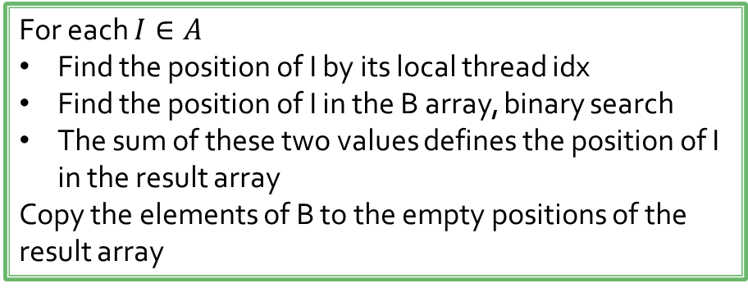
Parallel Sorting
Merge sort
A
0 3 5 8 9
?
0 1 2 3 4 5 6 7 8 9
B
1 2 4 6 7
For each $I∈A$
Find the position of I by its local thread idx
Find the position of I in the B array, binary search
The sum of these two values defines the position of I in the result array
Copy the elements of B to the empty positions of the result array

Slide 20
Parallel Sorting
Radix sort
Ordering by local values from LSB to MSB
Put 0 to the left and 1 to the right
Do not change the relative order of elements that contain 0
Do not change the relative order of elements that contain 1
Element# | 1 | 2 | 3 | 4
Value | 7 | 14 | 4 | 1
Binary form | 0111 | 1110 | 0100 | 0001

Slide 21
Parallel Sorting
Element# | 1 | 2 | 3 | 4
Value | 7 | 14 | 4 | 1
Binary form | 0111 | 1110 | 0100 | 0001
Element# | 2 | 3 | 1 | 4
Value | 14 | 4 | 7 | 1
Binary form | 1110 | 0100 | 0111 | 0001

Slide 22
Parallel Sorting
Element# | 2 | 3 | 1 | 4
Value | 14 | 4 | 7 | 1
Binary form | 1110 | 0100 | 0111 | 0001
Element# | 3 | 4 | 2 | 1
Value | 4 | 1 | 14 | 7
Binary form | 0100 | 0001 | 1110 | 0111

Slide 23
Parallel Sorting
Element# | 3 | 4 | 2 | 1
Value | 4 | 1 | 14 | 7
Binary form | 0100 | 0001 | 1110 | 0111
Element# | 4 | 3 | 2 | 1
Value | 1 | 4 | 14 | 7
Binary form | 0001 | 0100 | 1110 | 0111

Slide 24
Parallel Sorting
Element# | 4 | 3 | 2 | 1
Value | 1 | 4 | 14 | 7
Binary form | 0001 | 0100 | 1110 | 0111
Element# | 4 | 3 | 1 | 2
Value | 1 | 4 | 7 | 14
Binary form | 0001 | 0100 | 0111 | 1110

Slide 25
Parallel Sorting
How do we calculate the position of an element?
Count the number of 0 and 1
Calculate the relative position of each element in its own corresponding group
The sum of these two values indicates the position in the result
Element# | 1 | 2 | 3 | 4
Value | 7 | 14 | 4 | 1
Binary form | 0111 | 1110 | 0100 | 0001

Slide 26
Parallel Sorting
Calculate the number of 0s and 1s
Element# | 1 | 2 | 3 | 4
Value | 7 | 14 | 4 | 1
Binary form | 0111 | 1110 | 0100 | 0001
 | 0 bit | 1 bit
Histogram | 2 | 2
Prefix sum | 0 | 2
The prefix sum is a result of an exclusive scan. It tells the staring index in the result array of the corresponding group (it is more interesting if more bits are considered together)

Slide 27
Parallel Sorting
Calculate the relative position of each element
Element# | 1 | 2 | 3 | 4
Value | 7 | 14 | 4 | 1
Binary form | 0111 | 1110 | 0100 | 0001
Relative positions | 0 | 0 | 1 | 1
New position | 2+0=2 | 0+0=0 | 0+1=1 | 2+1=3
Element# | 2 | 3 | 1 | 4
Value | 14 | 4 | 7 | 1
Binary form | 1110 | 0100 | 0111 | 0001

Slide 28
Parallel Sorting
Parallel parts of the radix sort
Histogram calculation
Exclusive scan on the histogram
Calculation of the relative position – exclusive scan on each group

Slide 29
Parallel Sorting
//Radix sort by Robert Crovell - Nvidia
//uses single warp only
#include <stdio.h>
#include <stdlib.h>
#include "cuda.h"
#define WSIZE 32
#define LOOPS 100000
#define UPPER_BIT 31
#define LOWER_BIT 0
__device__ unsigned int ddata[WSIZE];
int main() {
unsigned int hdata[WSIZE];
for (int lcount = 0; lcount < LOOPS; lcount++) {
unsigned int range = 1U << UPPER_BIT;
for (int i = 0; i < WSIZE; i++) hdata[i] = rand() % range;
cudaMemcpyToSymbol(ddata, hdata, WSIZE * sizeof(unsigned int));
mykernel << <1, WSIZE >> >();
cudaMemcpyFromSymbol(hdata, ddata, WSIZE * sizeof(unsigned int));
for (int i = 0; i < WSIZE - 1; i++) if (hdata[i] > hdata[i + 1]) { printf("sort error at loop %d, hdata[%d] = %d, hdata[%d] = %d\n", lcount, i, hdata[i], i + 1, hdata[i + 1]); return 1; }
// printf("sorted data:\n");
//for (int i = 0; i < WSIZE; i++) printf("%u\n", hdata[i]);
}
printf("Success!\n");
return 0;
}
__global__ void mykernel() {
__shared__ volatile unsigned int sdata[WSIZE * 2];
// load from global into shared variable
sdata[threadIdx.x] = ddata[threadIdx.x];
unsigned int bitmask = 1 << LOWER_BIT;
unsigned int offset = 0;
unsigned int thrmask = 0xFFFFFFFFU << threadIdx.x;
unsigned int mypos;
// for each LSB to MSB
for (int i = LOWER_BIT; i <= UPPER_BIT; i++)
{
unsigned int mydata = sdata[((WSIZE - 1) - threadIdx.x) + offset];
unsigned int mybit = mydata&bitmask;
// get population of ones and zeroes (cc 2.0 ballot)
unsigned int ones = __ballot(mybit); // cc 2.0
unsigned int zeroes = ~ones;
offset ^= WSIZE; // switch ping-pong buffers
// do zeroes, then ones
if (!mybit) // threads with a zero bit
// get my position in ping-pong buffer
mypos = __popc(zeroes&thrmask);
else // threads with a one bit
// get my position in ping-pong buffer
mypos = __popc(zeroes) + __popc(ones&thrmask);
// move to buffer (or use shfl for cc 3.0)
sdata[mypos - 1 + offset] = mydata;
// repeat for next bit
bitmask <<= 1;
}
// save results to global
ddata[threadIdx.x] = sdata[threadIdx.x + offset];
}

