Slide 1
CUDA

Slide 2
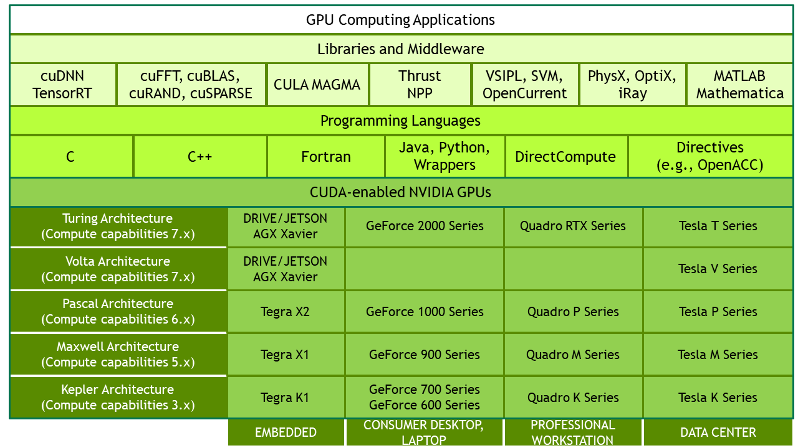
Introduction
CUDA was introduced by Nvidia in 2006
Parallel computing platform and programming model
Available in several programming languages

Slide 3
Hardware realization
Threads are grouped in blocks
Blocks are run by Streaming Multiprocessor (SM)
Threads in a block run parallel
Threads of a block reside in the same SM
One SM can host multiple blocks

Slide 4
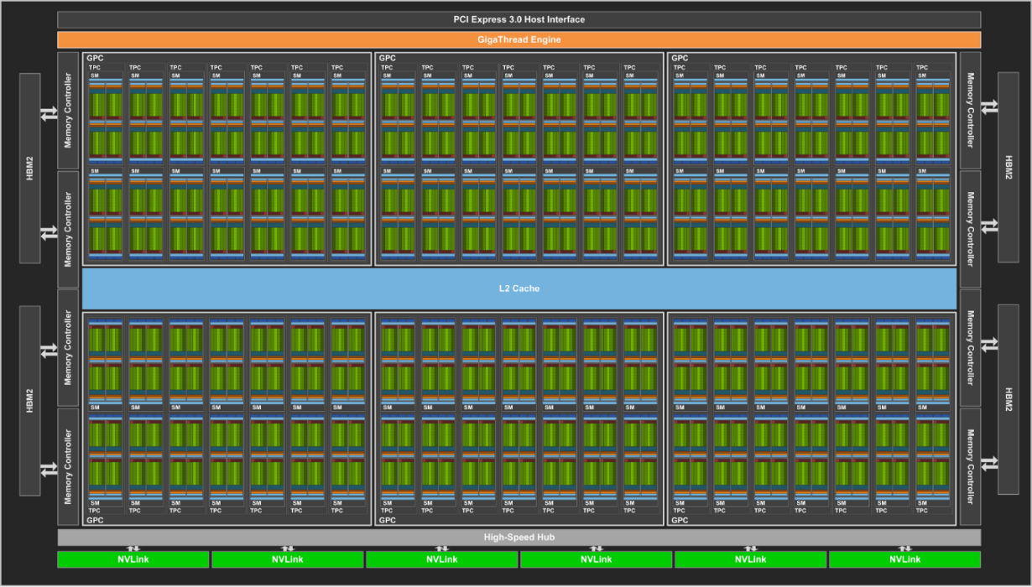
Hardware realization
There are multiple SMs on a single GPU
Multiple FP32/FP64 cores in the SMs
Tesla V100
SM: 80
FP32 core/SM: 64
FP32 core/GPU: 5120

Slide 5
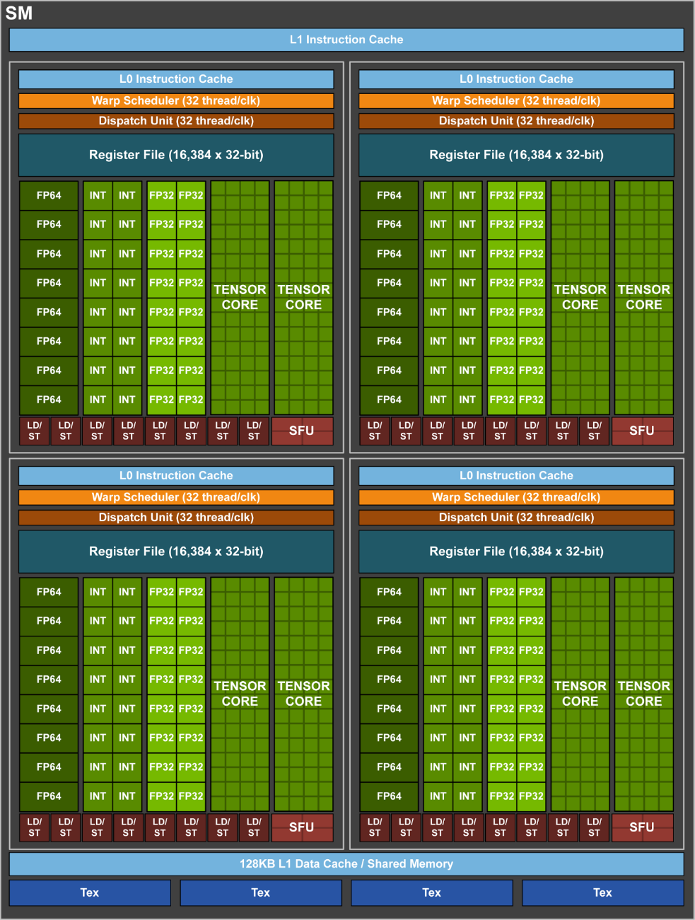
Hardware realization
An SM schedules multiple warps
Single warp runs 32 threads in parallel
Tesla V100 Streaming Multiprocessor

Slide 6
Hardware realization
SIMT – Single Instruction Multiple Thread
Thread IDs are consecutive and increasing in a single warp
Threads in a warp always perform one common instruction
One common instruction counter (prior to Volta)
Branching is realized with masking

Slide 7
Hardware realization
SIMT – Single Instruction Multiple Thread
Execution context (program counter, registers …) can be saved
Fast context switch
Scheduling executable warps
Hiding memory operations
Available number of registers and amount of shared memory is architecture dependent
The amount of blocks and warps that can be executed at the same time is hardware resource dependent

Slide 8
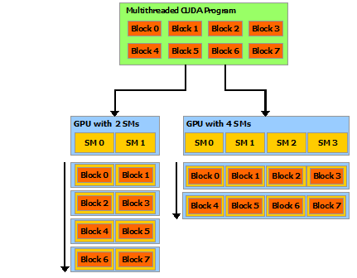
Scalable model
Scheduling is managed by the driver in run time
The programmer defines only the number and size of the blocks

Slide 9
Scalable model
Key features
Thread hierarchy
Shared memory
Synchronization points
Sub problems solved within a block
Threads in a block can communicate
Synchronization between blocks is not possible (prior to Volta)

Slide 10
Programming model
Kernel
__global__
<<<…>>> run configuration
__global__ void VecAdd(float* A, float* B, float* C)
{
int i = threadIdx.x;
C[i] = A[i] + B[i];
}
int main()
{
...
VecAdd<<<1, N>>>(A, B, C);
...
}

Slide 11
Programming model
Thread hierarchy
threadIdx: three dimensional vector
threadIdx: unique id in a block
blockIdx, blockDim: unique id of the block and size of the block
Global unique id of a thread can be calculated
globalId = threadIdx + blockIdx * blockDim

Slide 12
Programming model

Slide 13
Programming model
__global__ void MatAdd(float A[N][N], float B[N][N], float C[N][N])
{
int i = threadIdx.x;
int j = threadIdx.y;
C[i][j] = A[i][j] + B[i][j];
}
int main()
{
...
int numBlocks = 1;
dim3 threadsPerBlock(N, N);
MatAdd<<<numBlocks, threadsPerBlock>>>(A, B, C);
...
}

Slide 14
Programming model
__global__ void MatAdd(float A[N][N], float B[N][N], float C[N][N])
{
int i = blockIdx.x * blockDim.x + threadIdx.x;
int j = blockIdx.y * blockDim.y + threadIdx.y;
if (i < N && j < N)
{
C[i][j] = A[i][j] + B[i][j];
}
}
int main()
{
...
dim3 threadsPerBlock(16, 16);
dim3 numBlocks((N + threadsPerBlock.x - 1) / threadsPerBlock.x,
(N + threadsPerBlock.y - 1) / threadsPerBlock.y);
MatAdd<<<numBlocks, threadsPerBlock>>>(A, B, C);
...
}

Slide 15
Memory model
Block
Block
Shared memory
Shared memory
Thread
Thread
Thread
Thread
Local memory
Local memory
Local memory
Local memory
GPU
Global memory
Constant memory
Host
Texture memory
Host program
Host memory

Slide 16
Memory model
Typical workflow
Memory allocation on the host and on the GPU
Gather data on the host
Transfer data to the GPU
Process data on the GPU
Transfer data back to host
Release host and GPU memory

Slide 17
Example
__global__ void VecAdd(float* A, float* B, float* C, int N)
{
int i = blockDim.x * blockIdx.x + threadIdx.x;
if (i < N)
{
C[i] = A[i] + B[i];
}
}
int main()
{
// N depends on the problem size
int N = ...;
size_t size = N * sizeof(float);
// memory allocation on the host
float* h_A = (float*)malloc(size);
float* h_B = (float*)malloc(size);
float* h_C = (float*)malloc(size);
// Generating input data, h_A, h_B
...

Slide 18
Example
…
// GPU memory allocation
float* d_A;
cudaMalloc(&d_A, size);
float* d_B;
cudaMalloc(&d_B, size);
float* d_C;
cudaMalloc(&d_C, size);
// Copy data to the GPU
cudaMemcpy(d_A, h_A, size, cudaMemcpyHostToDevice);
cudaMemcpy(d_B, h_B, size, cudaMemcpyHostToDevice);
// Kernel launch
int threadsPerBlock = 256;
int blocksPerGrid = (N + threadsPerBlock - 1) / threadsPerBlock;
VecAdd<<<blocksPerGrid, threadsPerBlock>>>(d_A, d_B, d_C, N);
…

Slide 19
Example
…
// Copy data from the GPU to the host
cudaMemcpy(h_C, d_C, size, cudaMemcpyDeviceToHost);
// releasing GPU memory
cudaFree(d_A);
cudaFree(d_B);
cudaFree(d_C);
// Releasing host memory
free(h_A);
free(h_B);
free(h_C);
return 0;
}

Slide 20
Compile and Linkage
The program contains C language extensions
__global__, <<<…>>>, etc.
Higher level C functions are defined to manage the devices
Memory handling, data transfer, multiple GPUs
These functions rely on the driver API
The driver API is also available to the programmer
Seldom used
Provides low level access, similar to OpenCL

Slide 21
Compile and Linkage
Kernel functions can be written with the instruction set of the CUDA architecture (PTX) or with the higher level C language
Because of the special language extensions, separate compiler is needed -> nvcc

Slide 22
Compile and Linkage
Offline compile
The source file contains both CPU and GPU code
The compiler separates those parts
The GPU code can be complied into PTX or binary format
In the host code, the <<<…>>> part is replaced with driver API calls that load and launch the kernel function
The modified host code is compiled into an object file by the nvcc (complete C++ support) or other complier
If driver API is used, the host code does not have to be compiled with nvcc

Slide 23
Compile and Linkage
Just-in-Time compile
The run time loaded PTX code is complied into binary format by the driver
The programs load slower, but newer compliers can generate more effective binaries
The programs can be run on GPUs that were not available when the program was written
The driver caches the binaries

Slide 24
Compile and Linkage
Binary compatibility
The binary code is architecture dependent
The target architecture can be defined with the –code switch
E.g.: -code=sm_35 -> compute capability 3.5
Binaries are compatible from one minor version to the next one, but not from one minor version to the previous one
Binaries are not compatible across major versions

Slide 25
Compile and Linkage
PTX compatibility
PTX code produced for some specific compute capability can always be compiled to binary code of greater or equal compute capability
A binary compiled from an earlier PTX version may not make use of some hardware features

Slide 26
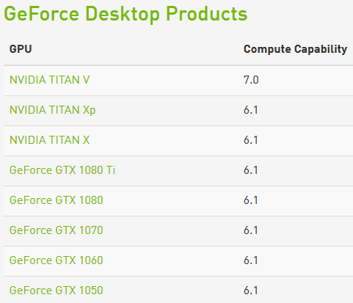
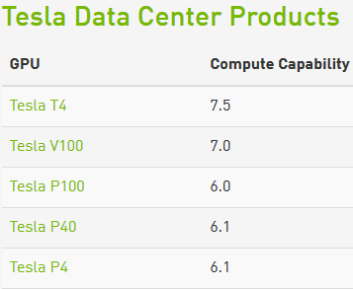
Compute Capability
Name | CUDA version | Compute Capability
Fermi | 3.2 | 2.0
Kepler | 5 | 3.0, 3.5, 3.7
Maxwell | 6 | 5.0, 5.2, 5.3
Pascal | 8 | 6.0, 6.1, 6.2
Volta | 9 | 7.0, 7.2
Turing | 10 | 7.5

Slide 27
In Details

Slide 28
Memory model
Block
Block
Shared memory
Shared memory
Thread
Thread
Thread
Thread
Local memory
Local memory
Local memory
Local memory
GPU
Global memory
Constant memory
Host
Texture memory
Host program
Host memory

Slide 29
Memory model
Memory types
Local
Allocated in the register array
Accessible only by one thread
Split-store if there is not enough registers
Shared memory
Shared within a block
Constant memory
Global memory
GPU memory
Linear memory addressing

Slide 30
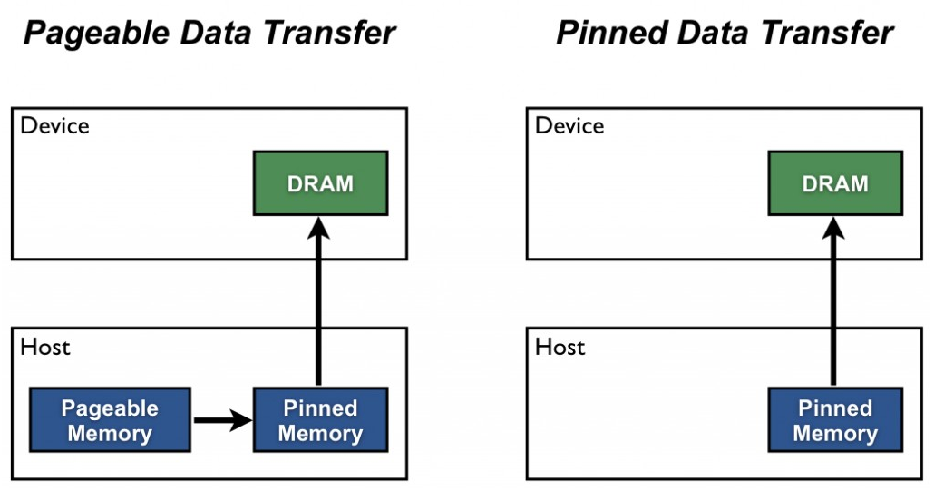
Memory model
Memory types
Host side CUDA memory
Page-Locked Host memory
Not pageable memory on the host
cudaHostAlloc(), cudaFreeHost(), cudaHostRegister()
Data transfer can overlap with kernel calls
Data transfer is faster compared to pageable host memory

Slide 31
Memory model
Memory types
Host side CUDA memory
Portable memory
Favorable properties of the page-locked memory is available only in one context
Portable flag extends it to all available devices
Write-Combining Memory
The allocated area is non cacheable
40% faster memory transfer
Host side access is slower because of the lack of caching

Slide 32
Memory model
Memory types
Host side CUDA memory
Mapped Memory
Memory allocated host side is available to the GPU
During kernel calls its transfer to the GPU on demand
No streams are required to overlap memory operations and kernel calls
PCI-E bus bandwidth is a limiting factor
Unified Virtual Address Space
Available from Compute Capability 2.0
Same address space for the host and the GPU

Slide 33
Memory model
Handling device memory
cudaMemcpy* functions
Last parameter defines the direction
cudaMemcpyHostToDevice
cudaMemcpyDeviceToHost
cudaMemcpyDeviceToDevice
cudaMemcpy(dataGPU, dataCPU, sizeof(int)*dataSize,
cudaMemcpyHostToDevice);

Slide 34
Memory model
Handling device memory
Peer-to-Peer memory
Compute Capability 2.0 Tesla
cudaDeviceCanAccessPeer()
cudaDeviceEnableAccess()
Peer-to-Peer copy
If no UAVS is enabled
cudaSetDevice(0);
float* p0;
cudaMalloc(&p0, size);
cudaSetDevice(1);
cudaDeviceEnablePeerAccess(0,0);
kernel<<<grid, block>>>(p0);

Slide 35
CUDA stream
CUDA stream
Parallel kernel calls
To overlap memory transfer and kernel calls
cudaStream_t stream[numberOfStreams];
for(int i = 0; i < numberOfStreams; ++i)
cudaStreamCreate(&stream[i]);
…
for(int i = 0; i < 2; ++i)
{
cudaMemcpyAsync(…,cudaHostToDevice, stream[i]);
kernel<<<grid,block,shared,stream[i]>>>(params, …);
cudaMemcpyAsync(…, cudaDeviceToHost, stream[i]);
}
…
for(int i = 0; i < numberOfStreams; ++i)
cudaStreamDestroy(stream[i]);

Slide 36
CUDA stream
CUDA stream
Default stream, if no other is defined
Synchronization
Explicit
cudaDeviceSynchronize() – each stream finishes its work
cudaStreamSynchronize() – a given stream finishes its work
cudaStreamWaitEvent() – synchronization within a stream

Slide 37
CUDA stream
Synchronization
Implicit
Page-locked memory allocation
Device memory allocation
Copy in GPU memory
Command execution on the default stream
Cache configuration change

Slide 38
CUDA C
Function prefixes
__device__: can be called from kernel only
__global__: can be called from kernel and host code
__host__: can be called from the host only
__noinline__
__forceinline__

Slide 39
CUDA C
Variable prefixes:
__device__: stored in the device memory
Stored in the global memory
Available in the whole life cycle of the application
Accessible from all threads and from the host
__constant__: constant variable
Stored in the constant memory
Similar to __device__
__shared__: shared variable
Stored on-chip
Available in single block, while the block is running

Slide 40
CUDA C
Variable prefixes:
__restrict__: non overlapping pointers
Promise to the compiler, that the pointers are independent
Helps the optimization

Slide 41
CUDA C
Vector types
Available on host and device side
Type make_type() format constructors
E.g.: float4 v = make_float4(1.0f);
Maximum 4 elements
Available for the common C types
dim3 types to indicate dimensions
Kernel launches

Slide 42
CUDA C
Special variables
dim3 gridDim: actual grid size
uint3 blockIdx: actual block index
dim3 blockDim: actual block size
uint3 threadIdx: actual size index
int warpSize: warp size

Slide 43
CUDA C
Synchronization functions
Memory synchronization within a block
Can be called from only one thread as well
threadfence_block()
Synchronizes the global and shared memories
threadfence()
Synchronizes the global memory
threadfence_system()
Synchronizes on all available memory areas

Slide 44
CUDA C
Synchronization functions
void __syncthreads()
All threads must reach this line
Code execution is synchronized within a block
int __syncthreads(int predicate)
Returns the number of threads where the predicate is not zero
int __syncthreads_and(int predicate)
Returns if the predicate was non zero on all threads
int __syncthreads_or(int predicate)
Returns if there was a thread with non zero predicate

Slide 45
CUDA C
Built-in functions:
Mathematic functions
Texture and surface handling functions
Time handling
Atomic
Voting
Transferring variables between threads
Printf
Memory allocation
Kernel launch

Slide 46
NSight

