Slide 1
Optimizing parallel reduction in CUDA
Follows the presentation of Mark Harris - Nvidia

Slide 2
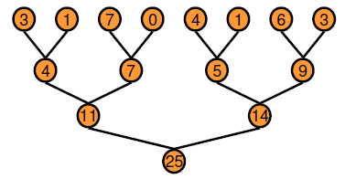
Parallel Reduction
Tree based approach in each thread block
Use multiple thread blocks
To process large arrays
To keep all the SMs on the GPU busy
Each block process a portion of the array

Slide 3
Parallel Reduction
CUDA has no global synchronization
Decompose the process into multiple kernel launches

Slide 4
Optimization Goal
We should strive to reach peak GPU performance
GFLOP/s for compute-bounded kernels
Memory bandwidth for memory-bounded kernels
Reduction has very low computational need
1 flop/element
We should strive for peak bandwidth

Slide 5
Reduction v0
// Reduction in the global memory
__global__ void reduceKernel_v0(unsigned int *g_idata, unsigned int *g_odata, size_t dataSize)
{
unsigned int lid = threadIdx.x; // local id in the block
unsigned int id = blockIdx.x * blockDim.x + threadIdx.x; // global id, base index of the thread block
if (id >= dataSize) return;
// do reduction in global memory
for (unsigned int s = 1; s < blockDim.x; s *= 2)
{
// modulo arithmetic is slow!
if ((lid % (2 * s)) == 0)
{
if (id + s < dataSize)g_idata[id] += g_idata[id + s];
}
__syncthreads();
}
// write result for this block to global memory
if (lid == 0) g_odata[blockIdx.x] = g_idata[id];
}

Slide 6
Reduction v1
V0 uses global memory to store intermediate results
Use shared memory instead

Slide 7
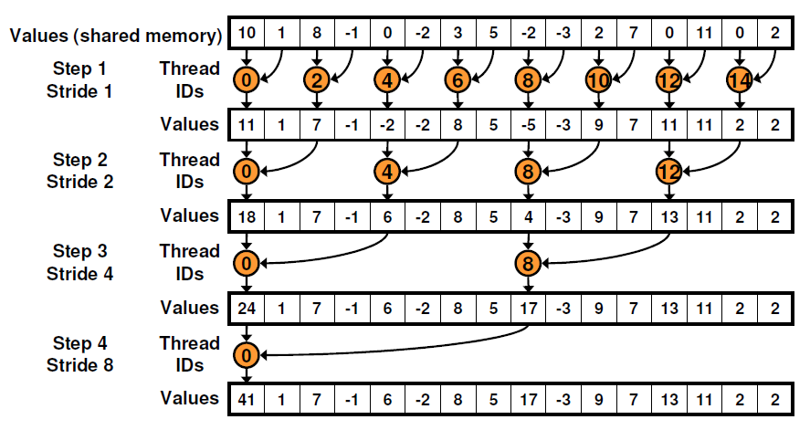
Reduction v2
V1 : highly divergent branches

Slide 8
Reduction v2
Strided index and non-divergent branch

Slide 9
Reduction v3
V2 memory access pattern
Notes:
Bank conflict
Shared memory is divided into equally sized memory modules called banks
A bank can serve one request at once
Banks can be access simultaneously
If same bank is accessed, the request are serialized

Slide 10
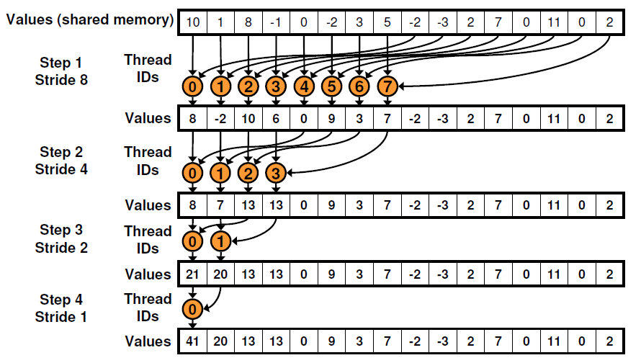
Reduction v3
Use sequential addressing instead
Notes:
Bank conflict
Shared memory is divided into equally sized memory modules called banks
A bank can serve one request at once
Banks can be access simultaneously
If same bank is accessed, the request are serialized

Slide 11
Reduction v4
In v3 half of the threads are idle in the first iteration
Halve the number of blocks
Replace the single shared memory load with two global memory reads and the first add of the reduction

Slide 12
Reduction v5
V4 is still limited by address arithmetic and loop overhead
Unroll the loops

Slide 13
Reduction v5
When s <= 32, only 32 active thread remained
These threads are in a single warp
Instructions are SIMD synchronous within a warp
We do not need __synchthreads()
If(tid < s) is also needless
Unroll the last 6 iterations of the loop
Note: This saves useless work in all warps, not just the last one!
Without unrolling, all warps execute every iteration of the for loop and if statement

Slide 14
Reduction v6
Complete unrolling
If we know the number of iterations at compile time, we can unroll the whole reduction
Block size is limited to 1024 threads
We use power of 2 block sizes
Loop can be unrolled for a fixed block size
Use templates
generic solution

Slide 15
Reduction v7
Algorithm cascading
Combine sequential and parallel reduction
Each thread loads and sums multiple elements into shared memory
Tree-based reduction in shared memory
Each thread should sum O(log n) elements
Or even more, try different parametrization

