Slide 1
Computational Fluid Dynamics

Slide 2
Reset
__kernel
void resetSimulation(const int gridResolution,
__global float2* velocityBuffer)
{
int2 id = (int2)(get_global_id(0), get_global_id(1));
if( id.x < gridResolution && id.y < gridResolution){
velocityBuffer[id.x + id.y * gridResolution] = (float2)(0.0f);
}
}

Slide 3
Initial reset
initSimulation()
{
…
resetSimulation();
}

Slide 4
Display
// TODO
// MAP velocityBuffer TO visualizationBuffer
// visualizationBuffer[x,y] := (1.0 + velocity) / 2.0
__kernel
void visualizationVelocity(const int width, const int height, __global float4* visualizationBuffer,
const int gridResolution, __global float2* velocityBuffer){
int2 id = (int2)(get_global_id(0), get_global_id(1));
if( id.x < width && id.y < height){
// TODO
}
}

Slide 5
Test

Slide 6
Adding force
// TODO
//
// Add force to velocityBuffer
// Add matter to densityBuffer
//
// Example:
// dx := global_id(0) / gridResolution - x
// dy := global_id(1) / gridResolution - y
// radius := 0.001
// c := e^(-(dx^2 + dy^2) / radius) * dt
//
// velocityBuffer[x,y] += c * force
// densityBuffer[x,y] += c * density
__kernel
void addForce(const float x, const float y, const float2 force,
const int gridResolution, __global float2* velocityBuffer,
const float4 density, __global float4* densityBuffer){
int2 id = (int2)(get_global_id(0), get_global_id(1));
// TODO
}

Slide 7
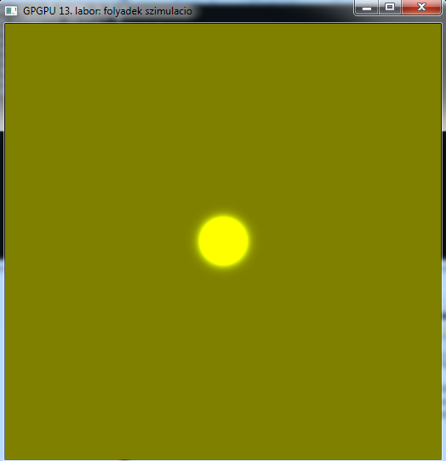
Test

Slide 8
Advection
// TODO
//
// Inner parts:
// velocity := inputVelocityBuffer[x,y]
// p := id.xy - velocity.xy * dt
// outputVelocity[x,y] = getBil(p, gridResolution, inputVelocityBuffer)
//
// Border:
// outputVelocity = -inputVelocity (nearest neighbour)
__kernel
void advection(const int gridResolution,
__global float2* inputVelocityBuffer,
__global float2* outputVelocityBuffer){
int2 id = (int2)(get_global_id(0), get_global_id(1));
// TODO
}

Slide 9
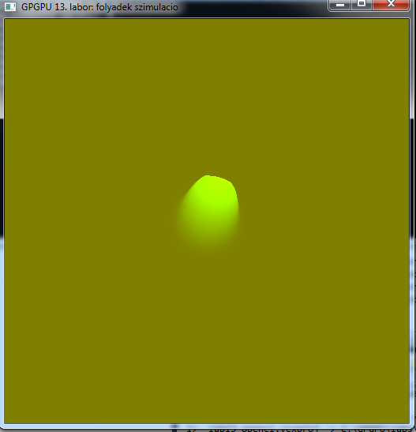
Test

Slide 10
Diffusion
// TODO
//
// Inner parts:
// alpha := 1.0 / (viscousity * dt)
// beta := 1.0 / (4.0 + alpha)
//
// vL := inputVelocityBuffer[x - 1, y]
// vR := inputVelocityBuffer[x + 1, y]
// vB := inputVelocityBuffer[x, y - 1]
// vT := inputVelocityBuffer[x, y + 1]
//
// velocity := inputVelocityBuffer[x,y]
//
// outputVelocityBuffer[x,y] := (vL + vR + vB + vT + alpha * velocity) * beta
//
// Border:
// outputVelocityBuffer[x,y] := inputVelocityBuffer[x,y]
__kernel
void diffusion(const int gridResolution,
__global float2* inputVelocityBuffer,
__global float2* outputVelocityBuffer){
int2 id = (int2)(get_global_id(0), get_global_id(1));
// TODO
}

Slide 11
Divergence
// TODO
//
// Inner parts:
// vL := velocityBuffer[x - 1, y]
// vR := velocityBuffer[x + 1, y]
// vB := velocityBuffer[x, y - 1]
// vT := velocityBuffer[x, y + 1]
// divergenceBuffer[x,y] := 0.5 * ((vR.x - vL.x) + (vT.y - vB.y))
//
// Border:
// divergenceBuffer[x,y] := 0.0
__kernel
void divergence(const int gridResolution, __global float2* velocityBuffer,
__global float* divergenceBuffer){
int2 id = (int2)(get_global_id(0), get_global_id(1));
// TODO
}

Slide 12
Pressure
// TODO
//
// Inner parts:
// alpha := -1.0
// beta := 0.25
// vL := inputPressureBuffer[x - 1, y]
// vR := inputPressureBuffer[x + 1, y]
// vB := inputPressureBuffer[x, y - 1]
// vT := inputPressureBuffer[x, y + 1]
// divergence := divergenceBuffer[x,y]
//
// ouputPressure := (vL + vR + vB + vT + divergence * alpha) * beta
//
// Border:
// ouputPressure[x,y] = inputPressureBuffer (nearest neighbour)
__kernel
void pressureJacobi(const int gridResolution,
__global float* inputPressureBuffer,
__global float* outputPressureBuffer,
__global float* divergenceBuffer){
int2 id = (int2)(get_global_id(0), get_global_id(1));
// TODO
}

Slide 13
Projection
// TODO
//
// Inner parts:
// pL := pressureBuffer[x - 1, y]
// pR := pressureBuffer[x + 1, y]
// pB := pressureBuffer[x, y - 1]
// pT := pressureBuffer[x, y + 1]
// velocity := inputVelocityBuffer[x,y]
//
// outputVelocity[x,y] = velocity - (pR - pL, pT - pB)
//
// Border:
// outputVelocity = -inputVelocity (nearest neighbour)
__kernel
void projection(const int gridResolution,
__global float2* inputVelocityBuffer,
__global float* pressureBuffer,
__global float2* outputVelocityBuffer){
int2 id = (int2)(get_global_id(0), get_global_id(1));
// TODO
}

Slide 14
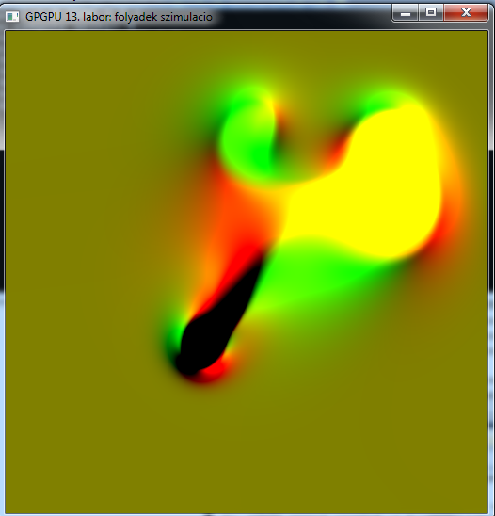
Test

Slide 15
Density advection
// TODO
//
// Inner parts:
// velocity := velocityBuffer[x,y]
// p := id.xy - velocity.xy * dt
// outputDensityBuffer[x,y] := getBil4(p, gridResolution, inputDensityBuffer)
__kernel
void advectionDensity(const int gridResolution,
__global float2* velocityBuffer,
__global float4* inputDensityBuffer,
__global float4* outputDensityBuffer){
int2 id = (int2)(get_global_id(0), get_global_id(1));
// TODO
}

Slide 16
Displaying density
// TODO
// MAP densityBuffer TO visualizationBuffer
// visualizationBuffer[x,y] := density
__kernel
void visualizationDensity(const int width, const int height, __global float4* visualizationBuffer,
const int gridResolution, __global float4* densityBuffer){
int2 id = (int2)(get_global_id(0), get_global_id(1));
if( id.x < width && id.y < height){
// TODO
}
}

Slide 17
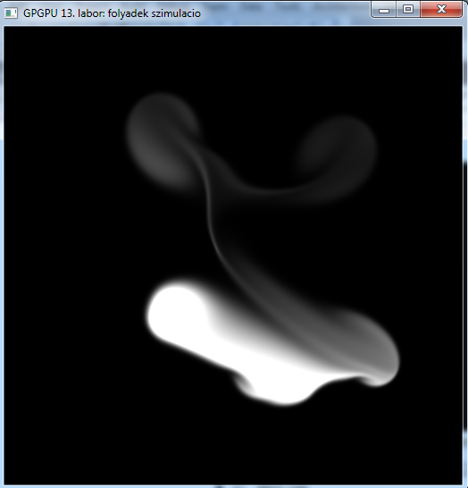
Test

Slide 18
DIY
Use keys 1,2,3,4 to inject different colors
Inject color and force at the current position of the mouse
(Display pressure and divergence)
Velocity diffusion
Jacobi method
Similar kernel to the pressure Jacobi kernel, but the arguments are different, see the slides of the lecture

Slide 20
Vorticity
__kernel
void vorticity(const int gridResolution,
__global float2* velocityBuffer,
__global float* vorticityBuffer)
{
int2 id = (int2)(get_global_id(0), get_global_id(1));
if(id.x > 0 && id.x < gridResolution - 1 &&
id.y > 0 && id.y < gridResolution - 1){
float2 vL = velocityBuffer[id.x - 1 + id.y * gridResolution];
float2 vR = velocityBuffer[id.x + 1 + id.y * gridResolution];
float2 vB = velocityBuffer[id.x + (id.y - 1) * gridResolution];
float2 vT = velocityBuffer[id.x + (id.y + 1) * gridResolution];
vorticityBuffer[id.x + id.y * gridResolution] = (vR.y - vL.y) - (vT.x - vB.x);
}
else {
vorticityBuffer[id.x + id.y * gridResolution] = 0.0f;
}
}

Slide 21
Vorticity
__kernel
void addVorticity(const int gridResolution, __global float* vorticityBuffer, __global float2* velocityBuffer)
{
int2 id = (int2)(get_global_id(0), get_global_id(1));
const float scale = 0.2f;
if(id.x > 0 && id.x < gridResolution - 1 &&
id.y > 0 && id.y < gridResolution - 1){
float vL = vorticityBuffer[id.x - 1 + id.y * gridResolution];
float vR = vorticityBuffer[id.x + 1 + id.y * gridResolution];
float vB = vorticityBuffer[id.x + (id.y - 1) * gridResolution];
float vT = vorticityBuffer[id.x + (id.y + 1) * gridResolution];
float2 force = (float2)(fabs(vT) - fabs(vB), fabs(vR) – fabs(vL));
force = normalize(force);
force *= scale * vorticityBuffer[id.x + id.y * gridResolution] * (float2)(1.0f, -1.0f);
velocityBuffer[id.x + id.y * gridResolution] += force.xy * dt;
}
}

Slide 22
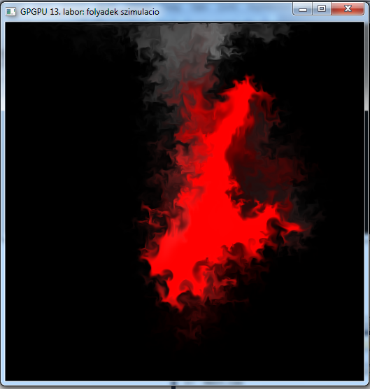
Test

Slide 23
The End

