Slide 1
Transformations
”τὰ πάντα ῥεῖ καὶ οὐδὲν μένει.”
Ἡράκλειτος
Szirmay-Kalos László

Slide 2
Transformations
$$\left(x^{′},y^{′}\right)=T(x,y)$$
Assigns points to points
May destroy the representation and the equation
Allow transformations preserving lines (segments) and planes (triangles)
$$T$$
$$(x,y)$$
Affine transformations
Preserves lines and parallelism
Translation, rotation, scaling, shearing, reflection…

Slide 3
Affine transformations: preserves parallel lines
$$T(p)$$
=($x^{′},y^{′}$)
$$p$$
=($x,y$)
(0, y)
(0,1)
T(0,y)
T(0,1)
T(x,0)
T(1,0)
(0,0)
(1,0)
(x,0)
T(0,0)
$$T\left(p\right)=T\left(0,0\right)+\left(T\left(x,0\right)−T\left(0,0\right)\right)+(T\left(0,y\right)−T\left(0,0\right))$$
$$=T\left(0,0\right)+x\left(T\left(1,0\right)−T\left(0,0\right)\right)+y(T\left(0,1\right)−T\left(0,0\right))$$
$$=o′+xi′+yj′$$
$$\left[\begin{matrix}{i′}_{x}^{} & {i′}_{y}^{} & 0 \\ {j′}_{x}^{} & {j′}_{y}^{} & 0 \\ {o′}_{x}^{} & {o′}_{y}^{} & 1\end{matrix}\right]$$
$$x^{′}=ax+by+c$$
$$y^{′}=dx+ey+f$$
$$\left[x^{′},y^{′},1\right]=[x,y,1]$$

Slide 4
2D rotation
$$−sin⁡(φ)$$
$$j$$
$$j′$$
$$i′$$
$$φ$$
$$sin⁡(φ)$$
$$φ$$
$$−i$$
$$i$$
$$cos⁡(φ)$$
$$\left[\begin{matrix}cos⁡(φ) & sin⁡(φ) & 0 \\ −sin⁡(φ) & cos⁡(φ) & 0 \\ 0 & 0 & 1\end{matrix}\right]$$
$$\left[x^{′},y^{′},1\right]=[x,y,1]$$

Slide 5
3D translation
$$v$$
$$\left[\begin{matrix}\begin{matrix}1 & 0 \\ 0 & 1\end{matrix} & \begin{matrix}0 & 0 \\ 0 & 0\end{matrix} \\ \begin{matrix} 0 & 0 \\ v_{x} & v_{y}\end{matrix} & \begin{matrix}1 & 0 \\ v_{z} & 1\end{matrix}\end{matrix}\right]$$
$$\left[x^{′},y^{′},z′,1\right]=[x,y,z,1]$$

Slide 6
3D scaling
$$\left[\begin{matrix}\begin{matrix}s_{x} & 0 \\ 0 & s_{y}\end{matrix} & \begin{matrix}0 & 0 \\ 0 & 0\end{matrix} \\ \begin{matrix} 0 & 0 \\ 0 & 0\end{matrix} & \begin{matrix}s_{z} & 0 \\ 0 & 1\end{matrix}\end{matrix}\right]$$
$$\left[x^{′},y^{′},z′,1\right]=[x,y,z,1]$$

Slide 7
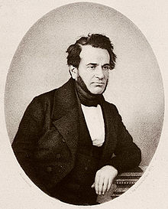
Rotation around axis d: Rodrigues formula
Axis $d$: unit vector
$$r||=d(rd)=r’||$$
$$φ$$
$$r$$
$$r’$$
$$= r’||+r’$$
$$r’||$$
$$r$$
$$r $$
$$r’=d(rd)+(r−d(rd))cos⁡(φ)+drsin⁡(φ)$$
$$=r cos⁡(φ)+d(rd)(1−cos⁡(φ))+dr sin⁡(φ)$$
$$φ$$
$$r=$$
$$r−d(rd)$$
$$r  =$$
$$dr=dr$$
$$r’$$
Rows of the matrix:
Images of $i, j, k$, and the origin

Slide 8
Projective geometry
”μὴ εἶναι βασιλικὴν ἀτραπὸν ἐπί γεωμετρίαν”
Εὐκλείδης
Szirmay-Kalos László

Slide 9
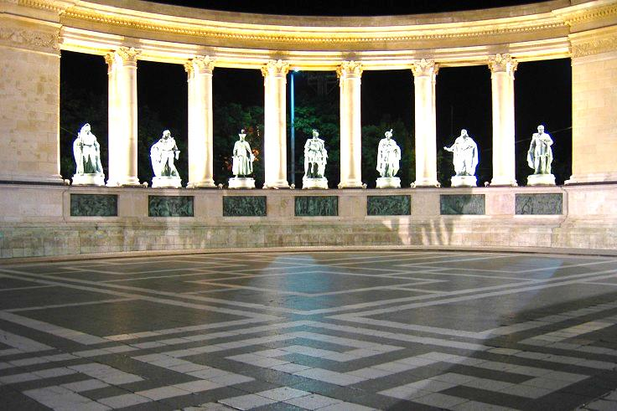
Perspective
Maps lines to lines
Does not preserve parallel lines
Euclidean geometry has a hole

Slide 10
Euclidean → Projective plane
Euclid’s axioms:
Two points define a line.
A line has at least two points.
If a is a line and A is a point not on this line, then there is exactly one other line that crosses point A but not line a.
Axioms of projective geometry:
Two points define a line.
A line has at least two points.
Two lines intersect in a single point.
→

Slide 11
Analytic geometry of the projective plane
$$[X,Y,w]$$
w
w=1
y
$$\left(x,y\right)$$
x
Y
$$[X,Y,0]$$
X
Euclidean points:
Ideal points:
$$\left(x,y\right)→\left[x,y,1\right] \sim \left[x∙w,y∙w,w\right]=[X,Y,w]$$
$$[X,Y,0]$$
Homogenous division: $x=\frac{X}{w}, y=\frac{Y}{w}$
$$w≠0$$

Slide 12
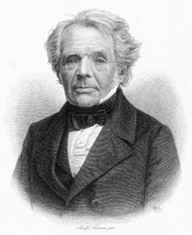
Homogenous coordinates
Ideal
point
$$\left[x,y,0\right]$$
Möbius
$$\left[x,y,1/3\right]$$
Direction + inverse distance scaling
$$\left[x,y,1\right]$$
$$\left[2x,2y,1\right]\sim \left[x,y,1/2\right]$$
y
x
Ideal
point
$$\left[−x,−y,1\right]\sim \left[x,y,−1\right]$$
$$\left[x,y,0\right]$$
$$\left[x,y,−1/2\right]$$

Slide 13
Parametric equation of the Projective Line
$$[X_{1},Y_{1},w_{1}]$$
w
$$[x_{2},y_{2},1]$$
$$[X_{2},Y_{2},w_{2}]$$
$$[x_{1},y_{1},1]$$
Y
w=1
X
$$\left[X\left(t\right),Y\left(t\right),w\left(t\right)\right]=\left[X_{1},Y_{1},w_{1}\right]\left(1−t\right)+\left[X_{2},Y_{2},w_{2}\right]t$$

Slide 14
Implicit equation of the line
Euclidean line, Descartes coordinates: $n_{x}x+n_{y}y+c=0$
Euclidean line, homogeneous coordinates: $n_{x}X/w+n_{y}Y/w+c=0$ $w≠0$
Euclidean line: $n_{x}X+n_{y}Y+cw=0$ $w≠0$
Projective line:
×
$$\left[\begin{matrix}n_{x} \\ n_{y} \\ c\end{matrix}\right]$$
Line:
Column
vector
Point: row vector
$\left[X,Y,w\right] =0$

Slide 15
Projective space with homogeneous coordinates
Euclidean points: $\left(x,y,z\right)→\left[x,y,z,1\right] \sim \left[x∙w,y∙w,z∙w,w\right]=\left[X,Y,Z,w\right]$ Homogeneous division: $x=\frac{X}{w}, y=\frac{Y}{w}, z=\frac{Z}{w}$
Ideal points: $[X,Y,Z,0]$
Parametric equation of the line: $\left[X\left(t\right),Y\left(t\right),Z\left(t\right),w\left(t\right)\right]=\left[X_{1},Y_{1},Z_{1},w_{1}\right]\left(1−t\right)+\left[X_{2}, {Y_{2},Z_{2},w}_{2}\right]t$
Implicit equation of the plane: $n_{x}X+n_{y}Y+n_{z}Z+dw=0$

Slide 16
Homogeneous linear transformations
Multiplication of homogeneous coordinates by a matrix
Contains affine transformations
2D transformation is a $3×3$ matrix $\left[X^{′},Y^{′}, w′\right]=\left[X,Y, w\right]∙T_{3×3}$
3D transformation is a $4×4$ matrix $\left[X^{′},Y^{′},Z^{′},w′\right]=\left[X,Y,Z,w\right]∙T_{4×4}$
Concatenation of transformations: Associative
$\left[X^{′},Y^{′},Z^{′},w′\right]=(…(\left[X,Y,Z,w\right]∙T_{1}$) $∙T_{2})…∙T_{n}$
$=\left[X,Y,Z,w\right]∙(T_{1}∙T_{2}∙ …∙T_{n}$)
$=\left[X,Y,Z,w\right]∙T$

Slide 17
Properties of homogeneous linear transformations
Lines to lines, combinations to combinations, convex combinations to convex combinations
If not invertible, degeneration possible
Example: lines to lines:
$\left[X\left(t\right),Y\left(t\right),Z\left(t\right),w\left(t\right)\right]=[X_{1}$, $Y_{1},Z_{1},w_{1}]t+[X_{2}$,$Y_{2},Z_{2},w_{2}](1−t)$
$p\left(t\right)=p_{1}t+p_{2}(1−t)$ // $∙T$
$$p^{∗}\left(t\right)={(p}_{1}∙T)t+{(p}_{2}∙T)(1−t)$$
$$p^{∗}\left(t\right)=p_{1}t+p_{2}(1−t)$$
*
*

Slide 18
Invertible transformations: planes to planes
$$\left[\begin{matrix}\begin{matrix}n_{x} \\ n_{y}\end{matrix} \\ \begin{matrix}n_{z} \\ d\end{matrix}\end{matrix}\right]$$
$$p^{∗}=p∙T$$
$\left[X,Y,Z, w\right]$= 0
$$T$$
$$p^{∗}{∙T }^{−1}=p$$
$p∙n^{T}$ = 0
$$p$$
$${T }^{−1}$$
$${(p}^{∗}{∙T }^{−1})∙n^{T}=0$$
$$p^{∗}{∙(T }^{−1}∙n^{T})=0$$
Transformed plane:
$n^{∗T}=$ ${T }^{−1}∙n^{T}$
$$p^{∗}{∙n}^{∗T}=0$$
Notes:
In Euclidean geometry, using Cartesian coordinates, the plane is a linear equation of the coordinates. To find the plane in projective space, the points at infinity are added to this plane. First, Cartesian coordinates are replaced by homogeneous ones, assuming that h is not zero (it is forbidden to divide by zero). Then, both sides are multiplied with h. In this new equation we do not divide by h, so we can ignore the ”h is not zero” requirement. This corresponds to adding ideal points to the plane.
The projective plane is thus a homogeneous linear equation of homogeneous coordinates. We can also express it as a dot product of two 4D vectors, one describes the point, the other the parameters of the plane.

Slide 19
Central projection
$$\left(x,y,z\right)$$
$$y$$
$$\left(x^{′},y^{′},z^{′}\right)=\left(x\frac{d}{z},y\frac{d}{z},d\right)$$
$$d$$
$$z$$
$$x$$
Left-handed
$$\left[x^{′},y^{′},z^{′},1\right]=\left[x\frac{d}{z},y\frac{d}{z},d,1\right]\sim \left[x,y,z,\frac{z}{d}\right]$$
$$\left[x,y,z,1\right]\left[\begin{matrix}\begin{matrix}1 & 0 \\ 0 & 1\end{matrix} & \begin{matrix}0 & 0 \\ 0 & 0 \end{matrix} \\ \begin{matrix}0 & 0 \\ 0 & 0\end{matrix} & \begin{matrix}1 & 1/d \\ 0 & 0 \end{matrix}\end{matrix}\right]=\left[x,y,z,\frac{z}{d}\right]\sim \left[x^{′},y^{′},z^{′},1\right]$$

Slide 20
Wrap-around problem
$$z_{2}>0$$
$$z_{1}>0$$
$$y$$
$$z_{1}>0$$
$$y$$
$$w_{2}>0$$
$$z_{2}<0$$
$$w_{1}>0$$
$$w_{1}>0$$
d
$$z$$
$$w=\frac{z}{d}$$
$$z$$
$$x$$
$$w_{2}<0$$
$$x$$
Projective line (topology)
$\left[X\left(t\right),Y\left(t\right),Z\left(t\right),w\left(t\right)\right]=[X_{1}$, $Y_{1},Z_{1},w_{1}]t+[X_{2}$,$Y_{2},Z_{2},w_{2}](1−t)$
Ideal point
Line segment ???

