Slide 1
Computer Graphics Requirements
”Учиться, учиться и учиться!”
Влади́мир Ильи́ч Улья́нов
Szirmay-Kalos László
email: szirmay@iit.bme.hu
http://cg.iit.bme.hu/portal/en/cgbme

Slide 2
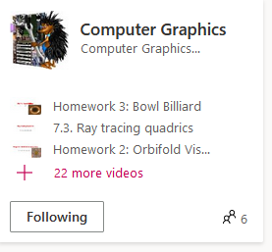
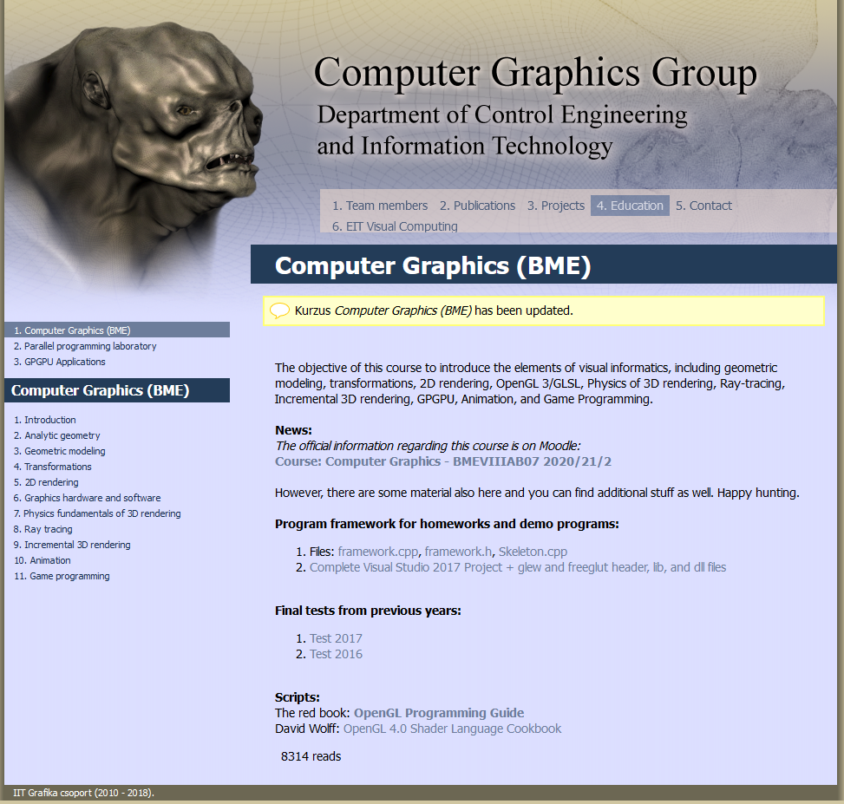
On-line support
Lectures = knowledge for examination
Moodle:
https://edu.vik.bme.hu/course/view.php?id=8198
News
PPT, PDF, Sample programs, Books
Quizes, Test questions
Forum: communication
videos
Webpage: http://cg.iit.bme.hu/portal/en/cgbme
Videos 2020/21:
https://web.microsoftstream.com/channel/ad2e9ef3-0770-4d13-9702-730ee387187b
YouTube: https://www.youtube.com/playlist?list=PLNtm1qMQYSLTT3YQx7B7oFPDXijbu1a7N
Homework portal: cg.iit.bme.hu/grafhazi
Not started yet!

Slide 3
Requirements
Weekly quiz
homeworks:
I2
II3
III
4
3 lectures/week
mark: homeworks + test
3 credits
2
2
2
Homework bonus questions:
Test: 30
Homeworks: 18
Bonus
0
50+
Minimum: 3 homework points + 7 quizzes
1
2
3
4
5
+you are a hero
0
12
16
20
24
32
50+

Slide 4
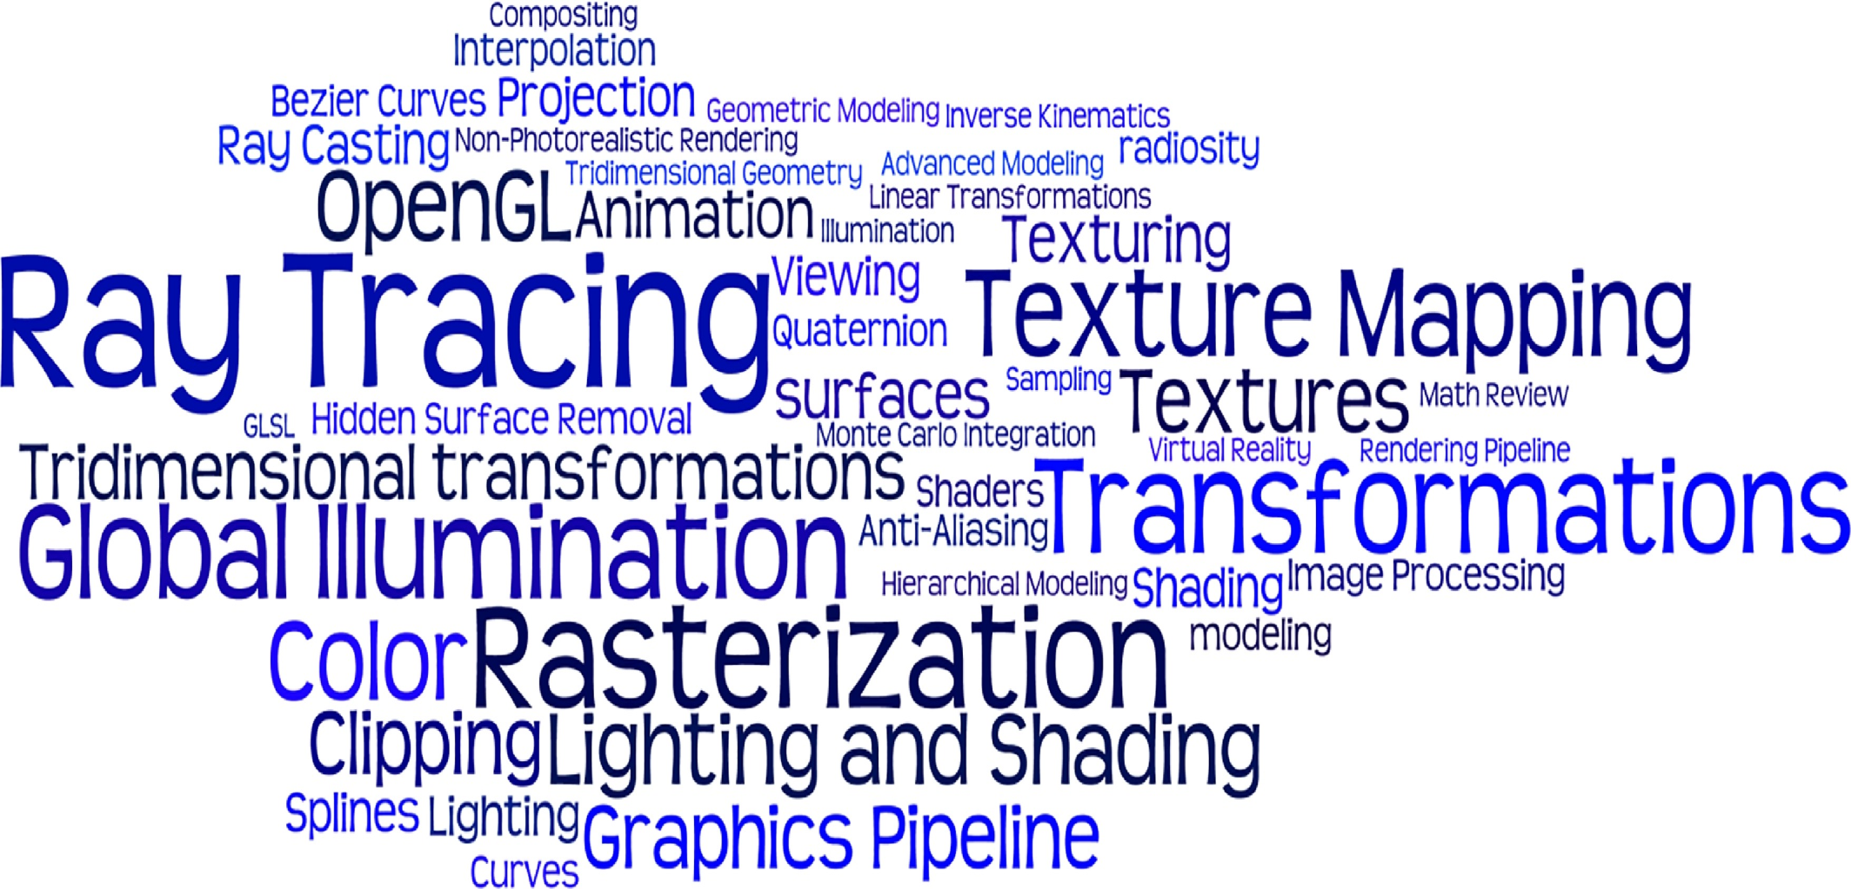
Computer Graphics BSc
Dennis G.Balreira, MarceloWalter, Dieter W.Fellner: A survey of the contents in introductory Computer Graphics courses, Computers & Graphics, Volume 77, December 2018, Pages 88-96

Slide 5
OpenGL: Green triangle
CPU init
glGenVertexArrays(1, &vao); glBindVertexArray(vao);
glGenBuffers(1, &vbo); glBindBuffer(GL_ARRAY_BUFFER, vbo);
float vtx[] = {-0.8, -0.8, 0, 1, -0.6, 1, 0, 1, 0.8, -0.2, 0, 1};
glBufferData(GL_ARRAY_BUFFER, sizeof(vtx), vtx, GL_STATIC_DRAW);
glVertexAttribPointer(0, 4, GL_FLOAT, GL_FALSE, 0, NULL);
glUniform4f(glGetUniformLocation(gpu, “color"), 0, 1, 0, 1);
float mat[] = {1,0,0,0, 0,1,0,0, 0,0,1,0, 0,0,0,1};
glUniformMatrix4fv(glGetUniformLocation(gpu, "MVP"), 1, 1, mat);
glViewport(0, 0, 600, 600);
glBindVertexArray(vao); glDrawArrays(GL_TRIANGLES, 0, 3);
CPU draw
Vertex shader
Pixel shader
uniform mat4 MVP;
layout(location = 0) in vec4 v;
void main() {
gl_Position = v * MVP;
}
uniform vec4 color;
out vec4 outColor;
void main() {
outColor = color;
}

Slide 6
Entry questions
Which multiplications have the properties of associativity, commutativity and distributivity on additions from dot/cross product of vectors, matrices, complex numbers.
What is the derivative of sin(x³)/cos(x²)?
Write a C++ class for complex numbers.
Write a C++ function that computes the intersection of a line defined by points p1 and p2, and the circle of center c and radius r.
If we measured the time in minutes and the length in feet (0.3 m), what would be the gravitational acceleration (g) on Earth? Write a C++ function that calculates the position and velocity of a rock at t minutes, thrown from point p with velocity v.
What is the dimension (unit of measurement) of the index of refraction?
Why are summer hot and winter cold?
Write a C++ function that obtains one real root of equation x⁵+2x²-x +1 = 0.
What object is defined by equation x²-y² = 1?

