Slide 1
Sirius triangle drawing
Homework 1

Slide 2
Specification
Aliens from the Sirius star constellation love the 2D drawing package of Word, Powerpoint, etc., but they cannot use it directly since their geometry differs from the Euclidean geometry popular in planet Earth. You are contracted to make the necessary adaptation for the simple case when a triangle defined by three points is to be drawn. Fortunately, they also provided a dictionary to pair the Sirius geometric terms to our familiar Euclidean geometric terms:
The Sirius plane is a unit radius circle of the Euclidean plane, which is called the base circle.
Points of the Euclidean plane can be identified by a complex number. Points of the Sirius plane are identified by a complex number of absolute value less than 1. The metric of the Euclidean plane is|dz|=sqrt(dx^2+dy^2), while the metric of the Sirius plane is |dz|/(1-|z|^2) = sqrt(dx^2+dy^2)/(1 - x^2-y^2)
The Sirius line is an circular arc in Euclidean geometry, which arrives at the base circle perpendicularly.
The program should render a filled Sirius triangle defined by three mouse clicks. The boundary of the Sirius triangle should be drawn with a different color. The lengths of the edges of the triangle should be printed on the standard output.

Slide 3
Sirius line defined by points p₁, p₂ is a circle of center c and radius r
Constraints from which c and r can be computed:
p₁ is on the circle:|p₁-c|= r
p₂ is on the circle: |p₂-c|= r
Pythagoras: r²+1=c²
The center of the circle c is on the line that is halfway between p₁,p₂ and perpendicular to direction p₁-p₂:
(c-(p₁+p₂)/2)⋅(p₁-p₂) = 0
Inverting the circle on the base circle, we get the same circle:
Inverse of p_{i}: p_{i}*= p_{i} / (p_{i} ⋅ p_{i})
Base circle
1
p₁
1
r
p₂
c

Slide 4
Line segment
The polar angle of the two endpoints can be obtained with the atan2 function. We need that difference which is not greater than 180 degrees.
The circular arc can be vectorized by making small steps in the polar angle, evaluation the circle equation, and connecting the subsequent points with a line strip.

Slide 5
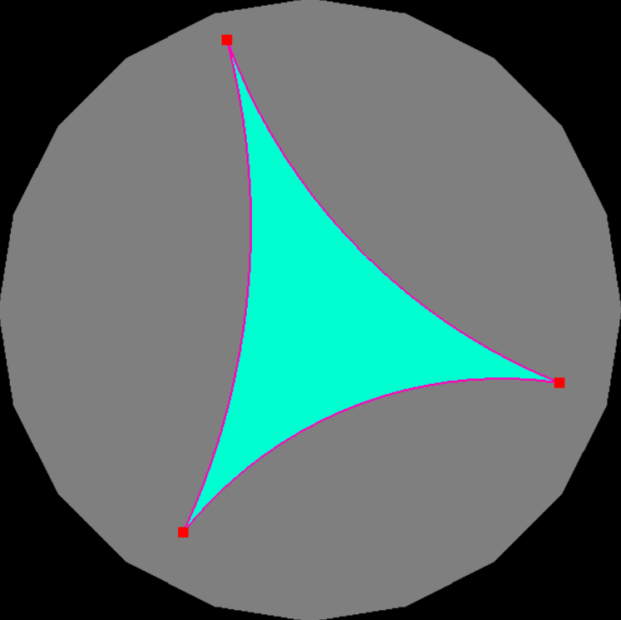
Sirius triangle
= Euclidean regions of circular arc boundaries
≈ concave polygon
= triangle lines (e.g. ear clipping), GL_TRIANGLES
+ edge drawing: GL_LINE_LOOP

Slide 6
Length computation
After vectorization, the Sirius length of the small line segments need to be calculated and added.
The Sirius length of a small line segment of endpoints (x,y) and (x+dx, y+dy) :
ds = sqrt(dx*dx+dy*dy)/(1–x*x–y*y)

