Slide 1
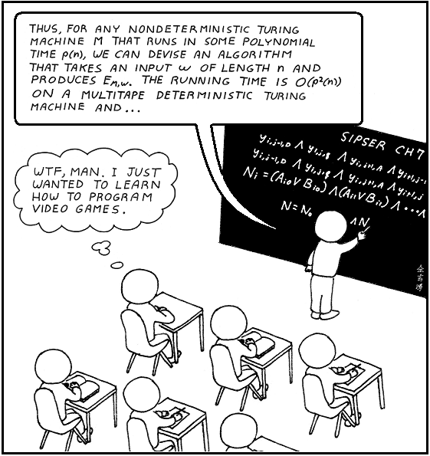
Game Programming
Szirmay-Kalos László

Slide 2
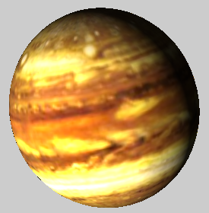
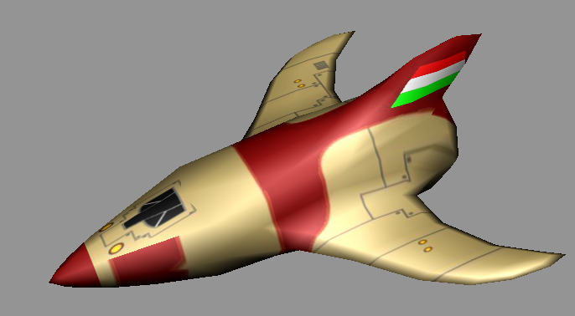
Virtual Reality
rendering
interaction
control
avatar
Virtual world = objects and rules

Slide 3
Game OO
Animate( ), Draw( )
Control( )
rendering
Interact( )
control
ProcessInput( )
SetCameraTransform( )
avatar
World coordinate
system
Scene: vector<GameObject *> objects;

Slide 4
GameObject
Which points belong to the object: equation
Visibility: root finding
Transformation: equation modification
Triangle mesh
How the light is modified
Shading: algorithm
Material: parameters
Texture: parameter changes on the surface
Operations:
Control: game dependent
Animate, Draw: general

Slide 5
Scene
Simulate()
Build()
App
onKeyboard()
onKeyboardUp()
onDisplay()
onIdle()
getKeyStatus()
Light
La, Le,
wLightPos
*
Shader
objects
Surface Shader
Volumetric Shader
*
GameObject
pos, velocity, acc
Control()
Animate()
Draw()
Avatar
ProcInput()
CamTransf()
Material
Texture
TriangleMesh
SpaceShip
Planet
Player
LoadedMesh
ParamSurface
Bullet
Explosion
Game
Sphere
Game Engine

Slide 6
Animate: Affine transformation
Translation, rotation, scaling, mirroring, shearing, …
Lines to lines, planes to planes, preserves parallelism
Triangles to triangles
p
T(p)
=($x^{′},y^{′}$)
=($x,y$)
(0, y)
(0,1)
T(0,y)
T(0,1)
T(x,0)
T(1,0)
(0,0)
(1,0)
(x,0)
T(0,0)
T(p) = T(0,0)+(T(x,0)-T(0,0))+(T(0,y)-T (0,0))
= T(0,0)+x(T(1,0)-T(0,0))+y(T(0,1)-T (0,0))
= o’ + xi’ + yj’
$$\left[\begin{matrix}{i′}_{x}^{} & {i′}_{y}^{} & 0 \\ {j′}_{x}^{} & {j′}_{y}^{} & 0 \\ {o′}_{x}^{} & {o′}_{y}^{} & 1\end{matrix}\right]$$
$$\left[x^{′},y^{′},1\right]=[x,y,1]$$

Slide 7
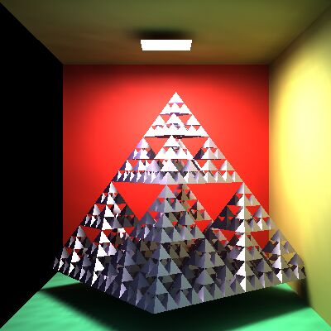
Draw: Where is it visible
Onto which pixels is it projected and how far is it?
Keep the closest in each pixel.
Depth buffer
World coordinate system

Slide 8
Simulation (Game) loop
tstart
tend
dt
void Scene::Simulate( ) { // idle call back
static float tend = 0;
float tstart = tend;
tend = glutGet(GLUT_ELAPSED_TIME);
avatar->ProcessInput( );
// Simulation
for(float t = tstart; t < tend; t += dt) {
float Dt = min(dt, tend – t);
for (GameObject * obj: objects) obj->Control(t, t+Dt);
for (GameObject * obj: objects) obj->Animate(t, t+Dt);
}
// Rendering
glClear(GL_COLOR_BUFFER_BIT | GL_DEPTH_BUFFER_BIT);
avatar->SetCameraTransform(state);
for (GameObject * obj: objects) obj->Draw(state);
glutSwapBuffers( );
}

Slide 9
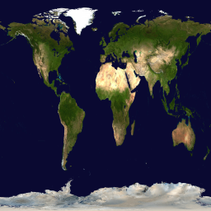
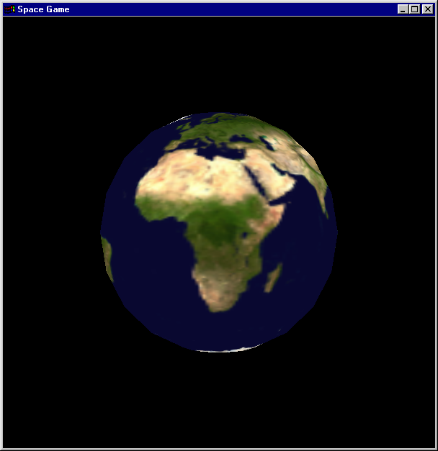
Planet
Geometry: Sphere
Texture: 2D map
Script animation

Slide 10
Sphere to Triangle mesh
z
$x\left(U,V\right)=c_{x}+rcos\left(U\right)sin\left(V\right)$ y$\left(U,V\right)=c_{y}+rsin\left(U\right)sin\left(V\right)$
$z\left(U,V\right)=c_{z}+rcos\left(V\right)$
$U∈\left[0,2π\right], V$ $∈\left[0,π\right]$
cos(V)
V
1
U
y
sin(V)
x
1
3
U,V
5
E.g. BME:
V = 47,5º
U = 19,0º
0
3
5
2
1
4
0
2
4

Slide 11
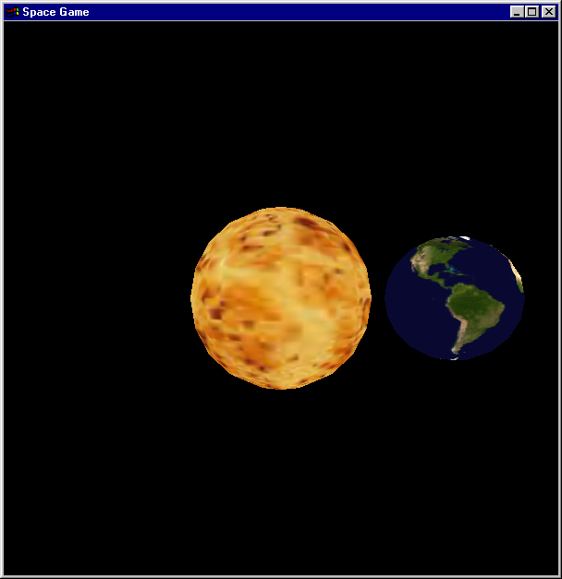
Animate: Rotating and revolving around the Sun
$$M=\left[\begin{matrix}\begin{matrix}cos⁡(\text{f}∙\text{t}) & sin⁡(\text{f}∙\text{t}) \\ −sin⁡(\text{f}∙\text{t}) & cos⁡(\text{f}∙\text{t})\end{matrix} & \begin{matrix}0 & 0 \\ 0 & 0\end{matrix} \\ \begin{matrix}0 & 0 \\ 0 & 0\end{matrix} & \begin{matrix}1 & 0 \\ 0 & 1\end{matrix}\end{matrix}\right]∙$$
$\left[\begin{matrix}\begin{matrix}1 & 0 \\ 0 & cos⁡(23°)\end{matrix} & \begin{matrix}0 & 0 \\ sin(23°) & 0\end{matrix} \\ \begin{matrix}0 & −sin(23°) \\ 0 & 0\end{matrix} & \begin{matrix}cos⁡(23°) & 0 \\ 0 & 1\end{matrix}\end{matrix}\right]$ $∙$
$\left[\begin{matrix}\begin{matrix}1 & 0 \\ 0 & 1\end{matrix} & \begin{matrix}0 & 0 \\ 0 & 0\end{matrix} \\ \begin{matrix}0 & 0 \\ D cos⁡(k∙t) & D sin(k∙t)\end{matrix} & \begin{matrix}1 & 0 \\ 0 & 1\end{matrix}\end{matrix}\right]$
f⋅ t
f: rotation speed
k: revolution speed
D
k⋅ t
Notes:
Earth not only rotates around its axis but also revolves around the Sun. So, we need two animation parameters, rotation angle and revolution angle, which are updated according to the rotation speed (1/day in real world) and the revolution speed (1/year in real world), respectively.
Let us read the DrawIt function backwards since transformation should be read in this order. SphereInOrigin passes a triangular mesh approximation of a sphere centered in the origin to OpenGL. glRotatef(rot_angle, 0, 0, 1) rotates the sphere around axis z.
glTranslatef(dist, 0, 0) translates the sphere to distance dist from the origin where the Sun is supposed to be. Finally, we apply another rotation glRotatef(rev_angle, 0, 0, 1), around axis z, which keeps the Earth on the circle of radius dist and in the xy plane around the Sun.
By the way, the real Earth’s rotation axis is not perpendicular to the plane of revolution, but is tilted by about 23 degrees. The addition of this transformation is a homework.

Slide 12
SpaceShip
Geometry: quad mesh
Texture: drawn
Physics animation
forces (gravity, rocket)
Collision detection
Behavior (AI)
Controlling its own rocket to survive and kill
Collision avoidance, escape from avatar, chasing the avatar

Slide 13
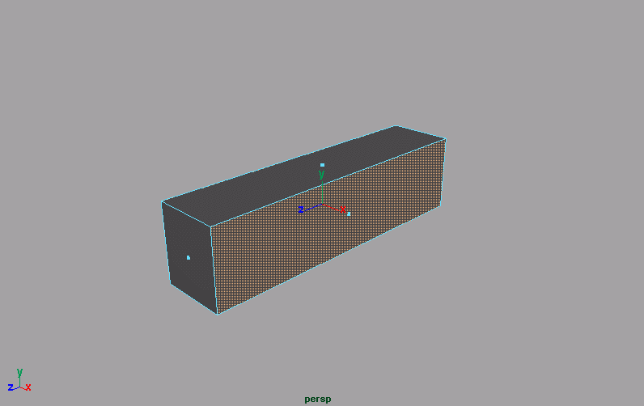
Ship: Quad mesh

Slide 14
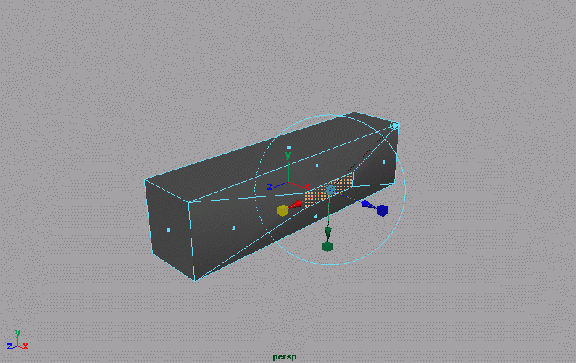
Ship geometry with Euler operations
vertices + faces = edges + 2

Slide 15
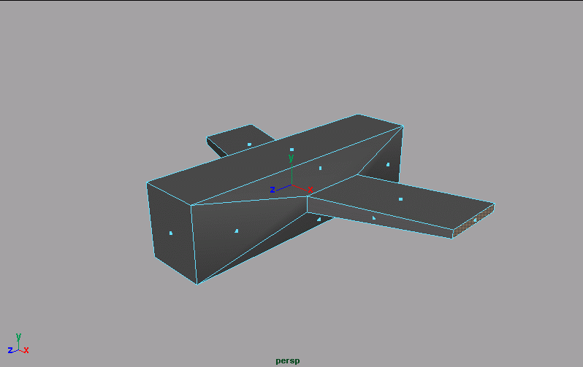
Extruding

Slide 16
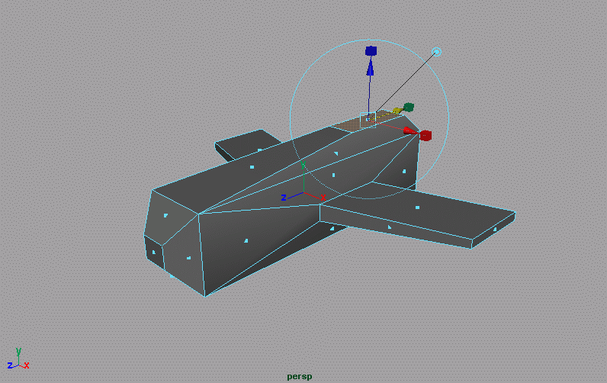
Extruding

Slide 17
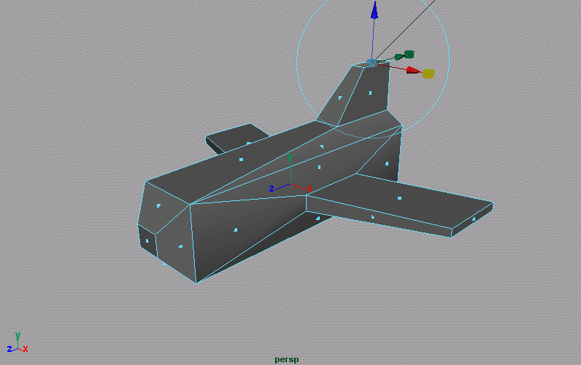
Extruding

Slide 18
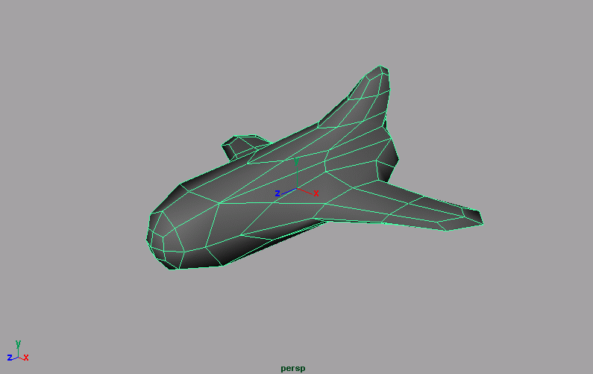
Subdivision surface

Slide 19
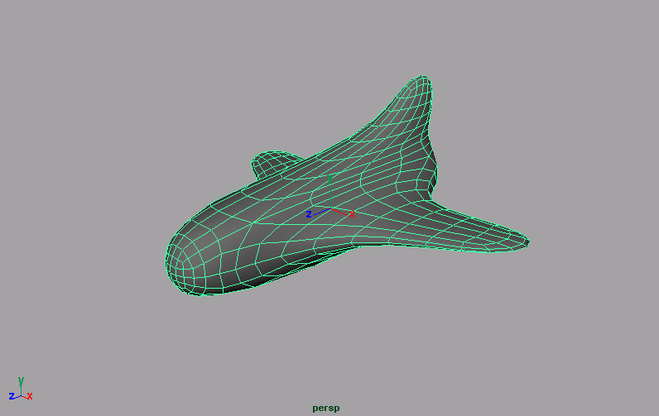
Subdivision surface

Slide 20
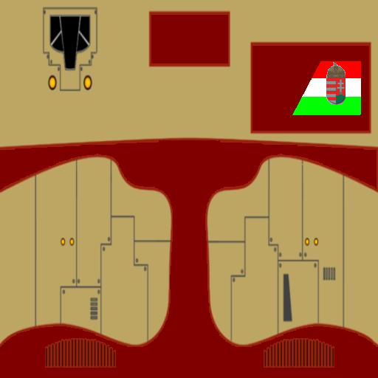
Parameterization for texturing
(1,1)
(0,0)

Slide 21
OBJ file format
v -0.708698 -0.679666 2.277417
v 0.708698 -0.679666 2.277417
v -0.735419 0.754681 2.256846
...
vt 0.510655 0.078673
vt 0.509594 0.070000
vt 0.496429 0.079059
...
vn -0.843091 0.000000 0.537771
vn -0.670151 -0.543088 0.505918
vn -0.000000 -0.783747 0.621081
…
f 65/1/1 37/2/2 62/3/3 61/4/4
f 70/8/5 45/217/6 67/218/7 66/241/8
f 75/9/9 57/10/10 72/11/11 71/12/12
...

Slide 22
Animate: Newton 2 + Frenet frame
k’
head: j
i’
i’ 0
j’ 0
k’ 0
p 1
p
M =
j’
k
i
$$F=ma, a=\frac{dv}{dt}, v=\frac{dp}{dt}$$
$$a=\frac{F}{m}, v+=adt, p+=vdt$$
Orientation: not orthogonal:
$$j’ = v,$$
$k^{∗} =k^{′}\left(1−α\right)+aα$,
$$i’ = j’ ×k^{∗}$$
Gram-Schmidt orthogonalization
$j’ = v/|v|$,
$$i’ = j’ ×k^{∗}/|j’ ×k^{∗}|,$$
$$k’= i’ × j’$$

Slide 23
Control: AI and force computation
void Ship :: Control( float tstart, float tend ) {
force = vec3(0, 0, 0);
for (GameObject * obj : objects) {
if (dynamic_cast<Planet*>(obj)) {
}
if (dynamic_cast<Avatar*>(obj)) {
}
}
}
m·M
r²
F = f
bullet
avatar
avatar
aiming angle

Slide 24
Discrete collision detection
Problem if objects are fast
t
given t
t + Δ t
dist = obj1.pos - obj2.pos
min = obj1.BoundingRadius() + obj2.BoundingRadius()
if (dist.Length() < min) Collision!

Slide 25
Photon torpedo
Complex geometry
Looks similar from
different directions
Easier to use its image
transparent

Slide 26
Billboard
Transparent image on a rectangle that is rotated
towards the camera
pos
QUAD
pos

Slide 27
Explosion
Dynamic geometry
Discretization for simulation: points
Points are rendered as billboards
Particle system

Slide 28
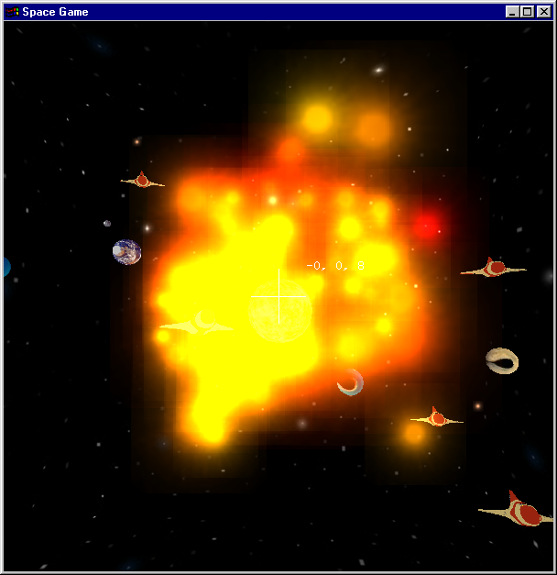
Particle system
force
pos: pos += velocity * dt
velocity: velocity += acceleration * dt
acceleration: acceleration = force / weight
lifetime
age: age += dt; if (age > lifetime) Kill();
size, dsize: size += dsize * dt;
weight, dweight: weight += dweight * dt
color, dcolor: color += dcolor * dt
Random
Initial
values

Slide 29
Explosition parameters
var
Rand(mean, var)
mean
pos = center; // focused
lifetime = Rand(2, 1);
size = 0.001; // originally small
dsize = Rand(0.5, 0.25) / lifetime;
velocity = Vector(Rand(0,0.4),Rand(0,0.4),Rand(0,0.4));
acceleration = Vector(Rand(0,1),Rand(0,1),Rand(0,1));
// Planck law: from opaque yellow to transparent red
color = Color(1, Rand(0.5, 0.25), 0, 1 );
dcolor = Color(0, -0.25, 0, -1) / lifetime;

Slide 30
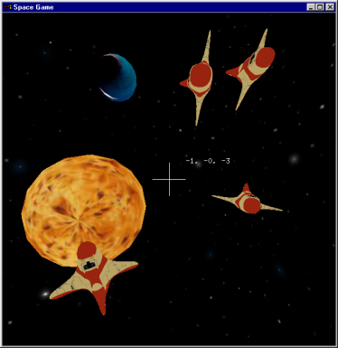
Keyboard handling with Polling
bool keys[256]; // is pressed?
void onKeyboard(unsigned char key,
int pX, int pY) {
keys[key] = true;
}
void onKeyboardUp(unsigned char key,
int pX, int pY) {
keys[key] = false;
}
KeyboardFunc
KeyboardUpFunc
SpecialKeysFunc
SpecialKeysUpFunc
keys
IdleFunc:
GameLoop
virtual
world

Slide 31
Avatar :: ProcessInput
up
right
Avatar :: ProcessInput() {
if ( keys[‘ ‘] ) // fire!
objects.push_back(new Bullet(pos, velocity));
// Steering in the coordinate system of the avatar
vec3 head = normalize(velocity);
vec3 right = normalize(cross(wVup, head));
vec3 up = cross(head, right);
if (keys[KEY_UP]) force -= up;
if (keys[KEY_DOWN]) force += up;
if (keys[KEY_LEFT]) force -= right;
if (keys[KEY_RIGHT]) force += right;
}
head

